Slide 1
Project/SEO report
151215_SAITO
1. Present status of iKAGRA
** Master schedule and delay of iKAGRA
** iKAGRA configuration (Michelson Interferometer) and Beam Splitter
** installation so far done
2. Scheduling of iKAGRA installation/commissioning
** milestone
3. bKAGRA (2016-17)
** Task force for updating “budget schedule and roadmap of bKAGRA”

Slide 2
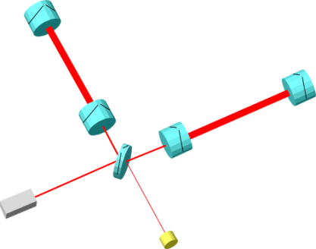
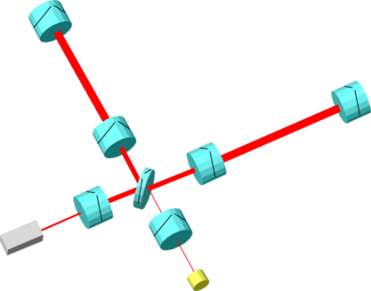
KAGRA Master Schedule
150709_SAITO
・iKAGRA (2010.10 – 2015.12)
3-km FPM interferometer
- Baseline 3km room temp.
- Operation of total system
with simplified IFO and VIS.
2012
2013
2014
2015
2016
2017
2018
bKAGRA
iKAGRA
OBS
・bKAGRA (2016.1 – 2018.3)
Operation with full config.
- Final IFO+VIS configuration
- Cryogenic operation.
Cryo-mirrors
Recycling
mirrors

Slide 3
KAGRA Master Schedule
151215_SAITO
・iKAGRA (2010.10 – 2016.3)
3-km FPM interferometer
- Baseline 3km room temp.
- Operation of total system
with simplified IFO and VIS.
iKAGRA delayed
2012
2013
2014
2015
2016
2017
2018
bKAGRA
iKAGRA
OBS
・bKAGRA (2016.1 – 2018.3)
Operation with full config.
- Final IFO+VIS configuration
- Cryogenic operation.
Cryo-mirrors
Recycling
mirrors

Slide 4
Project/SEO report
151215_SAITO
1. Present status of iKAGRA
** Master schedule and delay of iKAGRA
** iKAGRA configuration (Michelson Interferometer) and Beam Splitter
** installation so far done
2. Scheduling of iKAGRA installation/commissioning
** milestone
3. bKAGRA (2016-17)
** Task force for updating “budget schedule and roadmap of bKAGRA”

Slide 5
iKAGRA configuration (Michelson Interferometer)
150709_SAITO
iKAGRA obs. Run in Dec. 2015 ~1 month
iKAGRA configuration
- Room-temp. test masses
suspended by Type-Bp payload
- MI with 2.94 km arm
- Low laser power, w/o power recycling
- On-site test of VIS and Cryo system
Type-A isolator
full-system test
ETM
- Room-temp. test
Sapphire (?), 23kg, 290K
- Tall seismic isolator
IP + GASF + Payload
Y-arm
Shorter arm
length by 61m
MC
BS
X-arm
Type-C system
IO
ETM
- Mode cleaner
Silica, 0.5kg, 290K
- Stack + Payload
Cryogenic system test
- Cryostat + Rad. shield duct
- Cryo-cooler
- Cryogenic payload
- Fixed Type-A SAS
Type-Bp payload;
Test mass and core optics.
Table + GASF + Type-B payload.
Type-B payload;
Beam splitter
IP + GASF + payload

Slide 6
iKAGRA configuration (Michelson Interferometer)
151215_SAITO
iKAGRA obs. Run in Mar. 2016 ~1 month
Further changed in iKAGRA
iKAGRA configuration
- Room-temp. test masses
suspended by Type-Bp payload
- MI with 2.94 km arm
- Low laser power, w/o power recycling
- On-site test of VIS and Cryo system
Type-A isolator
full-system test
ETM
- Room-temp. test
Sapphire (?), 23kg, 290K
- Tall seismic isolator
IP + GASF + Payload
Y-arm
Shorter arm
length by 61m
MC
BS
X-arm
Type-C system
IO
ETM
- Mode cleaner
Silica, 0.5kg, 290K
- Stack + Payload
Cryogenic system test
- Cryostat + Rad. shield duct
- Cryo-cooler
- Cryogenic payload
- Fixed Type-A SAS
Type-Bp payload;
Test mass and core optics.
Table + GASF (simplified) + Type-B payload.
Type-B payload;
Beam splitter
IP + GASF + payload Type-C (to use CLIO BS mirror/suspension)

Slide 7
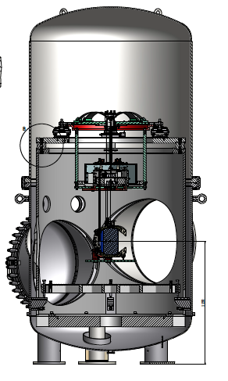
iKAGRA configuration (Michelson Interferometer)
151215_SAITO
iKAGRA obs. Run in Mar. 2016 ~1 month
Further changed in iKAGRA
iKAGRA configuration
- Room-temp. test masses
suspended by Type-Bp payload
- MI with 2.94 km arm
- Low laser power, w/o power recycling
- On-site test of VIS and Cryo system
Type-A isolator
full-system test
ETM
- Room-temp. test
Sapphire (?), 23kg, 290K
- Tall seismic isolator
IP + GASF + Payload
Y-arm
Shorter arm
length by 61m
MC
BS
X-arm
Type-C system
IO
ETM
- Mode cleaner
Silica, 0.5kg, 290K
- Stack + Payload
Cryogenic system test
- Cryostat + Rad. shield duct
- Cryo-cooler
- Cryogenic payload
- Fixed Type-A SAS
Type-Bp payload;
Test mass and core optics.
Table + GASF (simplified) + Type-B payload.
Type-B payload;
Beam splitter
IP + GASF + payload Type-C (to use CLIO BS mirror/suspension)

Slide 8
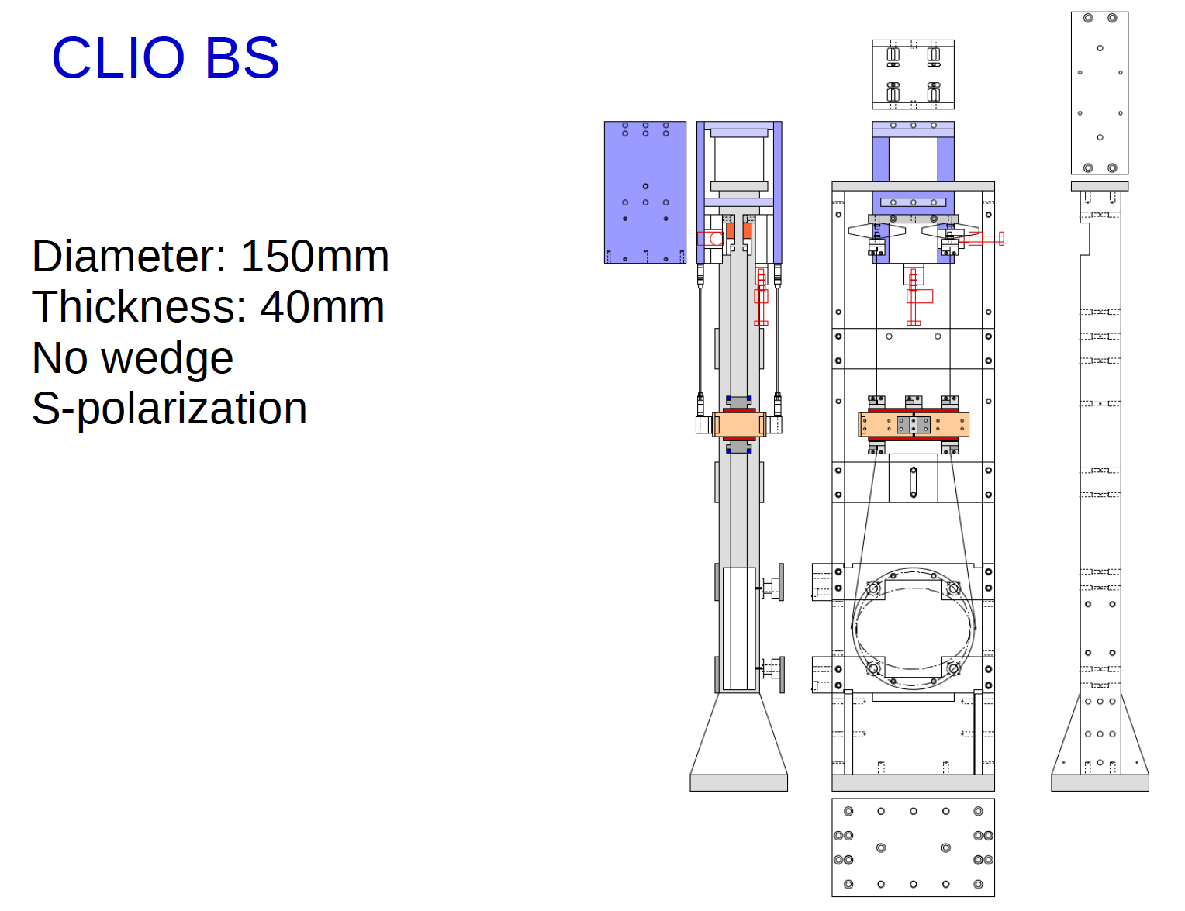
iKAGRA configuration (Michelson Interferometer)
151215_SAITO
iKAGRA obs. Run in Mar. 2016 ~1 month
Further changed in iKAGRA
iKAGRA configuration
- Room-temp. test masses
suspended by Type-Bp payload
- MI with 2.94 km arm
- Low laser power, w/o power recycling
- On-site test of VIS and Cryo system
Type-A isolator
full-system test
ETM
- Room-temp. test
Sapphire (?), 23kg, 290K
- Tall seismic isolator
IP + GASF + Payload
Y-arm
KAGRA BS
Diameter: 200 mm
Thickness: 80 mm
HR point (injection point) of CLIO BS
is to be adjusted as the same position
as of KAGRA.
The thickness difference does not cause
any large shift at the ETM.
Shorter arm
length by 61m
MC
BS
X-arm
Type-C system
IO
ETM
- Mode cleaner
Silica, 0.5kg, 290K
- Stack + Payload
Cryogenic system test
- Cryostat + Rad. shield duct
- Cryo-cooler
- Cryogenic payload
- Fixed Type-A SAS
Type-Bp payload;
Test mass and core optics.
Table + GASF (simplified) + Type-B payload.
Type-B payload;
Beam splitter
IP + GASF + payload Type-C (to use CLIO BS mirror/suspension)

Slide 9
Project/SEO report
151215_SAITO
1. Present status of iKAGRA
** Master schedule and delay of iKAGRA
** iKAGRA configuration (Michelson Interferometer) and Beam Splitter
** installation so far done
2. Scheduling of iKAGRA installation/commissioning
** milestone
3. bKAGRA (2016-17)
** Task force for updating “budget schedule and roadmap of bKAGRA”

Slide 10
iKAGRA installation so far done by Mar 2015
150709_SAITO
Clean booths constructed;
MC, PR, BS, EX(Y)C chambers.
Preparing for filter operation.
EYC
Four of cryo-chambers installed.
Chambers for IP carried up in 2nd floor.
ETM
Type-C payload;
Base plate and stacks set upped.
Preparing to set breadboard.
Two of 1.5-km GIF tubes (400 mm in dia.)
jointed and leak-tested.
Y-arm
Two of 3-km KAGRA arm tubes (800 mm in dia.)
and 125 of baffles jointed and leak-tested.
MC
PR
IO
BS
EXC
X-arm
ETM
Laser booth cleaned.
Optical bench set upped.
Preparing for input-optics setting.
All the vacuum chambers aligned and anchored
SR
Type-Bp payload;
Inner frames prepared.
Adding traverser under the first filter.
Control system installed in the computer room inside tunnel.
Network between tunnel and Mozumi office connected.
Type-B payload;
Outer frame set upped and anchored.
The prototype tested in TAMA.

Slide 11
iKAGRA installation (from Apr to Dec 2015)
151215_SAITO
Clean booths for iKAGRA TMs constructed.
Inside the booths of PR, BS area re-cleaned,
being kept as Class-4, or better.
EYC
ETM
Two of 3-km KAGRA arm being kept in vacuum.
MC mirrors and FI installed on Type-C VIS.
Y-arm
Beam injected in one of the 1.5-km GIF arms.
MC
MC
PR
IO
BS
EXC
X-arm
ETM
Support structure of CLIO BS on the KAGRA optical bench prepared.
SR
Full assy, but with a spare mirror, of PR3 is being installed.
Racks for local controller/driver distributed close to the booths, and linked to the network
PR
BS

Slide 12
Project/SEO report
151215_SAITO
1. Present status of iKAGRA
** Master schedule and delay of iKAGRA
** iKAGRA configuration (Michelson Interferometer) and Beam Splitter
** installation so far done
2. Scheduling of iKAGRA installation/commissioning
** milestone
3. bKAGRA (2016-17)
** Task force for updating “budget schedule and roadmap of bKAGRA”

Slide 13
iKAGRA commissioning milestone in 2015
150709_SAITO
EYC
9/1 – 11/30; commissioning
11/30; Michelson lock
12/2 - ; iKAGRA observation
7/30; optics of IFI and IMM installed
ETM
11/4; EYA (ETM-Y) mirror suspended
Y-arm
8/17; MC lock
10/14; EXA (ETM-X) mirror suspended
MC
PR
IO
BS
EXC
X-arm
ETM
6/9; PSL beam quality check
SR
5/8; control system started working.
6/30; control room in Mozumi office ready for operation.
8/24; PR3 mirror suspended
9/17; PR2 mirror suspended
11/3; BS mirror suspended

Slide 14
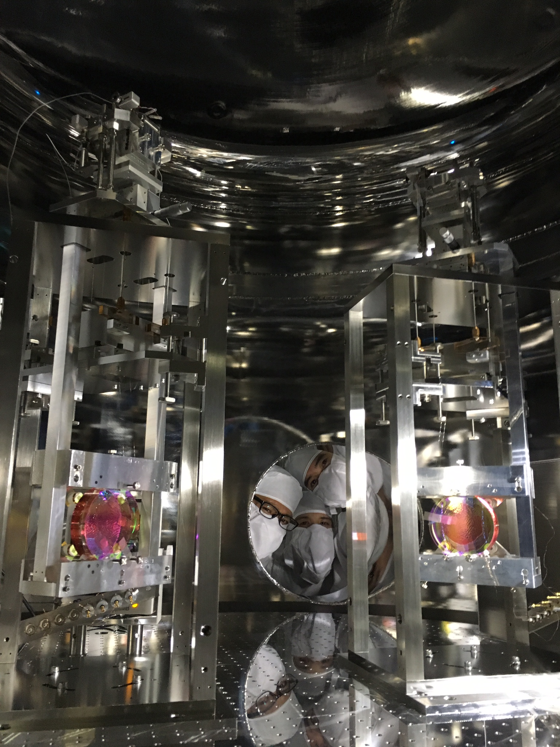
iKAGRA commissioning milestone in 2015
151215_SAITO
EYC
3/22 - ; iKAGRA observation
ETM
12/11; MC mirrors aligned,
and a transmission fringe from MC observed
3/11; EYA (ETM-Y) mirror suspended
Y-arm
3/18; EXA (ETM-X) mirror suspended
MC
PR
IO
BS
EXC
X-arm
ETM
6/9; PSL beam quality check
VIS installation;
6 weeks for each ETM
7 weeks for each PR
by two teams for four mirrors
SR
12/22; PR3 test hanging
(full assy with a spare mirror)
1/28; PR2 mirror suspended
2/5; PR3 mirror suspended
12/22; BS mirror (CLIO) suspended

Slide 15
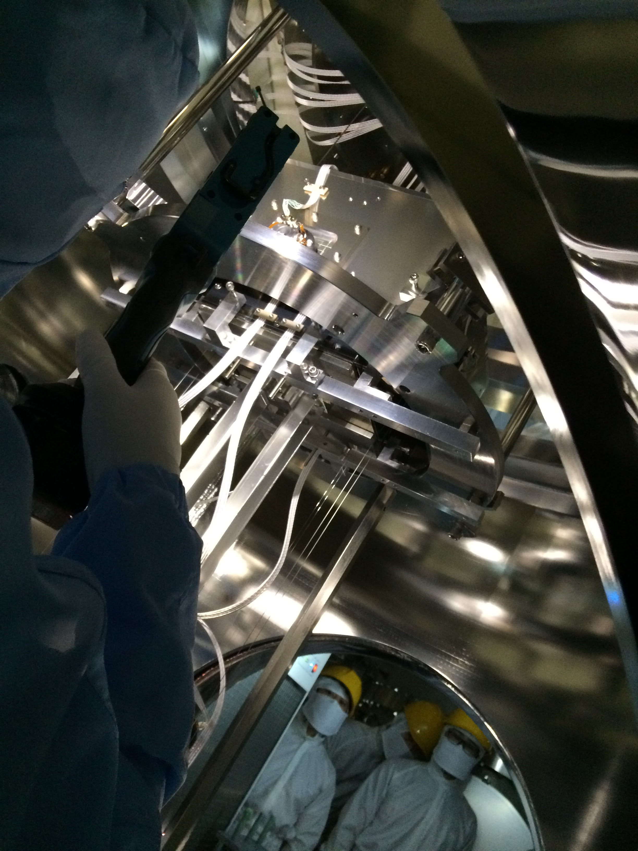
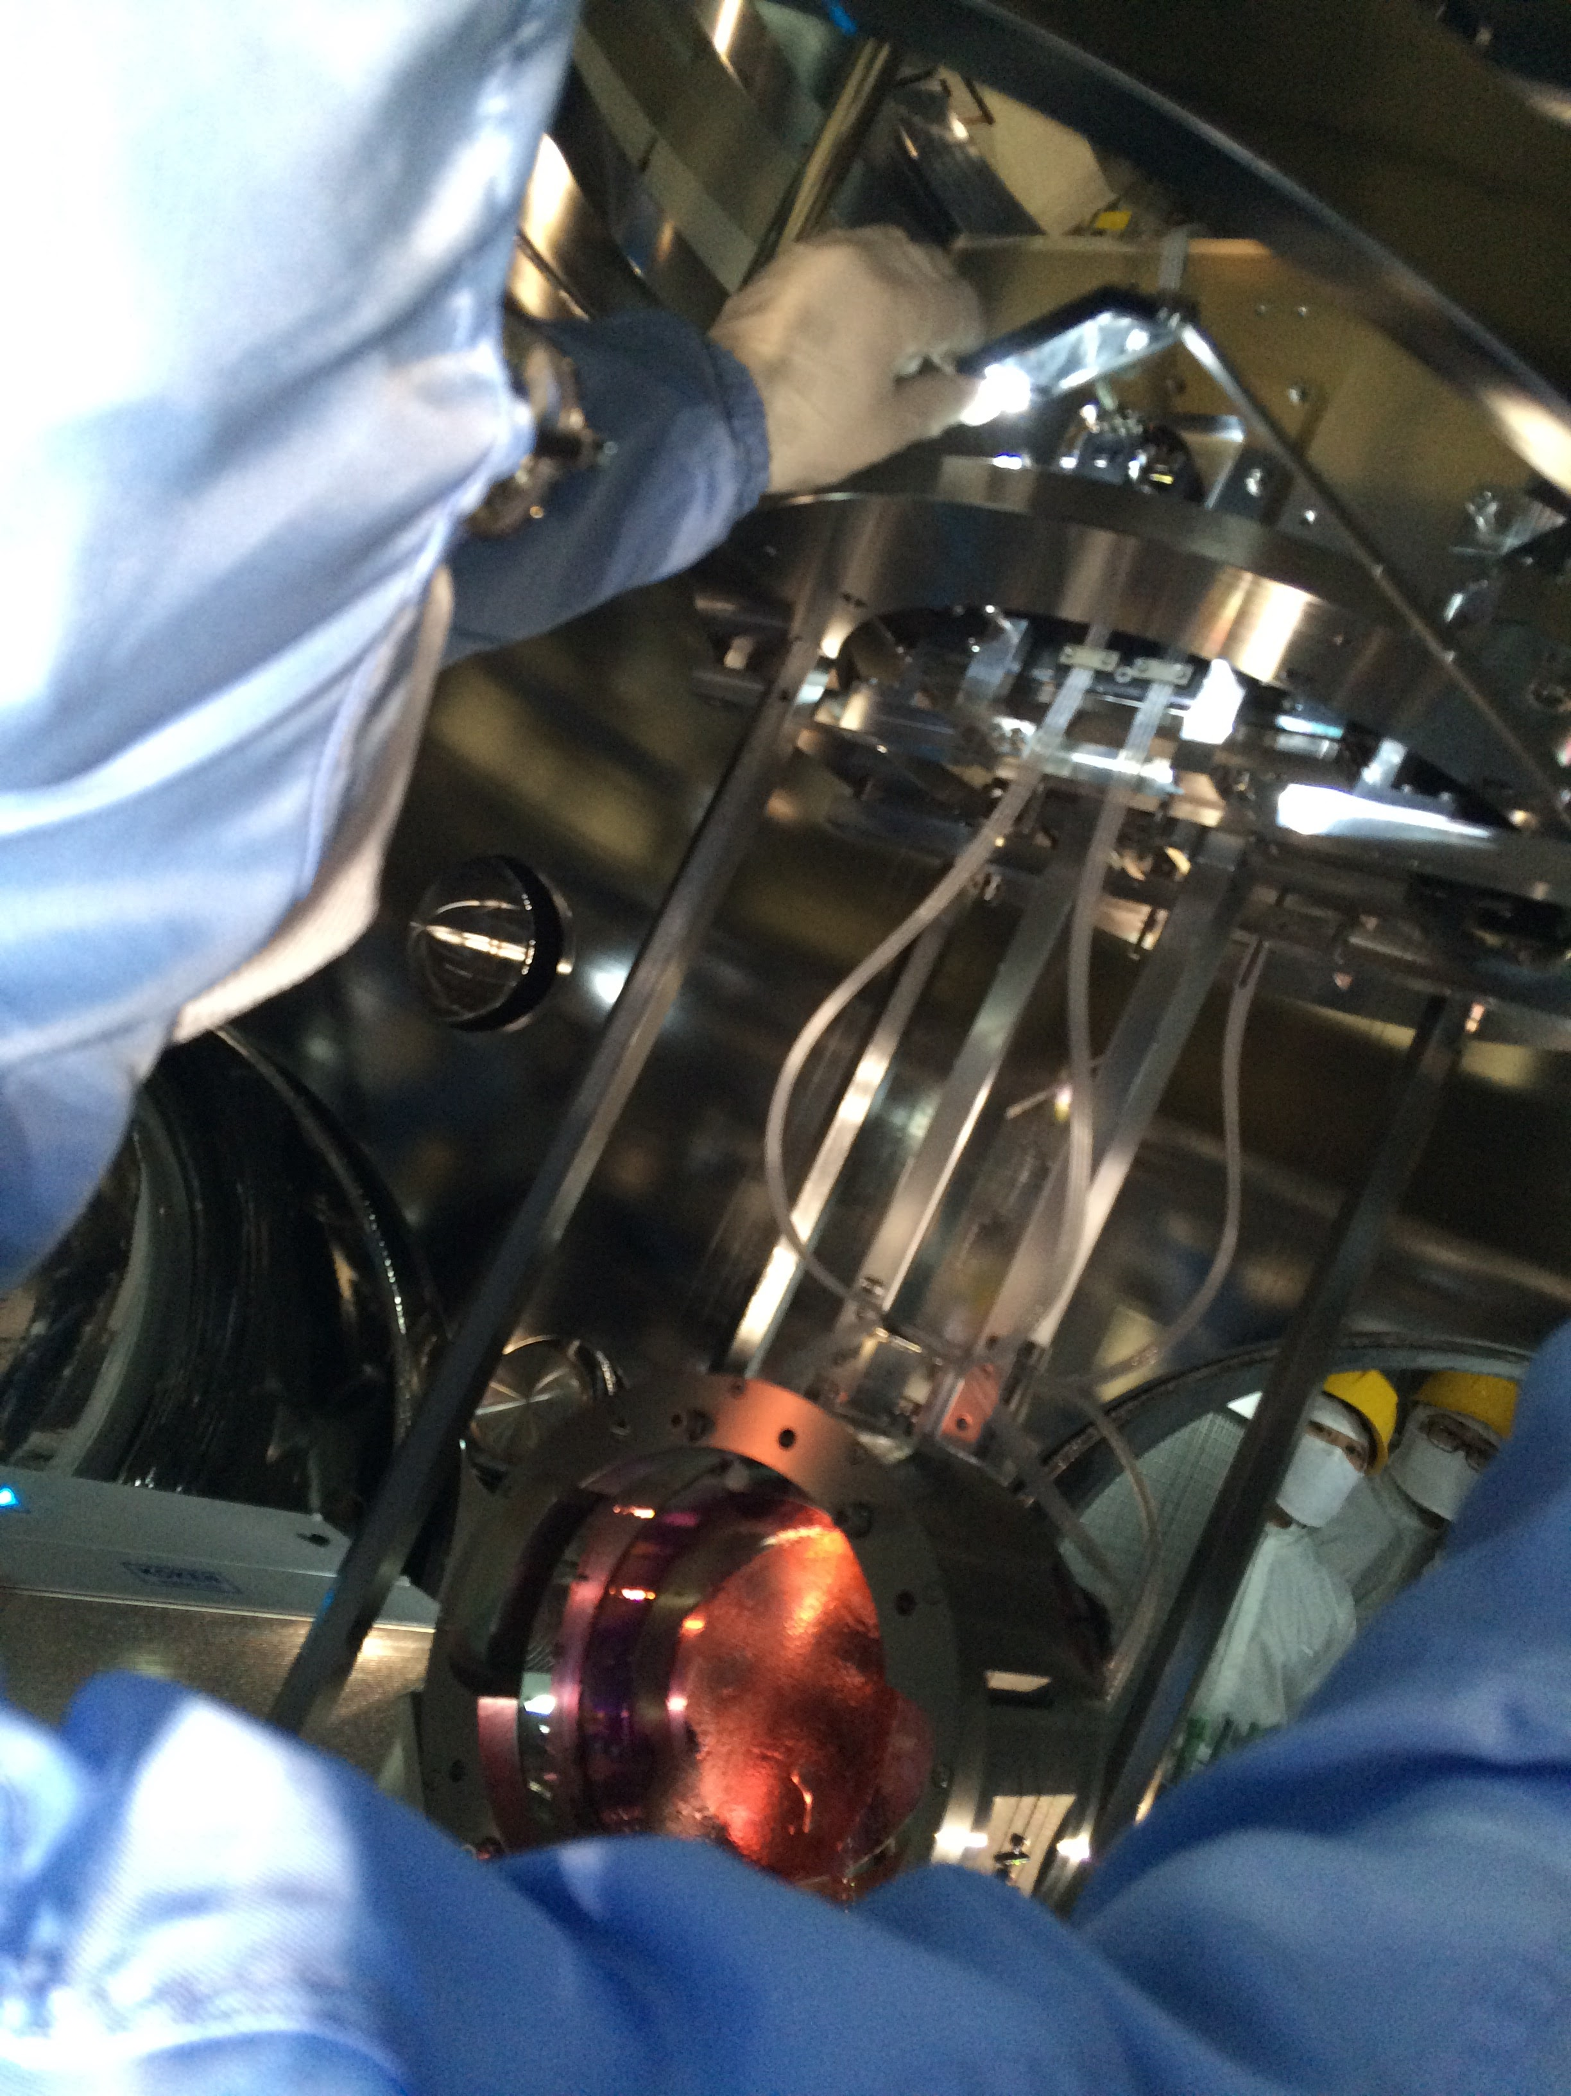
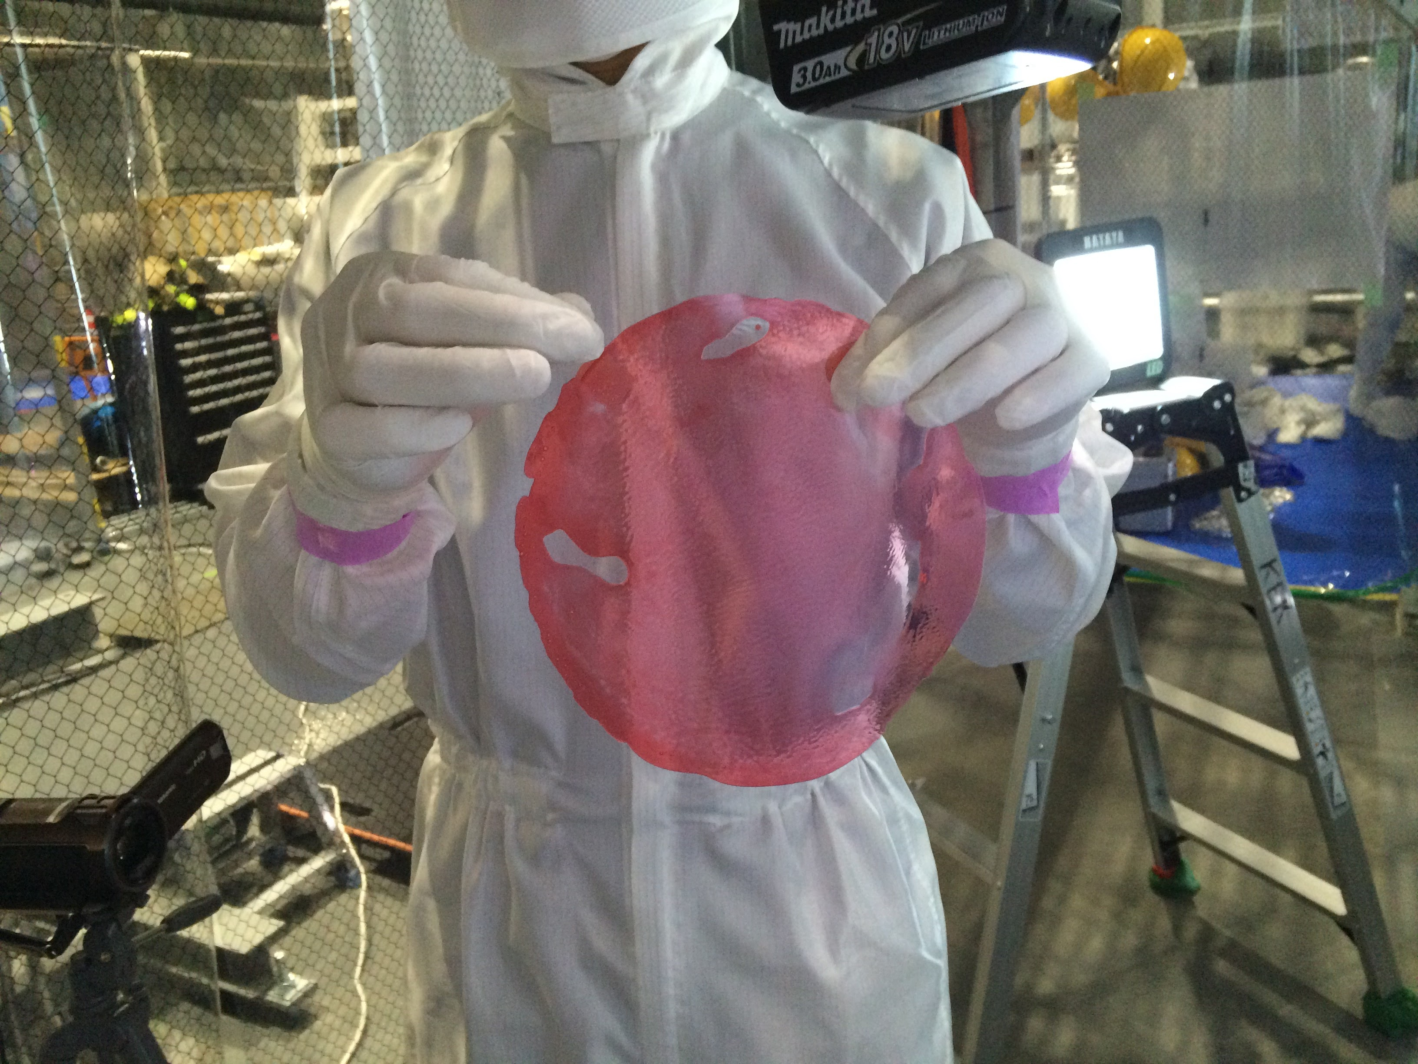
iKAGRA commissioning milestone in 2015
151215_SAITO
EYC
3/22 - ; iKAGRA observation
ETM
12/11; MC mirrors aligned,
and a transmission fringe from MC observed
3/11; EYA (ETM-Y) mirror suspended
Y-arm
3/18; EXA (ETM-X) mirror suspended
MC
PR
IO
BS
EXC
X-arm
ETM
6/9; PSL beam quality check
VIS installation;
6 weeks for each ETM
7 weeks for each PR
by two teams for four mirrors
SR
12/22; PR3 test hanging
(full assy with a spare mirror)
1/28; PR2 mirror suspended
2/5; PR3 mirror suspended
12/22; BS mirror (CLIO) suspended

Slide 16
iKAGRA commissioning milestone in 2015
151215_SAITO
iKAGRA delayed
EYC
3/22 - ; iKAGRA observation
ETM
12/11; MC mirrors aligned,
and a transmission fringe from MC observed
3/11; EYA (ETM-Y) mirror suspended
Y-arm
3/18; EXA (ETM-X) mirror suspended
MC
PR
IO
BS
EXC
X-arm
ETM
6/9; PSL beam quality check
VIS installation START SOON!!;
6 weeks for each ETM
7 weeks for each PR
by two teams for four mirrors.
Each team needs 1 more shift
(Total 2 shift member) until
completion of VIS installation.
SR
12/22; PR3 test hanging
(full assy with a spare mirror)
1/28; PR2 mirror suspended
2/5; PR3 mirror suspended
12/22; BS mirror (CLIO) suspended

Slide 17
Project/SEO report
151215_SAITO
1. Present status of iKAGRA
** Master schedule and delay of iKAGRA
** iKAGRA configuration (Michelson Interferometer) and Beam Splitter
** installation so far done
2. Scheduling of iKAGRA installation/commissioning
** milestone
3. bKAGRA (2016-17)
** Task force for updating “budget schedule and roadmap of bKAGRA”

Slide 18
bKAGRA configuration
150709_SAITO
first science run in FY2017
Type-A system
bKAGRA configuration
- Cryogenic test masses
- 3 km arm cavities
- RSE with power recycling
ETM
- Cryogenic test mass
Sapphire, 23kg, 20K
- Tall seismic isolator
IP + GASF + Payload
Y-arm
ITM
MC
PRM
BS
X-arm
Type-C system
IO
ITM
ETM
- Mode cleaner
Silica, 0.5kg, 290K
- Stack + Payload
Type-B system
SRM
- Core optics (BS, SRM,…)
Silica, 10kg, 290K
- IP + GASF + Payload
Type-Bp payload
Test mass and Core optics (BS, FM,..)
Silica, 10kg, 290K
- Seismic isolator
Table + GASF + Type-B Payload

Slide 19
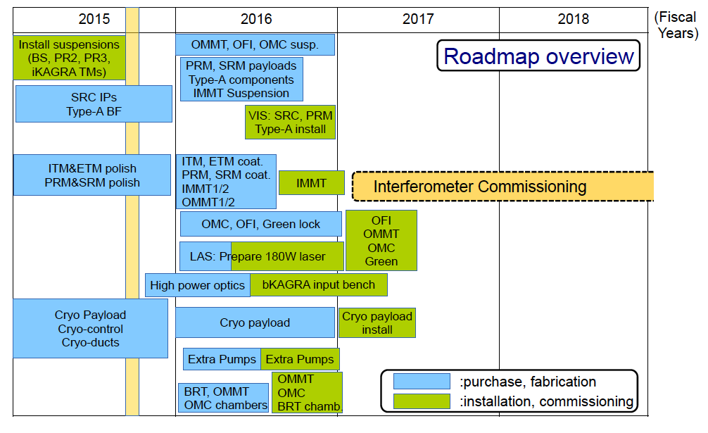
bKAGRA configuration
150709_SAITO
first science run in FY2017
Type-A system
bKAGRA configuration
- Cryogenic test masses
- 3 km arm cavities
- RSE with power recycling
ETM
- Cryogenic test mass
Sapphire, 23kg, 20K
- Tall seismic isolator
IP + GASF + Payload
Y-arm
ITM
MC
PRM
BS
X-arm
Type-C system
IO
ITM
ETM
- Mode cleaner
Silica, 0.5kg, 290K
- Stack + Payload
Type-B system
SRM
- Core optics (BS, SRM,…)
Silica, 10kg, 290K
- IP + GASF + Payload
- Stack for aux. optics
Type-Bp payload
Test mass and Core optics (BS, FM,..)
Silica, 10kg, 290K
- Seismic isolator
Table + GASF + Type-B Payload
We need detailed plan to maximize the feasibility and achievement.

