Slide 1
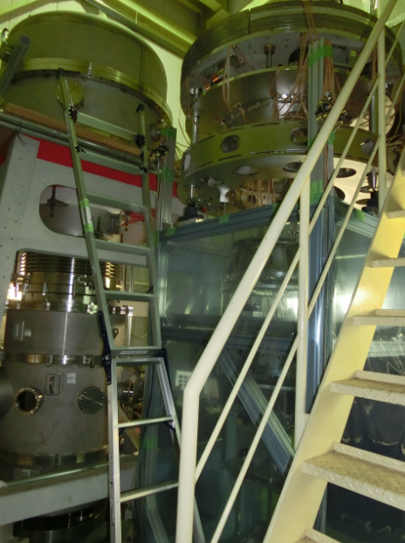
Type-B SAS Prototype Test
KAGRA domestic
collaboration MEETING
May. 2015
Takanori Sekiguchi

Slide 2
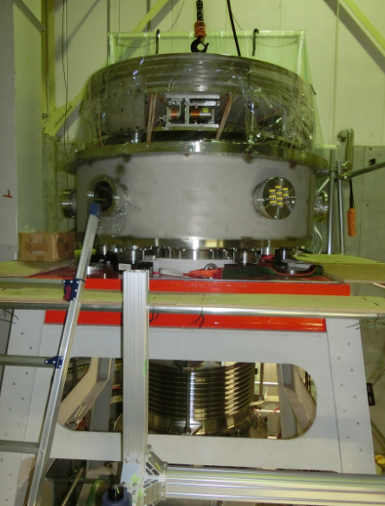
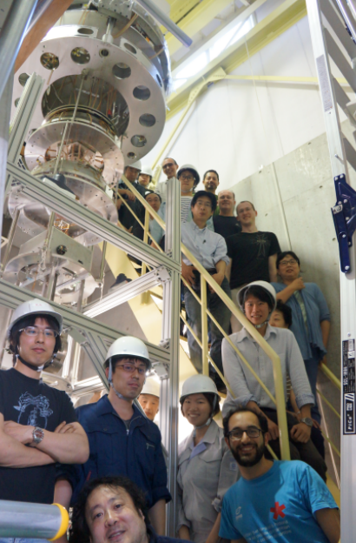
Contents
Type-B SAS prototype
fully assembled and
successfully installed to
vacuum chamber!

Slide 3
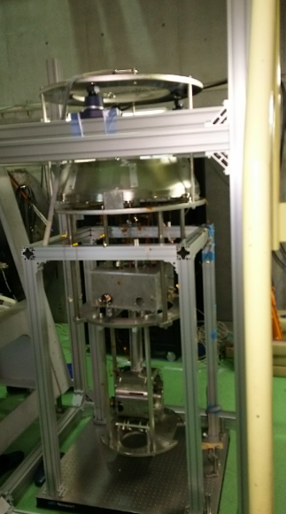
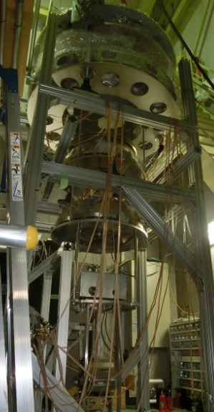
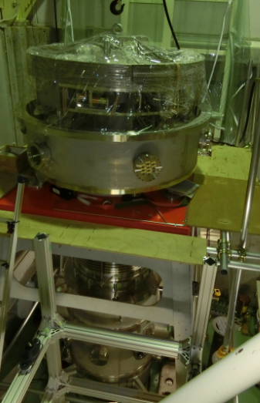
Evolution
Fab.
Apr.
May.

Slide 4
Any findings during assembly works?
How does the installation go?

Slide 5
ASSEMBLY

Slide 6
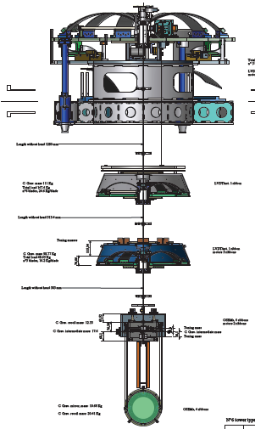
Assembly
Top GAS filter
Standard GAS filter
Make a ‘GAS filter chain’
Bottom GAS filter

Slide 7
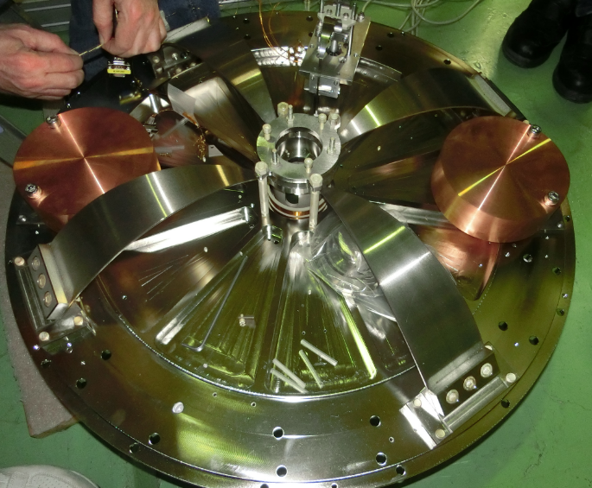
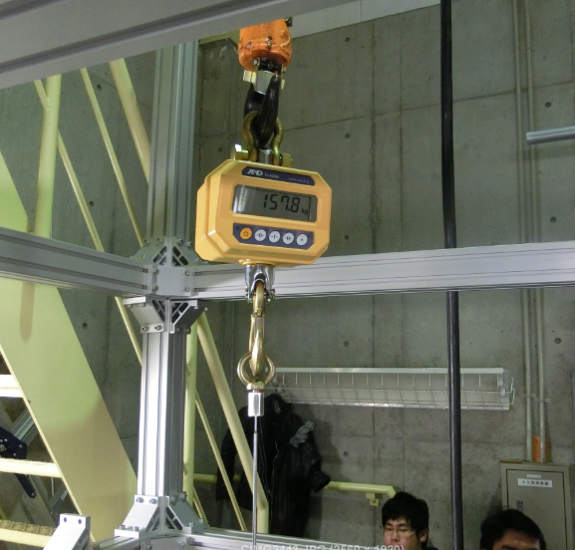
How to build up GAS filter chain
1. Check the optimal load of a GAS filter.
2. Measure the weight of the payload.
162.5 kg

Slide 8
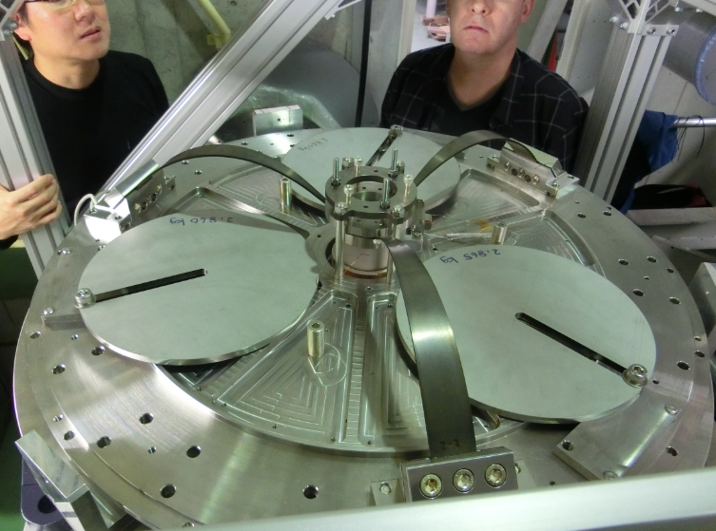
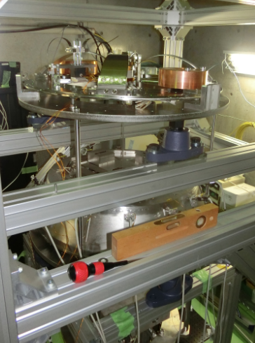
How to build up GAS filter chain
3. Roughly adjust the weight of the payload.
4. Suspend the payload from the GAS filter.
(Tuning masses on bottom filter)

Slide 9
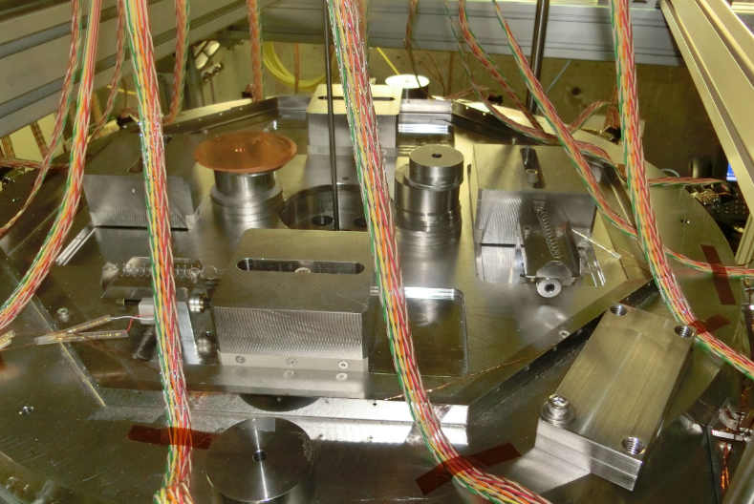
How to build up GAS filter chain
5. Finely adjust of the load on the GAS filter.
6. Level the payload by adjusting the position of masses.
Tuning masses

Slide 10
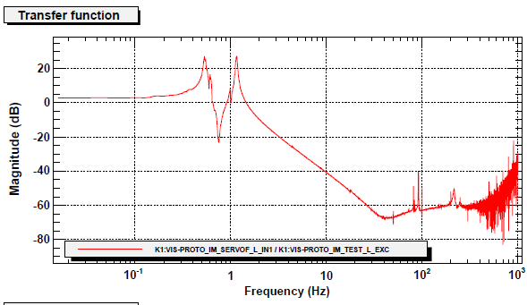
How to build up GAS filter chain
8. Check frequency response of the suspension using sensors and actuators.
Any funny response?
yes
no
Debug the system
(any frictions, broken parts, …)
Continue assembly work of upper parts

Slide 11
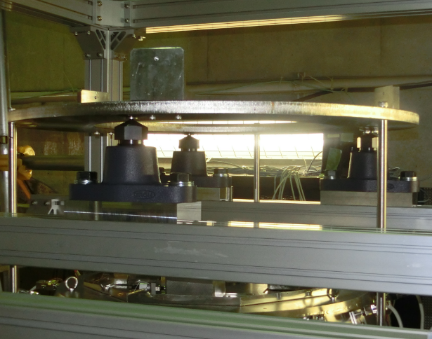
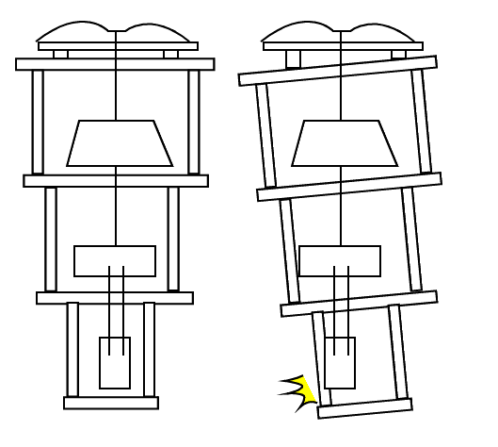
Level of the security frame is important!

Slide 12
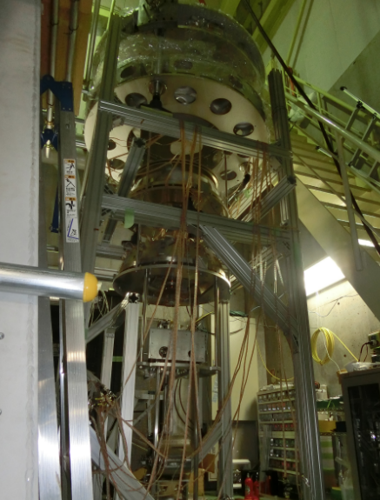
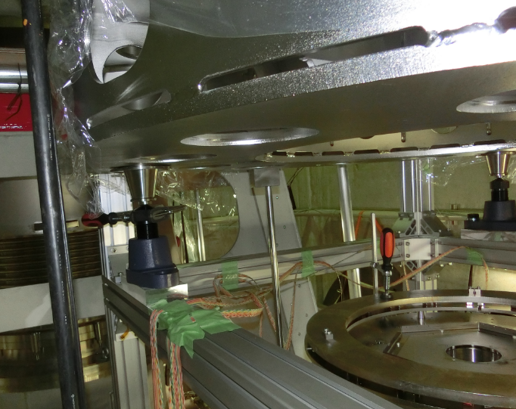
Pre-isolator

Slide 13
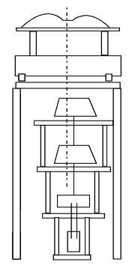
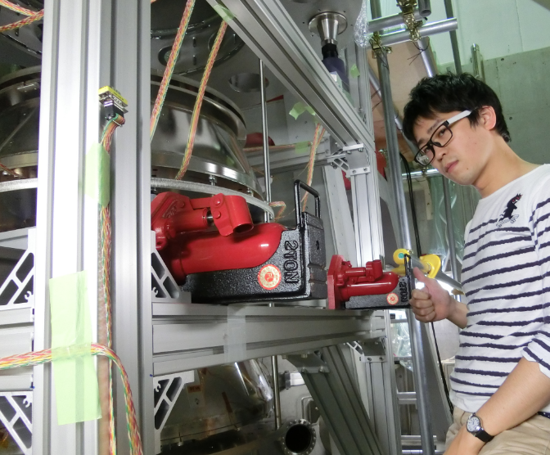
Be careful of miscentering!
We needed to push the suspension by jacks

Slide 14
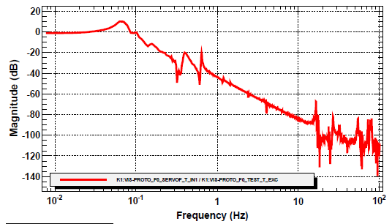
Tuning of IP
Frequency response of top stage from actuation force
75 mHz

Slide 15
INSTALLATION

Slide 16
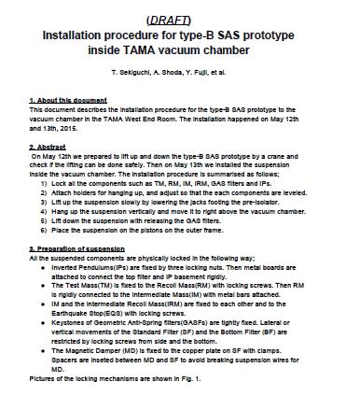
For more details:
JGW-T1503578-v1

Slide 17
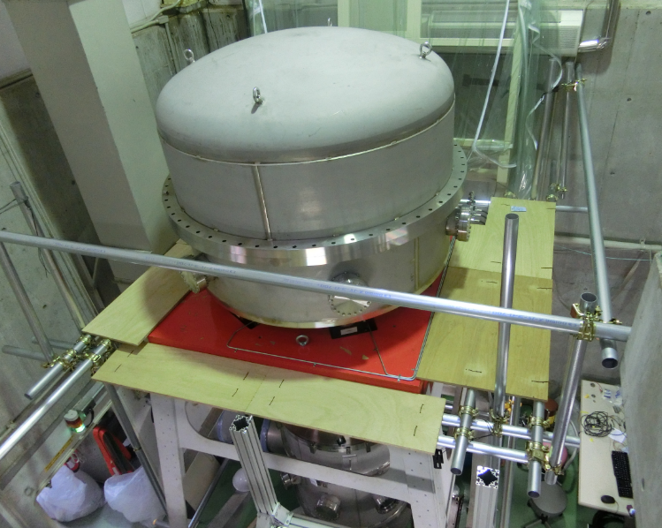
First important step:
Construct walkthrough around vacuum chamber!
Special thanks: Ishitsuka-san

Slide 18
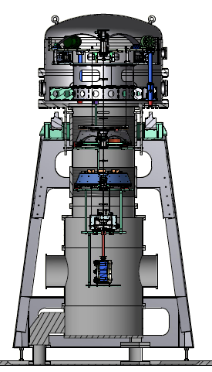
What’s difficult?
1. Limited height of the crane
2. Vibration by crane operation
3. Small clearance between bellows and the suspension system (<1 cm)

Slide 19
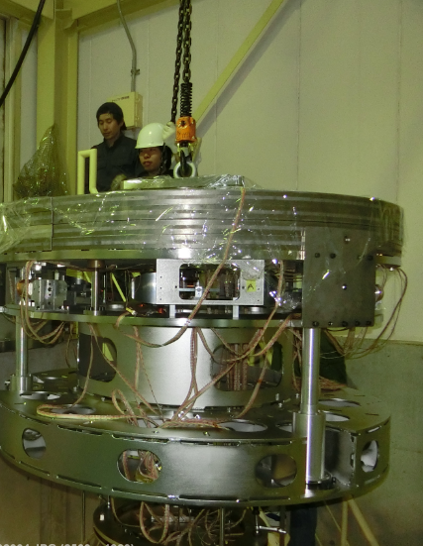
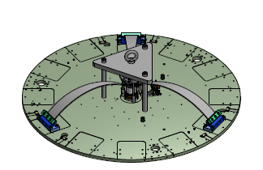
Crane adapter

Slide 20
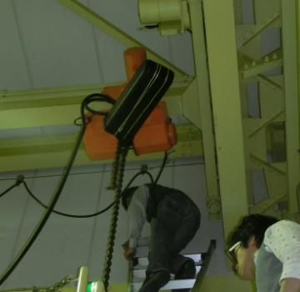
Modification on crane

Slide 21
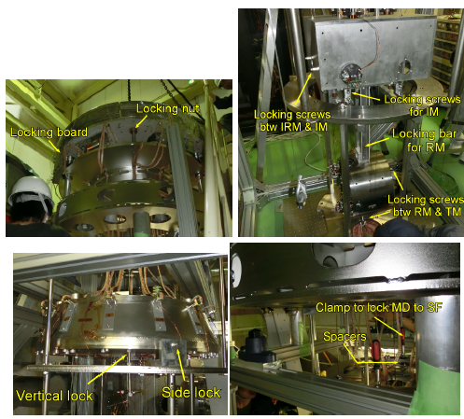
Lock the suspensions

Slide 22
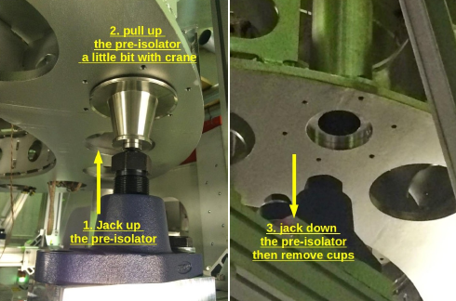
Lifting the suspension by crane

Slide 23
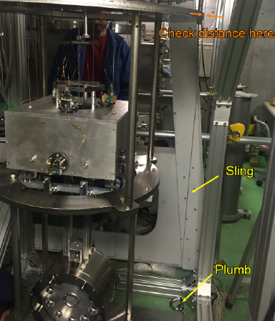
Plumb (下げ振り)

Slide 24
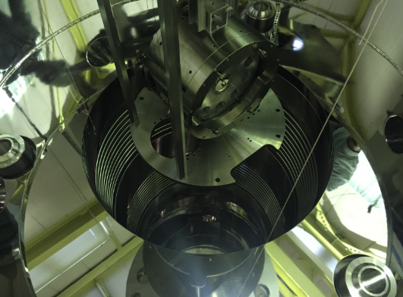
Plumb (下げ振り)

Slide 25
Procedure

Slide 26
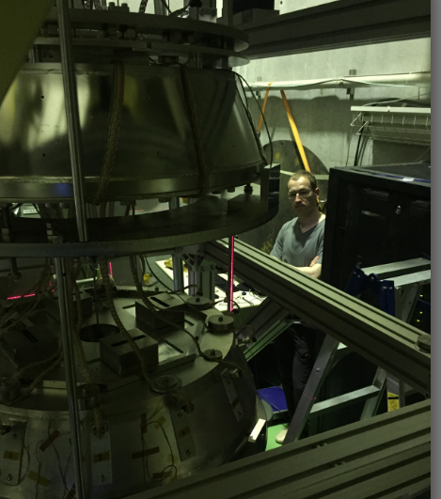
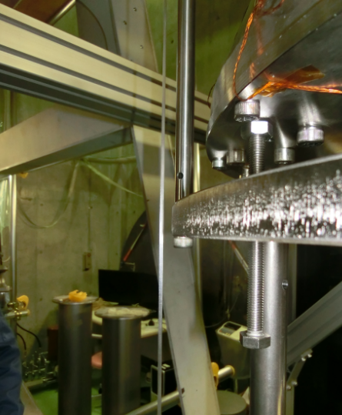
Lifting test / leveling check

Slide 27
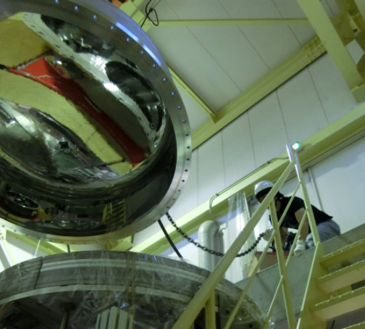
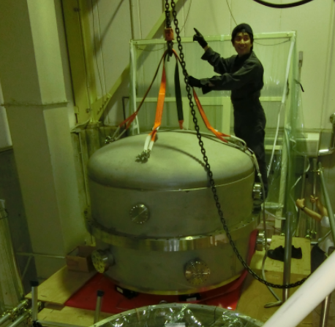
Remove top chamber cap

Slide 28
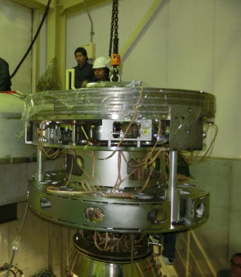
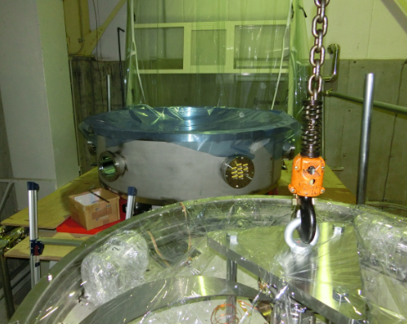
Lifting up

Slide 29
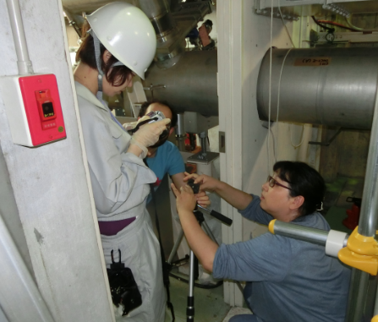
(have a break)

Slide 30
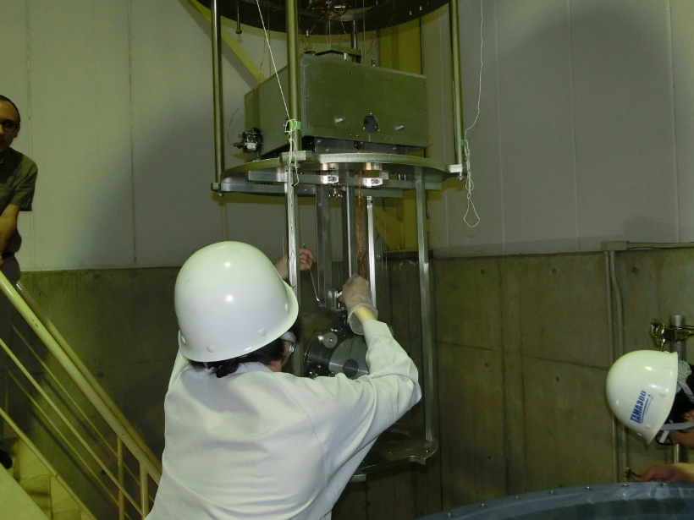
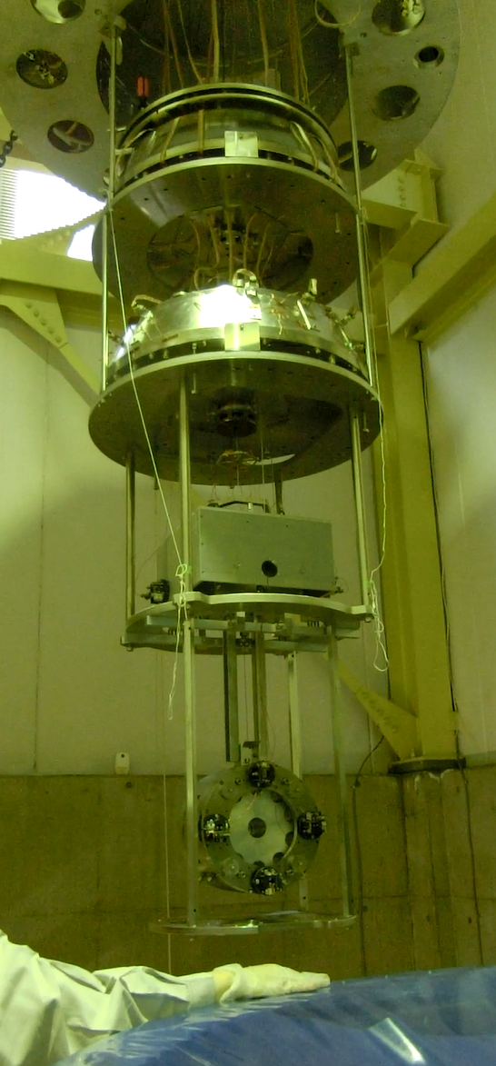
Move the suspension

Slide 31
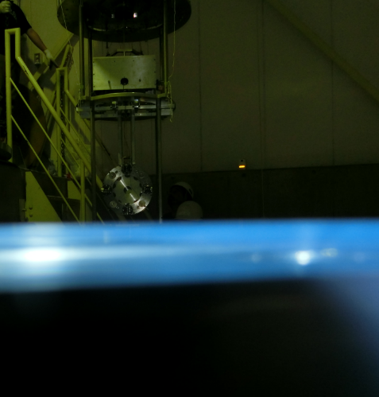
Check the height of the suspension
→ Adjust height of the vacuum chamber

Slide 32
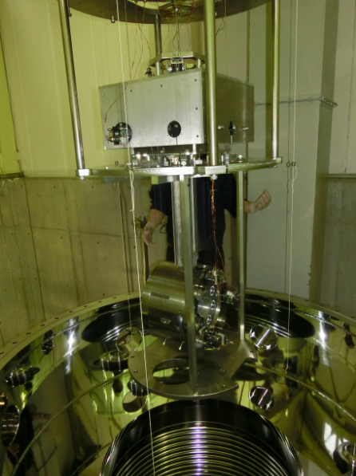
Move the suspension

Slide 33
Centering the suspension using plumbs

Slide 34
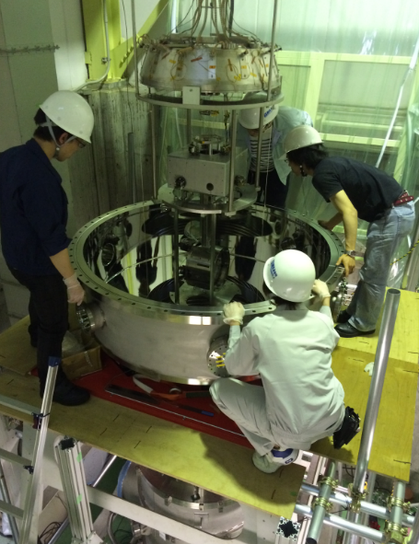
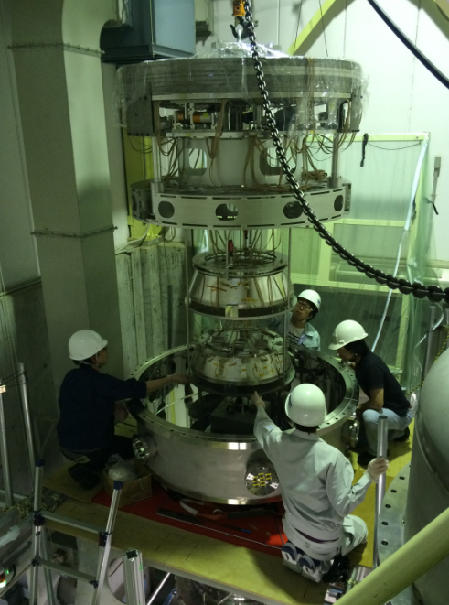
Lift down

Slide 35
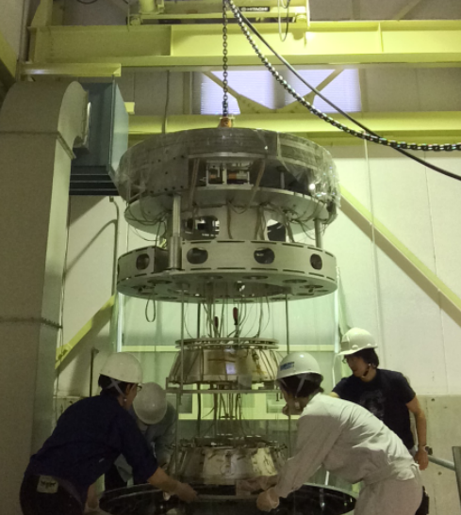
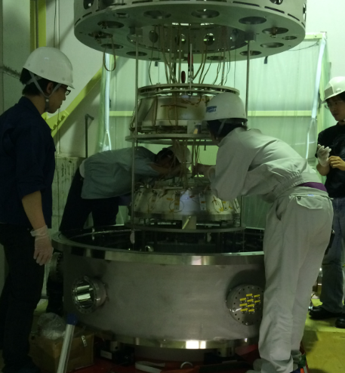
Lock release & Lift down

Slide 36
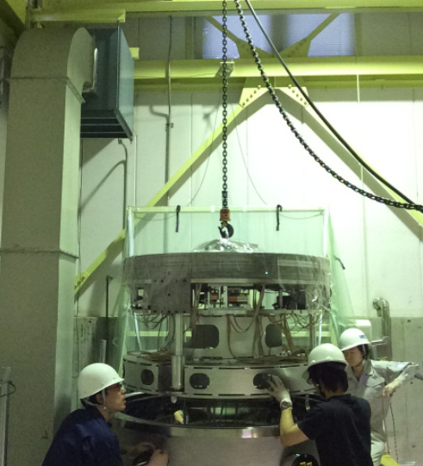
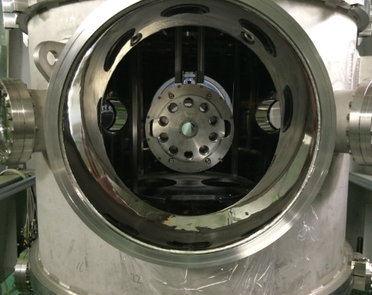
Launch

Slide 37
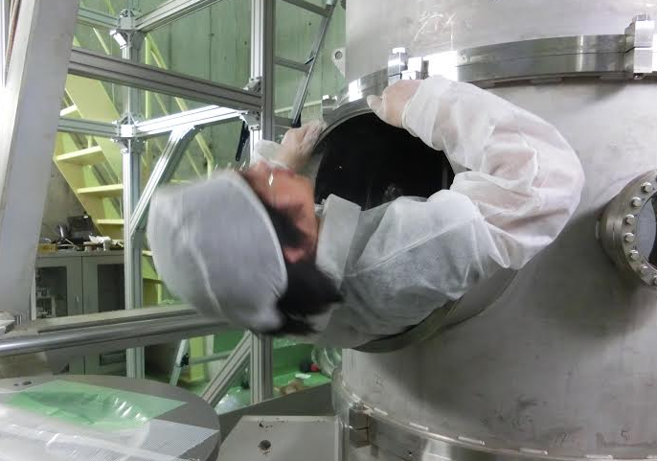
Troubles
Test mass position is too low → Raise the external frame later
One OSEM flag (for TM) is broken. → Fixed inside the vacuum chamber

Slide 38
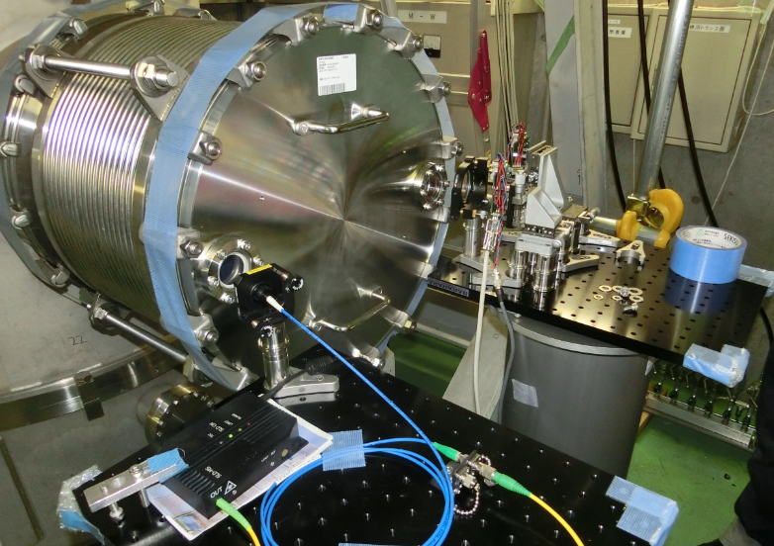
Now
Set optical lever
Measure transfer functions

