Slide 1
My work in 2015 2-1
Hiroki Tanaka

Slide 2
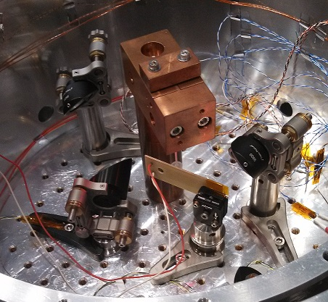
Measurement of fiber A

Slide 3
Measurement
We measured Q of monolithic fiber(fiber A).
The peak was 86Hz, 88Hz.
In 86Hz case, the highest Q was 4400, and in 88Hz case, the highest Q was 4100 in room temperature.

Slide 4
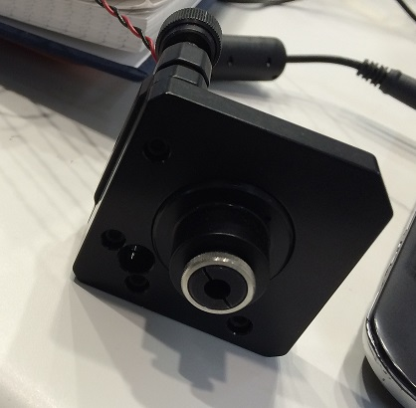
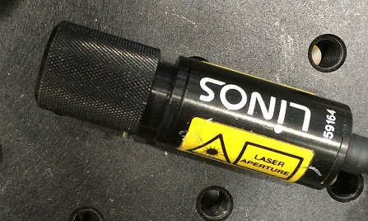
Method to get higher Q 1
I changed the laser, but there was no peak.

Slide 5
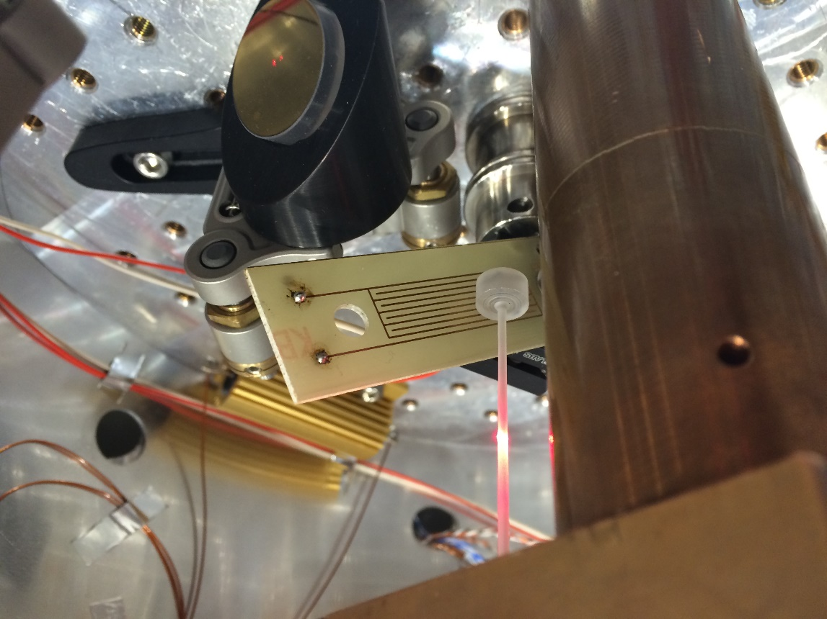
Method to get higher Q 2
We moved the position of
the fiber from the edge of the
circuit of the actuator to the
center of the actuator.
Then, there was a peak in 90.7Hz
(Q=3460)

Slide 6
Next step
We cooled down the cryostat but there was no peak.
So we are raising the temperature and we will check what’s wrong.

