Slide 1
Burst noise investigation for cryogenic GW detector
3rd Symposium ‐ New Development in Astrophysics through
Multi-messenger Observations of Gravitational Wave Sources
NAOJ
Daisuke TATSUMI
2015-02-21 @ Hiroshima U.

Slide 2
1. Introduction
My two year’s research plan of
“Burst noise investigation for cryogenic GW detector”
was approved as a 「公募研究」 of A04 group.
Related Public Subscription Researches = 公募研究
In this talk, I would like to make a brief report
on my research program.

Slide 3
Outline
1. Introduction
2. Overview of my system
2.1 Cryogenic sensor
2.2 Data Acquisition
2.3 Data Transfer
2.4 Detector Characterization
3. Current Status of KAGRA
4. Summary

Slide 4
Purpose of this program
In this research program,
we focus on burst noises induced by
cryogenic system, because KAGRA is
unique cryogenic interferometer
in the world.
It means that there is very little information about
noise behavior of cryogenic interferometer.

Slide 5
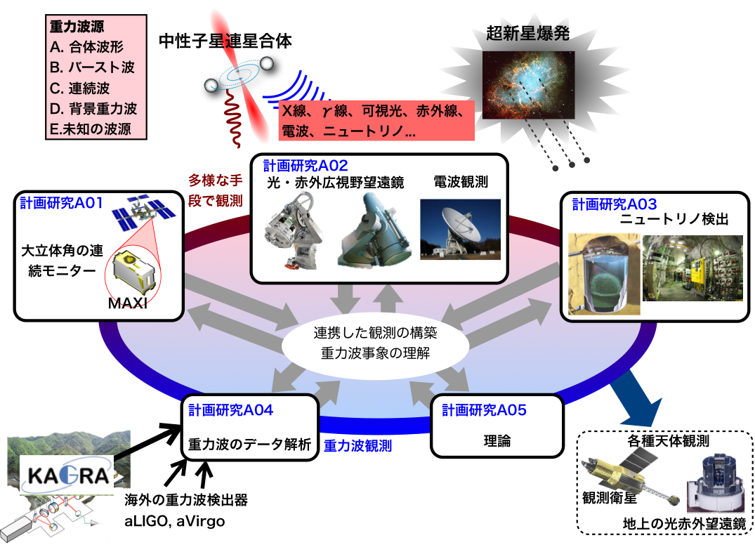
Multi-messenger
Needless to say, this Kakenhi project aims to make a multi-messenger observation system for GW sources.
To realize the system and make it effective, not only the detector sensitivity and also low false alarm rate are important.
Notes:
Needless to say, this Kakenhi project aims to make a multi-messenger observation system for GW sources.
To realize the system and make it effective, not only the detector sensitivity
and also low false alarm rate are important.

Slide 6
1. Overview of noise investigation system

Slide 7
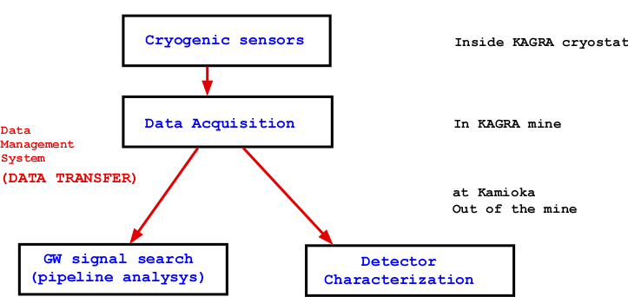
Noise Investigation of cryogenic interferometer
To realize low false alarm rate with cryogenic interferometer,
we need noise monitoring system inside the cryostat.
This shows overview of our noise monitoring system.
Notes:
To realize low false alarm rate with cryogenic interferometer,
we need noise monitoring system inside the cryostat.
This shows overview of our noise monitoring system.
Of course, cryogenic compatible sensors are needed.
These are installed inside the cryostat.
Sensor output are recorded by some data acquisition system.
And then, data is transferred to the computer cluster for GW pipeline analysis
And also for detector characterization system.

Slide 8
2. Cryogenic Sensor

Slide 9
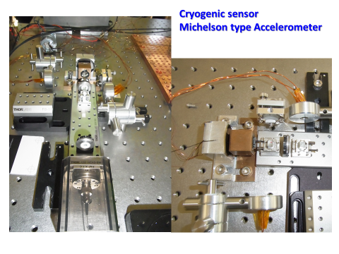
Cryogenic Sensor
Notes:
This is a cryogenic compatible sensor to sense the vibration.
Based on design of Yamamoto-san in ICRR, some modifications were applied.

Slide 10
Cryogenic Sensor
Notes:
This is seismic spectrum at TAMA site.
Mitaka campus is very loud than that of Kamioka mine.

Slide 11
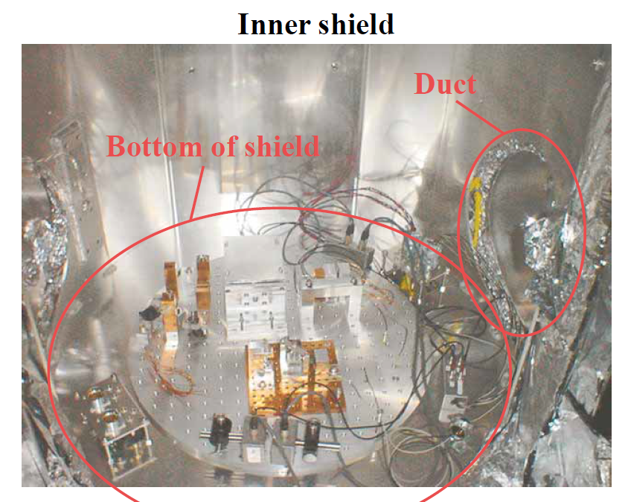
Photo: CLIO inner shield
K. Yamamoto
JPS2006 Spring
This picture shows a cryogenic vibration sensor inside the vacuum chamber.
Notes:
In my original research plan,
the sensor will be installed inside CLIO cryostat like that.
This picture was taken in 2005 or 2006.
As you know, at the Kamioka site lack of manpower is very serious.
Therefore, we could not operate CLIO detector in cryogenic temperature.

Slide 12
Photo: CLIO inner shield
K. Yamamoto
JPS2006 Spring
We made noise investigations with cryogenic interferometer of CLIO.
Notes:
We made noise investigations with cryogenic interferometer of CLIO.

Slide 13
CLIO: achievement
By cooling the mirrors,
we succeed to demonstrate
thermal noise reduction
at CLIO.
Notes:
Anyway, we made noise investigations with cryogenic interferometer of CLIO.
Finally we succeed to demonstrate thermal noise reduction
By cooling the mirrors.

Slide 14
Data Transfer
Notes:
As for KAGRA, we have a plan to install various sensors to monitor the noises
as shown in this figure. Thermometer, barometer and seismometer and so on.
In addition, cryogenic sensors are important for noise investigations.

Slide 15
3. Data Transfer
Notes:
Before talking about the current works, I will review the past work with TAMA300 detector.

Slide 16
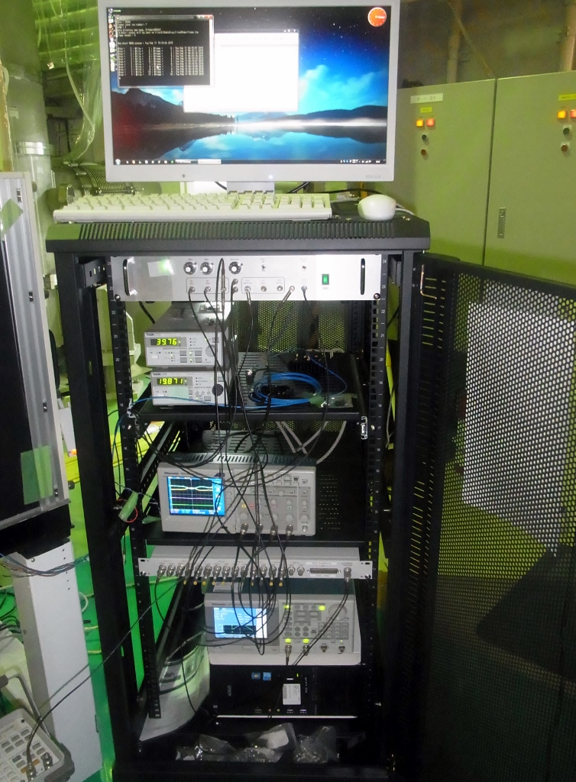
Data Acquisition
At the KAGRA site, KAGRA Digital Control
System is available to record various noise sensors.
But in the past two years
we need temporal data acquisition system
to record data with FRAME FORMAT.
The FRAME FORMAT is
Common Data Frame Format
for Interferometric Gravitational Wave Detector
(IGWD).
The data is mainly analyzed by KAGRA pipeline
analysis programs.

Slide 17
Data Transfer

Slide 18
Data Transfer

Slide 19
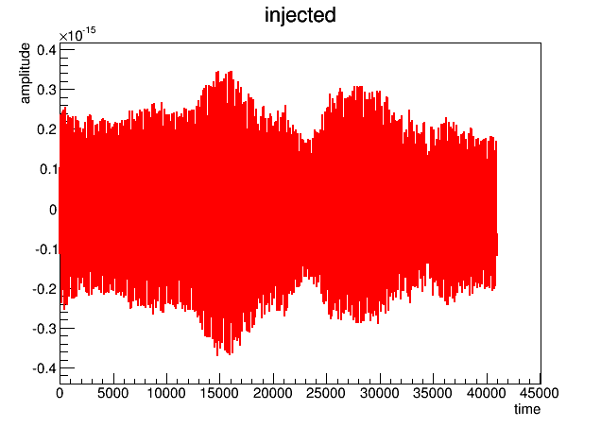
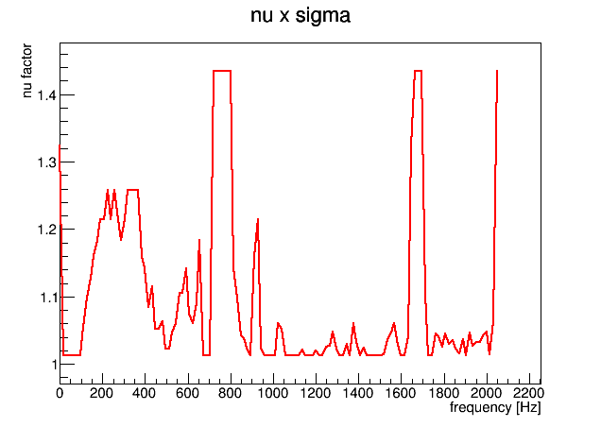
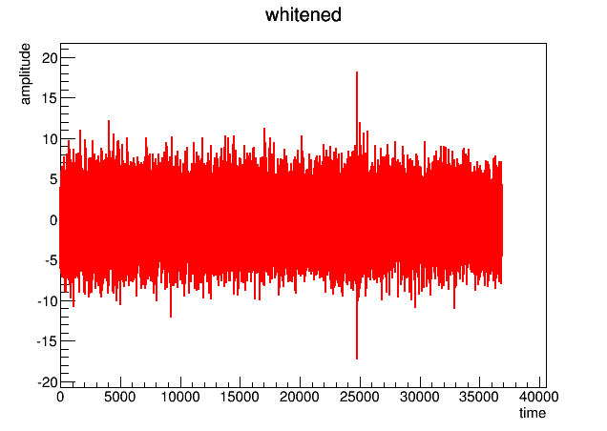
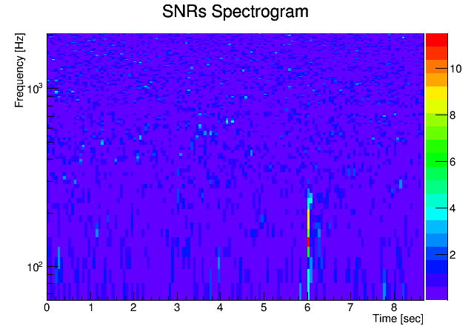
Burst Pipeline
Hayama
In progress
To reduce the false alarm rate,
non-gauss noise model is applied to determine
detection threshold.
LIGO S5 DATA
Whitening by Linear Prediction Error Filter
Signal to Noise ratio on time-freq. plane
Notes:
Based on “Excess Power Filtering”, burst pipeline is being prepared for KAGRA.
In the time and frequency plane, some excess signals are picked up.

Slide 20
4. Detector Characterization
Notes:
Before talking about the current works, I will review the past work with TAMA300 detector.

Slide 21
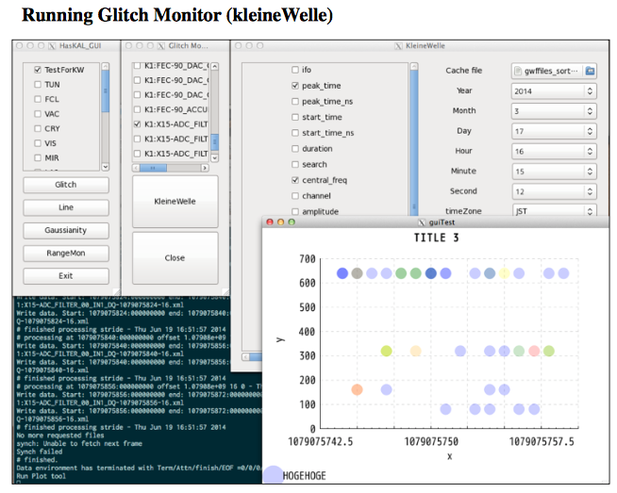
Glitch noise monitor
Reference：
http://gwdoc.icrr.u-tokyo.ac.jp/DocDB/0019/G1301979/002/20131112_detchar_glitch_monitor.pdf
Notes:
Glitch monitoring for any noise sensors is available.
By using graphical user interfaces, not only analyst but also experimentalist can easily check the noise behavior.

Slide 22
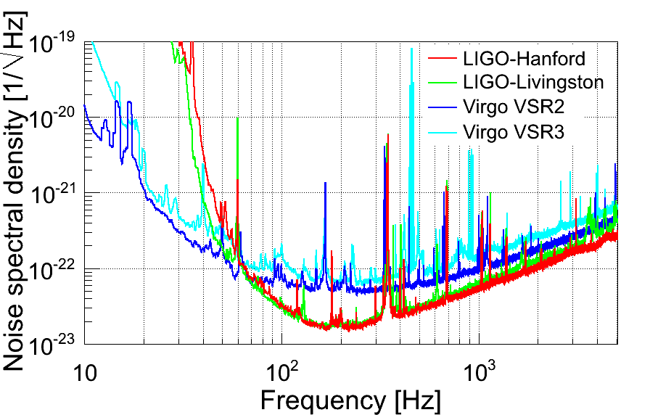
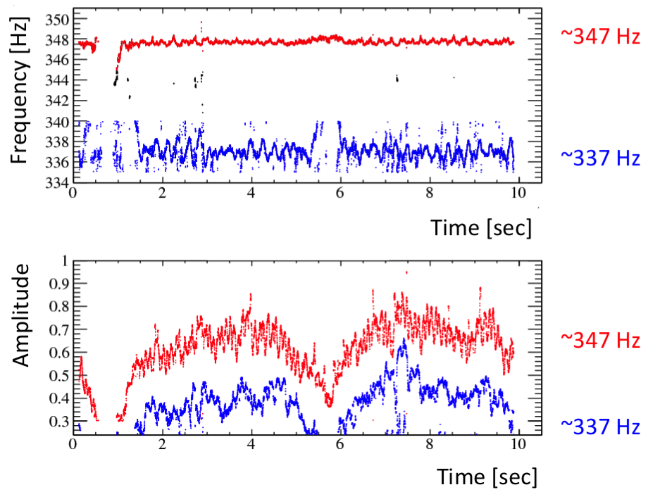
Line noise monitor
peak
peak
Notes:
In the detector output spectrum, we can found several line noises.
In the room temperature, most of line noise is stable.
But as for cryogenic interferometer, there is a possibility
To change as a function of temperature.
In addition, violin modes are deeply related to the thermal noises.
Therefore, this monitor is very important for cryogenic interferomter.

Slide 23
Detector Characterization
Glitch monitor
Line monitor

Slide 24
Detector Characterization
Glitch monitor
Line monitor
Notes:
These figures show results of simulation test.
In this test, artificial non-gauss noises are embedded.
And then, these are reconstructed as empirical nu.
Noise modeling by taking into account of non-gaussianity is very important
to determine detection threshold. It can reduce the fake rate.

Slide 25
6. Status of KAGRA cryostat

Slide 26
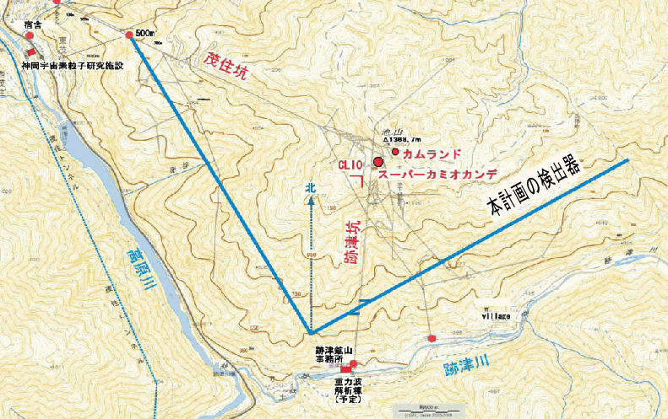
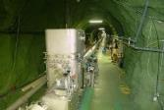
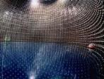
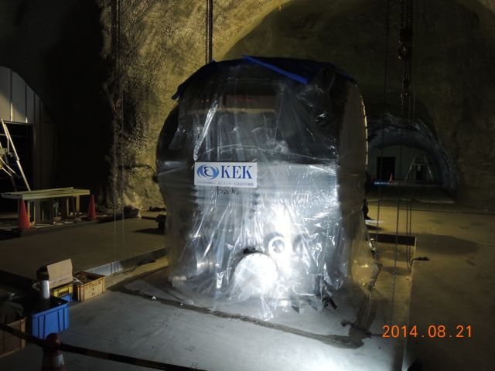
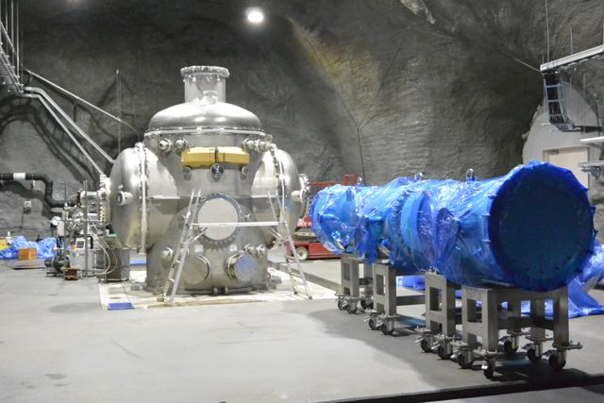
Y-end
Mozumi Entrance
Super-Kamiokande
CLIO
X-end
K A G R A
3km
3km
Shin-atotsu Entrance
Two cryostats have been installed into X and Y ends.
And we start assembly of cryostat from Nov. 2014.
Notes:
As I said, unfortunately we cannot operate CLIO detector.
But KAGRA cryogenics installations were started in the last November.

Slide 27
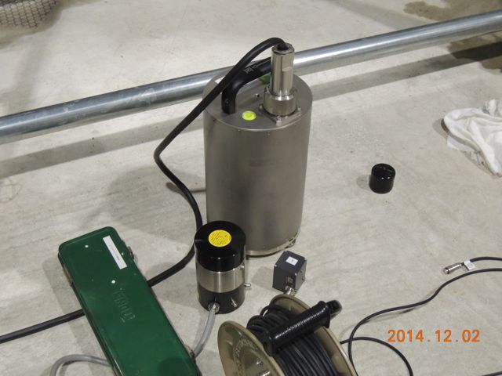
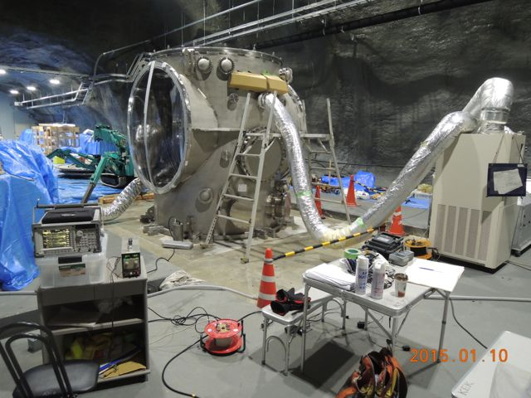
Seismic Vibration Measurement
3-axis Seismometer
(Guralp, CMG-3T)
+ Spectrum Analyzer
1-axis Accelerometer
(RION, LA50)
Notes:
After the installation of the cryostat,
Tomaru-san made some measurements on seismic.
This figure shows some sensors place on the floor.

Slide 28
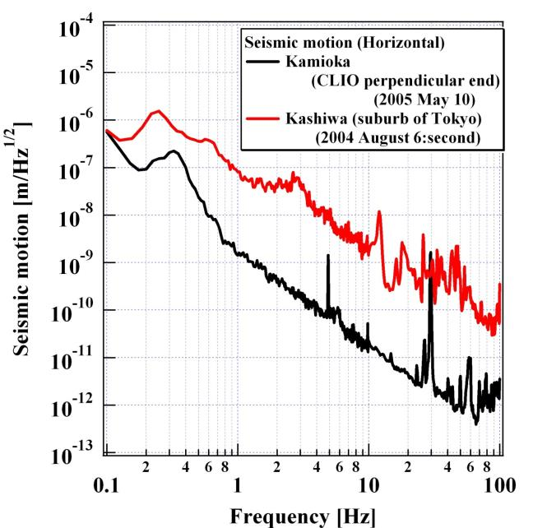
Kamioka Underground
Seismic Vibration
Kashiwa
~ 10⁻⁹
~ 10⁻¹¹
Kamioka
CLIO
Notes:
The black spectrum shows seismic motion at CLIO.
CLIO is placed at deep under the ground.
But KAGRA is placed closer than CLIO.

Slide 29
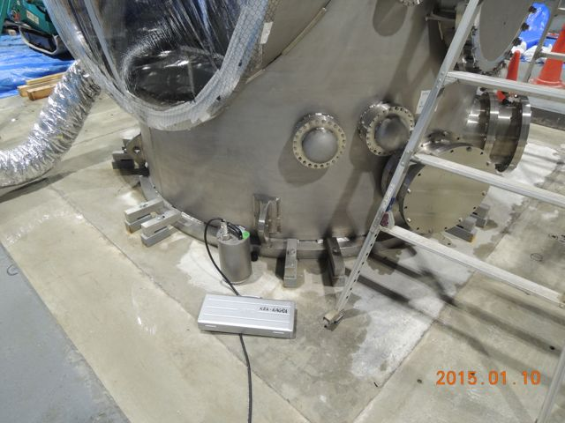
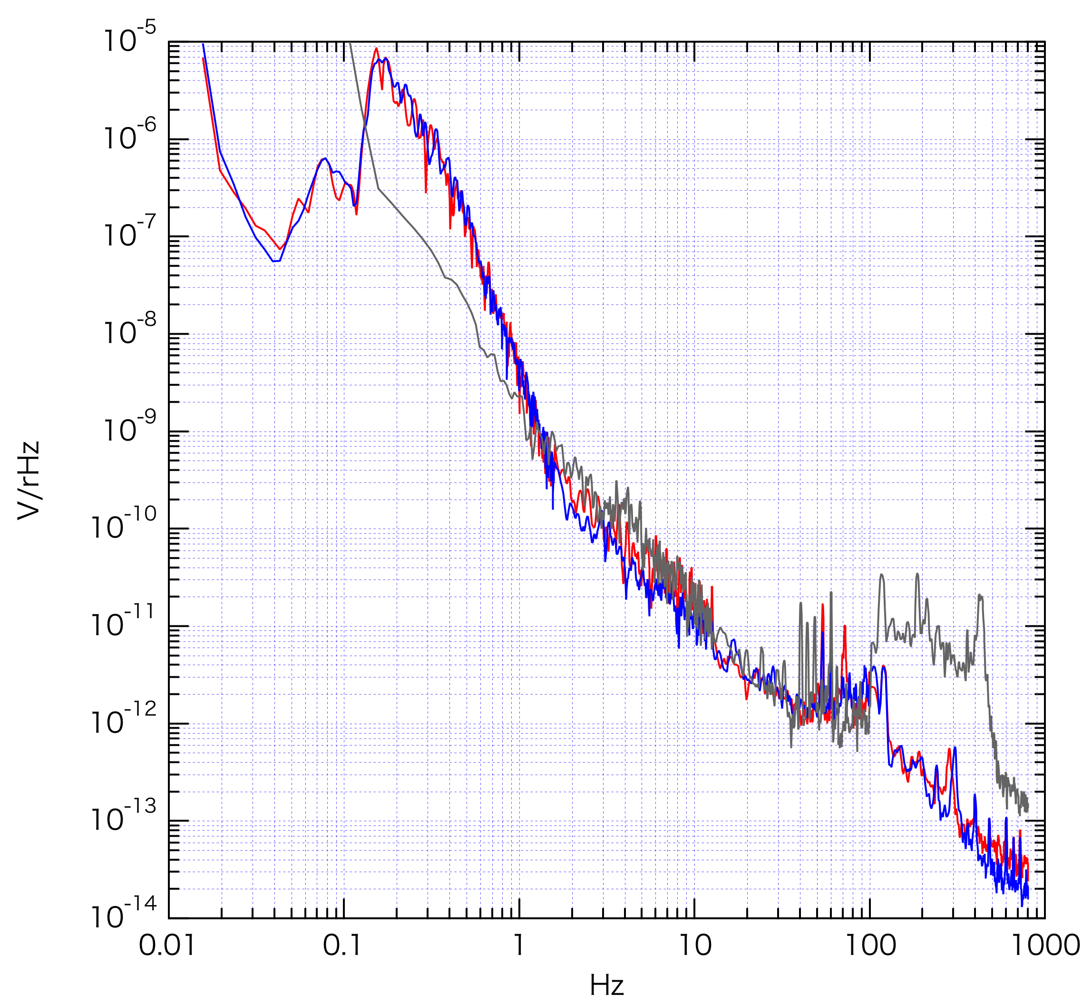
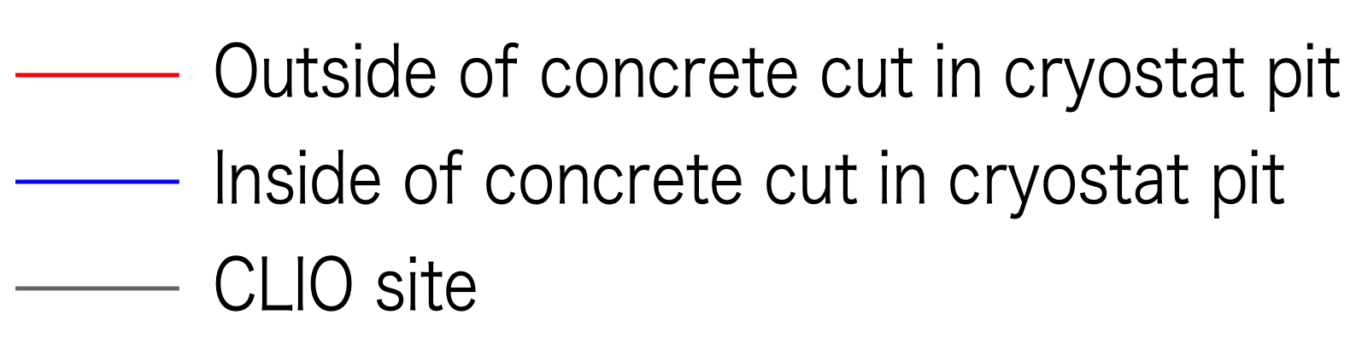
Result of Seismic Vibration Measurement at X-end (1)
- Concrete Cut Effect -
Affect of Concrete Cut
• Water gushing
• Tilt
Vertical
~ 3x10⁻⁹
Concrete cut
m_{rms}/rHz
~ 10⁻¹¹
# Only CLIO data was measured by
laser accelerometer
This concrete cut looks no effect
to reduce vibration conduction
0.01
0.1
1
Hz
10
100
1000
Notes:
The results show there is no excess noise.

Slide 30
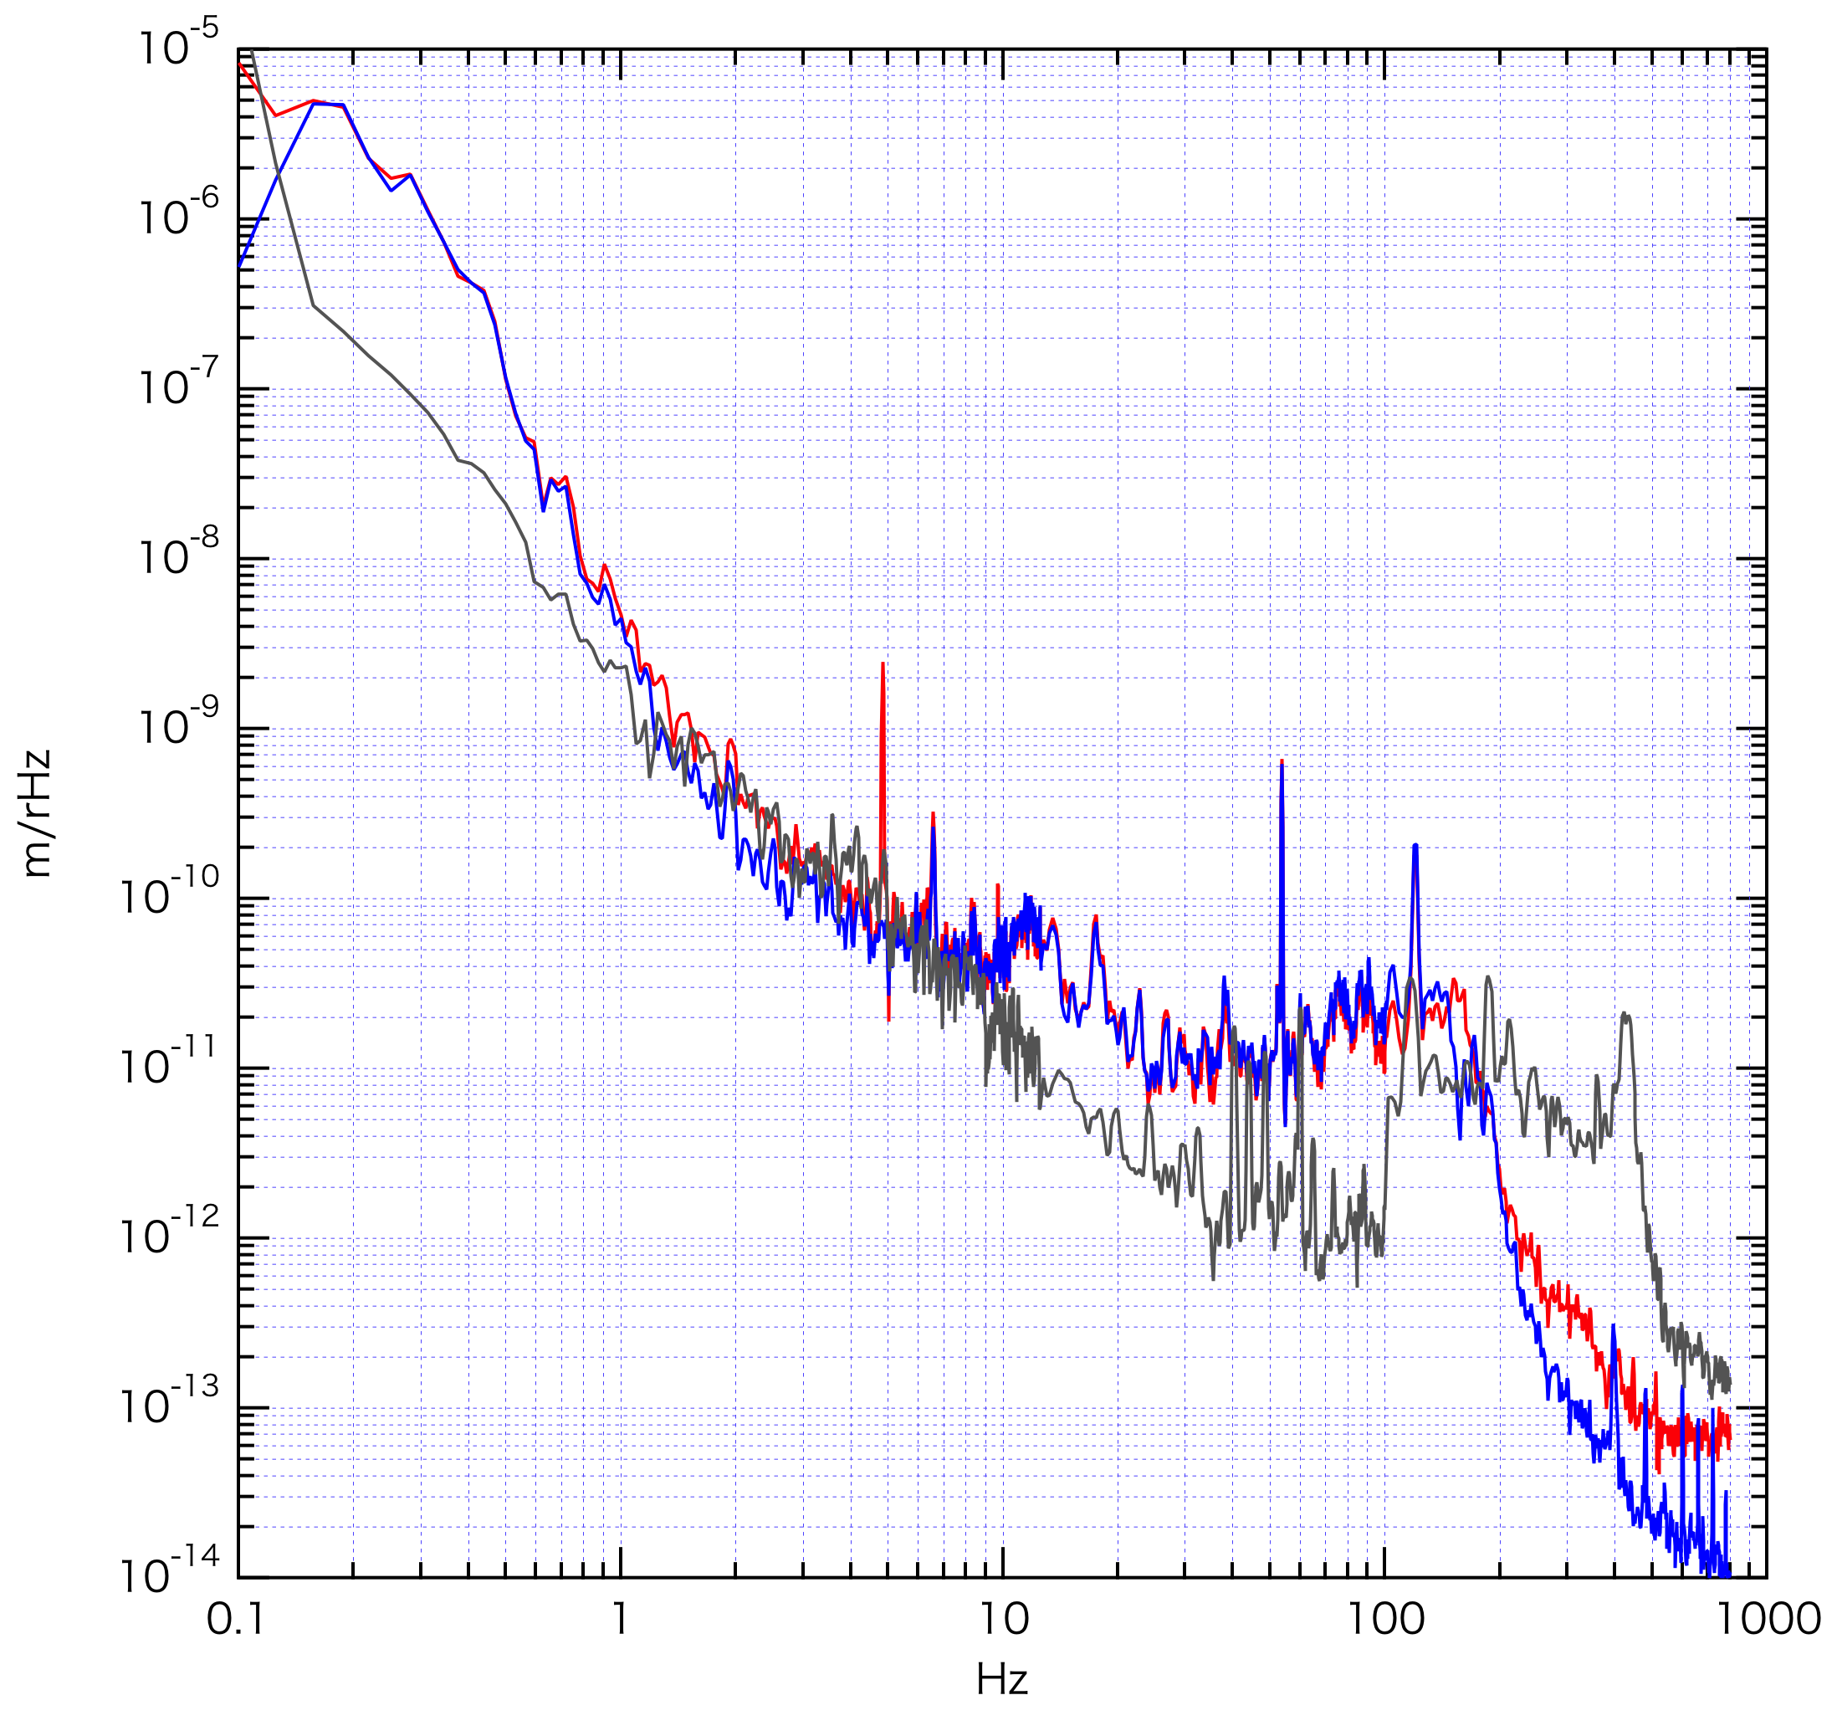
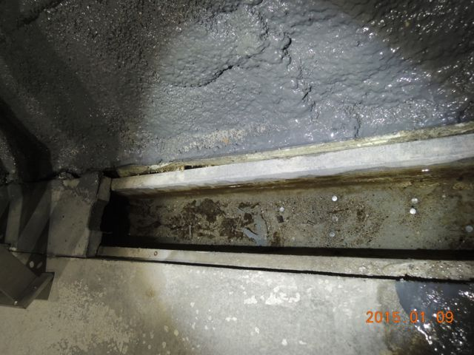
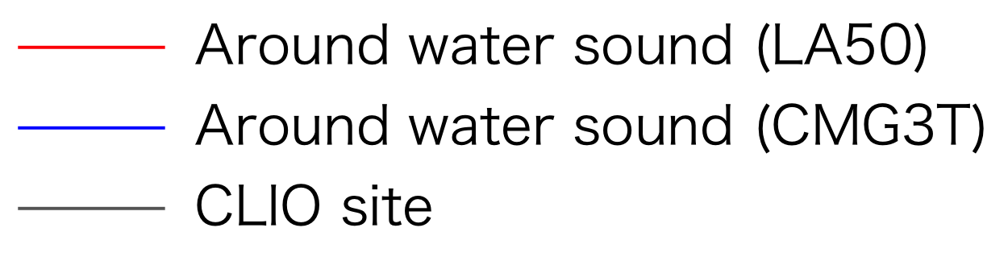
Result of Seismic Vibration Measurement at X-end (2)
- Water Flow Effect -
Vertical
~ 3x10⁻⁹
Excess
m_{rms}/rHz
~ 10⁻¹⁰
m_{rms}/rHz
at Just next of water pit
Apparent excess of vibration
was observed at between
10 – 100Hz.
This may arise from real sound.
But no effect was observed at cryostat position, where about 10m from water pit.
0.1
1
10
100
1000
Hz
Notes:
There is a lot of water leakages.
Therefore, around the water pit we can see some excess noises.
Maybe these are sound noise induced by water flow.

Slide 31
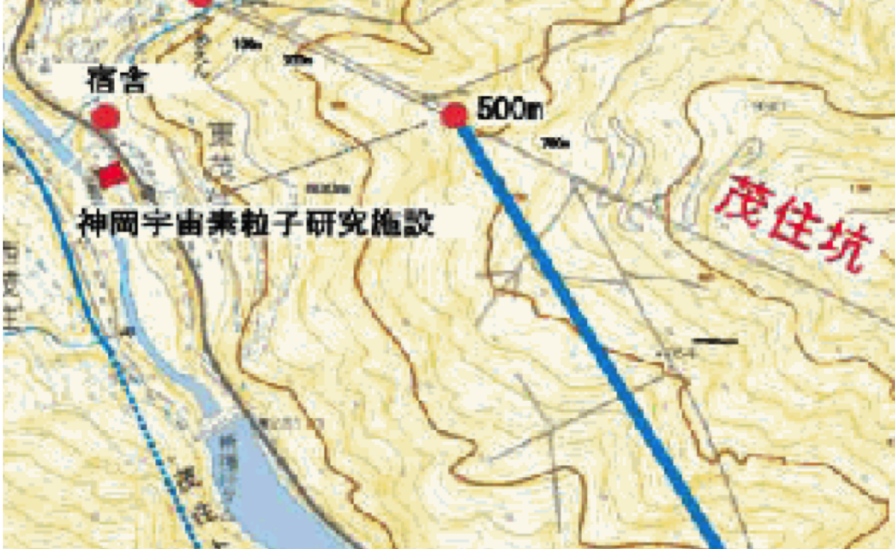
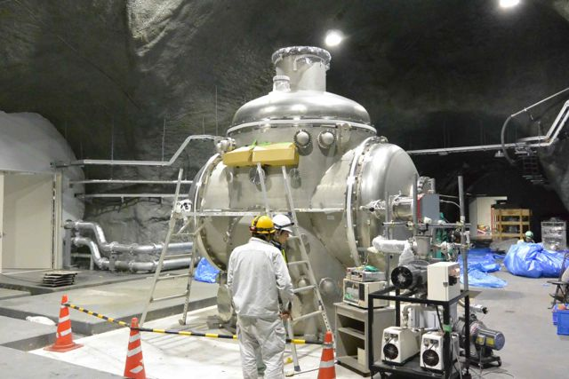
Access tunnel
Y-end has another access
tunnel and there is wind
flow now.
This wind can excite larger
seismic vibration at Y-end.
Wind
Notes:
Another end room is also checked.
This Y-end room has another access tunnel and
We can feel some air flow in this room.

Slide 32
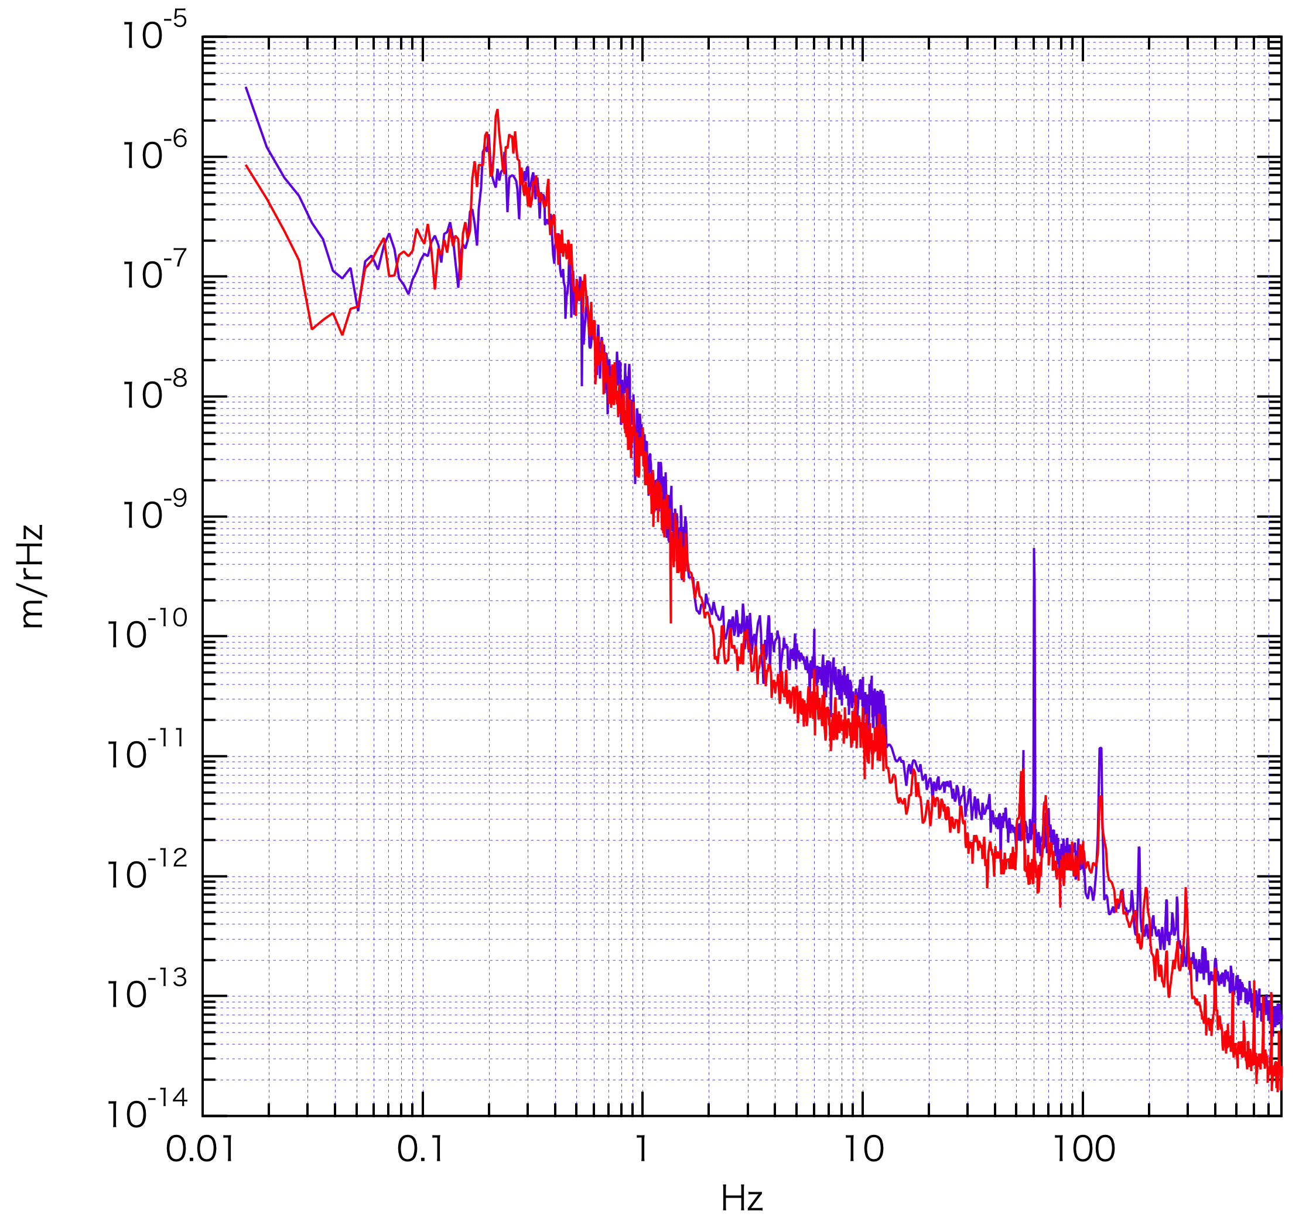
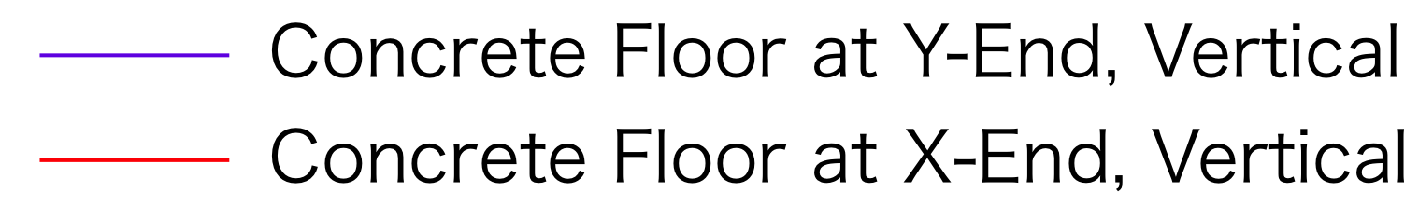
Result of Seismic Vibration Measurement at Y-end (1)
- X-end vs. Y-end -
Vertical
Measured by Seismometer
~ 3x10⁻⁹
m_{rms}/rHz
Seismic vibration at Y-end
was little bit larger than
that at X-end over 1Hz.
~ 3x10⁻¹¹
0.01
0.1
1
10
100
Hz

Slide 33
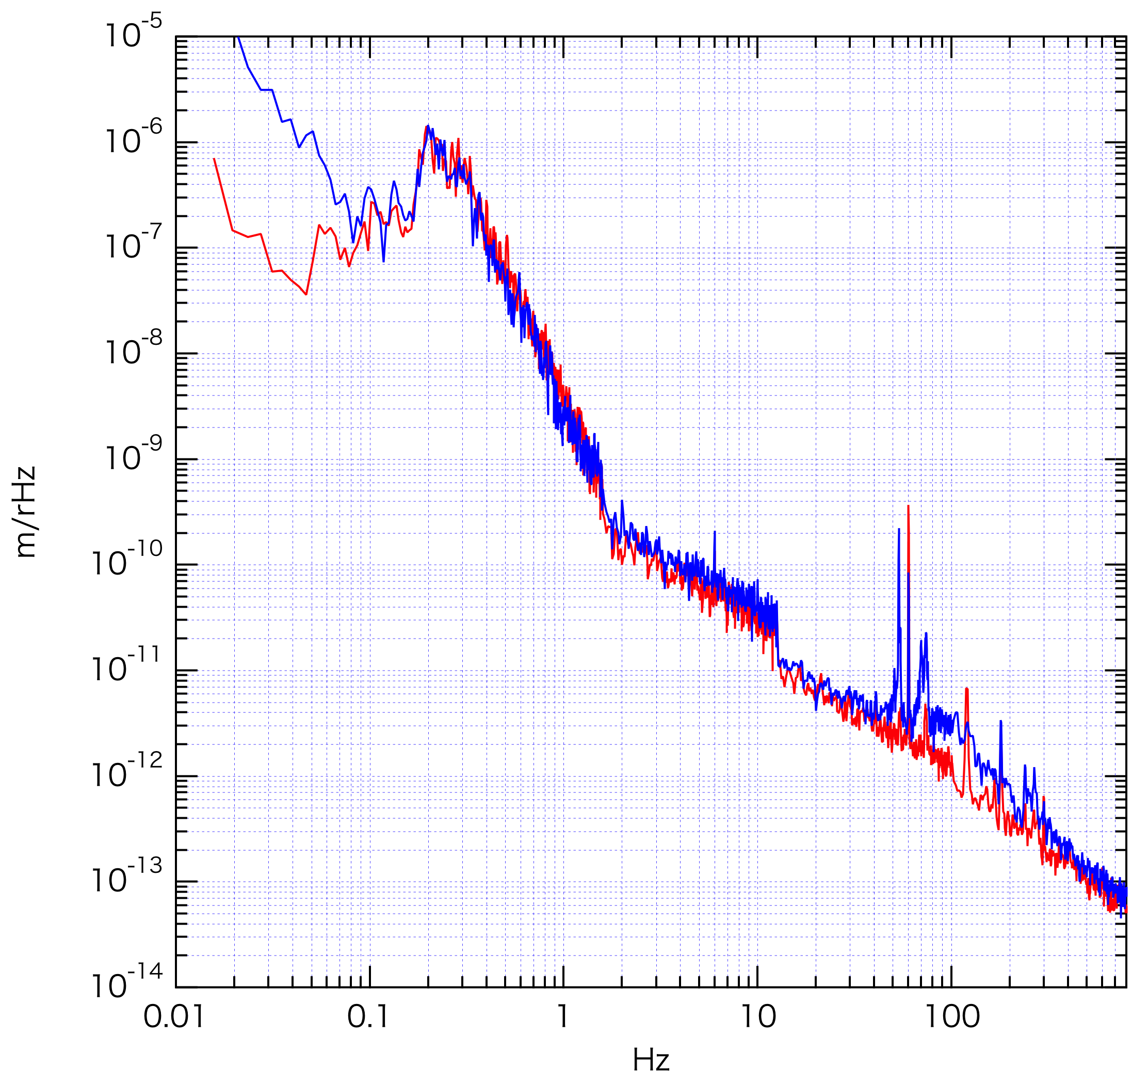
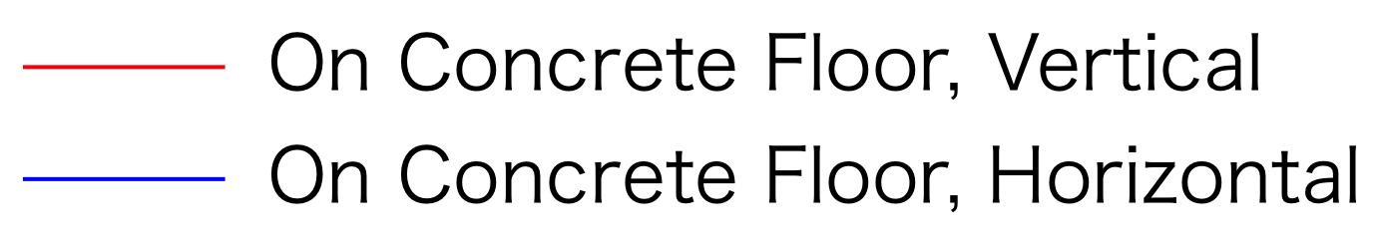
Result of Seismic Vibration Measurement at Y-end (2)
- Vertical vs. Horizontal -
Measured by Seismometer
~ 3x10⁻⁹
m_{rms}/rHz
~ 3x10⁻¹¹
Horizontal vibration was
little bit larger than vertical.
0.01
0.1
1
10
100
Hz

Slide 34
KAGRA Cryostat
Installation of two cryostats were finished. (two among four)
Seismic noise spectra at the both end rooms
were measured by Tomaru-san.
No excess noise can be found.
Now there is no cryo-pump and compressors.
In this summer, whole of cryogenic system will start operation.
After that, we have plan to install cryogenic sensors into
the cryostat.

Slide 35
Summary
Noise monitoring inside the cryostat is important
for KAGRA observations.
Cryogenic sensor, data acquisition system, data transfer,
Detector characterization system and
pipeline GW search system are being developed
by many KAGRA collaborators.
In the last two years there are many progresses.
Toward the KAGRA test observation in 2015,
these systems will be assemble
as a data analysis and noise monitoring system.
We will start noise investigations at KAGRA within a year.

Slide 36
---

