Slide 1
ELiTES
ET-LCGT Interferometric Telescopes Exchange of Scientists
KAGRA 11th Face to face meeting
E. Majorana
February 5-7, 2015, Hongo Campus, The University of Tokyo

Slide 2
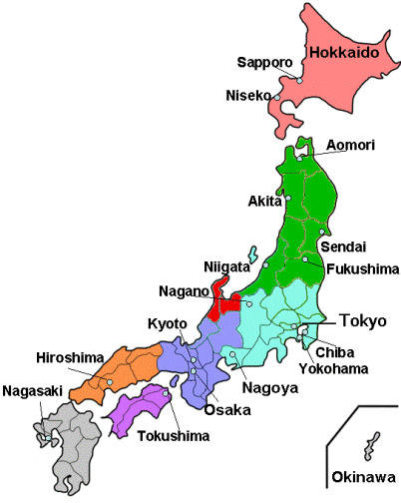
Project No.: 295153: ELiTES
WP1, WP2:Suspensions materials, fibres
WP1: Suspensions design and test
WP3: Infrastructures & Vacuum apparatuses
WP2: Coatings, Optics

Slide 3
ELiTES Partners
ID | Institute | Country
1 | EGO | Italy/France
2 | Institute for Cosmic Rays Research (ICRR)- University of Tokyo | Japan
3 | Università degli Studi di Roma "La Sapienza" | Italy
4 | Friedrich-Schiller-Universität (FSU) - Jena | Germany
5 | University of Glasgow | UK
6 | Stichting Voor Fundamenteel Onderzoek der materie - FOM | NL
7 | Max Plank Gesellschaft zur Foerderung der Wissenschaften E.V. - MPG | Germany
8 | Università del Sannio | Italy
9 | University of West Scotland (UWS) | UK
10 | Centre National de la Recherche Scientifique (CNRS) | France

Slide 4
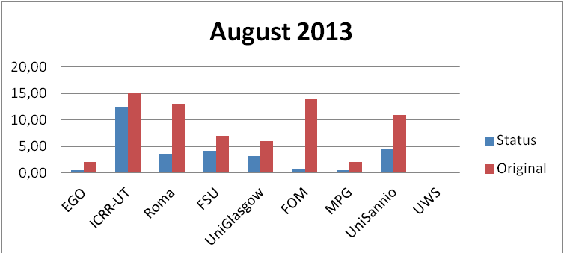
MANPOWER
Just after 1.5 years (over 4) ELiTES experienced a dramatic reduction of exchange participation with respect to what planned, especially by some groups, mainly due to the engagements in construction of AdV. The situation improved in 2014 but a lower impact had to be envisaged.
CNRS joined in 2014
A new plan was negotiated in 2014, in order to reallocate at least partially the initial funding.
CNRS, specifically, LMA is mainly involved in WP2 activities, coating thermal noise and optics

Slide 5
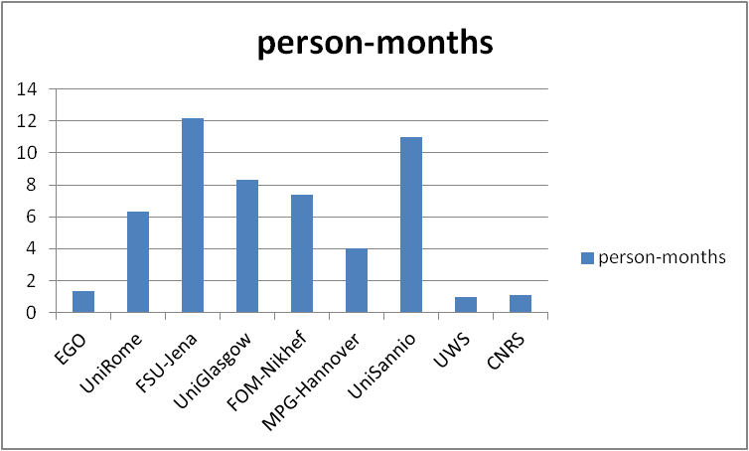
Secondments
However, ELiTES generated, until now, more than 53 man-months of presence of European scientists in Japan
a stimulating bridge EU and JapaneseGW communities

Slide 6
Secondments
ELiTES motivated, only upon the base of scientific exchange, - i.e. by supporting scientific activity through laboratory facilities – a significant participation of Japanese young scientists in Europe supported by Japanese institutions (mainly JSPS).
53
University of Tokyo, as partner of ELiTES
Program, gathers the contribution of research institutions involved in KAGRA
Participation mainly leading to support KAGRA implementation
Participation strictly coordinated with KAGRA manpower demand
person-months
22
EU partners
Univ. of Tokyo

Slide 7
Scientific production
ELiTES program aims to strengthen the collaboration and the scientific exchange of ideas and know-how between Japanese and European scientists and is focused practical solutions leading to the implementation of KAGRA as well as R&D subjects aimed to 3rd generation detectors.
Scientific outcome, even if limited to specific items, is expected
Mobility in international context, useful for young scientists
ELiTES has no budget for experiments, only for traveling
Posters and talks provided at ET project conferences and GWDAW
At least 6 paper published reporting ELiTES acknowledgements.
http://www.et-gw.eu/elites-related-publications

Slide 8
Papers
D. Heinert, S. Kroker, D. Friedrich, S. Hild, E.-B. Kley, s. Leavey, I. W. Martin, A. Tünnermann, S. P. Vyatchanin, K. Yamamoto, Calculation of thermal noise in grating reflectors, Phys. Rev. D 88 (2013) 042001
R. Douglas, A. A. van Veggel, L. Cunningham, K. Haughian, J. Hough, S. Rowan,
Cryogenic and room temperature strength of sapphire jointed by hydroxide-catalysis bonding, Class. Quantum Grav. 31 (2014) 4 5001
A. Khalaidovski, G. Hofmann, D. Chen, J. Komma. C. Schwarz, C. Tokoku, N. Kimura, T. Suzuki, A. O. Scheie, E. Majorana, R. Nawrodt, K. Yamamoto, Evaluation of heat extraction through sapphire fibers for the GW observatory KAGRA, Class. Quant. Gravity, 31, 105004 (2014). arXiv:1401.2346 [astro-ph.IM]
M. Punturo, K. Somiya, Underground gravitational wave observatories: KAGRA and ET, Int. J. Mod. Phys. D 22, 1330010 (2013)
F. Frasconi, E. Majorana, L. Naticchioni, F. Paoletti and M. Perciballi,
A vertical accelerometer for cryogenics implementation in third-generation gravitational-wave detector, Meas. Sci. Technol. 25 (2014) 015103 (9pp)
D. Chen, L. Naticchioni, A. Khalaidovski, K. Yamamoto, E. Majorana, Y. Sakakibara, C. Tokoku, T. Suzuki, N. Kimura, S. Koike, T. Uchiyama and S. Kawamura, Vibration measurement in the KAGRA cryostat, Class. Quantum Grav. 31 (2014) 224001 (12pp)

Slide 9
Conferences
GWADW 2013 (Elba 19 May 2013), https://agenda.infn.it/conferenceOtherViews.py?confId=5484&view=standard
- 5th ET Symposium - Einstein Telescope (Hannover 22 Oct 2013) http://www.et-gw.eu/meetandevt
GWADW 2014 (Takayama 25 May 2014),
http://www.gravity.ircs.titech.ac.jp/GWADW2014/index.htm
- 2nd ELiTES general meeting (Tokyo 4 Dec 2013) https://events.ego-gw.it/indico/conferenceDisplay.py?confId=7
…..

Slide 10
JOINT TASKS RELATED TO THE CRYOGENIC PAYLOAD
SEISMIC ISOLATION
WP1
WP1
WP1
TEST MASS
+ THERMAL NOISE
CRYOGENICS + TECH. NOISE WP3
INTERFEROMETER
WP2
WP2
WP1
CONTROL + TECH. NOISE

Slide 11
FRUITFUL ACTIVITY
DELIVERED
Cryostats technical noise (KEK, ICRR, Roma)
Suspension design and modeling for KAGRA (ICRR, NIKHEF, Roma, Sannio)
Sapphire thermal conductivity (Jena, ICRR, Roma)
Sapphire mechanical Q measurements (ICRR, Jena, Glasgow, Roma)
Sapphire bonding techniques and breaking strength, cryogenic cycling (Glasgow, KEK)
Q VS composite material and bonding (Jena, ICRR, Glasgow, KEK, NIKHEF)
Sapphire Blade design and clamping (ICRR )
Sapphire components design, selection and manufacturing (ICRR, Jena, Roma)
ELiTES reports
(overall still missing)
Test facility at ICRR dedicated
to the test of payload concept
Test facility at KEK dedicated
to payload prototype

Slide 12
What is missing
and next DELIVERABLES
urgent
KAGRA & ET: room temperature VS cryogenics interface, vertical mechanical filters
for heat links and, for suspension thermal noise, parallel approaches, for ET and KAGRA
(KEK, NAOJ, Roma* ?, Sannio ?)
KAGRA & ET: Direct payload control in cryogenic environment,
partially addressed for KAGRA (NAOJ, UT, ICRR, NIKHEF?, Roma?, Glasgow?)
ET: Stray-light baffles, successfully developed by KAGRA,
no idea for ET (NAOJ, UT, ICRR, NIKHEF?, Roma?, Glasgow?)
ET: Cryogenic system, successfully developed by KAGRA,
just tentative ideas for ET (NAOJ, UT, ICRR, NIKHEF?, Roma?, Glasgow?)
* Mechanical Engineering Dep. of Univ. Rome: 2 person-months by 03/16

Slide 13
DELIVERABLES AREN’T JUST USEFULE STUDIES. THEY ARE, ALSO, DUE DOCUMENTS
Task 1.1
month 24; Seismic attenuator and Suspension overall model including control issues.
month 36; Standalone performance of seismic isolation system and payload prototype will be tested also in presence of cryogenic links.
Task 1.2
month 48; Overall report on cryogenic payload, including heat link, and projection of KAGRA design results on ET applications.
Task 1.3
month 36; The need of further seismic isolation chains dedicated to thermal links will be assessed and a preliminary design for cryogenic application will be focused in a dedicated note.
Task 1.4
month 48; A realistic scheme of sensor and actuators conceived for payload control in KAGRA and a possible application for ET will be resumed in a dedicated document.
Task 1.2 and 1.3 have to be delayed or re-negotiated with EC

Slide 14
DELIVERABLES AREN’T JUST USEFULE STUDIES. THEY ARE, ALSO, DUE DOCUMENTS
Task 2.2
month 24; Coating loss model, dielectric mixture mechanical loss model; database of cryogenic properties of bulk and coatings materials.
month 36; Report on mirror thermal noise: verify HR coatings on sapphire substrates for KAGRA and comparison with HR coatings on silicon substrates for ET.
Task 2.3
month 24 Report on the bonding of sapphire test pieces for KAGRA and comparison with bonded silicon components planned for use in ET.
month 48; Overview of the thermal noise and cryogenic performance of sapphire and silicon suspensions.
Task 2.4
month 48; Report on mirrors for filter cavities

Slide 15
Task 3.1:
month 40; Report about the impact of pulse-tube compressor disturbance onto environmental noise background in cavern GW interferometer installations
Task 3.2:
month 48; A preliminary study of ET radiation shield based upon KAGRA configuration.
Task 3.3:
month 48; Overview of contamination free designs, description and detailed analysis.
A major contribution towards ET design is probably expected by W3

Slide 16
conclusions
The program covers four years and we are approaching to the last.
Some partners, more directly involved in AdV were underperforming due to manpower lack
Nevertheless the scientific outcome was effective and it is still quite promising.
Next exchanges are crucial for KAGRA payload prototyping and suspensions.

Slide 17
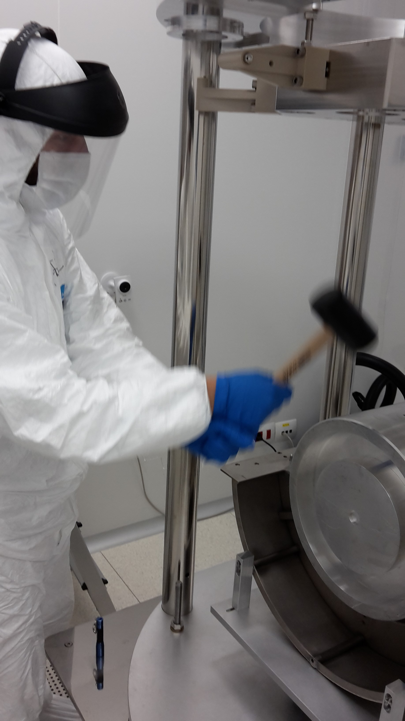
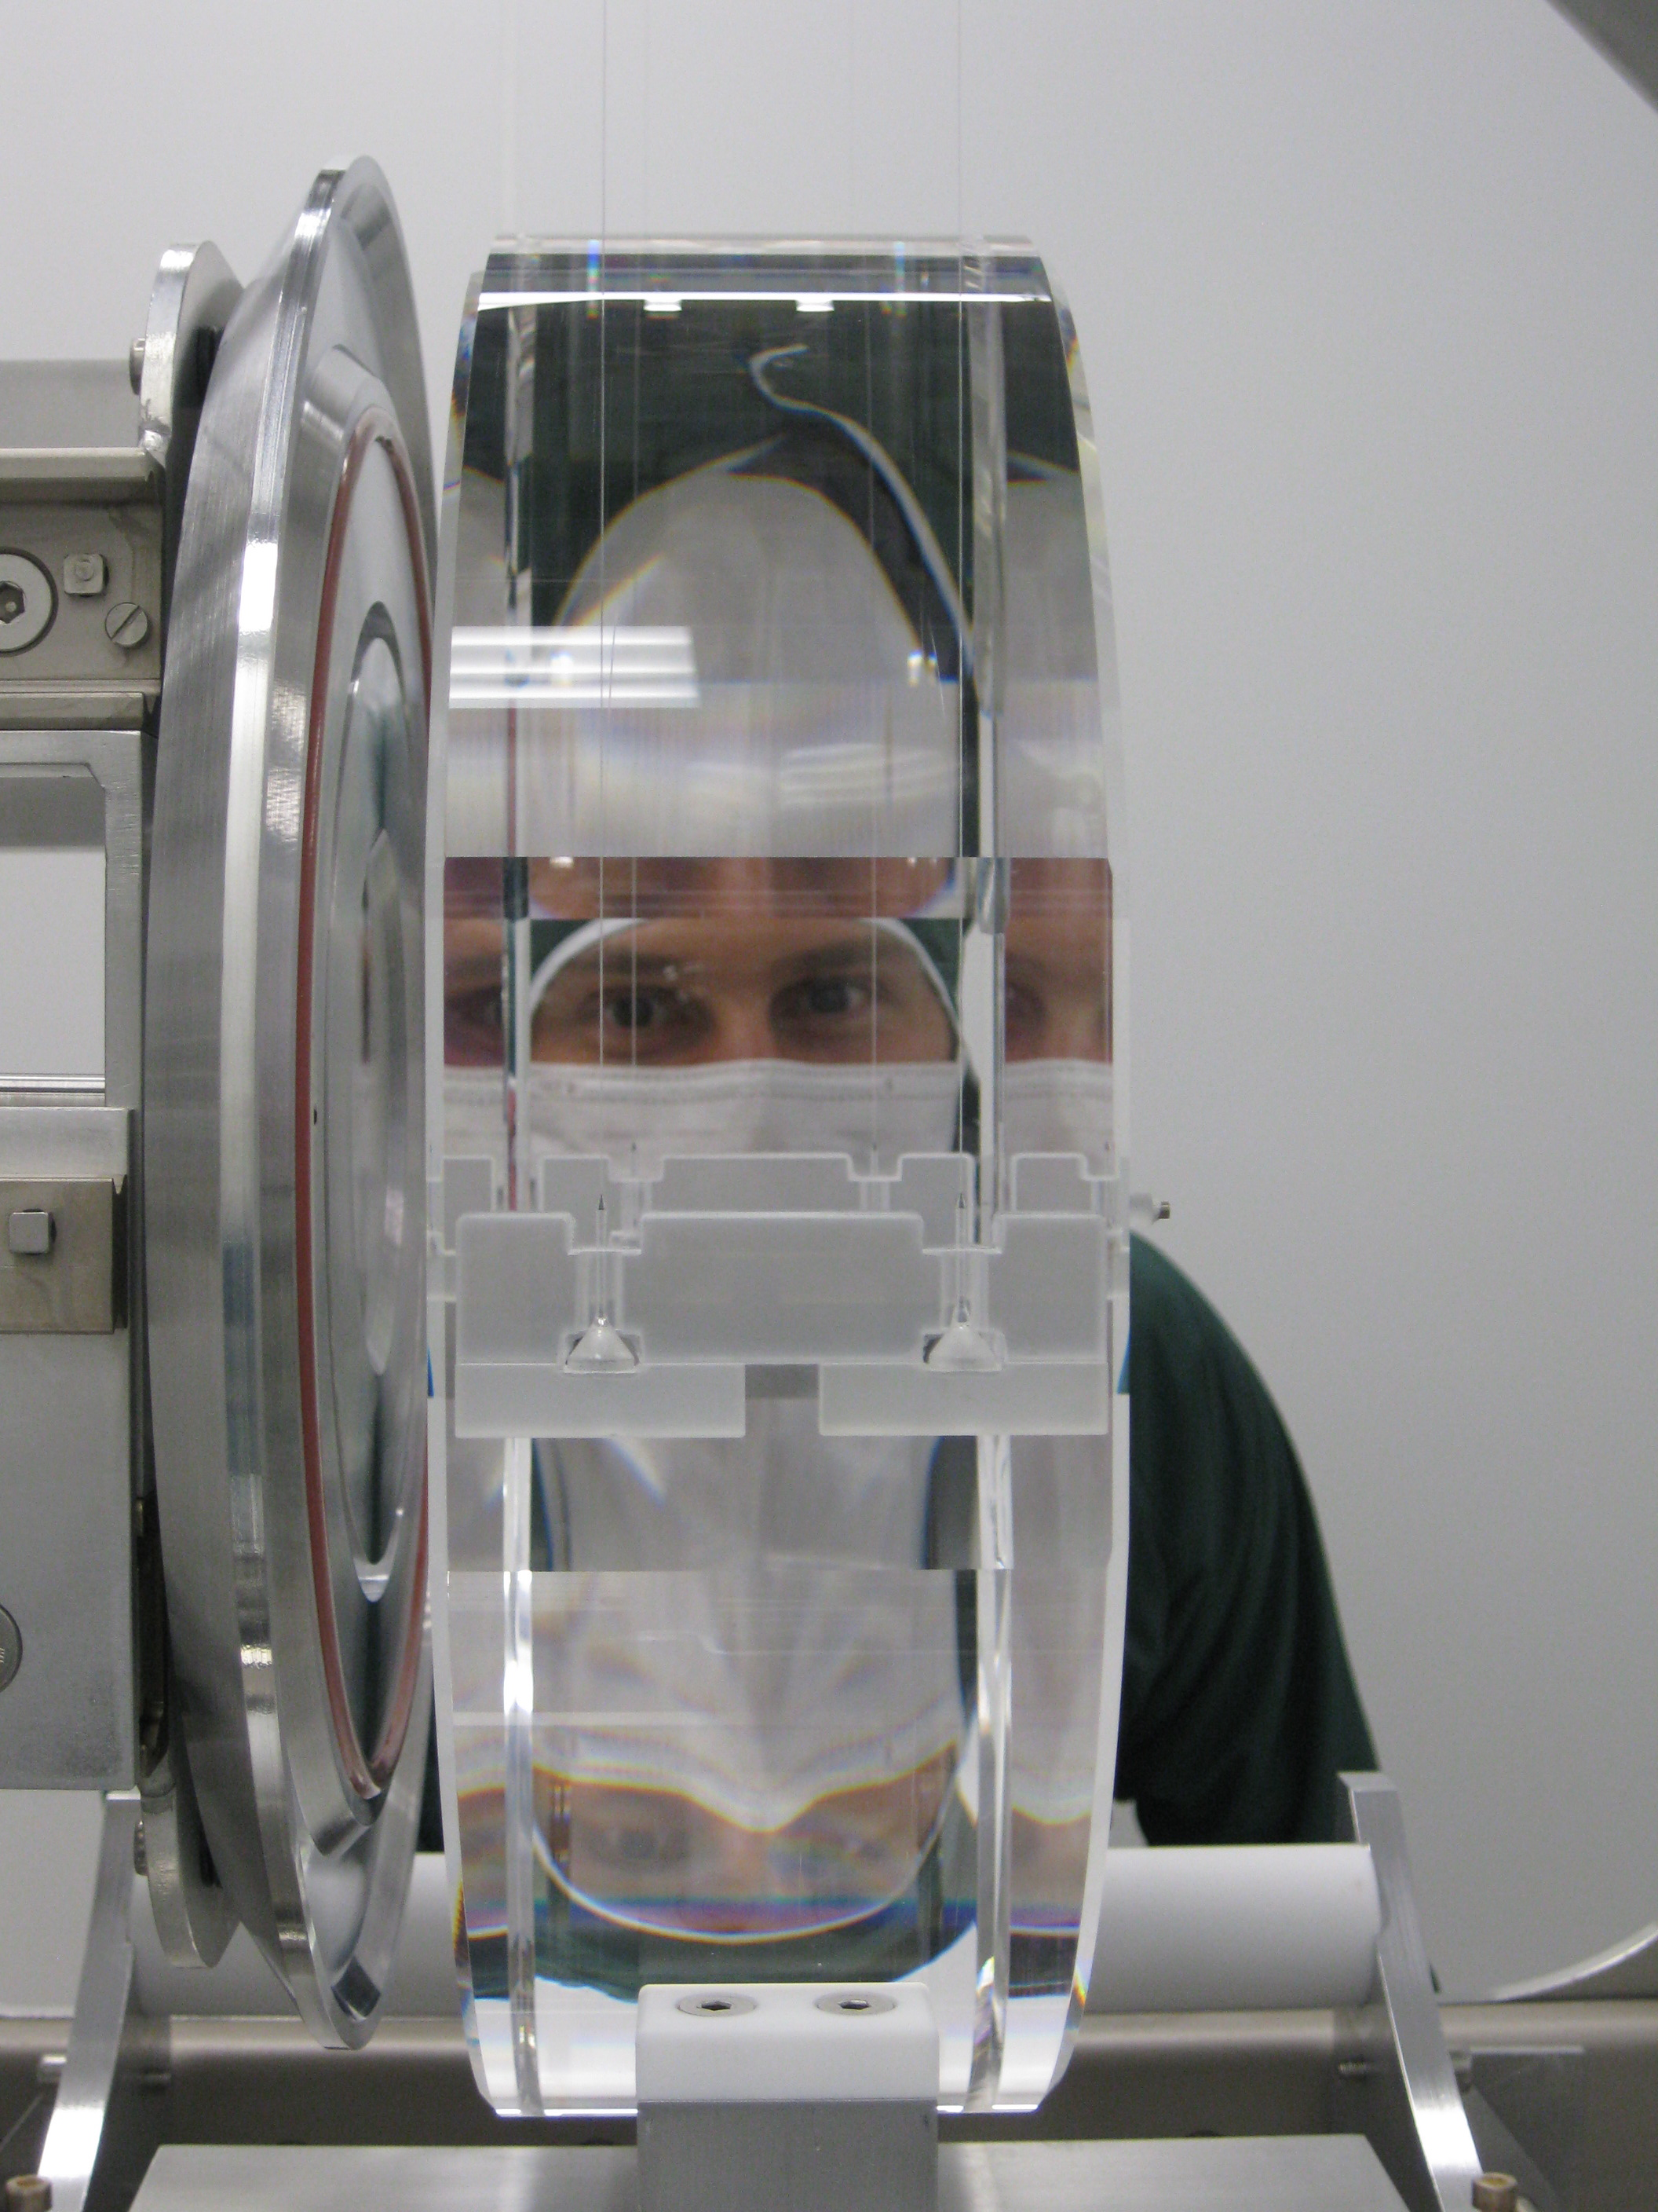
K. Yamamoto and T. Tomaru special guests during AdV END mirror payload assembly
(June-July ‘15)

