Slide 1
１１月後半にやったこと
田中宏樹

Slide 2
Suspension of the sapphire mass

Slide 3
Thermometer and heater

Slide 4
Displacement sensor

Slide 5
The indium
I heated up the heater like the previous page, but the indium didn’t melt down.
So I’m buying a stronger one.

Slide 6
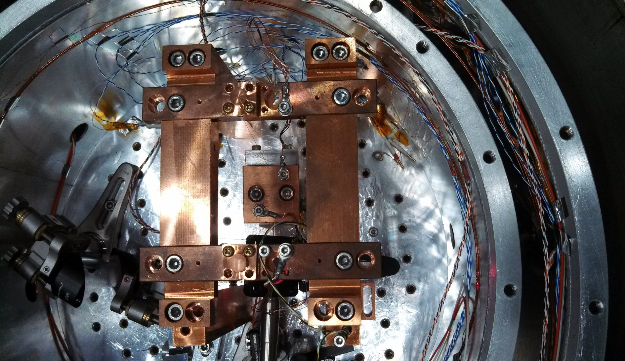
Q measurement
I installed the heat link to the block and the fixture.

Slide 7
After unbinding the twist
1st mode, room temperature:Q=1.3×${10}^{4}$（almost the same as Q before I unbound）
^{2nd} mode, room temperature:Q=3.8×${10}^{4}$（it is the highest Q in my measurement）

