Slide 1
Backscattering TMS
Junko Katayama

Slide 2
What I did
I computed the backscattering noise on the each surface of BRT and GPT lenses.
Simple estimation
Including radiation pressure
up-conversion
up-conversion using the relative motion between ETM and TMS elements

Slide 3
Transmission Monitor System
TMS
ETM
BRT
GPT
B1
B2
G1
G2
G3
G4
QPD
B3
B4

Slide 4
Simple estimation
Φ(t) << 1
h = sqrt(f_{sc}) * T/L * δx
f_{sc} = |overlap integral|² * R_{AR}

Slide 5
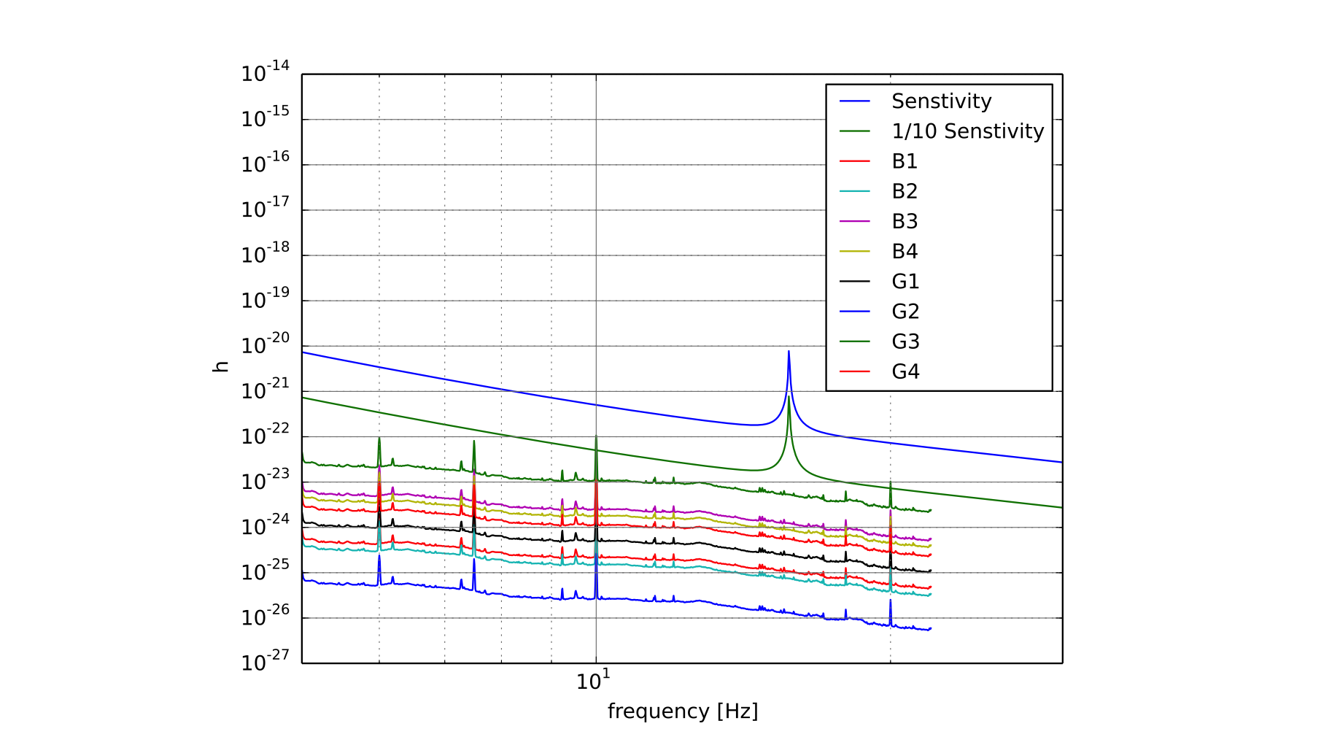
Simple estimation on each surface of lenses

Slide 6
Including radiation pressure
h = G*sqrt(f_{sc}*T*P_{cav}/P_{in})/L*4pi/λ*δx
(G is given by Aso-san)
Transfer Function (Simple pendulum)
TF = 1/(1-ω²/ω₀²+iω/ω₀*1/Q)

Slide 7
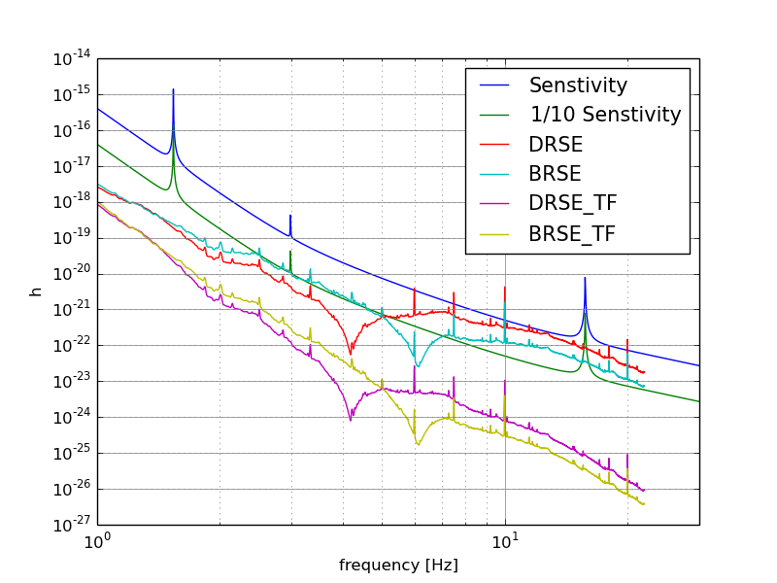
Including radiation pressure with TF

Slide 8
up-conversion
Esc*e^{iΩt}[cos(φ(t))+isin(φ(t))]
φ(t) << 1
h = G*sqrt(f_sc*T*Pcav/Pin)/L*4pi/λ*δx
φ(t) >> 1
Up-conversion ; φ(t) → sin(φ(t))
P_{φ}(ω) → P_{sinφ}(ω) ≡ P_{a}(ω)
P_{φ}(ω)

Slide 9
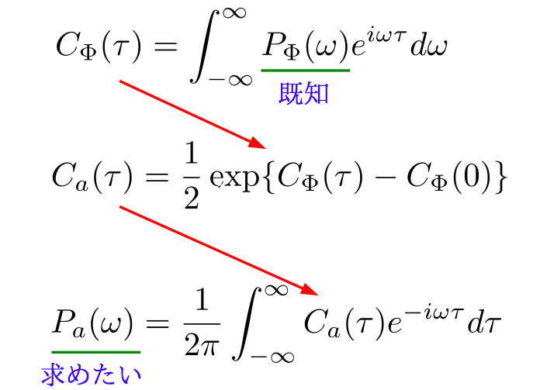
autocorrelation function
already know
want to know
From Aso-san slides ‘ScatteringWorkshop’

Slide 10
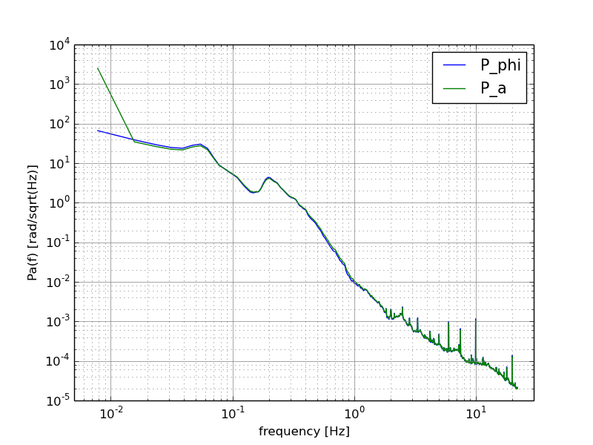
P_{φ}(ω) & P_{a}(ω)

Slide 11
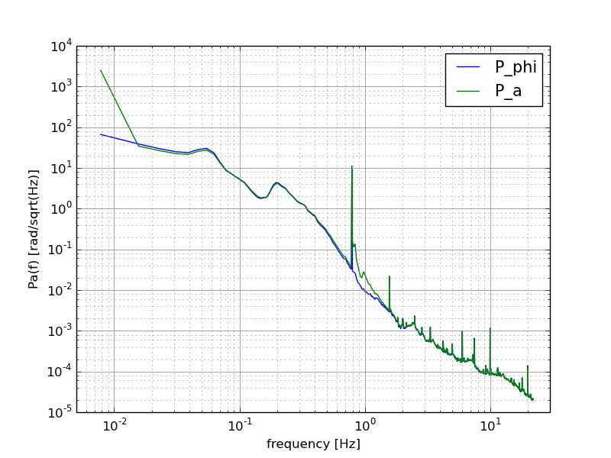
P_{φ}(ω) & P_{a}(ω) adding peek

Slide 12
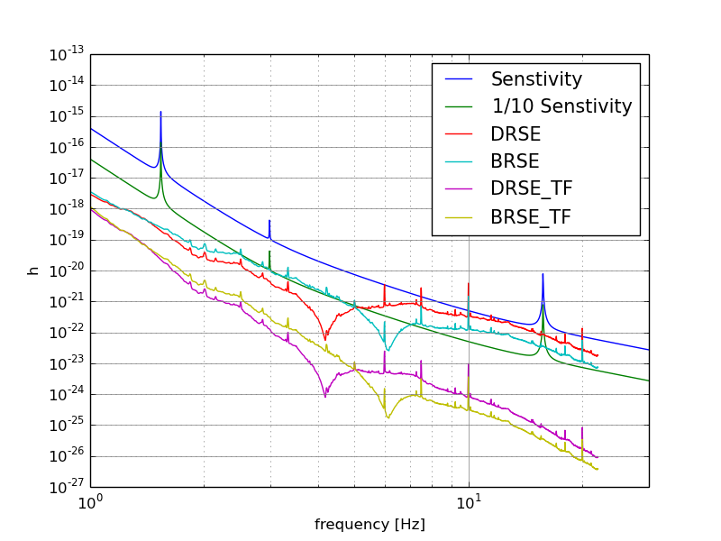
up-conversion with TF

Slide 13
using relative motion between ETM and TMS
at low frequency :
ETM moves larger, as much as the seismic motion
→ We should consider the relative motion between ETM and TMS elements.
ETM
element
x_{relative} = (x_{ETM}² + x_{TMS}²)^{1/2}
x_{ETM}
x_{TMS}

Slide 14
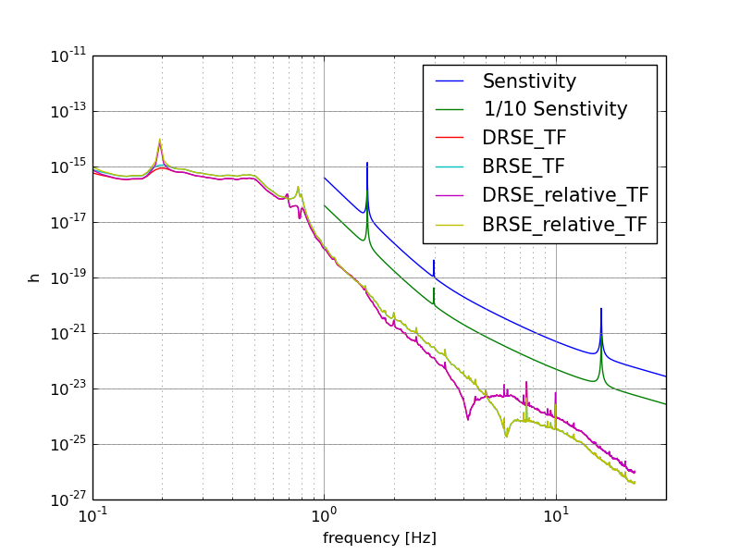
up-conversion with TF comparing normal & using relative motion

Slide 15
up-conversion with TF comparing normal & using relative motion
From last slide, we can say that the result computed by the relative motion has almost no effect on KAGRA sensitivity.
..we can find this reason in the next two slides. ETM motion and its contribution to h are enough smaller than TMS motion at > 1 Hz.

Slide 16
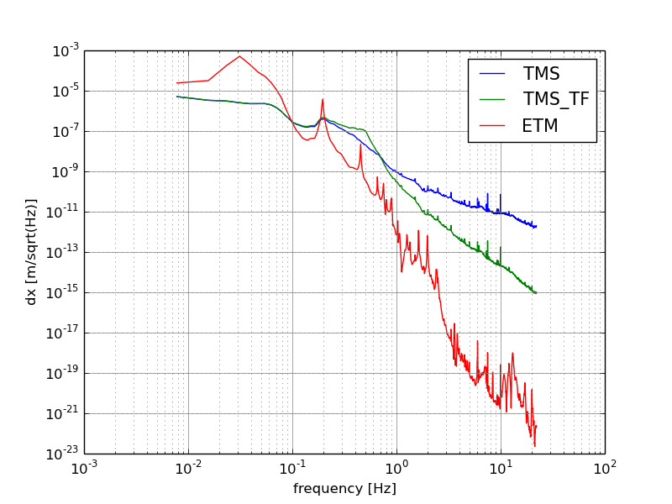
comparing ETM & TMS motion

Slide 17
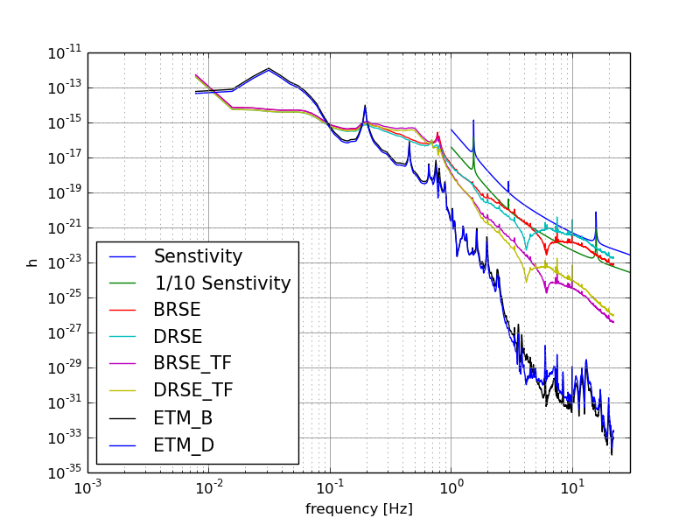
ETM contribution to h

Slide 18
Conclusion
TMS should be suspended
Simple pendulum is enough for TMS
ETM motion is quite smaller than TMS motion
→ no need to consider the relative motion

