Slide 1
Fishing Rod Design for KAGRA GAS Filters
NAOJ-VIS Meeting
2014.6.4
T. Sekiguchi, E. Hennes

Slide 2
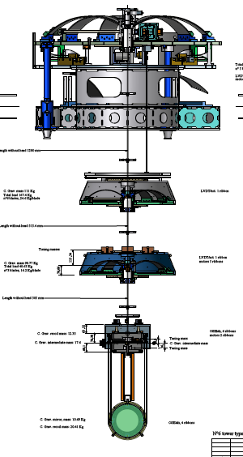
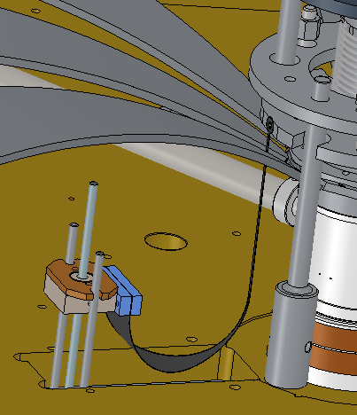
Purpose of this work
A compensation spring is mandatory when operating a GAS filter, which requires fine tuning of the load under vacuum environment.
In the current design, there is no compensation system in KAGRA standard GAS filters. The compensation system should be designed so that it fits to the current system and can be installed easily.

Slide 3
Compensation System at Top Filter
The compensation system for the KAGRA top GAS filter equips with a cosine-shape thin maraging blade, which is clamped at a motorized base block.

Slide 4
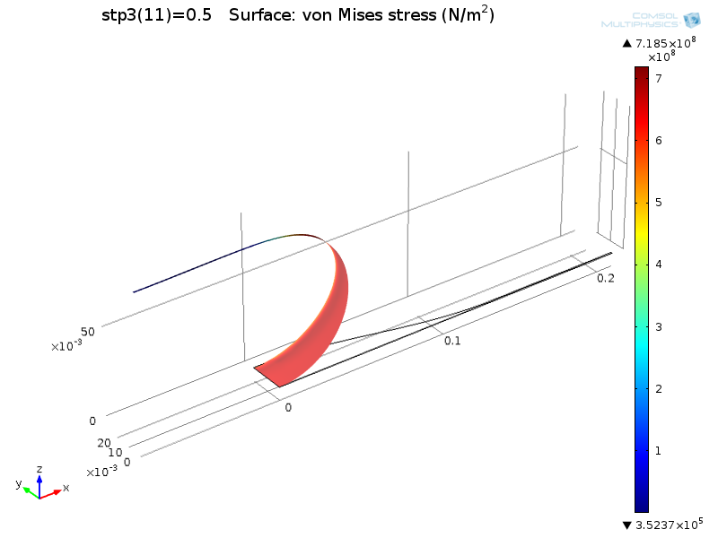
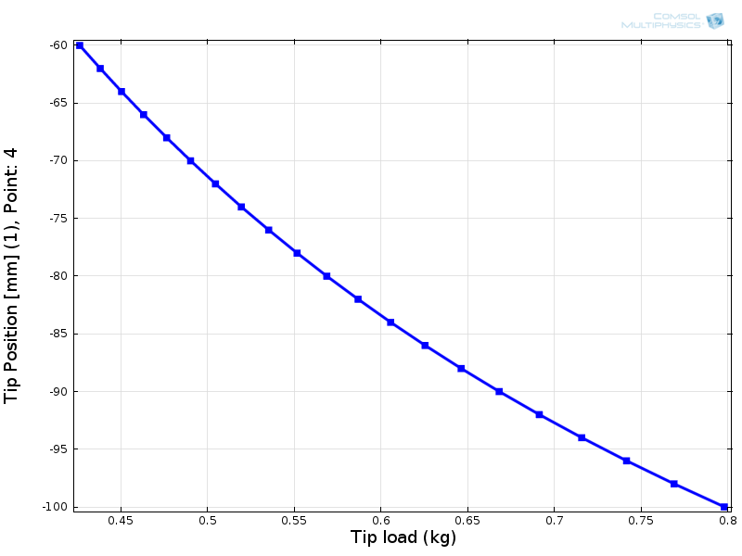
Finite Element Analysis
Calculated from FEA: k=9.0 gf/mm, σ_{Max} = 0.85 GPa
Assuming +/- 20 mm range, it can change effective load by +/- 0.18 kg.
We need roughly +/- 0.4 kg to move GAS filter by +/- 5 mm.
We increase thickness from 0.3 to 0.4 mm (→2.4 times larger load)

Slide 5
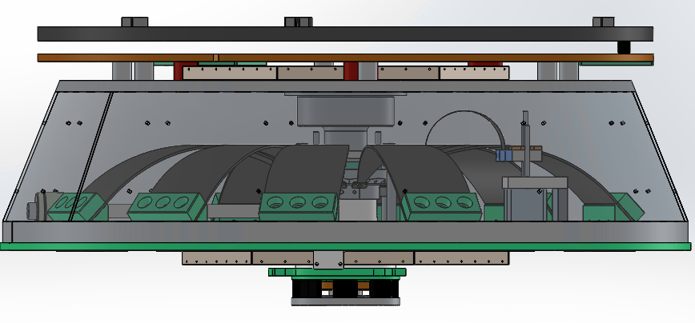
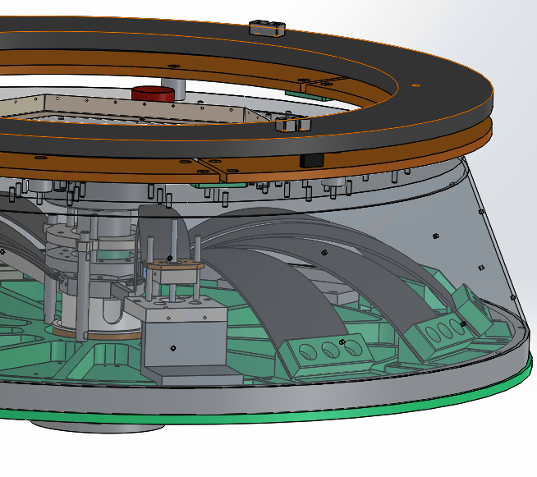
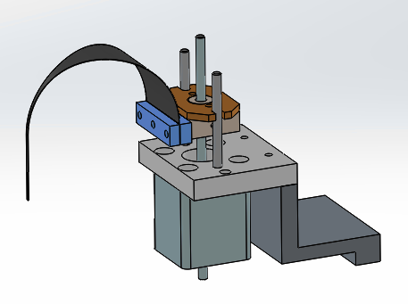
Fishing Rod for Standard Filter
Fishing rod for top filter also fits to standard filter.
Space for magic wand can be used.
Total Mass of compensation system: ~1 kg
Preliminary

