Slide 1
Fishing Rod Design for KAGRA GAS Filters
G1402449
2014.5.30
T. Sekiguchi, E. Hennes

Slide 2
Purpose of this work
A compensation spring is mandatory when operating a GAS filter, which requires fine tuning of the load under vacuum environment.
Design of the compensation system is overviewed. Its stiffness and load tuning range is investigated. Since the compensation spring introduces additional stiffness on the system, its spring constant should be taken care of.
In the current design, there is no compensation system in KAGRA standard GAS filters. The compensation system should be designed so that it fits to the current system and can be installed easily.

Slide 3
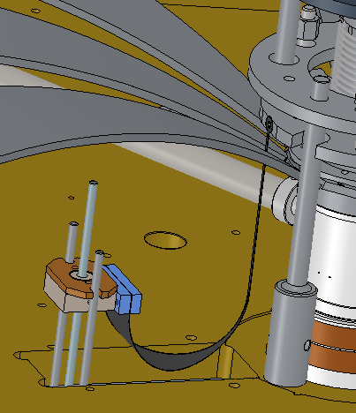
Compensation System at Top Filter
The compensation system for the KAGRA top GAS filter equips with a cosine-shape thin maraging blade, which is clamped at a motorized base block.

Slide 4
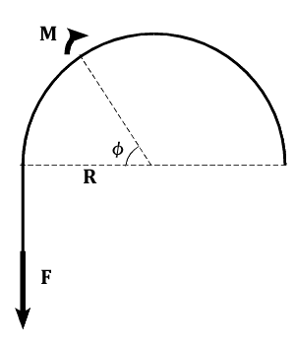
Physics and Design Concept
Moment balance at the point φ:
For constant radius of curvature,
Relation between t and R is determined by maximum stress vs young’s modulus
This ratio is 7.5e-3 for t=0.3 mm, R=40 mm.
(σ=0.69 GPa, E = 184 Gpa)

Slide 5
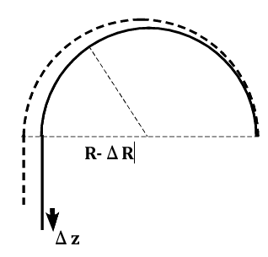
Rough Idea to Calculate Stiffness
Tip force F depends on R
Pulling the blade by Δz
Stiffness:
Top filter design: E=184 GPa, t=0.3 mm, w₀=41.4 mm, R=41.4 mm,
F=0.51 kgf, k= 7.8 gf/mm

Slide 6
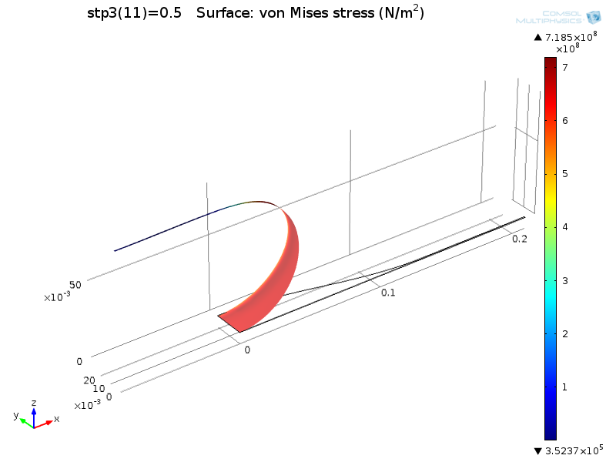
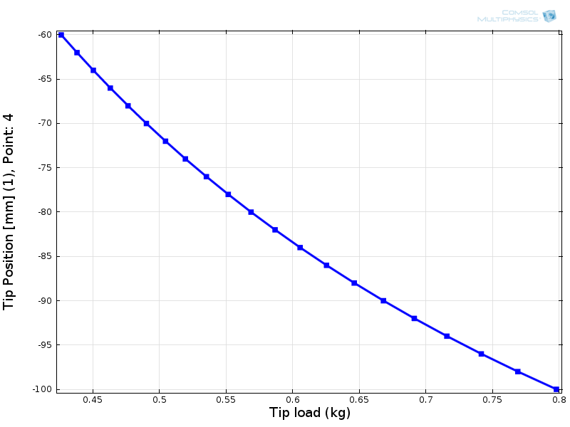
Finite Element Analysis
Calculated from FEA: F=0.57 kgf, k=9.0 gf/mm
~12% larger than predicted from theory, because of Poisson ratio effect
Assuming +/- 20 cm range, it can change effective load by 0.37 kg.

Slide 7
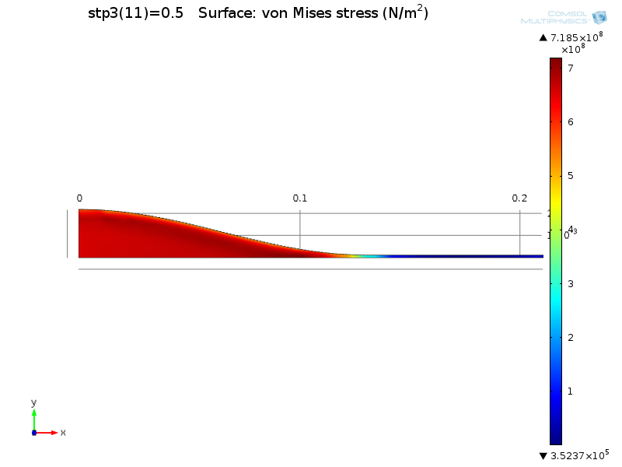
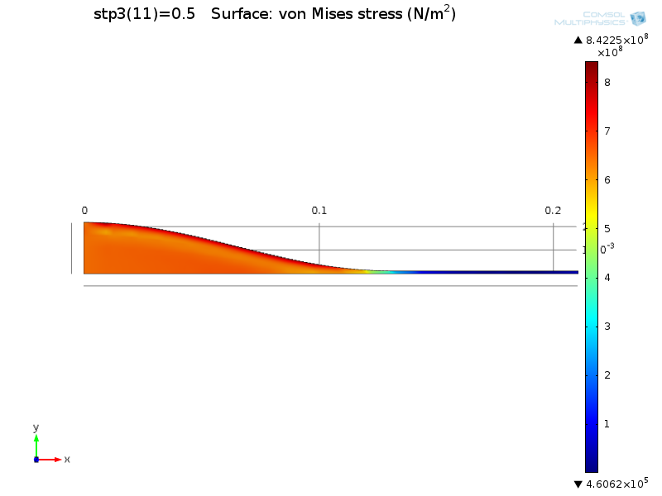
Finite Element Analysis
Surface stress around working point: σ_{max} ~ 0.85 GPa
Inner Surface
Outer Surface

Slide 8
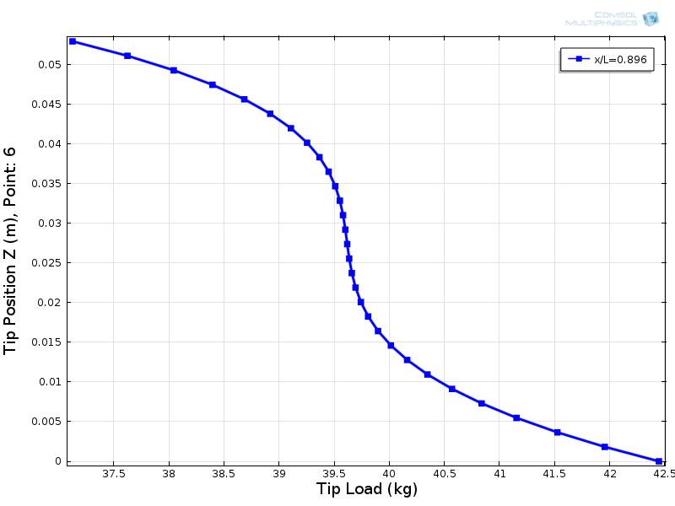
Necessary Force for DC Compensation
Range of standard GAS filter is roughly +/- 5 mm.
When the filter is tuned at 0.3 Hz, necessary force to move GAS filter by 5 mm is (1.8E-3)*M [kgf]. (M [kg] is load on GAS filter)
Type-B Top Filter: M=230kg, F=0.414 [kgf]
Optimal load: 39.6 kg
Load vs tip height of standard GAS filter, tuned at 0.22 Hz

Slide 9
For Stronger Blade
Changing thickness from 0.3->0.4 mm, the surface stress becomes 1.2 [Gpa], the stiffness becomes 0.89 [kgf] for 40 mm movement, DC force becomes 1.2 [kgf].

Slide 10
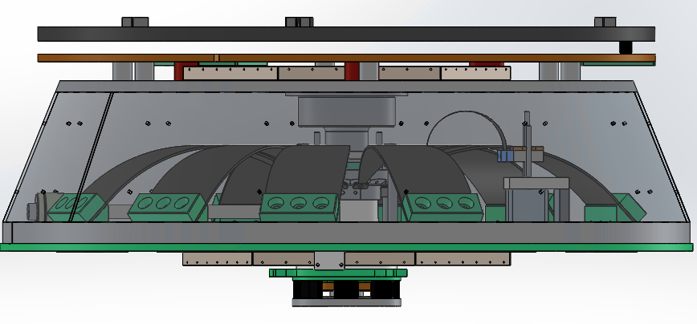
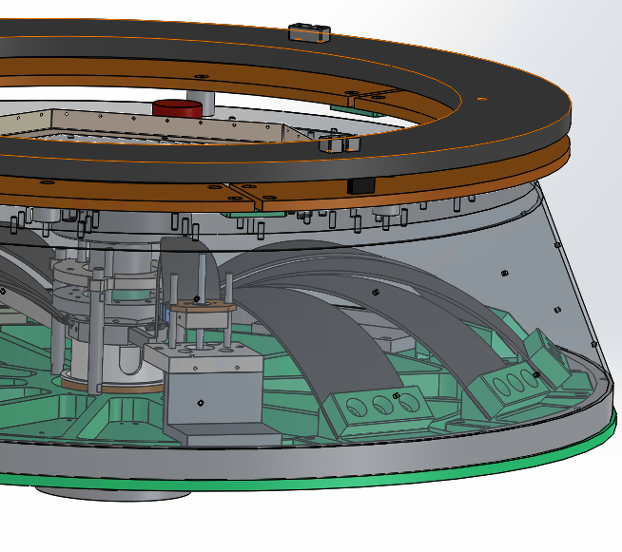
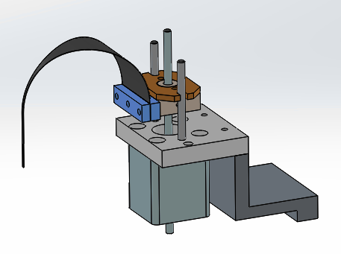
Fishing Rod for Standard Filter
Fishing rod for top filter also fits to standard filter.
Space for magic wand can be used.
Total Mass of compensation system: ~1 kg
Preliminary

