Slide 1
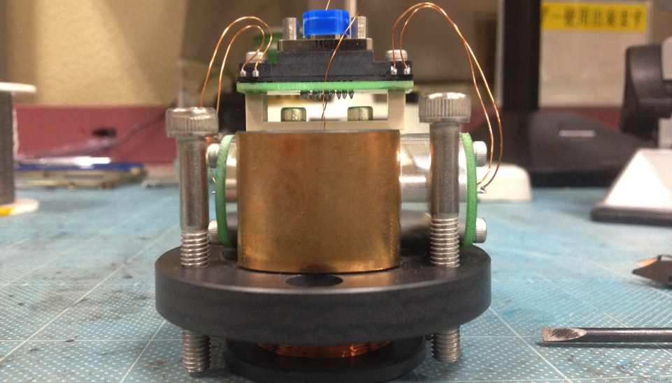
OSEM LED Selection Measurements: Intensity Noise and Angular Distribution
NAOJ VIS Meeting, April 29nd, 2014

Slide 2
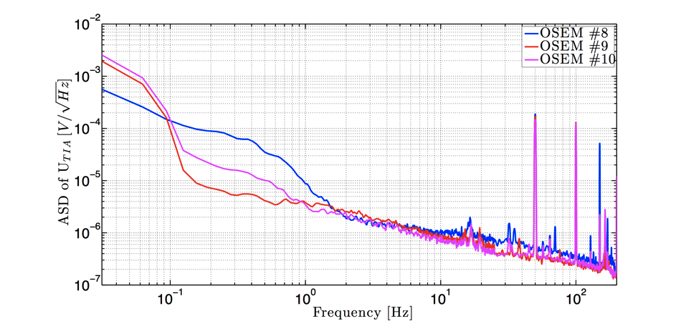
Results from OSEMs last November (1/2)
LIGO papers have shown that OP232 LED intensity noise varies from batch to batch

Slide 3
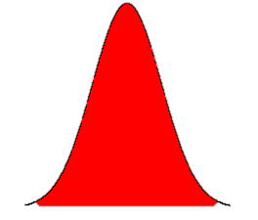
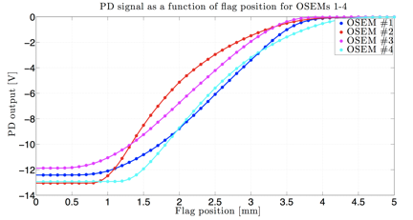
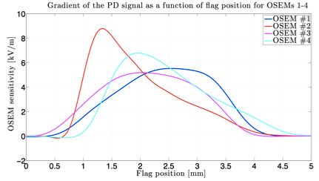
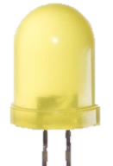
Results from OSEMs last November (1/2)
In addition, LIGO papers show different angular distribution and peak locations for different LEDs

Slide 4
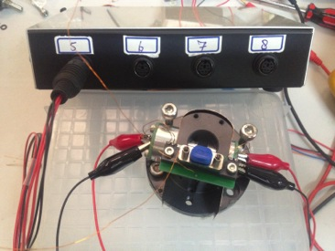
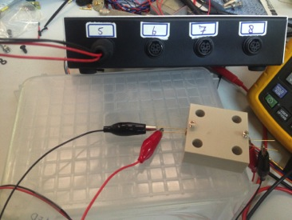
Measurement set-up
Determined with the first (!) fully assembled
OSEM what current to run the LED, now with collimator, to have -12V on U_{TIA} output:
R_{s,LED} = 300Ω
U_{LED} = 8V
I_{LED} ≈ 25mA
For fast comparative measurement, LED is run in a simple set-up at 25 mA and ASD on the U_{TIA} signal is taken
First, a dependence of intensity noise on the LED intensity magnitude is investigated

Slide 5
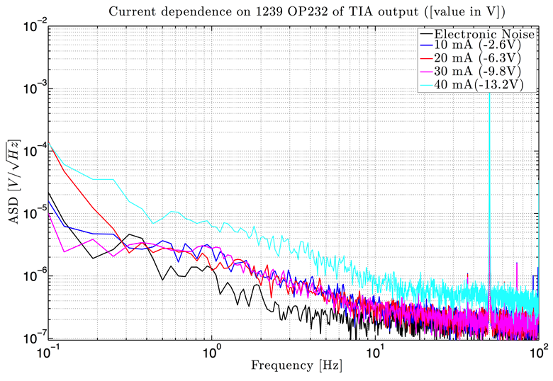
Intensity noise LED current dependence

Slide 6
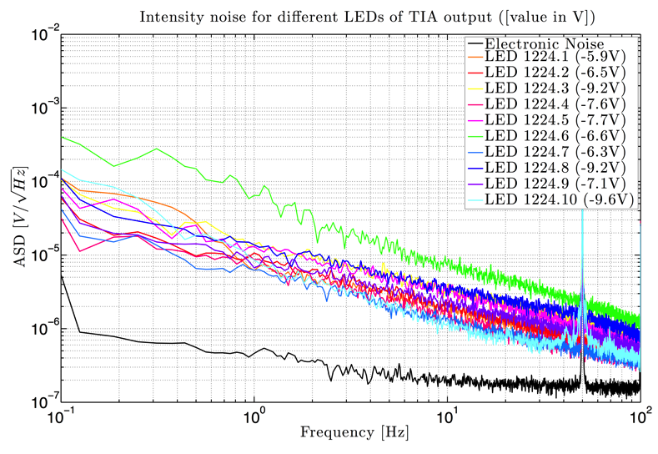
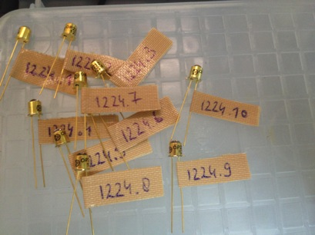
Intensity noise first batch of LEDs

Slide 7
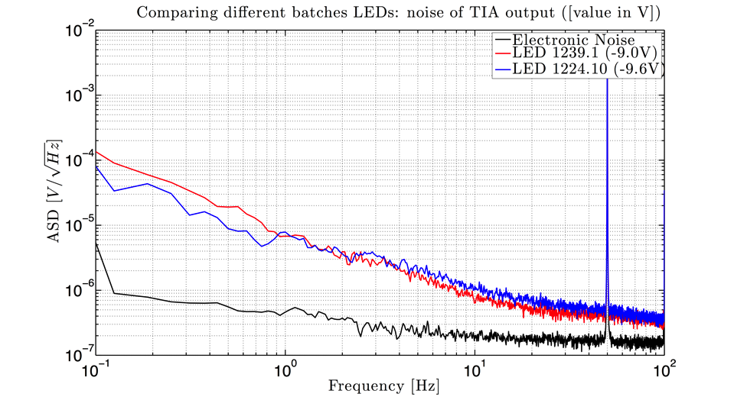
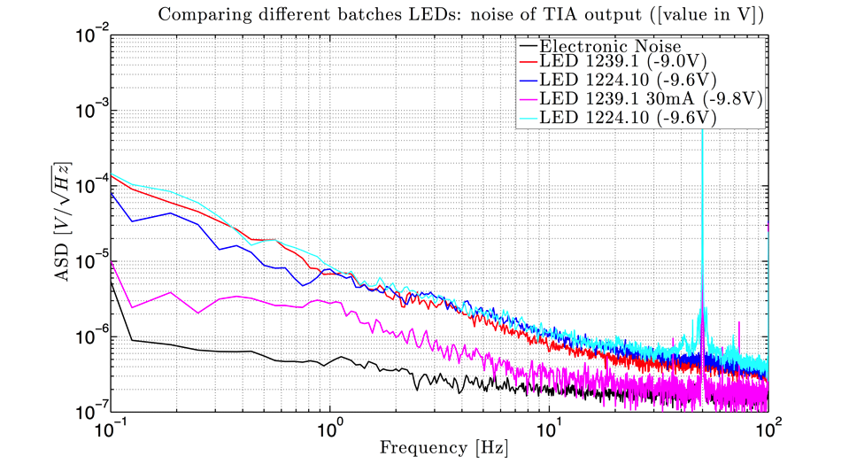
Comparison between batches

Slide 8
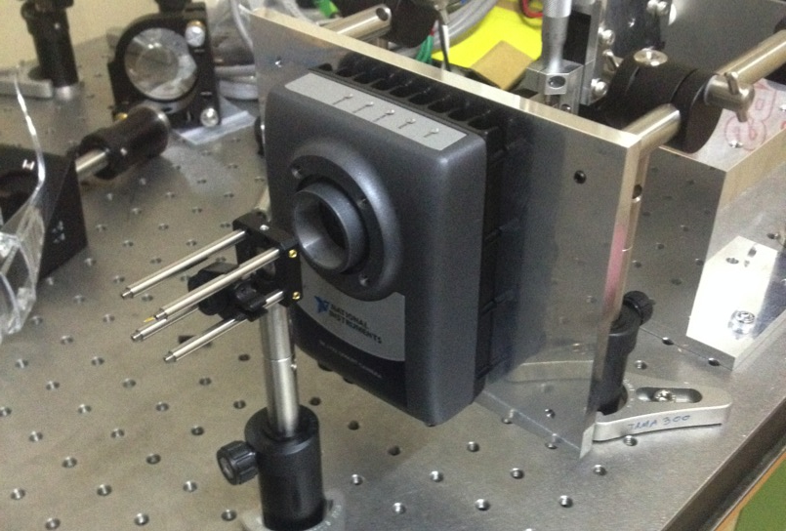
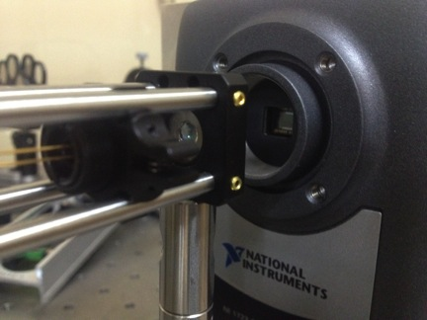
Measurement set-up
Lens (f = 8mm)
LED
CCD Camera
OSEM optics
Replace for trans- lation stage

