Slide 1
Type-A SAS Local Control Simulation (Current Status)
JGW-G1402200-v1
2014/01/22
T. Sekiguchi

Slide 2
Local Control Strategy
(based on Virgo control scheme)
During interferometer operation:
Resonances of pendulum modes are damped by IP control to reduce RMS.
No longitudinal damping is applied at IM.
Pitch & yaw of TM are controlled by optical levers.
For lock acquisition:
Resonances of internal modes are damped by using local sensors (OSEMs) at IM.

Slide 3
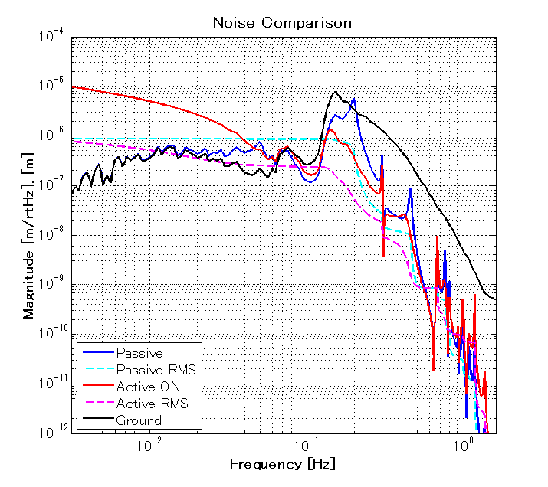
IP Control
We have not yet achieved required TM RMS displacement (= 1e-7 m).
Two disturbing points:
Notch at 0.16 Hz in actuator response of IP
Glowing sensor noise of geophone at low frequencies
http://gwdoc.icrr.u-tokyo.ac.jp/cgi-bin/DocDB/ShowDocument?docid=2132

Slide 4
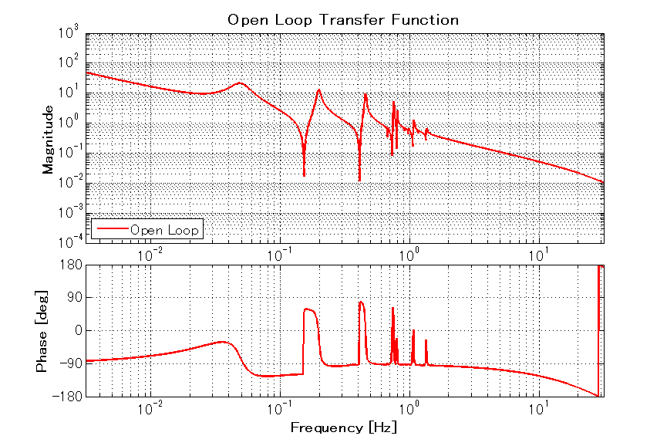
IP Control
Open loop gain
Notch at 0.16 Hz

Slide 5
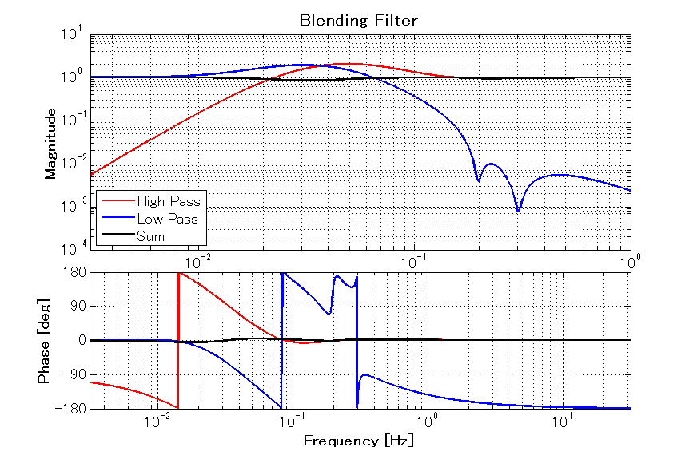
IP Control
Sensor Blending

Slide 6
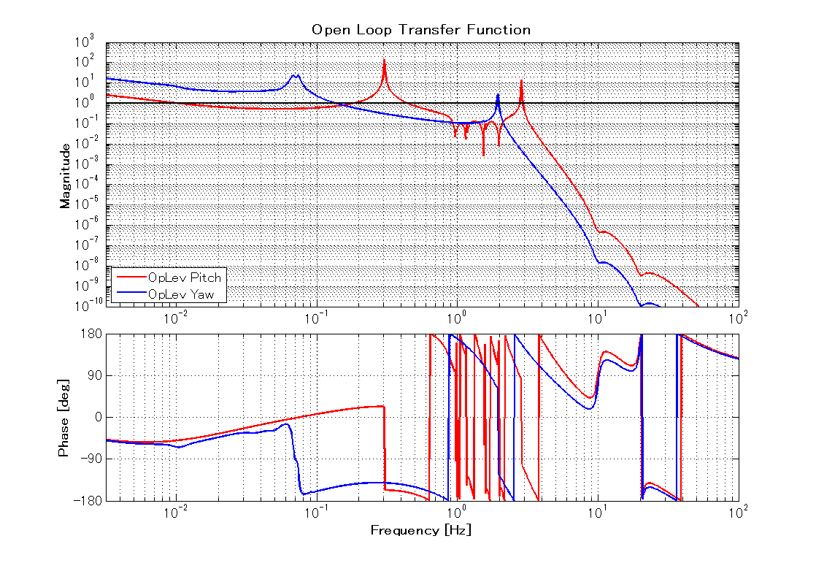
Optical Lever Control
Optical lever control is applied to reduce RMS of mirror pitch & yaw:
Preliminary

Slide 7
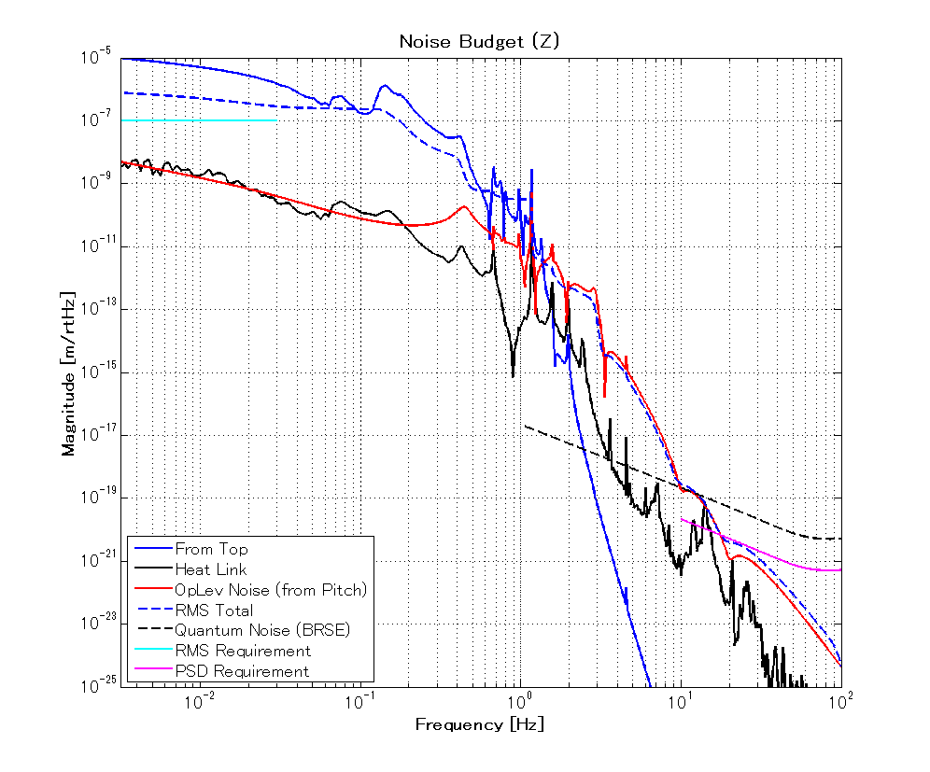
OpLev Sensor Noise Contribution
Assuming optical lever sensing noise of 3e-11 rad/rtHz (at 10 Hz). (estimated from analogue electronics noise used in i-KAGRA)
Pitch and yaw: OK, but noise coupling to Z is large.
Large coupling from pitch actuation to zTM: can it be mitigated by actuator diagonalization??
10 times larger than requirement

Slide 8
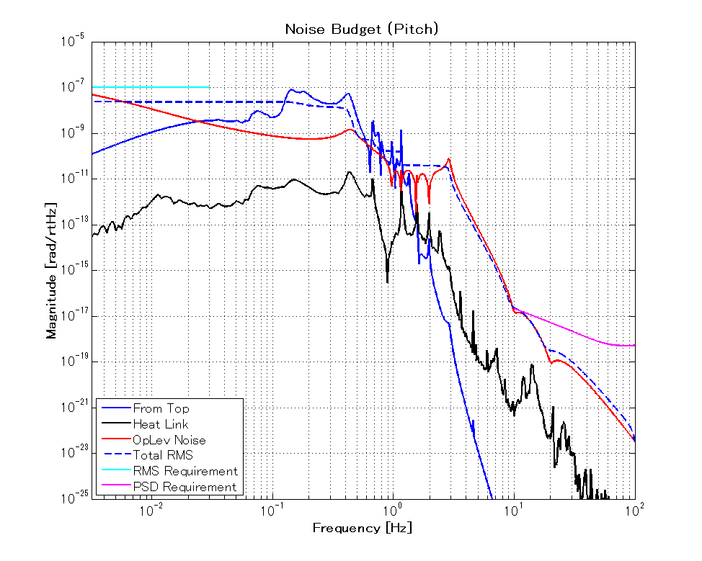
OpLev Sensor Noise Contribution
Pitch
OK

Slide 9
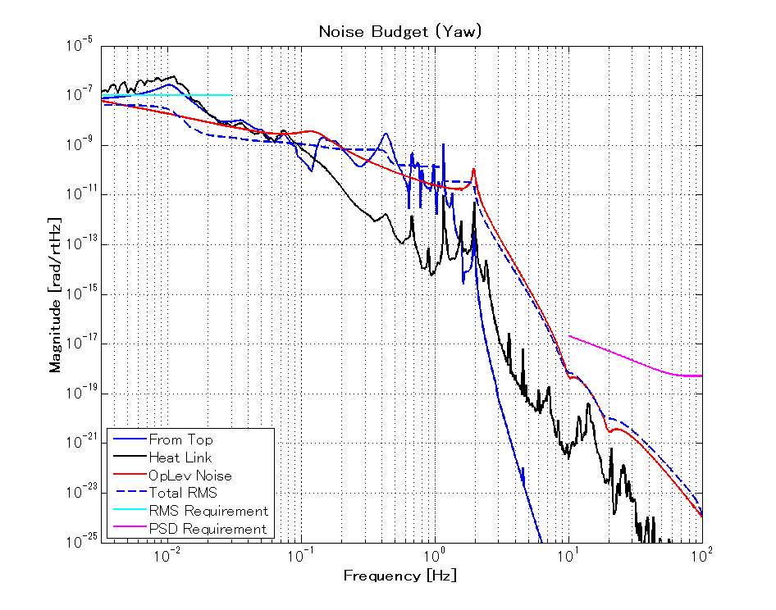
OpLev Sensor Noise Contribution
Yaw
OK

Slide 10
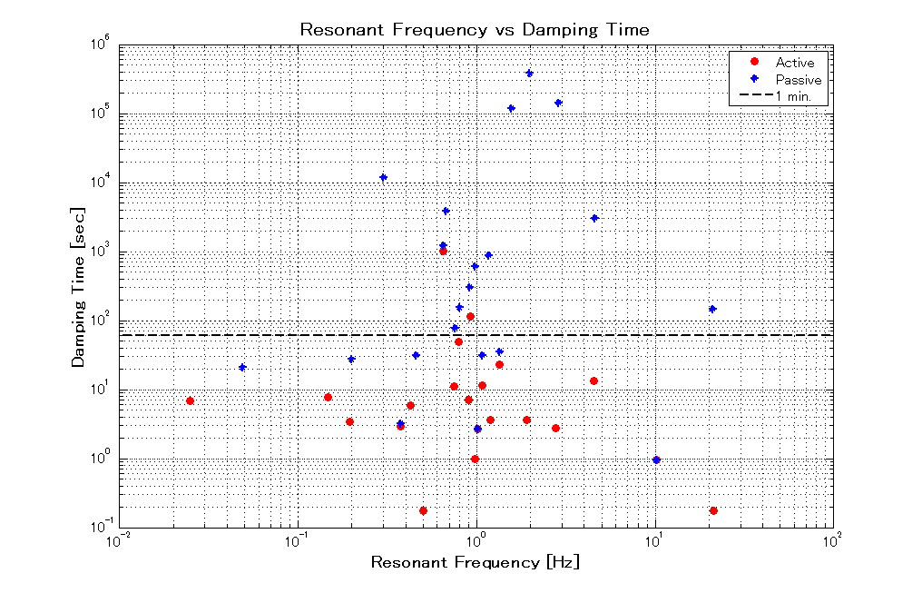
Local Damping with OSEM
Check damping time of resonances (Z and Pitch)
GAS Filter
Tilt Mode

Slide 11
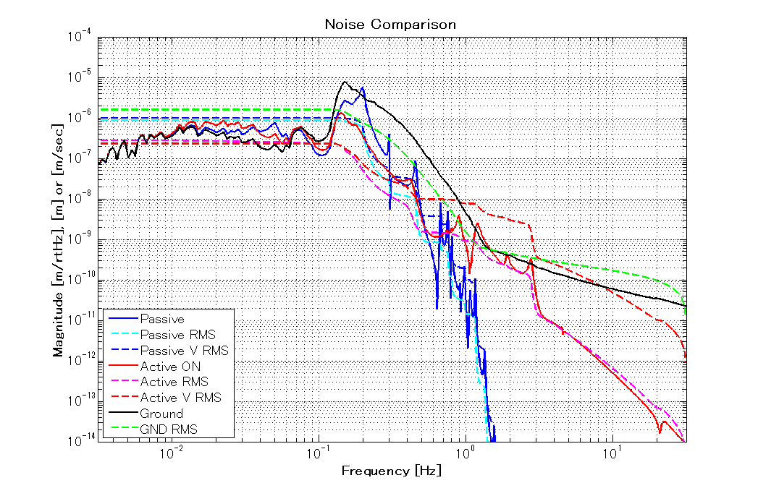
Displacement Noise During Damping
Assuming OSEM sensitivity of 2e-10 m/rtHz @10 Hz (measured in prototype at room temperature)

Slide 12
Future Works
TBD
Requirement for inertial sensor noise
Requirement for local sensor noise at IM (used for damping)
Requirement for actuator noise
Simulation about other DoFs (transversal, vertical, roll, yaw)

