Slide 1
Burst noise investigation for cryogenic GW detector
2nd Symposium ‐ New Development in Astrophysics through
Multi-messenger Observations of Gravitational Wave Sources
NAOJ
Daisuke TATSUMI
2014-01-13 @ TITECH

Slide 2
Outline
1. Brief introduction
2. Past Investigations with TAMA
3. Research Plan

Slide 3
1. Brief introduction
My two year’s research plan of
“Burst noise investigation for cryogenic GW detector”
was approved as a 「公募研究」 of A04 group.
Related Public Subscription Researches = 公募研究
In this talk, I will make a brief introduction of my research
program.

Slide 4
Purpose of this program
In this research program,
we focus on burst noises induced by
cryogenic system, because KAGRA is
unique cryogenic interferometer
in the world.
It means that there is very little information about cryogenic
interferometer. In other words, it is valuable to study it.

Slide 5
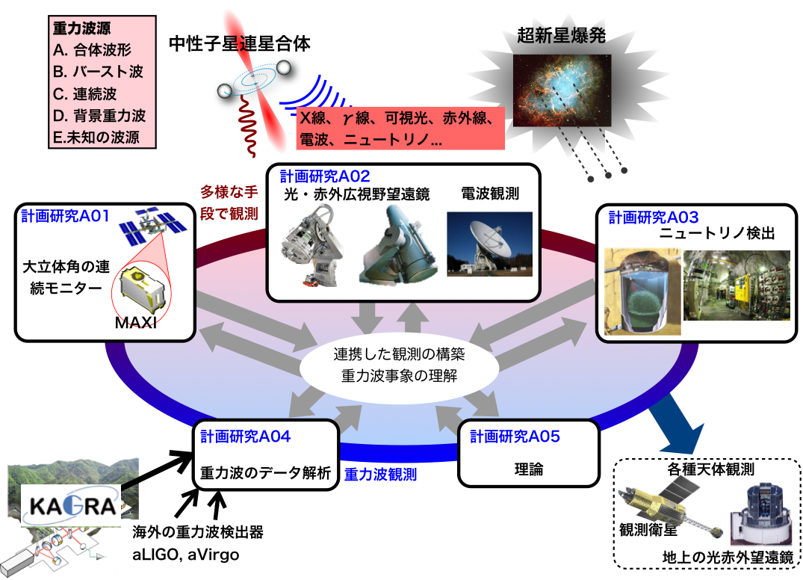
Multi-messenger
Needless to say, this Kakenhi project aims to make a multi-messenger observation system for GW sources.
To realize the system and make it effective, not only the detector sensitivity and also low rate of false alarm are important.
Notes:
Needless to say, this Kakenhi project aims to make a multi-messenger observation system for GW sources.
To realize the system and make it effective, not only the detector sensitivity
and also low rate of false alarm are important.

Slide 6
Target of this program
As a target value of this research program,
I set the false alarm rate to be
less than one event per month.
This value of one event per month has no special means. Let’s have an order estimation. If every day GW alerts are triggered and then should make follow-up observations every day, it is a little bit tough work. I don’t know how often alerts can be acceptable. But I set the target high, because there is still time.
Of course, less than one event per month is a very severe request. We needs to think about that seriously.

Slide 7
Toward GW alerts (1)
To make the GW alert system of low fake rates
the following things are necessary.
1) Co-operation with DetChar and
Burst and CBC GW search system
Data transfer and monitoring system will start operations within the next one or two years. Kanda-san is in charge of KAGRA Data Management System.
The noise monitoring systems are being developed by Hayama-kun
as KAGRA DetChar group. Collaborations with DetChar and low latency
GW search system are necessary.
Notes:
To reduce the burst noises the following research plan is necessary.

Slide 8
Toward GW alerts (2)
2) By using CLIO detector
the noise investigation should be started.
Cryogenic operation of KAGRA is planed in 2018.
Before starting the final sensitivity operations of KAGRA,
we need to know noise behaviors induced by the cryogenic system.
Therefore, during the initial KAGRA construction
test runs of CLIO is necessary for us.
Notes:
To reduce the burst noises the following research plan is necessary.

Slide 9
Toward GW alerts (4)
3）Vibration sensors in cryogenic environment
are needed for the noise investigations.
Now Michelson interferometer type sensor is being prepared by myself.
The details are reported later.
4）Noise reduction and removing
After the noise investigations, noise sources will be identified
and then should be vanished. This is one of the priority works.
We need some systematic tools of both hardware and software.
The second work to do is providing the Veto flags
for GW alert system to remove the noise events.
I will contribute to make such veto system for KAGRA.

Slide 10
2. Past Investigations at TAMA and CLIO
Notes:
Before talking about the current works, I will review the past work with TAMA300 detector.

Slide 11
The past achievements
Before talking about the current status and what we need,
I would like to review the past activities and what we did
at TAMA and CLIO for GW alert system.
These are what we learned at TAMA and CLIO.
Notes:
These are what we learned at TAMA and CLIO.

Slide 12
What I did
1) Online Calibration and the Sensitivity Monitoring
Detector sensitivity is not constant in the long term observations. It should be checked continuously and in time.
2) Online Noise Analysis (spectrum base)
There are many noise contributions. Mechanisms of the noise contamination were investigated to reduce the noises. And the noise couplings can be changed time by time. Therefore, online noise analysis system is needed.

Slide 13
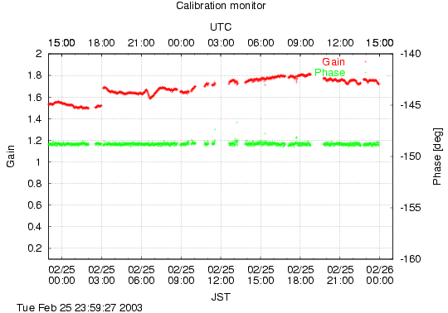
Online Calibration of
TAMA300 detector
The Open-loop response at 625 Hz
Servo Gain
1 day
This figure shows a detector response at a frequency.
The red points are gain of the detector, and the phase is time delay of the signals.
The horizontal axis is time and the full scale is one day.
During the long-term observation detector response will be changed like this.
Notes:
This figure shows a detector response at a frequency.
The red points are gain of the detector, and the phase is time delay of the signals.
The horizontal axis is time and the full scale is one day.
During the long-term observation detector response will be changed like this.

Slide 14
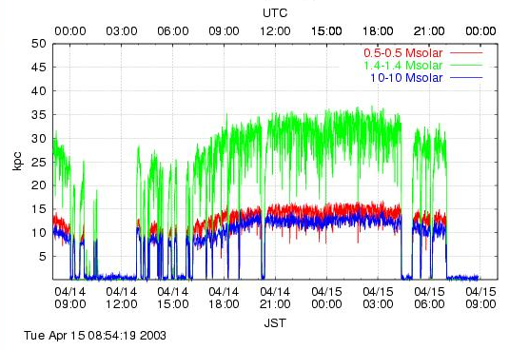
Observable Distances for inspiraling compact star binaries
Observable Distances
After the online calibration, the detector noise levels are checked as observable distances. with SNR=10 for CBCs.
This monitor can be shown in real-time.
To keep the sensitivity in the long-term observation, this plot was very useful.
Notes:
After the online calibration, the detector noise levels are checked as observable distances. with SNR=10 for CBCs.
This monitor can be shown in real-time.
So this plot was very useful to keep the sensitivity in the long-term observation.

Slide 15
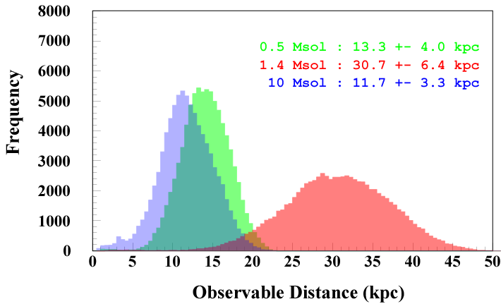
The Observable Distances for CBC
This is a histogram of the observable distances.
With the help of these online monitoring systems, we can keep the detector conditions are well.
The basic systems were already demonstrated at TAMA.
To increase the sensitivity of KAGRA, the detector complexity will be increased.
Therefore, we should refine the system for KAGRA.
Notes:
This is a histogram of the observable distances.
With the help of these online monitoring systems, we can keep the detector conditions are well.
The basic systems were already demonstrated at TAMA.
To increase the sensitivity of KAGRA, the detector complexity will be increased.
Therefore, we should refine the system for KAGRA.

Slide 16
What I did
1) Online Calibration and the Sensitivity Monitoring
Detector sensitivity is not constant in the long term observations. It should be checked continuously and in time.
2) Online Noise Analysis (spectrum base)
There are many noise contributions. Mechanisms of the noise contamination were investigated to reduce the noises. And the noise couplings can be changed time by time. Therefore, online noise analysis system is needed.
Notes:
The second thing is online noise analysis.

Slide 17
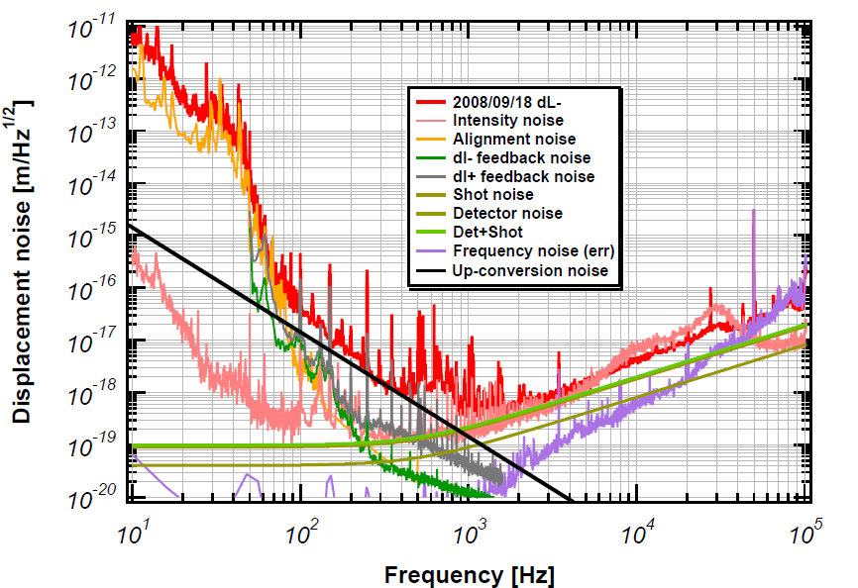
Noise Budgeting
This is a detector noise spectrum of the TAMA final.
Many kinds of noises were contributed in each frequency regions.
Notes:
There are many noise contributions.
Mechanisms of the noise contamination were investigated to reduce the noises.
And the noise couplings can be changed time by time.
Therefore, online noise analysis system is needed.

Slide 18
Noise Mechanism
(l- noise)
UGF: 20Hz
coupling
constant
H
Hslm
(llm)
-
(slm)
-
A
D
Aslm
Dslm
F
Fslm
WFer
WFslm
V₄
V₂
Noise Transfer Function = V4 / V2
For example, noise coupling mechanism is modeled like this.
And then the model is checked its validity by measuring the noise transfer function.
Notes:
For example, noise coupling mechanism is modeled like this.
And then the model is checked its validity by measuring the noise transfer function.

Slide 19
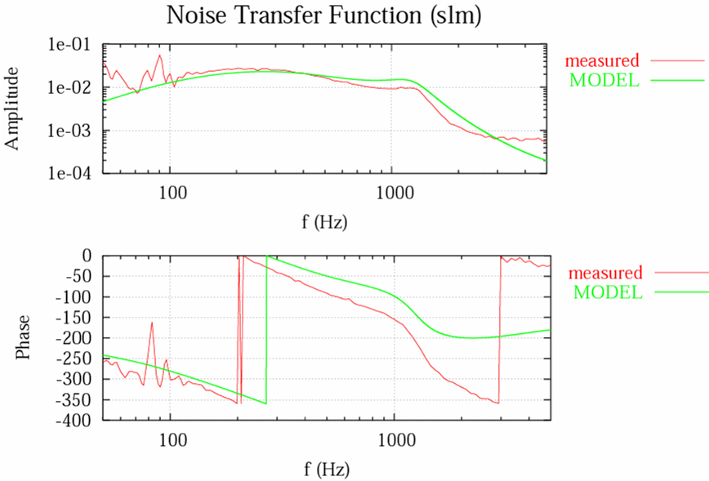
Noise Transfer Function
(l- noise)
Not consistent with measurement.
In this case, we found the discrepancy between the modeled and measured transfer function. We modified the model.
Notes:
In this case, we found the discrepancy between the modeled and measured transfer function.
As a result of these investigations, we refine the noise model.

Slide 20
Noise Mechanism
(l- noise)
Ref: LIGO-T970084-00
H
UGF: 20Hz
coupling
constant
H
Hslm
(llm)
-
(slm)
-
A
D
Aslm
Dslm
F
Fslm
WFer
WFslm
V₄
V₂
Noise Transfer Function = V4 / V2
Notes:
The knowledge of the noise contamination mechanism is very important
to reduce the noise.

Slide 21
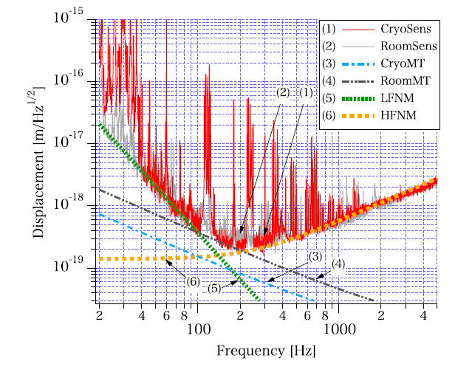
An achievement of CLIO
“Reduction of Thermal Fluctuations
in a Cryogenic Laser Interferometric Gravitational Wave Detector”
Phys. Rev. Lett. 108, 141101 (2012) [5 pages]
As you know, CLIO is the first cryogenic
interferometer as a GW detector.
At CLIO detector, similar noise investigations were
performed. As a result, we succeed to demonstrate
the thermal noise reductions by cooling the mirrors.
Notes:
As you know, CLIO is the first cryogenic interferometer as a GW detector.
At CLIO detector, similar noise investigations were performed.
As a result, we succeed to demonstrate the thermal noise reductions by cooling the mirrors.

Slide 22
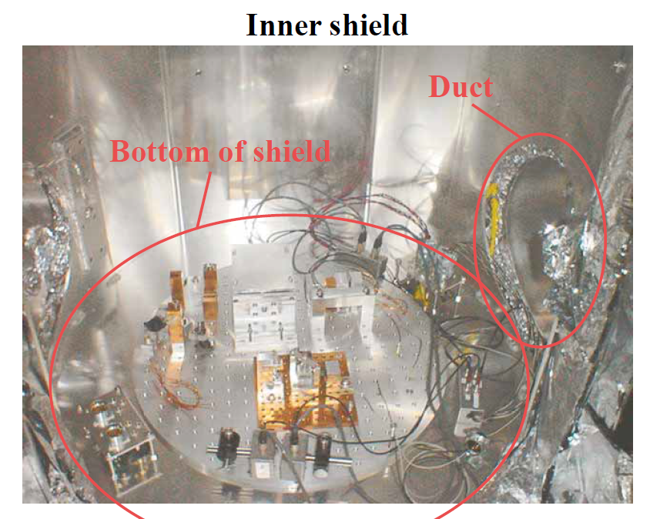
Photo: CLIO inner shield
This picture shows a cryogenic vibration sensor inside the vacuum chamber.
Notes:
In such noise investigations, cryogenic sensors are necessary and are important.
This picture shows a cryogenic vibration sensor inside the vacuum chamber.
The GW detector is very delicate and sensitive for many things.
The installation of such sensors is not so easy, because the sensor may induce the additional noises.

Slide 23
What we learned from TAMA and CLIO
TAMA:
To realize long-term observation
and to keep the stable operation,
the detector characterization system
is very important.
CLIO:
A number of sensors in cryogenic environment
are necessary for noise investigation and stable operation.
These are what we learned from TAMA and CLIO.
Notes:
These are what we learned from TAMA and CLIO.

Slide 24
3. What we need for KAGRA
Notes:
Based on these things, let’s think about what we need for KAGRA.

Slide 25
What we need
1) Burst noise investigation with cryogenic sensors
For example, cooling wires of the mirror have thermal gradient in these. In such situation, acoustic noise emissions are expected to release the internal stress.
2) At lease a few days of test runs
In the CLIO developments, short term noise investigations
are performed. For more detailed noise investigations
the longer data are needed.

Slide 26
What we need
3) Software tools for time-series data
In the previous works, most of the analysis is based
on spectral data. As for burst noise investigations, time-series
of data and its handling software (library) are necessary.
4) Detail design of the veto system
As well as low-latency GW search system,
the veto system is necessary for the alert.
These two systems are closely related.
I will contribute to make the veto system.

Slide 27
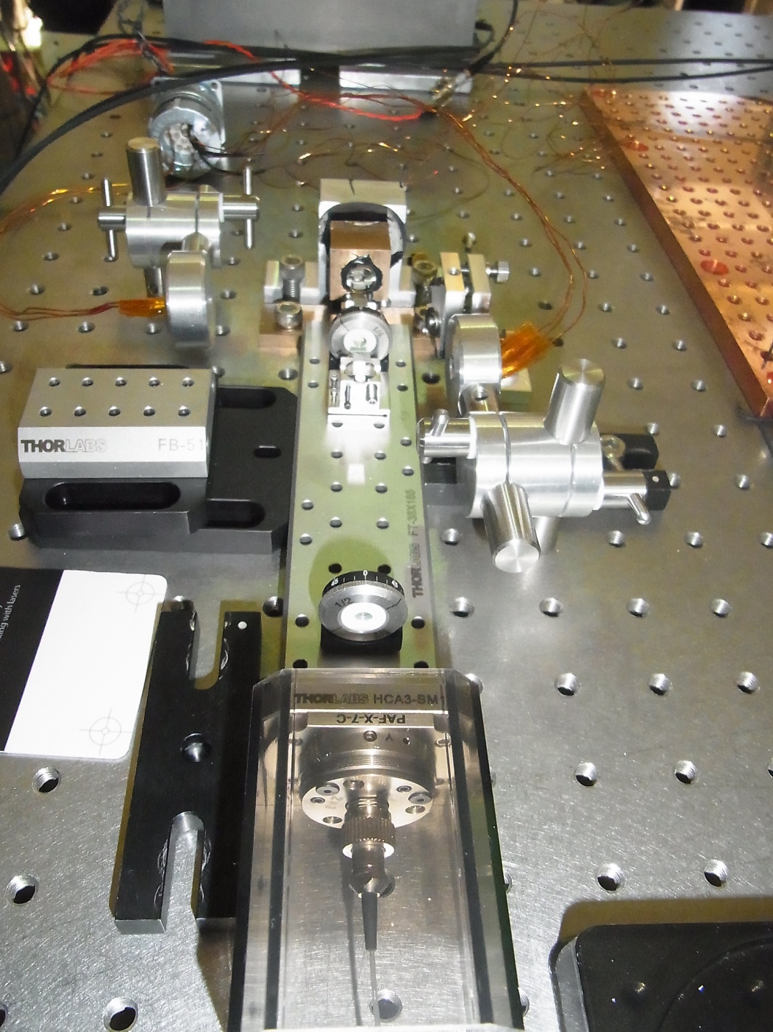
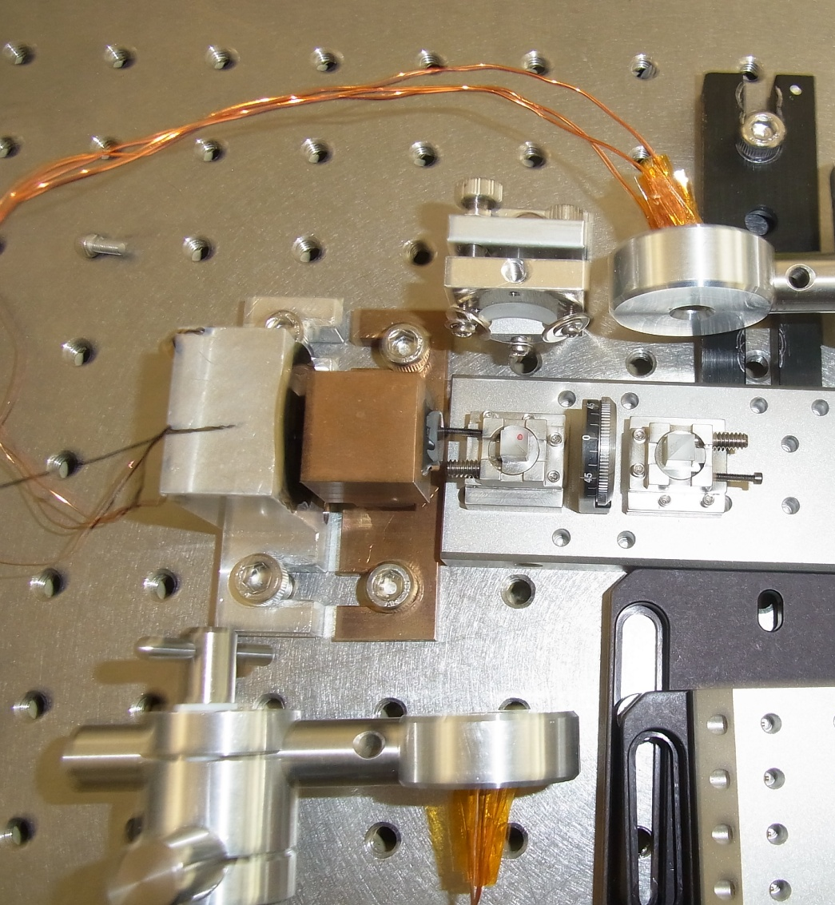
Cryogenic sensor
Michelson type Accelerometer
Notes:
At the end of my talk, current status of my research program are reported shortly.
Most of preparation works for noise investigation were finished or almost finished.
This is a cryogenic vibration sensor. The base system is developed by Yamamoto-san
and Chen dan-kun.
For long-term observations a few modifications were applied.

Slide 28
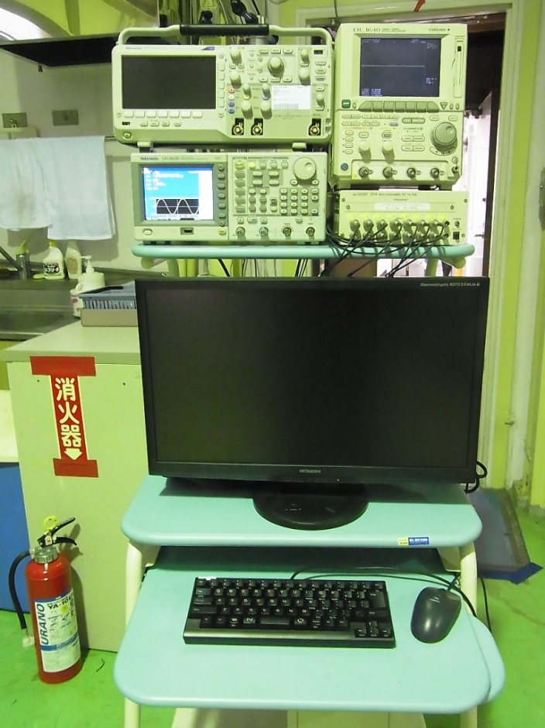
Data Acquisition System
for burst noise investigations
ADC: 16 bit resolution
effective 14 bits
Number of channels: 8
Sampling: 16.384 kHz
Notes:
In this year I will start to the test observations at CLIO.
That’s all. Thank you.

Slide 29
Toward GW alerts
To reduce the false alarm rate is
one of the most important things
for multi-messenger observations.
Before the starting of KAGRA cryogenic operations,
noise investigations are necessary for maximizing its performance.
Fortunately we have
CLIO detector as a prototype cryogenic interferometer.
We can start the noise investigation by using CLIO detector.
In this research program, I will contribute to make
GW alert system together with noise investigations.

Slide 30
---

