Slide 1
Cryogenic Payload Modeling: Vibration via Heat Links
JGW-G1302026
Cryogenic Payload Meeting
2013.12.3
Takanori Sekiguchi

Slide 2
Design Updates

Slide 3
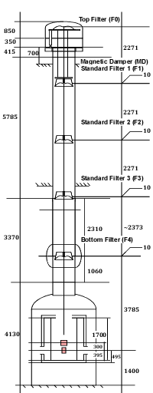
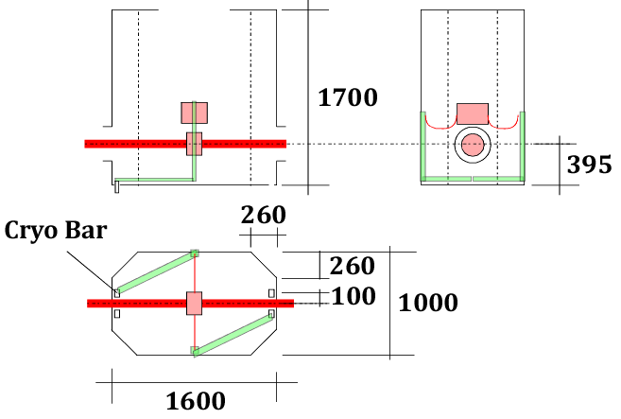
Type-A SAS Dimension
References：
Type-A SAS by R. DeSalvo (JGW-D1200904-v3, last update: 2013/04/08)
Type-A vacuum chamber (drawing #: VM5926, last update: 2013/06/26)
KAGRA cryostat (drawing #: 1KN005806, last update: 2012/07/09)
Inner radiation shield (drawing #: 1KN005807, last update: 2012/05/16)

Slide 4
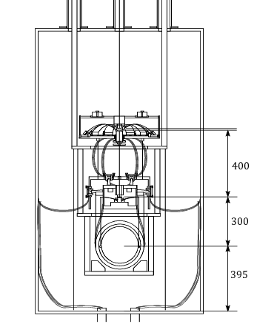
Cryogenic Payload Tentative Parameters
Mass Distribution
Platform | PF | 62 kg
Intermediate Recoil Mass | IR | 45 kg
Intermediate Mass | IM | 53 kg
Recoil Mass | RM | 34 kg
Test Mass | TM | 23 kg
Total |  | 217 kg
PF
IR, IM
Spring Rate
 | Q | F₀
GAS Filter at PF-IM | 1E3 | 0.5 Hz
Sapphire springs at IM-TM | 1E6 | 10 Hz
RM, TM

Slide 5
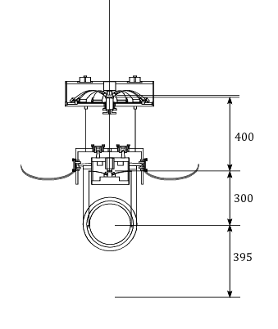
Cryogenic Payload Tentative Parameters
Wire Dimension
 | # | L | Φ | σ [MPa] | dx | dy
PF-IM | 1 | 400 | 1.8 | 390 | - | -
PF-IR | 3 | 230 | 1.0 | 220 | 120
IM-RM | 4 | 300 | 0.4 | 580 | 25 | 145
IM-TM | 4 | 300 | 1.6 | 28 | 15 | 125
PF
IR, IM
Heat Links
 | # | L | R | Φ | Strand #
CB-IR | 4 | 470 | 150 | 0.15 | 45
RM, TM

Slide 6
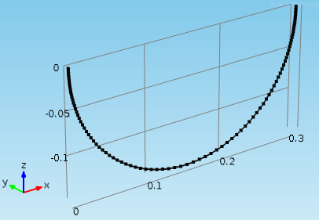
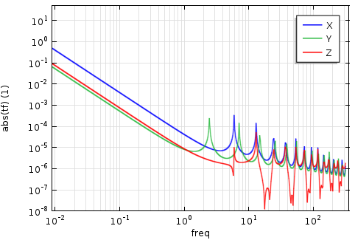
Heat Link Design and Vibration Transmissivity
Conventional heat link design (a=400mm, b=200mm, L=974mm) is not feasible in the limited space of the current cryostat design. Shorter fibers are certainly necessary:
Pure aluminum (E=70GPa, Loss=1E-2)
Semi-circular shape with R150, L=470
Number of fibers: 2x2=4 (symmetric cabling)
Each fiber consists of 45 strands with Φ0.15
Simulated TF of a strand fiber: Attached to a 50kg Mass

Slide 7
Vibration via Heat Links

Slide 8
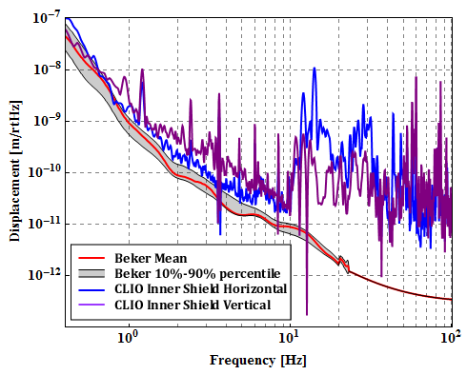
Cryostat Vibration Model
From CLIO:

Slide 9
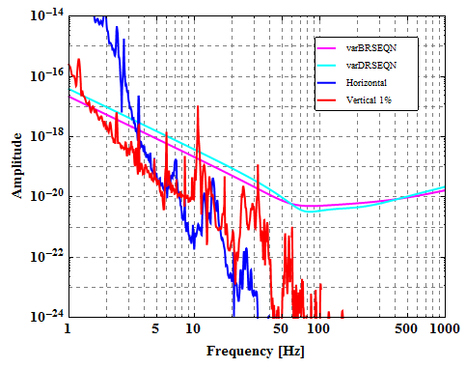
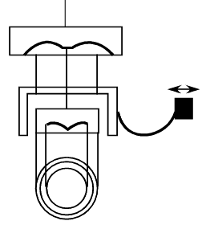
Type-B Like Default Design
GAS filter @PF tuned at 0.5 Hz
Sapphire cantilever with 10 Hz bounce frequency

Slide 10
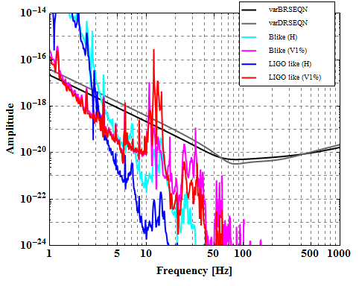
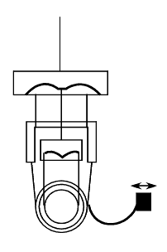
Type-B Like V.S. LIGO Like
Type-B like
Anyway vertical noise is harmful…
LIGO-like

Slide 11
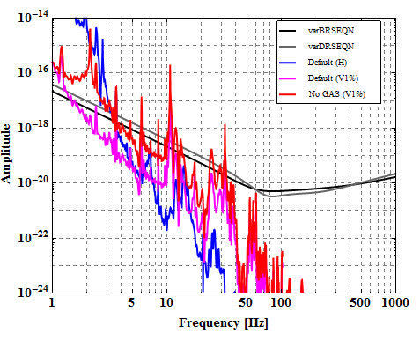
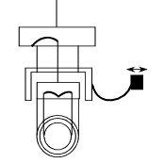
Type-B Like NO GAS
Normal Spirng @PF tuned at 1.5 Hz
Worse attenuation around 10 Hz…

Slide 12
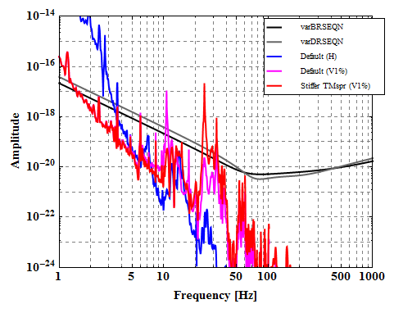
Type-B Like, Stiffer TM Spring
Sapphire cantilever with 20 Hz bounce frequency
Get worse >20 Hz

Slide 13
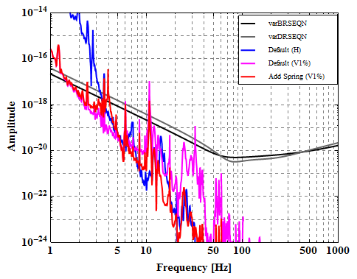
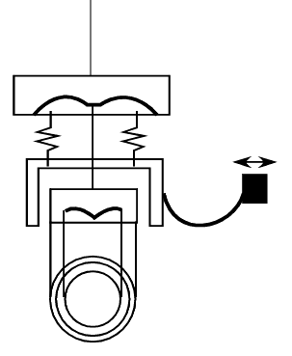
Type-B Like + V Spring for IRM
Adding springs for IR suspension with 3 Hz resonant freq
Better attenuation above 10 Hz
Difficulty in assembly: How to compensate large drift after cooling??

Slide 14
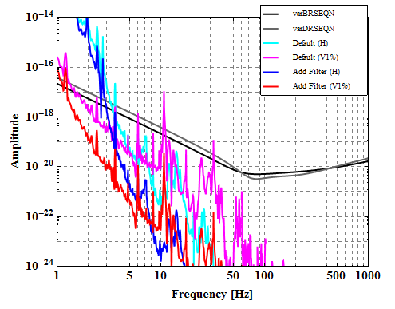
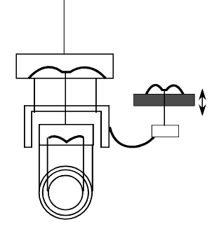
Type-B Like + 1 More Filtering
GAS filtering (tuned at 0.5 Hz) in front of the suspension
Certainly the vibration is attenuated by additional filter

Slide 15
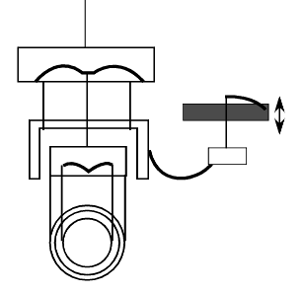
Type-B Like + 1 More Filtering (2 Hz)
Normal Spring (resonance at 2 Hz) in front of the suspension
Even 2 Hz spring helps a lot.

Slide 16
TO BE INVESTIGATED
Effect of heat links between masses
Optimization of heat link geometry

