Slide 1
Cryogenic Payload Modeling: Vibration via Heat Links
JGW-G1302026
Cryogenic Payload Meeting
2013.12.3
Takanori Sekiguchi

Slide 2
Design Updates

Slide 3
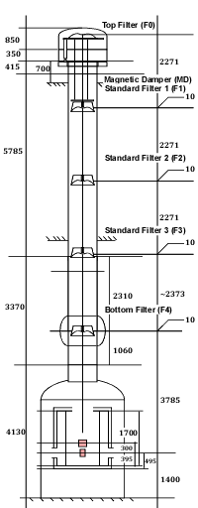
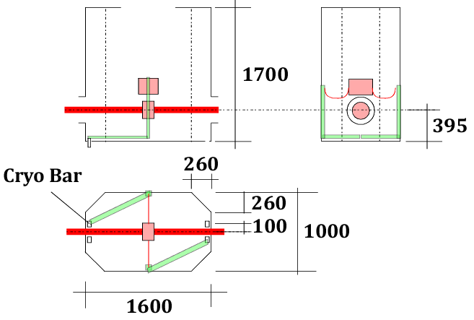
Type-A SAS Dimension
References：
Type-A SAS by R. DeSalvo (JGW-D1200904-v3, last update: 2013/04/08)
Type-A vacuum chamber (drawing #: VM5926, last update: 2013/06/26)
KAGRA cryostat (drawing #: 1KN005806, last update: 2012/07/09)
Inner radiation shield (drawing #: 1KN005807, last update: 2012/05/16)

Slide 4
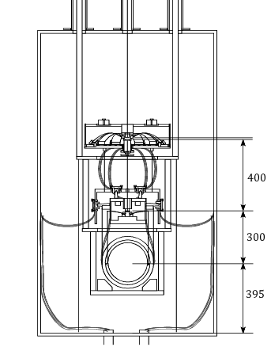
Cryogenic Payload Tentative Parameters
Mass Distribution
Platform | PF | 62 kg
Intermediate Recoil Mass | IR | 45 kg
Intermediate Mass | IM | 53 kg
Recoil Mass | RM | 34 kg
Test Mass | TM | 23 kg
Total |  | 217 kg
PF
IR, IM
Spring Rate
 | Q | F₀
GAS Filter at PF-IM | 1E3 | 0.5 Hz
Sapphire springs at IM-TM | 1E6 | 10 Hz
RM, TM

Slide 5
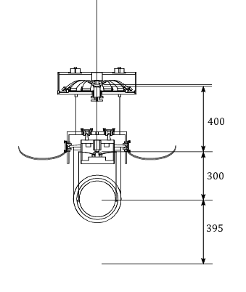
Cryogenic Payload Tentative Parameters
Wire Dimension
 | # | L | Φ | σ [MPa] | dx | dy
PF-IM | 1 | 400 | 1.8 | 390 | - | -
PF-IR | 3 | 230 | 1.0 | 220 | 120
IM-RM | 4 | 300 | 0.4 | 580 | 25 | 145
IM-TM | 4 | 300 | 1.6 | 28 | 15 | 125
PF
IR, IM
Heat Links
 | # | L | R | Φ | Strand #
CB-IR | 4 | 470 | 150 | 0.15 | 45
RM, TM

Slide 6
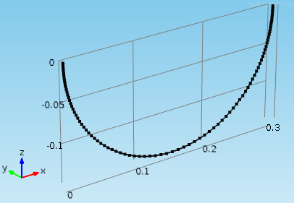
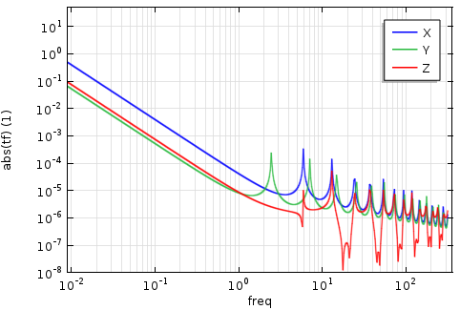
Heat Link Design and Vibration Transmissivity
Conventional heat link design (a=400mm, b=200mm, L=974mm) is not feasible in the limited space of the current cryostat design. Shorter fibers are certainly necessary:
Pure aluminum (E=70GPa, Loss=1E-2)
Semi-circular shape with R150, L=470
Number of fibers: 2x2=4 (symmetric cabling)
Each fiber consists of 45 strands with Φ0.15
Simulated TF of a strand fiber: Attached to a 50kg Mass

Slide 7
Vibration via Heat Links

Slide 8
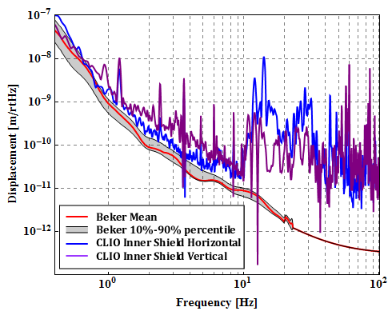
Cryostat Vibration Model
From CLIO:

Slide 9
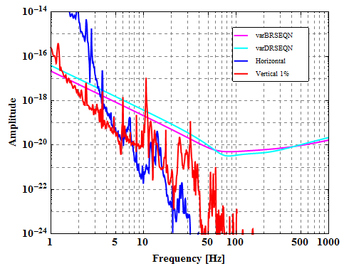
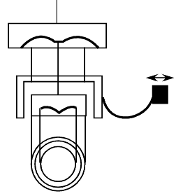
Type-B Like Default Design
GAS filter @PF tuned at 0.5 Hz
Sapphire cantilever with 10 Hz bounce frequency

Slide 10
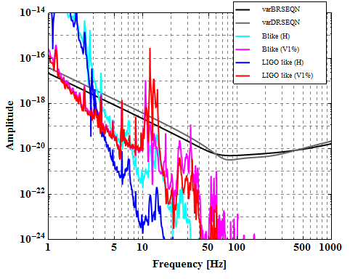
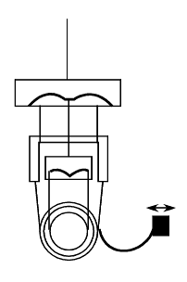
Type-B Like V.S. LIGO Like
Type-B like
Anyway vertical noise is harmful…
LIGO-like

Slide 11
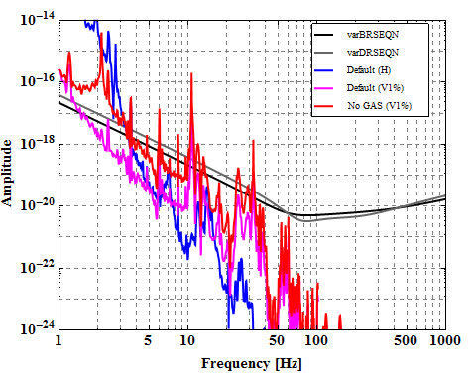
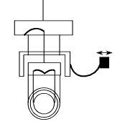
Type-B Like NO GAS
Normal Spirng @PF tuned at 1.5 Hz
Worse attenuation around 10 Hz…

Slide 12
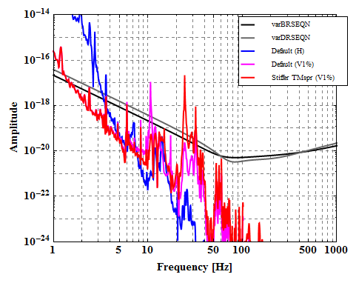
Type-B Like, Stiffer TM Spring
Sapphire cantilever with 20 Hz bounce frequency
Get worse >20 Hz

Slide 13
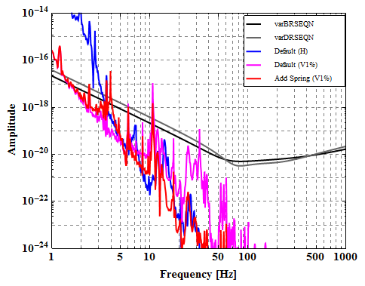
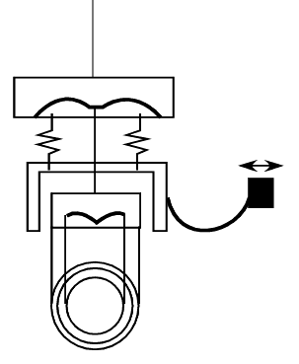
Type-B Like + V Spring for IRM
Adding springs for IR suspension with 3 Hz resonant freq
Better attenuation above 10 Hz
Difficulty in assembly: How to compensate large drift after cooling??

Slide 14
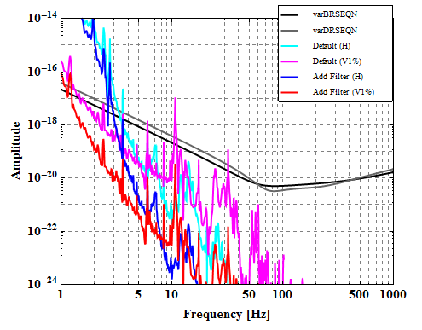
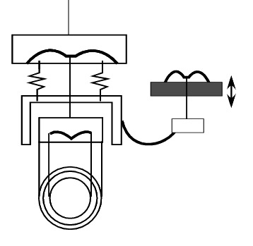
Type-B Like + 1 More Filtering
GAS filtering (tuned at 0.5 Hz) in front of the suspension
Certainly the vibration is attenuated by additional filter

Slide 15
TO BE INVESTIGATED
Effect of heat links between masses
Optimization of heat link geometry

