Slide 1
Prototype Test of Vibration Isolation System Current Status & Schedule
ICRR, D2
Takanori Sekiguchi

Slide 2
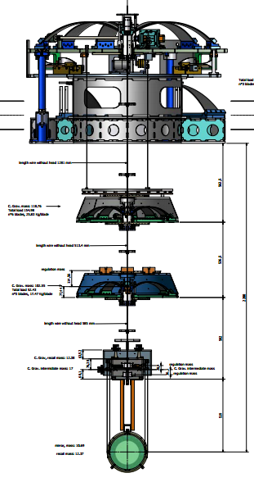
Prototype Test of SAS
Standard GAS Filter @Nikhef & Kashiwa (Jan. 2011~)
Pre-Isolator @Kashiwa (Aug. 2011~)
Payload @NAOJ (Aug. 2013~)

Slide 3
Current Status

Slide 4
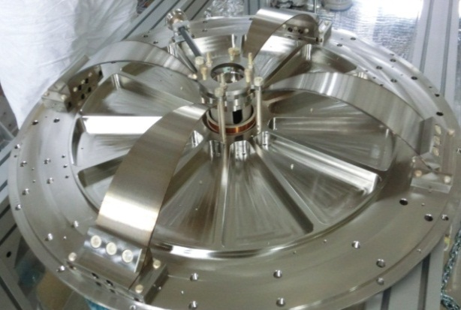
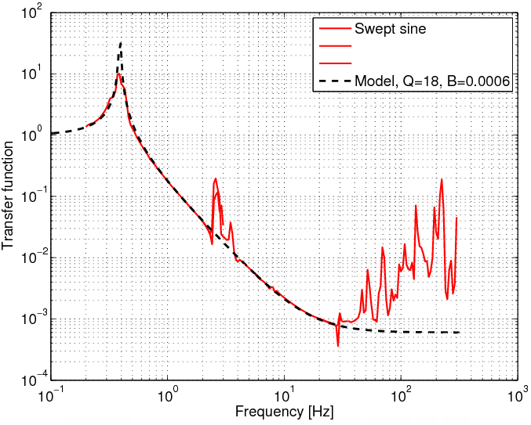
Standard GAS Filter Test
Done at NIKHEF:
Tuning of resonant frequencies
Measurement of mechanical transfer function
Measurement should be done:
Tuning of magic wands (establish the procedure at Kashiwa and apply it to actual equipment in Akeno)

Slide 5
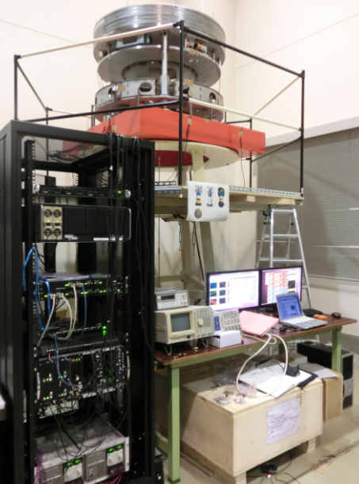
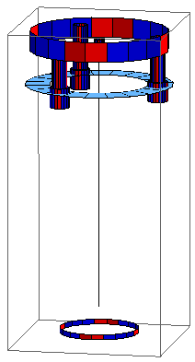
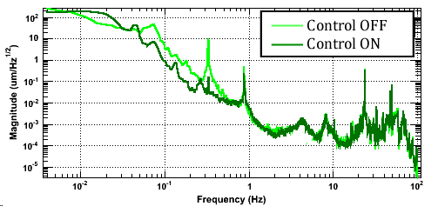
Pre-Isolator Prototype Tests
Done at Kashiwa:
Tuning of GAS & IP resonant frequencies
Digital (standalone) system setup
IP control in 3 DoFs with LVDT and geophone
DC control of IP with stepper motors
Test should be done:
Torsion mode damping

Slide 6
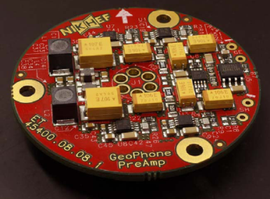
Problems in Pre-isolator Prototypes
Easily broken stepper motor drivers (circuits used in TAMA, manufactured >10 years ago)
→ New driver should be designed soon…
Low frequency (<0.1 Hz) noise of geophone preamp circuits (thermo-electromotive effect coupled with temperature fluctuation)
→ Need temperature stabilization with an envelope

Slide 7
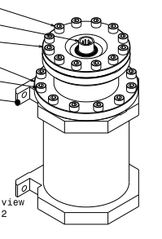
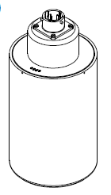
Vacuum Envelope for Geophone
Preamp and geophone are equipped inside

Slide 8
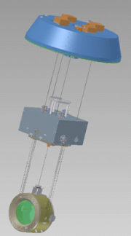
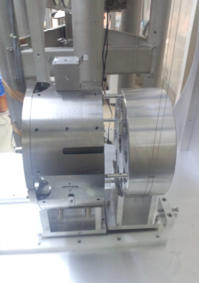
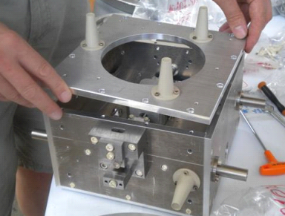
Payload Prototype Tests
Done at NAOJ:
Assembly test of TM suspension
Order components for OSEM driver
Test should be done:
OSEM calibration
Assembly of RM, IM, IRM suspension
Mechanical TF check
Active control with OSEM

Slide 9
Test Plan for Full Type-B Prototype

Slide 10
Important Schedule
Pre-isolator and its control system will be delivered to NAOJ this month. (on 10/22-23)
Installation of the actual vibration isolation system for i-KAGRA will start in the middle of FSY 2014 (~ Oct. 2014).
i-KAGRA
operation
Installation
Start
~9 months left
Now

Slide 11
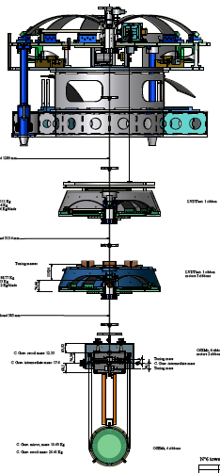
What We Learned from TAMA-SAS ??
& What is New from TAMA-SAS??
Angular fluctuation of the mirror was more critical in TAMA.
Need tools to adjust DC alignment
Need dampers for torsion modes
Torsion damper
Picomotor
For yaw alignment
Motor + moving mass
For pitch alignment
Actively controlled stage with OSEM. (c.f. eddy current damping in TAMA-SAS)
OSEM
We should spend time for testing these items.

Slide 12
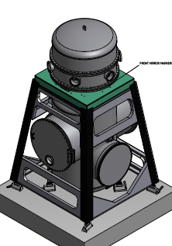
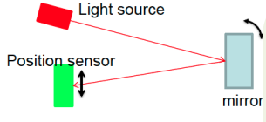
Main Action Item for Full Type-B Test
Measure angular fluctuation of the mirror with an optical lever.
Check DC alignment adjustment
Check efficiency of torsion mode damping
Establish control scheme with OSEMs
Length sensing: Michelson interferometer from ground?? (TBD)

Slide 13
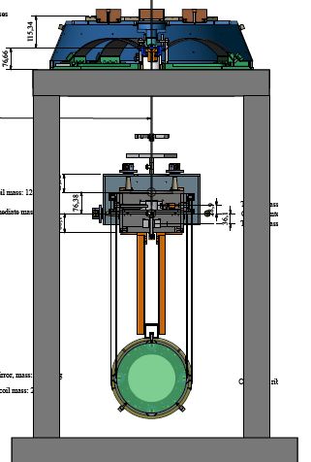
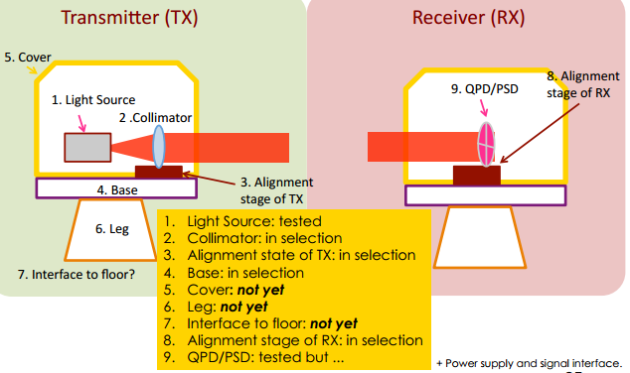
Action Items (1)
Payload Test @20m Lab, NAOJ
Tuning bottom GAS filter
OSEM test & calibration
Check motors for mirror alignment
Check mechanical transfer functions with OSEMs
Control test with OSEMs
Optical Lever Setup @TAMA
Designing holders and covers for light source & detector
Check commercial electric circuit for PSD
Measure noise level

Slide 14
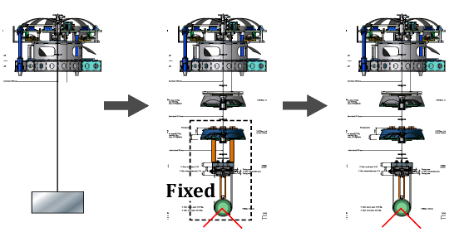
Steps for Type-B Test
Payload Prototype
Optical Lever
1. Pre-isolator Test in Vacuum
2. Full Type-B with Fixed Payload
3. Full Type-B Test

Slide 15
Action Items (2)
Pre-isolator Test in Vacuum @TAMA
Re-setup of digital control system
Compared with the result of in-air experiment
Full Type-B with Fixed Payload @TAMA
Torsion mode damping test
Check cabling effects
Optical lever working test
Full Type-B Test @TAMA
Mechanical TF check with equipped sensors and actuators
Apply full control, check DC alignment adjustment

Slide 16
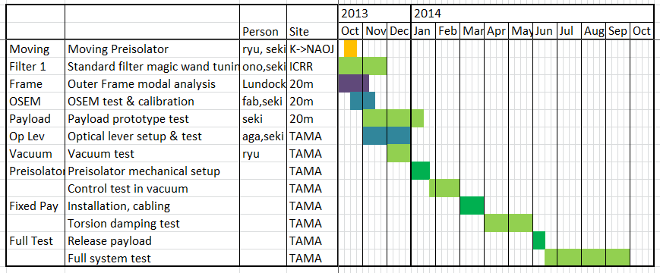
Schedule
2013: payload test + sensor preparation
2014: Type-B test utilizing TAMA facility
Agatsuma & Joris join from NIKHEF

Slide 17
END

Slide 18
Appendix

Slide 19
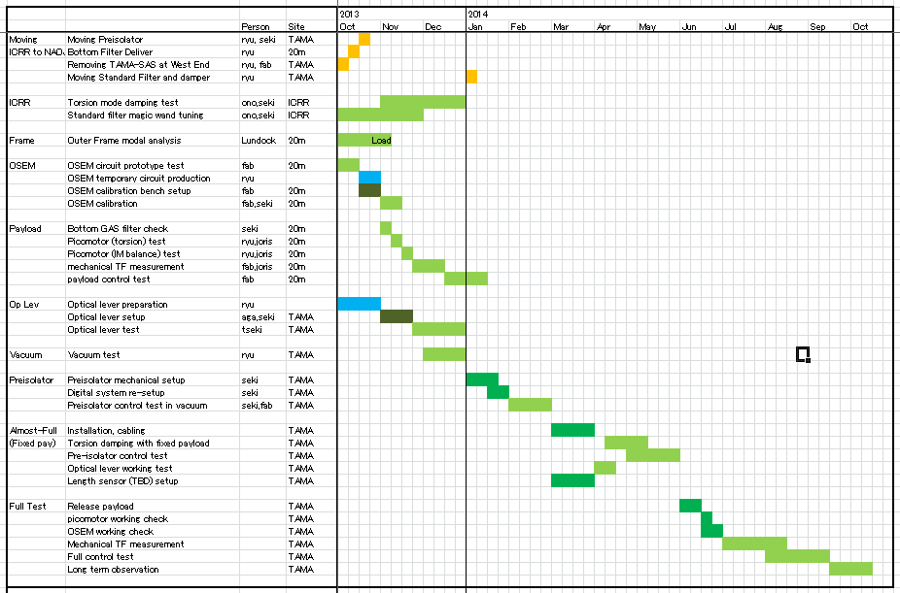

Slide 20
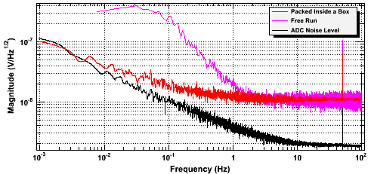
Problems in Pre-isolator Prototypes
Excess control noise at low frequency (<0.1 Hz) due to electronic noise in geophone preamp circuits
Excess Noise
Ideal Noise Level
Possible source: thermoelectromotive effect coupled with temperature fluctuation of the circuit/geophone

