Slide 1
Reserve

Slide 2
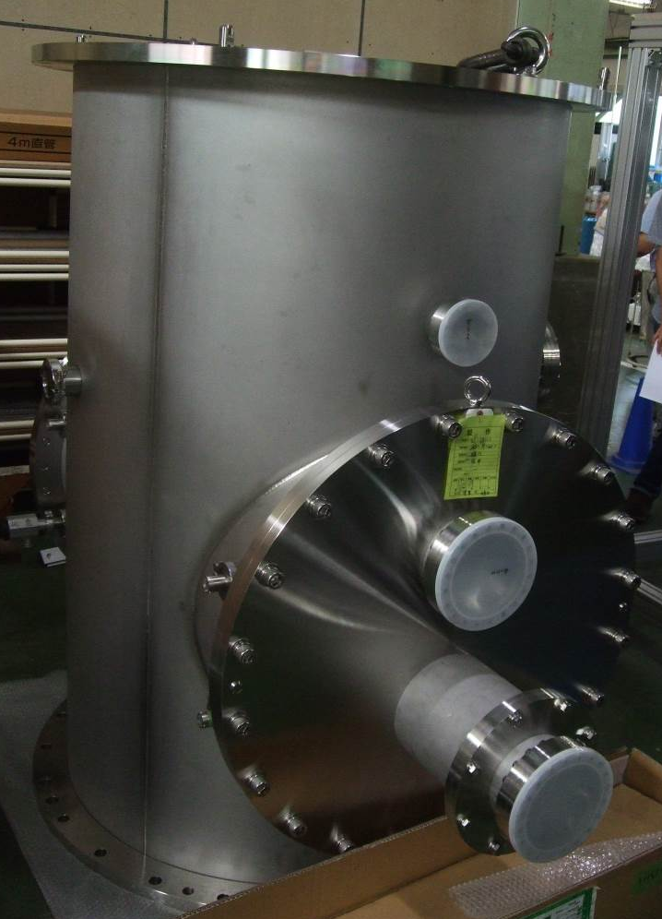
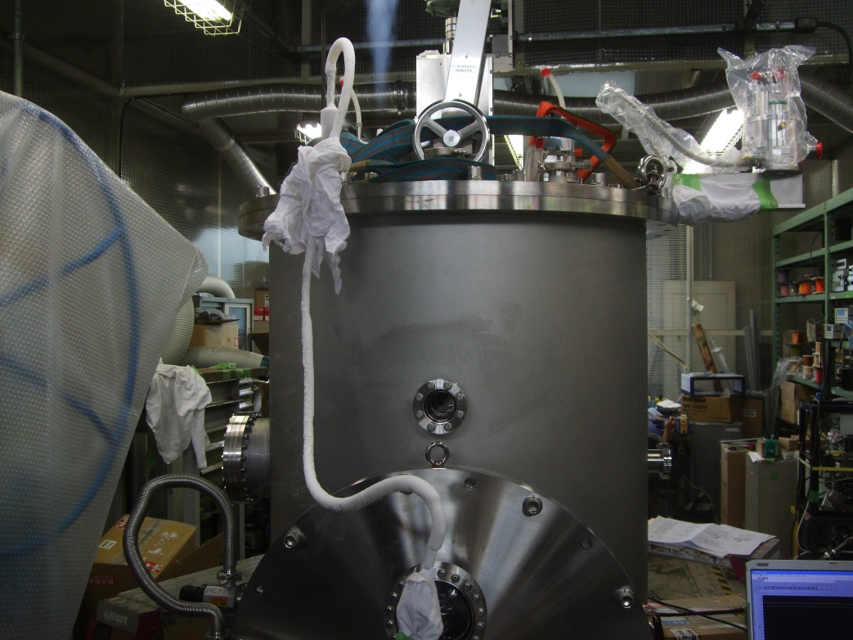
1/4 Crystal
Motivation : Performance test of cryogenic payload
Initial cooling test with liquid nitrogen (Jecc Torisha)
: 30th Aug. 2013
Delivery : 27th of Sep. 2013
2
2

Slide 3

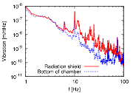
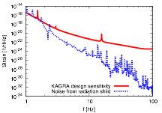
Vibration measurement of KAGRA cryostat
Radiation shield
Heat links
Vibration from the radiation shield through heat links.
Recoupling into main laser via scattered light
80K
Cooling bar
8K
Laser
mirror
Noise of the interferometer
Cryo cooler
Baffle
Cryo cooler
Measure the vibration of the radiation shield, and estimate the influence on the sensitivity of KAGRA.
The impact on the sensitivity of KAGRA
(Horizontal component)
Measurement at 10K
Increase because of the cryostat structure
Preliminary
Consistent
T=10K
> 100 times
The noise from the horizontal vibration component is significantly lower than the design sensitivity.
Notes:
Analysis is on going now by Chen Dan kun.

Slide 4
Main Interferometer Subsystem
Basic Optical design has been fixed
Phys. Rev. D, 88, 043007 (2013)
Detailed design
Actual servo topology, filter design, noise analysis
Analog electronics
Optical layout including auxiliary beams
Output optics design needs more work
OMC design
Output Faraday
Suspensions for output optics (OMC, Faraday, etc)
Notes:
Basic optical design of the main interferometer was fixed a while ago. We recently published a paper on this.
Now, the main focuses of the main interferometer group are the detailed design of the actual servo system, developing analog electronics for high frequency servos, detailed optical layout including auxiliary beams and so on.
However, there remain an area more work is necessary, that is, the output optics system.
The design of the OMC is still immature and the design of the other optics for the output path are not yet finished. So we are working hard on these.

Slide 5
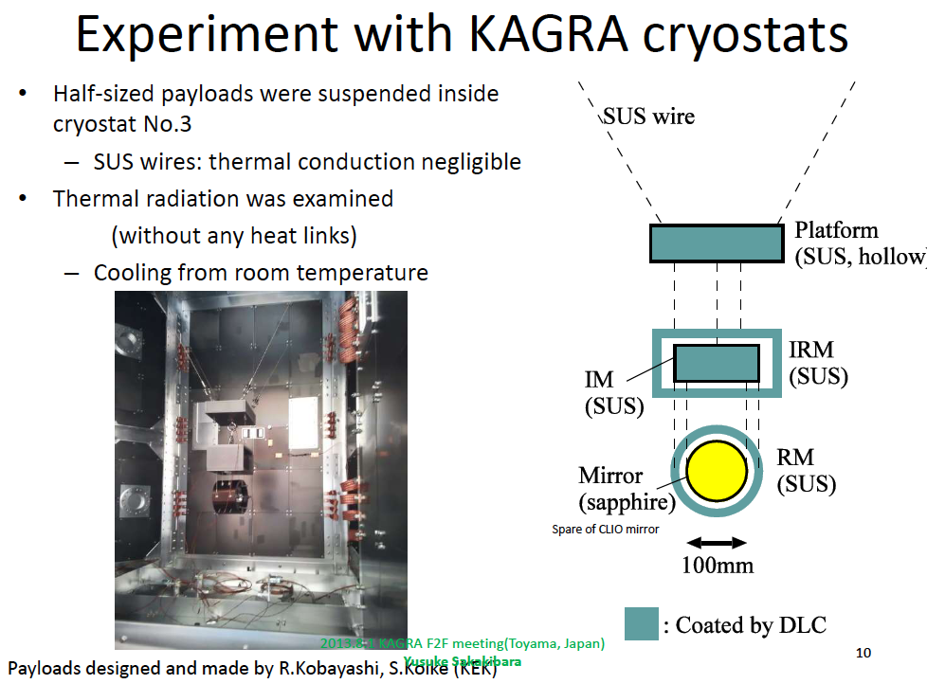

Slide 6
Black coating on baffle surface
The black coating on the baffles is classified into a few difficulty levels.
Our default candidate was a diamond-like carbon (DLC) coating, but we found it was not so black (~20% reflectivity) at 1 um. We look for other candidates, even though the DLC is the best choice if only the vacuum compatibility is considered.

Slide 7
Reflectivity of candidates
Solblack, a kind of electroless Ni-P plating by Asahi Precision Co., has the lowest reflectivity!!
Notes:
P; phosphorus [fάsfərəs | fɔ́s-]｟記号P｠
ECB: Electric Chemical Buffling

Slide 8
Reflectivity of candidates
in ATC-NAOJ
Notes:
ECB: Electric Chemical Buffling

Slide 9
Scattering distributions
Our design principle: use mirror-like surfaces and suppress wide-spread scatter.
Scattering profiles differ as the base material’s surfaces!
FWHM :About 4 deg
Solblack on SUS 2B
Scattering probability distribution per unit solid angle
SolBlack on SUS BA
Solblack on A1050 ,ECB
ECB (Electro-Chemical Buffing)
Source: 1um
Rotating detector
Note: Different from “BRDF” .
Candidate
Goniophotometer
Measurement by Y. Niwa in JASMINE Project, NAOJ
Measurement system also belongs to their project.

Slide 10
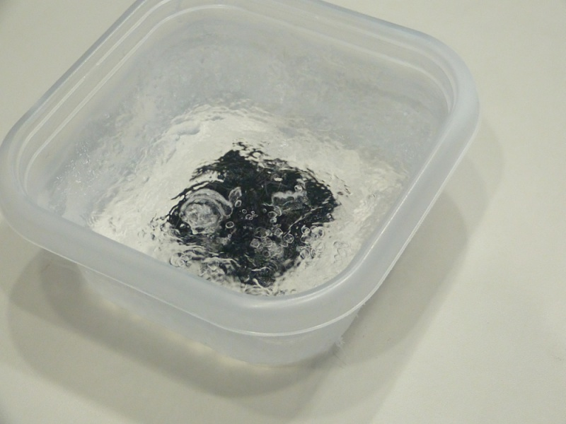
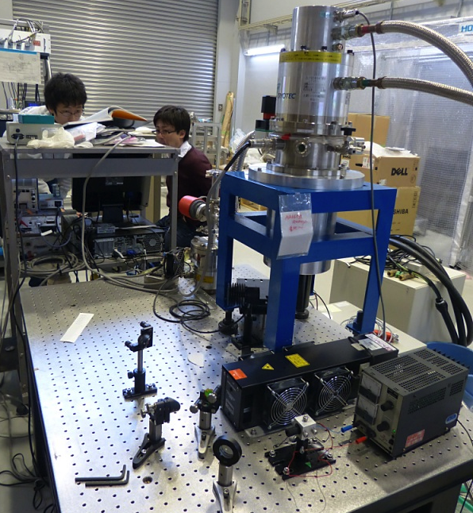
Other tests
Tests for the vacuum compatibility is done (after baking in vacuum).
Tests for cryogenic compatibility is almost done.
Remaining test: compatibility for 8K environment (now ongoing...)
Cryogenic Test in 70K (for the surface of 5-m cryoduct shield)
First, the reflectivities of a sample in 1um (YAG) and 10um (CO2 laser) are measured.
Next, the sample is cooled in liquid nitrogen.
And then, a visual inspection is perfomed.
Again, the reflectivities of the sample in 1um and 10um are measured. (cryo-resistant test)
More other test: Reflectivity check during cooling.
Liquid N₂
Cryostat
Sample: SolBlack on Al
by Asahi-Precision
CO2 laser (10um)
The same test w/ 1um laser was done.

Slide 11

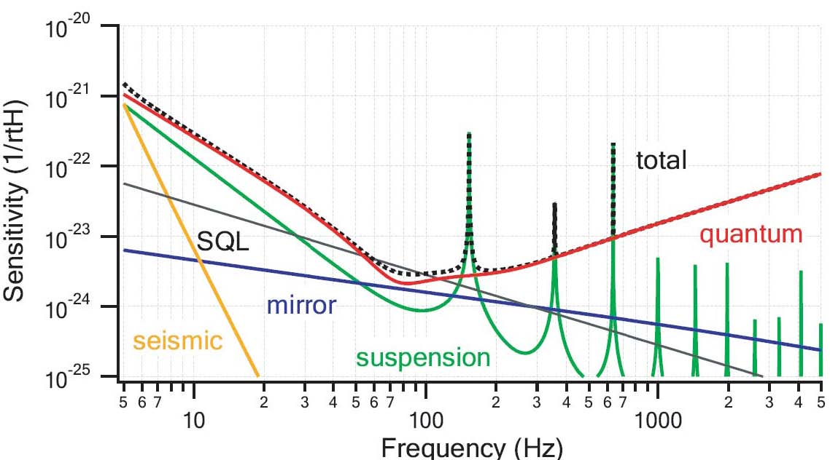
Ultimate design sensitivity of KAGRA
This sensitivity achieves 167 Mpc for
coalescence GW of 1.4 Ms NSB.
Duty factor: > 80%
Expected event rate
20kg test mass at 20 K
Suspension of Q=10⁸
Bulk Q of mirror 10⁸
400kW cavity power
Q of coating: 10⁴
DC read out
9.8
+14
yr⁻¹
-6.6

Slide 12
Interferometer configuration
Input/Output Optics
- Beam Cleaning and stab.
- Modulator, Isolator
- Fixed pre-mode cleaner
- Suspended mode cleaner
Length 26 m, Finesse 500
Main Interferometer
- 3 km arm cavities
- RSE with power recycling
- Cryogenic test masses
Sapphire, 20K
‘Type-A’ vibration isolator
Cryostat + Cryo-cooler
- Room-temp. Core optics
(BS, PRM, SEM, …)
ETM
- Output MC
- Photo detector
Y-arm cavity
ITM
Power
~180 W
80 W
825 W
Power ~400 kW
Input
Bench
PRM
BS
ITM
ETM
Laser
26-m MC
Power-recycling
Gain ~11
X-arm cavity
Length 3,000 m
Finesse 1,550
Laser Source
- Wavelength 1064 nm
- Output power 180 W
High-power MOPA
RSE: (Resonant
sideband Extraction)
Signal-band Gain ~15
Detuned RSE
(Variable tuning)
SEM

Slide 13
From iKAGRA to bKAGRA
Fabry-Perot Michelson
Power Recycled Fabry-Perot Michelson with broadband RSE
Cryogenic mirror, output MC
Operational run in 2015
Without cryogenic & PR
Fused silica mirror
Operation starts in 2017
Observation in 2018

Slide 14
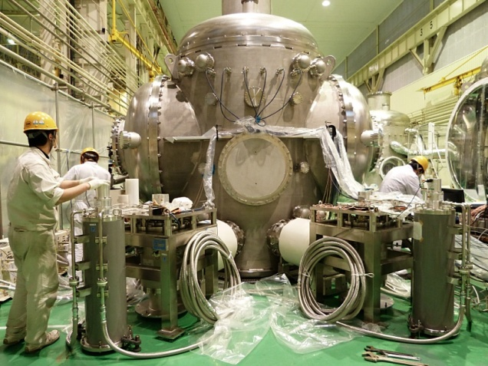
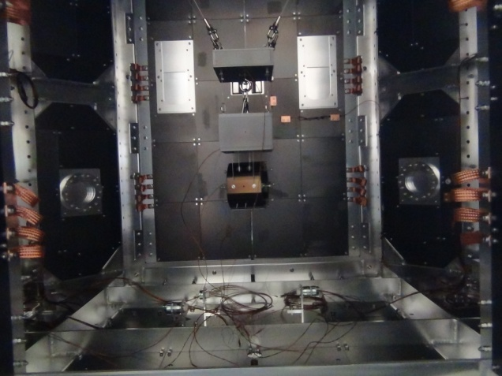
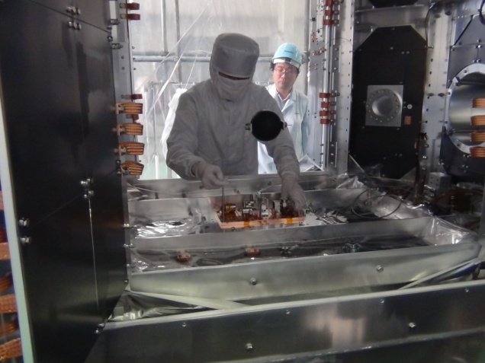
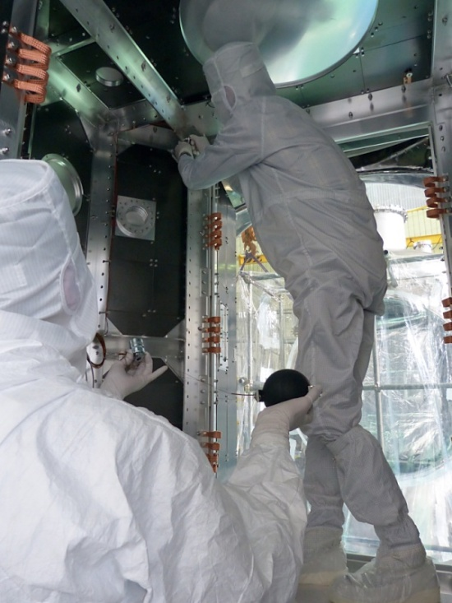
Cryogenics : Cryostat assembling and performance test
Cryostat No.1
1/2 scaled payload in the cryostat No.3.
Accelerometer and black Al sphere.
Assembling and performance tests of Cryostats are in progress in the TOSHIBA Keihin Product Operations.
Cooling test of Cryostat No.1 was completed.
  It took about 2 weeks of cooling without artificial heat load.
  Rate of radiation cooling of Al sphere was agreed well with a result of simulation.
Specific test items
  Cryostat No.1 : Cooling test of φ105 Al sphere without DLC. Done.
  Cryostat No.2 : Cooling test of φ105 Al sphere with DLC and vertical vibration measurement of 8K shield by accelerometer (Roma Univ.).
  Cryostat No.3 : Cooling test of 1/2 dummy payload with DLC coating and sapphire dummy mirror and horizontal vibration measurement of 8K shield by accelerometer (ICRR) .
  Cryostat No.4 : Cooling test of φ105 Al sphere with Solblack coating.
Installation of black Al sphere

Slide 15
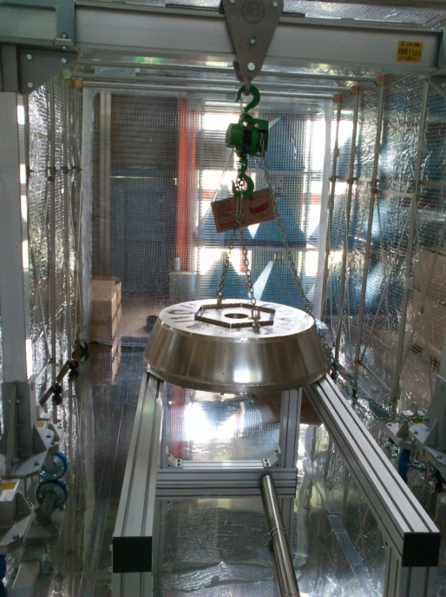
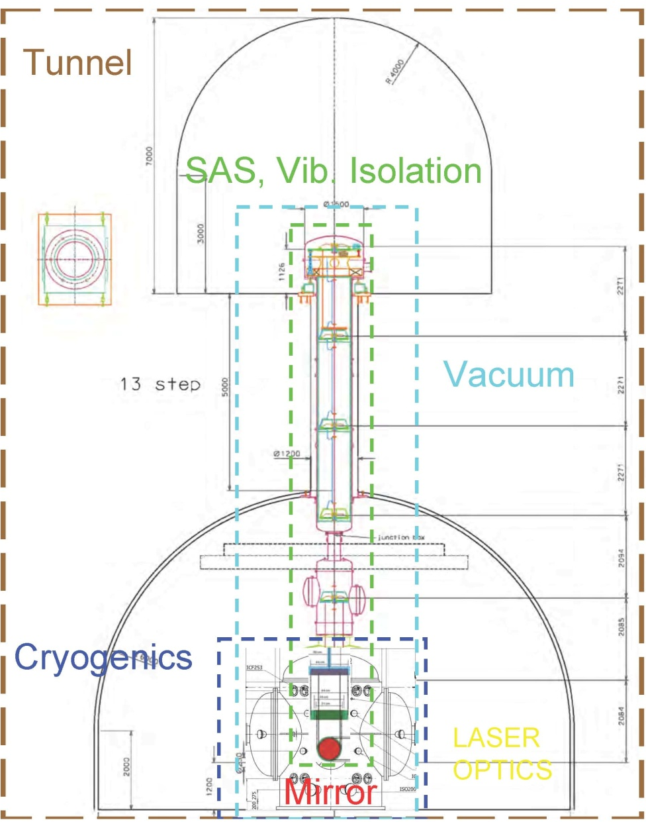
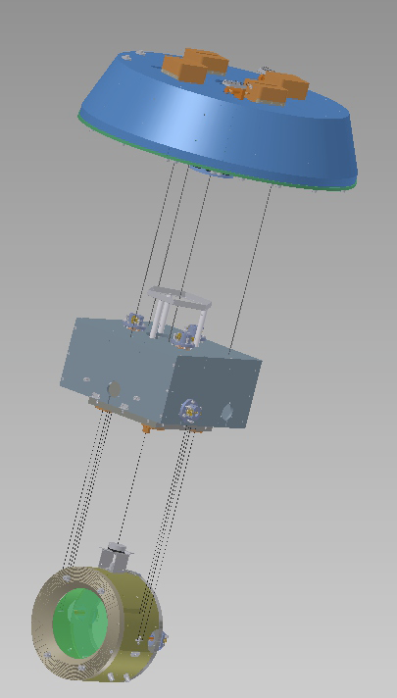
Vibration Isolation
Main SAS: 13m tall
2 stages of floor
19 standard filters have been built and delivered: final assembly of the GAS filters is ongoing
Six out of 11 pre-isolator top filters have been finished
Prototypes of a complete chain pre-isolator, standard filter, bottom filter and optical payload have been completed and are under tests in Japan

Slide 16
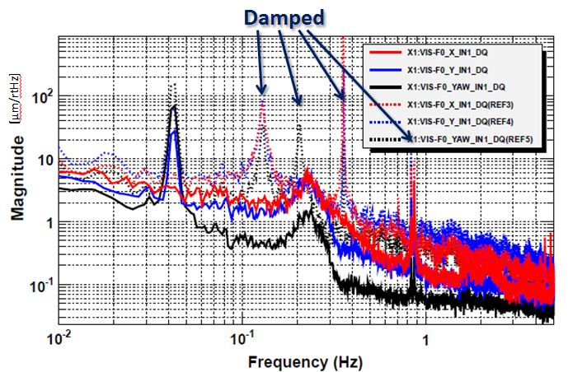
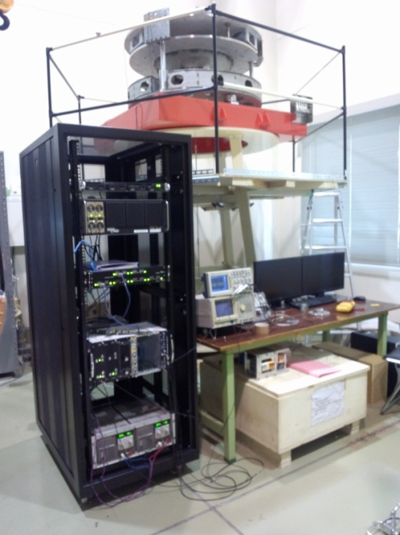
SAS in digital control
Digital control of Inverted Pendulum for horizontal isolation 3 degrees of freedom using LVDT&voice coil (sensors of acceleration) was successively conducted.
Pre-isolator cosists of three set
of Inverted pendulums and
vertical filter
Prototype test of Pre-isolator in Kashiwa
Digital control system is constructed in collaboration with aLIGO

Slide 17
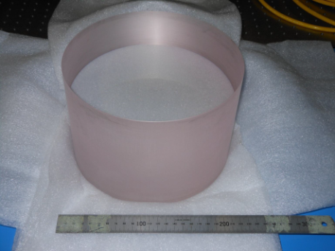
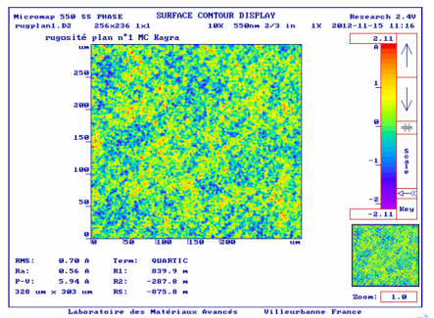
Core optics
BS:
S-Polarization
37cm diameter , 8cm thickness
iKAGRA cavity mirrors
ETMs: iLIGO mirrors
ITMs: reformed iLIGO mirrors
(wedge angle must be changed)
iKAGRA cavity mirrors
22cm diameter , 15cm thickness
C-Axis Sapphire
MC &MT mirrors
Polish of MC mirrors has been inspected at LMA.
Recycling & Signal extraction cavities mirrors
reformed iLIGO mirrors
Radius of curvature must be fabricated with extremely small uncertainties.
Ex.
PR2: R=(-3.0764±0.01) m
PR3: R=(24.9165±0.01) m
~150μm
Large crystal
Flat Mirror： < 1 Årms

Slide 18
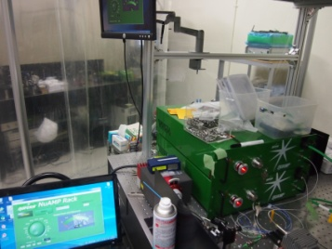
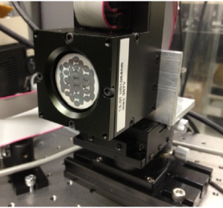
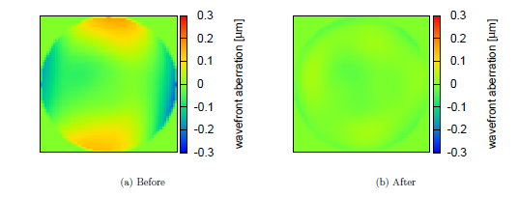
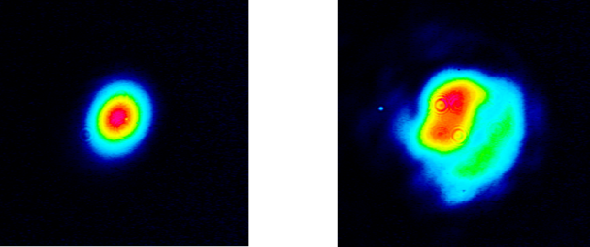
Laser : R&D for high power
Wave-front distortion caused by a solid-state amplifier
The wave front distortion was corrected by using a deformable mirror.
Coherent addition
Bright port 78W
Dark port 4W
The highest power was 78 W obtained from two 41-W outputs.
The performance of each component is being tested.
Total system assemble will be started soon as the next step.

