Slide 1
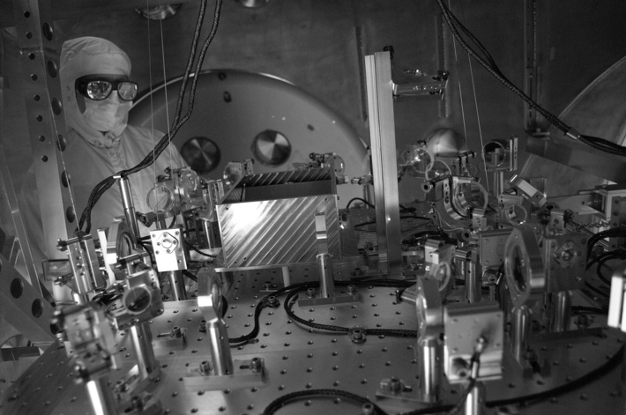
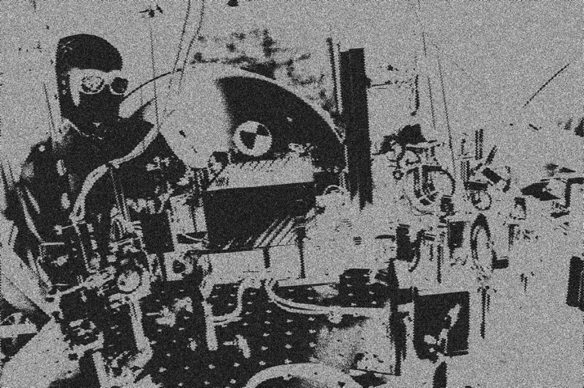
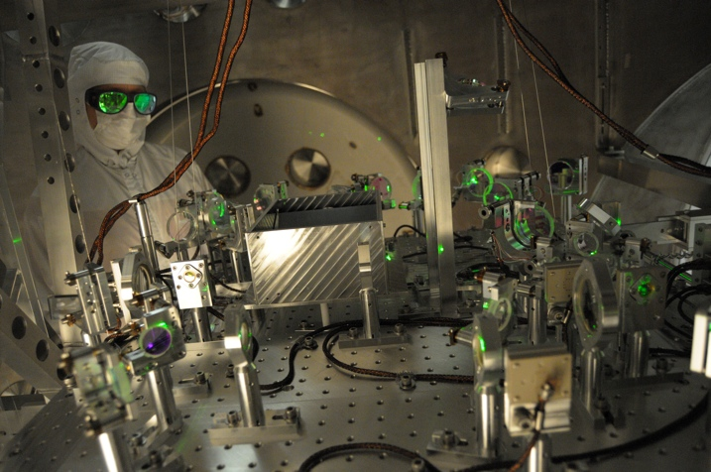
Installing Advanced LIGO: problems, challenges and some solutions
M. Landry
LIGO Hanford Observatory/Caltech
KAGRA Collaboration Meeting
Toyama University
2 August 2013
LIGO-G1300759
Notes:
Thanks for the opportunity to i) present ii) see your collaboration in action iii) visit the site
Keita Kawabe working on the Arm Length Stabilzation system, or ALS. Green light is injected from the each endstation.
Optics specialist might be worried about the level of green scatter.

Slide 2
Outline
A (very brief) introduction to LIGO
Organization: project controls, installation planning, documentation
Selected topics in installation
Problems and some solutions
Brief status of integration

Slide 3
Outline
A (very brief) introduction to LIGO
Organization: project controls, installation planning, documentation
Selected topics in installation
Problems and some solutions
Brief status of integration

Slide 4
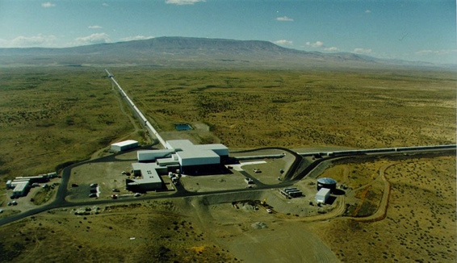
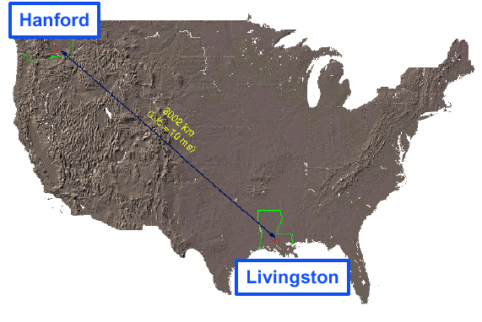
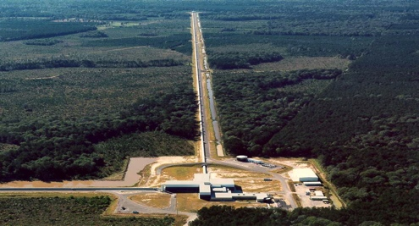
LIGO Laboratory: two Observatories, Caltech and MIT campuses
Mission: to develop gravitational-wave detectors, and to operate them as astrophysical observatories
Jointly managed by Caltech and MIT; responsible for operating LIGO Hanford
and Livingston Observatories
Requires instrument science at the frontiers of physics fundamental limits
MIT
Caltech
LIGO Livingston
Notes:
LIGO is actually two observatories.
Describe parameters
Emphasize that the arms are in ultra high vacuum. 8 km of steel 1.2 m dia beam tubes at each site
Separate observatories allow for coincidence detection – since the detectors see uncorrelated noise, only a true gravitational wave would appear on all the interferometers with the correct amplitude.
Emphasize that the LIGO Observatories were designed and are operated by Caltech and MIT

Slide 5






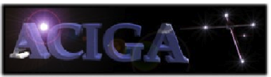


































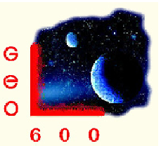









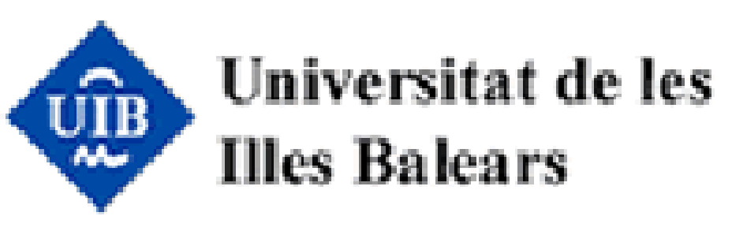








LIGO Scientific Collaboration

Slide 6

Optical configuration

Slide 7
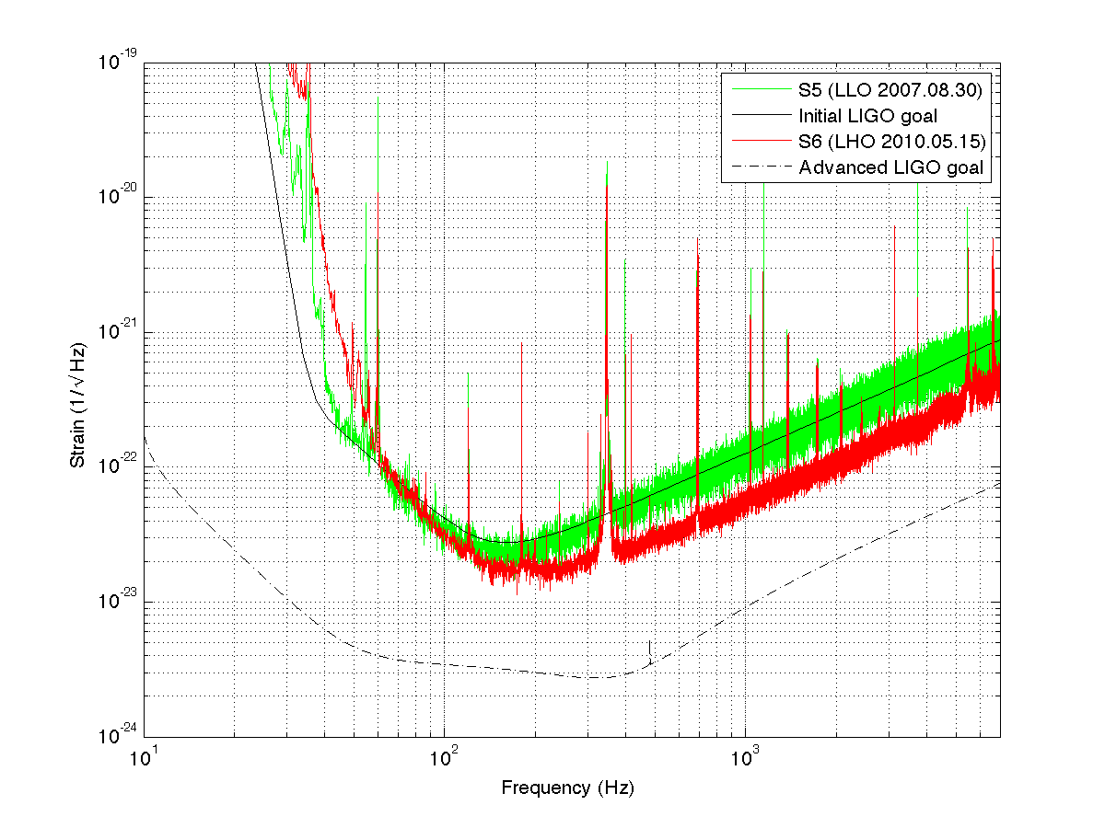
Initial LIGO reach
~20Mpc
Advanced
LIGO
goal
Advanced LIGO reach
~200Mpc
Notes:
We made INITIAL LIGO. Now we’re installing for ADVANCED LIGO.

Slide 8
Better
seismic
isolation
Higher
power
laser
Better
test masses
and
suspension

Slide 9
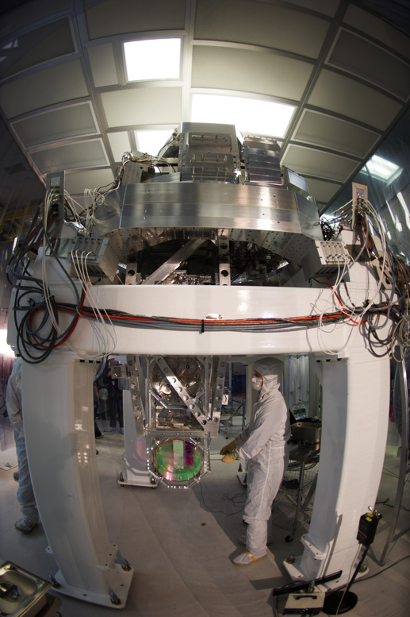
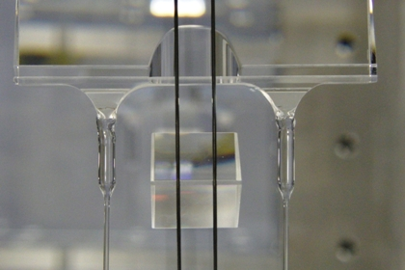
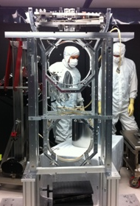
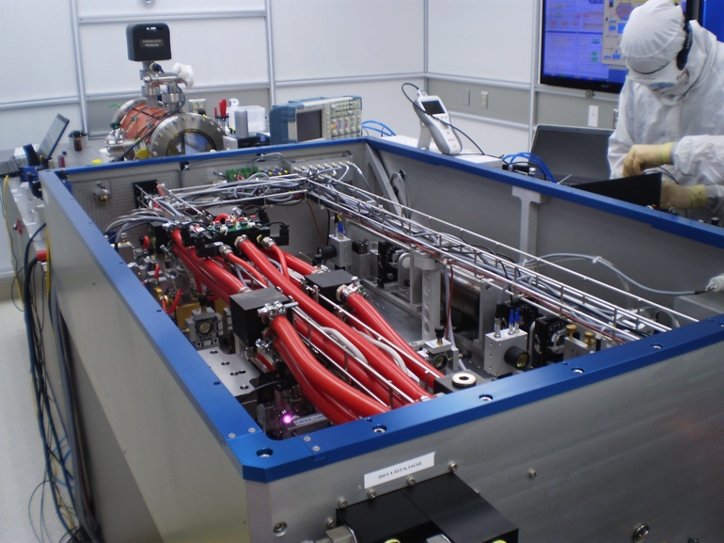
Better
seismic
isolation
Higher
power
laser
Better
test masses
and
suspension

Slide 10
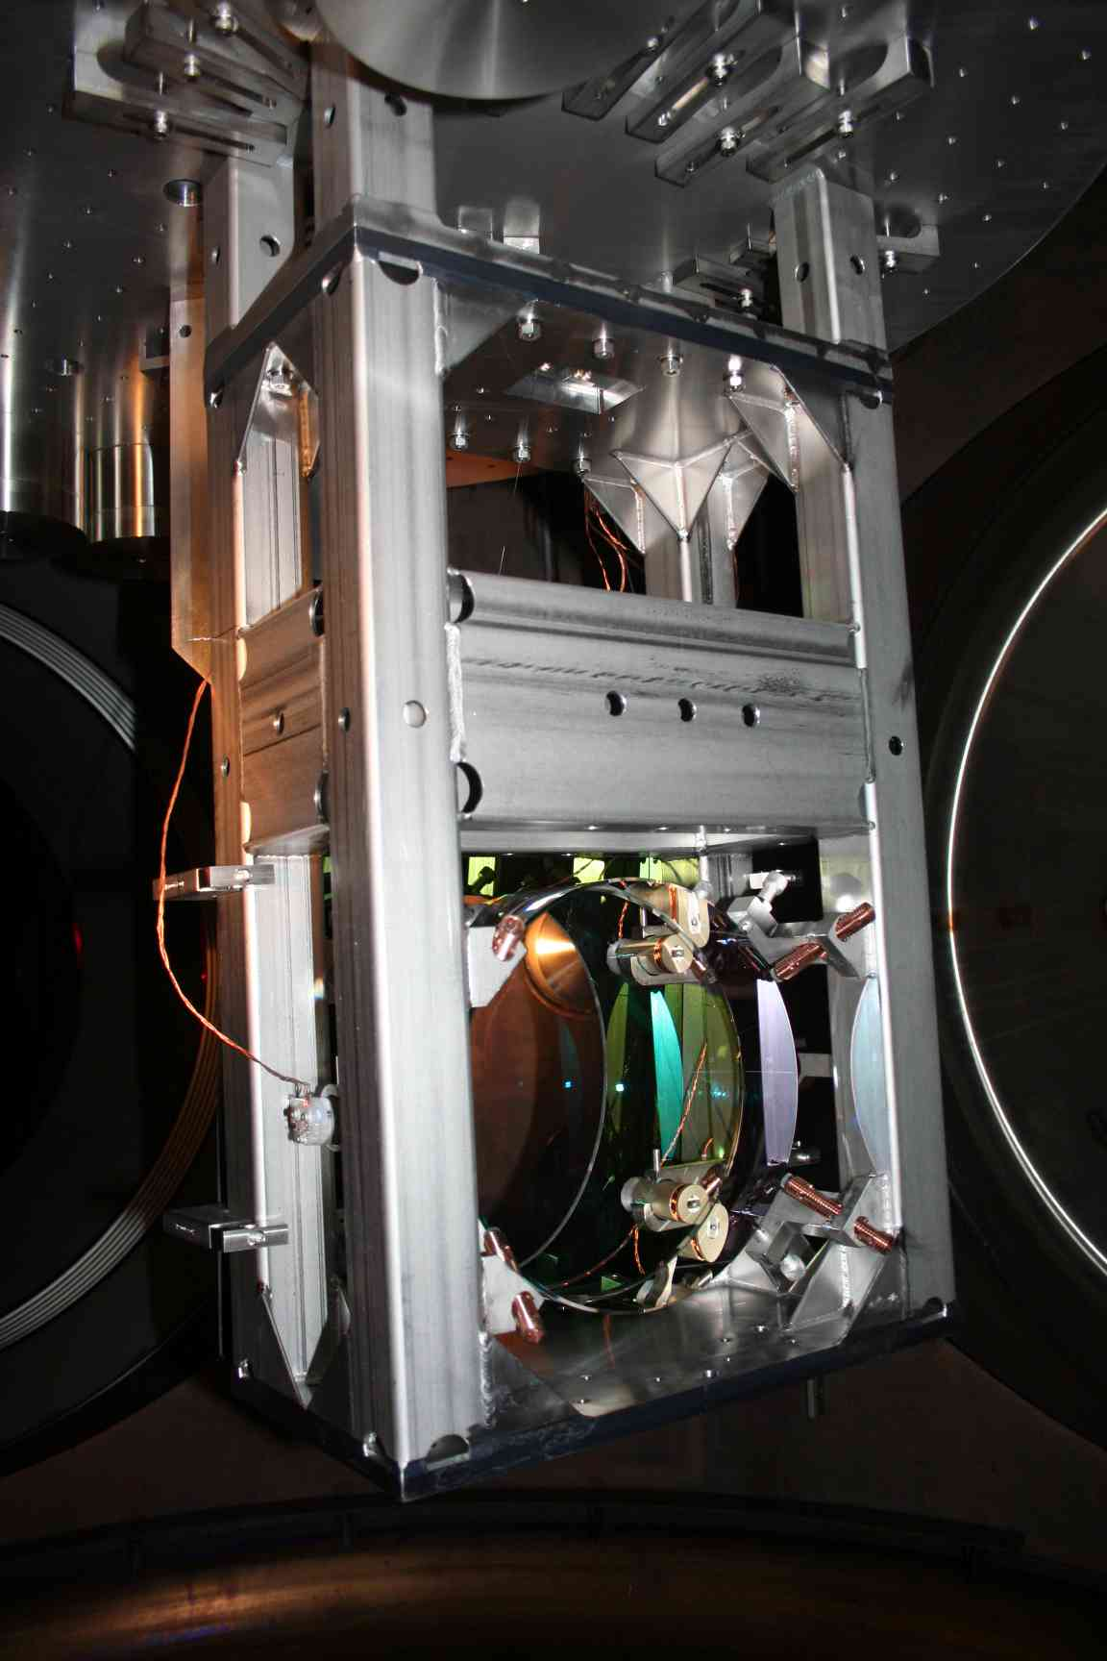
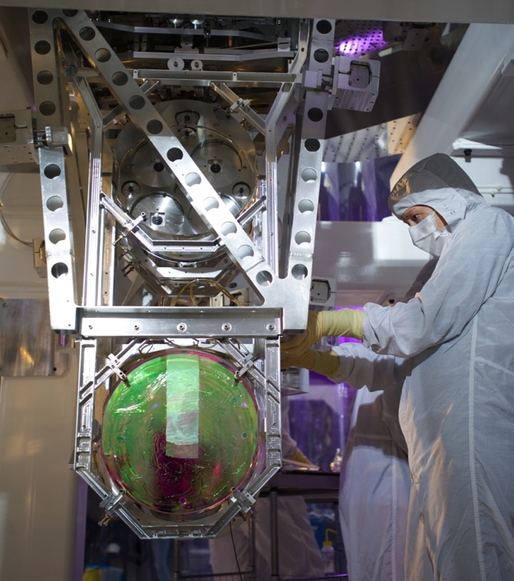
10X more sensitive, >10X harder…
14 unique fabricated parts
68 fabricated parts total
165 total including machined parts and hardware
188 unique fabricated parts
1569 fabricated parts total
3575 total including machined parts and hardware
Test mass suspension
From Initial LIGO
Test mass suspension
From Advanced LIGO

Slide 11
Outline
A (very brief) introduction to LIGO
Organization: project controls, installation planning, documentation
Selected topics in installation
Problems and some solutions
Brief status of integration

Slide 12
Advanced LIGO support
NSF-supported (~$205M MREFC phase)
  Caltech as awardee, MIT and Caltech sharing responsibility institutionally, organizationally, scientifically, and technically
  Several US LSC institutions supported on subcontracts from LIGO Lab in Project phase (all US-supported aLIGO work to be on aLIGO MREFC)
Foreign contributions – from experienced collaborators
  Germany – Pre-stabilized laser (value ~$14M incl. development); all equipment delivered; L1 and H1 installed
  United Kingdom – Test mass suspensions and some test mass optics (value ~$14M incl. development); deliveries complete, continued training, installation, and risk reduction
  Australia – wavefront sensors, optics, and suspensions (value ~$1.7M incl. development); all procurements made, software in final development, extensive staff visits made
  Well integrated into aLIGO organization & project team
  Delivery risk retired
Notes:
MREFC = Major Research Equipment and Facilities Construction

Slide 13
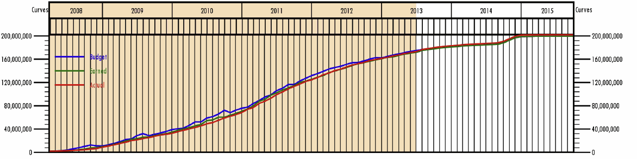
Progress
86.1% complete – onto flat part of the curve
Estimate to Complete (ETC) of $28.7M at the end of June 2013
Remaining contingency is $8.1M (May: 8.3); if acted on all liens, $3.0M remain
Estimated remaining contingency is 0.6 months for H1 acceptance; for L1, all 7 months of originally allocated contingency plus an additional time
Notes:
Late project spending jump arises from expenditure for analysis computers.

Slide 14
LHO installation org chart

Slide 15
Staff
Steady state science running: ~40 people at each of the sites
At the peak of Advanced LIGO install ~90 people @ LHO, fewer at LLO owing to single interferometer
Includes technicians for assembly and clean and bake, engineering, scientists, project controls, facilities, management, i.e. everything
Also includes riggers/millwrights operating under $3.3M time and materials (T&M) contract. Expertise in rigging, pipefitting, sheet metal, etc. Flexibility in numbers (currently 4 at LHO, 2-3 part time at LLO)
Visitors: Lab and LSC visitors to sites. LSC on sub-contract

Slide 16
Install Sequence L1
L1 is pathfinder
Natural install sequence
Learn of problems early: interleave integration phases
Oct 2010
May 2012
July 2012
Sep 2014
Install
PSL/IO table
Install
IMC
Install
Rec’ld vertex MICH
Full interferometer
L1
Jun 2013
Notes:
Uninstall the 10% of H2 presently installed and store, anticipating the permission from the NSF to send the instrument to India

Slide 17
Install Sequence H1
Dec 2011
May 2012
Sep 2012
Feb 2013
Jul 2013
Squeezer install
Squeezing Test
Install
Install
Install
Install
IMC
Install
Install
PSL from H2
One Arm Test
HIFO-Y
May 2013
Install
Install
Dual Arm
Install
Full interferometer
HIFO-X
Oct 2014
Complicated by squeezed light experiment at the close of S6
First de-installed/installed on H2, i.e. second LHO interferometer
Later, backed out H2 in favour of LIGO India
LHO is the arm-locking pathfinder
Notes:
More complicated:

Slide 18
Sample install schedule - LLO

Slide 19
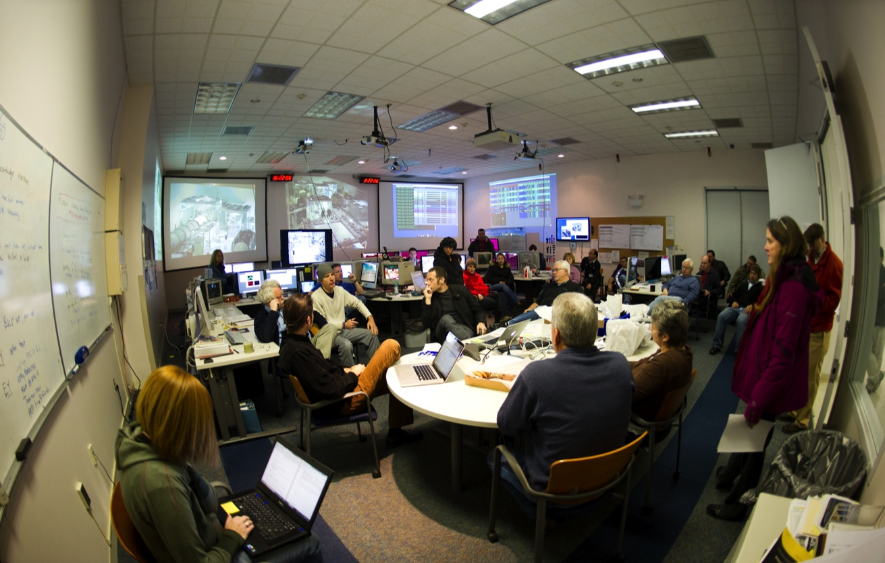
Daily installation meeting
Since Oct 2010, we have had daily 08:15 installation meetings
We sort INS priorities, near-term scheduling, staffing and interface issues
Look for collisions, staff and equipment shortages, solutions
Short (~30 minutes)
Work permits may be reviewed

Slide 20
Procedures and checklists
We have several flavours of installation documents
  Complete and detailed procedures
  Short, breakout checklists
  Safety documents, Hazard analyses
  Bug trackers
First we touch on short, aviation-style checklists

Slide 21
Checklists
Are:
  Short: 1-2 pages, 6-12 key items that the team absolutely must perform
  Not intended as a cookbook: people have to keep thinking
  Intended to encourage teamwork
  Living documents, intended to be refined
Are not
  Intended as comprehensive with respect to all steps
  A recipe whereby you can turn you brain off
  A panacea. Things will occasionally go wrong; we have to recognize problems early/respond/react accordingly

Slide 22
A couple of examples*
Aviation
  Long history of using and refining checklists
  Cessna engine failure checklist, first bullet: “Fly the plane”
Surgery
  Central line infection checklist: double-digit drops in infection rates, shorter ICU times, fewer deaths
  WHO surgery checklists: dramatic improvements in survival rates, infection rates, operating-theatre communications
  20% hold-outs from surgeons: when polled, however, 94% wanted checklists if they themselves were operated on
* From The Checklist Manifesto, A. Gawande (2009)

Slide 23
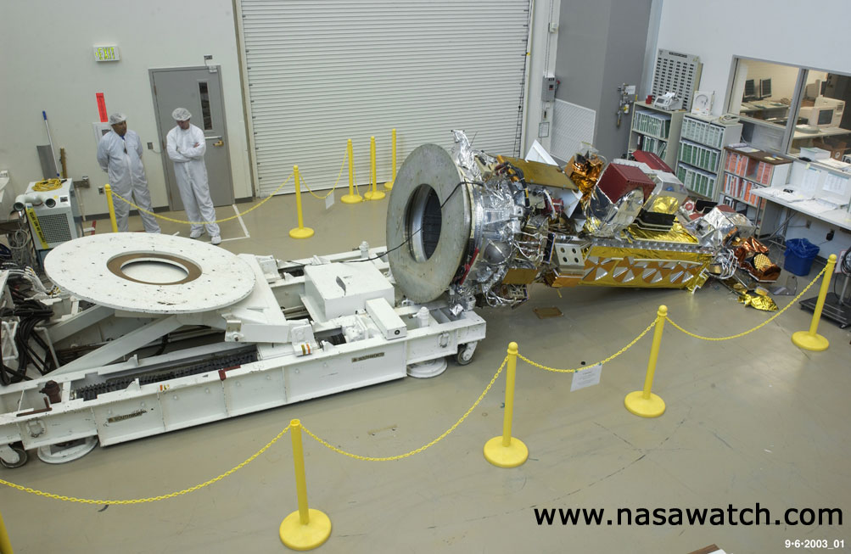
Adherence

Slide 24
Goddard analysis of event
EARTH SCIENCE MISSIONS ANOMALY REPORT
Date Released: Tuesday, September 9, 2003
Source: Goddard Space Flight Center, DATE OF ANOMALY: September 6, 2003
LOCATION OF ANOMALY: Lockheed Martin, Sunnyvale CA
DESCRIPTION OF EVENT:
As the NOAA-N Prime spacecraft was being repositioned from vertical to horizontal on the "turn over cart" at approximately 7:15 PDT today, it slipped off the fixture, causing severe damage. (See attached photo). The 18' long spacecraft was about 3' off the ground when it fell.
The mishap was caused because 24 bolts were missing from a fixture in the “turn over cart”. Two errors occurred. First, technicians from another satellite program that uses the same type of “turn over cart” removed the 24 bolts from the NOAA cart on September 4 without proper documentation. Second, the NOAA team working today failed to follow the procedure to verify the configuration of the NOAA “turn over cart” since they had used it a few days earlier.
IMPACT ON PROGRAM/PROJECT AND SCHEDULE:
The shock and vibration of the fall undoubtedly caused tremendous damage. Significant rework and retest will be required. NOAA-N Prime is planned for launch in 2008.

Slide 25
Safety
Advanced LIGO safety officer resident at each site
Stop work policy in force and routinely advertised, e.g.
  Trivial slowdowns for clarification of procedure
  ~few hour stop works to ensure safe practice, e.g. eLIGO stop work for HAM seismic platform fasteners
  ~month stop works for complicated impacts, e.g. fiber breakage
Detailed assessment of hazards and associated mitigations for given assembly and installation procedures: Hazard analyses
  Example on next page
  Crews meet at each site to ensure procedures and hazard analyses read and understood

Slide 26
Hazard analyses

Slide 27
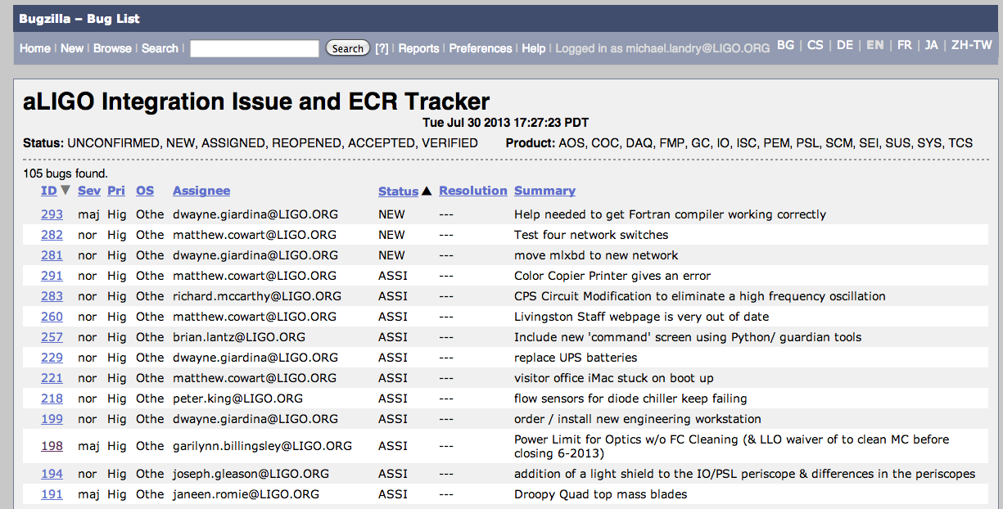
Tracking issues
We employ a web-based tracker of issues on installation, integration, and facilities
Every Friday, Systems meets with install and integration people to review status

Slide 28
Outline
A (very brief) introduction to LIGO
Organization: project controls, installation planning, documentation
Selected topics in installation
Problems and some solutions
Brief status of integration

Slide 29
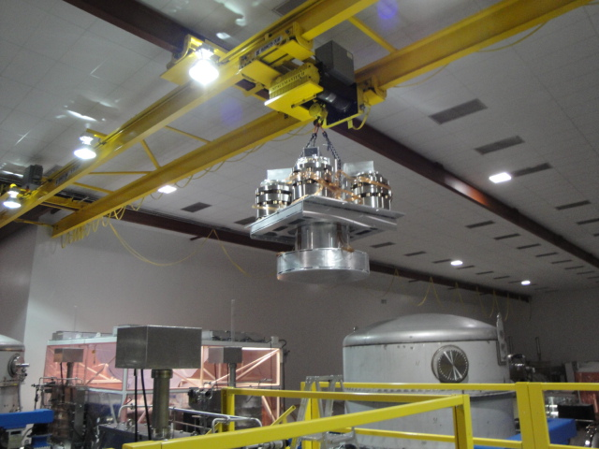
Installation at sites
Had (and have) to :
  deinstall Initial LIGO
  Modify the vacuum envelope
  Clean in-chamber
  Install Advanced LIGO detector components
  Commission
Initial LIGO deinstallation

Slide 30
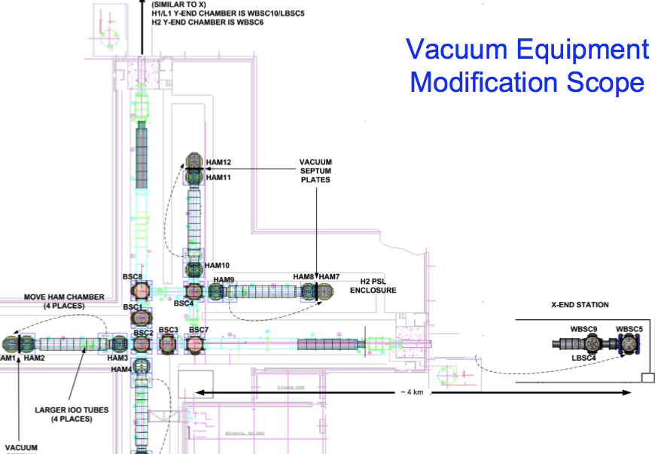
Vacuum equipment modification

Slide 31
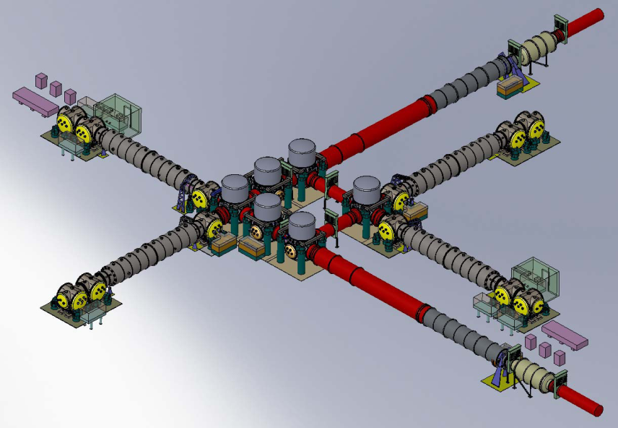
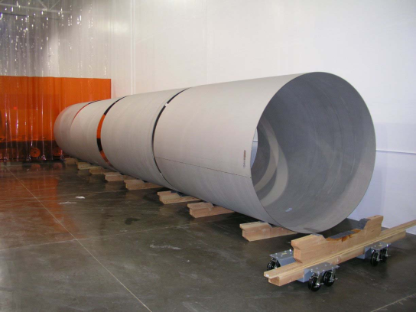
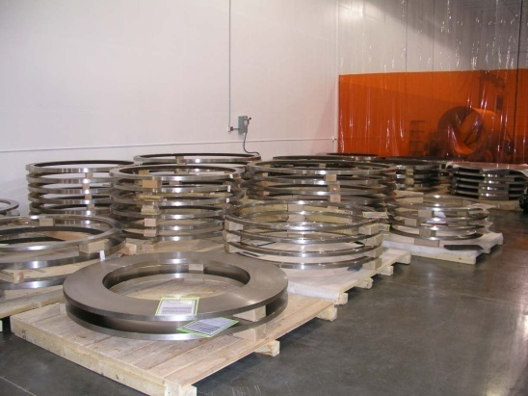
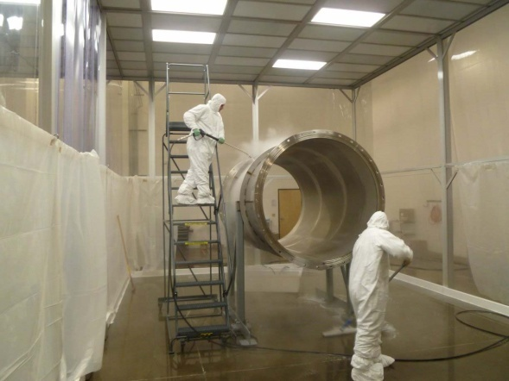
Vacuum mods
Vacuum Equipment
  Problems with testing to qualify cleanliness at required level – working with contractor to resolve
I/O Tube Rollups
Mid-Station Spool
Flange Sets

Slide 32
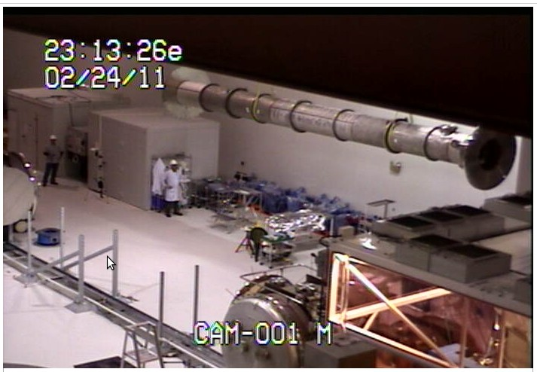
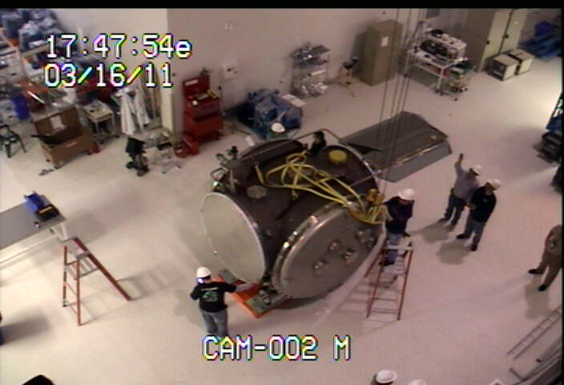
Vacuum mod highlights
Major L1 and H2 vacuum modifications in halls: input and output tubes removed, recycled. Two HAMs chambers moved
Degrouting underneath HAMs: dusty operations in the main hall: next year, deinstallation of H1 will be difficult alongside H2 INS
Notes:
32

Slide 33
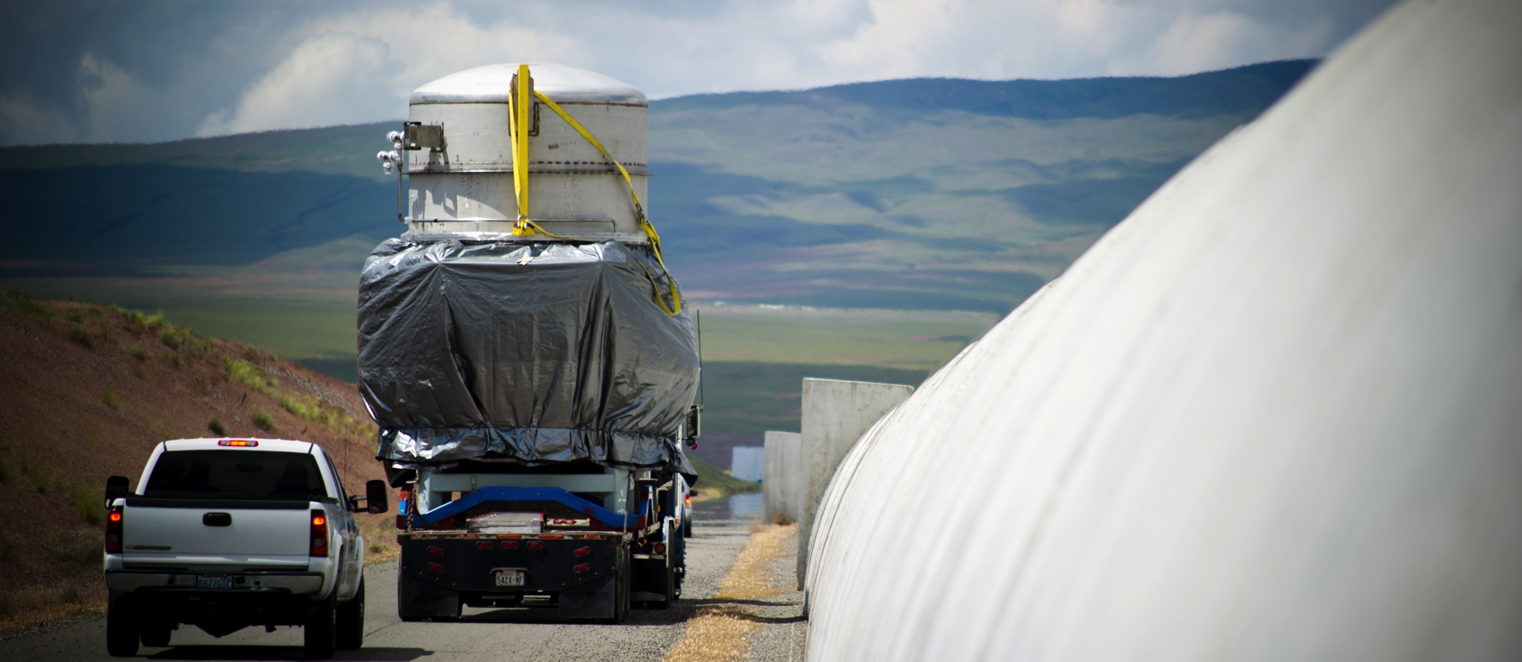
Extending H2 to 4km

Slide 34
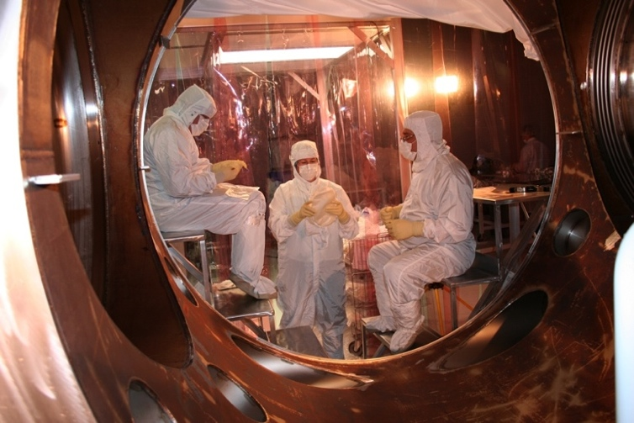
In-chamber cleaning
High in-chamber particulate levels have been observed in Initial LIGO (metal oxides from steel treatment, dusts, Al foil etc)
Removing oxide layer from interior heat-treated surfaces. Employ
  rotary-wire brush with HEPA vacuum assist
  dams and barriers
  solvent wipedown
  i) Fourier transform infrared spectroscopy (FTIR) assessment of hydrocarbon contamination, ii) swipe tests for particle density assessment
Pneumatic tools used, all lubricants removed (contamination risk; tool failure rates thus high)

Slide 35
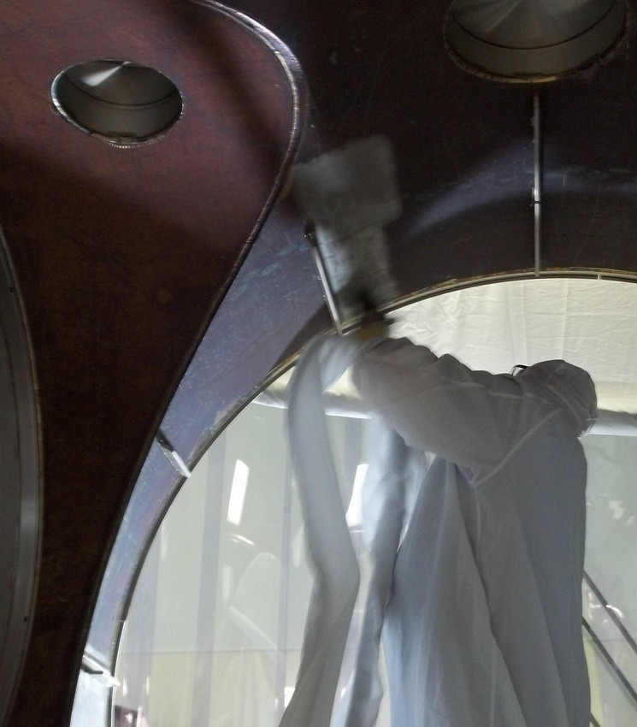
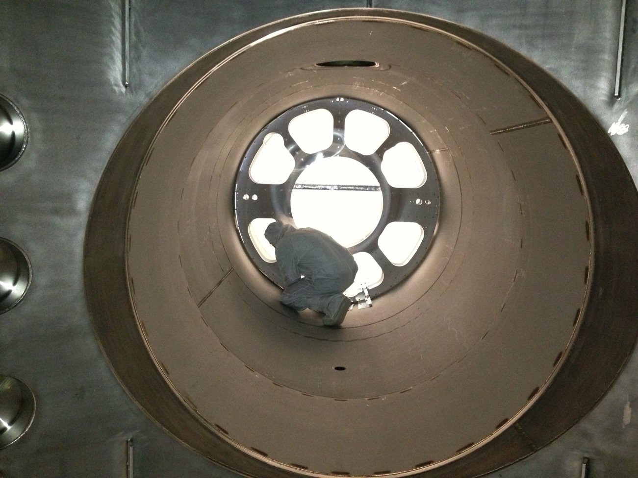
In-chamber cleaning
Was an ongoing R&D effort at LHO since early December 2010
Tools, brushing/vacuum/wipedown procedures, FTIR (Fourier-transform infrared spectroscopy) assays finalized
Completed successfully at both sites

Slide 36
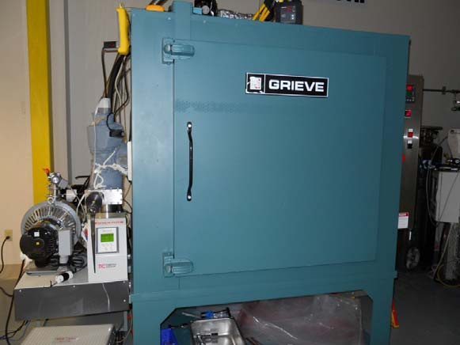
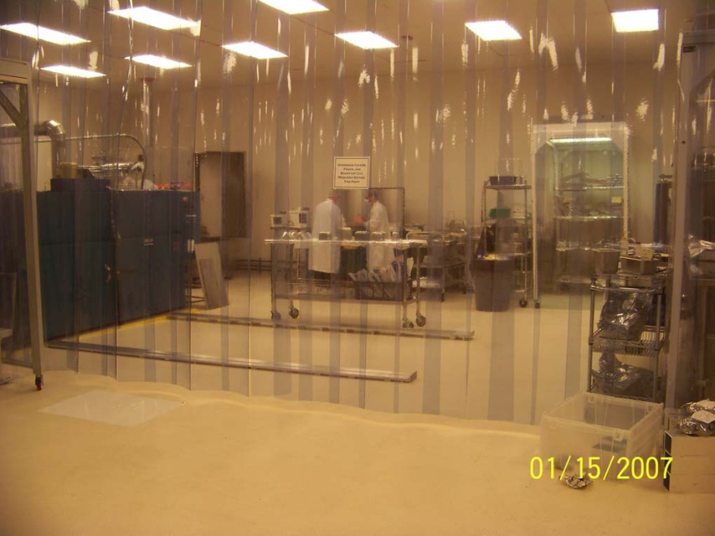
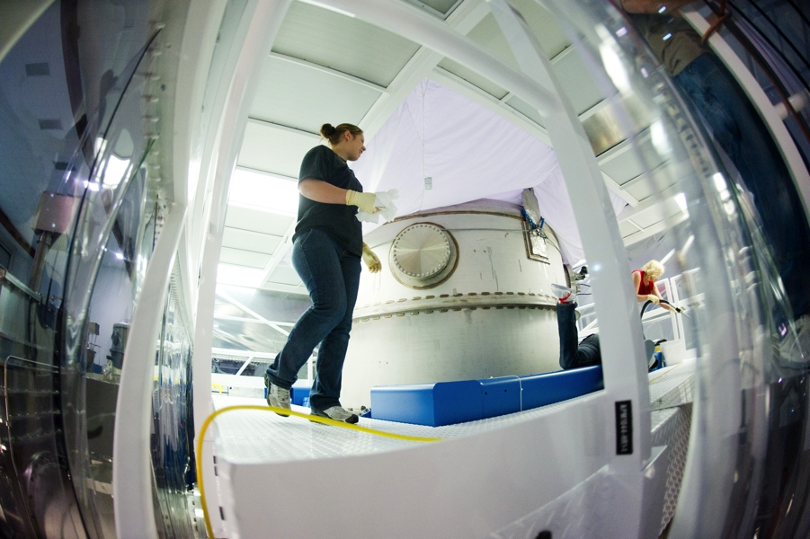
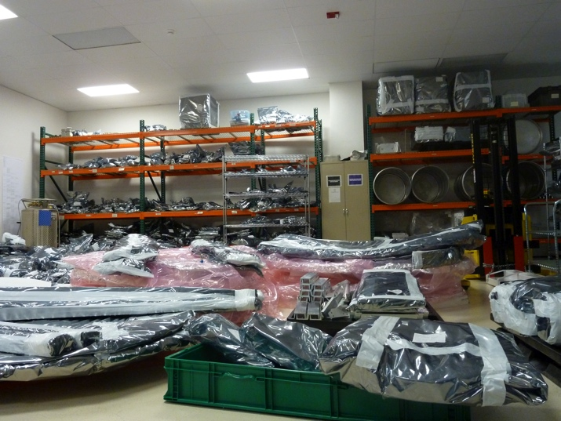
Clean and bake
Clean and Bake for Ultra-High Vacuum (UHV) Service
  Initially underestimated effort – hired more staff
  Procured additional vacuum bake ovens required to minimize downtime & meet throughput required
  Cleanliness certification (by FTIR testing)
Clean & Bake Lab (LHO)

Slide 37
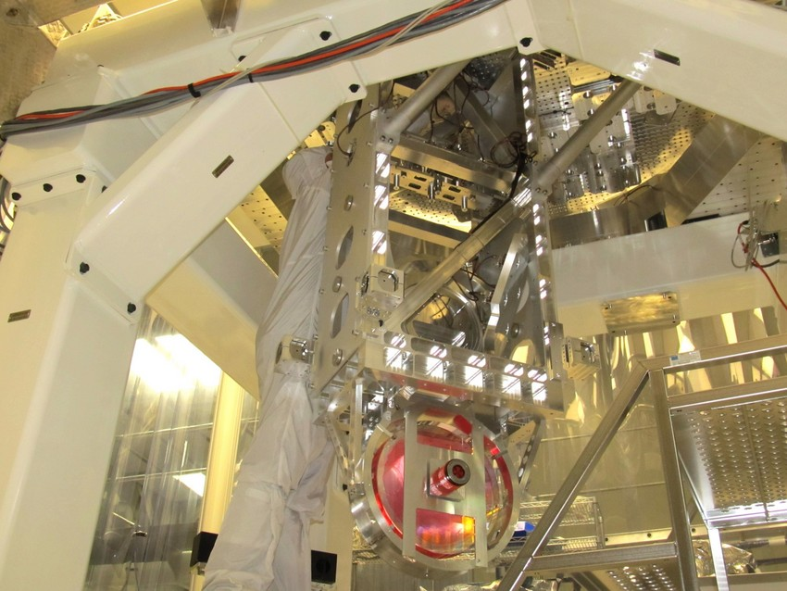
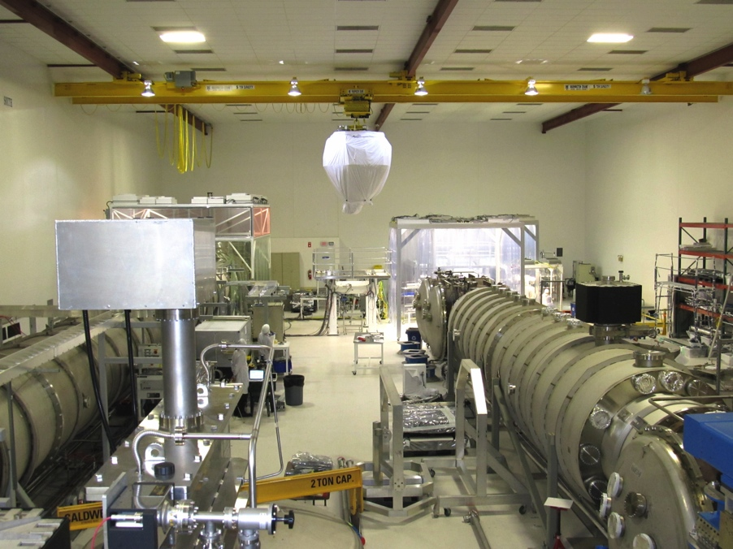
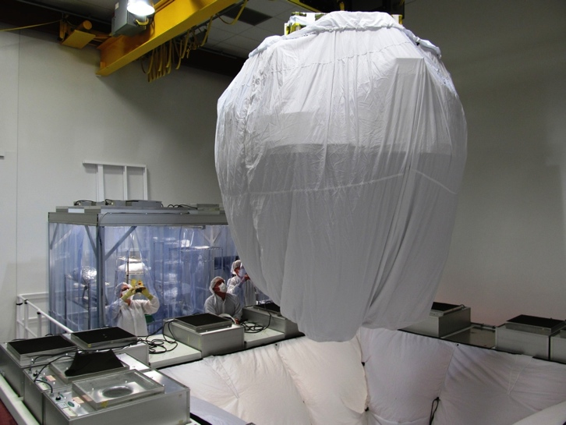
BSC installations
For LIGO large chambers (“BSCs”), we assemble a cartridge in a given hall, and then crane it into the vacuum envelope
BS
ETMY
37
Notes:
37

Slide 38
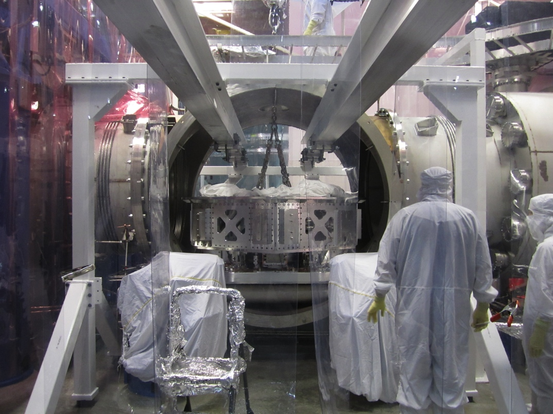
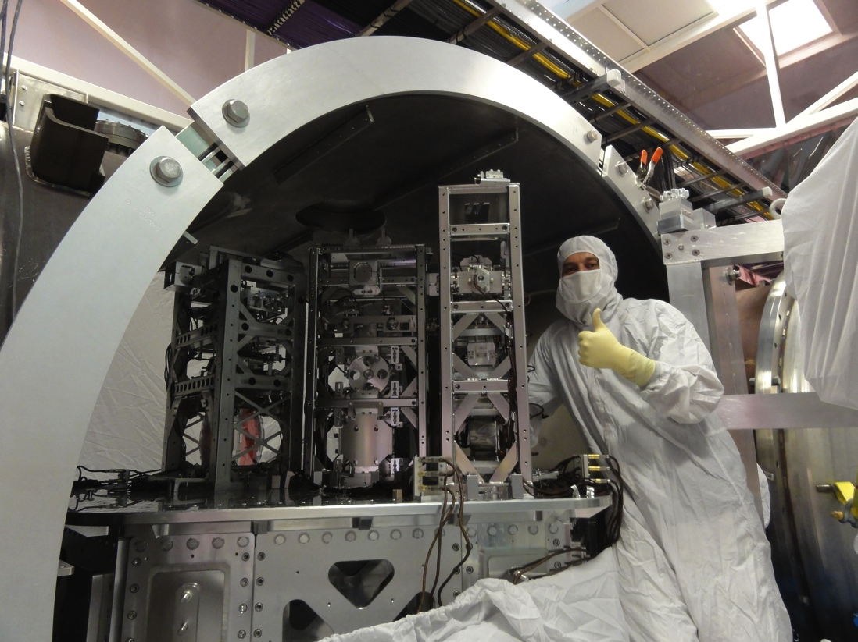
HAM installations
For LIGO smaller chambers (“HAMs”), we install the seismic isolation platform into the chamber, and then populate it in situ
LLO HAM installation
38
Notes:
38

Slide 39
Outline
A (very brief) introduction to LIGO
Organization: project controls, installation planning, documentation
Selected topics in installation
Problems and some solutions
Brief status of integration

Slide 40
Quality control
QAME: Quality Assurance and Manufacturing Engineering group, a subset of Systems Engineering
Check drawings, visit vendors, source inspect parts, coach designers, receive/inspect/record parts, etc.
Work now naturally drawing down as designs and procurements finishing
Some examples of their work
  Viewport and feedthrough testing
  Corrosion of suspension wires and blade springs

Slide 41
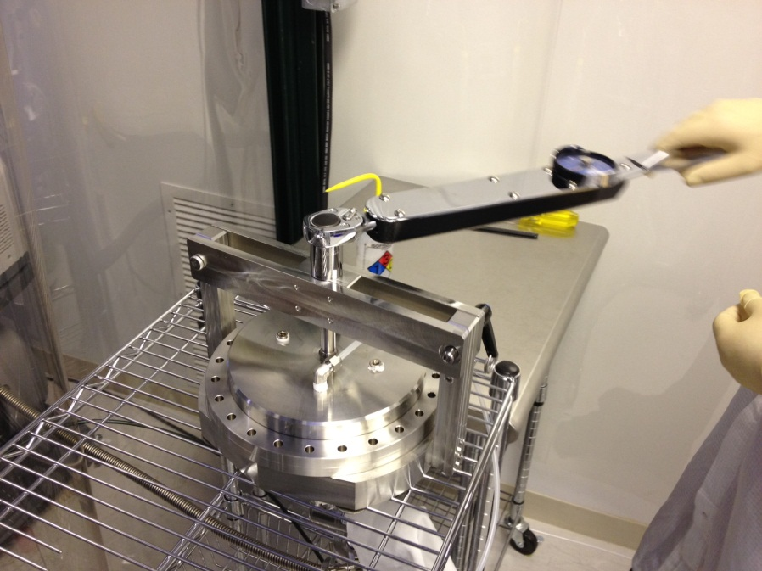
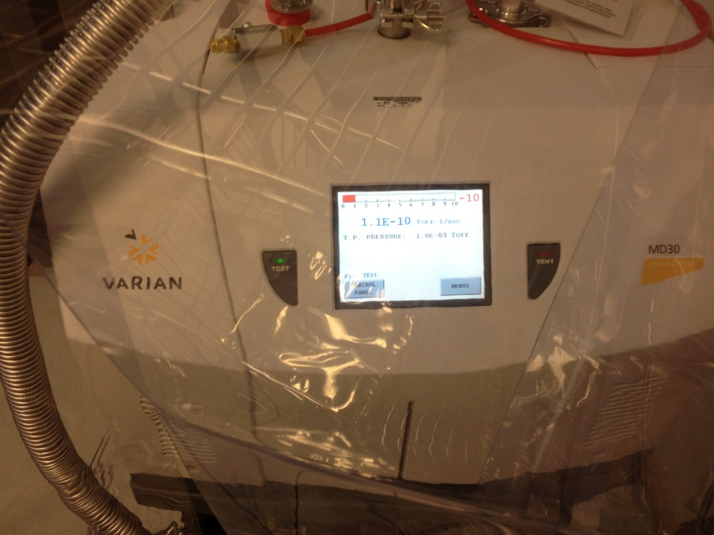
Viewport and feedthrough testing
QAME: Every viewport in the LIGO vacuum system at each observatory is visually inspected then proof and leak tested. Electrical feedthroughs are also 100% leak tested.

Slide 42
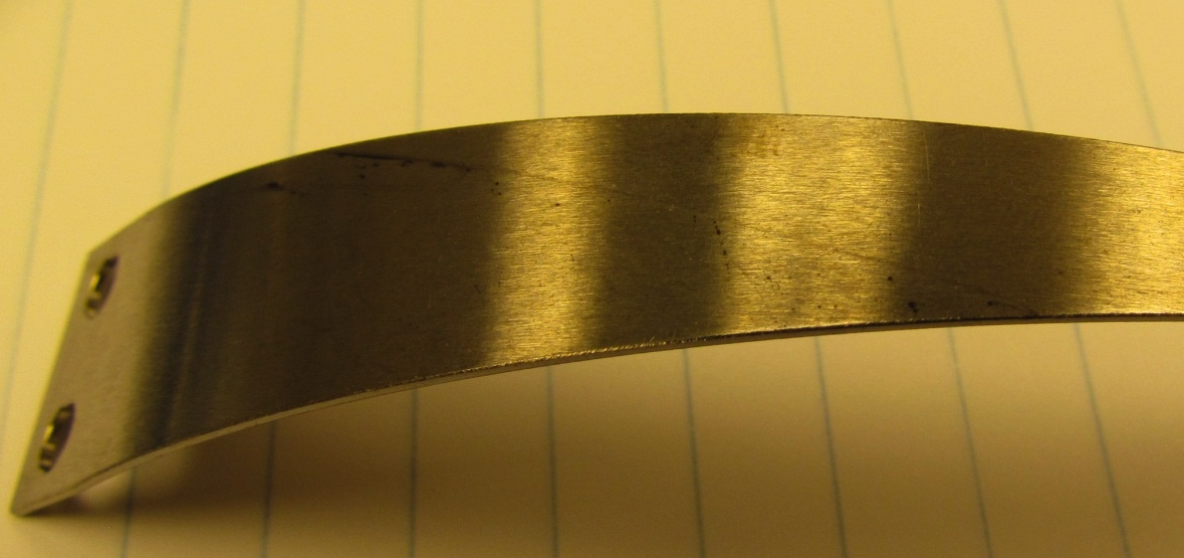
Blade spring corrosion
QAME: Cantilever Blade Springs were received from an overseas vendor with some spotting/light corrosion marks. There was insufficient time to remake the springs so QAME developed a mechanical and chemical process to remove the corrosion before Ni coating.

Slide 43
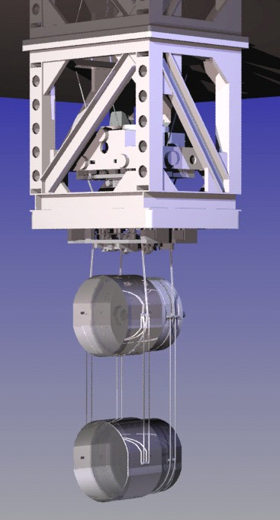
Sample problems
We consider here a few of the problems we are working through in Advanced LIGO. There are many more, of course
Penultimate mass, i.e. the second-to-last stage that comprises the monolithic structure
Gap between test mass and reaction mass, a potential site for gas damping

Slide 44
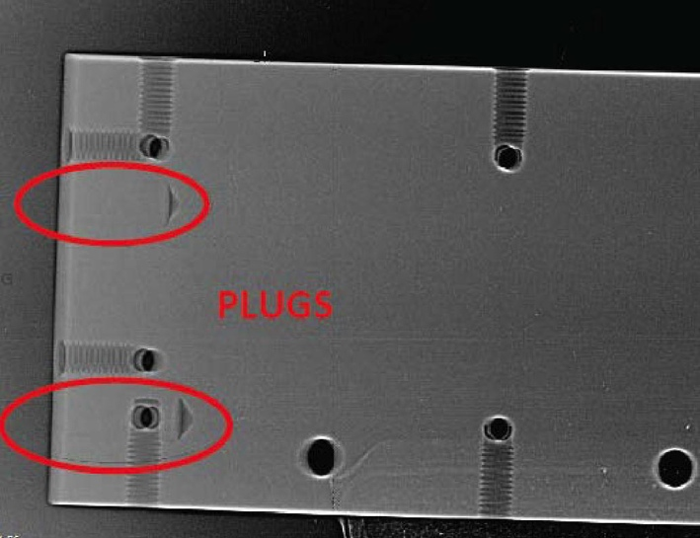
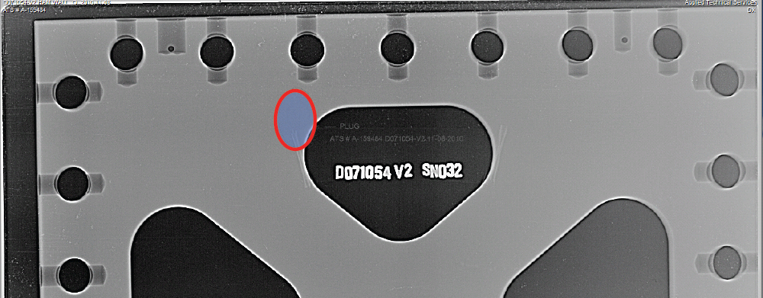
Weld repairs
Unauthorized weld repairs detected visually in some seismic plates
Investigated with contractor and x-rays
At issue is trapped volumes and virtual leaks
Concluded new parts were required

Slide 45
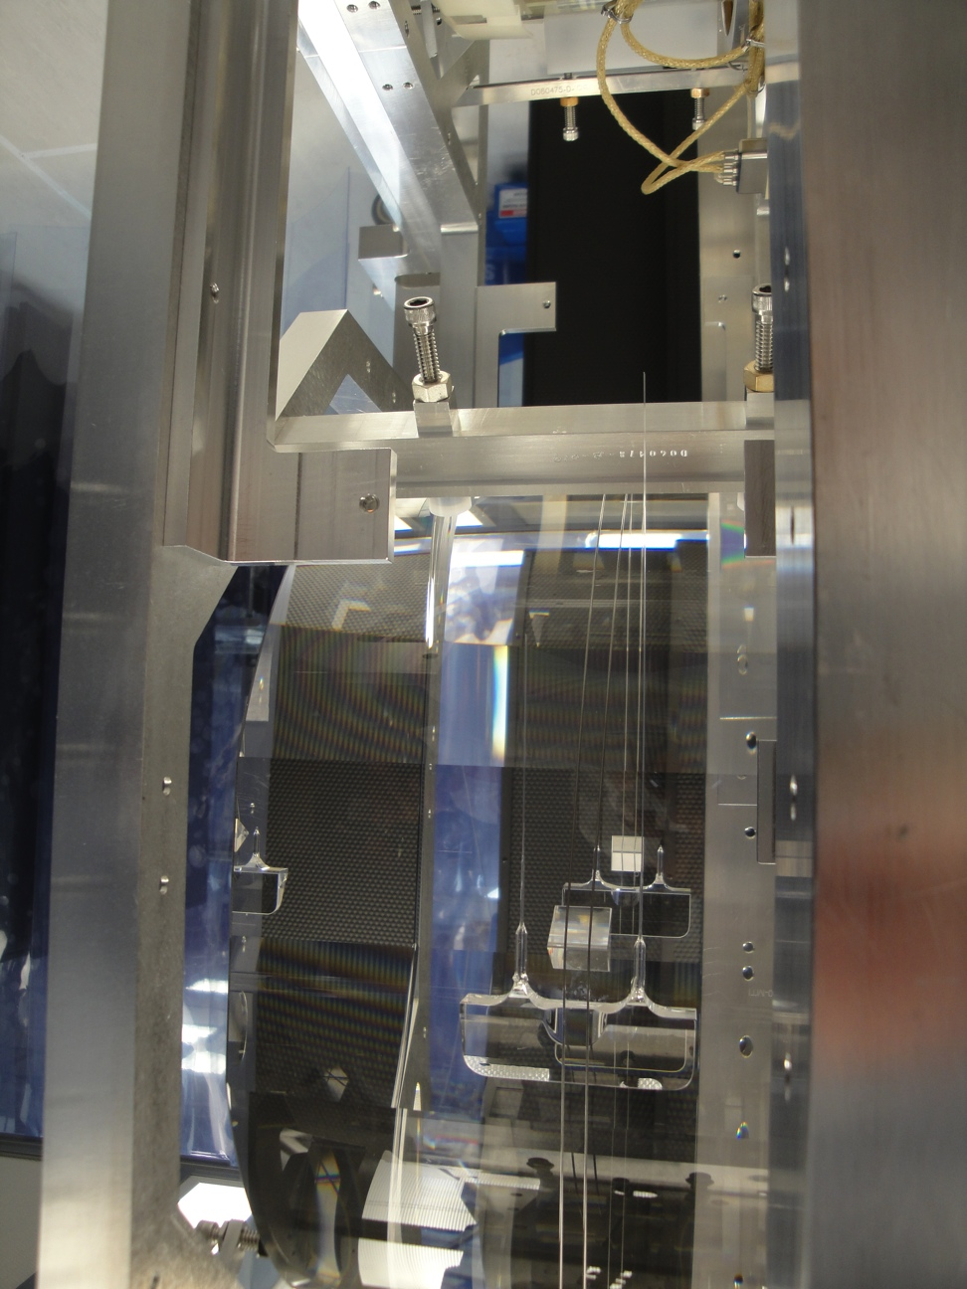
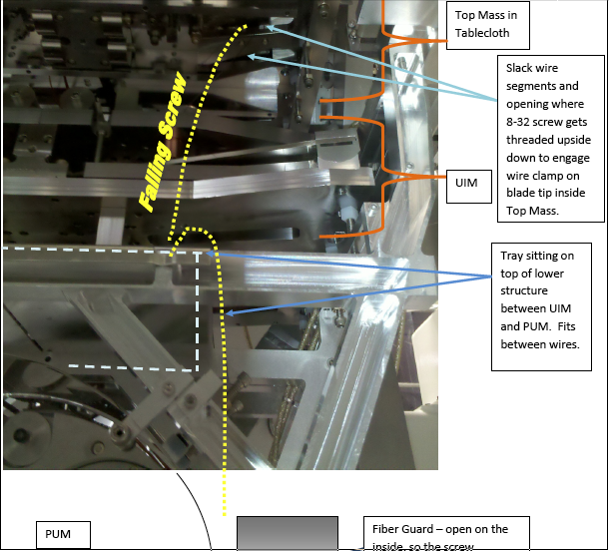
1st ITMY fiber break
First test mass successfully welded
Fiber break when rebalancing on ISI; fastener defeated existing catch-pan
New tooling, additional catch-surfaces to augment protection for such events fabricated

Slide 46
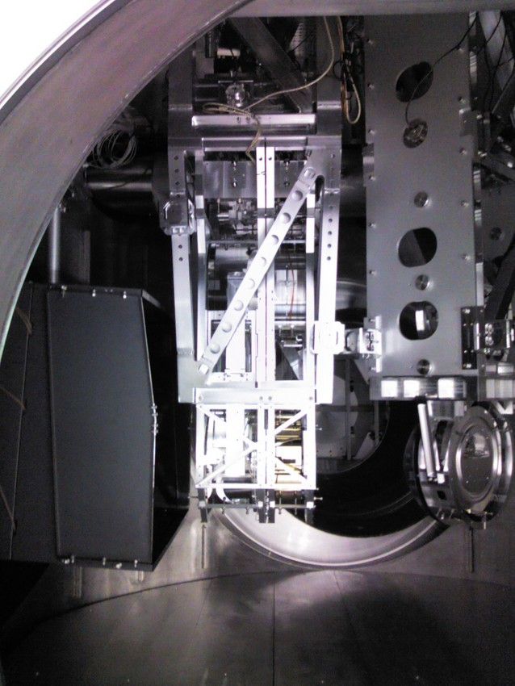

2nd ITMY (in-chamber) fiber break
ITMY fibers broken in shaking incident induced by code bug
Stop work called; code fixed/reviewed, testing restarted
Implemented wire hang of ITMY

Slide 47


Prism liftoff
(LLO PR3 secondary prism)
Notes:
This secondary prism has peeled away from the edges. Good view, difficult to get in HAM2. Will repeat later and compare. K. Gushwa and M. Phelps arrive Monday to photograph and evaluate similar LHO prisms.

Slide 48


LHO ETMX PUM
The Penultimate mass (PUM) for ETMx at LHO crack developed at prism which catches metal wires
Optic suspension continued, and looks ok – we will proceed with this
A review team assembled, made recommendations for modifications of gluing approach and means to better shield prism from welding heat
Next suspension is at LLO, able to proceed

Slide 49

Magnetic coupling
Suspensions: Excess magnetic coupling observed to test mass motion
  Test mass SUS magnetic coupling assessment continues
  Ruled out damper magnets and OSEM un-slitted parts as culprit
  Investigating reaction masses (cold-worked steel)
  Lab and in situ measurements ongoing: next tests at Livingston Aug/Sep

Slide 50

Magnetic coupling, contd.
Magnetic injection
Magnetic coupling at test mass
Optic yaw motion
Damping magnets (now vindicated as coupling site)

Slide 51

Core optics delivery/processing
Core optics readiness remains one of the primary installation risks
LMA recently shipped one input test mass (ITM) to Caltech for characterization
Have put both HR and now a first try at AR coatings on final optics, but may need another round of touchup coating
Depending on the AR coating quality, we may i) weld this optic, ii) wire hang this optic, or iii) wire hang another temporary optic
Our processing for test mass hangs is always just-in-time (uncomfortable), e.g. our PUMs are processed by one person
Planetary setup
at LMA, France

Slide 52


Active acoustic mode damping
Active damping using the electro-static actuators on the test masses
  FEA modeling of actuator force density & acoustic modes
Modeled force density

Slide 53


Gas damping
Residual gas in the gap between Test Mass and Reaction Mass produces increased damping of the TM pendulum motion
  Increased damping means higher suspension thermal noise, could be important for frequencies below about 50 Hz
  Monte Carlo simulations following gas particles in the gap used to calculate force noise
Simulation of a gas particle interacting with the TM-RM gap

Slide 54
Mitigation of gas damping
Gap between ITM & Compensation plate (CP) was increased from 5 mm to 2 cm
  Reduced the thickness of the CP
  Minor changes to accommodate in the quad suspensions
  Electrostatic drive (ESD) force reduced as a consequence, but there was margin to spare for the ITMs
  Force noise reduced by factor of 2.6
ETM-Reaction mass gap is a different issue
  Rely on ESD force for lock acquisition & global control: don’t want to reduce the force before we get experience with what we really need
  New reaction mass geometries could reduce damping and retain ESD force
  Solution could be a combination of new ERMs and more pumping; will be taken when we know more about required force & chamber pressure

Slide 55

Contamination control
Just one of the many critical roles played by the Systems group
Substantial effort to
  Identify components of contamination
  Implement mitigation approaches
  Monitor contamination
  Determine impact of contamination
“[Improvement through]…the aggregation of marginal gains…”
-Dave Brailsford,
Team Sky (UK)

Slide 56
Problematic particulate contamination
Particulate experiments in Caltech optics lab
  Exposure of dirty coatings to intensities found in Mode Cleaner
  See ‘cratering’ around dirt at low equivalent power into MC
  Currently limiting input to LLO DRMI to ~1 watt
  Not clear how to connect with eLIGO, early aLIGO high power tests and the continued satisfactory performance of the MC then
Continued measurement, modeling, observation, mitigation

Slide 57

Contamination control actions: particle analysis
A large collection of “FBI samples” (double sided carbon tape) of particulate contamination has been assembled and photographed and analyzed in a Scanning Electron Microscope (SEM) to build a database of contaminants.

Slide 58


Cleaning on the Go
It is clear from tests that a large portion of the contamination comes from the assembly and installation processes performed by us the humans.
Therefore to combat this “Cleaning on the go” has to become part of our in cleanroom and in chamber processes.
“Cleaning on the go” should be encouraged and performed using the tools described below.
  When performing localized cleaning (e.g. a stage of a suspension structure), one should check the status of the optic and at least ensure that the lens cap is in place prior to starting.

Slide 59

WIPED SIDE

Slide 60


Items illuminated by flashlight array – real dust from the sites
Flashlights illuminating a wafer at grazing incident. The wafer has real dust from the sites on it. Refer to LIGO-E1300183
Flashlight array illuminating (at grazing incident) the same TMS part which is shown above under UV-A blacklight.

Slide 61

Without flashlight array

Slide 62

With Flashlight array
*This is not dust from a site, it is dust collected in an open lab space at Caltech i.e. from room 318 in Downs

Slide 63


KAGRA HEPA suit
Below is is the particulate count comparison with the HEPA suit mentioned above (left on the plot) and two other types without HEPA (middle and right) when the worker was walking.

Slide 64

Beamtube leak at LLO
Not specifically an Advanced LIGO problem, but worth mentioning
LLO y-beamtube has developed several small leaks
Associated with rodents living (and urinating) in the beamtube insulation
Several fixes made
Will strip insulation at both sites
New insulation required
64
Notes:
64

Slide 65
Outline
A (very brief) introduction to LIGO
Organization: project controls, installation planning, documentation
Selected topics in installation
Problems and some solutions
Brief status of integration

Slide 66
Integration
So at this point you might rightfully ask, “what’s worked?”
Many things of course work mostly to plan, here we’ve highlighted issues
Let’s close with Integration status, or, commissioning
To the extent integration has moved quickly, it is a reflection on the entire team and the groundwork in design, test, review, clean and bake, assembly, installation, alignment, facilities support, etc.

Slide 67


H2 single arm
New lock acquisition strategy developed for aLIGO
Arm Length Stabilization system controls each arm cavity, putting them off-resonance
The 3 vertex lengths are controlled using robust RF signals
Arm cavities are brought into resonance in a controlled fashion
Therefore, commissioned single 4km arm
At End Y
Corner
ITMY
install

Slide 68


H2 single arm, contd.
Several days to align 4km Fabry Perot cavity, after which it was rapidly locked on resonance
Proved a successful integrated test of elements of SEI, SUS, Transmon, ALS, Controls, Oplevs, TCS, ISC
Sep 13, 2012 marked the end of the single arm test
Notes:
Initial LIGO lock acquisition partly stochastic. Instead, aLIGO is proactive – lock corner, arms, and marry.

Slide 69
Underway at Livingston
Dual-recycled Michelson Interferometer (‘DRMI’)
  All parts in place for this stage (not all chambers complete)
  So far, PRMI (power recycled Michelson) locked, first calibration
  Threading beam through the Output Mode Cleaner as we speak
  Good progress rate to date – testing paying off, again
  To continue to end-October with a mid-term break
Parallel installation of X, Y End station equipment
Followed by HIFOs
All systems to be ready to go,
full lock testing starting in March 2014
Full Interferometer Accepted Sept ‘14

Slide 70

LLO OMC locked

Slide 71
HIFO-Y
Old install plan: LLO as pathfinder, moving towards full installation at corner – dual-recycled Michelson test. At LHO, post-single arm, mirror this plan, albeit phase-delayed
Modified LHO one: exploit the existing single-arm further, and quickly learn more about lock acquisition
  Install Beamsplitter
  Move ITMY from H2 BSC8 to H1 BSC1
  Complete HAM2/3 installation, make IMC test
  Install in HAM1
  Make half-interferometer test, or HIFO-Y
In this way, continue have early look at new beampaths, hardware, software etc. Profitable commissioning for both LLO and LHO
71
Notes:
71

Slide 72


X
EY
X
- populated
X
- not populated
X
MY
LVEA
X
X
X
X
X
X
X
X
MX
EX
X
X
aLIGO NSF review, 8 Dec 2010
Notes:
72

Slide 73
HIFO-Y complete at LHO
Half-Interferometer (‘HIFO’) – Y-arm
components including 4km arm
  Green light demonstrated to allow a
  continuous controlled positioning of
  1.06μ cavity, anywhere on a fringe
  And, fluctuations of the length
  ~3 Hz RMS, so comparable to
  coupled cavity resonance width (1 Hz ultimate goal, but looks attainable)
Now being used to characterize SEI, SUS; some alignment and readout instabilities
Intensive work on end stations, to enable….
HIFO-X and DRMI in some order (ITMs – wire or silica hang?)
All systems to be ready to go, full lock testing starting in June ’14
Full Interferometer Accepted October ‘14
← 4km →

Slide 74

Current guess for sensitivity evolution, observation
Vertical scale is the number of binary inspirals detected
Rates based on population synthesis, realistic but uncertain
LIGO Scientific Collaboration (LSC) preparing for the data analysis challenge
Close collaboration with Virgo
Early detection
looks feasible
arXiv:1304.0670,
arXiv:1003.2480
Notes:
Lesson from iLIGO – short (months) runs interspersed with commissioning provides the best route to high sensitivity
Possible 1st run – 2 months at 50 Mpc
Possible 2nd run – >3 months at 100 Mpc
Possible ^{3rd} run – 2 months at 160 Mpc

Slide 75
Summary
Advanced LIGO began installation on Oct 20, 2010
We’ve slipped in schedule and made mistakes along the way, but the installations into the vacuum envelope are less than a year away from completion
After that, integration towards full lock takes place
Acceptance and project end expected ~Oct 2014
More commissioning, then initial science running in both 2015 and 2016

