Slide 1

Coatings research in the ELiTES Collaboration
K. Craig¹, E. Hirose2, K. Yamamoto², I.W. Martin¹, A. Cumming¹,
T. Suzuki³, K. Waseda⁴, M. Ohashi², J. Hough¹, S. Rowan¹
¹ SUPA, University of Glasgow
²ICRR, University of Tokyo
³KEK High Energy Accelerator Research Organisation
⁴National Astronomical Observatory of Japan
Italian Institute of Culture, Tokyo, April 2013

Slide 2
Coating thermal noise
Coating mechanical loss important for GW detector noise budget
Important to characterise coatings for a dependable estimate of noise
Glasgow also involved in the development of coatings with reduced thermal noise for:
  Enhancements to Advanced LIGO (LIGO3)
    May operate at cryogenic temperature
    (120 K?) or room temperature (or both –
    cryo-xylophone)
    May operate around 1550 nm
  3rd generation detectors e.g. ET (LF)
    Cryogenics (10 or 20 K)
    Change of wavelength to 1550 nm
Coating thermal noise
Temperature
Coating thickness
Laser beam radius
Coating mechanical loss

Slide 3
Paths to improved coating TN performance
Better amorphous coatings - we know they work! Just starting to understand what causes their dissipation
  (alternate materials - amorphous silicon for 1550nm?)
Crystalline coatings:
  Intrinsic Brownian loss of AlGAs shown to be low (few x 10‐6 at 10K ‐ G. Cole, GWADW Hawaii 2011)
    Low Brownian noise after being transferred to new substrate?
    Can they be used successfully on silicon at low temperature?
  GaP/AlGaP alternative - lattice matched to silicon - what is loss?
Remove coatings entirely?
  Diffractive / waveguide optics
  lots of increased (lossy?) surface area - what really is the thermal noise?
    Benefits not clear at room T – very promising on silicon at low T?
    See D. Heinert et al. LIGO-P1300034-v1
Way ahead not yet clear – studies ongoing in each of these areas

Slide 4
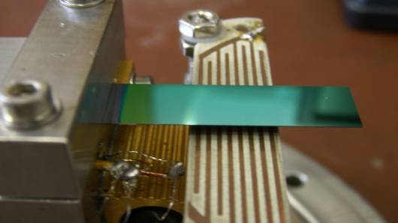
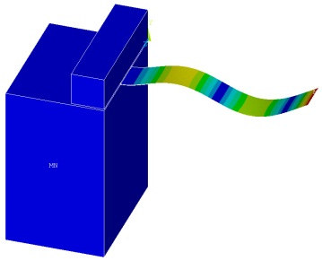

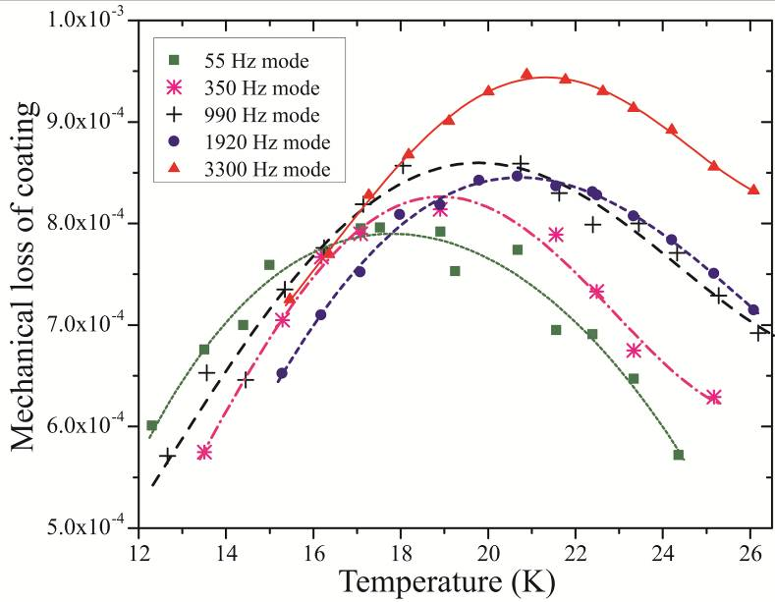
Cryogenic coating loss measurements
electrostatic
drive
tantala coating
Loss measured from ring down experiments using coated cantilever samples
Analysis of cryogenic loss peaks can reveal characteristics of microscopic energy loss mechanisms
τ₀ = relaxation constant
E_{a} = activation energy

Slide 5
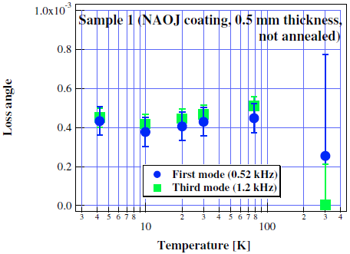
Previous measurements – silica/tantala
I. Martin - Glasgow
K. Yamamoto et al, Physical Review D 74, 022002 (2006)
Analysis of peaks and studies of atomic structure can provide information about loss mechanisms
Previous data taken at Glasgow conflicts with data taken at KEK by K. Yamamoto
Glasgow measurements taken using single layer coatings on silicon cantilevers
KEK measurements taken using multilayer coatings on sapphire disks
So where can this discrepancy come from?

Slide 6
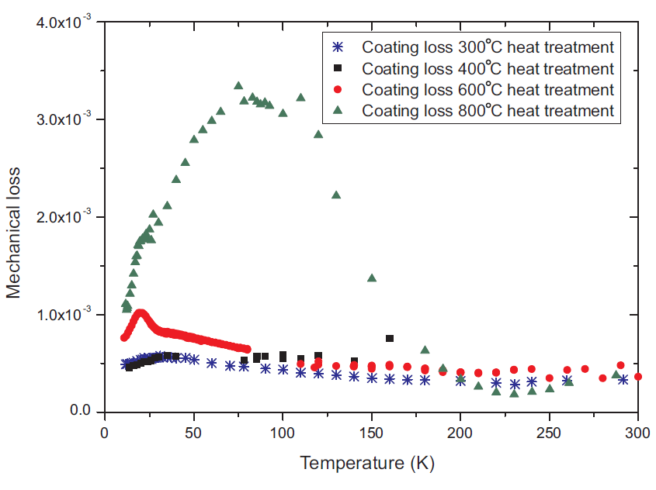
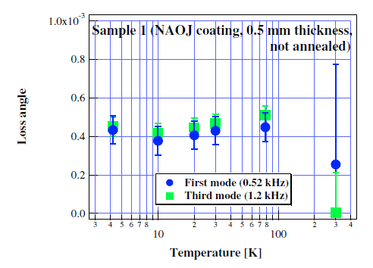
Current coatings – silica/tantala
There are so many variables!
The substrate and geometry is different
  Does this matter? Hopefully not!
Annealing temperature is very important [arXiv:1010.0577v1]
Coating thickness may also be important
Coating vendor ideally should not matter, but is not to be ruled out.
  Glasgow data using CSIRO coatings, KEK data using NAOJ/JAE coatings

Slide 7
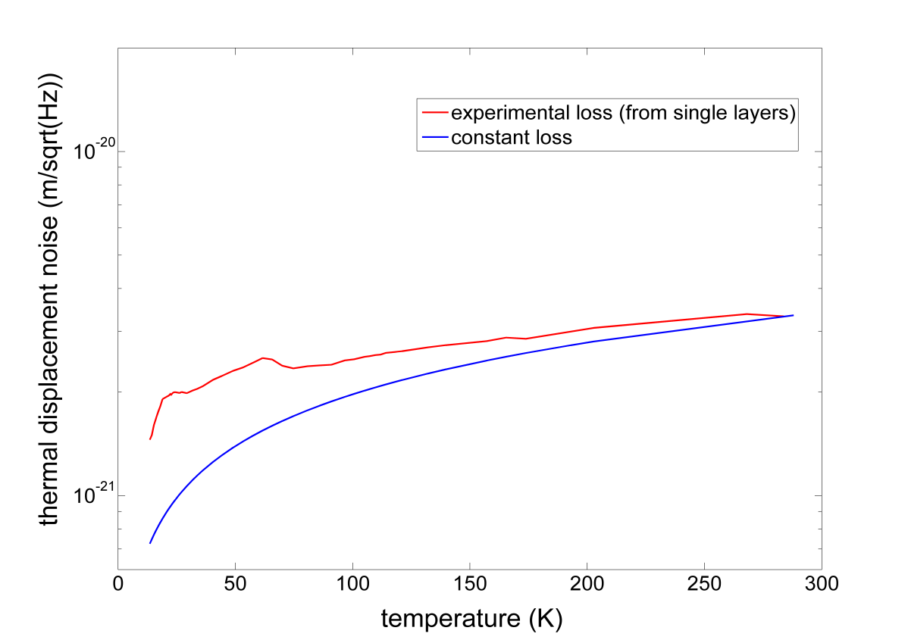
What impact do these results have?
How much will sensitivity increase by moving to cryogenic temperatures?
This is extremely important for cryogenic detectors such as ET/KAGRA
Assuming loss is independent of temperature gives a more sensitive detector at cryogenic temperatures than the estimate from single layer measurements
This needs to be resolved!
Disks to be re-measured with smaller temperature steps by ICRR and Glasgow members through ELiTES programme
Using measured single layer coating loss
Optimistic estimate – coating
loss remains constant at all T

Slide 8
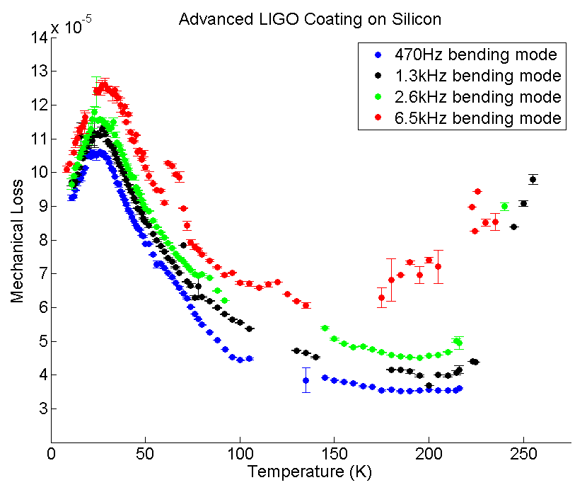
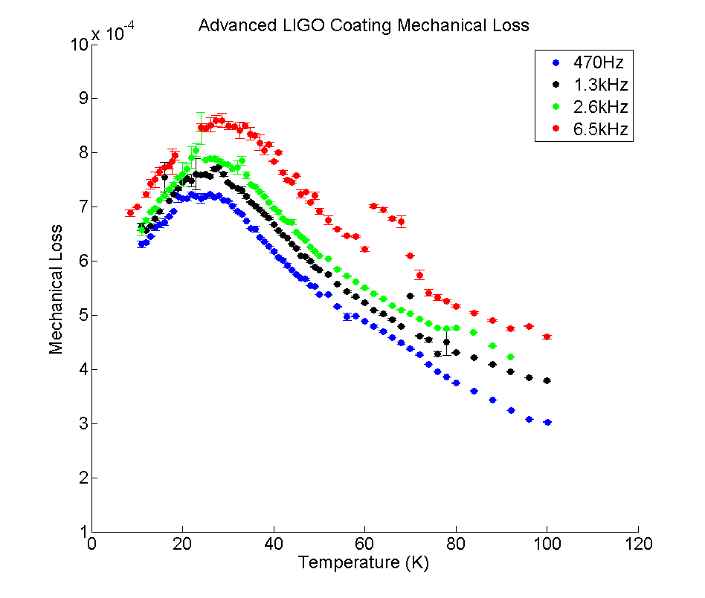
Other multilayer measurements – Advanced LIGO
Coupling into clamp/other modes
Coating loss measured on silicon cantilevers by both Glasgow and LMA independently
Coating loss upper limit (right) makes reasonable assumption that the substrate does not contribute to the loss below 100K
Loss peak between 20 and 30 K (frequency dependent) as expected from previous single layer measurements
Work done in collaboration with M. Granata, G. Cagnoli, R. Flaminio et al (LMA)

Slide 9
Other multilayer measurements – Advanced LIGO
Coupling into clamp/other modes
Not directly comparable to the KEK results due to differences in:
  Coating layer thickness
  Titania doping of tantala
  Post deposition heat treatment
  Different coating vendor
  Number of layers
  Substrate material and geometry
However, it is reassuring that the peak is observed in other setups

Slide 10
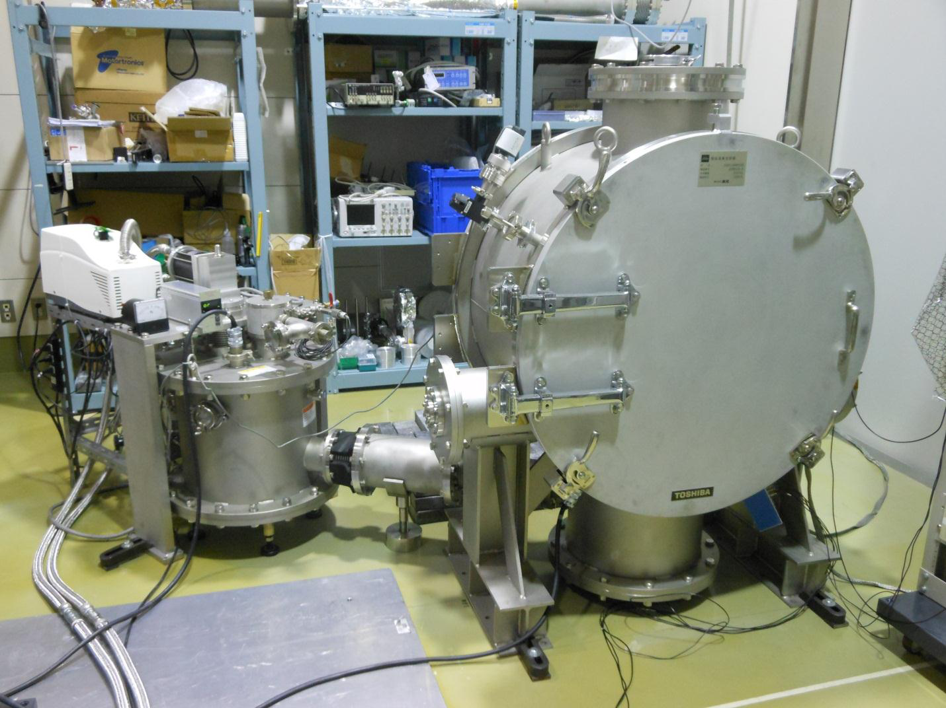
ICRR disk measurement setup
scroll and turbo pump (not seen)
CLIK
P ~ 1E-7
T = 15K–room temp
Helium
to compressor

Slide 11
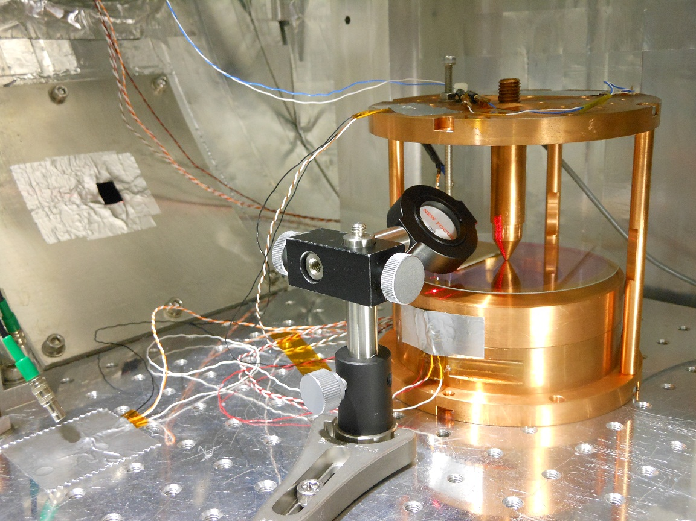
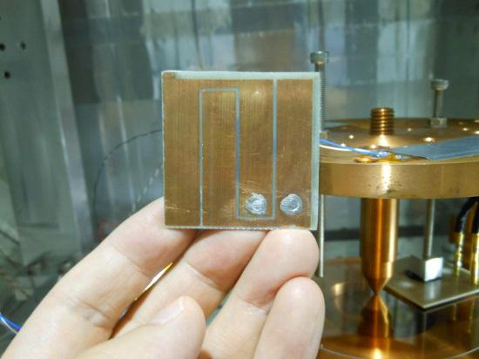
Inside CLIK
T sensor
heater
Mirror
Disk
Optical feed through
Electrode
T sensor

Slide 12
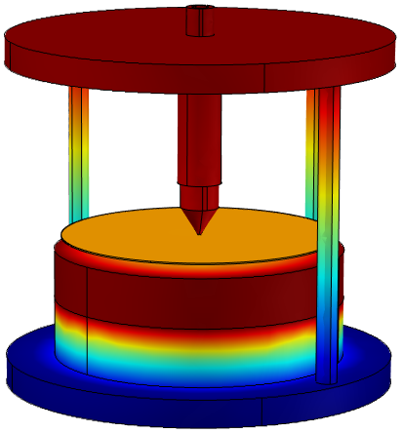
CLIK temperature
Temperature measured by silicon diode sensors on the top and bottom of clamp structure
Temperature also measured on base-plate
Temperature of disk obtained using COMSOL model of structure
Temperature control uses heater attached to the top of the clamp
T steps 1K at low temperatures

Slide 13
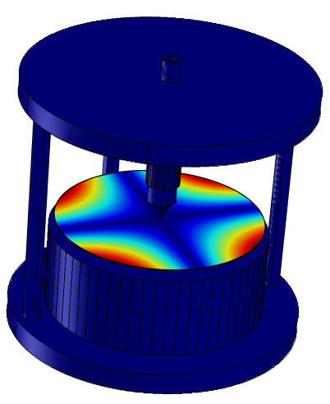
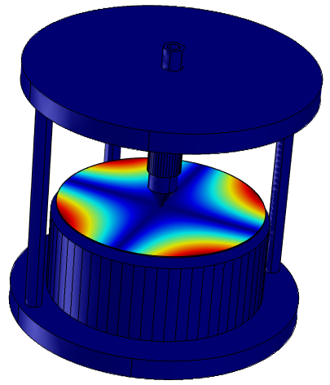
Coating loss measurement
Electrostatic drive used to vibrate resonant frequencies of the disk
Target mode (~500Hz) looks like this:
Optical lever approach with split photodiode used for vibration amplitude readout
Signal fed into lock-in amplifier with reference frequency on resonance

Slide 14
CLIK Measurement
Signal from lock-in recorded on computer
Coated and uncoated disks measured with the coating loss calculated by:
Energy ratio may be calculated analytically or using FEA
Results pending
Hopefully clear up any possible discrepancies in previous coating loss measurements

Slide 15
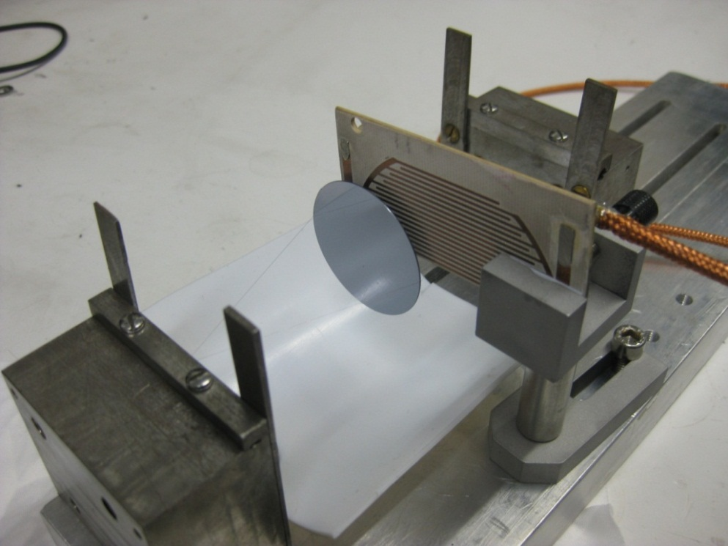
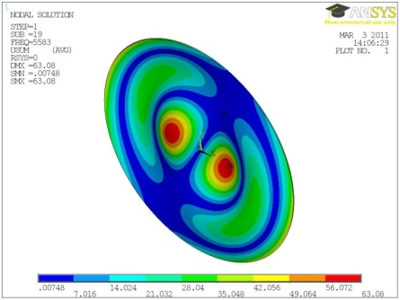
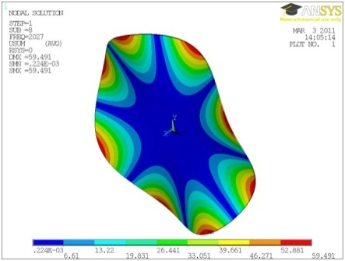
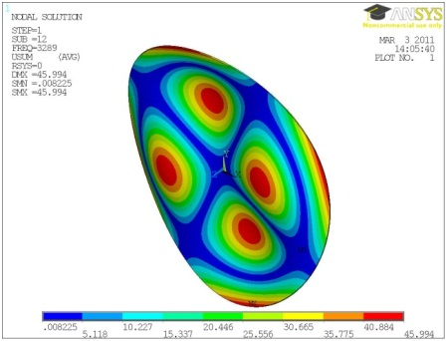
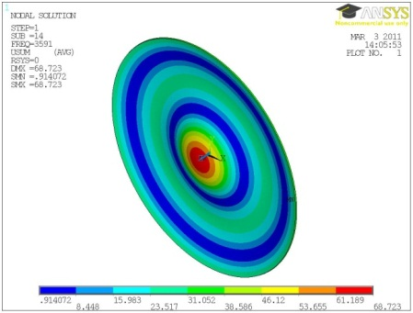
Nodal Support - Glasgow
JAE coatings on disks to be measured at cryogenic temperatures by nodal support. Loss of various modes measured using a nodal support technique.
  Disk supported by two 50 micron wires
  Setup previously used for smaller disks – can make larger version or make replica of ICRR setup
Clamp
Disk sample
Electrostatic drive plate
15

Slide 16
Summary
Important to clear up any possible discrepancies in coating loss measurement
  Loss as a function of temperature is important for noise budget of cryogenic detectors
  Loss peaks important for understanding loss mechanisms
Glasgow and ICRR collaborating through ELiTES exchange program towards this
Working coating loss measurement setup at ICRR with help from ELiTES exhange program
NAOJ Coatings being re-measured at ICRR
Other coatings being planned at ICRR
Effects of annealing also under investigation
KAGRA optics group interested in testing coatings made by different vendors
JAE coatings also being re-measured at Glasgow

