Slide 1
Precision Tilt and Radius of Curvature Sensor Using Double-Pass AOM
2013. 6. 10.
Kyuman Cho
Department of Physics
Sogang University

Slide 2
Overview
Introduction
Tilt Sensor Using AOM
Experimental Results
Local Slope Profiler
Summery

Slide 3
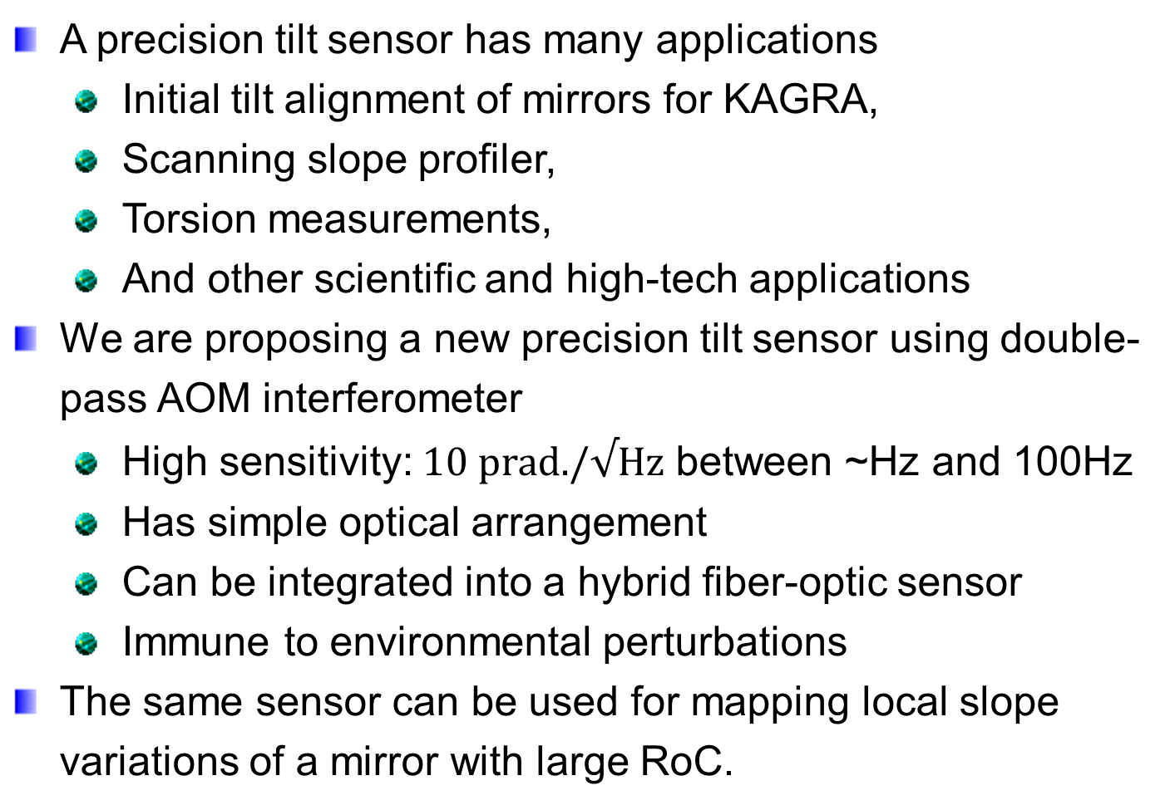
Introduction
A precision tilt sensor has many applications
  Initial tilt alignment of mirrors for KAGRA,
  Scanning slope profiler,
  Torsion measurements,
  And other scientific and high-tech applications
We are proposing a new precision tilt sensor using double-pass AOM interferometer
  High sensitivity: $10 \text{prad}\text{./}√\text{Hz}$ between ~Hz and 100Hz
  Has simple optical arrangement
  Can be integrated into a hybrid fiber-optic sensor
  Immune to environmental perturbations
The same sensor can be used for mapping local slope variations of a mirror with large RoC.

Slide 4
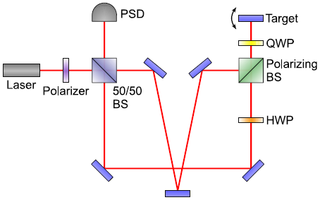
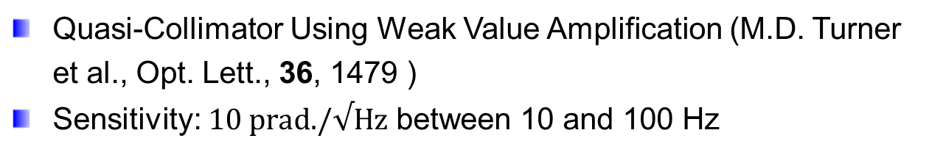
Introduction: Previous Works
Quasi-Collimator Using Weak Value Amplification (M.D. Turner et al., Opt. Lett., 36, 1479 )
Sensitivity: $10 \text{prad}\text{./}√\text{Hz}$ between 10 and 100 Hz

Slide 5
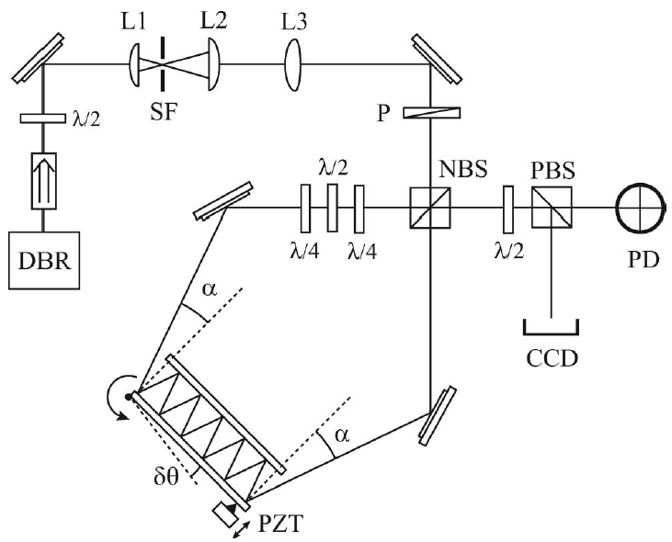
Introduction: Previous Works
Optical lever inside a Sagnac Interferometer (J.M. Hogan et al., Opt. Lett., 36, 1698 )
Sensitivity: $1\text{.2 }\text{prad}\text{./}√\text{Hz}$ between at 2.4 kHz Hz
11 bounces

Slide 6
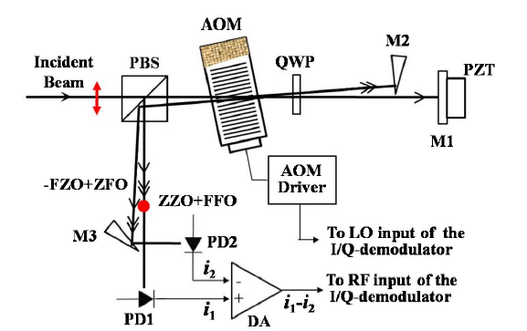
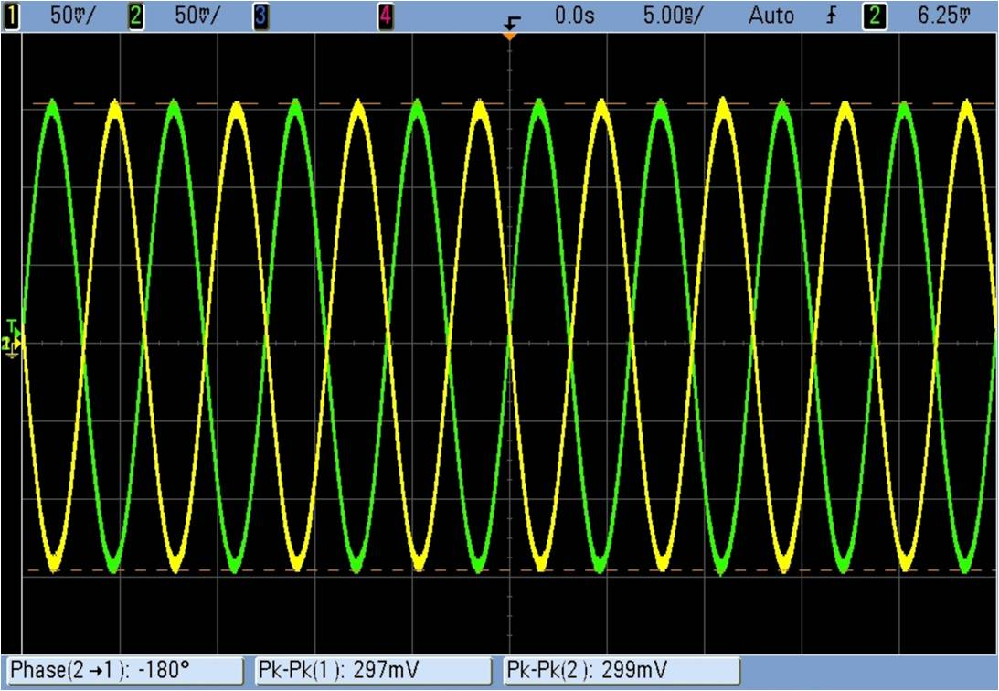
Double-Pass AOM Intterferometer
Youngkyu Park, Kyuman Cho, OPTICS LETTERS / Vol. 36, No. 3 / February 1, 2011

Slide 7

Tilt Sensor Arrangement
AOM
f
f
PBS
QWP
Incident
Beam
Lens
M
M

Slide 8
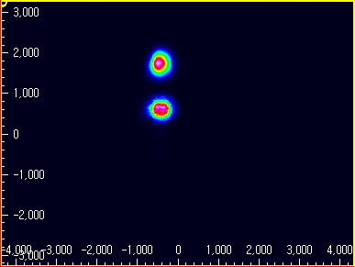
Experimental Results
0.945mm
CCD Beam profiler image
Beam Separation at focal plane: d = 0.945mm

Slide 9
Experimental Results: Directional Tilt
pivot line1
Pivot line2
Pivot line1
~ 33dB
pivot line2
~ 85dB
Pivot line1 = 45Hz
Pivot line2 = 85Hz
Driven angle variance
~0.27 rad

Slide 10
Experimental Results: Linearity
Motorized Rotation stage

Slide 11

Experimental Results
Applied Tilt
Sensitivity: $10 \text{prad}\text{./}√\text{Hz}$ between a few Hz and 100 Hz
Can provide almost photon noise limited sensitivity

Slide 12
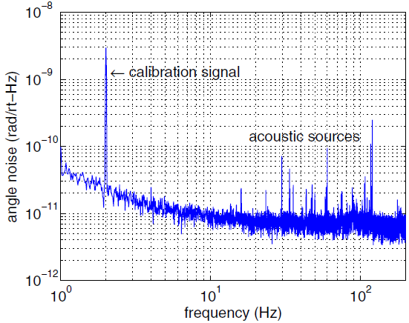
Work of M. D. Turner et al.
Opt. Lett., 36, 1479

Slide 13
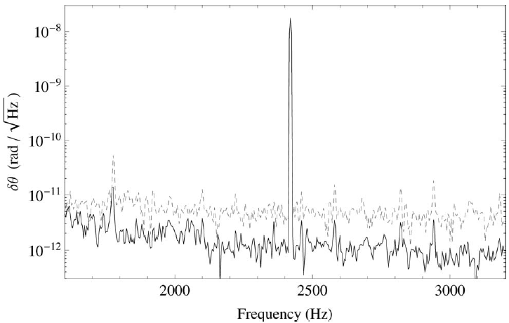
Work of J. M. Hogan et al.
Opt. Lett., 36, 1968

Slide 14
Experimental Results
DC stability is measured by using a fixed mirror
Laser
AOM
To Detector
Fixed Mirror
Stability
Excellent DC Stability!

Slide 15
Experimental Results
Measurement of lateral motion rejection using a displace mirror
8mm
Laser
AOM
To Detector
Displaced Mirror
Measurement result
-1.16 rad
(~58nm)

Slide 16
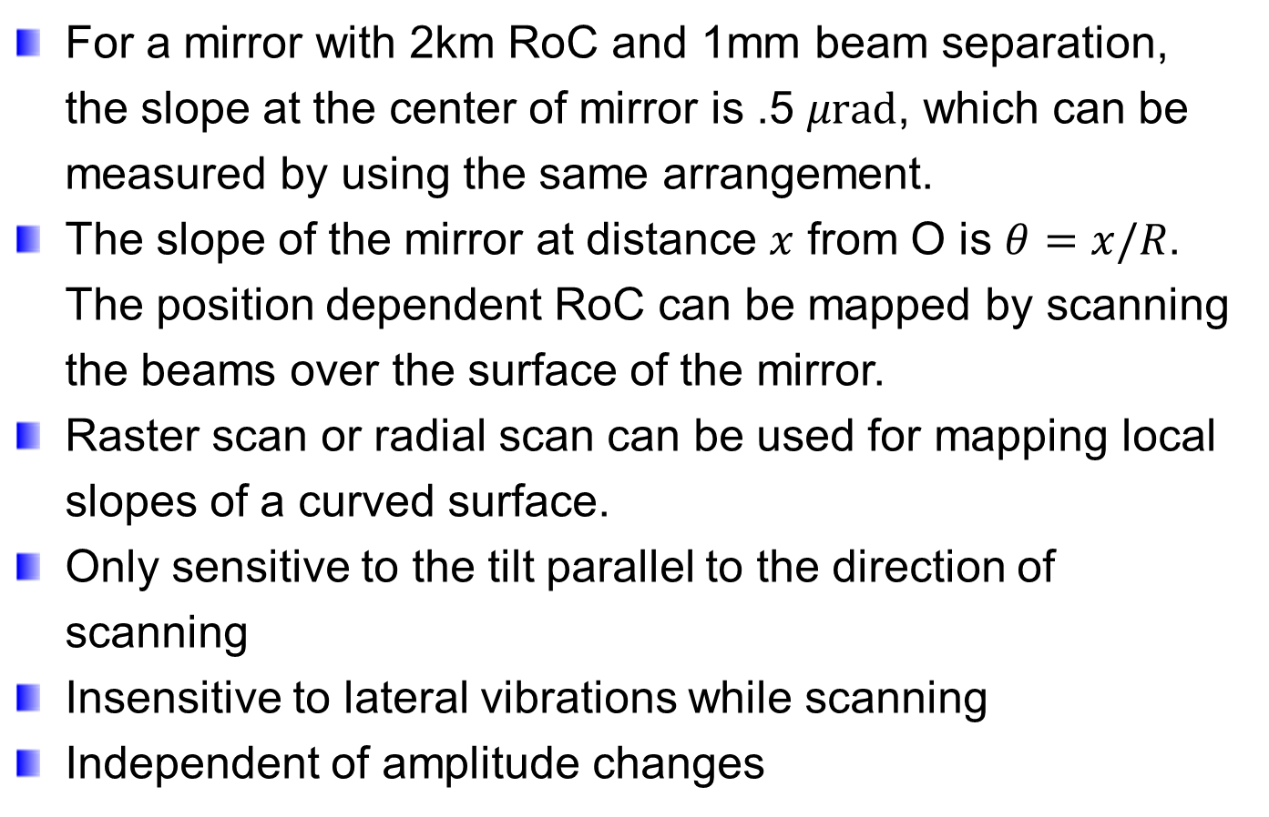
Scanning Local Slope Profiler
For a mirror with 2km RoC and 1mm beam separation, the slope at the center of mirror is .5 $μ\text{rad}$, which can be measured by using the same arrangement.
The slope of the mirror at distance $x$ from O is $θ=x/R$. The position dependent RoC can be mapped by scanning the beams over the surface of the mirror.
Raster scan or radial scan can be used for mapping local slopes of a curved surface.
Only sensitive to the tilt parallel to the direction of scanning
Insensitive to lateral vibrations while scanning
Independent of amplitude changes

Slide 17
Scanning Local Slope Profiler
Point by point scanning scheme for mapping local slope of the mirror
R
θ
x

Slide 18
Summary
A double-pass AOM interferometer scheme has been used for precision tilt measurements
  Can provide very high sensitivity,
  Highly immune to environmental perturbations
Application of our new scheme has been discussed
  Initial tilt alignment of mirrors for KAGRA,
  Local slope profiler for mirrors
  Potentially, a tilt sensor for TOBA

