Slide 1
OPENING A NEW ERA FOR THE ASTROPHYSICS: THE FUTURE DETECTORS OF GRAVITATIONAL WAVES
Michele Punturo
INFN Perugia and EGO
With many slides from Virgo coll.
and ET science team
Italian Embassy
in Tokyo

Slide 2
Why this workshop?
This event has been “catalyzed” thanks to the good willing of Dr. Alberto Mengoni, the Scientific Attaché of the Italian Embassy in Tokyo and it is inserted within the “Italy in Japan - Focus on Science, Technology and Innovation 2013” framework
The workshop is also supported by the ELiTES-FP7 project
Main target of the workshop is the exchange of know-how in key technologies for Advanced GW Detectors, KAGRA and the Einstein Telescope

Slide 3
From Virgo to ET … passing through Advanced Virgo

Slide 4
Virgo infrastructure
The Virgo infrastructure close to Pisa (as well as the LIGO infrastructures) is well established and it has been a relevant and successful investment of some of the most important research institutions in Europe (CNRS & INFN)
The Virgo Site is managed by the EGO consortium and to the Virgo scientific collaboration participate also Dutch, Polish and Hungarian teams

Slide 5
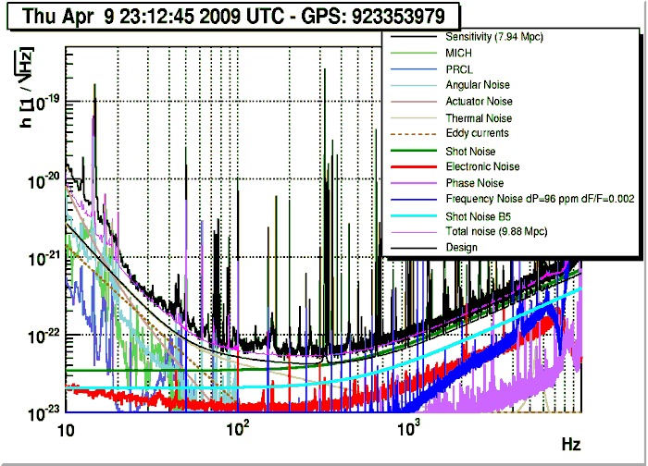
Noise Budget
The infrastructure is not clearly limiting the Virgo detector current sensitivity
The Virgo noise budget is almost completely understood
Virgo, 2009

Slide 6
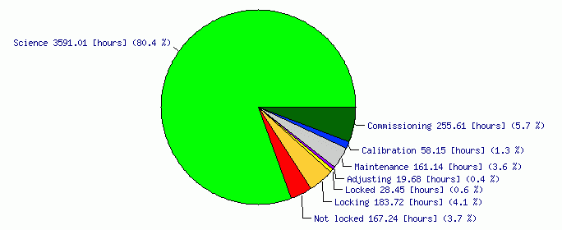
Duty Cycle
The infrastructure is not limiting the Virgo current duty cycle
Initial GW detectors are quite reliable
Science time: 80.4%
Locked time: 85.2%
VIRGO VSR2
Virgo: Jul 09 – Jan 10

Slide 7
Toward the 2nd generation
Initial (1st Generation) GW detector infrastructures have been, hence, selected to host the evolution of the interferometers toward the advanced (2nd generation)
But, in case of Virgo, this requested not negligible compromises

Slide 8
AdV optical layout

Slide 9
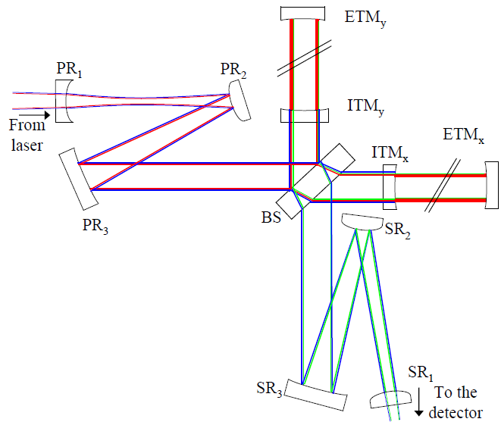
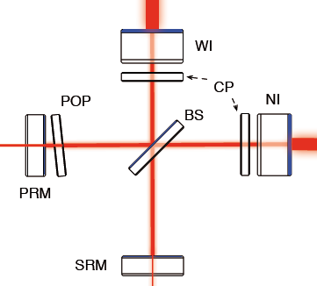
MSRC vs NDRC
MSRC
NDRC
Marginally Stable Recycling Cavities solution has been a trade-off solution due to a series of constrains where the cost of an upgrade of the infrastructures had a relevant role

Slide 10
AdV new technologies
MAIN CHANGES
Signal recycling
Larger beam
High power laser (fiber technology)
Heavier mirrors (x2)
Better polishing (ion beam)
Better coating
Monolithic suspensions
Notes:
AdV Virgo requires round trip losses <75ppm -> mirror flatness < 0.5nm RMS
Signal recycling tuning The signal recycling tuning is optimized to have the best Signal
to Noise Ratio (SNR) for a given type of gravitational wave source. Two configurations are considered here: the Resonant Sideband Extraction (RSE) configuration (zero tuning), and a ‘tuned’ configuration, optimized for Binary Neutron Stars (BNS) inspiral searches.

Slide 11
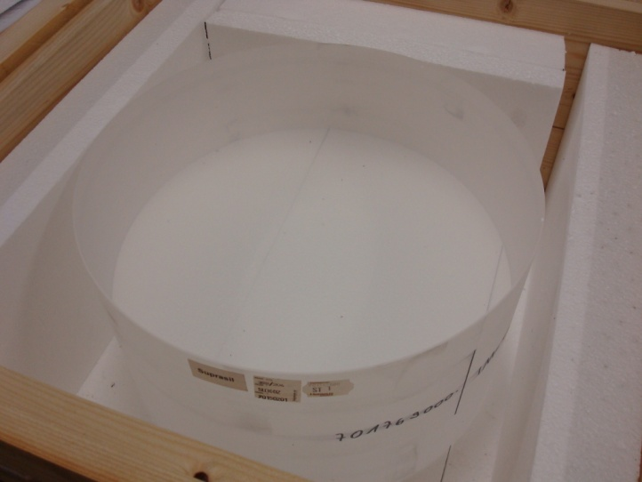
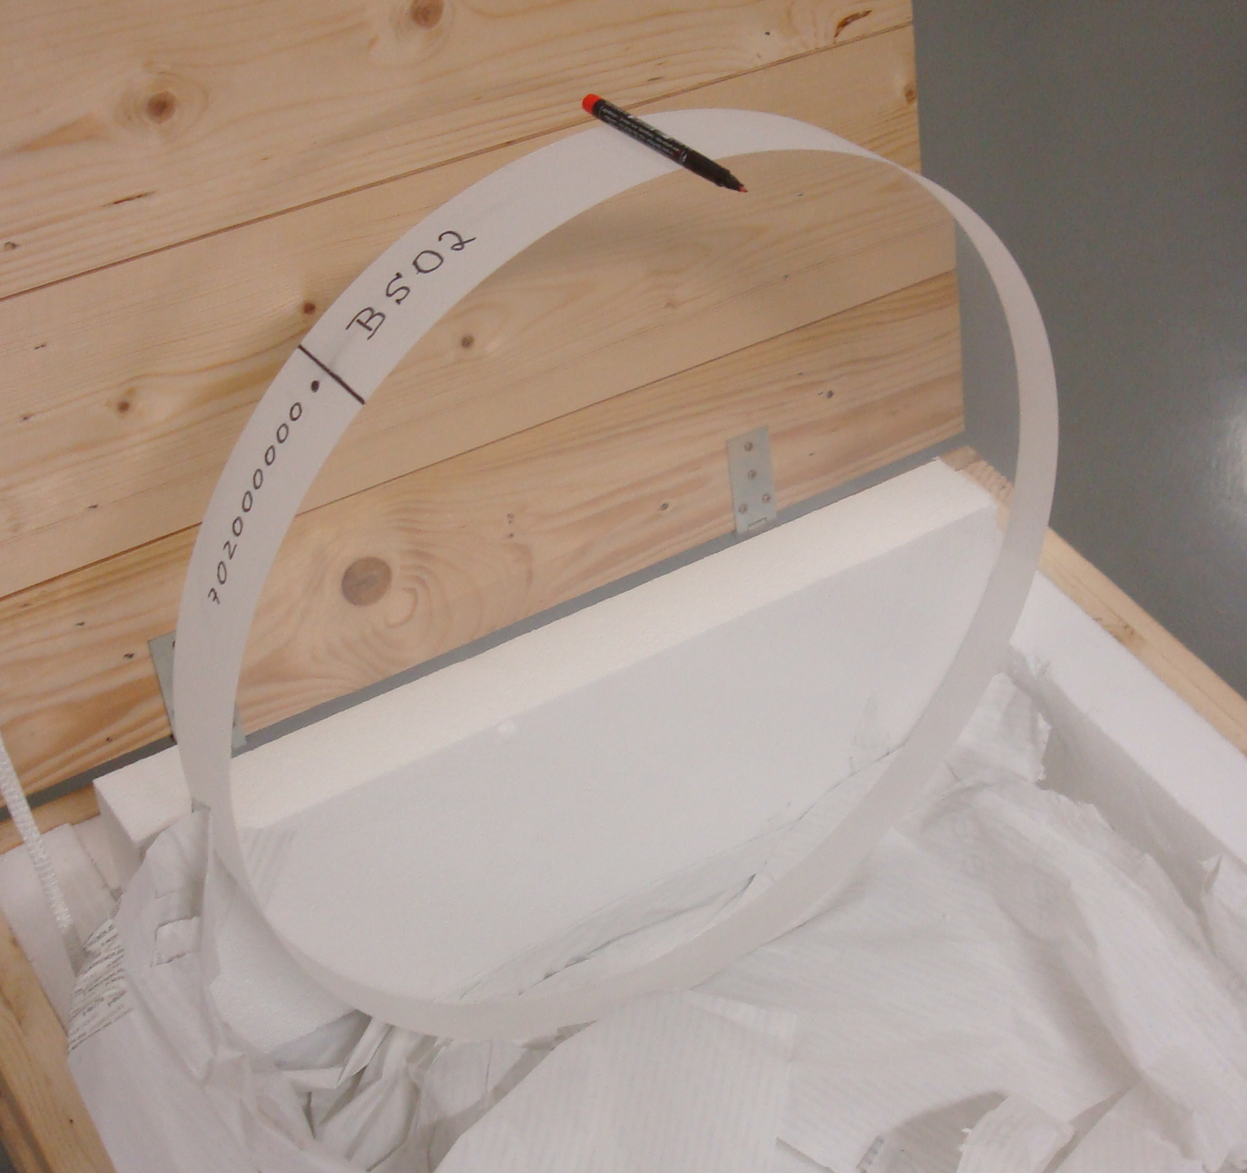
MIRRORS – SUBSTRATES
Large high quality mirrors: 35cm diameter, 20cm thick, 42 kg
Large beam splitter: 55cm diameter
Manufacturer = HERAEUS (like in VIRGO), leader in low absorption silica
New fused silica grade (Suprasil 3002):
Better bulk absorption (0.2 ppm/cm measured at LMA): better for thermal lensing
Good mechanical properties (expected high quality factor, > 10⁷)

Slide 12
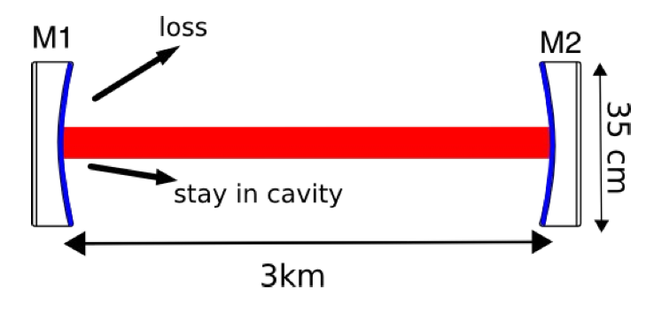
POLISHING
Optical losses must be minimized to
Maximize the circulating power (and thus the sensitivity)
Minimize the scattered light (and the associated noise…)
AdV requirement: round-trip losses <75ppm →
→ mirror flatness < 0.5 nm rms
Standard polishing may achieve flatness ~2 nm rms
Ion beam polishing (ZYGO) matches the requirements

Slide 13
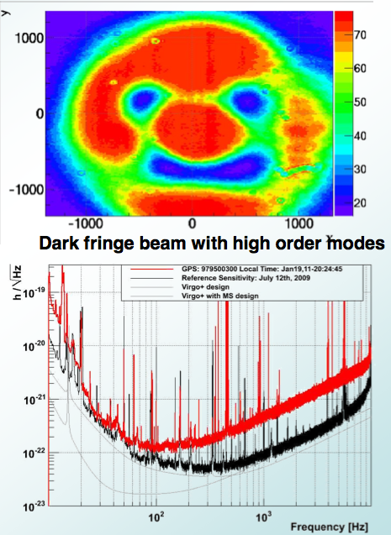
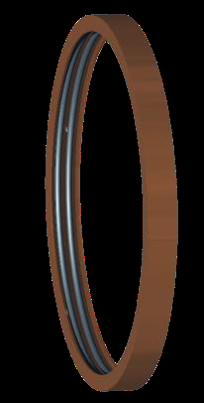
THERMAL COMPENSATION
Aberrations (intrinsic mirror defects or thermal deformations of the mirrors) spoil the beam quality
A set of sensors and thermal actuators has been conceived to get an “aberration free” interferometer
CO2 laser
CO2 laser shined on the mirror:
heat deposition where needed
to compensate for aberrations
Heating rings around
mirrors to tune RoC
(accuracy: ~1m over 1500m)
Effect of RoC asymmetry in Virgo+

Slide 14
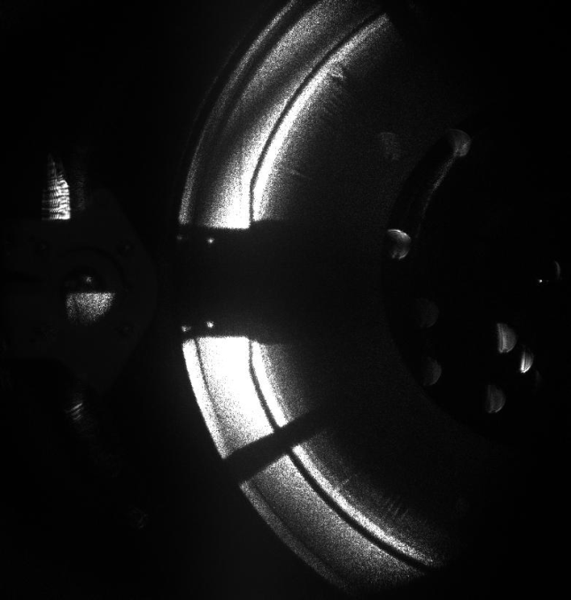
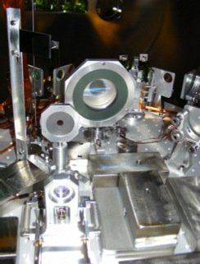
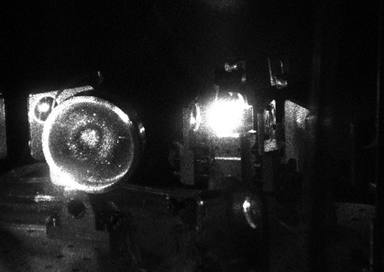
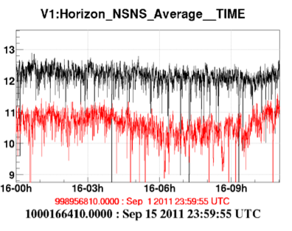
STRAY LIGHT
Scattered light has been one of the main issues of Virgo+
limiting the sensitivity in a wide frequency range
a lot of commissioning time used to mitigate it
Thorough risk mitigation approach in AdV (large investment)
stray light on
the output bench
SiC baffles added
(+ other changes)
horizon more stable
and higher

Slide 15
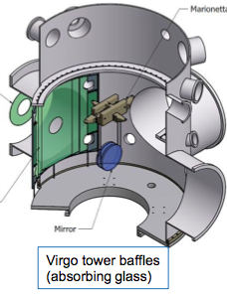
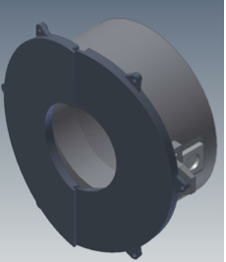
STRAY LIGHT MITIGATION
Baffles to shield mirrors, pipes, vacuum chambers exposed to scattered light

Slide 16
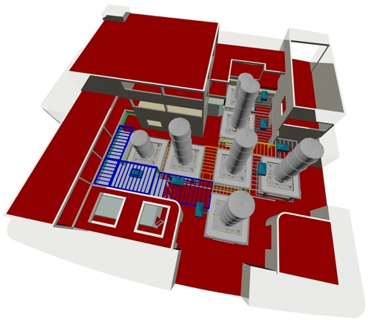
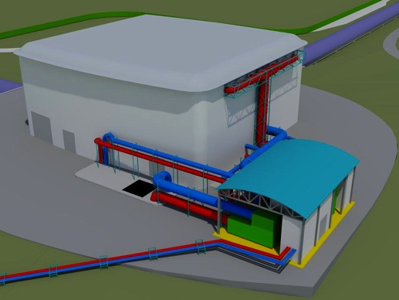
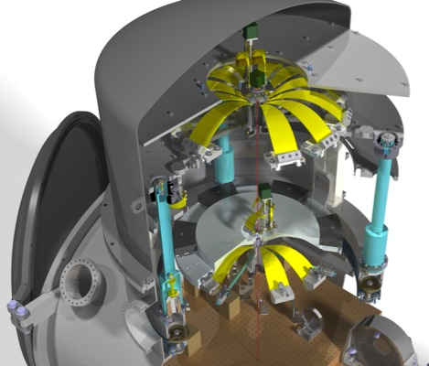
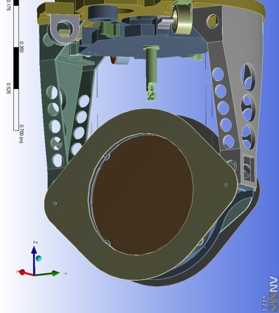
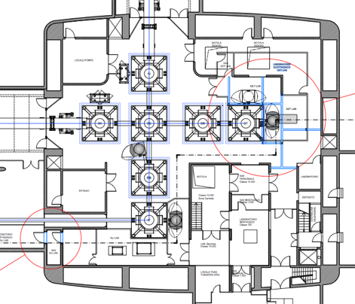
STRAY LIGHT MITIGATION
HVAC relocation
All photodiodes
seismically isolated
and In vacuum
halls re-arrangements
for hosting minitowers
large suspended baffles
+ payloads/superattenuators/vacuum modifications
for the large baffles suspension
+ superpolished optics on suspended benches
+ …

Slide 17
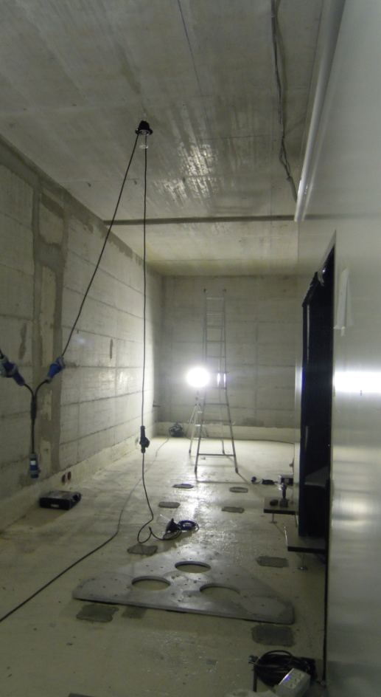
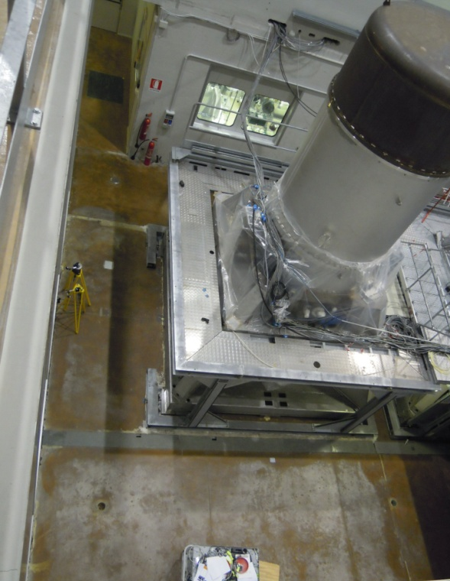
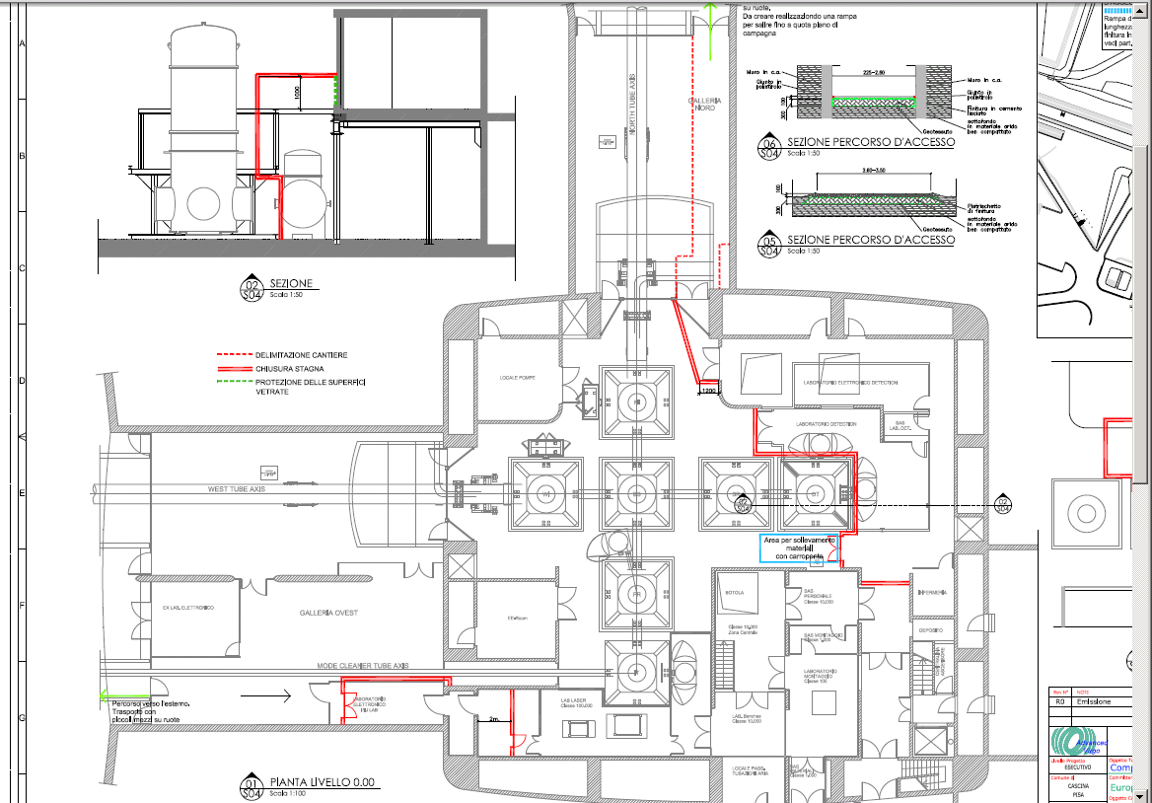
INFRASTRUCTURE
Substantial infrastructure modifications are needed to:
Enlarge/make clean areas in the laboratory hosting the laser and the detection photodiodes
Reduce the anthropogenic noise produced by the machines and its coupling to the interferometer
Create space to introduce new vacuum chambers to have the photodiodes in-vacuum and seismically isolated

Slide 18
AdV timeline

Slide 19
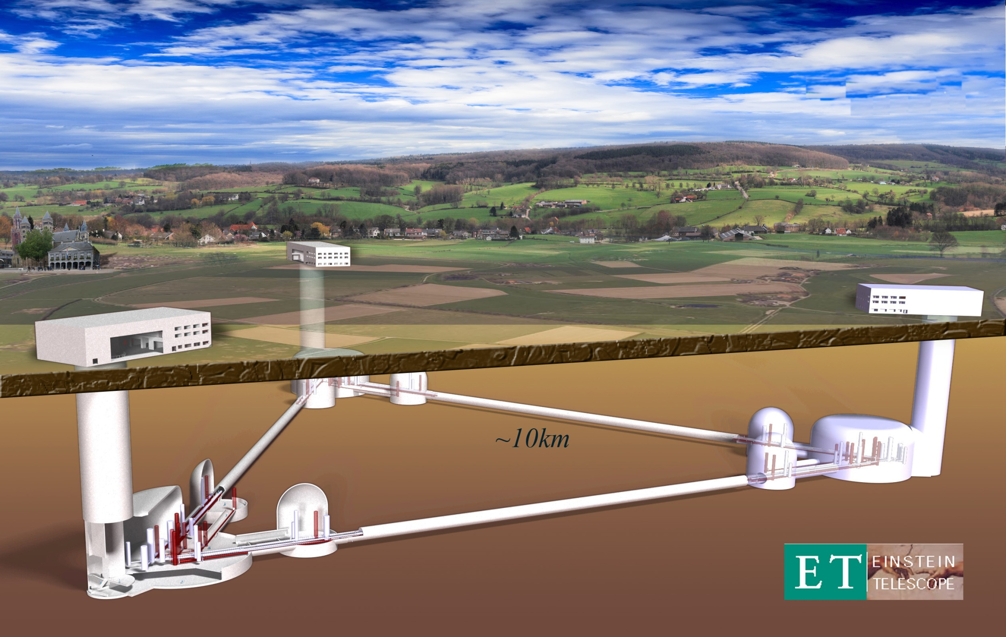
3rd Generation?

Slide 20
3rd generation?
Precision Astrophysics
Cosmology
?
Evolution of the GW detectors (Virgo example):
Limit of the current infrastructures
First detection
Initial astrophysics
Test of “advanced” techs
UL physics
Advanced
detectors
Detection distance (a.u.)
Proof of the working principle
Upper Limit physics
enhanceddetectors
Commissioning
& first runs
Infrastructure realization and detector assembling
Same
infrastructure
Same
infrastructure
Same
infrastructure
Same
Infrastructure
(≥20 years old for Virgo, even more for LIGO & GEO600)
year
2003
2008
2011
2017
2022

Slide 21
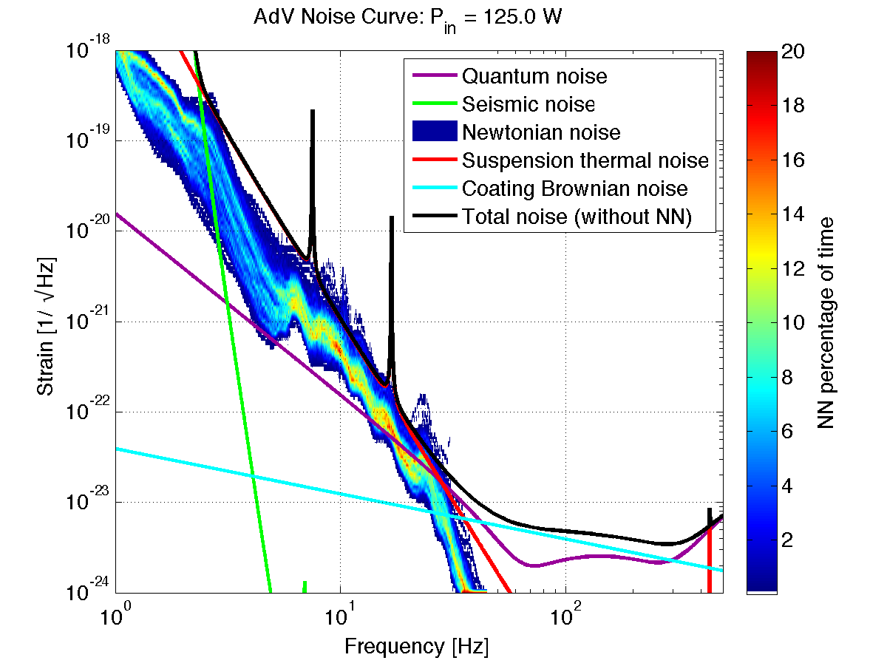
Gravity Gradient noise in AdV
The GGN noise could limit the AdV sensitivity during high seismic activity days:
M. Punturo (VIR-0073B-12)
M.Beker (GWADW 2012

Slide 22
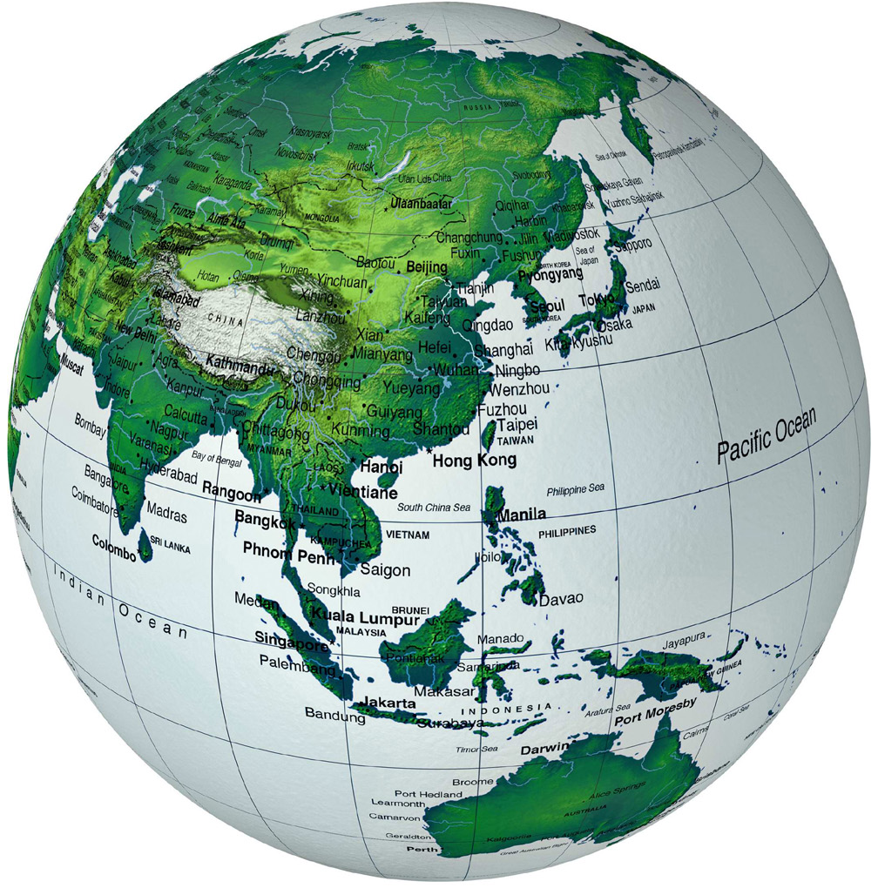
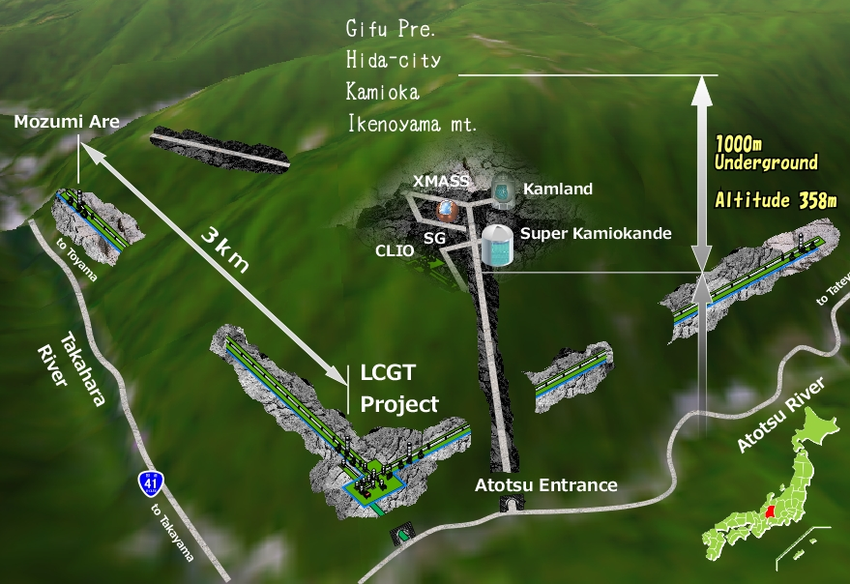
Lesson of LCGT/KAGRA
New infrastructure
Underground location
New technologies (Cryogenics)

Slide 23
ET strategy?
ET is a long term project started on EU “federal” support
Kick-off meeting supported by the European Science Foundation (Exploratory workshop in 2005)
Design study supported by the European Commission (FP7)
Two conflicting elements are dominating the ET scenario:
Need of a long term support, to develop technologies (R&D), to build-up the team (networking)
Direct support from the national research institutions will be null or low profile until advanced detectors will be operative and the detection achieved
We had to develop a strategy compliant with these constrains

Slide 24
ET Conceptual design
ELiTES
ERC starting grant
ET-R&D (Aspera)
GraWIToN (ITN)
H2020 R.I.
R&D
Technical design
First detection on advanced interferometers
ET Observatory Funding
Site preparation
First detector installation
ET Site and infrastructures realisation
Hardware production
Components pre-commissioning and first ET detector commissioning
GW – R.I. pre-selected for I3 calls
First science data
2012
2013
2014
2015
2016
2017
2018
2019
2020
2021
2022
2023
2024
2025
2026
2027
2028
2029

Slide 25
Current R&D Activities
Optical and Mechanical properties of Silicon substrates
Coatings
R.Flaminio , I.Pinto and K. Craig talks
Newtonian noise subtraction techniques
Site identification
Measurement ongoing in Italy and to be performed in Hungary.

Slide 26
Enjoy the Workshop

