Slide 1
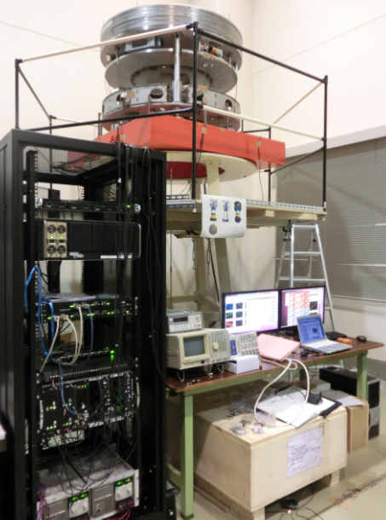
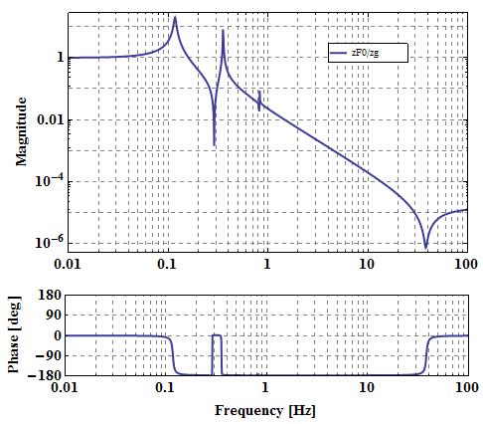
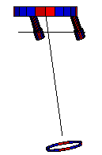
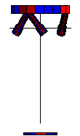
Development Status of Seismic Attenuation System for KAGRA
U. Tokyo, ICRR
Takanori Sekiguchi

Slide 2
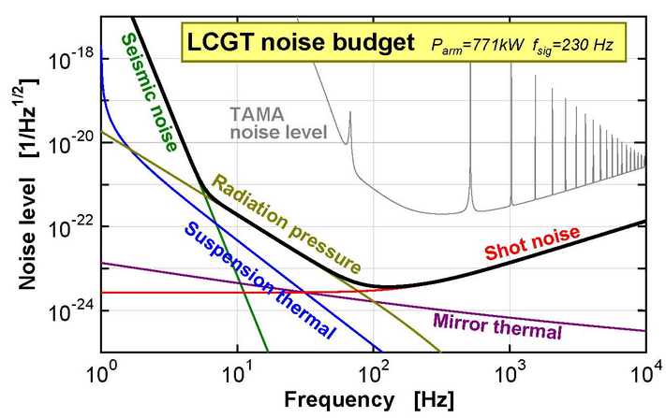
About SAS
SAS [Seismic Attenuation System]
Seismic isolation starting from ultra low frequency
old
KAGRA

Slide 3
Key Technology of SAS
Development of low frequency oscillator Natural frequency ~ 100 mHz
Geometric Anti-Spring (GAS) Filter
Inverted Pendulum [IP]

Slide 4
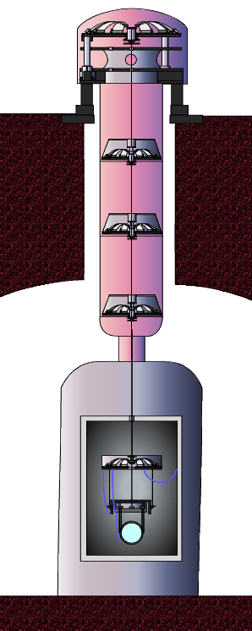
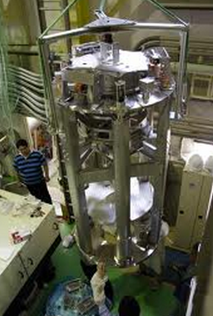
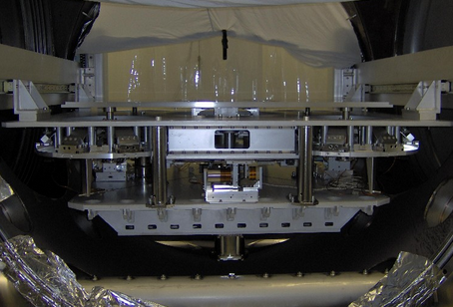
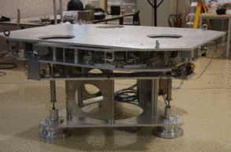
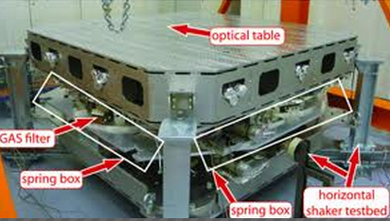
SAS for Gravitational Wave Detectors
KAGRA-SAS (JPN)
TAMA-SAS (JPN)
HAM-SAS (LIGO)
EIB-SAS (Virgo)
AEI-SAS (GER)
Multi-SAS (Virgo)
Collaboration with other GW project
2000
2005
2010

Slide 5
Contents
Introduction of KAGRA-SAS
Prototype Experiment
Modeling of SAS

Slide 6
Contents
Introduction of KAGRA-SAS
Prototype Experiment
Modeling of SAS

Slide 7
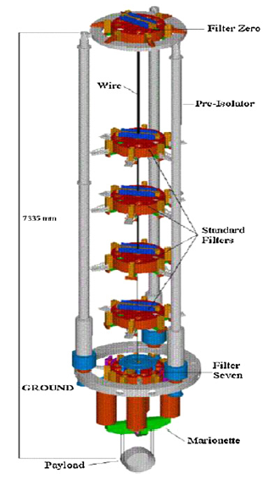
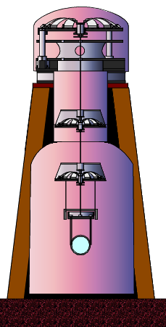
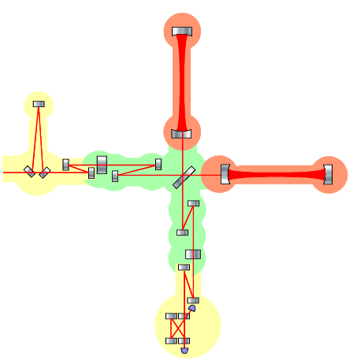
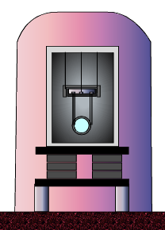
KAGRA-SAS Overview
Type-A
Type-B
KAGRA Interferometer
Type-C

Slide 8
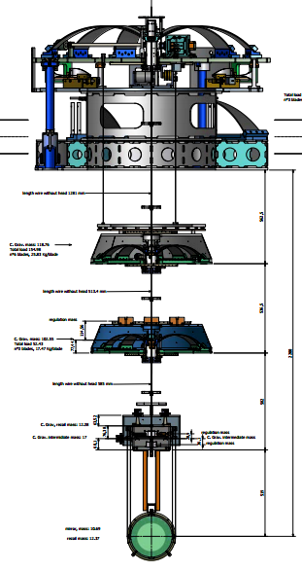
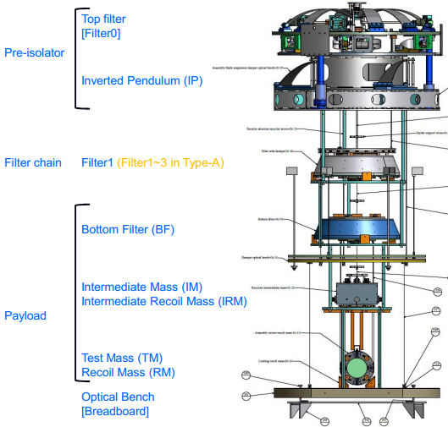
KAGRA-SAS Overview

Slide 9
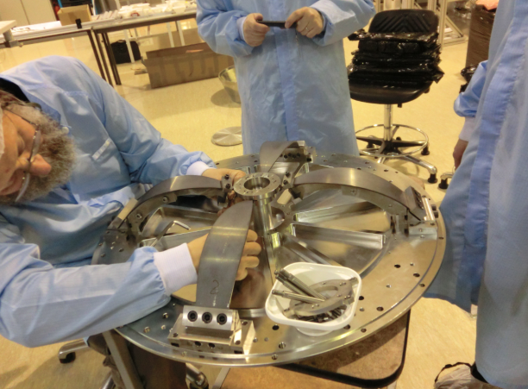
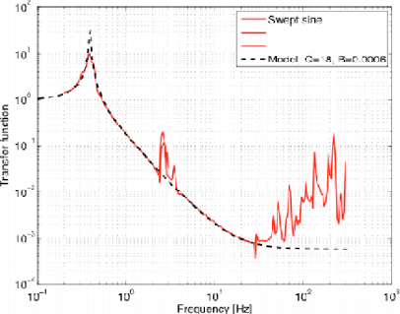
Development Status
Standard filter:
Prototype test at Nikhef (2011. 2.)
Production (19 filters) has been already finished.

Slide 10
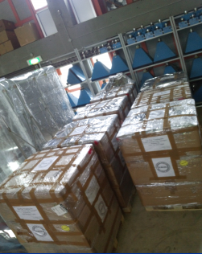
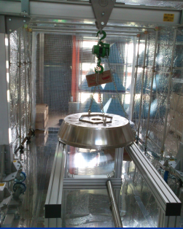
Development Status
Standard filter: test at Nikhef
Production (19 filters) has been finished.

Slide 11
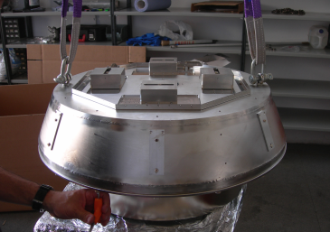
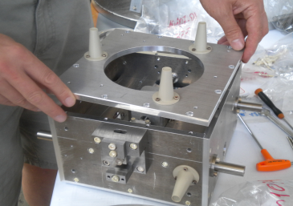
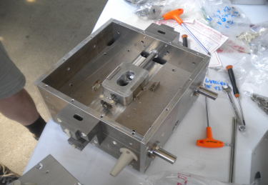
Development Status
Prototype has just been arrived at NAOJ.
Assembly test and performance test should be done.

Slide 12
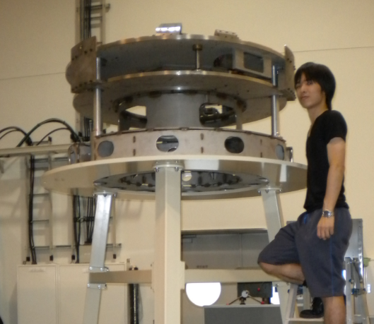
Development Status
(Today’s Main Topic)
Pre-isolator :
Prototype test is undergoing at Kashiwa.
Will be delivered to NAOJ for full system test
(summer, this year)

Slide 13
Contents
Introduction of KAGRA-SAS
Prototype Experiment
Modeling of SAS

Slide 14
Pre-Isolator
Role of Pre-Isolator
Pre-isolation of seismic noise (< 1 Hz)
Control the position of whole system

Slide 15
Pre-Isolator Prototype in Kashiwa
Purpose of this work
Verify the performance of passive isolation
Test bench for active control by the use of new digital system, new sensors and actuators.

Slide 16
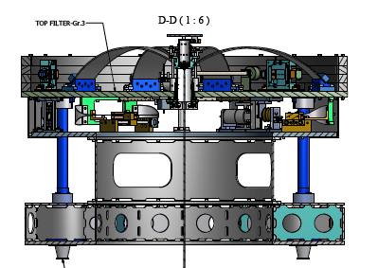
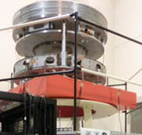
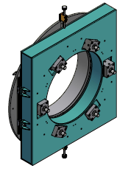
Mechanics
Accelerometer
→ Geophone
Large GAS Filter (Φ ~1200)
Stepper Motor with soft spring
IP Leg
LVDT & Voice Coil Actuator
Hydraulic Pistons

Slide 17
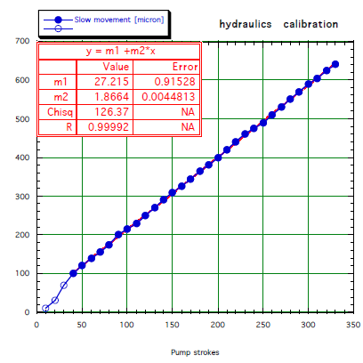
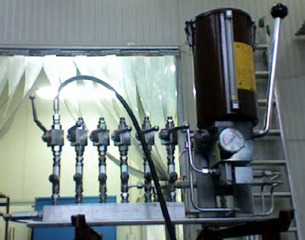
Hydraulic Piston
Inclination of the system can be finely tuned:
(~1.5 μrad/Stroke)

Slide 18
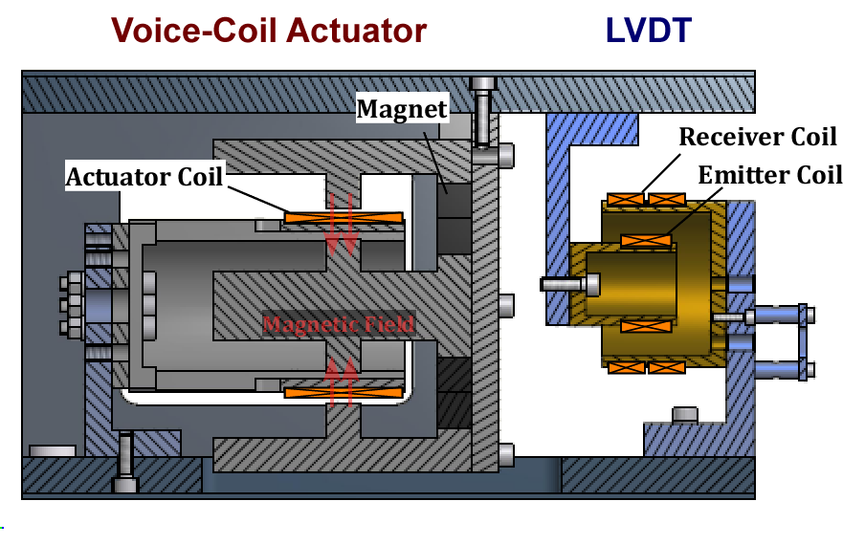
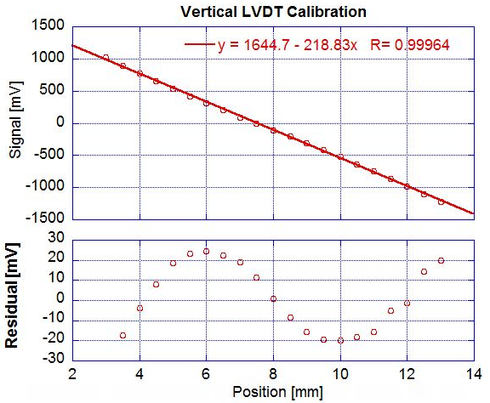
Sensor & Actuator Unit

Slide 19
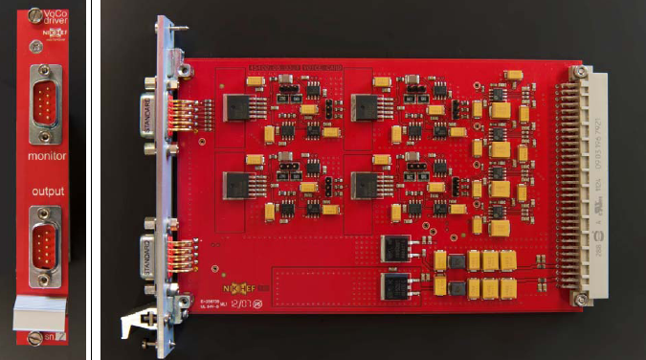
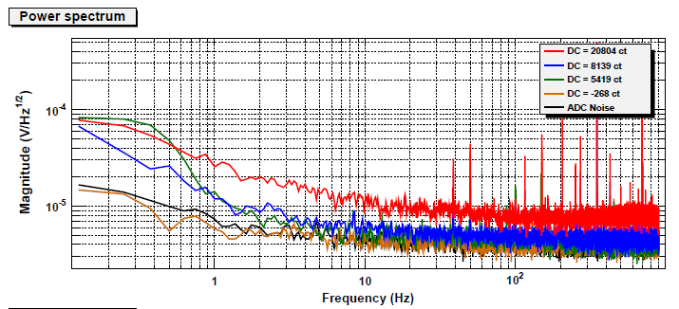
LVDT Driver
LVDT driver designed at Nikhef
Sensitivity is limited by ADC noise
Noise level increases with large DC
~ 3 nm/rtHz

Slide 20
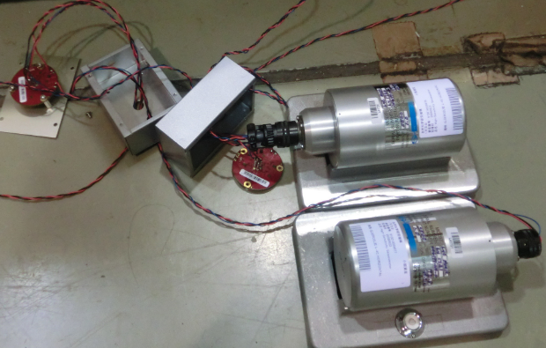
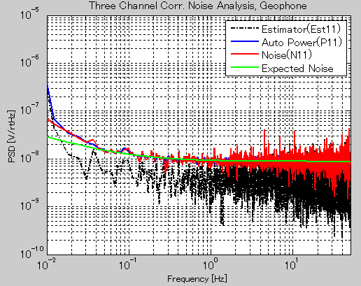
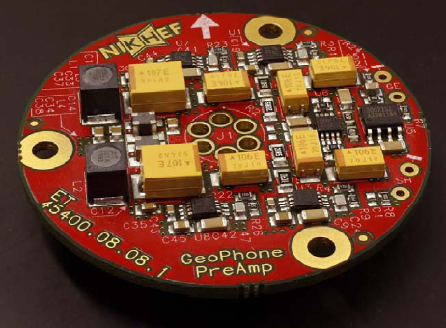
Inertial Sensor (Seismometer)
Geophone L-4C (Sercel)
Passive sensor (No lock)
→ stable operation, easy handling
Preamp designed at Nikhef
Noise measurement →

Slide 21
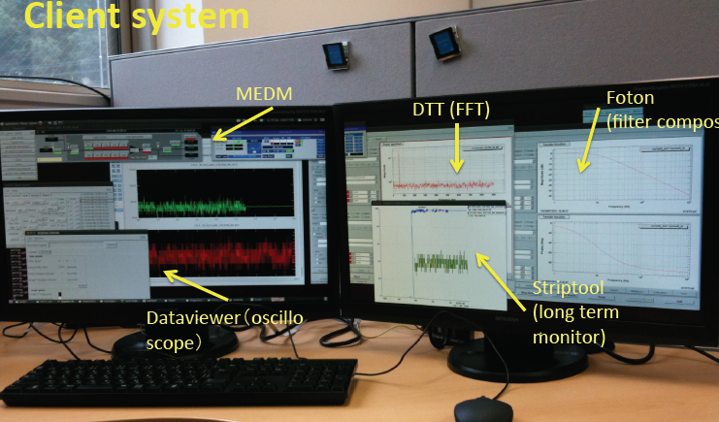
Digital System
Standalone digital system [LIGO]
16 kHz sampling
ADC 16 bit (65536)
Range: +/- 20 V (differential)
ADC Noise: 2 μV/rtHz
Digital System & Electric Devices

Slide 22
Study on GAS Filter

Slide 23
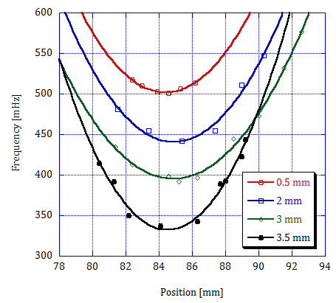
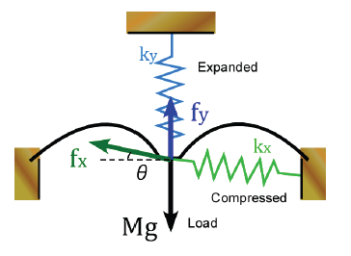
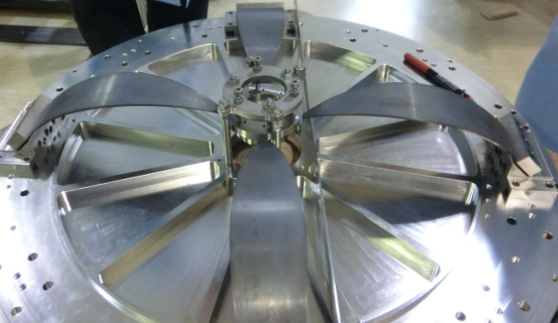
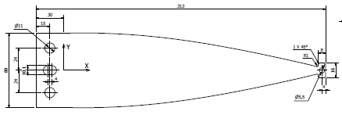
GAS Filter Tuning
Standard Filter Tuning
310 mm

Slide 24
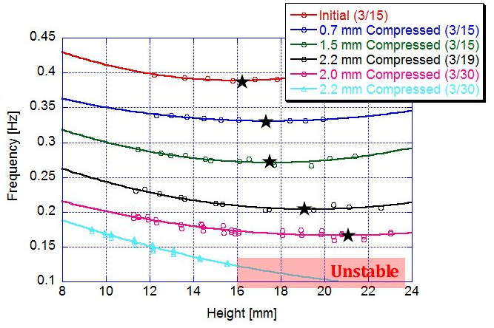
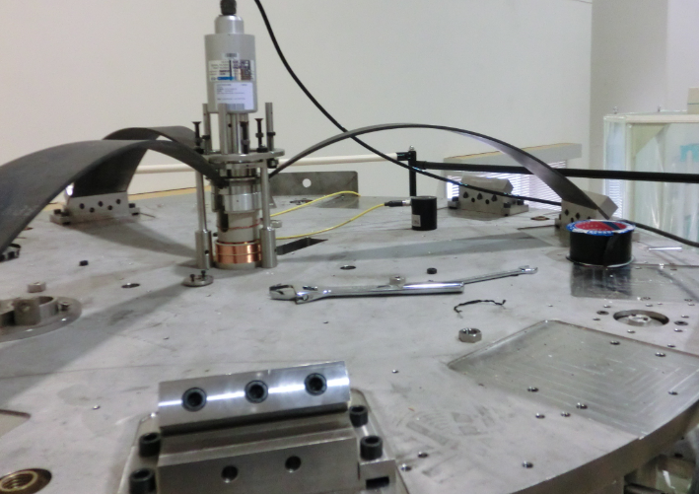
Large GAS Filter Tuning
645mm
Encounter run-out instability below ~0.15 Hz

Slide 25
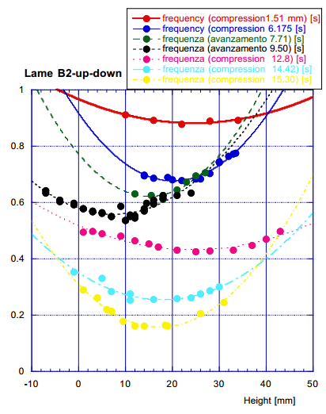
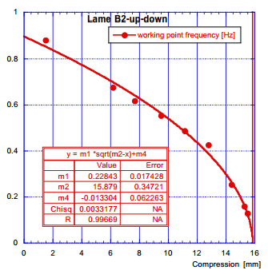
Large GAS Filter Tuning (2)
Real system (Not prototype)
@G&M, Lucca, Italy

Slide 26
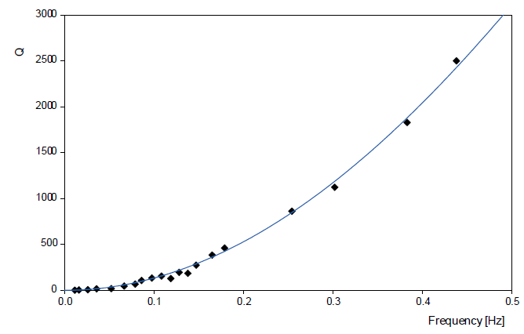
Q-factor Transition of Anti-Spring System
Q factor of GAS filter decreases as its frequency decreases
Energy loss per one cycle: Constant
⇒
Q ∝ f²
Kinetic energy of the oscillator ∝ f²
Q factor transition of TAMA-IP
(A. Takamori)

Slide 27
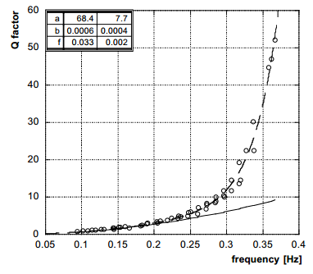
Q-factor Transition of GAS (Previous Result)
GAS filter Q measurement
@Caltech
Deviation from quadratic curve
Q ∝ f²
Different dissipation process??
Avalanche inside material?
Self-Organized Criticality ?

Slide 28
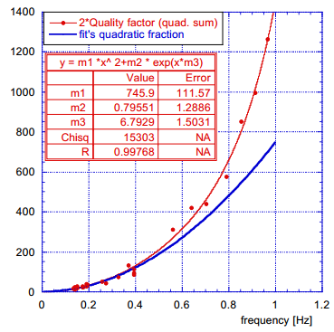
Q-factor Transition of Large GAS (New)
Large GAS Filter @Lucca
Deviation from quadratic curve
Q ∝ f²
Different dissipation process??
Avalanche inside material?
Self-Organized Criticality ?

Slide 29
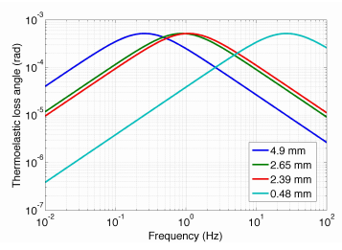
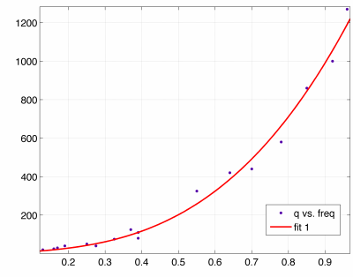
Interpretation of New Result
Thermoelastic loss is dominant.

Slide 30
Future Works
Study working point, instability and Q in more detail
How can we tune GAS filter to lower frequency without encountering instability??
Measure isolation performance of top Filter (tuning of magic wand)

Slide 31
Inverted Pendulum Control

Slide 32
IP Prototype System Overview
X
Y
Yaw
Pendulum

Slide 33
Tuning of IP
Resonant frequency shift due to gravitational anti-spring
Adding mass on the stage
0.1 Hz achieved

Slide 34
Top Stage Motion (LVDT Signal)
X, Y, θ motions are reconstructed from 3 LVDT signals
X Y θ
[μm/rtHz]

Slide 35
Top Stage Motion (LVDT Signal)
Wire torsion
(0.043 Hz)
IP [X,Y]
(0.133 Hz)
IP [θ]
(0.207 Hz)
Pendulum
(0.357 Hz)
Pitch
(0.865 Hz)

Slide 36
Active Damping
Damped
[μm/rtHz]

Slide 37
Isolation Performance with Active Damping
Put geophone on the top stage
LVDT control re-inject seismic noise above 0.1 Hz
RMS: 3 μm (20 μm for no control)

Slide 38
Active Damping with Geophone
Velocity damping by the use of geophone signal [for only X-direction]
Noise level above 0.1 Hz is improved
RMS: 1 μm

Slide 39
Future Plan
Increase the control gain to further decrease RMS [goal: 0.1 μm/sec for lock acquisition, ~0.1 μm for keeping lock (?)]
Combine geophone and LVDT signal [Crossover: ~0.1 Hz]
For control strategy, we have to learn a lot from Virgo and TAMA.

Slide 40
Contents
Introduction of KAGRA-SAS
Prototype Experiment
Modeling of SAS

Slide 41
For Better Modeling of SAS
Point-mass model (Super simple)
3D rigid-body model
(more realistic)
Only 1 dimension
No rotation coupling
No sensor noise estimation
…

Slide 42
Output from Rigid-Body Model
Eigen mode calculation with 3D graphics

Slide 43
Output from Rigid-Body Model
Estimate angular fluctuation of the mirror
Attachment point of heat links, asymmetry in IPs
Asymmetry in wire lenghs, asymmetry in suspension points

Slide 44
For Better User Interface

Slide 45
Future Works
Include active control in this model
Strategy for length & angular control
Control noise estimation (sensor & actuator noise)
Verified at Pre-isolator Prototype
Interface with MATLAB and other application
If you want to be a user, please contact me!!

Slide 46
END

Slide 47
Appendix

Slide 48
Sensor Noise: LVDT (Coupling from Actuator)
Due to high frequency (>2 kHz) noise from ADC, noise flour increases （Improved after digital system update）

Slide 49
Sensor Noise: Geophone
Preamp designed at Nikhef
Noise of preamp is measured
Geophone + Preamp の雑音測定： バックグラウンドが大きすぎて難しい ⇒ 神岡鉱山での測定を予定

Slide 50
Sensor Noise: Estimation

Slide 51
Transfer Function of Inverted Pendulum
< 0.1 Hz：Sensor Noise
> 10 Hz ：Acoustic (Environmental) Noise

Slide 52
Mechanics
Coil-Magnet Actuator
LVDT
Stepper Motor
Maraging Steel Spring

Slide 53
KAGRA-SAS Overview
Type-A
Type-B
Type-A 7-stage pendulum, 5-stage vertical spring, cryogenic system
Type-B 5-stage pendulum, 3-stage vertical spring
Type-C TAMA-Stack + double pendulum
Type-C

Slide 54
Simple Modeling
Simplified point-mass model
Meet the requirement!!

Slide 55
LVDT v.s. Geophone
<0.1 Hz poor sensitivity of geophone
>10 Hz poor sensitivity of LVDT

Slide 56
Active Control Demonstration
Damping ON
DC Control ON
Xに500 μmのオフセット
Displacement [μm]
ダンピングにより共振周波数での揺れを抑えることに成功
ステージのDC位置を制御することに成功

Slide 57
Response to Virtual X Actuation

Slide 58
Response to Virtual Y Actuation

Slide 59
Response to Virtual θ Actuation

Slide 60
What is Missing in the Model?
Coupling between translational and rotational DoFs
Detailed active control system and noise from it
Mechanical response of heat links (for heat paths)
Elastic mode of the wires, springs and bodies
Drift due to temperature change

