Slide 1
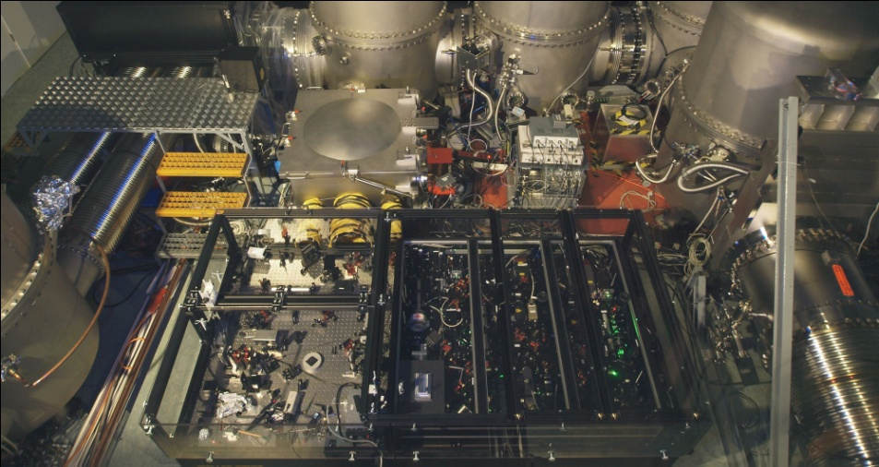
Application of squeezed light
in present and future GW observatories
Alexander Khalaidovski for the AEI Quantum Interferometry Group (Roman Schnabel)
Albert Einstein Institute
Max Planck Institute for Gravitational Physics
Institute for Gravitational Physics of the Leibniz University Hannover
http://www.qi.aei-hannover.de

Slide 2
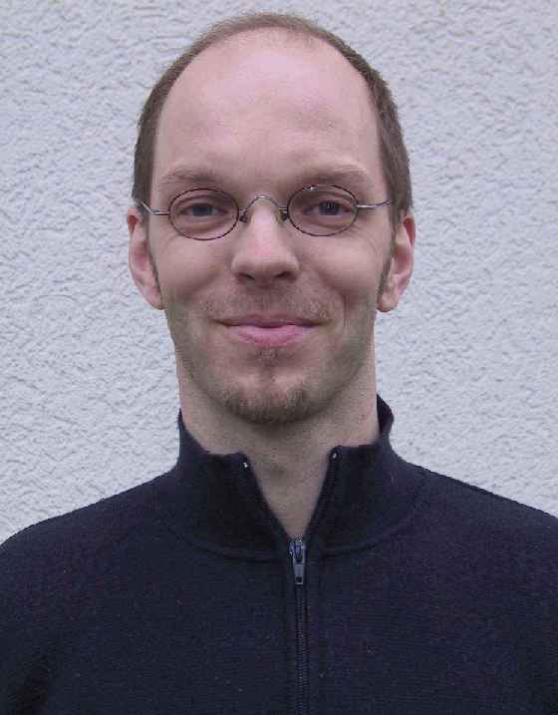
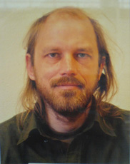
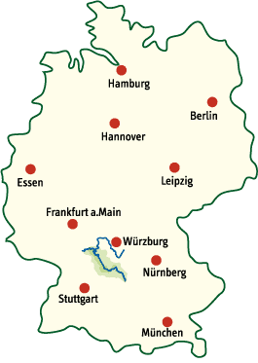
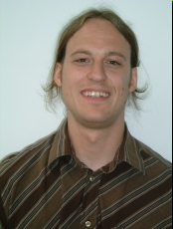
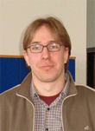
THE GEO 600 SQUEEZER TEAM
AEI HANNOVER
GEO 600
Roman Schnabel
Hartmut Grote
Further contributions:
Christian Gräf
Simon Chelkowski
James diGuglielmo
and many more ...
Henning Vahlbruch
Nico Lastzka

Slide 3


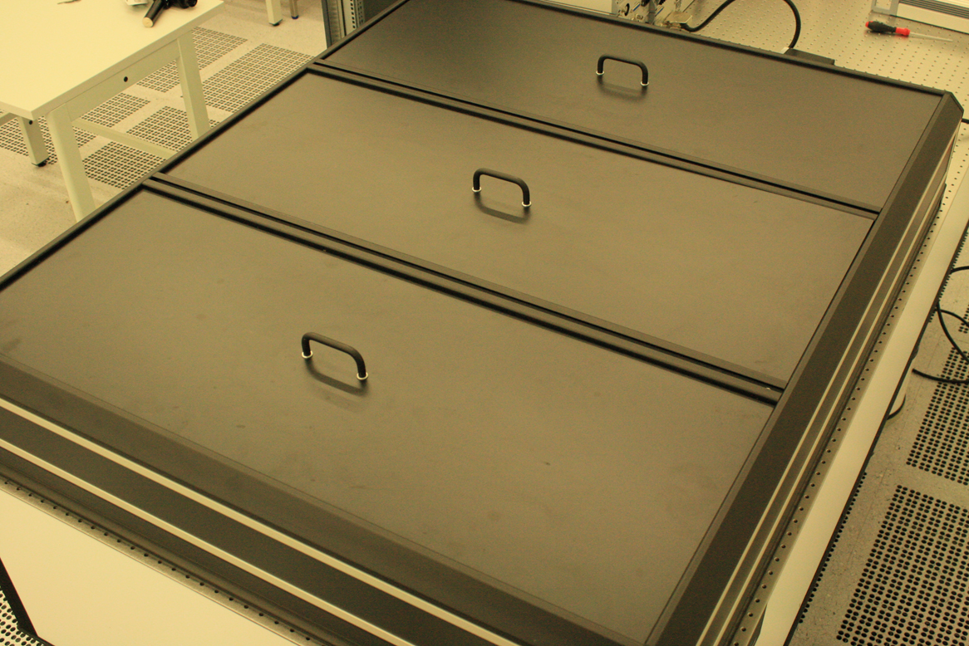
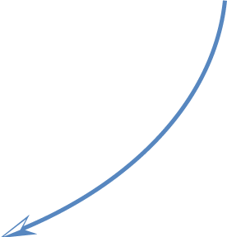
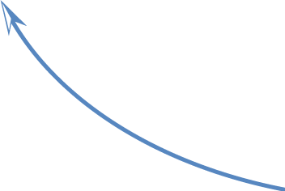
OUTLINE
A glimpse into the future
Motivation
Squeezed
light?
Open work for GEO-HF
Current achievements
in GEO 600 and LIGO-H
Notes:
In meiner thesis ging es um den squeezed light laser, den ich heute gerne vorstellen möchte. Erklärung Titel, dazu Stichworte

Slide 4
MOTIVATION
Surpass the quantum noise limit
Notes:
Shall we stop here?
A quantum optical technique exists, the so-called squeezed light, that is a possible solution

Slide 5
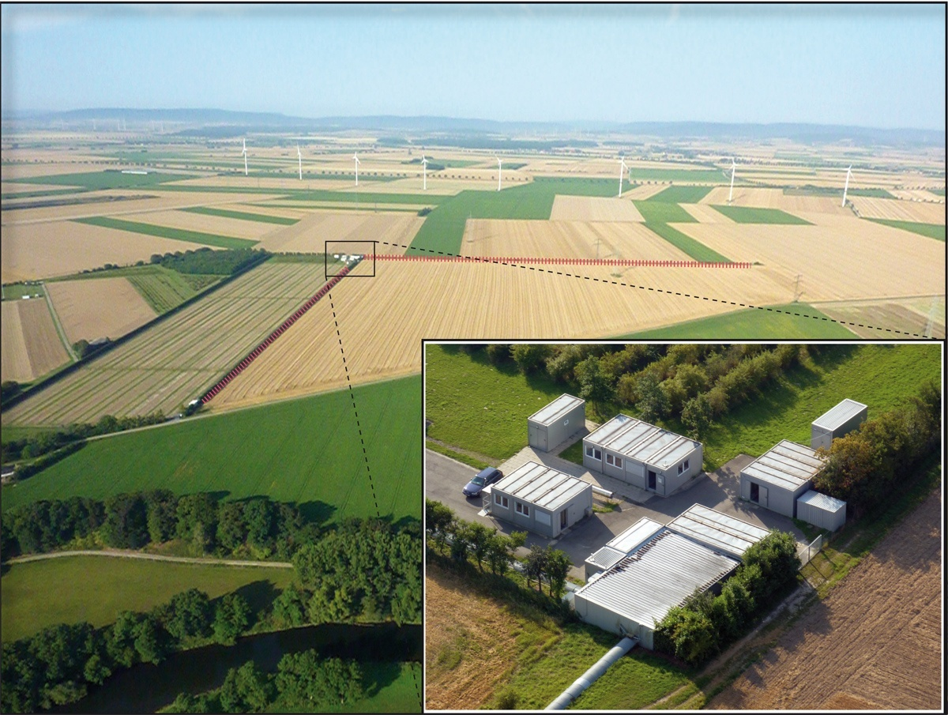
THE GW OBSERVATORY GEO 600

Slide 6
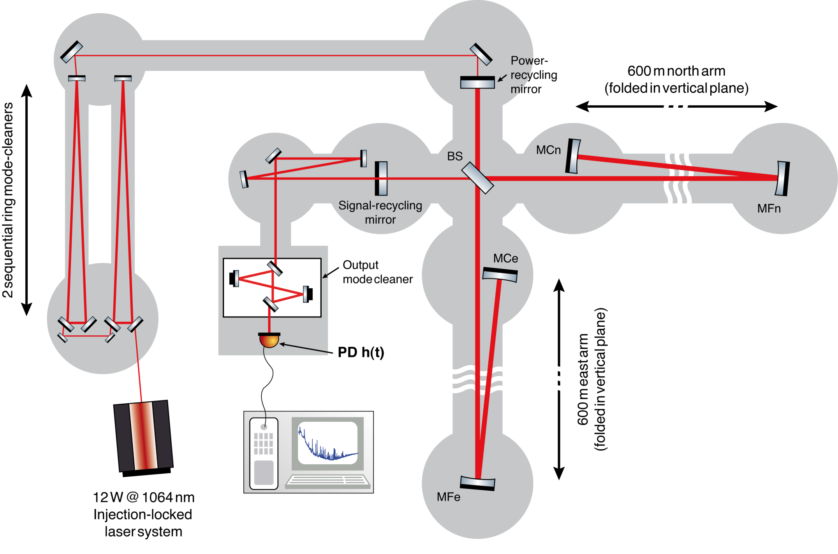
OPTICAL LAYOUT OF GEO 600

Slide 7
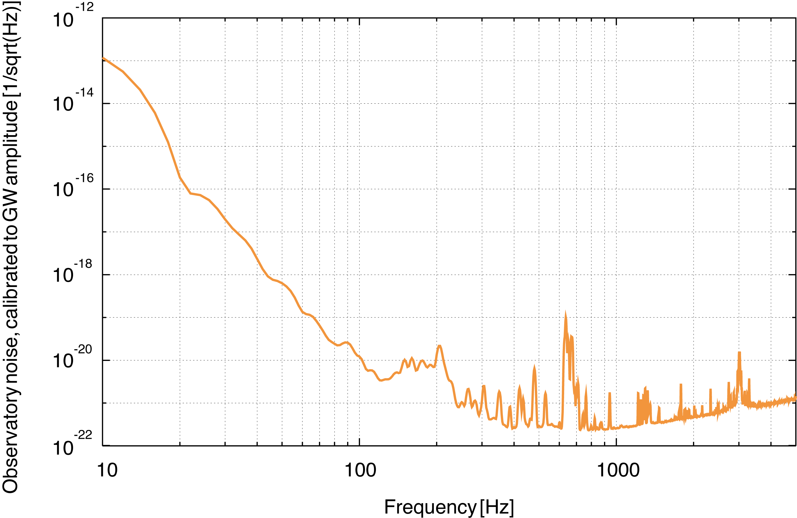
GEO 600 SENSITIVITY – AUGUST 2010
Notes:
Was sind nun die Begrenzungen dafür, dass diese Empfindlichkeit beschränkt ist? Fundamental: RPN und thermal, jedoch von seismic und control noises überdeckt.

Slide 8
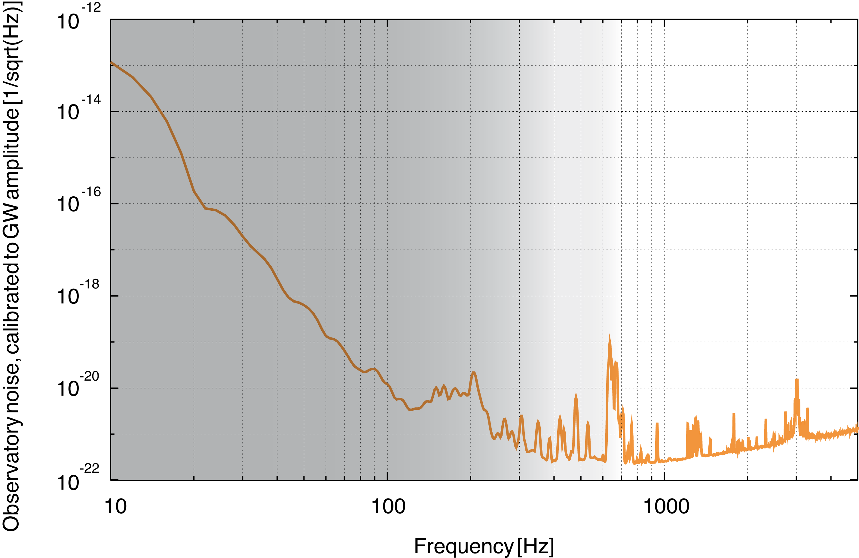
MEASUREMENT SENSITIVITY LIMITS
Seismic – Technical
Quantum

Slide 9

FURTHER SENSITIVITY IMPROVEMENT
Increase interferometer arm length
Decrease laser wavelength
Increase circulating
laser power
Reduce quantum noise
Notes:
Und nun stellt man sich die Frage: wie kann man die Empfindlichkeit der detektoren weiter verbessern? Eine Lösung wäre es, die zirkulierende Lichtleistung zu erhöhen, denn das Signal skaliert mit der Leistung, das Shot noise nur mit der Wurzel davon. Dies ist zweifelsfrei ein Ansatz, kann aber zu Problemen führen wegen höherer thermischen Last. Ein alternativer Ansatz ist es, das Quantenrauschen selbst anzugehen. Doch wo kommt dieses Rauschen eigentlich her? PS: Alternativer Ansatz im Quantenrauschlimitierten Bereich.

Slide 10
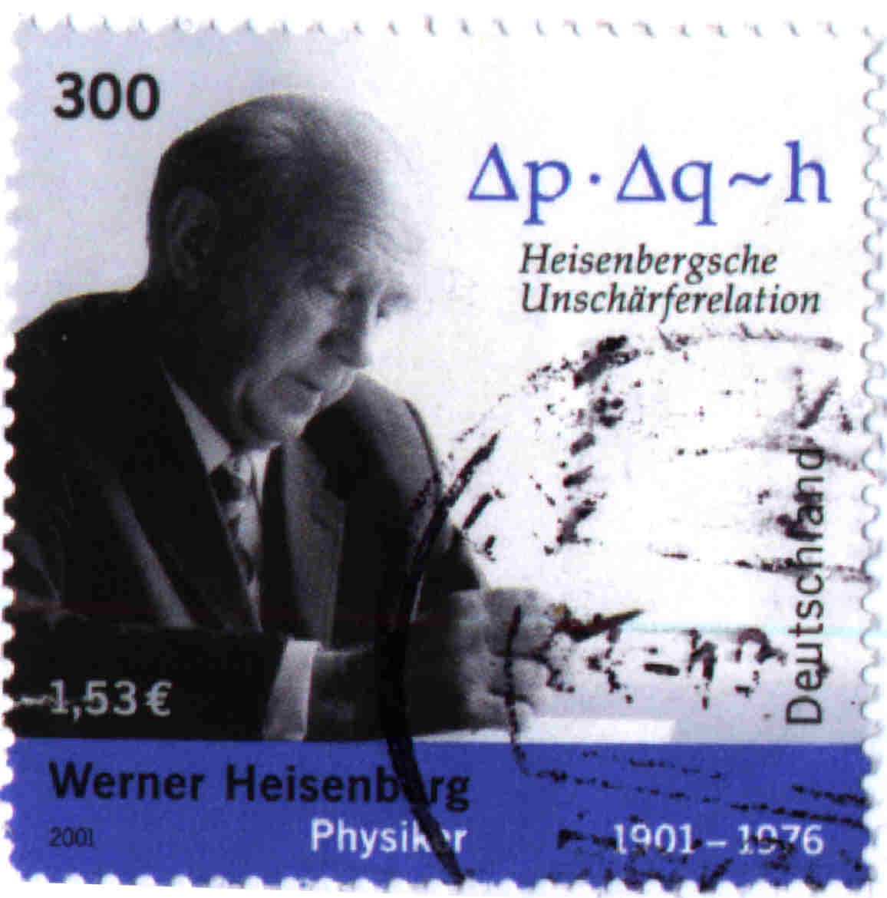
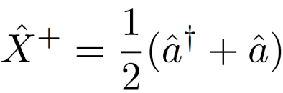


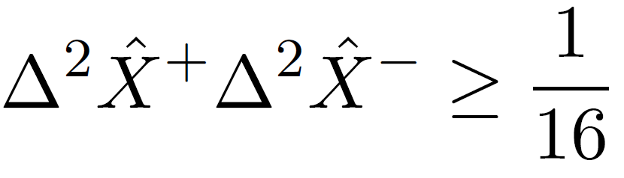

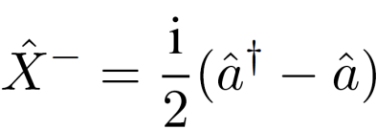
COHERENT STATES
Notes:
Um das zu sehen, betrachten wir zunächst einmal einen kohärenten Zustand, repräsentiert durch Phasor und Rauschen. Das ist beste Annäherung an Laserstrahl.

Slide 11
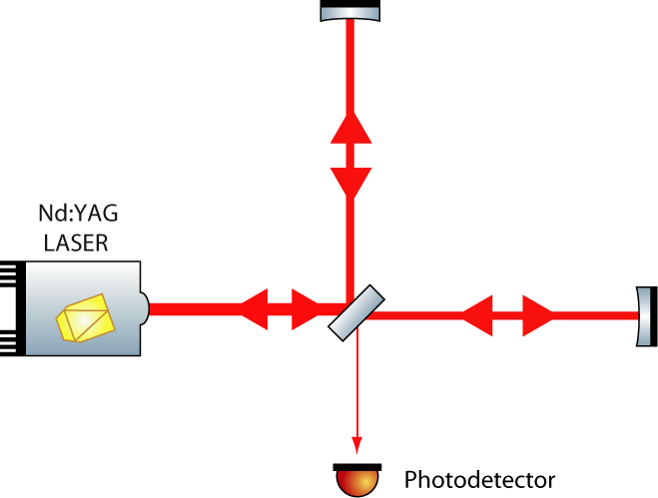
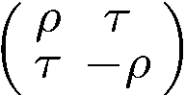



NOISE IN A MICHELSON IFO I – BRIGHT PORT

Slide 12

VACUUM STATE

Slide 13
NOISE IN A MICHELSON IFO II – DARK PORT

Slide 14


SQUEEZED VACUUM STATE
Notes:
Introduce degree of squeezing here, sqz. And anti-sqz

Slide 15
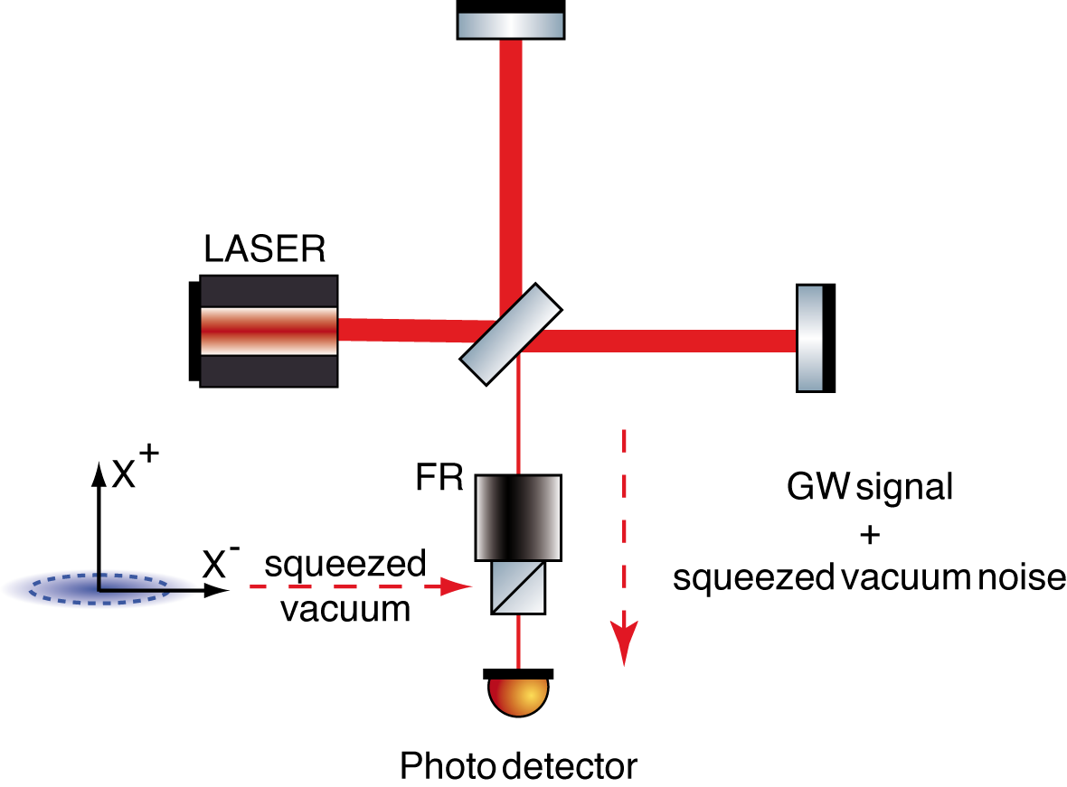
SQUEEZED VACUUM INJECTION

Slide 16
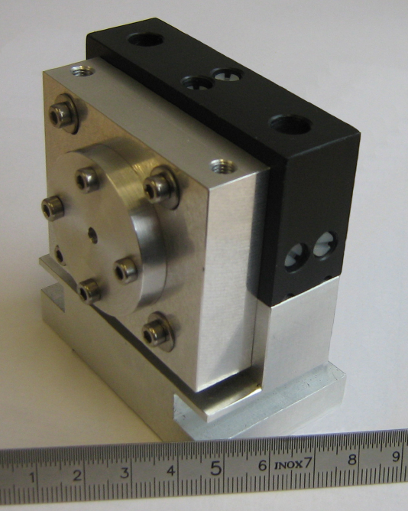
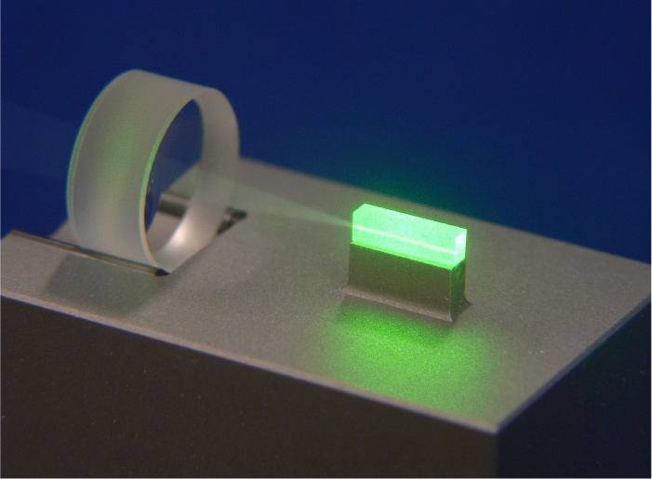
GENERATION OF SQUEEZING
BASED ON OPTICAL PARAMETRIC AMPLIFICATION (OPA)
For GW observatories
Pump field:
532 nm cw
Squeezed field:
1064 nm cw
LiNbO₃
or
PPKTP
Notes:
Wie werden solche Zustände des Lichtfeldes im Labor eigentlich erzeugt?

Slide 17
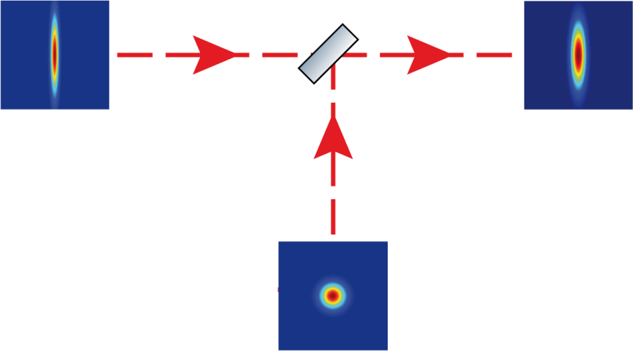
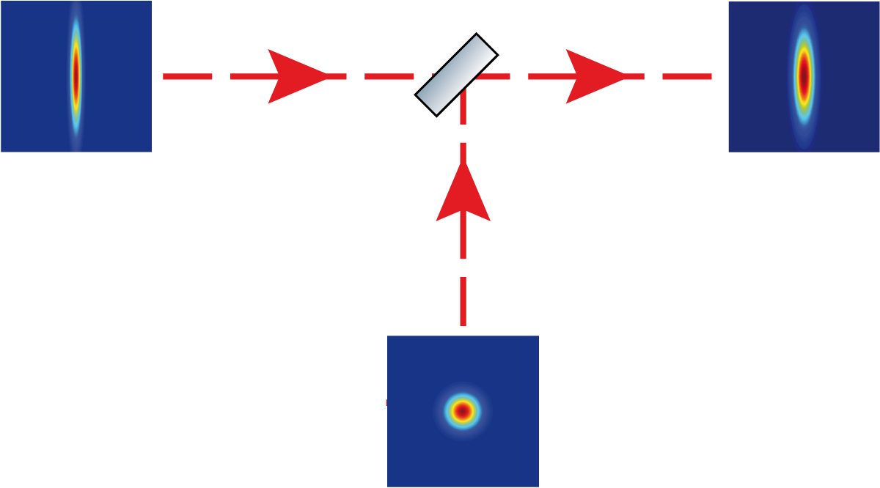
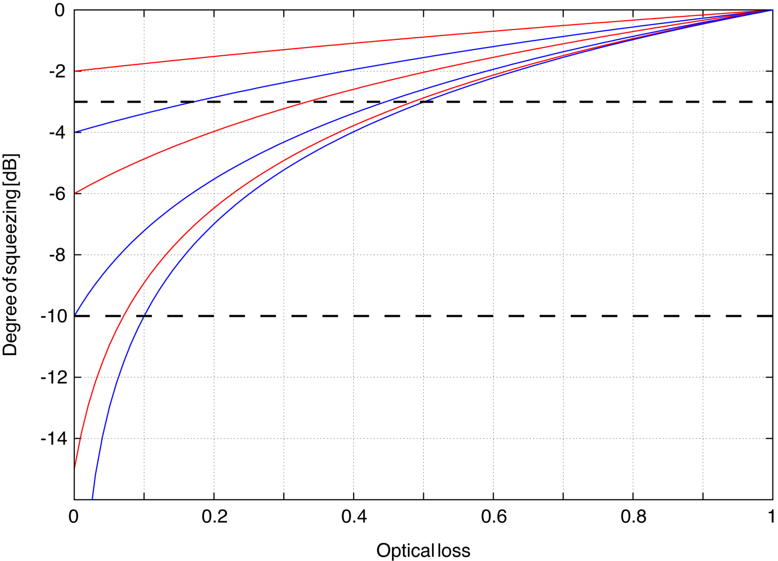
SENSITIVITY TO OPTICAL LOSS
70/30
50%
optical loss
10%
optical loss
Notes:
Empfindlichkeit erklären, darauf überleiten, dass Verlust herausgerechnet werden kann.

Slide 18
The GEO 600 Squeezed-Light Laser

Slide 19
BOUNDARY CONDITIONS
Goal
• Improved sensitivity at quantum-noise-limited frequencies
• Availability for future GW detector generations
Requirements
• Squeezing in earth-bound GW detection band
(10 Hz – 10 kHz)
• Strong squeezing
• Stable control scheme
(allowing for long-term, independent operation)
Approach
• Assembly on optical breadboard in AEI cleanroom
• After characterization integration into GEO 600

Slide 20
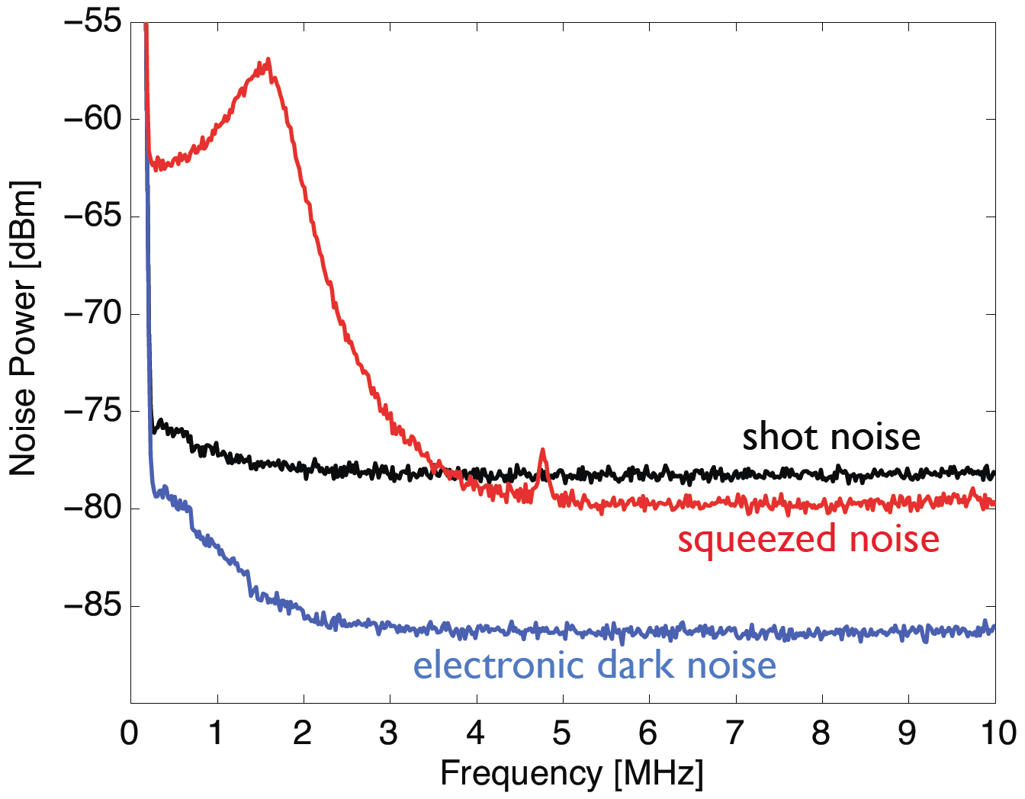
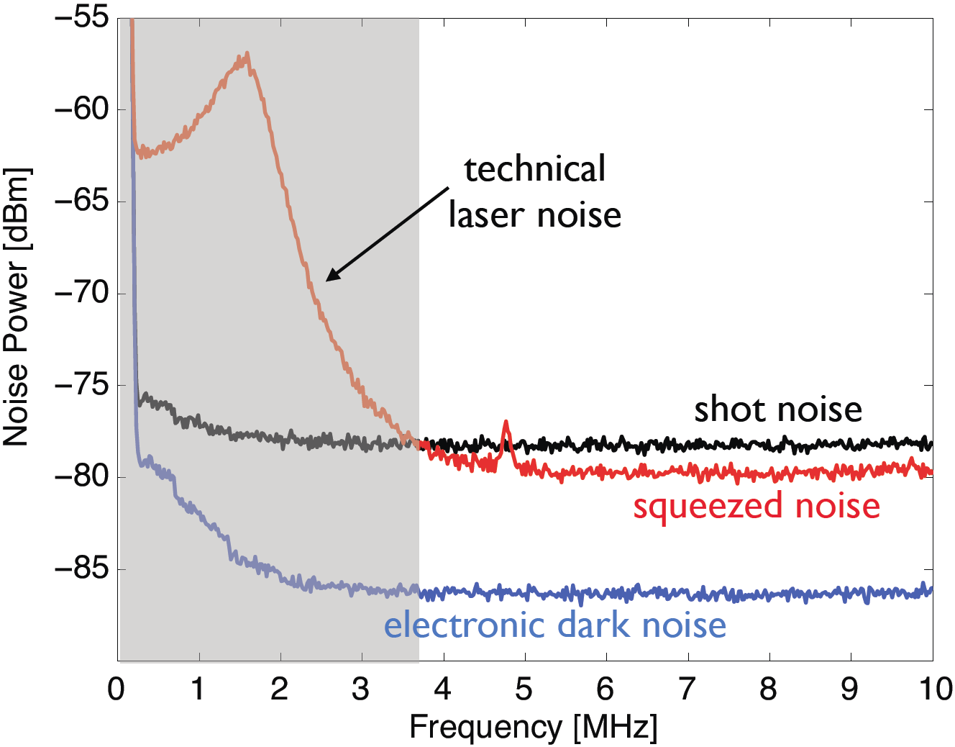
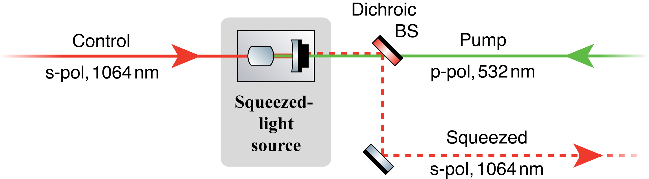
“CONVENTIONAL” CONTROL SCHEME
A. Franzen, Diploma thesis (2004)

Slide 21
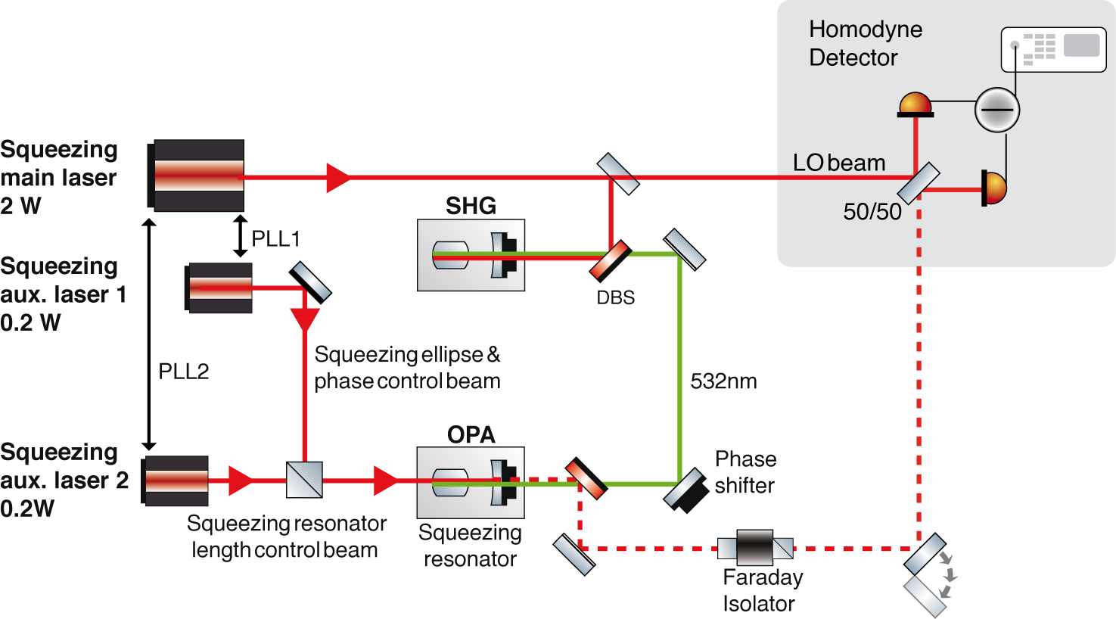
CONTROL SCHEME FOR AUDIO-FREQ SQUEEZING

Slide 22
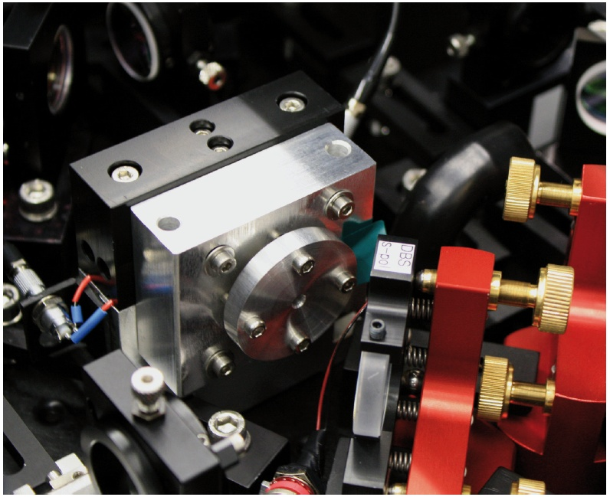
SQUEEZED-LIGHT RESONATOR

Slide 23
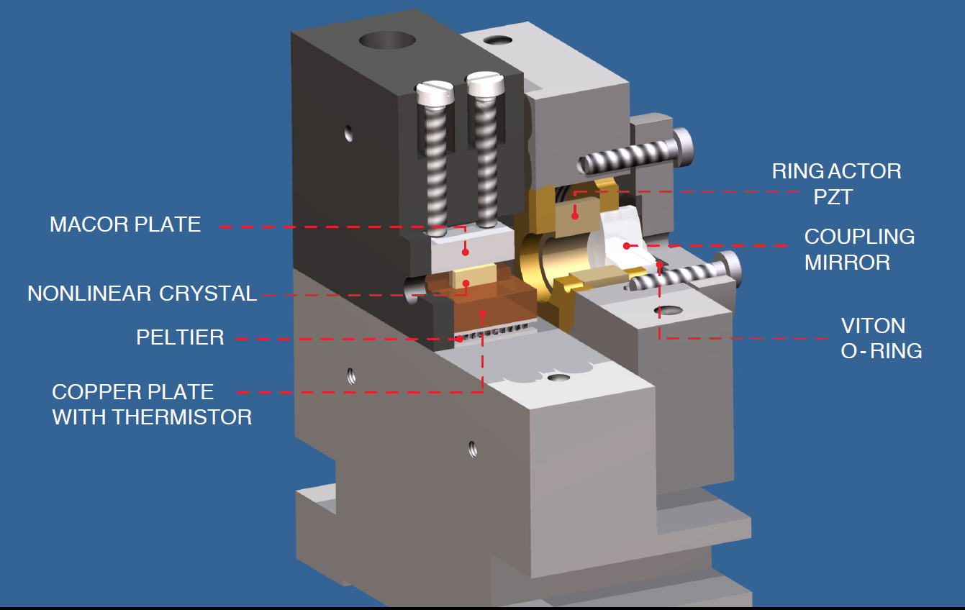
SQUEEZED-LIGHT RESONATOR

Slide 24
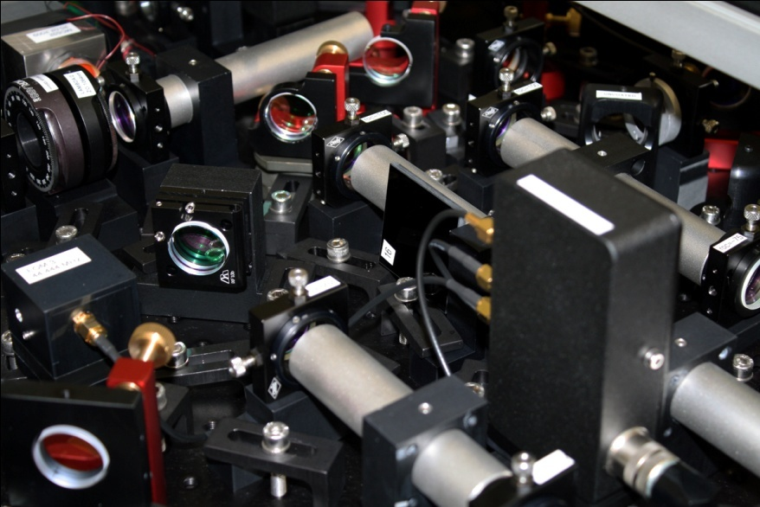
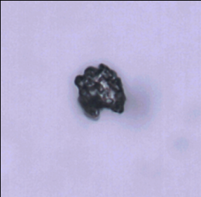
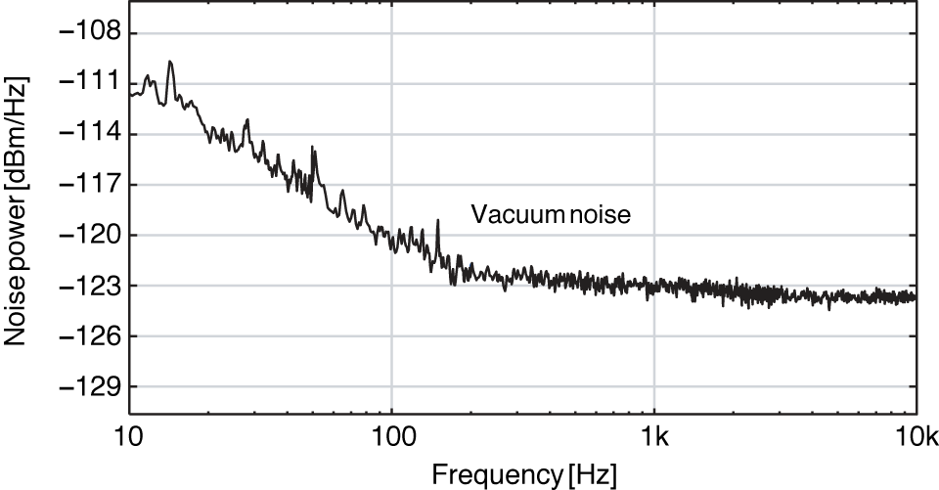
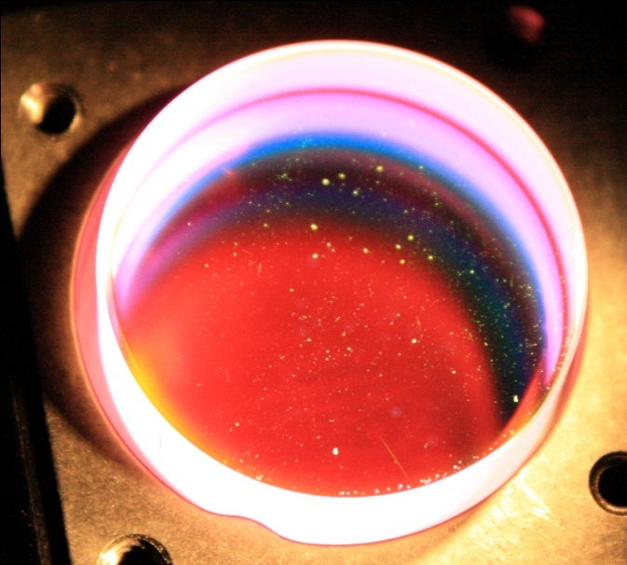
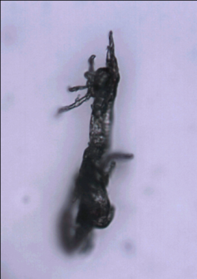
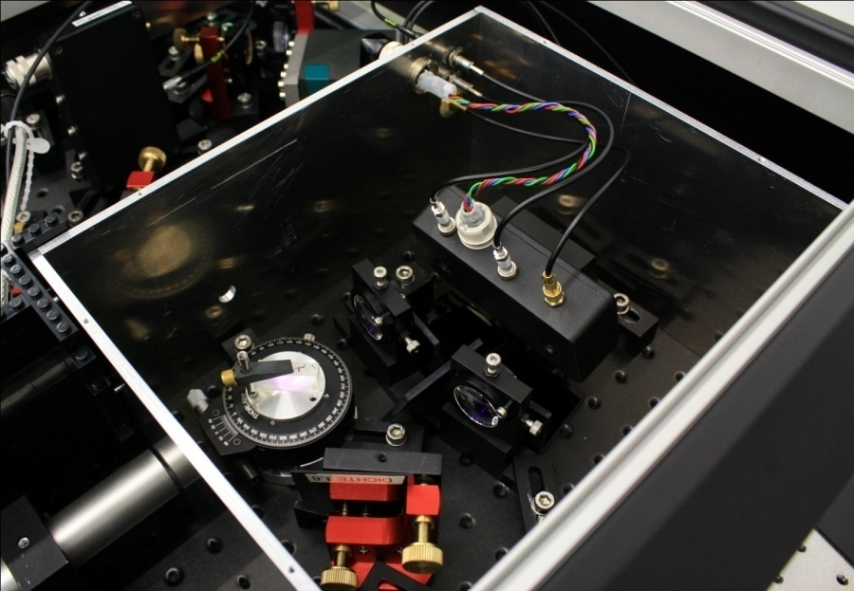
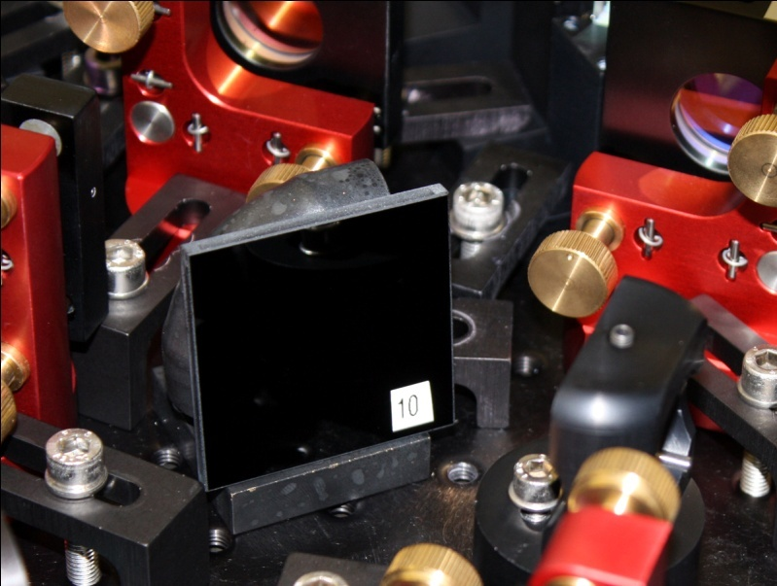
STRAY LIGHT SUPPRESSION
Vahlbruch et al., Phys. Rev. Lett.. 97 (2006) 011101
Notes:
kürze

Slide 25
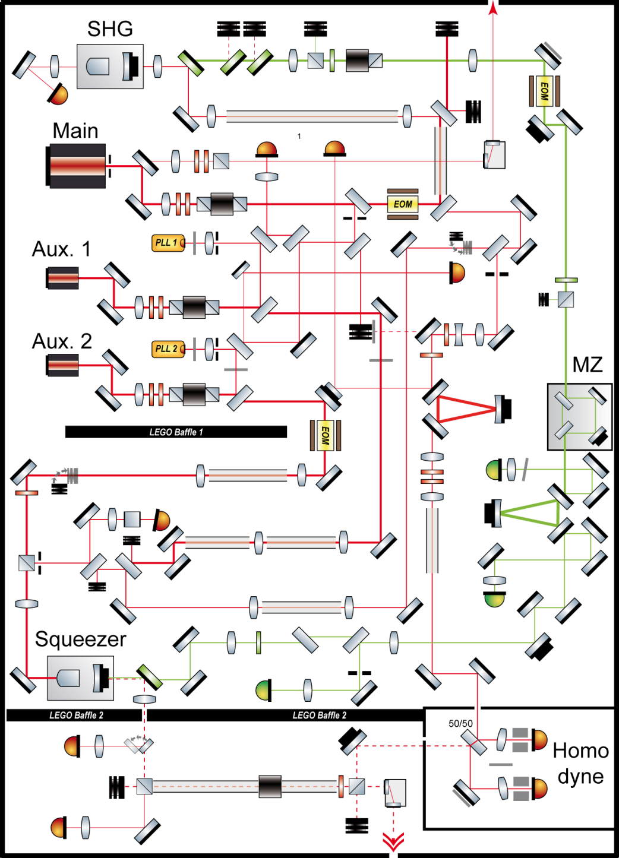
OPTICAL LAYOUT OF THE SQUEEZED-LIGHT LASER
• Main Laser: InnoLight Mephisto
• Aux. Lasers: Mephisto OEMs
• Optics: ATF (superpolished)
• Nonlinear medium: PPKTP
• Breadboard: 113x135 cm
• Beam height: 50mm
• Compact design
• About 120 opt. components
total weight ≈ 120 kg

Slide 26
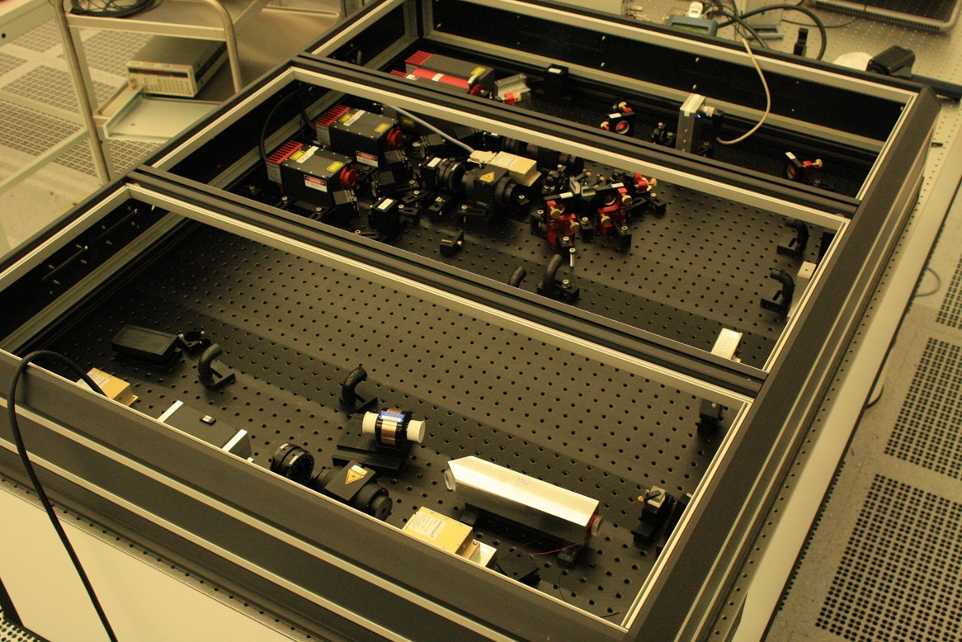
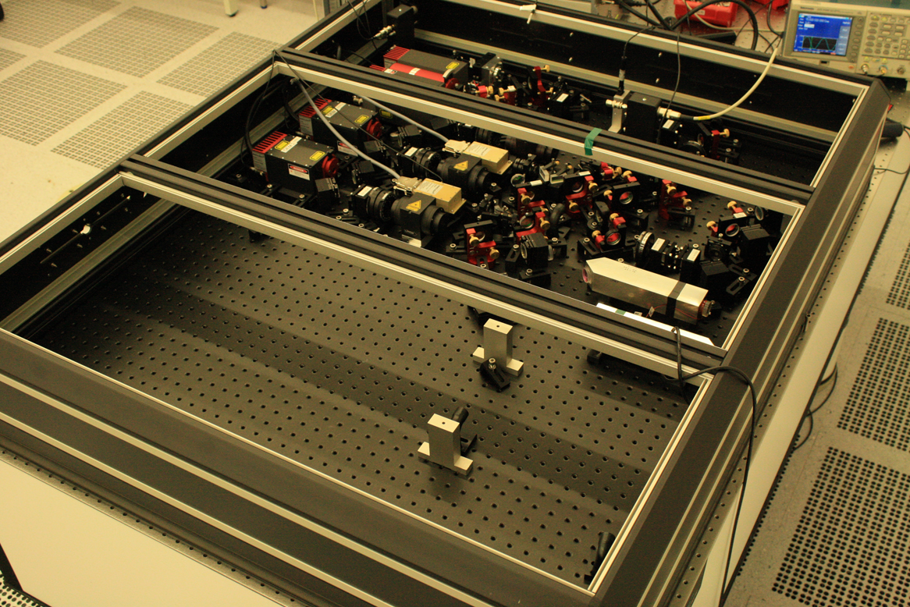
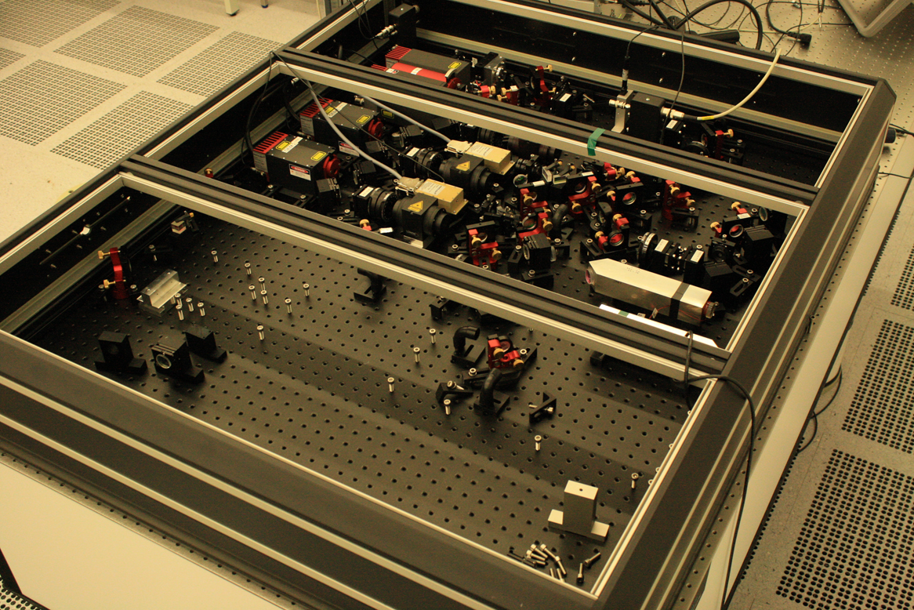
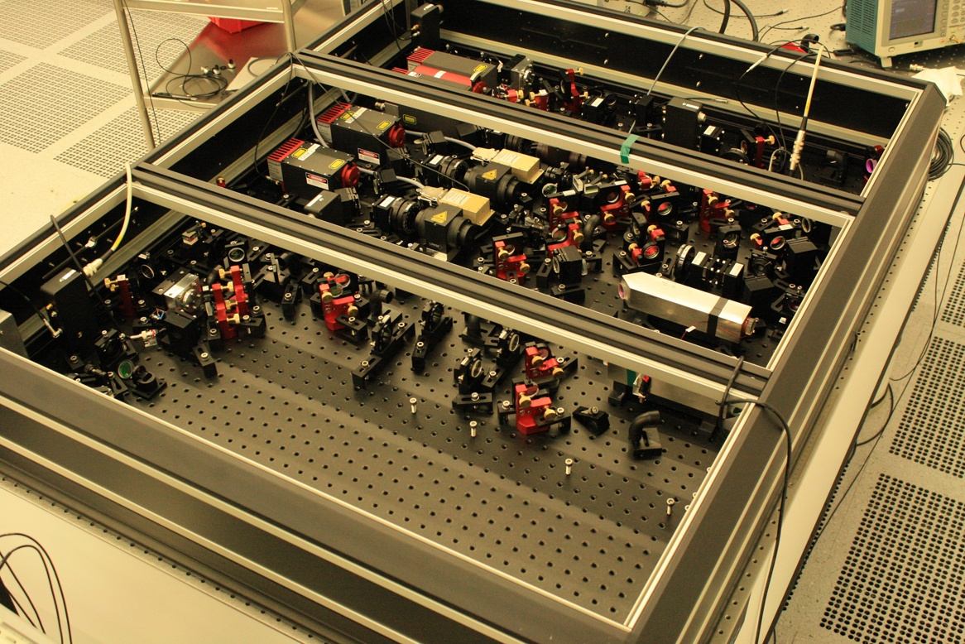
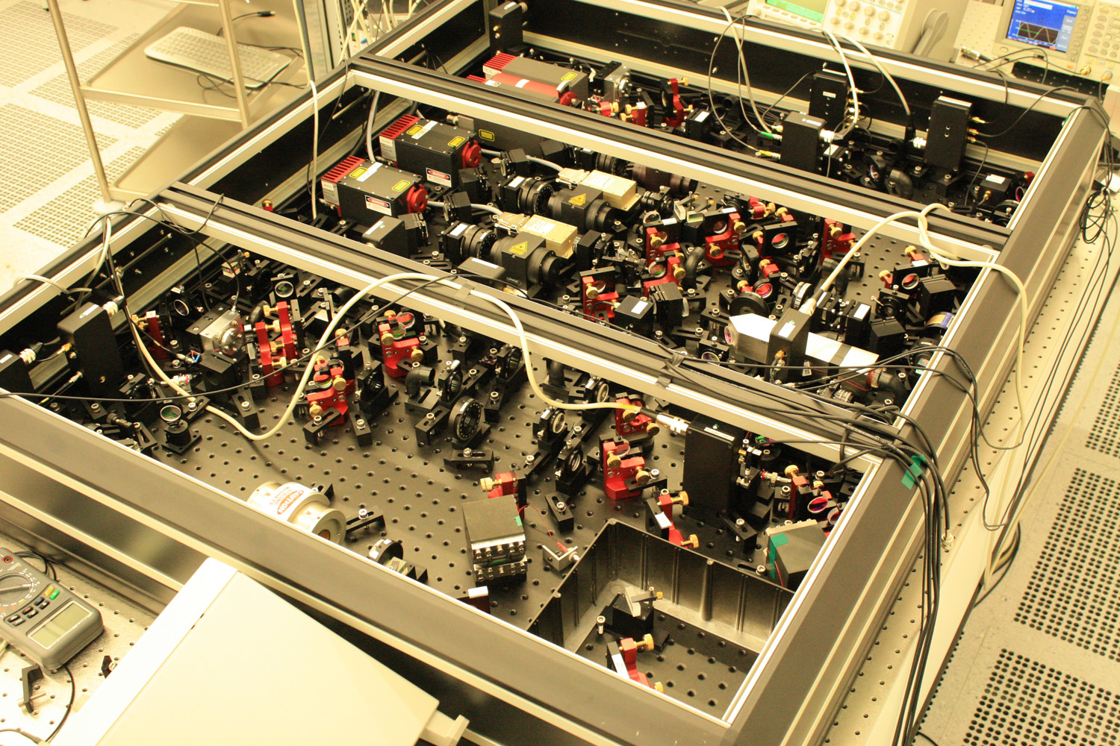
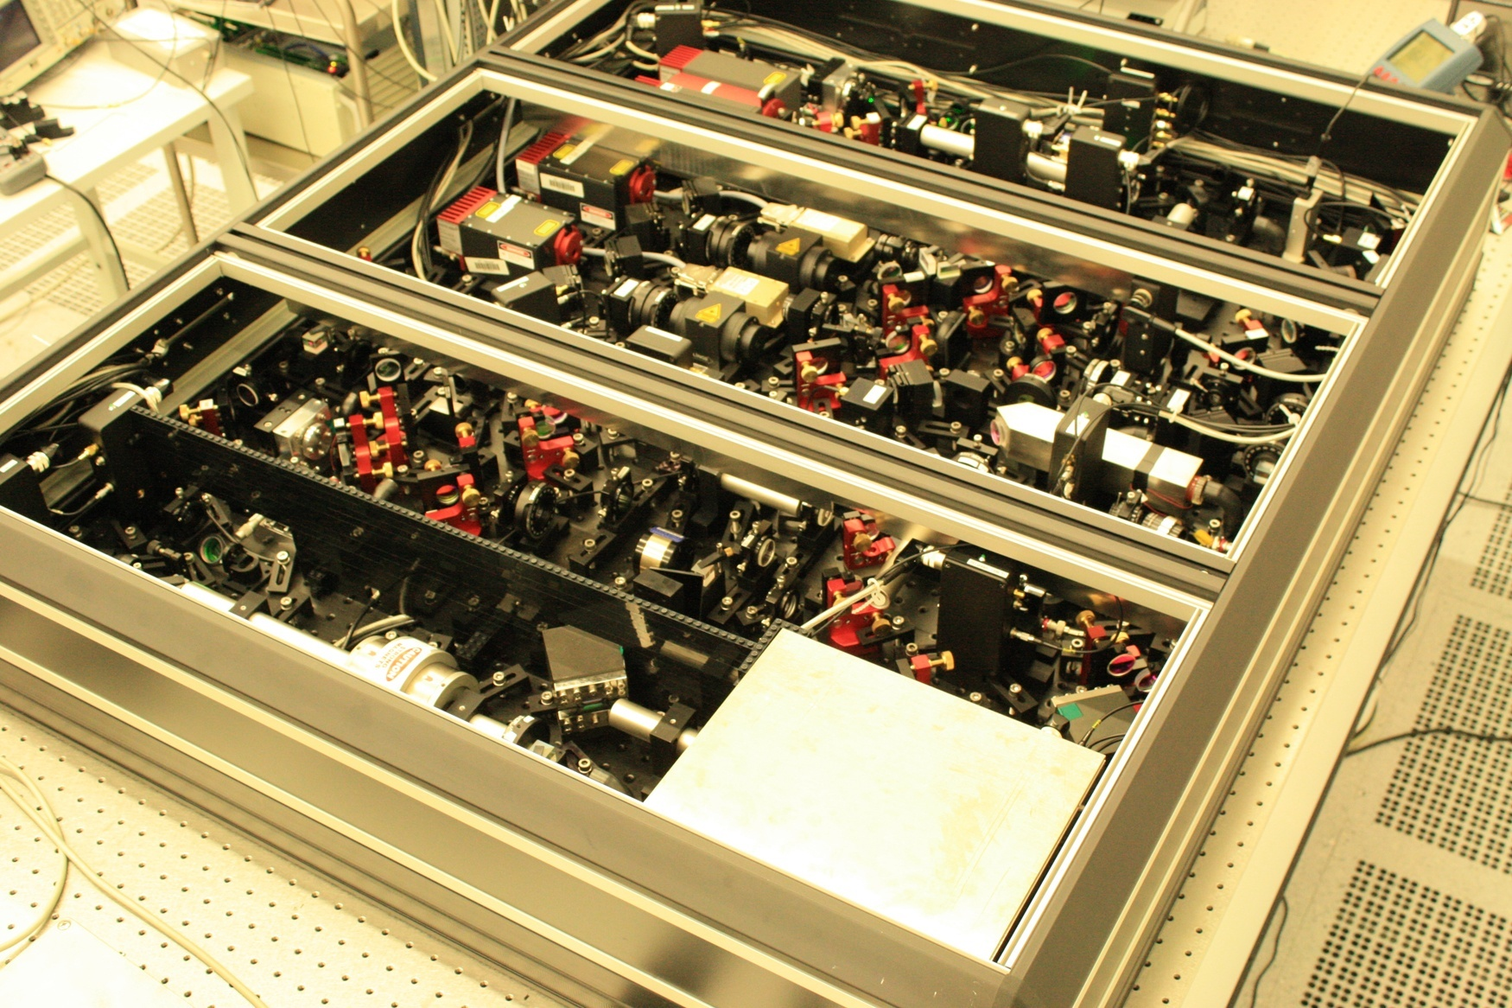
ASSEMBLING THE SQUEEZED-LIGHT LASER

Slide 27
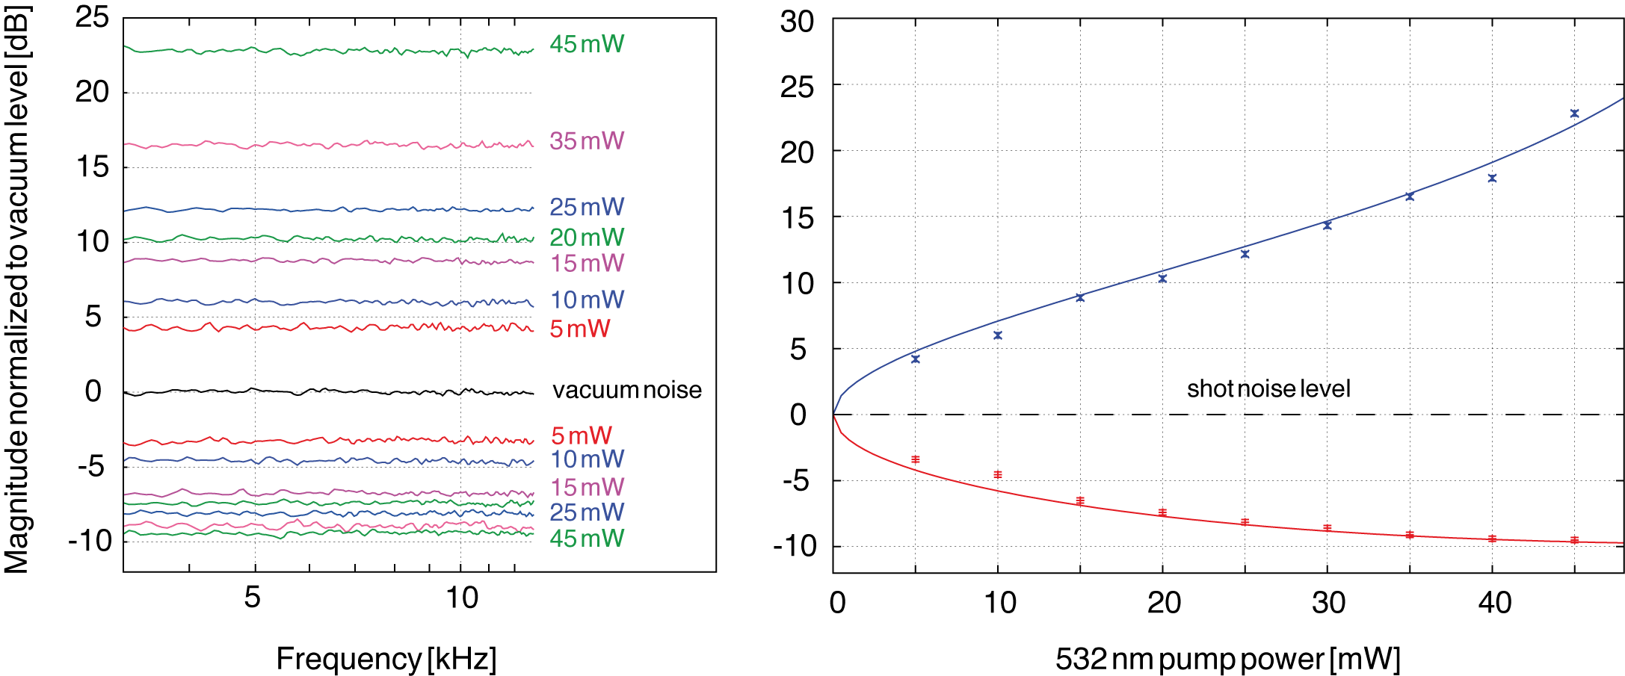
CHARACTERIZATION: SQUEEZING VALUES
f = 5 kHz
up to 9.6 dB of squeezing measured during characterization
⇒ more than 11dB available for injection in GEO 600
Khalaidovski et al., accepted for publication at JPCS, arXiv:1112.0198

Slide 28
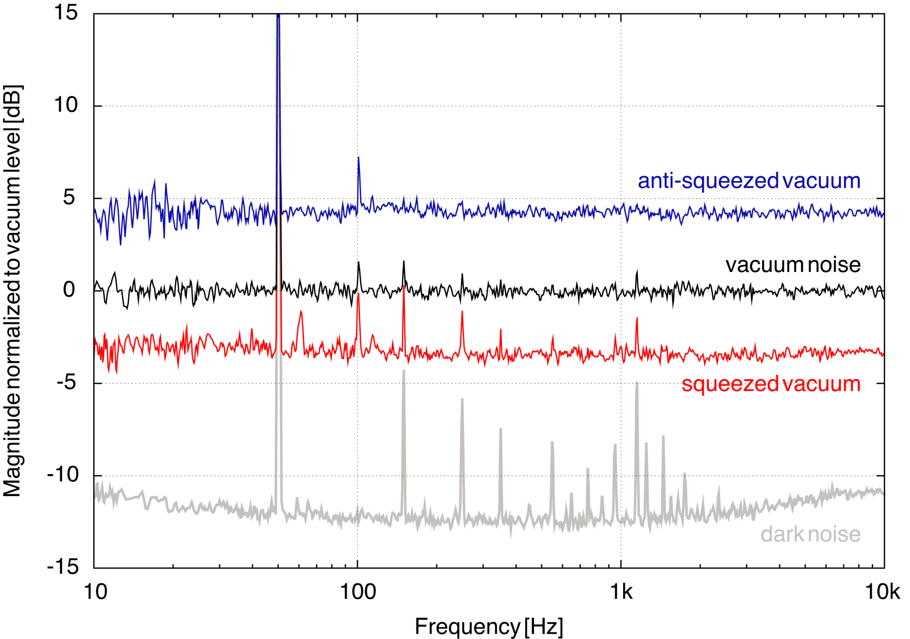
CHARACTERIZATION: SQUEEZING SPECTRUM
P_{532 nm} = 5 mW

Slide 29
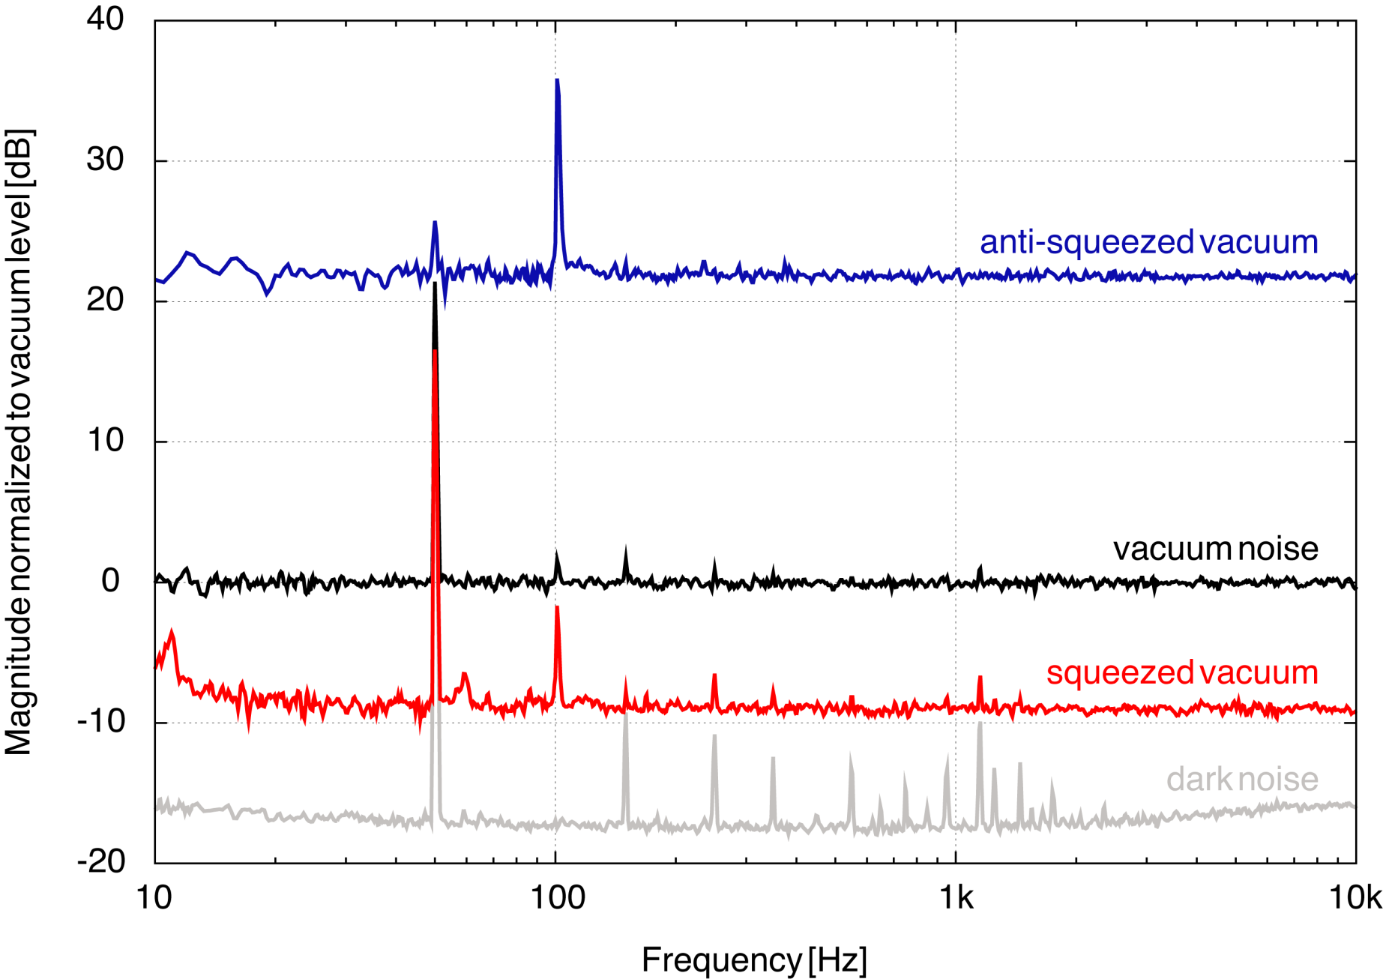
CHARACTERIZATION: SQUEEZING SPECTRUM
P_{532 nm} = 45 mW

Slide 30
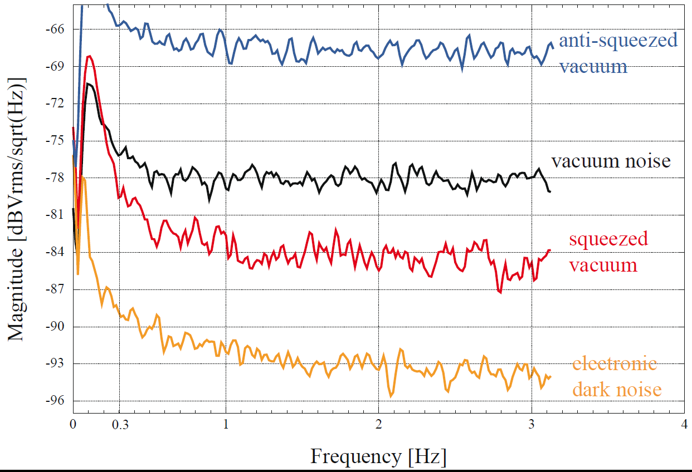
LOW-FREQUENCY SQUEEZING

Slide 31
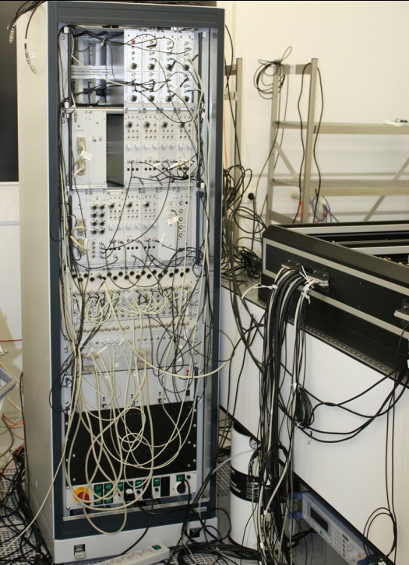

LONG-TERM OPERATION: ELECTRONIC CONTROL
• Analog electronics for high-bandwidth control loops
• Digitally interfaced to EPICS CDS
• Permanent operation, automated lock acquisition
• Fast lock (re)acquisition: max. 15 s
Notes:
Auch data taking

Slide 32



INFLUENCE OF CHANGING PUMP POWER
532 nm
pump power fluctuations
Changing crystal temperature
Cavity detuning for s-polarized light
Optical gain
Squeezing ellipse
angle change
Coherent control
error signals
Khalaidovski et al., Class. Quantum Grav. 29 (2012) 075001
Notes:
Temperatureintrag ändert sich. This will affect the optical gain that is a function of pump power and thus directly change the degree of squeezing or anti-squeezing. Direct effect. The detuning will additionally lead to the following effects:
- Ist die cavity nicht länger resonant, so nimmt zusätzlich der nichtlineare gain weiter ab und das beobachtete squeezing reduziert sich noch weiter.
The single sideband injected in the coherent locking scheme will see a detuned cavity. This will effectively lead to a rotation of the squeezing ellipse. Langzeitstabilität beruht nun darauf, dass wir das Experiment einstellen und nicht mehr anfassen. Rotiert die Ellipse, so ist die Auslesequadratur des Homodyndetektors nicht länger optimal und wir detektieren zum teil Anti-Squeezing. Somit verringert sich das beobachtete Squeezing-Level.
- Auch die erzeugten fehlersignale sind vom nichtlinearen gain abhängig. Ändert sich mit der Verstimmung der Gain, kann dies also zu einer zusätzlichen Drehung der Quetschellipse führen.

Slide 33

PUMP POWER STABILIZATION
Khalaidovski et al., Class. Quantum Grav. 29 (2012) 075001

Slide 34


PUMP POWER STABILIZATION
Khalaidovski et al., Class. Quantum Grav. 29 (2012) 075001

Slide 35


LONG-TERM STABILITY
Duty cycle: 99.93 %
Khalaidovski et al., Class. Quantum Grav. 29 (2012) 075001
Notes:
Wie schon vorher erwähnt, ist der duty-cycle sehr hoch, für diese Messung hier betrug er 99.93 Prozent.

Slide 36
Implementation in GEO 600

Slide 37

TRANSPORT

Slide 38

TRANSPORT

Slide 39

TRANSPORT

Slide 40

TRANSPORT

Slide 41

ARRIVED AT THE DETECTION BENCH
Notes:
1 week after transport same performance as at AEI cleanroom

Slide 42

INTEGRATION INTO GEO 600

Slide 43

INTEGRATION INTO GEO 600

Slide 44

INTEGRATION INTO GEO 600 – PLL
• 15 mW pick-off beam from GEO 600 main laser
• Fiber-coupled AOM (80 MHz)
• Fiber to detection bench (3 mW at output)
• Commercial PLL (InnoLight GmbH)

Slide 45

INTEGRATION INTO GEO 600 – MM

Slide 46

INTEGRATION INTO GEO 600 – MM
Mode-matching to IFO and OMC: 94.5 %

Slide 47

INTEGRATION INTO GEO 600

Slide 48

“CLASSICAL” GEO 600 SENSITIVITY
Up to 3.5 dB
detected squeezing

Slide 49

SQUEEZING-ENHANCED GEO 600 SENSITIVITY
Up to 3.5 dB
detected squeezing
Factor 1.5
sensitivity improvement
The LIGO Scientific Collaboration, Nature Phys. 7 (2011) 962-965

Slide 50

VIEW INTO THE MAIN BUILDING

Slide 51
The LIGO-H1 squeezing experiment

Slide 52

LIGO SQUEEZED-LIGHT LASER

Slide 53

LIGO-SQUEEZER
• generally similar to AEI device
• main differences:
- no cleanroom environment
⇒ higher stray light contribution possible
- bow-tie configuration
additional 42 dB isolation
- doubly-resonant (1064 nm and 532 nm)
- LO beam from PSL via fiber
excess phase noise, no MC
• AEI contributions
- SHG design
- balanced homodyne detector
(- control scheme)
Notes:
Advantage bow tie: additional isolation, one less Faraday Isolator. Possible disadvantage: more phase noise, because longer.

Slide 54

H1 WITH SQUEEZED LIGHT
• 2.25 dB squeezing enhancement
• squeezing observable down to 100 Hz
PRELIMINARY
• inspiral range improved by 1 Mpc
• no noise added at lower frequencies
Courtesy Lisa Barsotti for the LIGO Scientific Collaboration

Slide 55

H1 WITH SQUEEZED LIGHT
...
SUBMITTED

Slide 56
Near-term future: GEO-HF

Slide 57

Kate Dooley @ September LVC Meeting (Rome)

Slide 58

OPTICAL LOSS AT TIMES OF NAT. PHYS. 7
57

Slide 59

OPTICAL LOSS AT TIMES OF NAT. PHYS. 7
58

Slide 60

OPTICAL LOSS OPTIMIZATION – OMC
59

Slide 61



OPTICAL LOSS OPTIMIZATION – OMC
Before OMC (60mW):
After OMC (6mW)::
59

Slide 62
OPTICAL LOSS OPTIMIZATION – OMC
• not implemented yet
• currently event worse
(ca. 15% optical loss)
59

Slide 63

OPTICAL LOSS OPTIMIZATION – DET. BENCH
60

Slide 64

OPTICAL LOSS OPTIMIZATION – MM
61

Slide 65

MID-TERM GOAL
6 dB detected squeezing
Factor 2 sensitivity improvement
Notes:
In addition: control signal optimization

Slide 66
A glimpse into the future

Slide 67
aLIGO
• Squeezing is not a part of the aLIGO baseline design
• Use of squeezed light nonetheless probable
• Prototype squeezed-light laser ready, currently at MIT
• Frequency-dependent squeezed light will be required
• Prototype experiments in progress at Caltech and MIT

Slide 68




EINSTEIN GW TELESCOPE
Notes:
One approach: broadband squeezed light source

Slide 69

EINSTEIN GW TELESCOPE
Goal: 10 dB squeezing detected
total allowed optical loss: 10 %

Slide 70

1.) OPTICAL LOSS
• propagation loss, especially:
- Faraday isolators
- polarization optics
• non-perfect mode-matching ⇒ possibly use adaptive optics
• escape efficiency of the squeezed light source
• detection loss

Slide 71

2.) QUANTUM NOISES
Squeezing injection
Radiation pressure noise
dominated
Shot-noise
dominated

Slide 72


OPTICAL FILTER CAVITIES

Slide 73
CHALLENGES FOR FILTER CAVITIES
• very low round-trip loss required
• deviation from design parameters

Slide 74

EFFECT OF FILTER-CAVITY-BW MISMATCH

Slide 75
CHALLENGES FOR FILTER CAVITIES
• very low round-trip loss required
• deviation from design parameters tunable loss
• mode-matching
• filter cavity length control scheme (detuned from resonance!)

Slide 76



CRYOGENIC OPERATIONS - SILICON
Jerome Degallaix, 4th ET Symposium, 4.12.12:
• Silicon opaque @ 1064nm
• 1550 nm possible alternative

Slide 77




STATE OF THE ART: 1064nm and 1550nm
Notes:
In the next 10 years, one can slightly improve loss, thus yielding even higher measured squeezing values. But this is not essential!

Slide 78
CONCLUSIONS
• Squeezing is already used in the first detector generation (GEO 600, H1)
• Squeezing will become a ‚standard‘ technique in future detector
generations
• Optical loss is squeezings‘ biggest enemy!!!
}
- better AR coatings
- lower crystal absorption
⇒ higher squeezing contribution
- lower propagation loss (mainly polarization optics)
Notes:
One approach: broadband squeezed light source

Slide 79
どうも ありがとう ございます

Slide 80


GENERATION OF SQUEEZING

Slide 81
CHARACTERIZATION: OPTICAL LOSS
Loss during characterization
Loss during GEO 600 operation
• squeezed-light source :
5 %
• squeezed-light source :
5 %
• propagation:
2 %
• propagation:
2 %
• detection:
3.5 %
total loss ≈ 7 %
total loss ≈ 10.5 %
more than 10 dB injected squeezing
Khalaidovski et al., arXiv: 1112.0198 – submitted to JPCS (2011)

Slide 82

Sensitivity to optical loss
maximal squeezing: 9.6 dB
total identified loss: 10.5 %
Notes:
One approach: broadband squeezed light source

Slide 83

Loss sources
• escape efficiency of the squeezed light source
T
ρ =
T + L
Notes:
One approach: broadband squeezed light source

Slide 84

Loss sources
• escape efficiency of the squeezed light source
• propagation loss
• detection loss
Notes:
Particularly woth mentioning at this point is the FR

Slide 85
Loss sources
• escape efficiency of the squeezed light source
• propagation loss
• detection loss
<
total loss during characterization: 10.5 %
Notes:
Particularly woth mentioning at this point is the FR

Slide 86

Loss sources
<
total loss when operated with GEO 600: 7.5 %
Notes:
Particularly woth mentioning at this point is the FR

Slide 87

Squeezing available for injection
up to 11.5 dB available for injection
Notes:
One approach: broadband squeezed light source

Slide 88

Expected squeezing impact
due to loss from injection to detection
Notes:
One approach: broadband squeezed light source

Slide 89

SRC LOSS

Slide 90

EXPECTED SQUEEZING IMPACT
old MSR
measured with BHD
available for injection

Slide 91

FUTURE SQUEEZING IMPACT
current situation
expected after loss reduction

Slide 92

LONG-TERM CHARACTERIZATION

Slide 93

GEO 600 SENSITIVITY CURVE

Slide 94

FIRST SQUEEZING INPUT – JUNE 2010
with
squeezing input
without
squeezing input

Slide 95




STANDARD QUANTUM LIMIT

Slide 96

STANDARD QUANTUM LIMIT

Slide 97

STANDARD QUANTUM LIMIT

Slide 98



STANDARD QUANTUM LIMIT

Slide 99




PONDEROMOTIVE SQUEEZING
Goal: 7 db @ 100 Hz

Slide 100



FREQUENCY-DEPENDENT SQUEEZING
14.1 MHz

Slide 101



PHASE-MATCHING

Slide 102


SQUEEZING

Slide 103
SQUEEZING
(No signal, but photon shot noise)
(GW signal?)
N
Photons per time interval
Time intervals

Slide 104


SQUEEZING
Squeezing factor: 10 dB
~3
Noise squeezing
Probability [rel. units]
Photon number N

Slide 105
SQUEEZING
Squeezing
N
Photons per time interval
Time intervals
Notes:
Beachte: Broadband!

Slide 106

COHERENT STATE
E
α
t
Coherent state
Coherent amplitude:
Notes:
Beachte: Broadband!

Slide 107

AMPLITUDE-SQUEEZING
E
α
t
Notes:
Beachte: Broadband!

Slide 108

PHASE-SQUEEZING
E
α
t
Notes:
Beachte: Broadband!

Slide 109

SQUEEZED VACUUM
E
t
Notes:
Beachte: Broadband!

Slide 110
THERMAL NOISE
… will be one main problem in 2nd generation detectors
thermal noise amplitude ~ temperature
~ 1/quality factor
Abbott et al, Seismic isolation for advanced LIGO
Notes:
Beachte: Broadband!

Slide 111
SAPHIRE
Bulk substrate:
Q > 10⁸
Q > 10⁸ @ T < 20 K
46
Yamamoto et al, (2006)
Notes:
Beachte: Broadband!

Slide 112





EXPERIMENTAL LAYOUT
Vahlbruch et al., Phys. Rev. Lett. 97 (2006) 011101
Chelkowski et al., Phys. Rev. A 75 (2007) 043814
S. Chelkowski, PhD thesis (2007); H. Vahlbruch, PhD thesis (2008)

