Slide 1
A method to determine coating’s Young’s modulus from frequency shift of silicon cantilevers
Riccardo DeSalvo, Innocenzo Pinto
Wave group, University of Sannio at Benevento, Italy
Shiuh Chao, Jeng-shiun Ou, Vincent Huang, Julie Wang, Steve Wang, Howard Pan, Chia-Wei Lee
National Tsing Hua University, Taiwan

Slide 2
The physical effect
Adding a coating makes a cantilever stiffer
Resonant frequency moves up in frequency
Comparing the frequency shift measured with a Finite Element Model one can allow us to extract the coating Young’s modulus

Slide 3
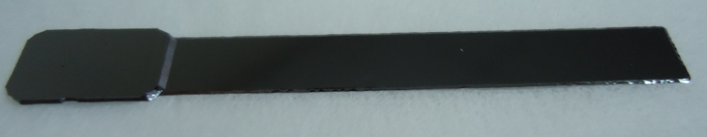
The enabler
Thick holding pad reduces re-clamping error and produce high measurement precision
10 mm
34 mm
0.35mm
5.5mm
92 μm or 52 μm
500 μm
44.35 mm

Slide 4
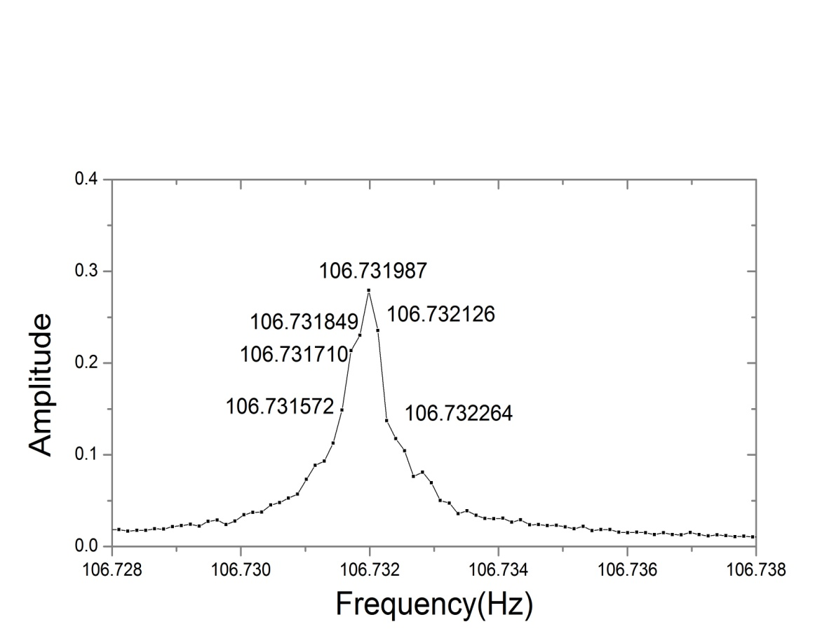
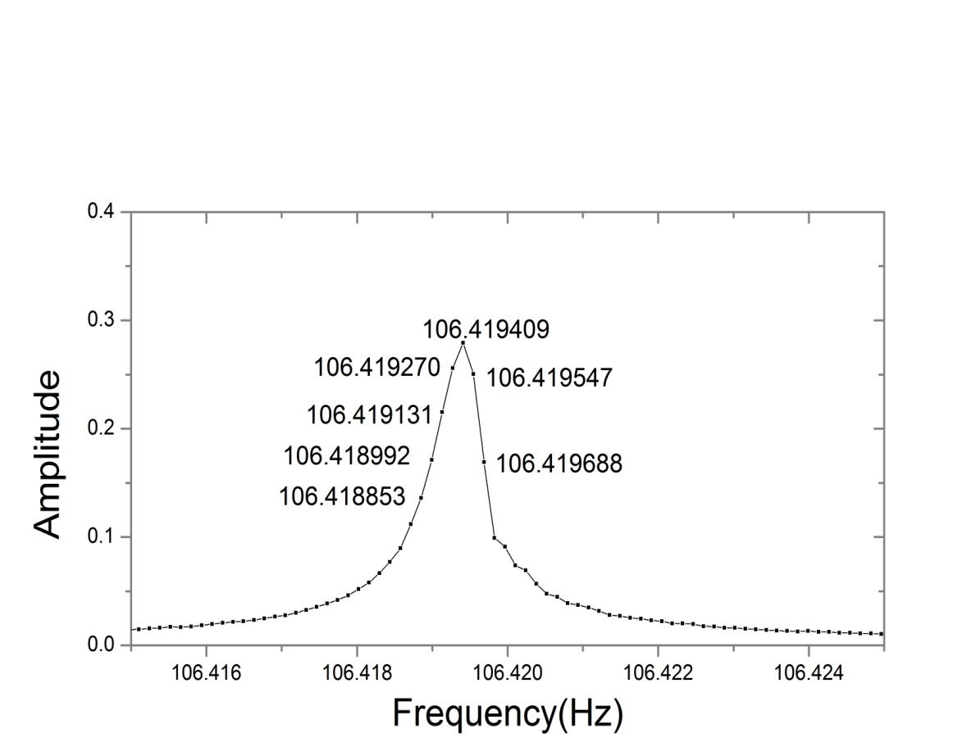
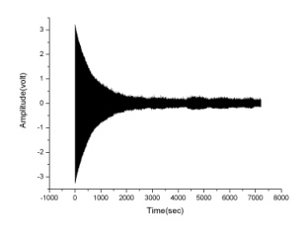
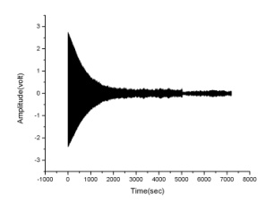
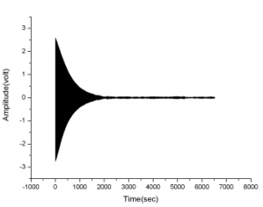
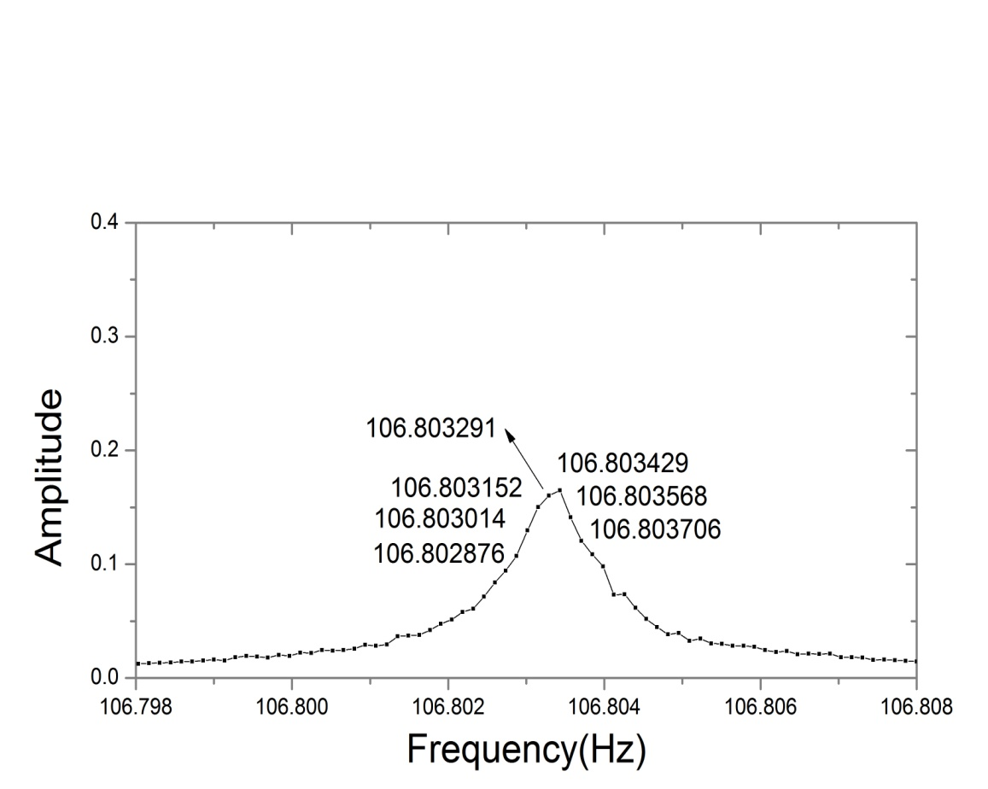
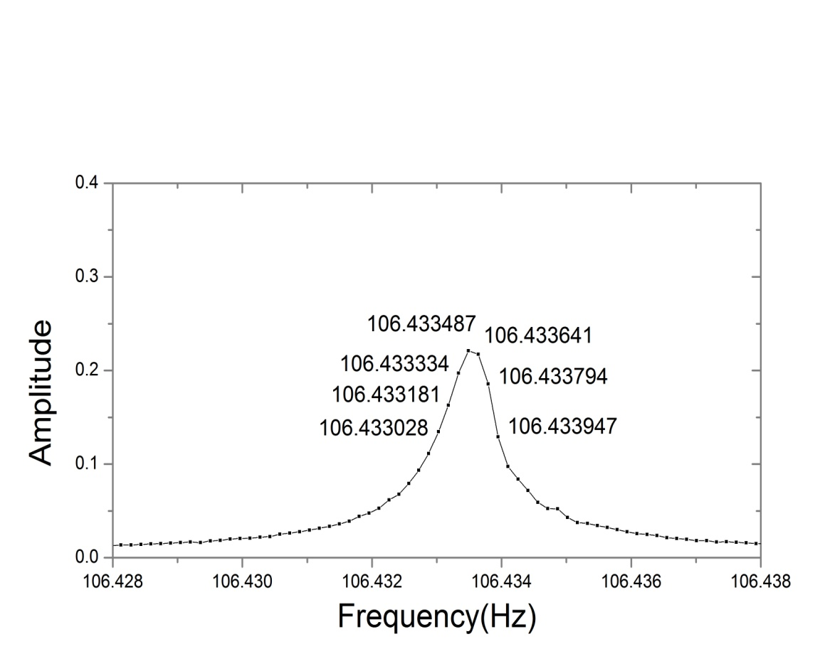
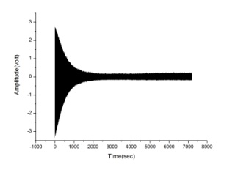
Frequency of silicon cantilever substrate
And with 3 nano-layers coated
Frequency of silicon cantilever substrate
And with 19 nano-layers coated
f₀=106.73 (Hz)
τ =635.0(sec)
Q= πf₀ τ
φ=4.55x10⁻⁶
f₀=106.41 (Hz)
τ =731.4(sec)
Q= πf₀ τ
φ=4.49x10⁻⁶
f₀=106.80 (Hz)
τ = 501.5(sec)
Q= πf₀ τ
φ=5.82x10⁻⁶
f₀=106.43 (Hz)
τ =551.5(sec)
Q= πf₀ τ
φ=5.32x10⁻⁶

Slide 5
Can measure the frequency shift caused by coating with precision < 10⁻³
Thermal frequency shifts likely dominate
MUST measure temperature to measure thermal shift
.0141
.00069
.00092
.0712
.00069
.00125

Slide 6
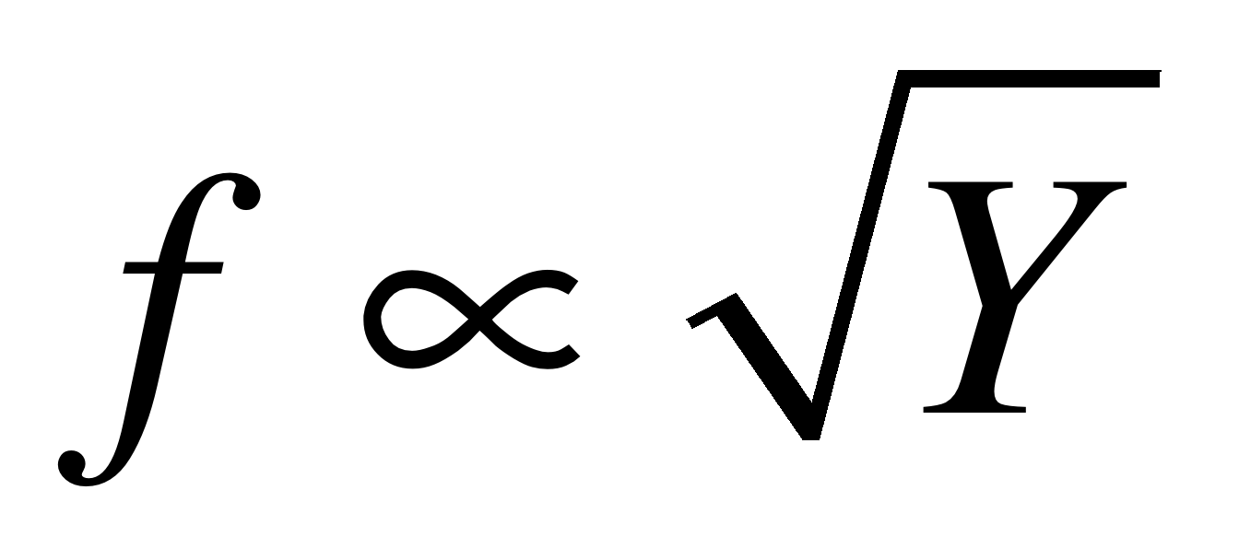
Thermal effects
∂Y/∂T = 127 x 10⁻⁶/ºC
Thermal shift ∂f/∂T ~ 50 10⁻⁶ /ºC
Measured ∆f ~ 100-600 10⁻⁶
Temperature affects the result

Slide 7
Question 1
Will the sensitivity be enough?
Frequency measurements at 10⁻⁶, OK
Simultaneous measurements over several higher mode resonant frequencies will increase the sensitivity

Slide 8
Question 2
Is this the desired Young’s Modulus?
This measurement extracts the parallel Young’s Modulus
Coating thermal noise requires the perpendicular Young’s Modulus

Slide 9
How to measure the // Young’s Modulus
Konrad Samwer uses a modified Atomic Force Acoustic Microscope to measure the local elasticity with a no-indentation method
The atomic force microscope needle is brought in contact, in the elastic regime
From the variation of resonant frequency of the needle’s cantilever the local Young’s modulus of the material is measured
Local elastic properties of a metallic glass Hannes Wagner, Dennis Bedorf, Stefan Küchemann, Moritz Schwabe, Bo Zhang, Walter Arnold & Konrad Samwer Nature Materials 10, 439–442 (2011)
And supplemental material

Slide 10
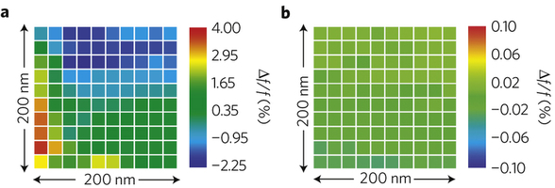
Typical AFAM scan
a, Map of the local contact-resonance frequencies on amorphous glass. b, on crystal. Both maps represent the results of AFAM data at 100 different positions on the samples surfaces

Slide 11
Good and bad
Samwer’s technique only measures Young’s modulus over the first nanometer depth
A mixture of parallel and perpendicular Young’s modulus is measured
The perpendicular Young’s modulus can be disentangled with the cantilever frequency shift information

