Slide 1
Cryogenic Cavity for Ultra Stable Laser
T. Ushiba, A. Shoda, N. Omae, Y. Aso, S. Otsuka S. Hiramatsu, K. Tsubono, ERATO Collaborations

Slide 2
Contents
Overview of the cryogenic cavity
Detail and current status
Summary

Slide 3
Overview of the cryogenic cavity

Slide 4
What is optical lattice clock?
frequency standard
Cs atom clock → definition of second
a candidate of new frequency standard
１. single ion in ion trap
２. group of atoms in laser cooling
３. optical lattice clock
Notes:
9.2GHz

Slide 5
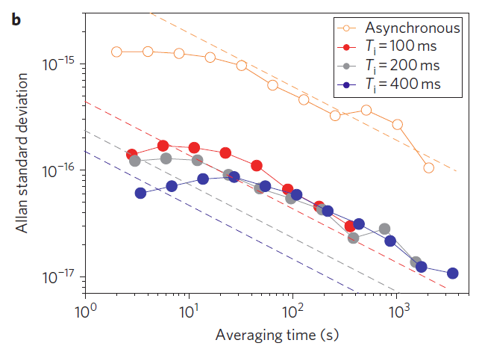
Motivation
We need a stable laser !
stability of optical lattice clock
Currently limited by the frequency stability of probe laser
Long integral time
Develop an ultra stable prove laser using a highly stable optical cavity
Our target
${10}^{−17}$ @ 1s
(fractional stability)
M. Takamoto, T. Takano, and H. Katori, Nat. Photon., 5, 288 (2011)
Applications in gravitational wave detectors

Slide 6
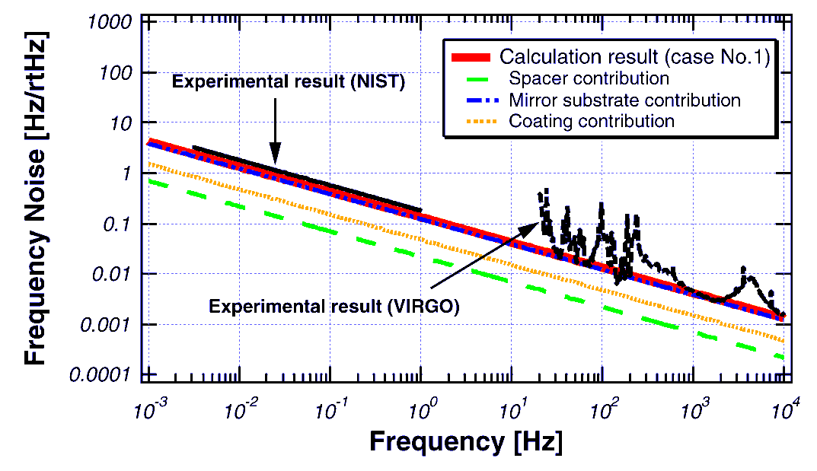
Limit of stability of present lasers
limit of stability of major stable lasers
Limited by thermal noise of optical cavity
Our strategy
monocrystaline silicon
Cool down to 18K
K. Numata，A. Kemery and J. Camp Phys. Rev. Lett. 93，250602(2004).
Spectrum of NIST laser’s noise

Slide 8
Our enemy
Stable laser $≈$ stable cavity length
Who are disturbing us ?
Thermal noise
Thermal vibration of atoms
ULE cavity is limited by this.($\sim {10}^{−15}$)
Vibration
Elastic deformation of cavity bodies
Need for vibration insensitive support
Thermal variation
Finite CTE (Coefficient of Thermal Expansion)
Cavity length flactuation

Slide 9
Thermal noise
In general:
Proportional to $\sqrt{T}$ and $1/{\sqrt{Q}}$
Larger beam spot size is better
Noise sources:
Cavity spacer
Mirror substrate
Mirror coatings
What we have to do
Find a material with good quality factor : silicon
Lower the temperature
Larger beam spot size
Mechanical quality factor
(intrinsic to materials)
Most problematic

Slide 10
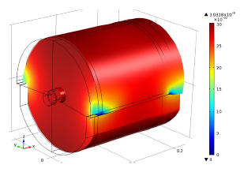
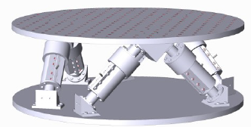
Vibration
Vibration insensitive support
Four point support
Vibration sensitivity:
${10}^{−11}$[1/(m/$s^{2}$)]
Active vibration isolation
Hexapod stage
Acceleration noise:
4$×{10}^{−7}$[(m/$s^{2}$)/$\sqrt{Hz}$]

Slide 11
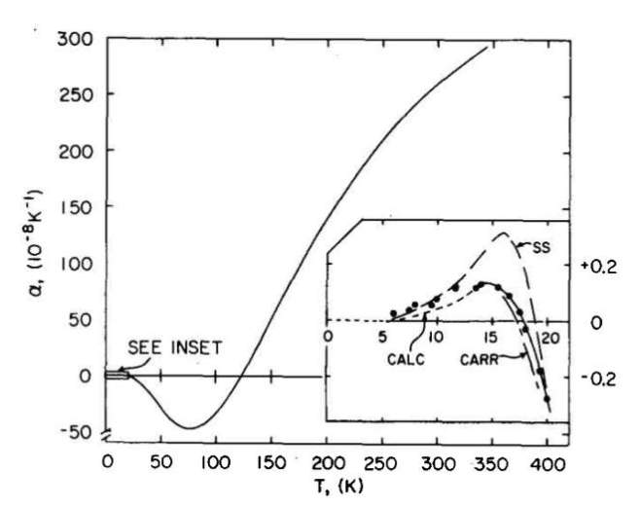
Temperature Variation
Low CTE materials
Temperature control
Zero-cross around 18K
K. G. Lyon，G. L. Salinger，
C. A. Swenson and G. K. White:
J. Appl. Phys. 48，865(1977).
Sillicon CTE

Slide 12
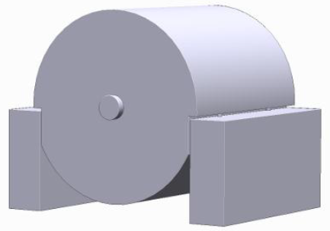
Design of cryogenic cavity
Material: monocrystaline silicon
Cavity length: 20cm
Mirror ROC: 3m → beam spot size = 0.5mm
Finesse $\sim$100,000 → coating thickness = 8um
Wave length: 1396nm
Cooled down to 18K by cryocooler
Helium liquifaction pulsetubecryocooler for low vibration

Slide 13
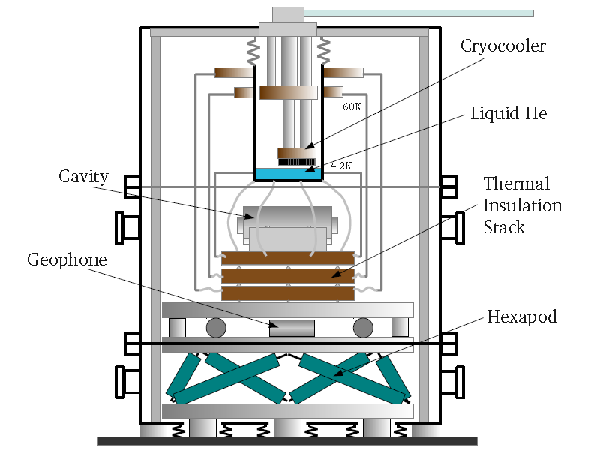

Slide 14
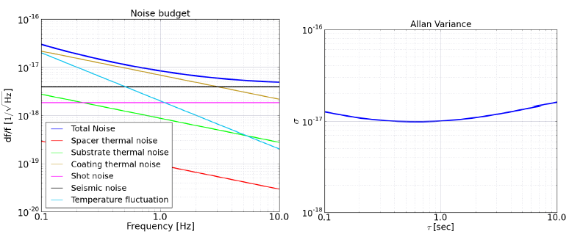
Noise budget
Assumption
Vibration sensitivity = ${10}^{−11}$[1/(m/$s^{2}$)]
Acceleration noise = 4$×{10}^{−7}$[(m/$s^{2}$)/$\sqrt{Hz}$]
Residual CTE = ${10}^{−11}$ [1/K]
Temperature fluctuation = 20[nK/$\sqrt{Hz}$]

Slide 15
Detail and current status

Slide 16
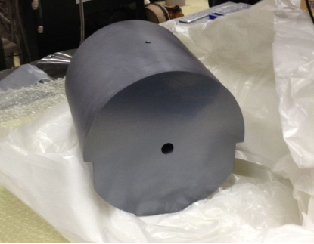
Silicon Cavity
Machining and polishing
spacer : finished
Mirror substrate : under re-polishing
Optical contact test
Contacted by SIGMA KOKI
Notes:
あ

Slide 17
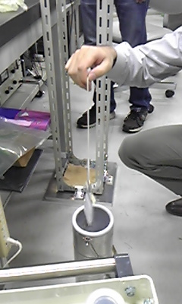
Cooling test of optical contact
Cooling test in liquid nitrogen
6 time thermal cycling
not broken

Slide 18
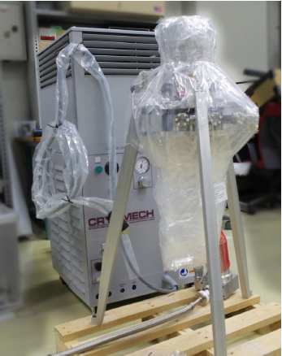
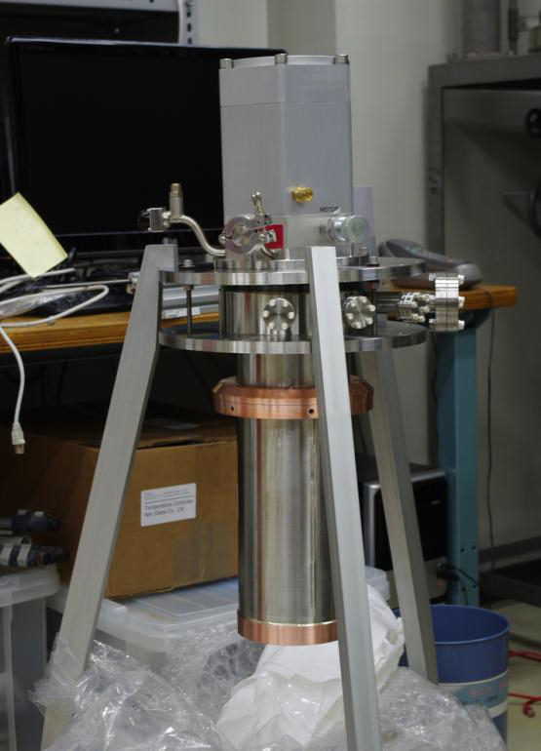
Cryostat
Cryocooler: cryomech
Helium liquifaction
He gas entrance
1st stage
(60K)
2nd stage
(4K)

Slide 19
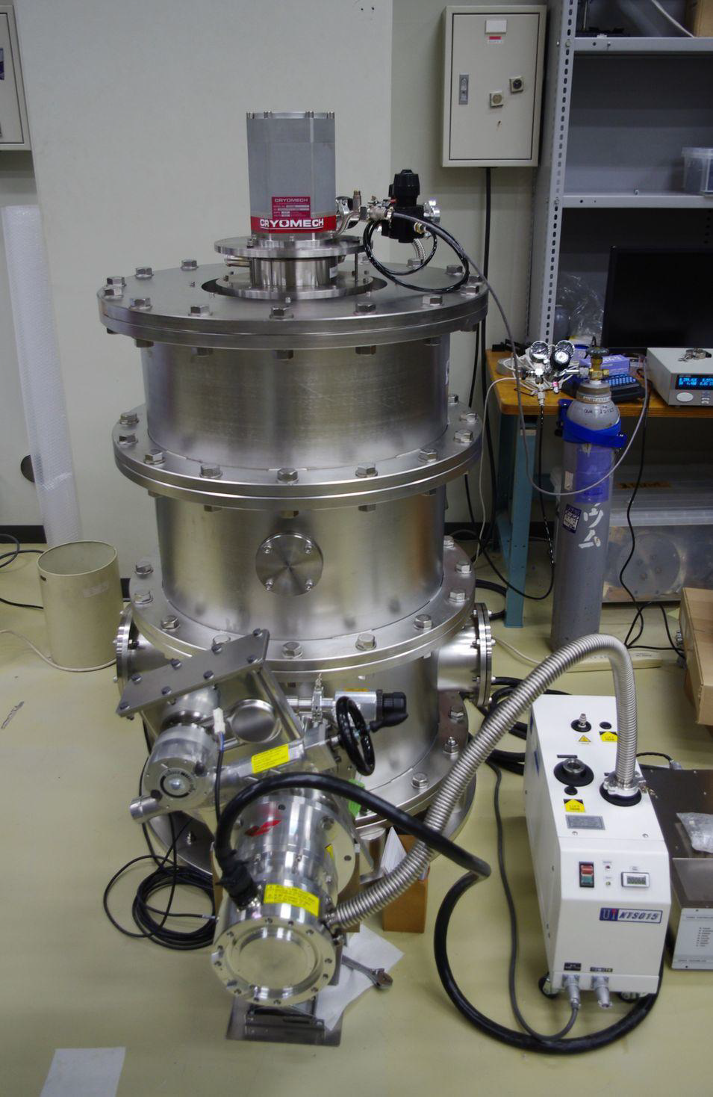
Cryostat
Cryocooler
Vacuum test
0.8m
He gas
Turbo pump on
Gate valve
Close gate valve
~10 hour
Turbo pump
dry pump

Slide 20
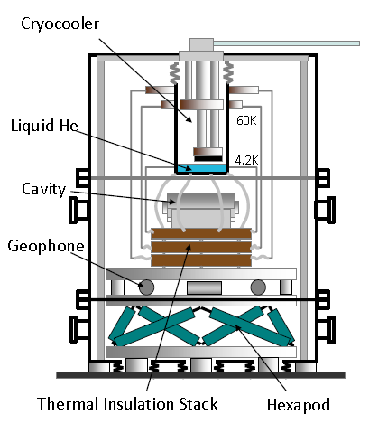
Cryostat
Cooling test
thermometer

Slide 21
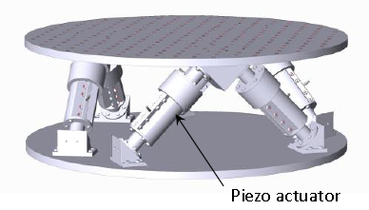
Active vibration isolation
Hexapod stage
Cryocooler’s vibration isolation

Slide 22
Summary
We are making monocrystaline silicon cavity for frequency stable laser.
The idea is cooling the cavity made by a high Q material and isolating vibration in a high level.
The experiment has many troubles but proceeds step by step.

