Slide 1
Welcome to Kashiwa and to the 2nd Korea-Japan workshop on KAGRA
Korea-Japan Workshop on KAGRA
Takaaki Kajita, ICRR, U. Tokyo
May 28, 2012

Slide 2
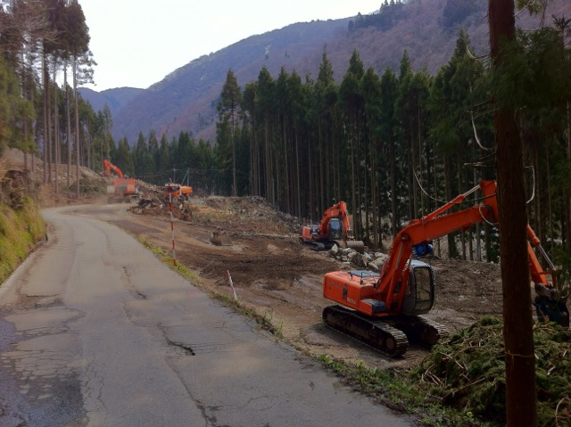
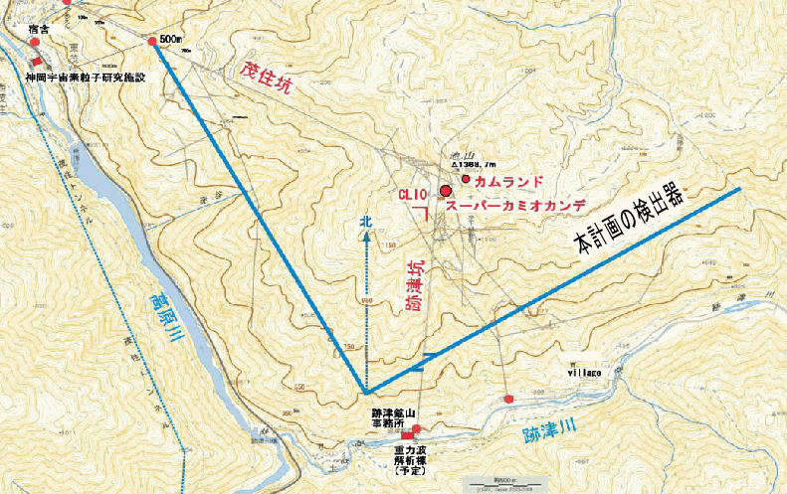
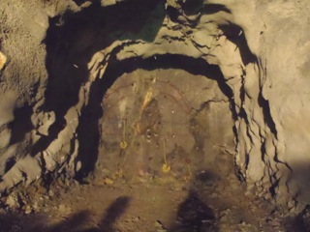
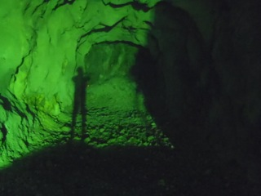
Progress since the previous workshop (1)
The construction work at Kamioka has really started.
Construction of the
new Atotsu entrance.
End of April.
Blasting started on May 22
⬅ Before
After ➔

Slide 3
Progress since the previous workshop (2)
At the previous workshop, there was a concern on the double citizenship in KAGRA and LIGO.
TK and N. Kanda had a EVO meeting on the data sharing with the top people in LIGO/LSC and Virgo in early March.
I. Nakatani attended the LIGO-Virgo meeting in March, discussing the data sharing
LIGO and Virgo welcome KAGRA to the data sharing.
We still need to discuss details of the agreement before signing the MoU on data sharing.
In any case, we think that the “double citizenship” should not be a major problem to us in the near future.
I hope that this workshop will be very successful!

