Slide 1
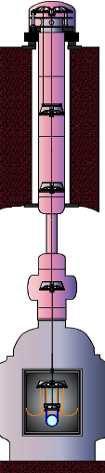

Cryogenic Suspension for KAGRA and Suspension Thermal Noise Issues
2012/08/21 Thermal Noise Seminar @ Jena
D1, ICRR, U. Tokyo
Takanori Sekiguchi
As a member of vibration isolation system (VIS) subgroup for KAGRA
Notes:
I

Slide 2
Contents
1. Introduction of KAGRA cryogenic suspensions
2. Suspension thermal noise in KAGRA
3. Ideas to reduce suspension thermal noise in KAGRA
4. Summary and discussion
tseki@icrr.u-tokyo.ac.jp

Slide 3
Contents
1. Introduction of KAGRA cryogenic suspensions
2. Suspension thermal noise in KAGRA
3. Ideas to reduce suspension thermal noise in KAGRA
4. Summary and discussion

Slide 4
KAGRA Key Features
Cryogenics
Underground
Seismic attenuation system (SAS)
~13 m
Mirror thermal noise
Expand observation band (~ 10 Hz)
Sapphire test mass
23kg, 20K

Slide 5
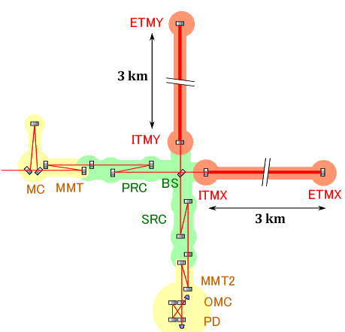
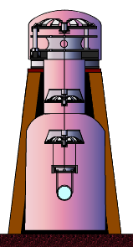
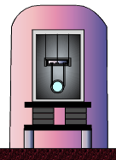
KAGRA-SAS Overview
Suspension systems for KAGRA core optics
Type-A for test masses
  * SAS technology
  * Cryogenics
Type-B for recyclers& BS
  * Simpler than Type-A
  * No cryogenics
Type-C for smaller optics
  * TAMA-stack
  + simple/double pendulum

Slide 6
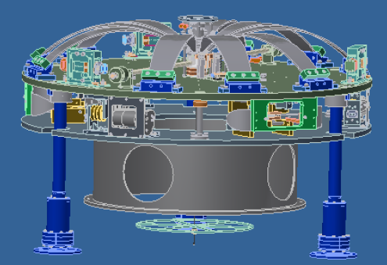
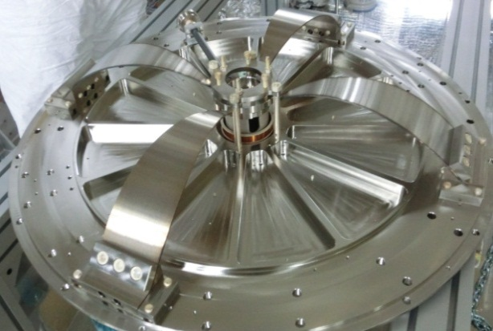
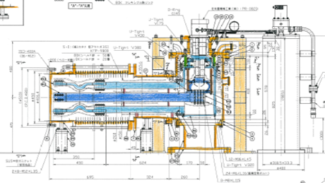
KAGRA-SAS Key Technologies
Inverted Pendulum stage
GAS filter chain
Control with LVDTs, accelerometers and voice-coil actuators
Developed in TAMA-SAS, HAM-SAS, AEI-SAS, etc.
Cryogenics
Developed in CLIO.
To be developed
Low vibration cryocooler
Radiation shields
Cryogenic sensors
Heat link wiring
Sapphire fibers
Still many R&Ds are necessary for this part !!!

Slide 7
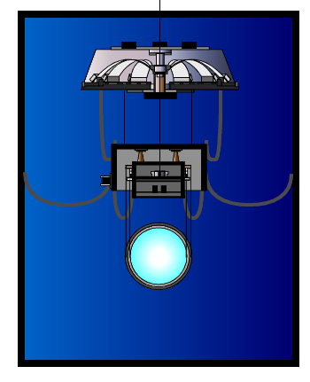
Cryogenic Suspension for KAGRA
KAGRA Cryogenic Payload Schematic Design
Platform with cryogenic spring (GAS)
Preliminary
Intermediate mass and its recoil mass for alignment control
Sapphire test mass and its recoil mass
Sapphire fibers (Φ1.6 mm, L 30 cm)
Aluminum heat links for heat transfer
Total mass: 300 kg

Slide 8
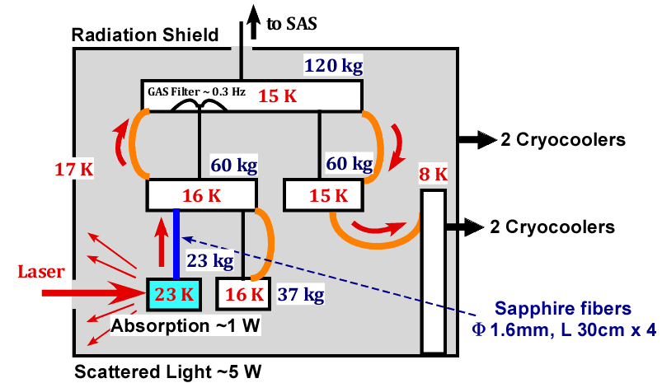
Heat Subtraction Scheme
KAGRA Cryogenic Payload Heat Flow

Slide 9
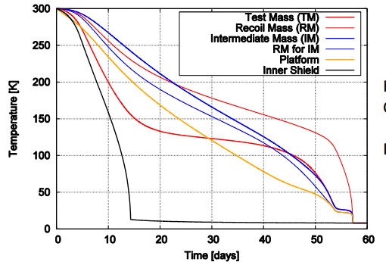
Cryogenic Suspension Problems [1]
Initial cooling time problem
(Discussed by Y. Sakakibara)
~ months to reach target temperature
→ Slow down commissioning, reduce duty cycle

Slide 10
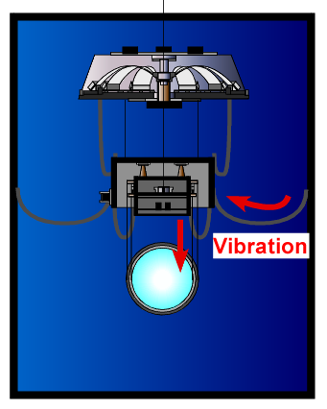
Cryogenic Suspension Problems [2]
Heat link wiring problem
Aluminum heat links work as soft mechanical springs (~10 mHz)
Cryostat vibration is transmitted to the mirror via heat links
→ Spoil the performance of SAS

Slide 11
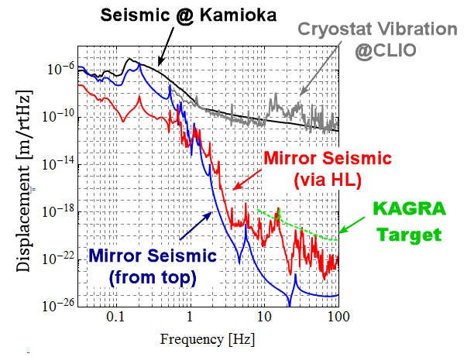
Cryogenic Suspension Problems [2]
Cryostat vibration can be larger than seismic vibration
Close to KAGRA sensitivity!!
More details: GWADW2012 presentation, JGW-G1201037

Slide 12
Cryogenic Suspension Problems [3]
Sapphire fiber problem
Thick and short sapphire fibers (Φ1.6 mm, L 30 cm).
Rough surface decreases thermal conductivity
→ Need surface polishing
Sapphire bonding may be necessary??
Many difficulties in engineering!!

Slide 13
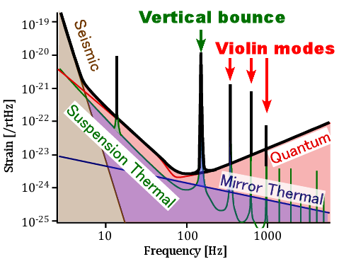
Cryogenic Suspension Problems [3]
Sapphire fiber problem
Vertical bounce mode and violin mode peaks at ~100 Hz.
→ Pollute detector sensitivity!!
(Even with low Q sapphire fibers, suspension thermal noise gets large because of small dilution factor.)

Slide 14
Summary
We use cryogenic suspension for thermal noise reduction.
Many difficulties have been found.
  Initial cooling time is quite long.
  Heat links introduce non-negligible seismic noise.
  Thick sapphire fibers introduce non-desired peaks around target frequencies.
Still many R&Ds remain!! (but schedule is tight…)

Slide 15
Contents
1. Introduction of KAGRA cryogenic suspensions
2. Suspension thermal noise in KAGRA
3. Ideas to reduce suspension thermal noise in KAGRA
4. Summary and discussion

Slide 16
Suspension Thermal Noise
Thermal fluctuation of mirror displacement due to mechanical loss of suspension system.
Power spectrum can be predicted by fluctuation-dissipation theorem
Imaginary part of force – displacement transfer function

Slide 17
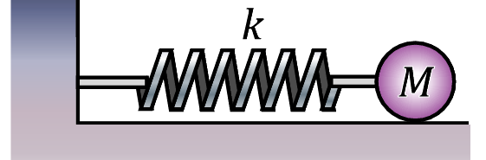
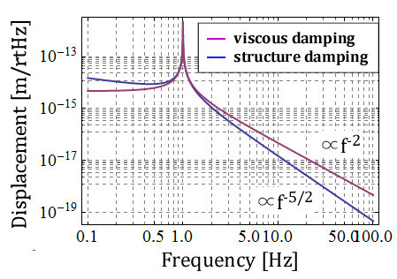
Suspension Thermal Noise
Thermal fluctuation of simple oscillator
Material loss: structural damping model
Pendulum Q is larger than intrinsic material Q (dissipation dilution)

Slide 18
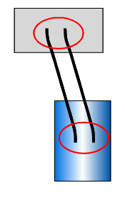
Dissipation dilution
In pendulum, most potential energy stored as lossless gravitational potential energy
Ue: Potential energy stored in the bending of fibers
Ug: Gravitational potential energy (lossless)
1 / Dilution factor

Slide 19
Dissipation dilution
Dilution factor gets large for thin and long fibers
L: wire length, d: wire diameter
However, thick and short fibers are used in KAGRA for thermal conduction.
Initial LIGO dilution factor: ~464
KAGRA dilution factor: ~19

Slide 20
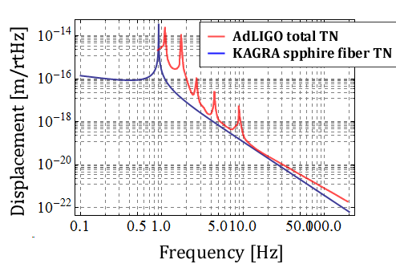
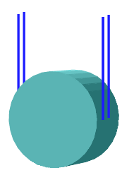
Sapphire Fiber Thermal Noise
Sapphire fiber thermal noise estimation (pendulum mode)
LIGO-G040298

Slide 21
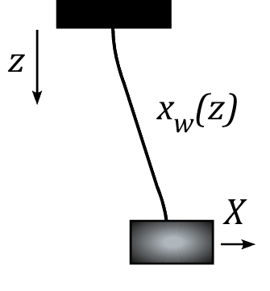
Violin Modes
For high frequency response, violin modes of fiber should be taken into account.
Eq. of motion of fiber
Eq. of motion of suspended mass

Slide 22
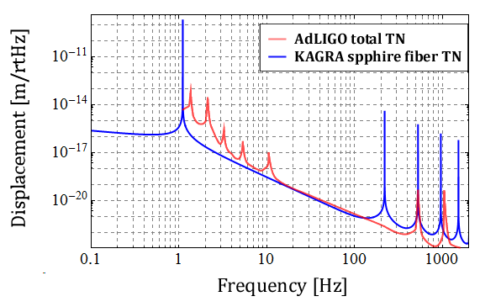
Sapphire Fiber Thermal Noise
Sapphire fiber thermal noise estimation
(pendulum mode + violin modes)
LIGO-G040298
220 Hz

Slide 23
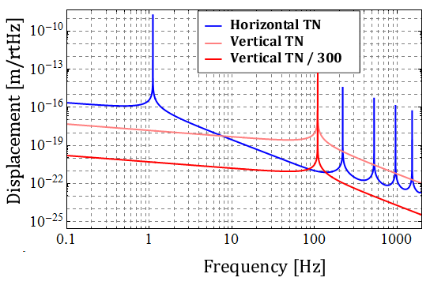
Vertical Thermal Noise
In KAGRA, we have un-avoidable V-H coupling of 1/300.
Contribution of vertical thermal fluctuation is not negligible.
110 Hz

Slide 24
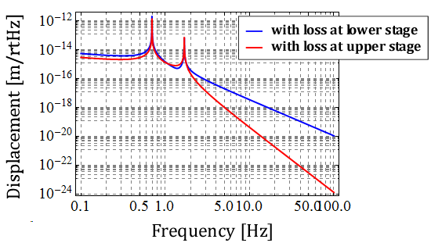
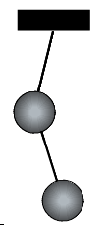
Contribution of Upper Stage Losses
Generally, thermal noise from upper stage (and recoil mass) loss is cut off at high frequencies.

Slide 25
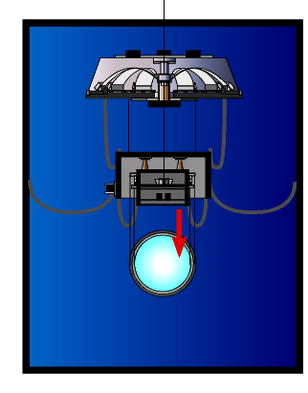
Contribution of Upper Stage Losses
In KAGRA, due to large stiffness of sapphire fibers, vertical thermal noise from upper stage (and recoil mass) loss directly transmits to the mirror.

Slide 26
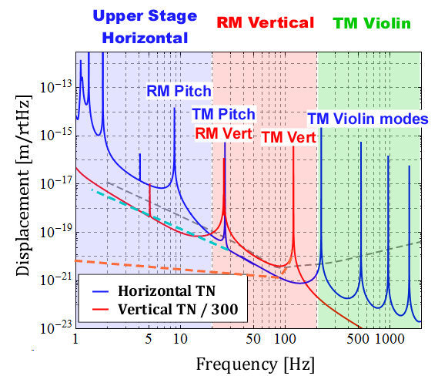
Suspension Thermal Noise in KAGRA
Thermal noise simulation including upper stages and recoil mass (with intrinsic material Q of ~10⁴)

Slide 27
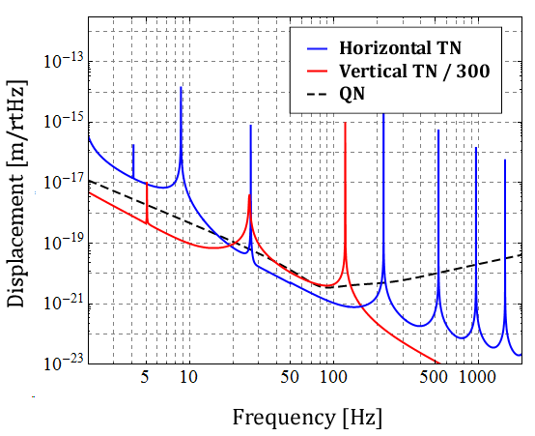
Summary
Thick sapphire fibers introduce resonant peaks of vertical & violin modes around 100 Hz.
Thermal noise from upper stages and recoil mass is not negligible even at high frequencies.
Especially, recoil mass can introduce large vertical thermal fluctuation at 20-200 Hz.

Slide 28
Contents
1. Introduction of KAGRA cryogenic suspensions
2. Suspension thermal noise in KAGRA
3. Ideas to reduce suspension thermal noise in KAGRA
4. Summary and discussion

Slide 29
To Reduce Suspension Thermal Noise
Vertical thermal noise
  Reduce V-H coupling (1/300)
  Reduce vertical bounce mode frequency (~100 Hz)
Horizontal thermal noise
  Increase dilution factor (~19)
  Push violin modes to higher frequencies (~200 Hz)
Loss at recoil mass
  Improve recoil mass suspension (Q~10⁴)
  Remove recoil mass

Slide 30
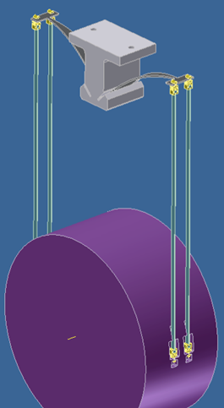
New Suspension Design
A fresh approach to the design of low thermal noise cryogenic suspension for KAGRA (and ET)
Design development is conducted by R. DeSalvo

Slide 31
Vertical Thermal Noise
Vertical stiffness of sapphire fiber introduces:
  An annoying peak around 100 Hz
  Large thermal fluctuation from recoil mass stage
  Practically, we cannot equalize tension of four fibers.

Slide 32
Cantilever Spring
Hold the mirror from cantilever springs
What material should be used?
  High Q
  Large thermal conductivity
→ Candidate: silicon cantilever

Slide 33
Silicon cantilever blades
Etch the bending area
Leave thick section for clamping and for fiber connection
With 0.15 Gpa only limited flexure possible (~25 Hz)
With >1GPa large deflection

Slide 34
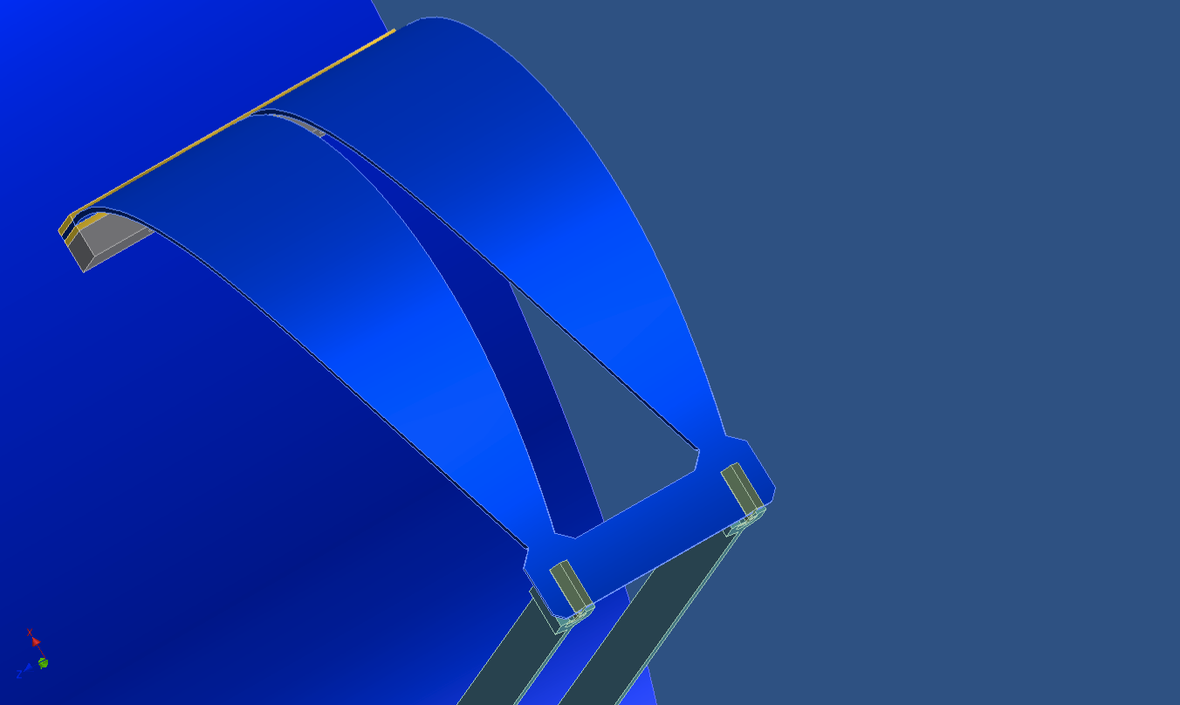
Larger stresses possible?
MEM sensors operating at 1.4 GPa, ~ 10 times higher limit!
Is etching eliminating surface defect and therefore causing the larger strength?
if YES, large bends possible!
Lower frequency bounce modes

Slide 35
NIKHEF Test
Produce a number of samples
Test and see

Slide 36
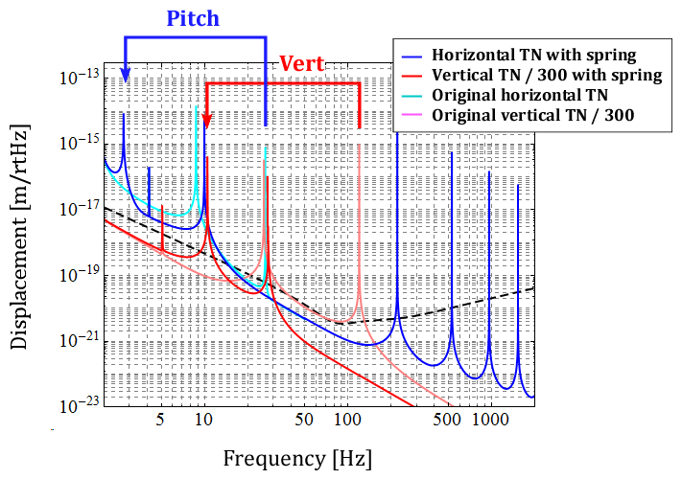
Silicon Cantilever Solution
Thermal noise estimation with cantilever spring
(assuming f0 ~10 Hz, Q~10⁻⁷)

Slide 37

Horizontal Thermal Noise
Small dilution factor due to thickness of fibers.
Can we increase dilution factor without spoiling thermal conductivity?
→ Fiber with flexure design
Flexure part
For thermal noise reduction
Thick fiber part
For thermal conductivity

Slide 38
Why Flexure?
Most bending energy concentrates on the fiber ends
Bending energy can be reduced by using soft fiber in the ends

Slide 39
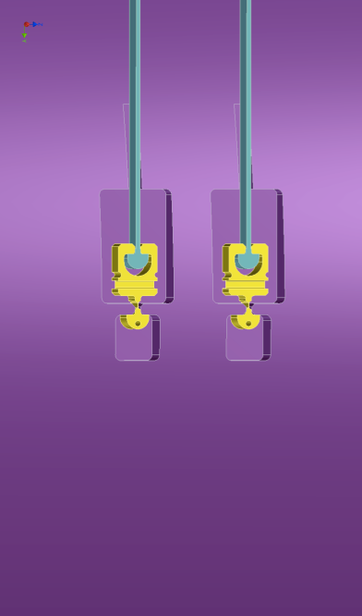
Flexure Design
Ultra-Sound Machined structure
Etching of the flexure surface
Expected to increase the break point >1GPa

Slide 40

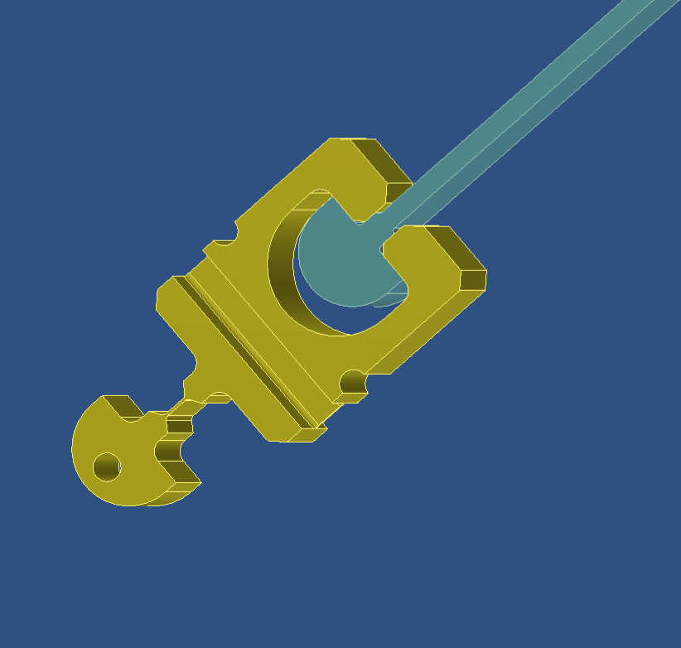
Ribbons Key features:
Compression joint attachment
Machined-polished Sapphire ribbons
(from bulk, not grown)
High quality sapphire
High quality surface finish (sub-phonon defect size)
= > High thermal conductivity !

Slide 41
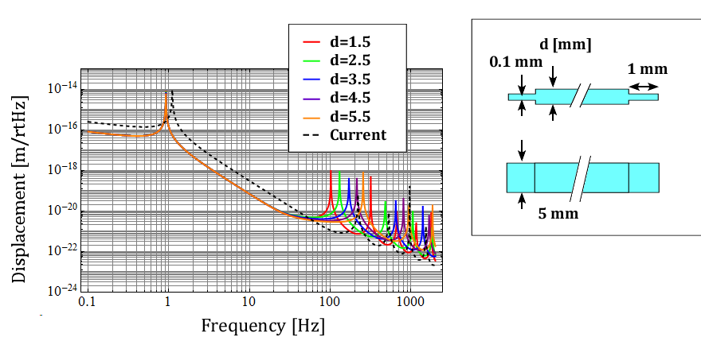
Sapphire Ribbon + Silicon Flexure
Preliminary result (calculated last night…)
The thermal noise is suppressed at low (< 100 Hz) frequencies.
Flour level around 100 Hz get worse
Violin mode frequencies can be pushed to high freq region.

Slide 42
Flexure Design Pro & Con
10-50 Hz thermal noise will be improved.
50-200 Hz thermal noise will get worse.
We can push the violin modes to higher frequencies.
Good, but not so effective?
Bad
Good

Slide 43
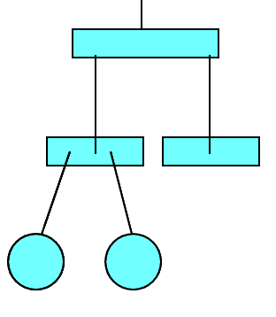
Can We Remove Recoil Mass ??
Thermal noise from RM suspension loss is quite large.
Can we remove recoil mass??
In Virgo, the actuators on TM are not used during operation!! (thanks to large seismic attenuation)

Slide 44
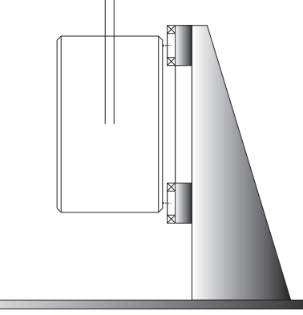
No Suspended Recoil Mass
No suspended recoil mass for TM
Actuators only used for damping
Coil should be opened during operation

Slide 45
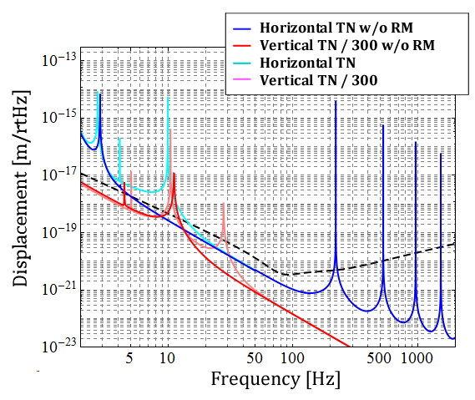
No Recoil Mass Case
No peaks at 10-100 Hz!!
Alternative: also employ springs for RM

Slide 46
Summary
Using low-loss cantilevers, vertical thermal noise is dramatically reduced and annoying peak disappears.
Fibers with flexure design has both profit and demerit.
Removing RM, or employing cantilever for RM?

Slide 47
Contents
1. Introduction of KAGRA cryogenic suspensions
2. Suspension thermal noise in KAGRA
3. Ideas to reduce suspension thermal noise in KAGRA
4. Discussion

Slide 48
Discussion

Slide 49
The END

Slide 50
Appendices

Slide 51
Flexure Design
Ultra-Sound Machined structure
Etching of the flexure surface
Expected to increase the break point >1GPa

Slide 52
Ribbons Key features:
Compression joint attachment
Machined-polished Sapphire ribbons
(from bulk, not grown)
High quality sapphire
High quality surface finish (sub-phonon defect size)
= > High thermal conductivity !

Slide 53
Why Gallium
Indium proved extremely effective to eliminate friction noise in compression joints (Vladimir Braginsky)
Melts at relatively high temperature
May need heating mirror to more than 160ºC for disassembly

Slide 54
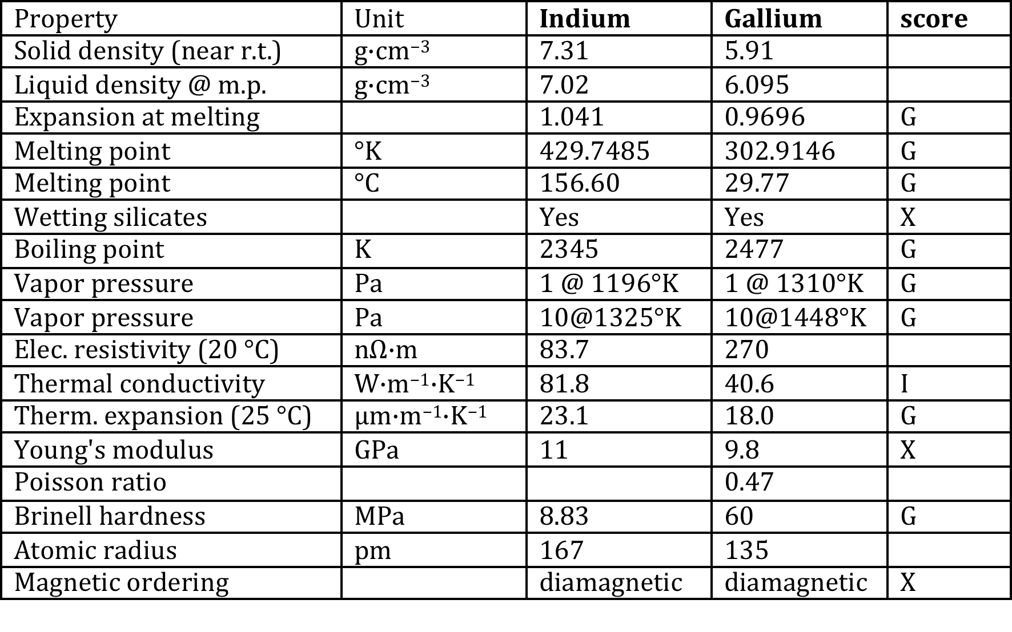
Indium vs. Gallium

Slide 55
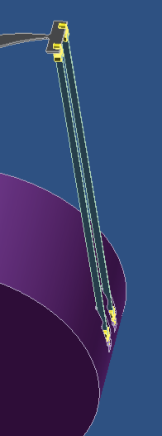
Violin mode elimination
Fiber-fed
Red-shifted
Fabry-Perot
Can cool
violin modes
and bounce modes
to mK level
(Same for Parametric Instabilities ?)

Slide 56
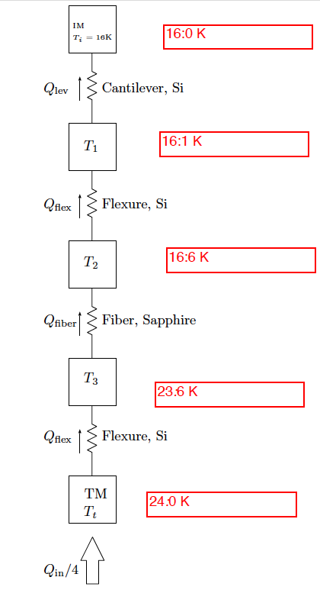
Conductance budget
Preliminary conductance budget from Sakakibara with 1 W load
Thin ribbon responsible for bulk of loss ! ! !
Plenty of space for parametric optimization

Slide 57
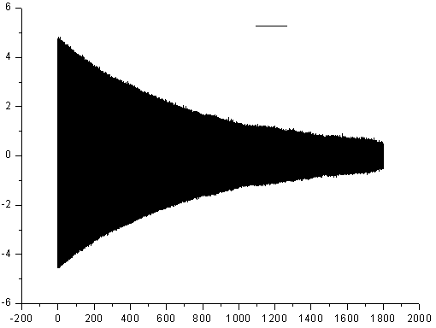
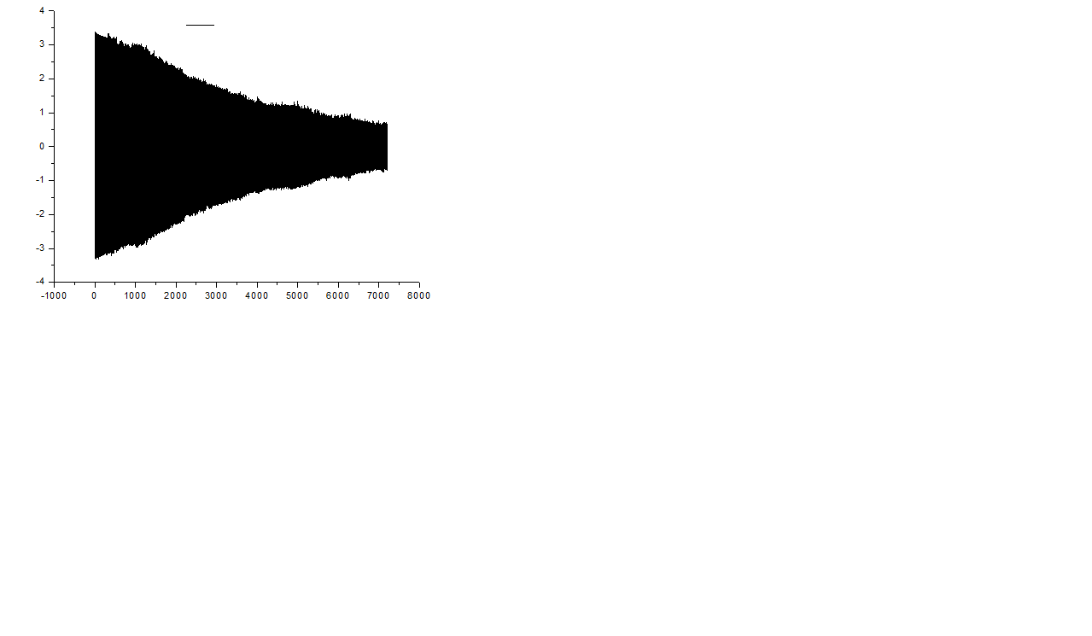
Chao Shiu laboratory, Taiwan
Silicon cantilever with KOH wet etching
4” un-doped double-side polished (001) silicon wafer,
500um thickness etched down to 92 and 52 µm
0.3 10⁻⁶ loss measured from residual gas
10 mm
34 mm
0.35mm
5.5mm
92 μm or 52 μm
500 μm
44.35 mm
Amplitude(V)
Original Data
Silicon cantilever (d=92um)
Amplitude
Silicon cantilever (d=52um)
Frequency = 103.20 (Hz)
Frequency=59.04 (Hz)
Decay Time = 710.1 (s)
Decay Time = 3940.8 (s)
φ_{measurement} = 4.3*10⁻⁶
φ_{measurement} = 1.4*10⁻⁶
Time(sec)

Slide 58
Thermo-elastic limit
@ 59 Hz 0.945 10⁻⁶ loss angle predicted (T.E.)
1.3 10⁻⁶ measured (-) 0.3 10⁻⁶ residual gas
1. 10⁻⁶ loss angle measured
=> 100% Thermoelastic limited ! ! !
Amplitude
Silicon cantilever (d=52um)
Frequency=59.04 (Hz)
Decay Time = 3940.8 (s)
φ_{measurement} = 1.4*10⁻⁶
Time(sec)

Slide 59
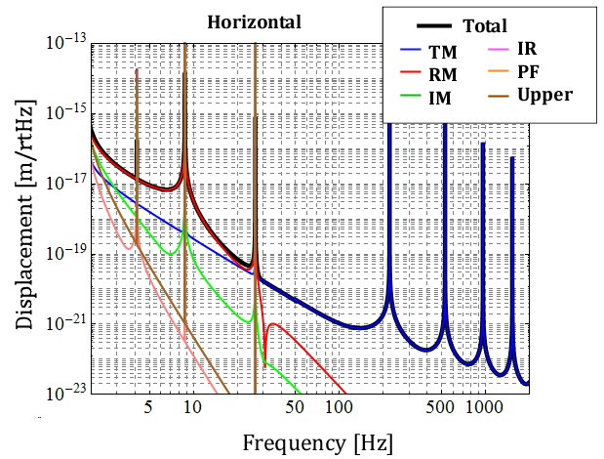
Suspension Thermal Noise in KAGRA
Distribution of thermal noise source (H)

Slide 60
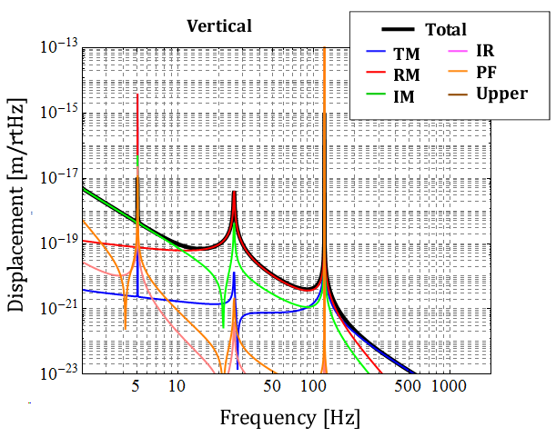
Suspension Thermal Noise in KAGRA
Distribution of thermal noise source (V)

Slide 61
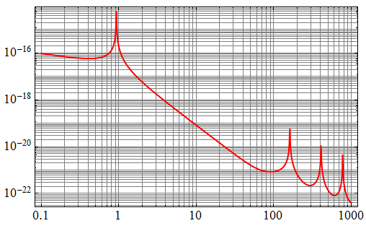
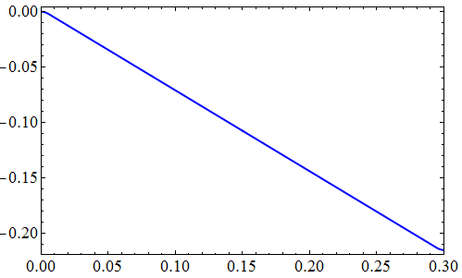
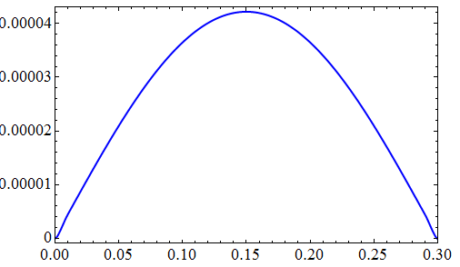

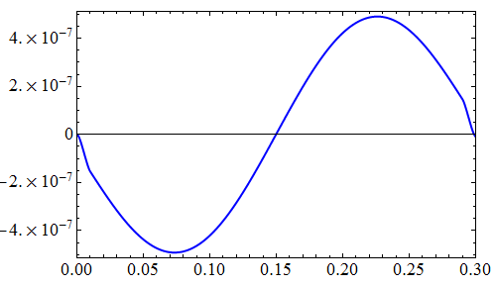
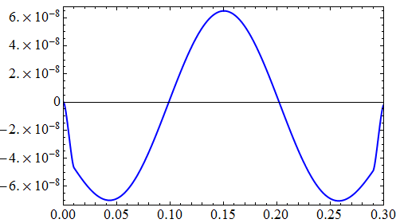
Mode Shape (Beam Profile)
Pendulum Mode
1st Violin Mode
2nd Violin Mode
3rd Violin Mode

