Slide 1
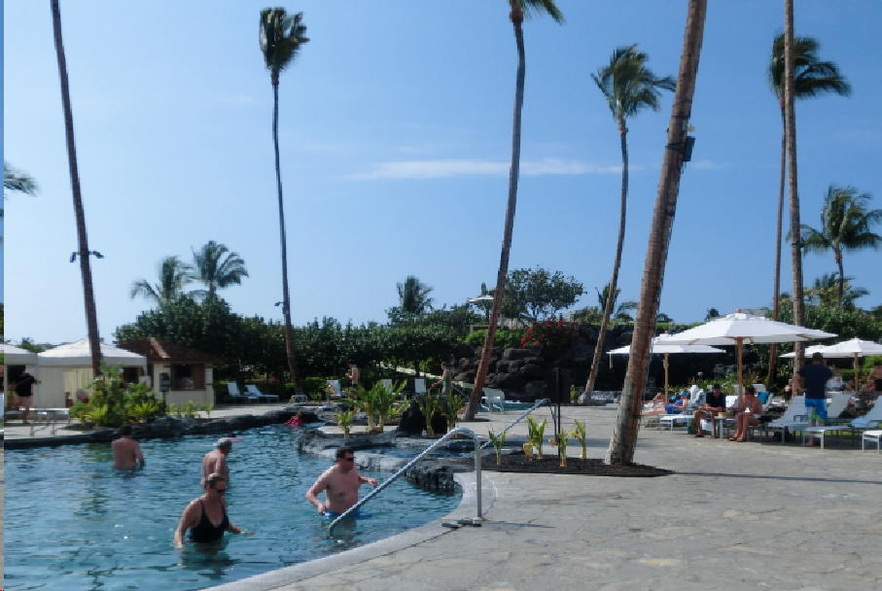
External forces from heat links in cryogenic suspensions
D1, ICRR, Univ. Tokyo
Takanori Sekiguchi
GWADW in Hawaii

Slide 2
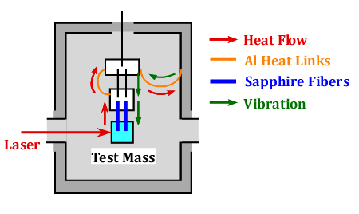
About this Talk
Estimate seismic noise introduced from heat links.
Discuss how to achieve cooling and seismic isolation at the same time.

Slide 3
Seismic Noise from Heat Links

Slide 4
Basic Requirement for KAGRA Test Mass Suspension
Attenuate seismic noise
Cool down test masses
Test Mass Displacement
< 3 x 10⁻²⁰ m/√Hz @ 10 Hz
Mirror Temp. ~ 20 K

Slide 5
Seismic Attenuation System for KAGRA Test Mass
①
Seismic vibration transmits to the mirror in two different paths
From the top through the attenuation chain
From the wall of the cryostat through heat links
~14 m
②

Slide 6
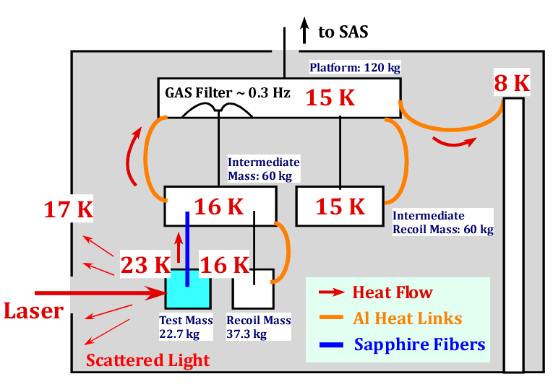
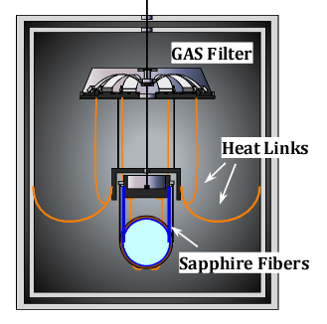
Cryogenics
Heat transferred via pure aluminum heat links.
We need Φ1 mm, L=1 m heat links x 7~8
Thermal simulation Done by Y. Sakakibara
(Φ1.6 mm, L=30cm)

Slide 7
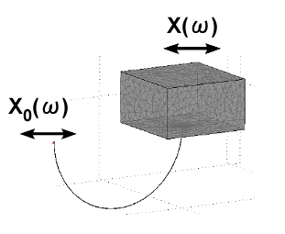
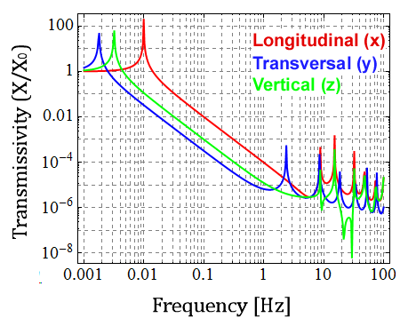
Mechanical Property of Heat Links
A heat link works as a soft spring (f₀~10 mHz) with violin modes above ~1 Hz
FEM Simulation Done by Y. Aso, (JGW-G1000108)

Slide 8
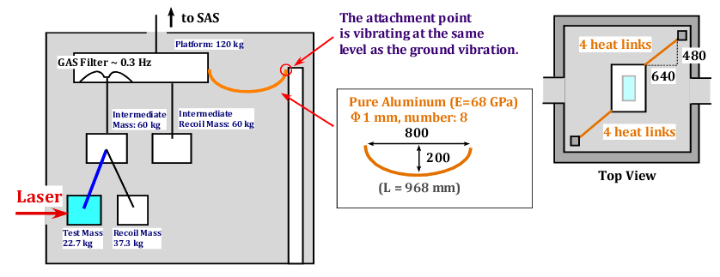
Estimation of Seismic Noise via Heat Links
Simulation Tool: 3-D rigid-body model simulation
T. Sekiguchi, Master Thesis (JGW-P1200770)

Slide 9
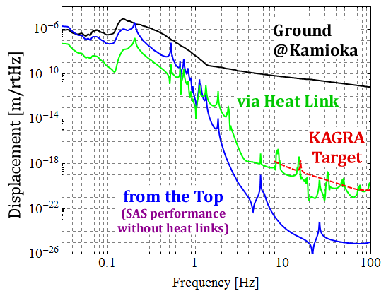
Calculation Result
①
* Assuming 1% coupling
from vertical
②
Polluting detector sensitivity above 10 Hz !!

Slide 10
To Make Matters Worse ..
There is no guarantee that the wall inside the cryostat is vibrating at the same level as the ground.
???

Slide 11
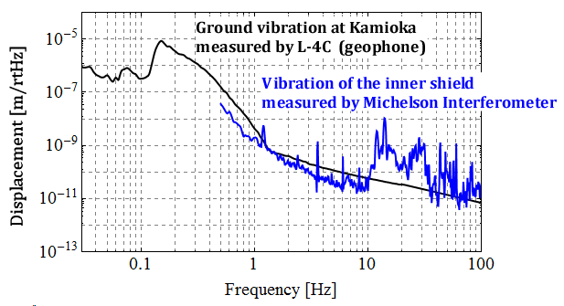
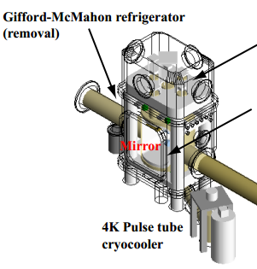
Vibration Inside the Cryostat in CLIO
10-100 times larger !!
K. Yamamoto et al, J. Phys.: Conf. Ser. 32 418 (2006)

Slide 12
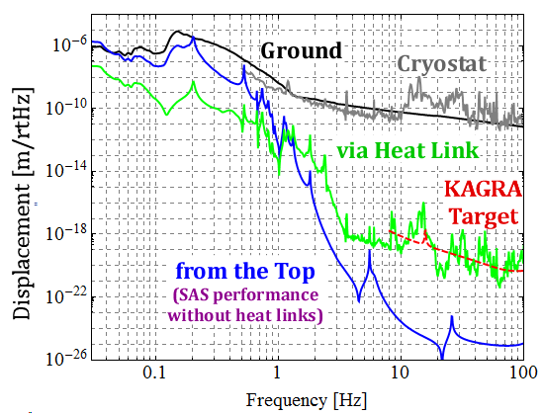
In Worse Case
①
If the attachment point of heat links is vibrating at the same level as cryostat vibration in CLIO..
②
* Assuming 1% coupling
from vertical

Slide 13
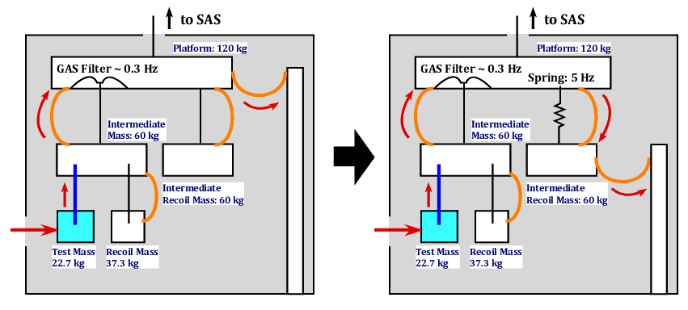
Improved Design
Add one more “cushion” between the cryostat and mirror

Slide 14
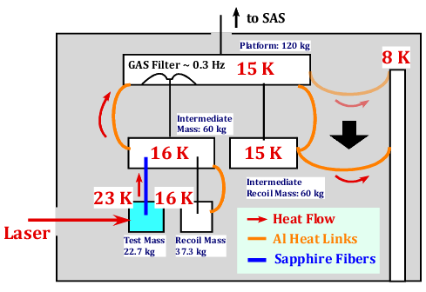
Consideration on Cooling
These two masses are thermally well connected by heat links*
* Pure aluminum Φ 3 mm, L=63 cm, Number: 5
(Φ1.6 mm, L=30cm)

Slide 15
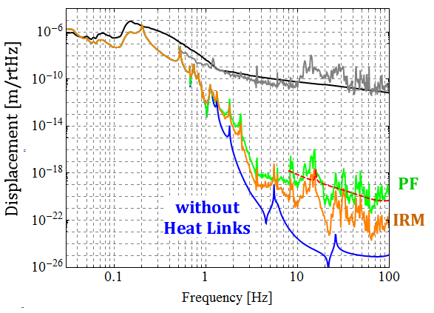
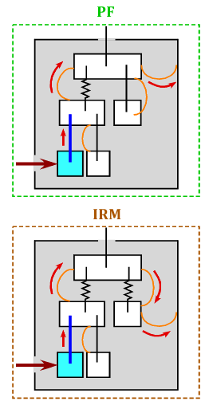
After Improving Wiring

Slide 16
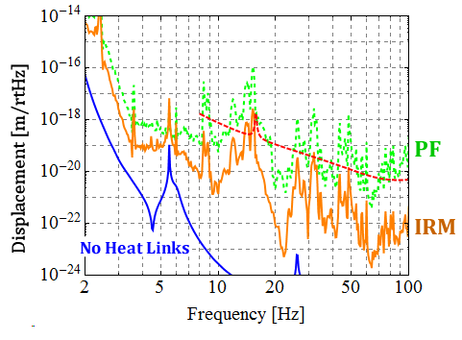
After Improving Wiring
Several peaks exceed the target sensitivity, but the flour level is OK.

Slide 17
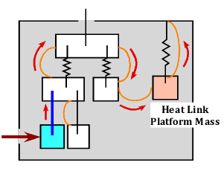
Possible Ideas of Further Improvement
Suppress the cryostat vibration passively/actively.
Put additional filters between suspension and cryostat.
Add vertical springs for test mass suspension.

Slide 18
Another Consideration

Slide 19
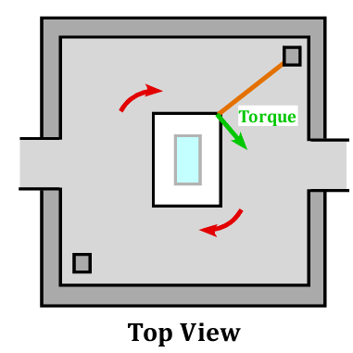
Effect on Angular Motion
SAS is very soft in yaw motion (~ 10 mHz).
Low frequency yaw motion can be easily excited.
Single wire suspension

Slide 20
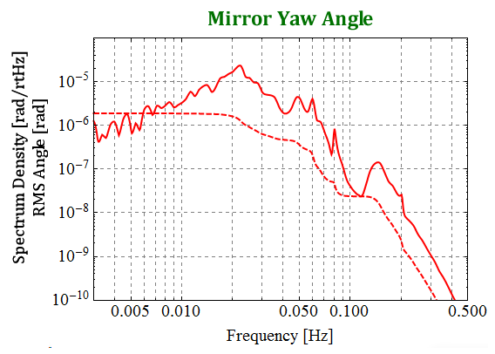
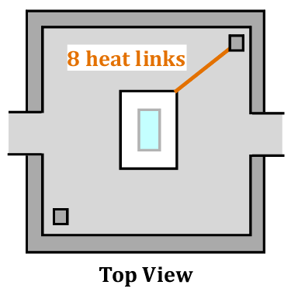
Effect on Angular Motion
If one employs asymmetric wiring of heat links..
Microseismic peak
RMS: 2 μrad
Yaw resonance
* Eddy current damping for yaw modes is applied
T. Sekiguchi, Master Thesis (JGW-P1200770)

Slide 21
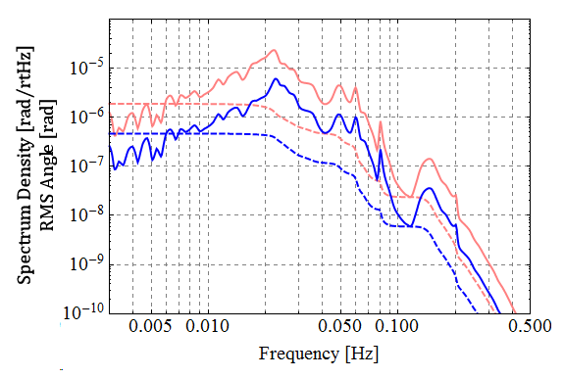
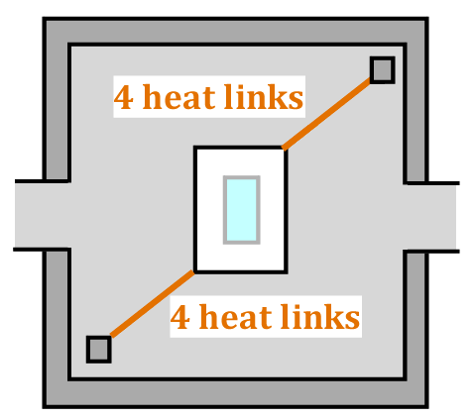
Symmetric Configuration
Symmetric wiring does not subject any torque.
If you admit 10% thickness difference in two connections → Blue Curve
Not small, but in a controllable level
Φ1.1 mm
RMS: 0.5 μrad
Φ1.０ mm

Slide 22
Summary

Slide 23
Summary
Careful wiring of heat links is required, in order to mitigate the seismic noise introduced from them.
Further isolation, or improvement of the suspension design may be necessary.
Yaw excitation by heat links would be not so huge (be in a controllable level).

Slide 24
Future Works
Transfer function measurement of heat links. (How to ??)
Vibration measurement inside the cryostat.
L. Naticchioni and D. Chen will start this autumn

Slide 25
The END

Slide 27
Appendices

Slide 28
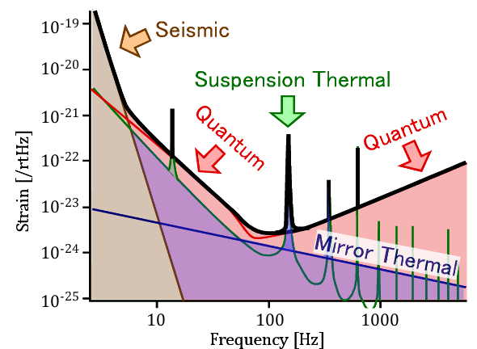
Requirement for KAGRA Test-Mass Suspensions (1)
Seismic noise should be much lower (at least 10 times smaller) than other noises at the detector observation band (> 10 Hz).
KAGRA Design Sensitivity
Seismic Noise Requirement:
< 3 x 10⁻²⁰ m/√Hz @ 10 Hz
And rolls off steeper than f⁻³

Slide 29
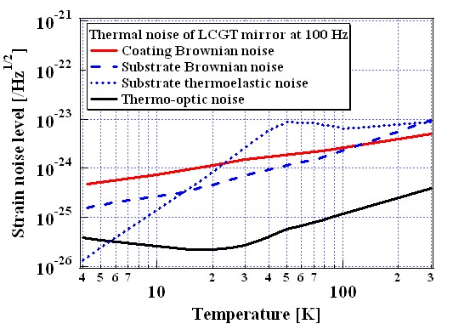
Requirement for KAGRA Test-Mass Suspensions (2)
Mirror temperature should be as low as 20 K to suppress thermal noise.
Substrate thermoelastic noise (∝T^{2.5}) gets lower than coating Brownian noise(∝T^{0.5}) at < 23 K

Slide 30
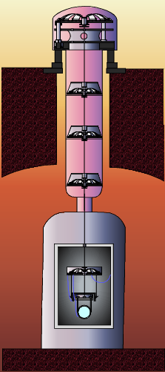
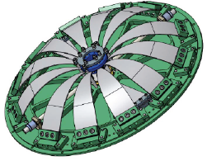
Seismic Attenuation System (SAS) for KAGRA
7-stage pendulum + 5-stages vertical spring
(horizontal attenuation)
(vertical attenuation)
Metal cantilever springs
~13 m
Geometric Anti-Spring (GAS) Filter
f₀ ~ 0.3 Hz
Last 3 stages are cooled at cryogenic temperature (<20 K) to suppress thermal noise
Mirror (Test Mass)
Cryostat
* Beam splitter and other optics are suspended by smaller vibration isolation systems

Slide 31
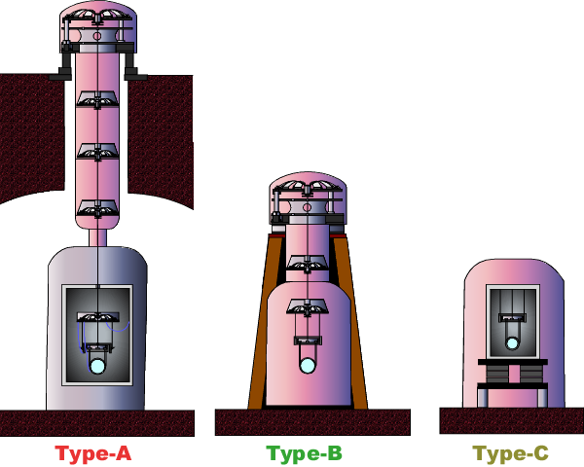
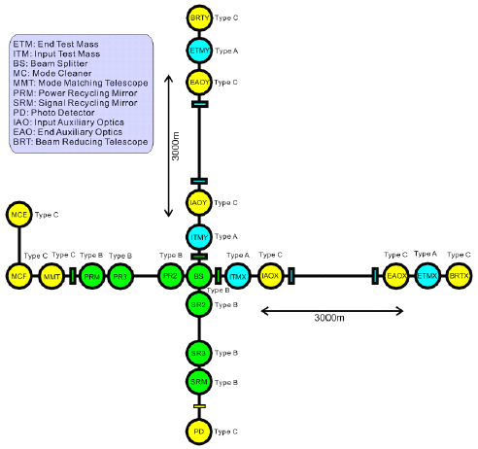
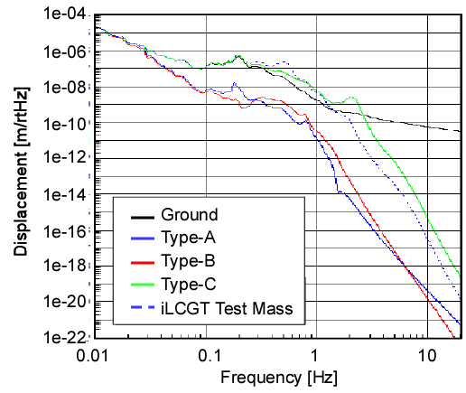
Vibration Isolation System Disposition
Expected Performance

Slide 32
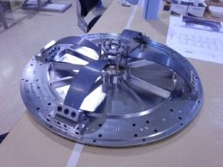
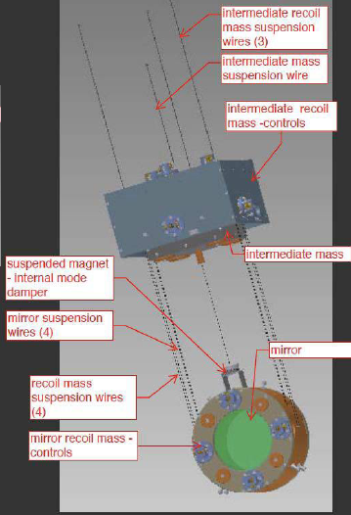
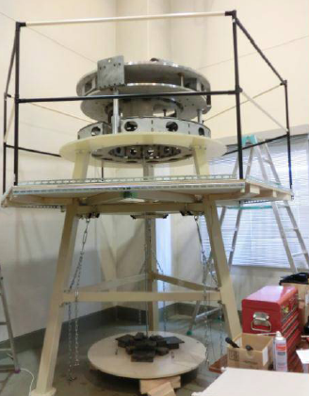
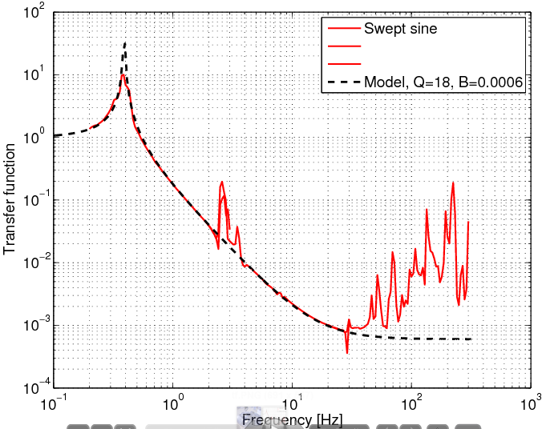
SAS Status
Prototype Experiment:
Standard filter (GASF): Performance was measured @NIKHEF
Pre-isolator (IP&GASF): Now Measuring @ Kashiwa
Design:
Type-B Payload: Now Designing
Measured
Transfer Function
(Feb. 16th, 2011)

Slide 33
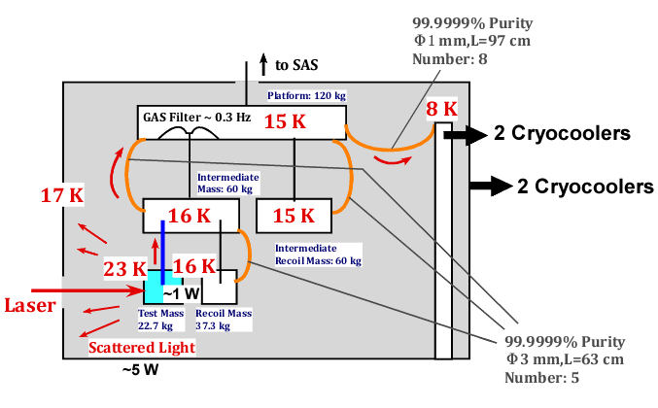
Cryogenics

Slide 34
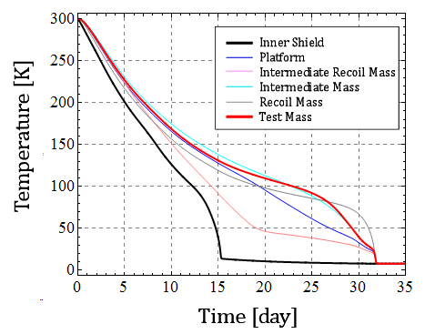
Initial Cooling Time
Thermal simulation with Y. Sakakibara’s Method
* The inner shield and the masses except for the test mass are DLC-coated (ε=0.41).
** Radiation cooling is dominant before 15th day.

Slide 35
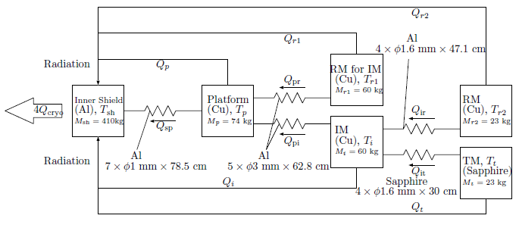
Initial Cooling Time Calculation Diagram
By Y. Sakakibara

Slide 36
Heat Load
Absorption in mirror
Coating: 0.4 W (1ppm)
Substrate: 0.6 W (50 ppm/cm)
Total: 1.0 W
Inner shield
Radiation from 80 K: 1.3 W
Conductance: 0.8 W
Scattered Light: 5 W (10 ppm)
Total: 7.1 W

Slide 37
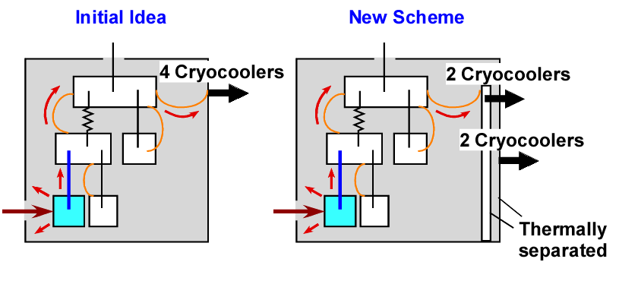
Heat Extraction Scheme
In the new heat extraction scheme, mirror temperature would not be raised, even if large scattered light attacks the shield.

Slide 38
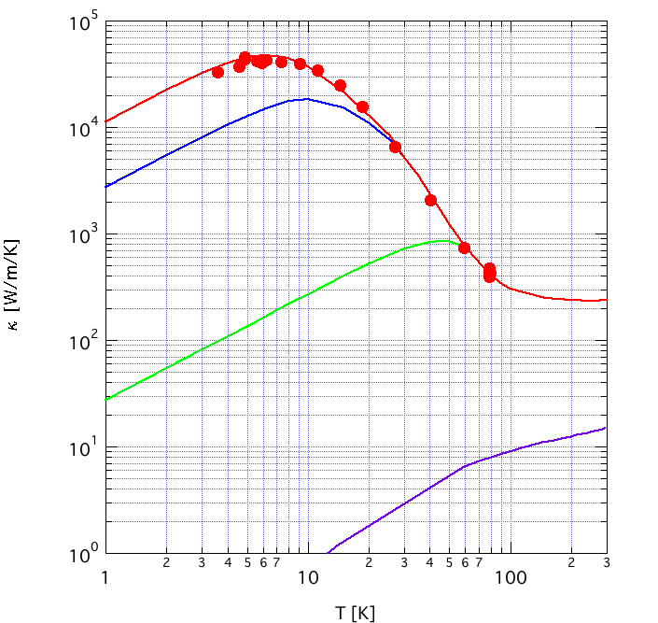
Thermal Conductivity of High Pure Aluminum
40,000 W/m/K @ 6K
6N Aluminum
5N up Al
RRR=3000
For outer shield
2N Aluminum
~Type A-1070
For inner shield

Slide 39
Heat Link TF Calculation
FEM Simulation Done by Y. Aso, (JGW-G1000108)
Pure aluminum (E=68 GPa), Φ1 mm
Half-ellipsoid (a=400 mm, b=200 mm)
Loss angle: 10⁻⁴

Slide 40
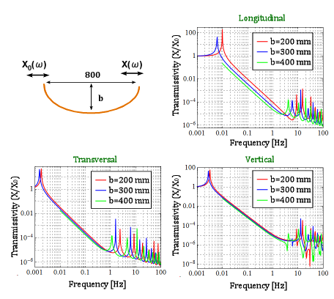
Heat Link Transfer Functions

Slide 41
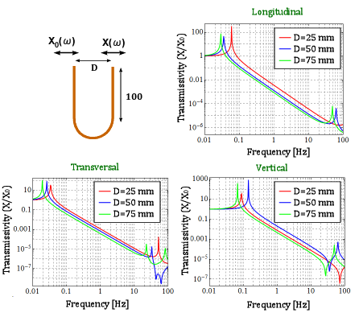
Heat Link TFs

Slide 42
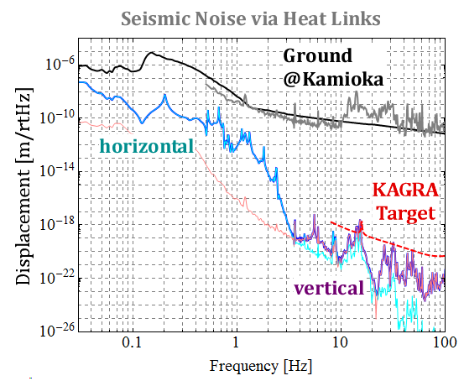
Seismic Noise via Heat Links
Couplings from the vertical motion is dominant above 3 Hz.
* Assuming 1% coupling
from vertical

Slide 43
Heat Links with Half Diameters
How about decreasing the fiber thickness, from Φ1.0 mm to Φ0.5 mm ?
Heat conductivity per link: x 1/4
Necessary number of links: x 4
Spring constant per link: x 1/16
Total stiffness: 1/4
Heat link total mass: Same

Slide 44
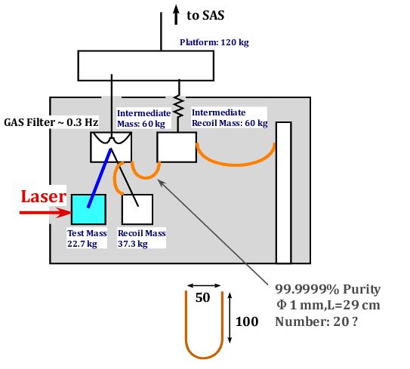
Hot Platform Design
Push heavy Platform to the room temperature part.
Decrease the initial cooling time.
Another vibration shortcut occurs between IM and IRM

Slide 45
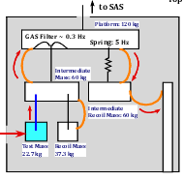
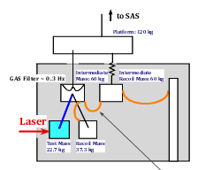
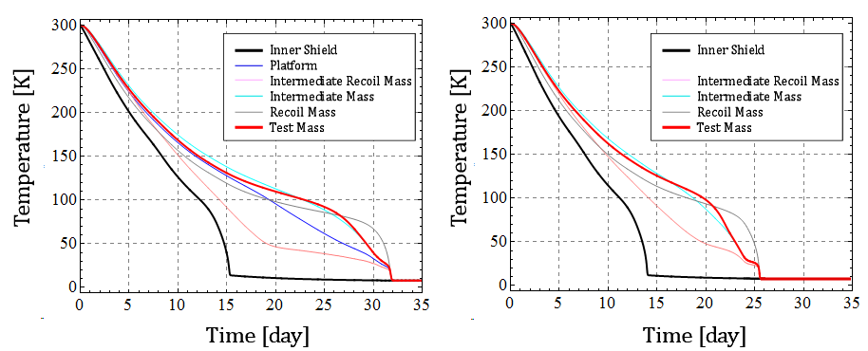
Hot Platform Initial Cooling Time
Current Design
Hot Platform
1 week earlier!!

Slide 46
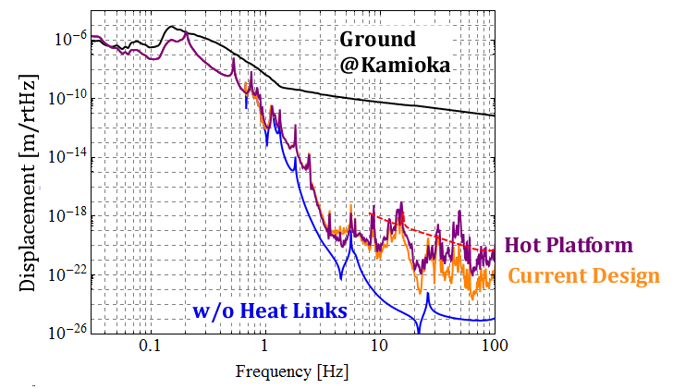
Hot Platform Seismic Noise
Due to the vibration shortcut, seismic noise gets larger above 10 Hz in ~1 order of magnitude

Slide 47
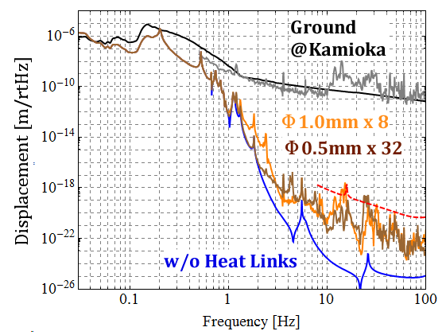
Heat Links with Half Diameters
Only better at 1-3 Hz, not so good above 10 Hz
* Assuming 1% coupling
from vertical

Slide 48
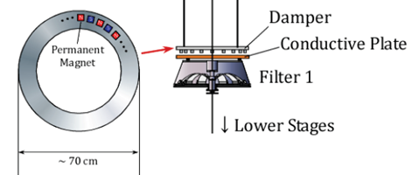
Torsion Mode Damping
Eddy current damping for yaw modes

Slide 49
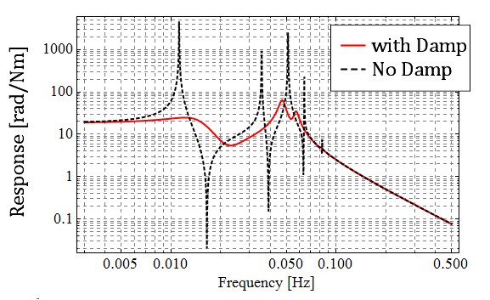
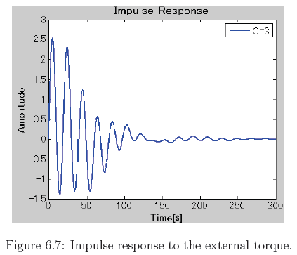
Torsion Mode Damping
Torsion modes of the single wire suspensions would be sufficiently damped by the eddy current damper.
Damping time:
1~2 min.
Mirror yaw angle response to applied torque

Slide 50
Effect on Angular Motion
RMS: 0.5 μrad

