Slide 1
External forces from heat links in cryogenic suspensions
D1, ICRR, Univ. Tokyo
Takanori Sekiguchi

Slide 2
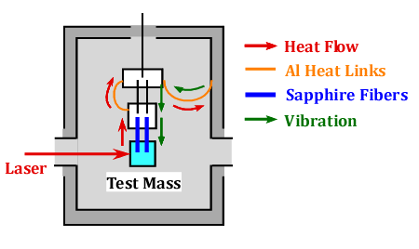
About this Talk
Estimate seismic noise introduced from heat links.
Discuss how to achieve cooling and seismic isolation at the same time.

Slide 3
Basic Requirement for Test Mass Suspension in KAGRA
Attenuate seismic noise
Cool down test masses
Test Mass Displacement
< 3 x 10⁻²⁰ m/√Hz @ 10 Hz
Mirror Temp. ~ 20 K

Slide 4
Seismic Attenuation System for KAGRA Test Mass
①
Seismic vibration transmits to the mirror in two different paths
From the top through the attenuation chain
From the wall of the cryostat through heat links
~14 m
②

Slide 5
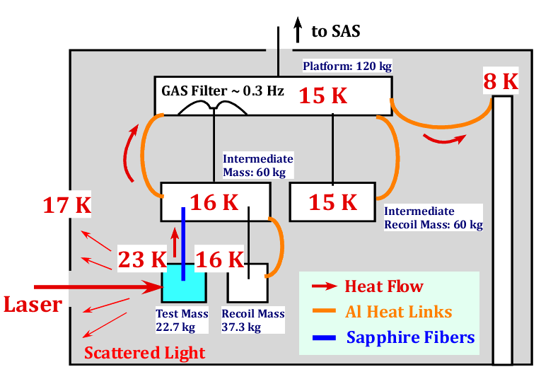
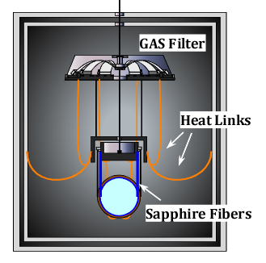
Cryogenics
Heat transferred via pure aluminum heat links.
We need Φ1 mm, L=1 m heat links x 7~8
Thermal simulation Done by Y. Sakakibara

Slide 6
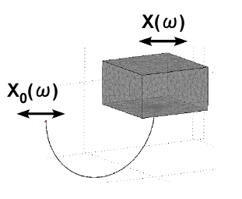
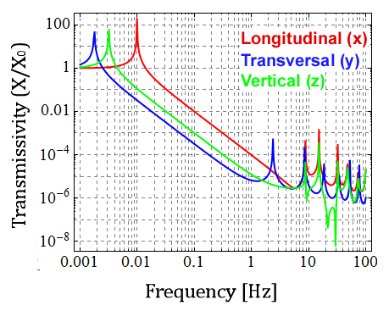
Mechanical Property of Heat Links
A heat link works as a soft spring (f₀~10 mHz) with violin modes above ~1 Hz
FEM Simulation Done by Y. Aso, (JGW-G1000108)

Slide 7
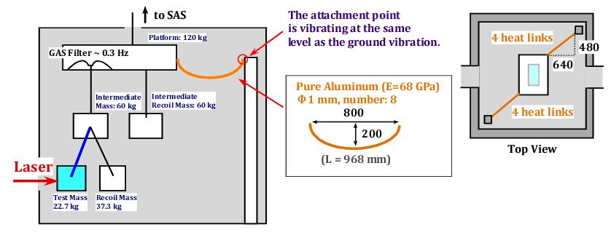
Estimation of Seismic Noise via Heat Links
Simulation Tool: 3-D rigid-body model simulation
T. Sekiguchi, Master Thesis (JGW-P1200770)

Slide 8
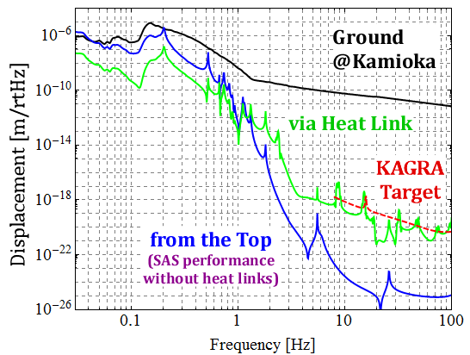
Calculation Result
①
* Assuming 1% coupling
from vertical
②
Polluting detector sensitivity above 10 Hz !!

Slide 9
To Make Matters Worse ..
There is no guarantee that the wall inside the cryostat is vibrating at the same level as the ground.
???

Slide 10
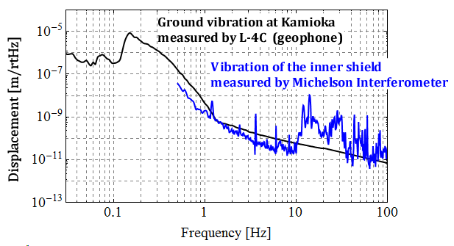
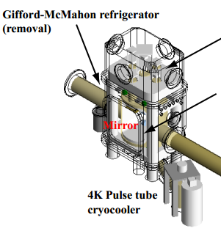
Vibration of the Shield inside the Cryostat in CLIO
10-100 times larger !!
K. Yamamoto et al, J. Phys.: Conf. Ser. 32 418 (2006)

Slide 11
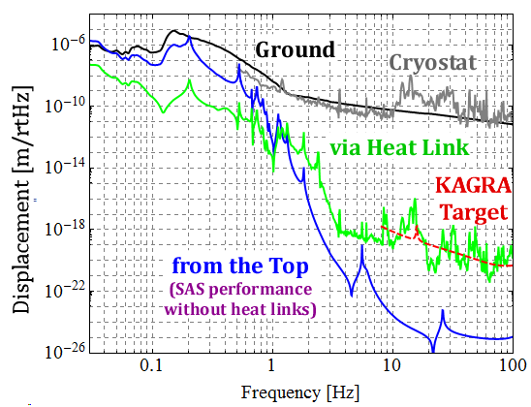
In Worse Case
①
If the attachment point of heat links is vibrating at the same level as cryostat vibration in CLIO..
②
* Assuming 1% coupling
from vertical

Slide 12
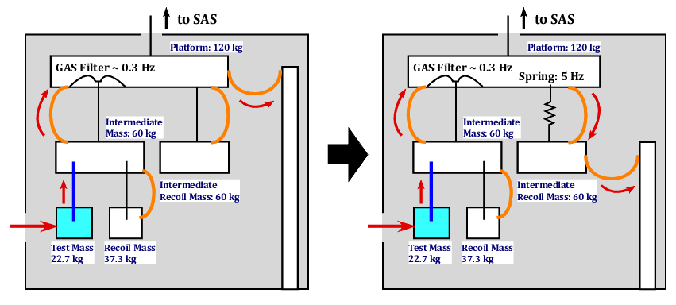
Improved Design
Add one more “cushion” between the cryostat and mirror

Slide 13
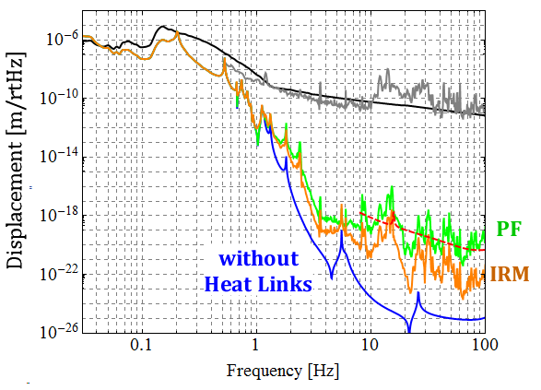
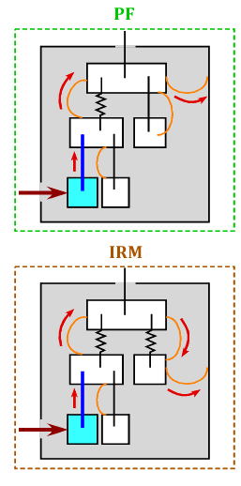
After Improving Wiring

Slide 14
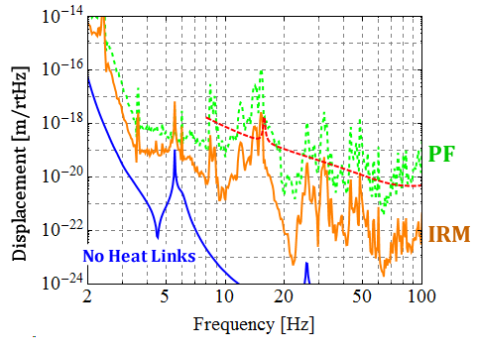
After Improving Wiring
Several peaks exceed the target sensitivity, but the flour level is OK.

Slide 15
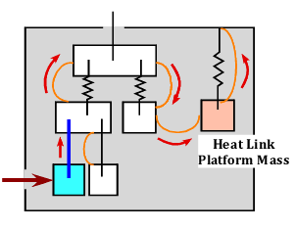
Further Improvement
Suppress the cryostat vibration passively/actively.
Put additional filters between suspension and cryostat.
Add vertical springs for test mass suspension.

Slide 16
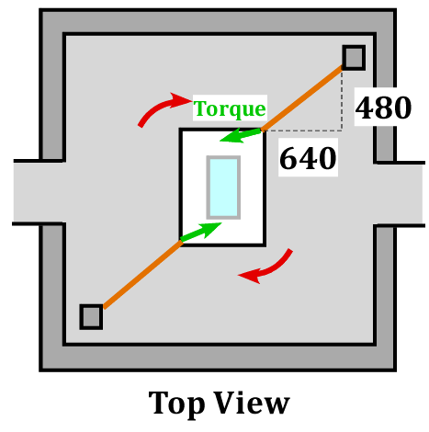
Effect on Angular Motion
SAS is very soft in yaw motion (~ 10 mHz).
Torque from heat links may excite low frequency angular motion.

Slide 17
Asymmetry
Symmetric wiring does not subject any torque.
Assume two kinds of asymmetry:
Different attachment point (~1cm)
Different stiffness (50%)

Slide 18
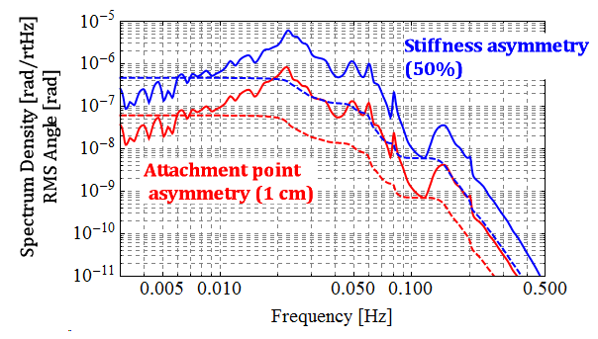
Effect on Angular Motion
RMS: 0.5 μrad
Not small, but can be controlled

Slide 19
Summary
Seismic noise introduced from the heat links can easily affect the detector sensitivity above 10 Hz.
One needs careful wiring of heat links, and further improvement of suspensions may be necessary.
The amplitude of the low-frequency mirror yaw motion excited by the heat links would be within acceptable level.

Slide 20
The END

Slide 22
Appendices

Slide 23
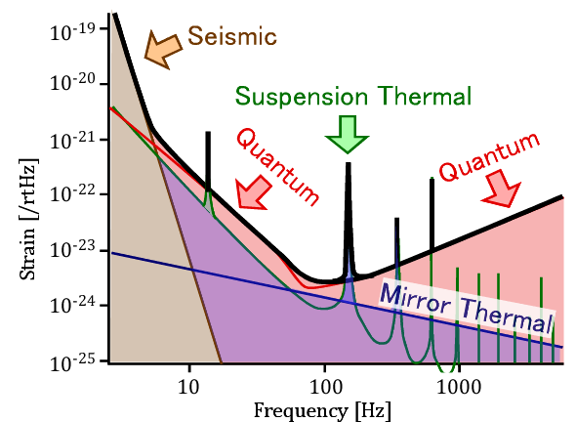
Requirement for KAGRA Test-Mass Suspensions
Seismic Noise Attenuation
Mirror Temp. < 20 K
KAGRA Design Sensitivity
Test Mass Displacement
< 3 x 10⁻²⁰ m/√Hz @ 10 Hz

