Slide 1
KAGRA Vacuum System
120418 VAC (YS)
1. Overview
Items
** two beam tubes of 3-km long and 800 mm in diameter
** optical baffles distributed at every 12 meter in the beam tubes
** beam monitor target inserted in the beam tubes
** chambers for the mirrors with suspension and vibration-isolation devices
** vacuum pumping system
** overall layout
Interface
all of the subsystem groups; entire systems is in an un-separated vacuum.
** choice of materials for components used in cryostat, optical devices,
vibration-isolation devices, . . .
** interferometer layout and operation sequence
cf. vacuum system philosophy in accelerator
** beam dynamics and vacuum system have to be designed simultaneously.
** choice of materials having low outgassing is most important.
** mechanical and electric design of every component has to be simple.
** materials properties have to be examined and measured before choosing.
(KEK Internal 07-17)

Slide 2
KAGRA Vacuum System
120418 VAC (YS)
2. Target specifications
Required Pressure：
in the order of 10⁻⁷ Pa, or lower
<<scattering effect due to residual gas>>
** We predict the noise δx due to the residual gas (water) molecules;
for δx = 1×10⁻²¹ m/√Hz@100 Hz (safety margin of 10),
the pressure in the beam tubes is to be kept at 2×10⁻⁷ Pa.
(h=3×10⁻²⁴ /(Hz)^{1/2} @100Hz corresponds to δx=1×10⁻²⁰ m/(Hz)^{1/2})
<<minimize the maintenance work>>
** For long-term and stable operation of the interferometer, the vacuum system is to be designed so as to minimize the maintenance work, and so as to shorten the pump-down time. A long lifetime of the vacuum component and low outgassing is required.
Penning cell
Ti cathode

Slide 3
KAGRA Vacuum System
120418 VAC (YS)
2. Target specifications
BRTY
ETMYA
Type A double chamber (2.4 and 1.5 m in dia.)
//GASF + I-Pendulum + cryogenic//
Layout:
less changes “i” to “b”
EAOY
ETM: end test mass
ITM: input test mass
BS: beam splitter
IAO/EAO: auxiliary optics of input/end
MC: mode cleaner
PRM: power recycling mirror
SRM: signal recycling mirror
PD: photo detector
BRT: beam reducing telescope.
Type C chamber
(1.5 m in dia./ 2 m for MC)
//stack + D-Pendulum//
IAOY
MC
ITMY
ITMX
3000 m
ETMXA
BRTX
MCF
MMT
PRM
PR3
PR2
BS
IAOX
EAOX
SR2
Type B chamber
(1.5 m in dia./2 m for BS)
//GASF + I-Pendulum//
IP
TMP
SR3
SRM
FL P
two beam tubes of 3-km long and 800 mm in dia.
//optical baffles at every 12 meter
//pumping unit at every 100 meter
PD

Slide 4
KAGRA Vacuum System
120418 VAC (YS)
2. Target specifications
Layout:
horizontal floors for installing chambers
Xopt
optical plane of interferometer
horizontal plane at X end
X arm
x
y
O (BS)
horizontal plane at center room
Yopt
Y arm
horizontal plane at Y end
ETMX
iLCGT
BS
Xopt
X arm
ITMY
ITMX
ETMY
Y arm
O
Yopt
1/300

Slide 5
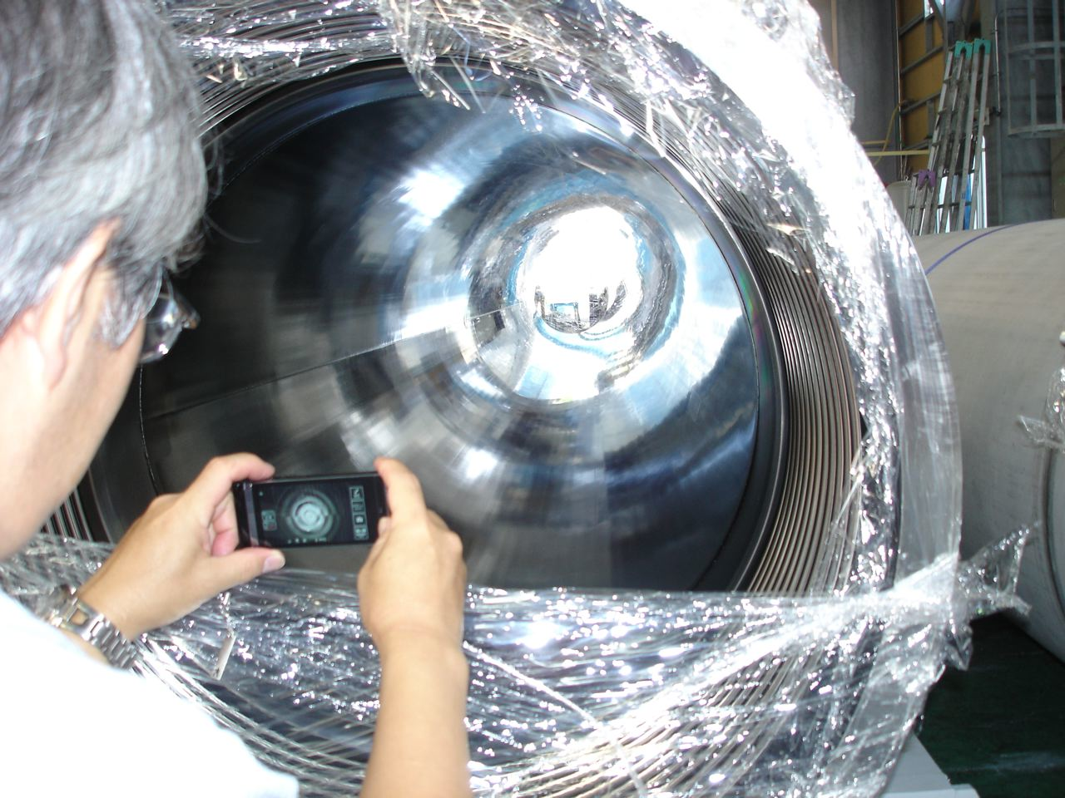
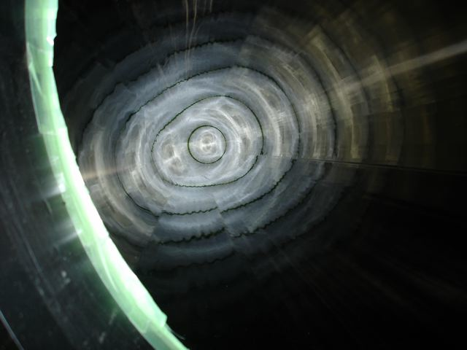
KAGRA Vacuum System
120418 VAC (YS)
3. Final design and quality assurance; (1) Beam tube
Beam tube (478 of 12-m long and 0.8 m in diameter); 320 tubes completed, so far.
“surface passivation by electro-polish followed by baking”
outgassing rate; 10⁻⁸ Pa m³ m⁻² s⁻¹, or lower
surface roughness; Rmax 3 μm, Ra 0.5 μm
“mirror finish by Electro-Chemical Buffing (tubes in the mid 800-m region)”
surface roughness; Rmax 0.2 μm, Ra 0.03 μm
“flange connection with metal O-ring (silver plated)”; erosion proof by humidity test
Electro-polished tube of 12 m long
Electro-chemical buffed tube of 12 m long

Slide 6
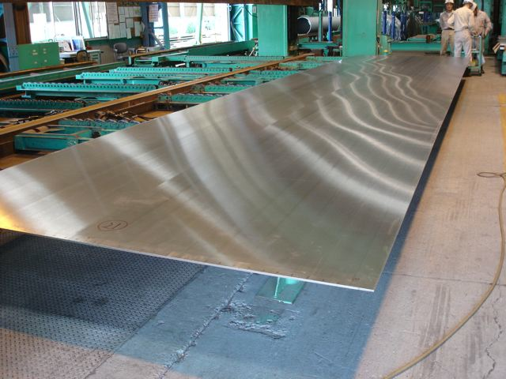
KAGRA Vacuum System
120418 VAC (YS)
3. Final design and quality assurance; (1) Beam tube
Manufacturing process of a beam tube (12-m long and 0.8 m in diameter
* hot roll → austenitic process (Annealing & Pickling) → surface grinding
Surface finish condition
grinding: Grit # 150, wet
Ry ~ 8 μm
SS 304L
8-mm thick
2.5-m wide
11.2-m long
Sumikin & Nippon Steel Stainless Steel Pipe Co., Noda

Slide 7
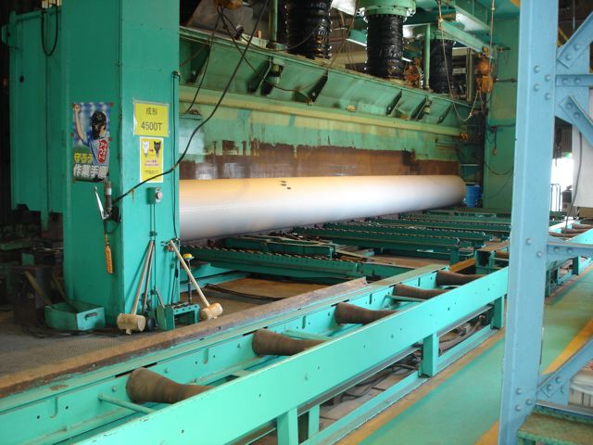
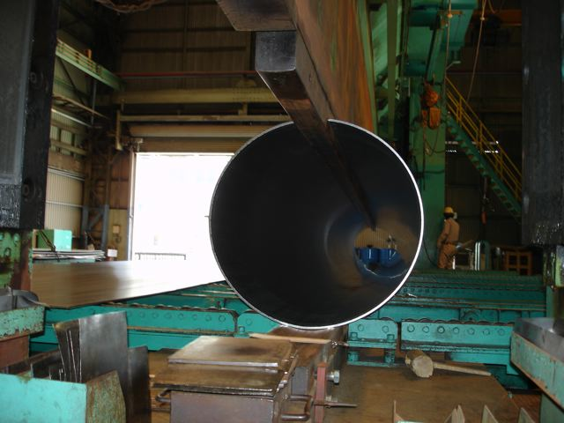
KAGRA Vacuum System
120418 VAC (YS)
3. Final design and quality assurance; (1) Beam tube
Manufacturing process of a beam tube (12-m long and 0.8 m in diameter
* press forming → one-seam weld (plasma welding without filler)
geometrical tolerance
straightness: 0.1%/L
circularity: 1%/D
perpendicularity: 0.2%/D
0.8 m in diameter
11.2-m long
Sumikin & Nippon Steel Stainless Steel Pipe Co., Noda

Slide 8
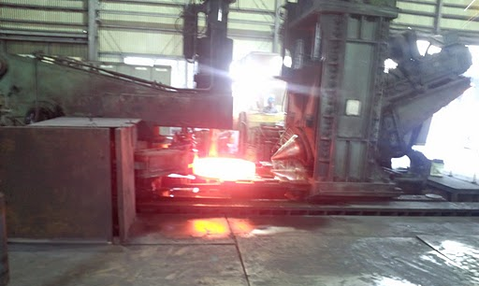
KAGRA Vacuum System
120418 VAC (YS)
3. Final design and quality assurance; (1) Beam tube
Manufacturing process of a beam tube (12-m long and 0.8 m in diameter
* flanges
flange
SS F 304; rotary forging
thickness; 30 mm
welding neck; 120 mm long
flatness: 0.1 mm
SS F 304; rotary forging
Shimoda Iron Works Co., Aioi /Yamashita Tanzosho Co., Katano

Slide 9
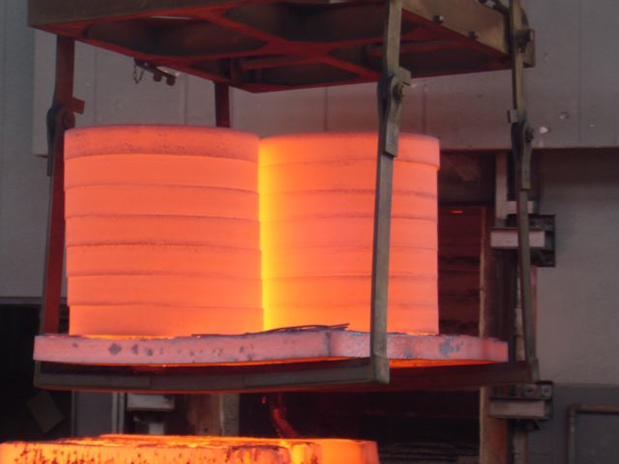
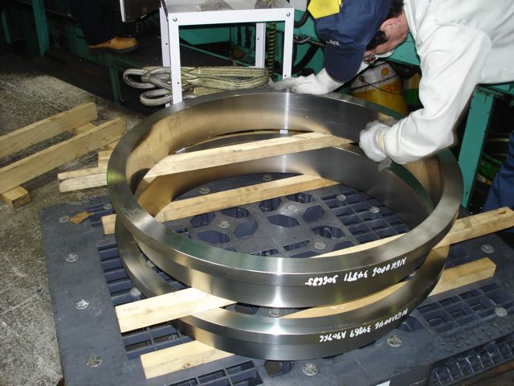
KAGRA Vacuum System
120418 VAC (YS)
3. Final design and quality assurance; (1) Beam tube
Manufacturing process of a beam tube (12-m long and 0.8 m in diameter
* flanges
flange
SS F 304; rotary forging
thickness; 30 mm
welding neck; 120 mm long
flatness: 0.1 mm
Austenitic process and machining: Shimoda Iron Works Co., Aioi

Slide 10
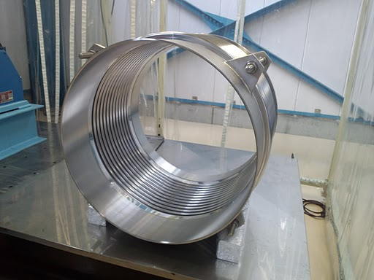
KAGRA Vacuum System
120418 VAC (YS)
3. Final design and quality assurance; (1) Beam tube
Manufacturing process of a beam tube (12-m long and 0.8 m in diameter
* bellows
bellows
SS316L; hydroformed
stiffness; 100 N/mm or less
finish: chemical polishing
Nippon Shinshukukan Co., Hosono

Slide 11
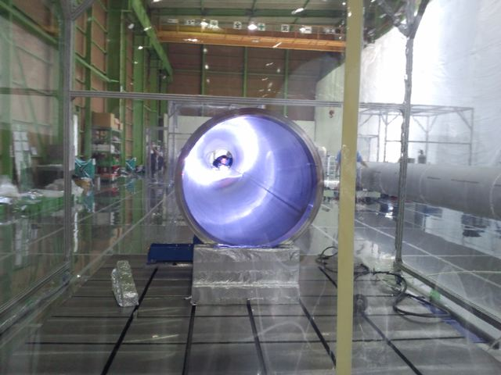
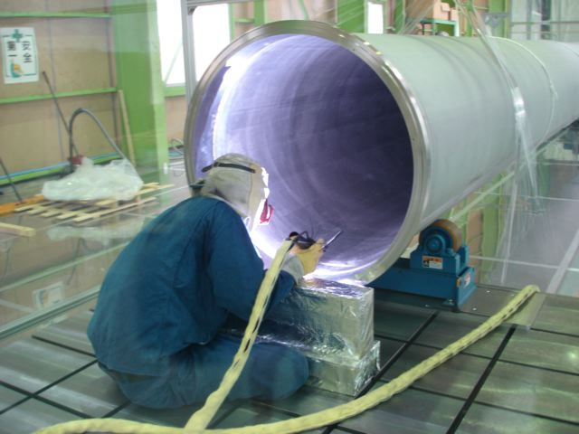
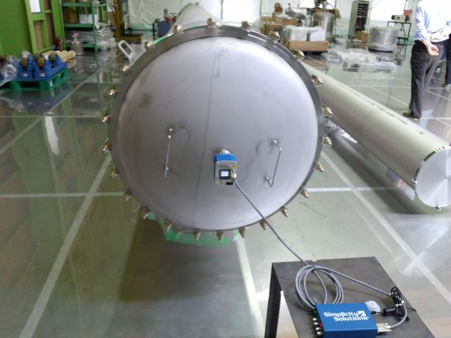
KAGRA Vacuum System
120418 VAC (YS)
3. Final design and quality assurance; (1) Beam tube
Manufacturing process of a beam tube (12-m long and 0.8 m in diameter
* weld flanges and bellows
MIRAPRO Co., Noda

Slide 12
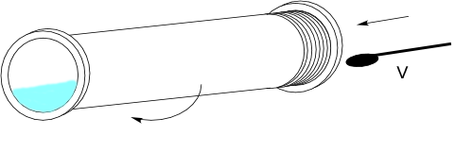
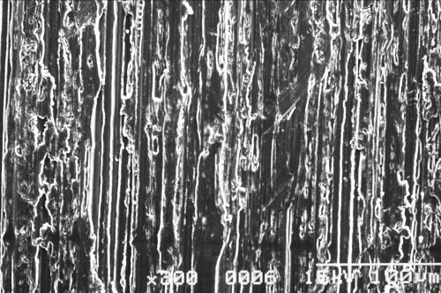
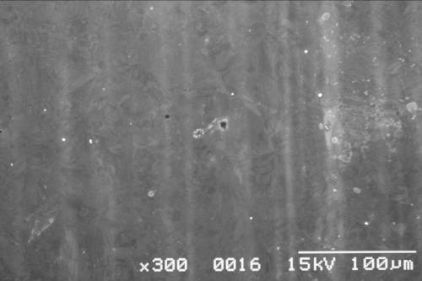
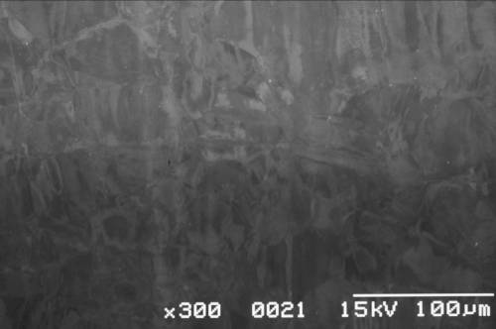
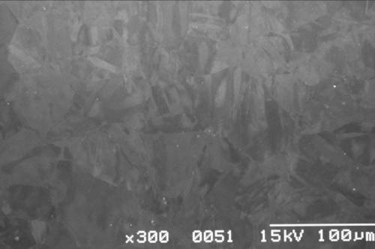
KAGRA Vacuum System
120418 VAC (YS)
3. Final design and quality assurance; (1) Beam tube
Manufacturing process of a beam tube (12-m long and 0.8 m in diameter
* electro polishing and rinsing
electro polishing
current density; 20 A/dm2
removal; 30-40 μm
Ry ~ 2.5 μm
rinsing
pure water; 15 MΩ
#150 grinding
Electro polishing;
San-ai Plant Co., Kisarazu / Marui Galvanizing Co., Kashiwa
（15 μm removal）
（25 μm removal）
35 μm removal）

Slide 13
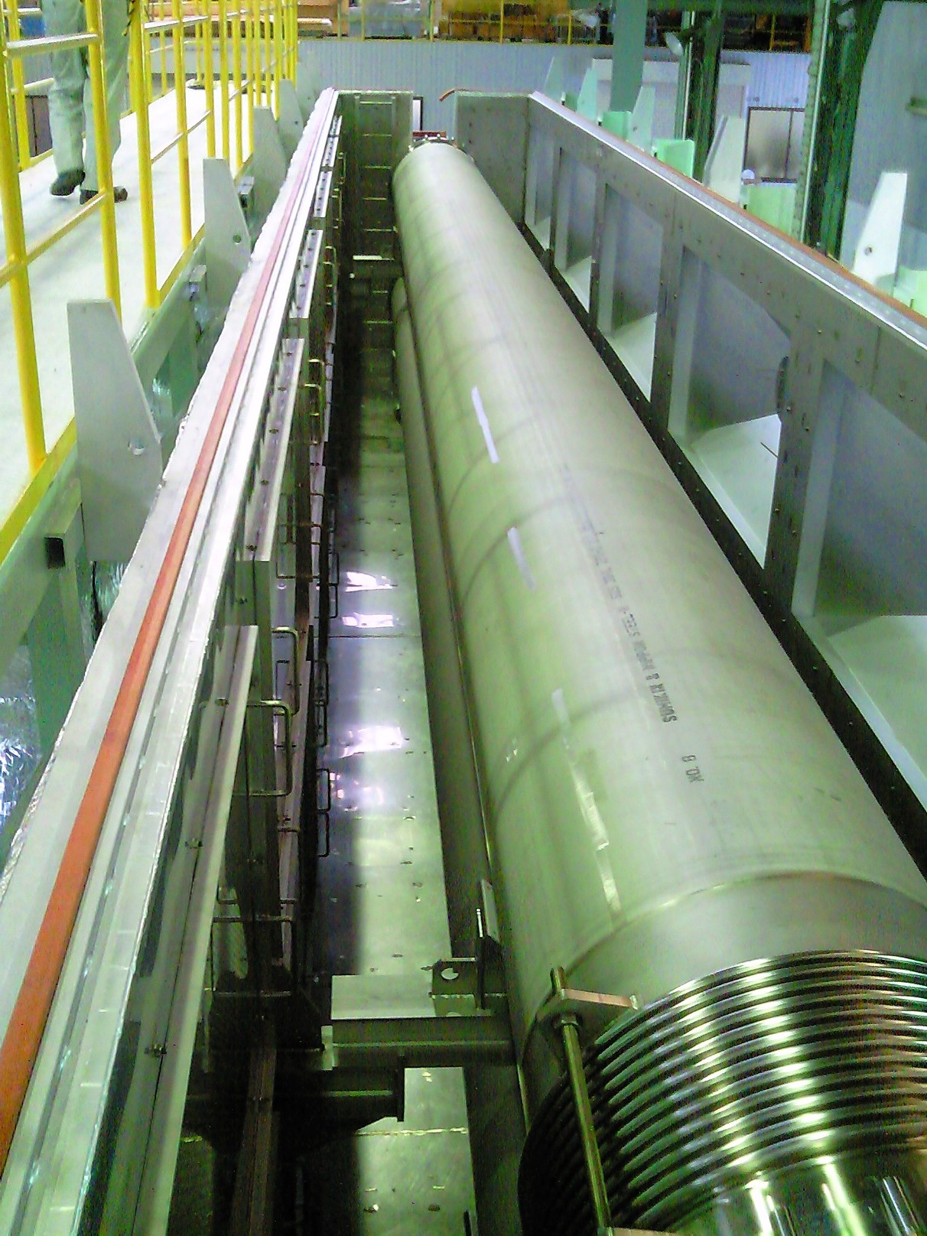
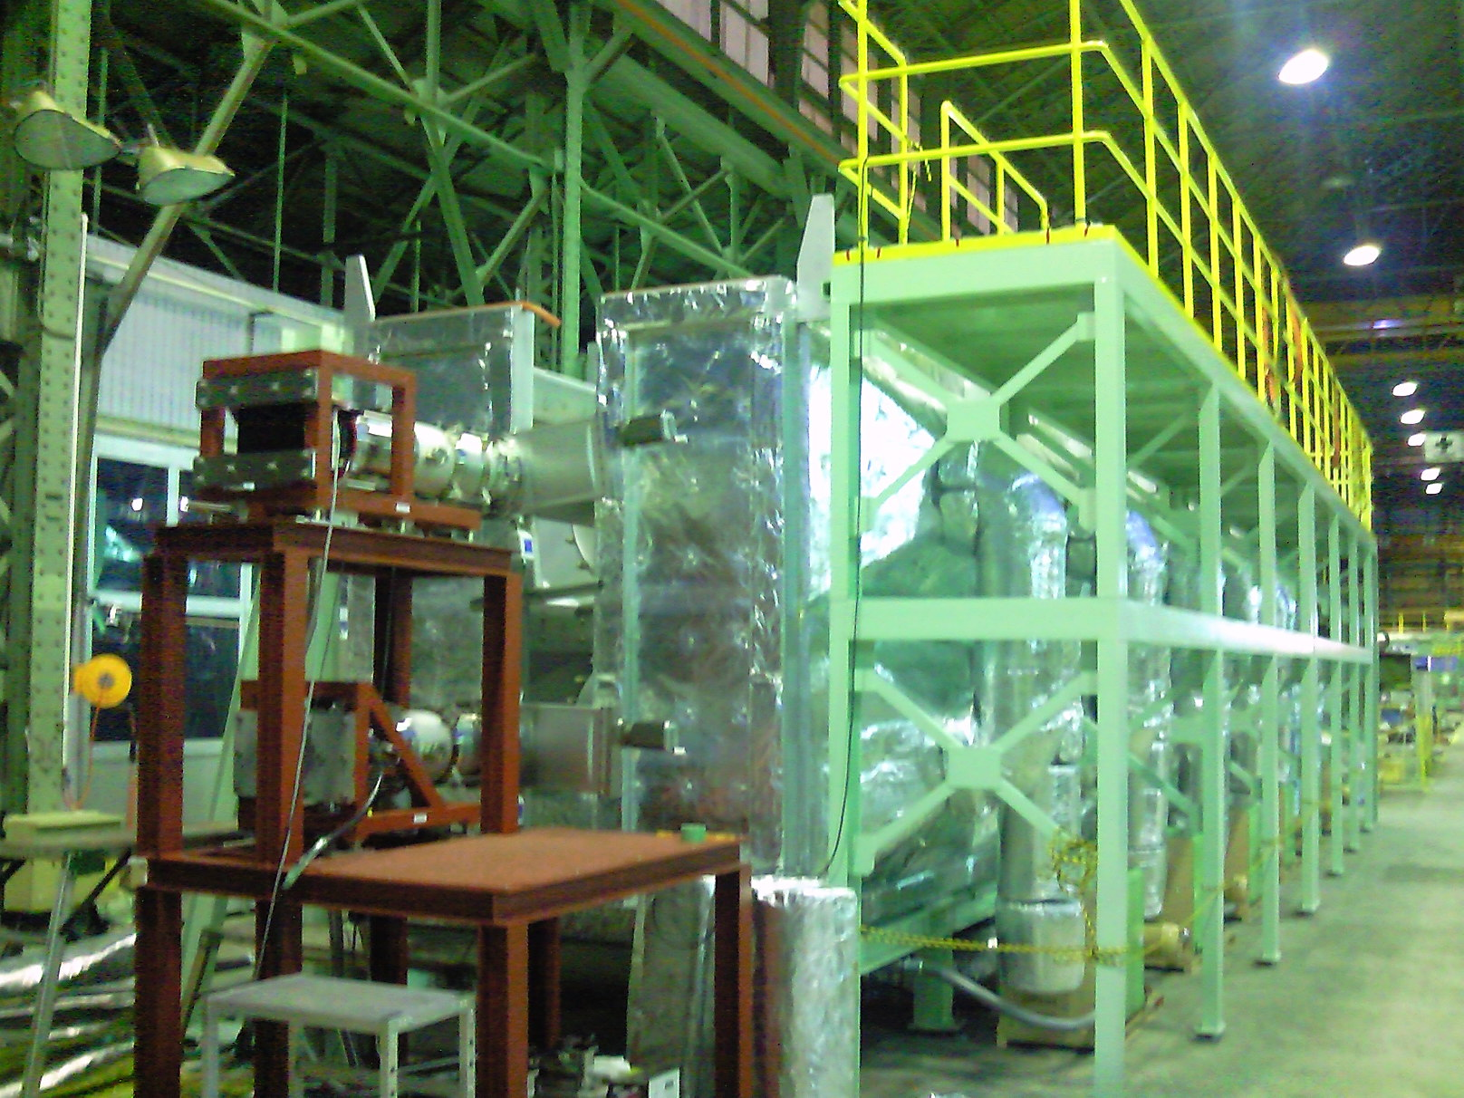
KAGRA Vacuum System
120418 VAC (YS)
3. Final design and quality assurance; (1) Beam tube
Manufacturing process of a beam tube (12-m long and 0.8 m in diameter
* vacuum baking
→ dry air venting (-40°C dew point)
→ seal (EPDM gasket)
furnace（200℃，〜3days）
MIRAPRO Co. Noda/MESCO, Kamioka

Slide 14
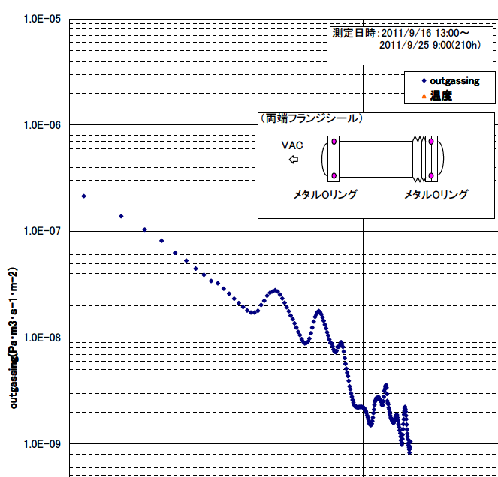
KAGRA Vacuum System
120418 VAC (YS)
3. Final design and quality assurance; (1) Beam tube
Measured outgassing rate of a beam tube
1 10 100 1000

Slide 15
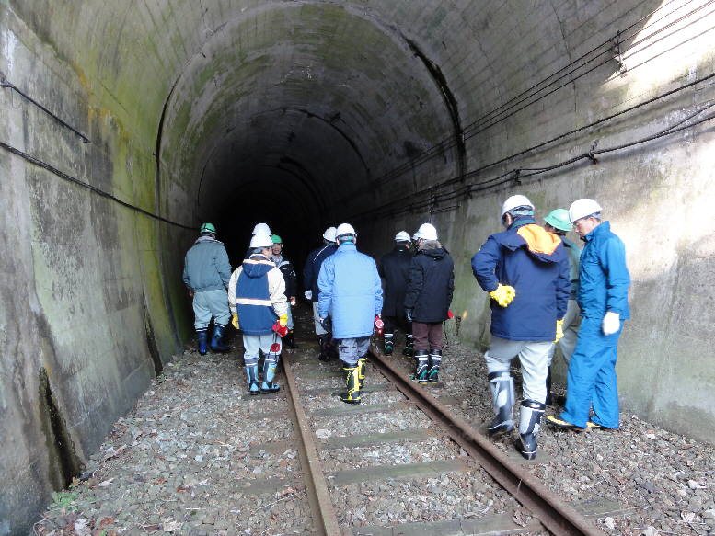
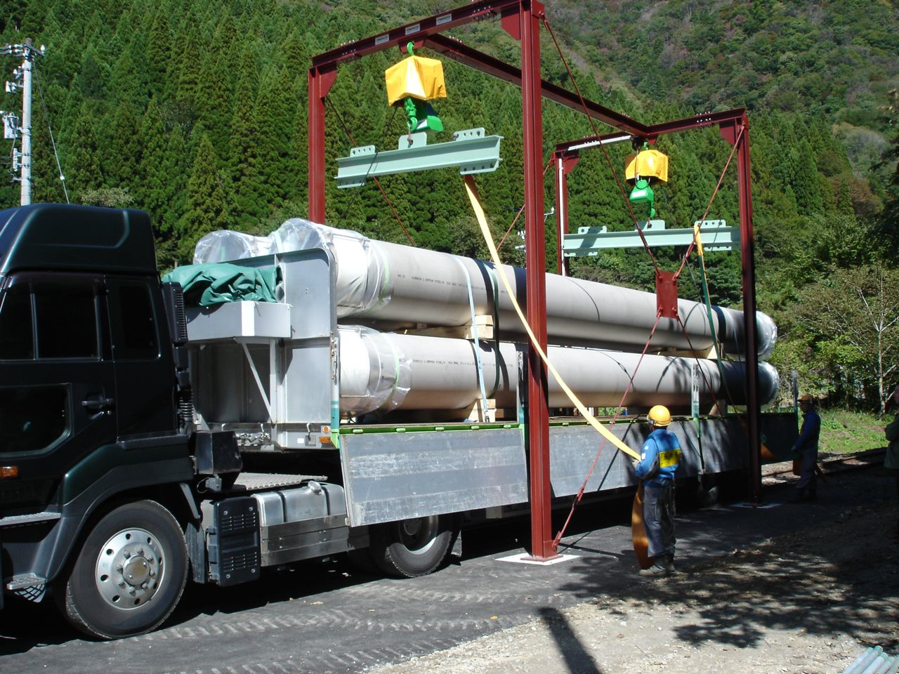
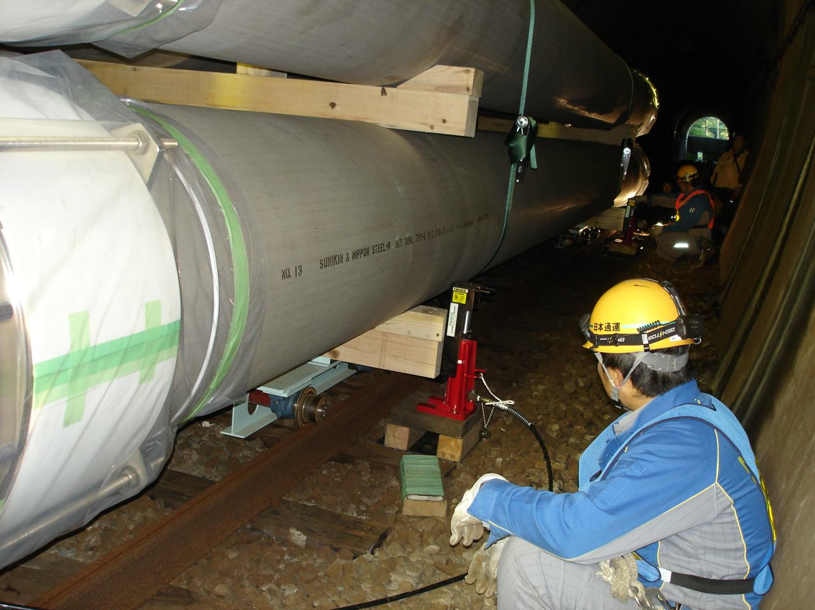
KAGRA Vacuum System
120418 VAC (YS)
3. Final design and quality assurance; (1) Beam tube
Storage beam tube (one year, or more)
A tunnel of Kamioka Mining Railway (not in service)

Slide 16
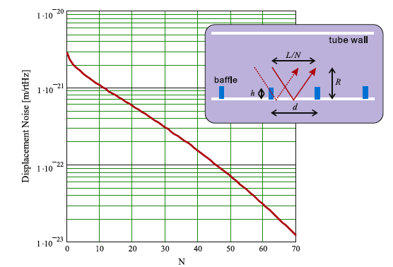
KAGRA Vacuum System
120418 VAC (YS)
3. Final design and quality assurance; (2) Optical baffles in beam tubes
Every12-m along the arm, 40-mm in height, 50-degree tilted
** estimated scattered light noise at Kamioka
δx = 3×10⁻²¹ m/√Hz@30Hz (tube vibration amplitude=1×10⁻¹¹ m/√Hz assumed )
** For more margin, baffles at “every 12 meters”. δx = 5×10⁻²² m/√Hz
** For randomizing phase of edge-scattered light, baffles with “saw-tooth edge”.
N=(h/d)/(L/R)

Slide 17
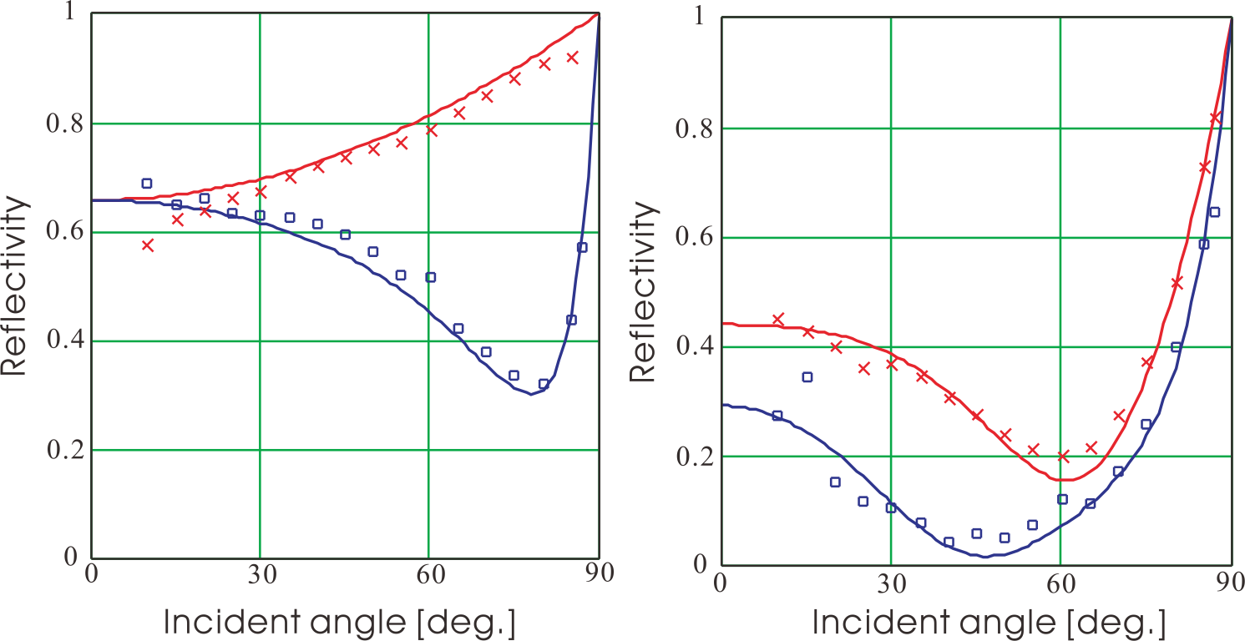
KAGRA Vacuum System
120418 VAC (YS)
3. Final design and quality assurance; (2) Optical baffles in beam tubes
Coating of diamond-like-carbon (DLC) film of 1 μm thick
outgassing rate = 4×10⁻⁹ Pa m³ m⁻² s⁻¹
absorption coefficient = 65% @ 0 deg
reflectivity = 0.1 - 0.2 @ 45-60 deg
Tomaru et. al, J. Vac. Soc. Jpn, 48, 2005
Black finishing | UB-NiP | Phosblack-II | DLC | Raydent
Absorption coeff.（%） | 99.89 | 85 | 65 | 83
Mirror polished SS
DLC coated
cross = p, open circle = s:
Takahashi et. al, Vacuum 73, 2004

Slide 18
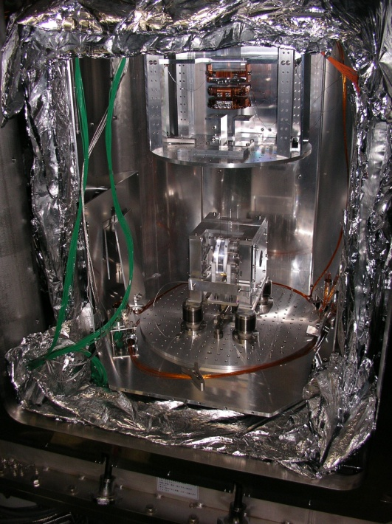
KAGRA Vacuum System
120418 VAC (YS)
3. Final design and quality assurance; (3) PET laminations for thermal shield
Outgassing measurement of Al-coated PET laminations
** Although the aluminum-coated thin PET (polyethylene terephtalate) film is suitable material for thermal shield, the outgassing rate is higher than those of metal surfaces.
CLIO cryostat

Slide 19
KAGRA Vacuum System
120418 VAC (YS)
3. Final design and quality assurance; (3) PET laminations for thermal shield
Outgassing measurement of Al-coated PET laminations
** Although the aluminum-coated thin PET (polyethylene terephtalate) film is suitable material for thermal shield, the outgassing rate is higher than those of metal surfaces.
** Outgassing rate of a PET film of 12 micrometer thick is measured.
The rate decreases to 10⁻⁶ Pa m³ s⁻¹ m⁻² for about 10h, then reaching to the order of 10⁻⁸ Pa m³ s⁻¹ m⁻² for 200h.
** Water molecules absorbed in film is possibly diffused to the surface
and desorbed with a long period of 100 hours.

Slide 20
KAGRA Vacuum System
120418 VAC (YS)
3. Final design and quality assurance; (4) Vacuum system operation
Pumping system (dry-pump and ion-pump)
** pumping unit is distributed “every 100 meters” along tubes.
ITMX
3000 m
ETMX
“expected pump-down scheme (a 3-km arm)”
to 1 Pa >> few days by dry-pump
to 10⁻⁶ Pa >> 50 hours by TMP
to 10⁻⁷ Pa >> 500 hours by ion pump
(based on the ougassing rate in test tubes)
“maintenance without breaking arm-vacuum”
ion pump life, B-A gauge failure,
feed-through erosion, . . .
durability for humidity is being examined (50°C-98%) for vacuum components.
IP
TMP
DRY P
FL P
** pumping speed of the unit (100 m)
600 m³/h >> dry-pump
2000 L/s >> TMP
500 L/min >> TMP foreline pump
1000 L/s >> IP
“fail-safe by closing gate valves (large dia,)”
electric-power shut down
anomalous pressure rise

Slide 21
KAGRA Vacuum System
120418 VAC (YS)
3. Final design and quality assurance; (4) Vacuum system operation
Vacuum system control
control signal 0/1
pressure readout
Center control
EPICS
→ status: 3
← control: 3
BA gauge
ULVAC GI-M2
controller
PLC
Yokogawa
Pirani gauge
Convectron type
controller
Ethernet
→ status: 4
Gate valve
（actuator）
A/D
Yokogawa MW100
controller
← control: 2
Ion pump
VARIAN type
controller
→ status: 2
← control: 1
Ion pump
Gamma type
controller
Micro IOC
RS485
arm tunnel, center/end room
A gate valves of large diameter takes 40 seconds for closing.

Slide 22
LCGT Vacuum System
KAGRA Vacuum System
120417 VAC (YS)
120418 VAC (YS)
4. Schedule for installing
1) manufacturing 478 of tubes;
from Apr 2011 to Mar 2013
2) manufacturing chambers;
from Sep 2012 to Mar 2014
Finish X-arm at the end of 2014
BRTY
3) installing chambers in X and Y ends; Apr 2014
Apr 2014
4) carrying tubes and lay on the supports;
from Apr 2014 to Jun 2014
ETMYA
EAOY
5) installing chambers in Center Room; Jul 2014
6) jointing tubes and pump down in X and Y arm
from Jul 2014 to Mar 2015
Jul 2014 to Mar 2015
IAOY
MC
ITMY
Apr 2014
MCF
MMT
PRM
PR3
PR2
BS
ITMX
IAOX
EAOX
ETMXA
BRTX
SR2
3000 m
Apr 2014
SR3
Jul 2014 to Mar 2015
SRM
Jul 2014
PD
22

Slide 23
KAGRA Vacuum System
120418 VAC (YS)
5. Risk management
Vacuum component failure and leakage
IP
TMP
** recovery “without breaking arm-vacuum”
•BA gauge failure: grid contamination, filament breakdown
•feedthrough erosion; high voltage feedthrough of ion pump
•power supply/controller erosion; ion pump, turbo molecular pump
durability for humidity is being examined (50°C-98%, 7 cycle of 8h-operation/98h-off).
** recovery “by re-pumping an arm”
•window (view port) break down
•crack and erosion in bellow joint
•metal gasket erosion
** safety “by closing gate valves (large dia,)”
•electric-power shut down
•anomalous pressure rise
DRY P
FL P
expected pump-down scheme (a 3-km arm)
to 1 Pa >> few days by dry-pump
to 10⁻⁶ Pa >> 50 hours by TMP
to 10⁻⁷ Pa >> 500 hours by IP
(based on the ougassing rate in test tubes)
ITMX
3000 m
ETMX

