Slide 1
Input/Output Optics subgroup
Current Members
  S. TELADA (AIST)
  S. MIYOKI (ICRR)
  T. UCHIYAMA (ICRR)
  O. MIYAKAWA (ICRR)
  N. MIO (U-Tokyo)
  S. MORIWAKI (U-Tokyo)
  N. OHMAE (U-Tokyo)
  K. IZUMI (U-Tokyo)
  K. SOMIYA (TITech)
  T. AKUTSU (NAO)
  E. HIROSE (ICRR)
  S. NAGANO (NICT)
  S. SAKATA (UEC)
  M. MUSHA (UEC)
Contact: Souichi TELADA <souichi.telada@aist.go.jp>

Slide 2
General definition
Make the input optics system from laser to power recycling mirror and make the all of output optics systems* including output mode-cleaner.
Prepare all of optics and facilities for them.
output optics system* AOS prepares too.

Slide 3
Item Lists [1/2]
Items | iLCGT | bLCGT | Presen- tation
(a) Laser Room | ◎ | ○ | Yes
(b) Input Optics | ◎ | ◎ | Yes
(c) Mode Cleaner | ◎ | ○ | Yes
(d) Mode Matching Telescope | ◎ | ○ | Yes
(e) Isolator | ◎ | ○ | Yes
(f) Output Optics* | ◎ | ◎ | No
(g) Output Mode Cleaner | － | ◎ | Yes
(h) Photo Detector | ◎ | ◎ | No
(i) Beam Shutter | ◎ | ○ | Yes
(j) Green Laser | ◎ | ○ | Yes
◎ develop or modify ○ same as iLCGT － none
Output Optics* AOS prepares too.

Slide 4
Item Lists [2/2]
(b) Input Optics
Sub Items | iLCGT | bLCGT | Presen- tation
(b-1) Pre Mode Cleaner | ◎ | ○ | Yes
(b-2) Reference Cavity | ◎ | ○ | Yes
(b-3) Intensity stabilization | ◎ | ◎ | Yes
(b-4) Frequency stabilization | ◎ | ◎ | Yes
(b-5) Modulator | ◎ | ◎ | Yes
(b-6) Alignment control of incident beam | ◎ | ○ | No
(b-7) Other optics | ◎ | ◎ | No
◎ develop or modify ○ same as iLCGT

Slide 5
(a) Laser Room [1/2]
iLCGT ◎
bLCGT ○
Vacuum Chamber
Vacuum Pipe
MC 26m
Laser Room
Front
Room

Slide 6
(a) Laser Room [2/2]
iLCGT ◎
bLCGT ○
Specifications
Higher class clean room than center room (class ???).
Better temperature stability with air conditioner (+/- 1K).
Soundproof room.
The floor is separated from center room floor ( blue broken line).
Lasers and input optics table are surrounded by Enclosers.
Inter-face | -> TUN, FCL and VAC <-> LAS

Slide 7
(b) Input Optics [1/3]
iLCGT ◎
bLCGT ◎
Isolator for backward light
180W
Mode Cleaner
Laser
ETMy
Pre Mode Cleaner
180W
Intensity stabilization
Laser
ITMy
PRM
PR2
BS
ITMx
ETMx
42W
Laser
PR3
SR2
AOM
Modulator
Mode matching
Alignment
SR3
SRM
Beam shutter
Variable attenuator
EOPM
AOM
Laser
AOM
Laser
Reference Cavity
Mode cleaning
Phase lock

Slide 8
(b) Input Optics [2/3]
iLCGT ◎
bLCGT －
First Step
(before tunnel )
Using commercial product laser.
Development pre-MC and RefCav.
Test of mode matching.
Pre Mode Cleaner
42W
Laser
AOM
EOPM
Reference Cavity

Slide 9
(b) Input Optics [3/3]
iLCGT ◎
bLCGT ◎
Pickoff light
Optical lever
Optical lever
PRM
PR2
POY
POX
PR3
ITMx
ETMx
POP
SR2
Green table 1
SR3
Wavefront sensor
SRM
Green table 2
MMT2 (SRM-OMC)
OMC

Slide 10
(b-1) Pre Mode Cleaner [1/2]
iLCGT ◎
bLCGT ○
RF noise reduction.
Suppress the intensity noise of the laser below shot noise level around the RF modulation frequency with passive effect of a cavity, because the Mode-cleaner transmits the RF modulations which are used for control of the main interferometer. If insufficient the RF noise reduction with one pre-mode-cleaner, then two or three pre-mode-cleaners will be used in series.
Requirement: < 1 x 10-8 /sqrt(Hz) (>10 MHz) for bLCGT
Spatial pre mode cleaning.
As the additional function, spatial mode of the laser beam is made clean.

Slide 11
(b-1) Pre Mode Cleaner [2/2]
iLCGT ◎
bLCGT ○
Design of Pre Mode Cleaner
Round-trip length | 1.95m
R (Coupler) | 98%
ROC | 0.3m
FSR | 154MHz
Finesse | 155
Cutoff frequency | 495kHz
Beam waist radius | 199mm
Beam radius on mirrors | 460mm
This cavity is put in air tight case, not in vacuum.
Error signal acquisition | PDH method
Actuator | Heating the spacer or Piezo stage (DC-0.1Hz)
 | Piezo (0.1Hz-1kHz)
Interface | <-> LAS, AEL and DGS

Slide 12
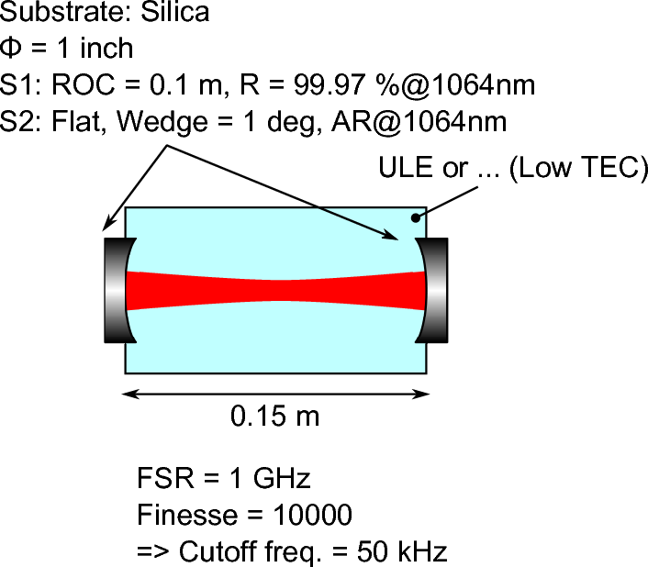
(b-2) Reference Cavity [1/1]
iLCGT ◎
bLCGT ○
Lower frequency stabilization
The laser frequency is stabilized as the reference of the ‘Reference cavity’ at the lower frequency (DC – 10 Hz). The ‘Reference cavity’ is rigid Fabry-Perot cavity placed in vacuum with vibration isolation.
Design of Pre Mode Cleaner
Length | 0.15m
R (Coupler) | 99.97%
ROC | 0.1m
Substrate | ULE or Silica
FSR | 1GHz
Finesse | 10000
Cutoff frequency | 50kHz
Interface | <-> LAS, AEL and DGS

Slide 13
(b-3) Intensity stabilization [1/1]
iLCGT ◎
bLCGT ◎
Intensity stabilization
Requirement: < 2 x 10-9 /sqrt(Hz) for bLCGT
< 10-8 /sqrt(Hz) for iLCGT
ETMy
PRM
PR2
ITMy
Laser
BS
ITMx
ETMx
PR3
SR2
SR3
SRM
AOM
PD | High-power photo detection of ~ 300 mW The position of just before the PRM set in vacuum
Actuator | Amplifier ( slow and intermediate ) Modulator ( fast )
slow
fast
Interface | <- DFT and MIF <-> LAS, AEL and DGS

Slide 14
(b-4) Frequency stabilization [1/1]
iLCGT ◎
bLCGT ◎
Frequency stabilization
Requirement: < 3 x 10-8 Hz/sqrt(Hz) (10Hz – 1kHz ) for bLCGT
slow
intermediate
fast
ETMy
Wideband
EOM
ITMy
Laser
PRM
PR2
BS
ITMx
ETMx
PR3
SR2
SR3
SRM
AOM
EOPM
Actuator | Thermal of Laser ( slow ) PZT of Laser ( intermediate ) Wideband EOM ( fast )
Interface | <-> LAS, DET, MIF, VIS, AEL and DGS
Reference cavity

Slide 15
(b-5) Modulator [1/3]
iLCGT ◎
bLCGT ◎
Parameters
EO crystal |  | RTP (RbTiOPO₄) MgO:SLN (MgO-doped LiNbO₃)
Aperture size | RF modulation | 4 x 4 mm² or 5 x 5 mm²
 | Wideband control ~1MHz | 2 x 2 mm²
 | Wideband control >100kHz | 4 x 4 mm²
Length |  | 20 – 40 mm
Wedged crystal
Polarization selectivity due to the birefringence of EO crystal.
e-LIGO has already used.
Detail design for LCGT is not fixed.

Slide 16
(b-5) Modulator [2/3]
iLCGT ◎
bLCGT ◎
Modulation Frequencies for Main Interferometer
bLCGT | 16.875 MHz (PM) 45 MHz (PM) 39.375 MHz (AM) [ if any ]
iLCGT | 16.875 MHz (PM) or 45 MHz (PM)
Interface | <- DFT and MIF <-> AEL and DGS

Slide 17
(b-5) Modulator [3/3]
iLCGT ◎
bLCGT ◎
PM + AM Generation Scheme
Dr. Ohmae has been performed in his doctor thesis.
PM
PM: simple configuration
  Amplitude ratio (CR : 1st SB : 2nd SB)
    |J0(m)| : |J1(m)| : |J2(m)|
AM: complex configuration
  Amplitude ratio (CR : 1st SB : 2nd SB)
    |J0(m)| : |J1(m)| : |J2(m)|
      Possible solution
    (Ideal AM) = 1 : m/2 : 0
      Impossible
Low-loss AM

Slide 18
(b-6) Alignment Control of Incident Beam [1/1]
iLCGT ◎
bLCGT ○
The alignment of the incident beam at lower frequency like a drift will be controlled with the last two folding mirrors on the input optical table.
Actuator | PZT(?) on mirror mount.
Sensing at | Before PRM. End of 3km inline arm.
Interface | <- DFT and MIF <-> AEL and DGS

Slide 19
(b-7) Other Optics [1/1]
iLCGT ◎
bLCGT ◎
We will prepare all of optics;
mirrors, lenses, BSs, PBSs, isolators, mirror mounts, …. , optical tables, and so on.
Interface | <-> DFT and MIF

Slide 20
(c) Mode Cleaner [1/6]
iLCGT ◎
bLCGT ○
Spatial mode cleaning.
Main function of the mode-cleaner is a spatial mode cleaning of laser beam and a reduce beam jitter for the main interferometer.
The mirrors are suspended independently for vibration isolation and placed in vacuum tanks.
Transmission sideband.
It must transmit the modulation sidebands for the main interferometer.
The current design of the modulation frequencies are 16.875 MHz and 45 MHz (optional 56.25 MHz).
The FSR of MC is 5.625 MHz.

Slide 21
(c) Mode Cleaner [2/6]
iLCGT ◎
bLCGT ○
Parameters
Round-trip length | 53.296m
R (In and Out) R (End) | 99.37 % 99.99 %
ROC (In and Out) ROC (End) | flat 40m
dimension (All) | φ100mm, t30mm
Wedge (All) | 2.5 deg.
FSR | 5.625 MHz
Finesse | about 500
Cutoff frequency | 5.625 kHz
Beam radius on mirrors (In and Out) Beam radius on mirrors (End) | 2.527 mm 4.377 mm

Slide 22
(c) Mode Cleaner [3/6]
iLCGT ◎
bLCGT ○
Overview
Wedge directions are decided.
-> Input, Output and Stray beams directions are fixed.

Slide 23
(c) Mode Cleaner [4/6]
iLCGT ◎
bLCGT ○
MC input mirror

Slide 24
(c) Mode Cleaner [5/6]
iLCGT ◎
bLCGT ○
MC output mirror

Slide 25
(c) Mode Cleaner [6/6]
iLCGT ◎
bLCGT ○
MC end mirror

Slide 26
(d) Mode Matching Telescope [1/1]
iLCGT ◎
bLCGT ○
Two suspended spherical mirror consist of the mode matching telescope between MC and PRM.
MMT1 is put into PRM vacuum tank.
MMT2 is put into another vacuum tank with optical isolator.
Beam waist radius = 4.00 mm
Parameters
ROC = 370 m
T = 30 mm
Substrate: Silica
Substrate | Silica
Dimensions | φ100mm, t30mm φ100mm, t30mm
ROC | ~ -14.98 m* ~ 19.5 m*
ROC ~ 19.5 m
4.243 m
MC2
PRM
3.82 m
7.625 m
Interface | -> MIR, VIS, AEL, and DGS
ROC ~ - 14.98 m
Beam waist radius = 2.53 mm

Slide 27
(e) Isolator [1/1]
iLCGT ◎
bLCGT ○
Faraday isolator is placed after the MC for pickoff backward light from the main interferometer.
The Faraday isolator is suspended for vibration isolation and placed in vacuum.
Suspension
table
Interface | -> VIS

Slide 28
(f) Output Optics [1/1]
iLCGT ◎
bLCGT ◎
We will prepare all of output optics include Beam Reducing Telescope and ,
mirrors, lenses, BSs, PBSs, isolators, mirror mounts, …. , optical tables, and so on.
Interface | <-> FCL, VAC, VIS, DFT and MIF

Slide 29
Output optics
Scope
Establish the DC readout scheme that realizes
BAE w/excess shot noise of less than 5%.
Components of output optics
output MMT, OMC module, control system,
PD (refl, trans), beam dumper,
Interface
MIR: surface error requirement of TMs
VAC/FCL: MMT length
VIS: OMC suspension design
MIF: modulation depth/freq, DC readout
Output MMT
OMC

Slide 30

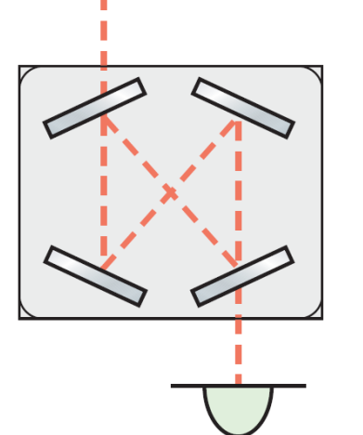

OMC requirement
R=1870m
R=1680m
IFO
from PRC
OMC
（filtered ）
SR2; R=-2.8m
with junk light
(unfiltered)
11m
Photo-detector
SR3; R=25m
SRM; R=305m
97+% TEM00 transmission
70+dB 16MHz SB reduction
40+dB HOM reduction
to OMMT
and OMC
(wSRM=4.0mm, wSR2=4.0mcm,
wSR3=36mm, wITM=35mm, ηSRC=20deg)
(preliminary)

Slide 31
OMC design
* TM loss: 41ppm/49ppm
RF |  |  |  |  |  | DC
TEM00 | TEM20 | TEM02 | TEM40 | TEM04 | TEM22 | TEM00 | TEM20 | TEM02 | TEM40 | TEM04 | TEM22
72mW | 0.7mW | 0.7mW | 0.5mW | 0.5mW | 0.3mW | 2.2mW | 0.15W | 0.15W | 13mW | 13mW | 8.7mW
(preliminary)
distance to the nearest
resonance (f/fBW)
simulation work under progress
prototype exp to be started in Feb
risk management:
~ alternatives to the conv. OMC
~ relying on variable RSE
work milestone:
~ ommt/omc roc fixed by 2012/3
~ prototype exp. done by 2014/3
Gouy phase of OMC (deg)
(L=0.5m,0.6m,0.7m,0.8m,0.9m)

Slide 32
(h) Photo Detector [1/1]
iLCGT ◎
bLCGT ◎
Parameters
Details are not fixed.
We will develop photo detectors with Analog electronics group.
Interface | <- MIF <-> AEL

Slide 33
(i) Beam Shutter [1/2]
iLCGT ◎
bLCGT ○
Beam shutters will be put due to protection of photo detector and safety.
The details are not fixed.
  Fast (quick?) shutter: ~ 1 ms
    Mechanical shutter or suspension taught by Rana.
  Slow shutter: ~ 1s
    Variable attenuator
We will develop beam shutters with Analog electronics group.
Interface | <-> AEL and DGS

Slide 34
(i) Beam Shutter [2/2]
iLCGT ◎
bLCGT ○
Entrance of vacuum system
Laser output
ETMy
PRM
PR2
ITMy
Laser
BS
ITMx
ETMx
PR3
SR2
AOM
SR3
SRM
EOPM
AOM
Laser
AOM
Laser

Slide 35
(j) Green Laser [1/2]
iLCGT ◎
bLCGT ◎
The green laser systems for pre-lock of arm length are installed.
The green lasers are stabilized as the reference of the main laser frequency with offset lock scheme.
The green lasers are inputted from the center room or from the end room. It is not fixed.
Interface | <-> LAS, MIR, AEL, DGS, DET and MIF

Slide 36
(j) Green Laser [2/2]
iLCGT ◎
bLCGT ○
ETMy
PRM
PR2
ITMy
Laser
BS
ITMx
ETMx
PR3
SR2
AOM
SR3
SRM
Alignment
EOPM
AOM
Mode matching
Laser
AOM
Phase modulation
Laser
Mode cleaning
Phase lock

Slide 37
Schedule
bLCGT
It will be same time as change from iLCGT to bLCGT.
iLCGT
2012
2013
2014
Apr.
Apr.
Apr.
May
Jun.
Jul. Aug. Sep. . . .
Buy 2012
Buy 2013
Laser Room
Test of Input Optics System
Installation
Pre-MC
RefCav
Mode matching
Modify
Input optics
MC
Isolator (vac.)
MMT
MC servo
MC alignment

Slide 38
Summary
We have a lot of items !!!
Almost items can be performed and developed.
We should fix final designs.
We will prepare those.
Thanks

Slide 39
Appendix
Subgroup symbols
DAS Data Analysis
TUN Tunnel
FCL Facility
VAC Vacuum
VIS Vibration Isolation
CRY Cryogenics
MIR Mirror
DET Detector Configuration
MIF Main Interferometer
DGS Digital System
AEL Analog Electronics
IOO Input/Output Optics
LAS Laser
GIF Geophysics Interferometer
AOS Auxiliary Optics System

