Slide 1
Suspension Thermal Noise of a Non-Uniform Fiber
2012/02/04 KAGRA F2F MEETING
Univ. Tokyo, ICRR M2,
Takanori Sekiguchi

Slide 2
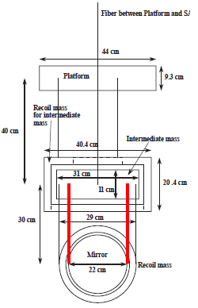
Sapphire Fibers for KAGRA
Short and thick sapphire fibers to transfer enough amount of heat (~1 W)
Cryogenic Payload for KAGRA
Current Parameters: Φ1.6 mm, L30 cm
Problems of thick & short fibers:
Low dilution factor and large thermal noise
High resonant frequency of vertical mode
Heavy violin modes
Degrade the sensitivity @ ~ 100 Hz
Sapphire Fibers

Slide 3
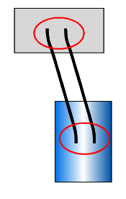
Non-Uniform Fiber
Thin fiber at both ends to lower the suspension thermal noise.
Thick fiber in the middle to obtain large thermal transmissivity.
Ue: Potential energy stored in the bending of fibers Ug: Gravitational potential energy (lossless)

Slide 4
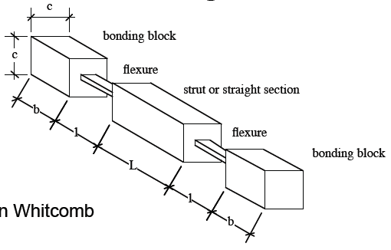
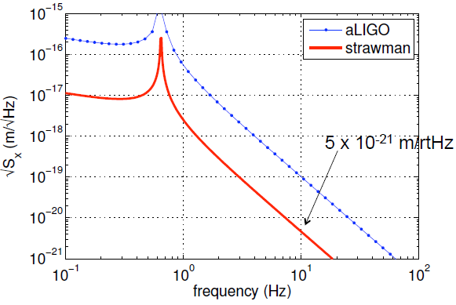
About This Work
“Flexure + Strut” fiber was suggested by Warren Johnson. [W. Johnson, KAGRA Collaboration Meeting, Nov. 8th, 2011]
We have not known its suspension thermal noise at high frequencies (>100 Hz), including the violin modes and the vertical modes.

Slide 5
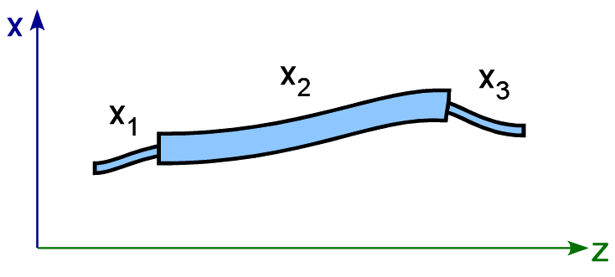
Model & Calculation Method
Analytical model in the frequency domain.
12 coefficients (A1~D3) must be calculated from boundary conditions.
Beam Profile

Slide 6
Boundary Conditions
Phil Willems, Physics Letters A 300 (2002) 162–168
The displacement and gradient are 0 at the top of the fiber.
Two beam profiles are smoothly connected at the boundary.
Continuous displacement
Continuous gradient
Equilibrium of moment
Equilibrium of force
Equation of motion about the suspended mirror.

Slide 7
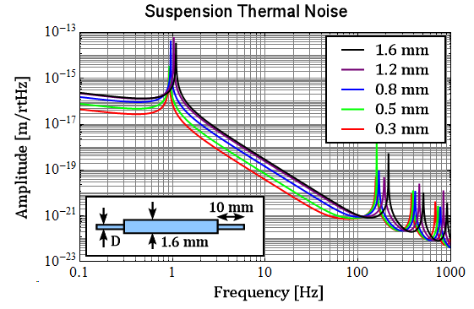
Calculation Result (1)
Decreasing the fiber thickness in the first 1 cm.
The thermal noise is suppressed at low (< 100 Hz) frequencies.
Pendulum mode frequency goes lower.
Violin mode frequencies also get lower.

Slide 8
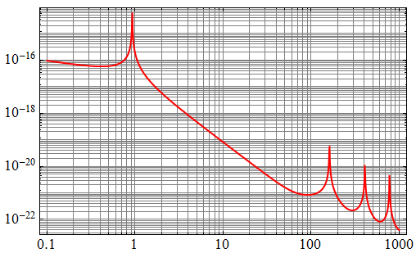
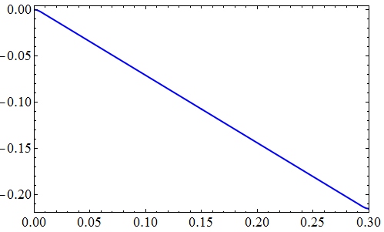
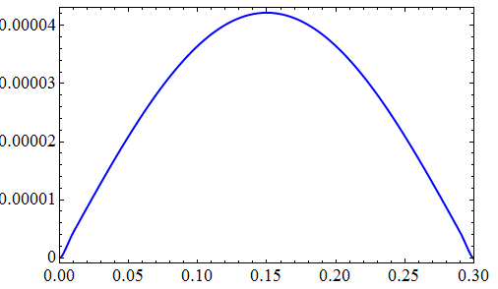
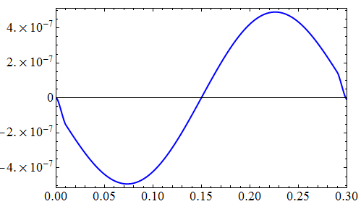
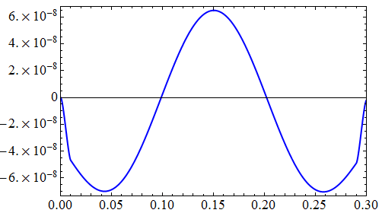
Mode Shape (Beam Profile)
Pendulum Mode
1st Violin Mode
2nd Violin Mode
3rd Violin Mode

Slide 9
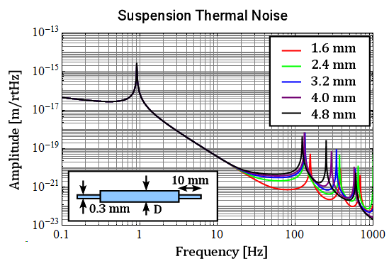
Calculation Result (2)
Increasing the thickness in the middle
Violin mode frequencies get even lower.
Floor level around 100 Hz increases!!

Slide 10
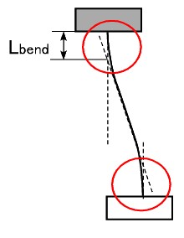
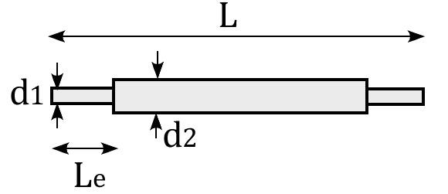
Parameters for KAGRA
1. Decrease the wire thickness in the ends.
2. Make the thin part long enough to cover the bending part of the fiber.
3. Increase the wire thickness in the middle to keep the heat transmissivity.
(taking into account the size effect of the thermal conductivity)
d1 [mm] | d2 [mm] | Le [mm] | f [Hz]
0.60 | 2.67 | 6.3 | 127
0.80 | 2.11 | 11.2 | 111
1.00 | 1.90 | 17.4 | 106
1.30 | 1.73 | 29.5 | 102
1.60 | 1.60 | 44.7 | 102
(vertical resonance)

Slide 11
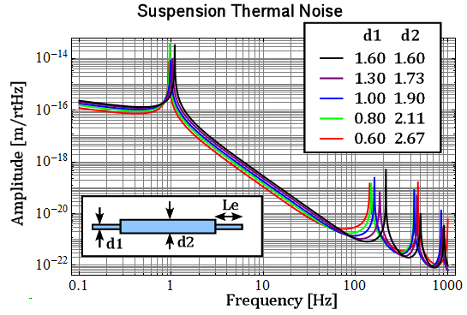
Calculation Result (3)
Decrease
Increase

Slide 12
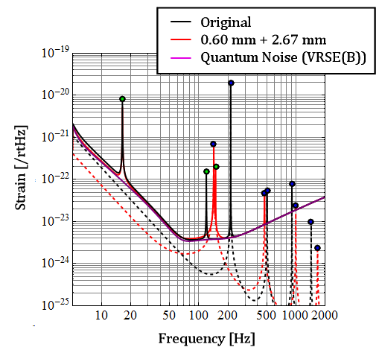
Total Sensitivity
Including vertical thermal noise and quantum noise
Vertical Mode
Violin Mode
<50 Hz:
Thermal noise decreases, but the sensitivity is not improved. (due to the existence of the quantum noise)
>50 Hz:
In both cases, the sensitivity around 100 Hz is degraded by the violin and the vertical mode resonances.

Slide 13
Conclusion
There is a trade-off of using non-uniform fibers :
The suspension thermal noise at low frequencies (<50 Hz) decreases, by the “dissipation dilution” effect.
However, the suspension thermal noise at high frequencies (~100 Hz) increases and the resonant frequencies of the violin modes get lower.
Increase
Decrease
Go low frequencies
Resonances of the violin modes and vertical mode still remain at ~100 Hz.

Slide 14
END

Slide 16
Appendix

Slide 17
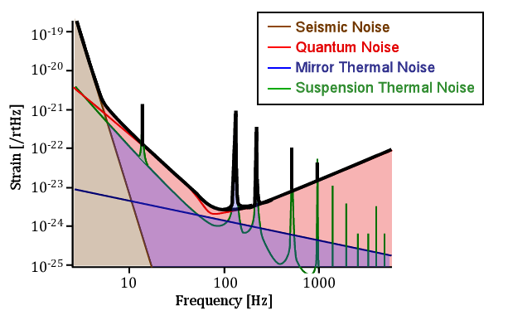
KAGRA Sensitivity
* 1/300 Coupling from vertical noise * Loss angle of the sapphire fiber: 2 x 10-7 * Quantum Noise: VRSE (Detuned)
Sapphire Fibers (Φ1.6 mm, L30 cm)
Vertical Mode
Violin Mode
Goal:
Exclude these resonances from ~100 Hz without increasing low-freq thermal noise

Slide 18
Dumbbell Fiber
The sensitivity is not dominated by the thermal noise at < 50 Hz
We want to exclude these resonances away from ~100 Hz
Reverse idea: dumbbell fibers
(Just making the effective length of the wire short …)

Slide 19
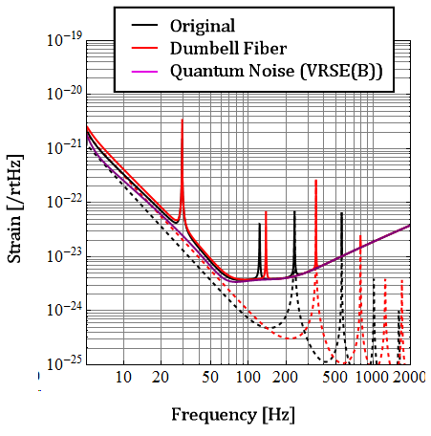
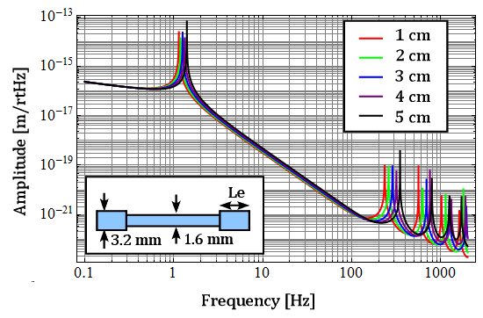
Dumbbell Fiber Results

Slide 20
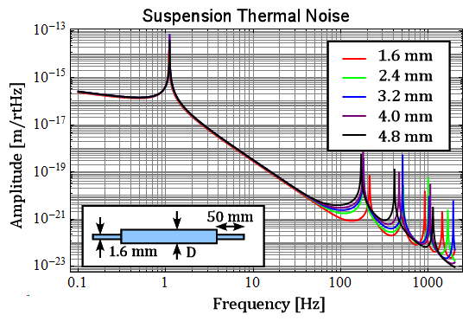
Increasing Middle Thickness

Slide 21
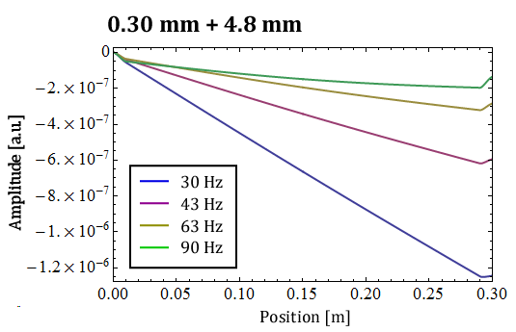
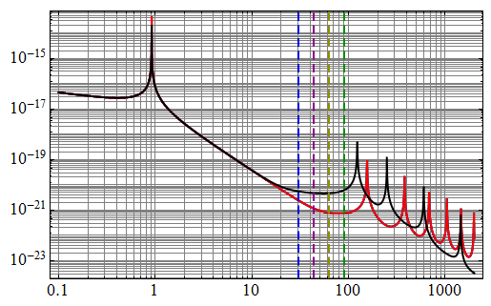
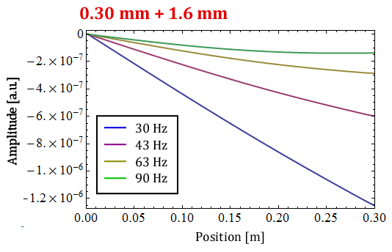
Beam Profile

Slide 22
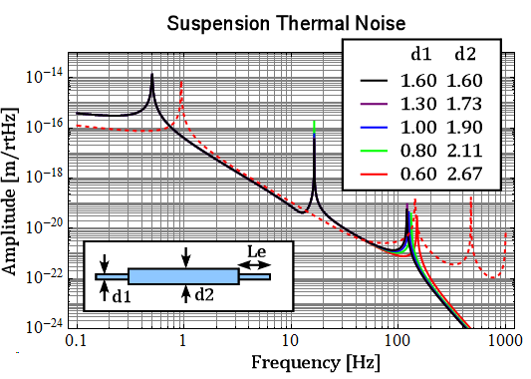
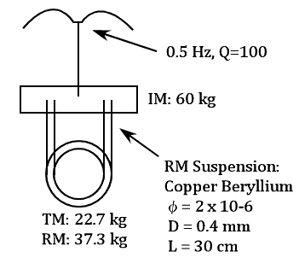
Vertical Thermal Noise

Slide 23
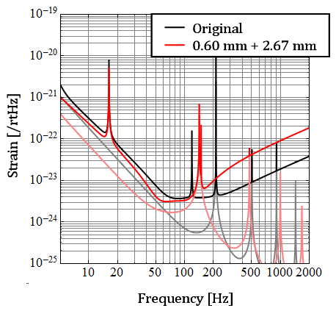
Optimize Quantum Noise
Laser Power→ 1/2
Finesse → 2/3
IR: 248 Mpc → 257 Mpc

