Slide 1
LCGT Vacuum System
120123 VAC (YS)
1. Overview
Items
** beam tubes of 3-km long and 800 mm in diameter
** optical baffles distributed in the beam tubes
** chambers for the mirrors with suspension and vibration-isolation devices
** vacuum pumping system
** overall layout
Interface
all of the subsystems
** choice of materials for components used in cryostat, optical devices, vibration-isolation devices, , …
** interferometer layout and operation sequence
cf. vacuum system philosophy in accelerator
** beam dynamics and vacuum system have to be designed simultaneously.
** choice of materials having low outgassing is most important.
** mechanical and electric design has to be simple.
** materials properties have to be examined and measured before choosing.
(KEK Internal 07-17)

Slide 2
LCGT Vacuum System
120123 VAC (YS)
2. System design
Required Pressure：in the order of 10⁻⁷ Pa, or lower
<<scattering effect due to residual gas>>
** We predict the noise δx due to the residual gas (water) molecules;
for δx = 1×10⁻²¹ m/√Hz@100 Hz (safety margin of 10),
the pressure in the beam tubes is to be kept at 2×10⁻⁷ Pa.
(h=3×10⁻²⁴ /(Hz)^{1/2} @100Hz corresponds to δx=1×10⁻²⁰ m/(Hz)^{1/2})
<<minimize the maintenance work>>
** For long-term and stable operation of the interferometer, the vacuum system is to be designed so as to minimize the maintenance work, and so as to shorten the pump-down time. A long lifetime of the vacuum component and low outgassing is required.
Penning cell
Ti cathode

Slide 3
LCGT Vacuum System
120123 VAC (YS)
ETMYB
2. System design
less changes “i” to “b”
ETMYA
double chambers (2.4 and 1.5 m in dia.)
//GASF + I-Pendulum + cryogenic//
chambers (2 m in dia.)
//stack + D-Pendulum//
MC
ITMY
ITMX
3000 m
ETMXA
ETMXB
MCF
MMT
PRM
PR3
PR2
BS
iLCGT
iLCGT
SR2
chambers (1.5 m in dia./2 m for BS)
//GASF + I-Pendulum//
SR3
IP
TMP
SRM
FL P
PD

Slide 4
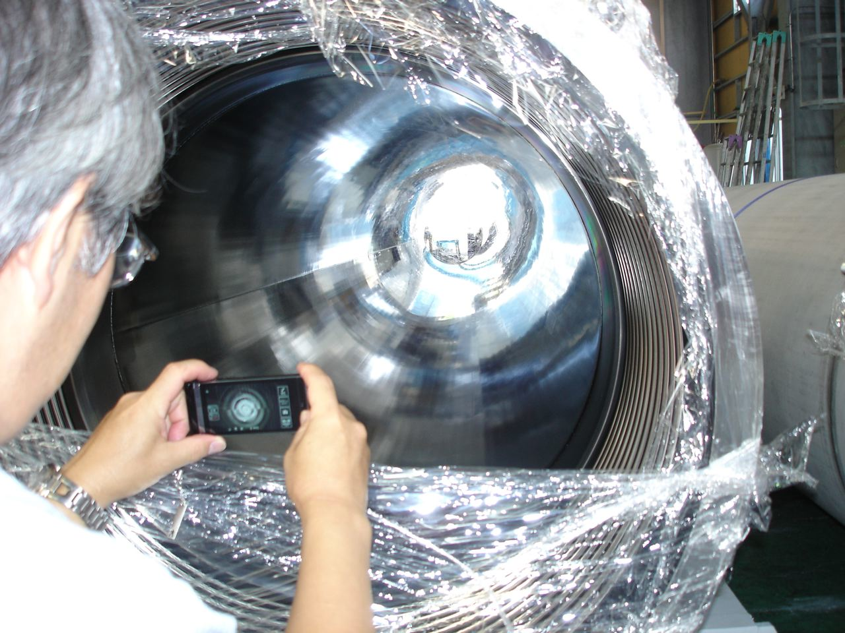
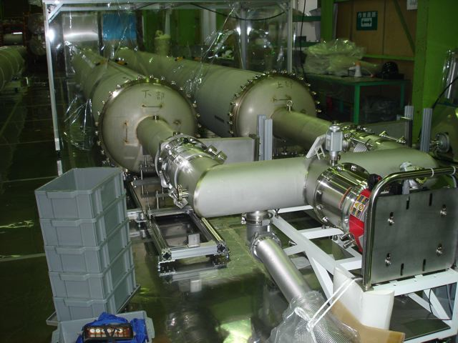
LCGT Vacuum System
120123 VAC (YS)
2. System design
beam tube (478 of 12-m long and 0.8 m in diameter)
** “surface passivation” is performed by electro-polish followed by bake.
expected outgassing rate is on the order of 10⁻⁸ Pa m³ m⁻² s⁻¹, or lower.
Rmax 3 μm, Ra 0.5 μm.
** “flange connection” with metal O-ring gasket (silver plated) is chosen.
humidity test of the gasket shows erosion proof.
** tubes of “mirror finish by Electro-Chemical Buffing” is to be installed in the mid region of 800-m long. Rmax 0.2 μm, Ra 0.03 μm
Electro-polished tube of 12 m long

Slide 5
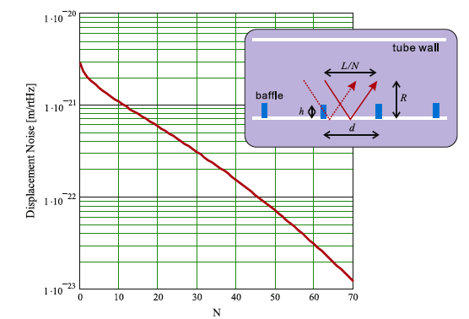
LCGT Vacuum System
120123 VAC (YS)
2. System design
optical baffle (every12-m along the arm, 40-mm in height, 45-degree tilted)
** estimated scattered light noise at Kamioka
δx = 3×10⁻²¹ m/√Hz@30Hz (tube vibration amplitude=1×10⁻¹¹ m/√Hz assumed )
** For more margin, baffles at “every 12 meters”. δx = 5×10⁻²² m/√Hz
** For randomizing phase of edge-scattered light, baffles with “saw-tooth edge”.
N=(h/d)/(L/R)

Slide 6
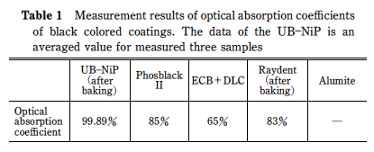
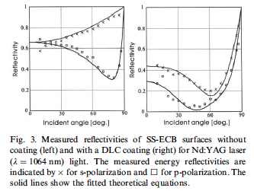
LCGT Vacuum System
120123 VAC (YS)
2. System design
optical baffle (diamond-like-carbon/DLC coated)
** measured outgassing rate of DLC is 4×10⁻⁹ Pa m³ m⁻² s⁻¹,
真空

Slide 7
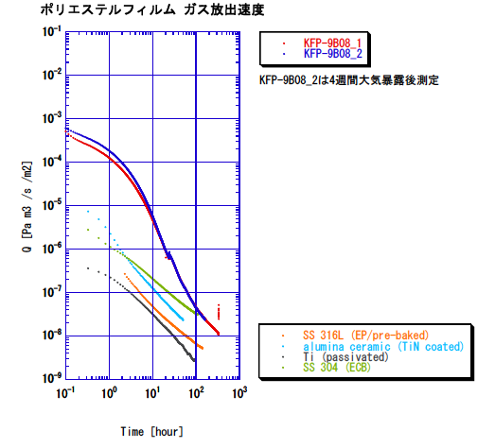
LCGT Vacuum System
120123 VAC (YS)
2. System design
chambers
** 17 of 21 chambers are operated at room temperature, 4 for cryogenic system
** installed materials of elastomer and plastomer should be investigated.
** Although the aluminum-coated thin PET (polyethylene terephtalate) film is suitable material for thermal shield,
the outgassing rate is higher than those of metal surfaces.
** Outgassing rate of a PET film of 12 micrometer thick is measured.
The rate decreases to 10⁻⁶ Pa m³ s⁻¹ m⁻² for about 10h, then reaching to the order of 10⁻⁸ Pa m³ s⁻¹ m⁻² for 200h.
** Water molecules absorbed in film is possibly diffused to the surface
and desorbed with a long period of 100 hours.

Slide 8
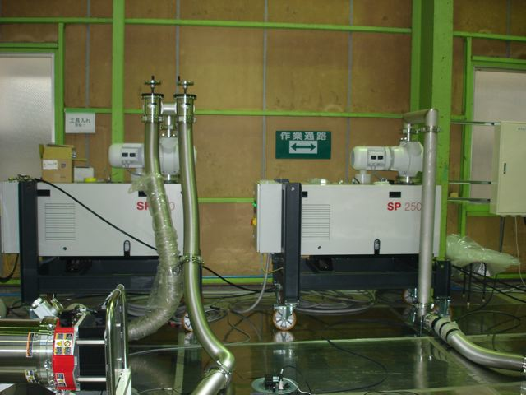
LCGT Vacuum System
120123 VAC (YS)
2. System design
pumping system (dry-pump and ion-pump)
** pumping unit consisted of dry-pump, TMP and ion-pump is distributed “every 100 meters” along tubes.
ITMX
3000 m
ETMX
** expected pump-down scheme (a 3-km arm)
to 1 Pa >> few days by dry-pump
to 10⁻⁶ Pa >> 50 hours by TMP
to 10⁻⁷ Pa >> 500 hours by IP
(based on the ougassing rate in test tubes)
IP
TMP
DRY P
FL P
** pumping speed of the unit (100 m)
600 m³/h >> dry-pump
2000 L/s >> TMP
500 L/min >> TMP foreline pump
1000 L/s >> IP

Slide 9
LCGT Vacuum System
120123 VAC (YS)
2. System design
vacuum system control
control signal 0/1
pressure readout
Center control
EPICS
→ status: 3
← control: 3
BA gauge
ULVAC GI-M2
controller
PLC
Yokogawa
Pirani gauge
Convectron type
controller
Ethernet
→ status: 4
Gate valve
（actuator）
A/D
Yokogawa MW100
controller
← control: 2
Ion pump
VARIAN type
controller
→ status: 2
← control: 1
Ion pump
Gamma type
controller
Micro IOC
RS485
arm tunnel, center/end room
A gate valves of large diameter takes 40 seconds for closing.

Slide 10
LCGT Vacuum System
120123 VAC (YS)
2. System design
bLCGT | HR Center |  | HR Chord Center |  | Center of Mass
 | x [m] | y [m] | x [m] | y [m] | x [m] | y [m]
PRM | -19.46123288 | 0.21377918 | -19.46120738 | 0.21377925 | -19.51120721 | 0.21364765
ETMX | 3.026507E+03 | -0.093909 | 3.026507E+03 | -0.093909 | 3.026582E+03 | -0.093909
ETMY | 0.060725 | 3.023222E+03 | 0.060725 | 3.023222E+03 | 0.060725 | 3.023297E+03
PR2 | -4.7006812 | 0.25262878 | -4.69784943 | 0.25267014 | -4.64785476 | 0.253400400
SRM | 0.13541083 | -19.41723194 | 0.13541104 | -19.41720645 | 0.13501125 | -19.46720485
SR2 | 0.25343357 | -4.65710099 | 0.25349012 | -4.65426948 | 0.25448854 | -4.60427945
SR3 | -0.10002163 | -15.71840442 | -0.10001528 | -15.71808665 | -0.1010137 | -15.76807668
PR3 | -15.7637214 | -0.04148993 | -15.76340359 | -0.04148529 | -15.81339825 | -0.04221555
BS | -7.63E-16 | -6.94E-18 | -7.63E-16 | -6.94E-18 | 0.02828427 | -0.02828427
ITMX | 26.50720079 | -0.09390876 | 26.50720439 | -0.09390876 | 26.43220439 | -0.09390876
ITMY | 0.06072497 | 23.22189738 | 0.06072497 | 23.22190098 | 0.06072497 | 23.14690098
iLCGT | HR Center |  | HR Chord Center |  | Center of Mass
 | x [m] | y [m] | x [m] | y [m] | x [m] | y [m]
PRM | -19.51677794 | 0.21417189 | -19.51675245 | 0.21417196 | -19.56675227 | 0.21404036
ETMX(iEOAX) | 3.001576E+03 | -0.093237 | 3.001576E+03 | -0.093237 | 3.001626E+03 | -0.093237
ETMY(iEOAY) | 0.061257 | 2.998291E+03 | 0.061257 | 2.998291E+03 | 0.061257 | 2.998341E+03
PR2 | -4.7281891 | 0.25309529 | -4.72535740 | 0.25313951 | -4.67536350 | 0.253920280
SRM | 0.13550922 | -19.47206837 | 0.13550943 | -19.47204288 | 0.13510964 | -19.52204128
SR2 | 0.25374881 | -4.68452802 | 0.25380268 | -4.68169646 | 0.25475388 | -4.63170551
SR3 | -0.07797132 | -15.7185301 | -0.07796549 | -15.71821231 | -0.07888163 | -15.76820392
PR3 | -15.76285711 | -0.06258281 | -15.76253931 | -0.06257763 | -15.81253268 | -0.06339185
BS | -4.09E-16 | 3.47E-18 | -4.09E-16 | 3.47E-18 | 0.02832301 | -0.02824548
ITMX(iIAOX) | 53.21470655 | -0.09323681 | 53.21471015 | -0.09323681 | 53.16471015 | -0.09323681
ITMY(iIAOY) | 0.06125676 | 49.92936491 | 0.06125676 | 49.92936851 | 0.06125676 | 49.87936851
layout
less changes “i” to “b”
ETMYB
ETMYA
MC
ITMY
MCF
MMT
PRM
PR3
PR2
BS
ITMX
iLCGT
iLCGT
ETMXA
ETMXB
SR2
3000 m
SR3
SRM
PD

Slide 11
LCGT Vacuum System
120123 VAC (YS)
2. System design
layout
less changes “i” to “b”
ETMYB
i-b | HR Center |  | HR Chord Center |  | Center of Mass
 | delta x [mm] | delta y [mm] | delta x [mm] | delta y [mm] | delta x [mm] | delta y [mm]
PRM | -55.545 | 0.393 | -55.545 | 0.393 | -55.545 | 0.393
ETMX | -24931.300 | 0.672 | -24931.300 | 0.672 | -24956.300 | 0.672
ETMY | 0.532 | -24931.340 | 0.532 | -24931.340 | 0.532 | -24956.340
PR2 | -27.508 | 0.467 | -27.508 | 0.469 | -27.509 | 0.520
SRM | 0.098 | -54.836 | 0.098 | -54.836 | 0.098 | -54.836
SR2 | 0.315 | -27.427 | 0.313 | -27.427 | 0.265 | -27.426
SR3 | 22.050 | -0.126 | 22.050 | -0.126 | 22.132 | -0.127
PR3 | 0.864 | -21.093 | 0.864 | -21.092 | 0.866 | -21.176
BS | 0.000 | 0.000 | 0.000 | 0.000 | 0.039 | 0.039
ITMX | 26707.506 | 0.672 | 26707.506 | 0.672 | 26732.506 | 0.672
ITMY | 0.532 | 26707.468 | 0.532 | 26707.468 | 0.532 | 26732.468
ETMYA
MC
ITMY
MCF
MMT
PRM
PR3
PR2
BS
ITMX
iLCGT
iLCGT
ETMXA
ETMXB
SR2
3000 m
SR3
SRM
PD

Slide 12
LCGT Vacuum System
120123 VAC (YS)
2. System design
layout
** floors for installing chambers; horizontal
Xopt
optical plane of interferometer
horizontal plane at X end
X arm
x
y
O (BS)
horizontal plane at center room
Yopt
Y arm
horizontal plane at Y end
ETMX
iLCGT
BS
Xopt
X arm
ITMY
ITMX
ETMY
Y arm
O
Yopt
1/300

Slide 13
LCGT Vacuum System
120123 VAC (YS)
2. System design
layout
** transformation matrix for 4 sets of coordinates
Xopt
optical plane of interferometer
horizontal plane at X end
X arm
x
y
O (BS)
horizontal plane at center room
Yopt
Y arm
horizontal plane at Y end
** unit vectors
in each coordinate

Slide 14
LCGT Vacuum System
120123 VAC (YS)
2. System design
layout
** transformation matrix for 4 sets of coordinates
Xopt
optical plane of interferometer
horizontal plane at X end
X arm
x
y
O (BS)
horizontal plane at center room
Yopt
Y arm
horizontal plane at Y end
** description
in other coordinate

Slide 15
LCGT Vacuum System
120123 VAC (YS)
2. System design
layout
** a set of two 1.5-km long interferometer for geophysics
Xopt
optical plane of interferometer
horizontal plane at X end
X arm
x
y
O (BS)
horizontal plane at center room
Yopt
Y arm
horizontal plane at Y end
ETMX
iLCGT
BS
Xopt
X arm
ITMY
ITMX
ETMY
Y arm
O
Yopt
1/300
500 m

Slide 16
LCGT Vacuum System
120123 VAC (YS)
3. Schedule
1) manufacturing 478 of tubes; from Apr 2011 to Mar 2013
2) manufacturing chambers; from Sep 2012 to Mar 2014
3) installing chambers in X end; Apr 2014
4) installing tubes in X arm; from Apr 2014 to Aug 2014
5) installing chambers in Center Room; Sep 2014
3) installing tubes in Y arm; from Oct 2014 to Mar 2015
5) installing chambers in Y end; Mar 2015
X arm pump down; Sep 2014
Y arm pump down; Mar 2015
expected schedule for installing (1)
ETMYB
ETMYA
Oct 2014 to Mar 2015
carrying tubes from MOZUMI pithead
MC
Apr 2014
ITMY
MCF
MMT
PRM
PR3
PR2
BS
ITMX
iLCGT
iLCGT
ETMXA
ETMXB
SR2
3000 m
Apr 2014
SR3
Apr 2014 to Aug 2014
SRM
Sep 2014
PD

Slide 17
LCGT Vacuum System
120123 VAC (YS)
3. Schedule
1) manufacturing 478 of tubes; from Apr 2011 to Mar 2013
2) manufacturing chambers; from Sep 2012 to Mar 2014
3) installing chambers in X and Y ends; Apr 2014
4) carrying tubes and lay on the supports;
from Apr 2014 to Jun 2014
5) jointing tubes and pump down in X and Y arm
from Jul 2014 to Mar 2015
6) installing chambers in Center Room; Jul 2014
X arm pump down; Oct 2014
Y arm pump down; Mar 2015
expected schedule for installing (2)
ETMYB
ETMYA
Oct 2014 to Mar 2015
carrying tubes from ATOTSU pithead
MC
Apr 2014
ITMY
MCF
MMT
PRM
PR3
PR2
BS
ITMX
iLCGT
iLCGT
ETMXA
ETMXB
SR2
3000 m
Apr 2014
SR3
Apr 2014 to Aug 2014
SRM
Sep 2014
PD

Slide 18
LCGT Vacuum System
120123 VAC (YS)
4. Risk management
vacuum component failure and leakage
IP
TMP
** recovery “without breaking arm-vacuum”
BA gauge failure: grid contamination, filament breakdown
feedthrough erosion; high voltage feedthrough of ion pump
power supply/controller erosion; ion pump, turbo molecular pump
durability for humidity is being examined (50°C-98%, 7 cycle of 8h-operation/98h-off).
** recovery “by re-pumping arm”
window (view port) break down
crack and erosion in bellow joint
metal gasket erosion
** safety “by closing gate valves (large dia,)”
electric-power shut down
anomalous pressure rise
DRY P
FL P
expected pump-down scheme (a 3-km arm)
to 1 Pa >> few days by dry-pump
to 10⁻⁶ Pa >> 50 hours by TMP
to 10⁻⁷ Pa >> 500 hours by IP
(based on the ougassing rate in test tubes)
ITMX
3000 m
ETMX

Slide 19
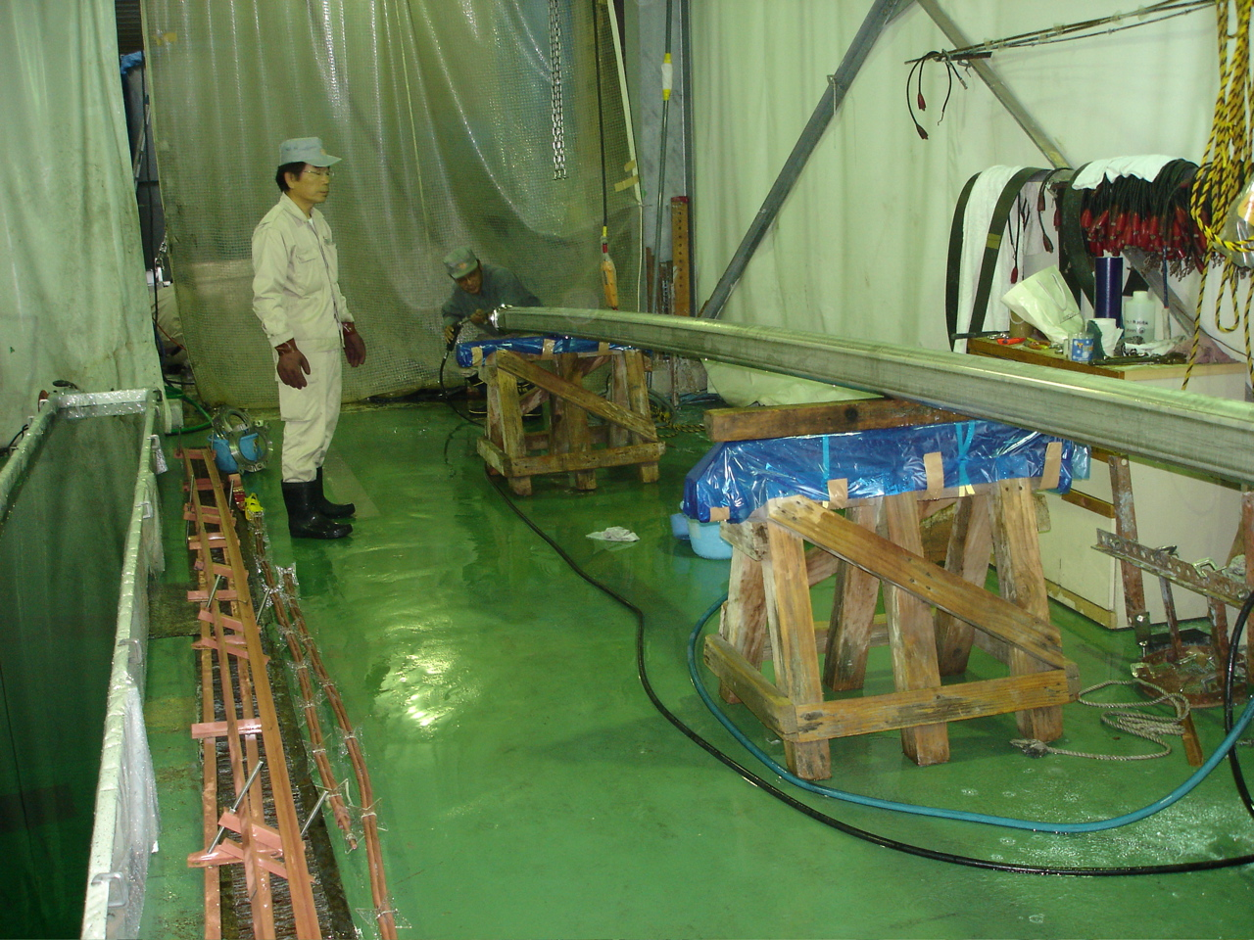
LCGT Vacuum System
120123 VAC (YS)
Appendix: outgassing data measured for technical surface
** “surface passivation process” of stainless steel prior to installation is planned by applying electro- polishing, and then followed by pre-baking treatment.
** “outgassing rate” of the order of 10⁻⁸ Pa m³ m⁻² s⁻¹, or lower is performed in J-PARC.

