Slide 1



Sapphire for the LCGT project
Eiichi Hirose
ICRR, University of Tokyo
Kyohei Watanabe, Norikatsu Mio
PSC, University of Tokyo

Slide 2
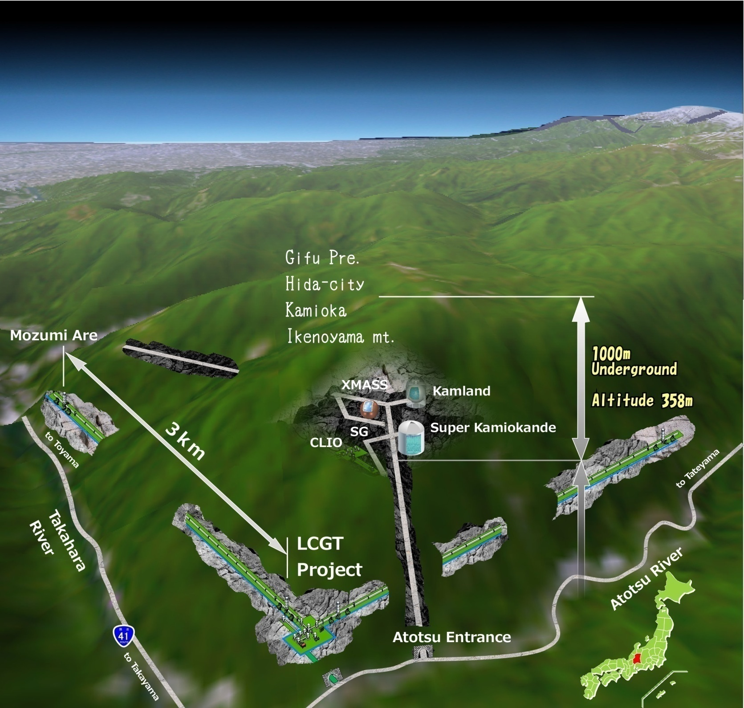
LCGT project
Underground
Low seismic noise
Cryogenic mirrors and suspensions
Reduction of thermal noise
Project got started last September and now under construction
@ low temperature, sapphire has
high mechanical Q (low loss)
large heat conductivity
ETMY
Gifu
Sapphire
Tokyo
10cm dia.
Laser
PRM
ITMY
ITMX
ETMX
Requirements to sapphire
25cm dia. x 15 thickness (30 kg)
absorption < 20ppm/cm
orientation < 0.04 deg
BS
The others are all silica
38cm dia.
SRM

Slide 3
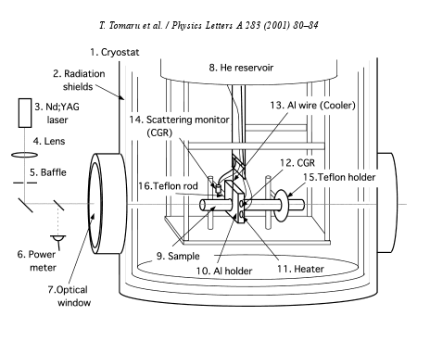
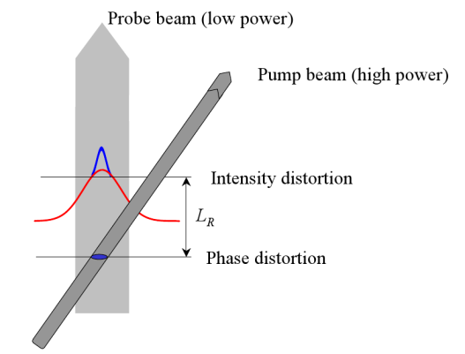
A few methods to measure optical absorption
Basic idea is that small optical absorption changes temperature
Laser calorimeter
Changes index of refraction
Changes optical length
=> interferometer
Changes direction of laser beam
=> Photo-thermal deflection method
Causes thermal expansion
Causes a sound wave
=> Photo-acoustic detection

Slide 4
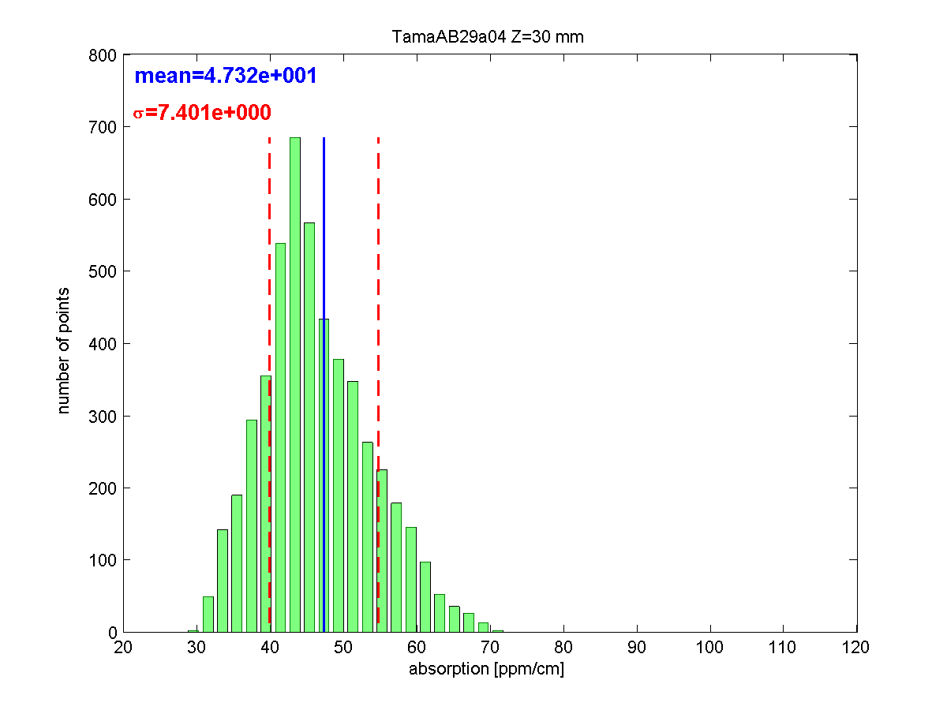
Photo-thermal deflection method
C-axis 100 mm dia. x 60 mm thickness
Z=50mm, 53.4 ppm/cm
Z=40mm, 45.5 ppm/cm
Z=30mm, 47.3 ppm/cm
Z=20mm, 46.1 ppm/cm
Z=10mm, 54,2 ppm/cm
Z=30mm (2005)

Slide 5
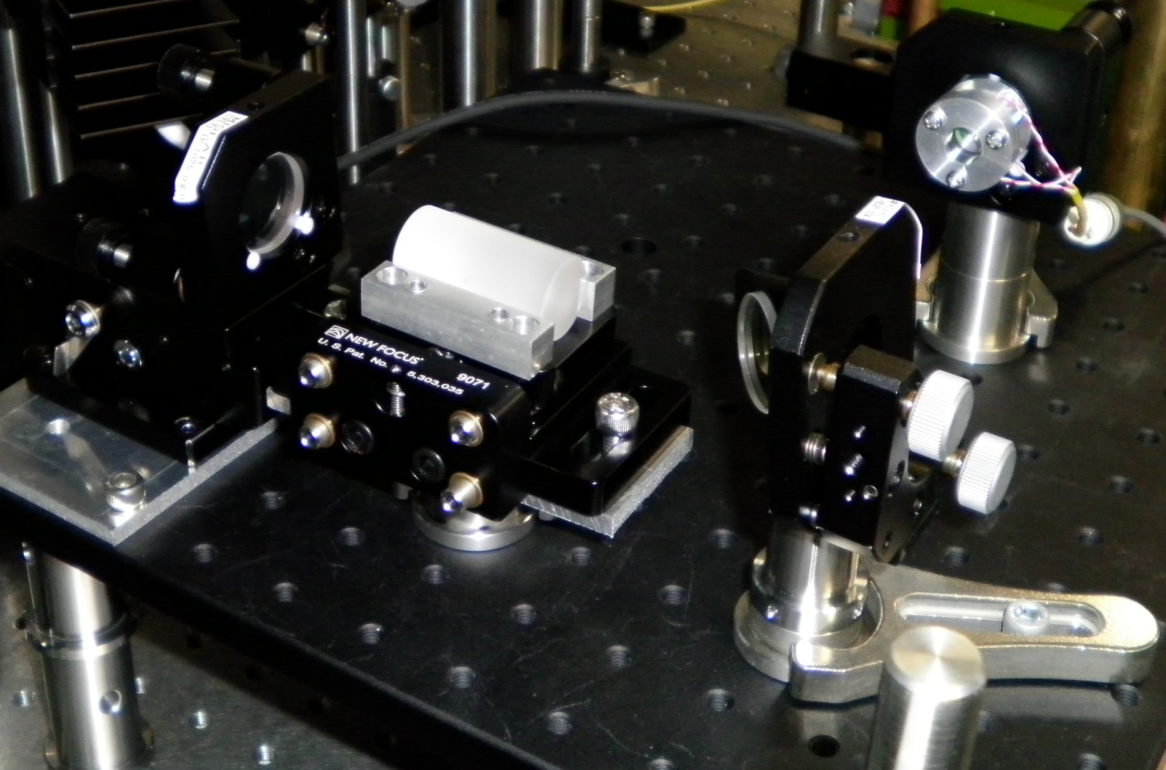
Interferometric method
light power
absorbed
120Hz
Chopped light is incident on a sample.
Signal is lock-in detected.
λ：1064nm
Power：10W
temperature
change
Laser
Lock-in Amplifier
Chopper
Refraction Index,
sample’s length
change
Sample
BPF
LPF
PD
Optical path
Length change
Mirror1
BS(R:98%)
Drak fringe
15kHz
Mirror2
Sample
PZT
BS
PZT driver
Filter

Slide 6
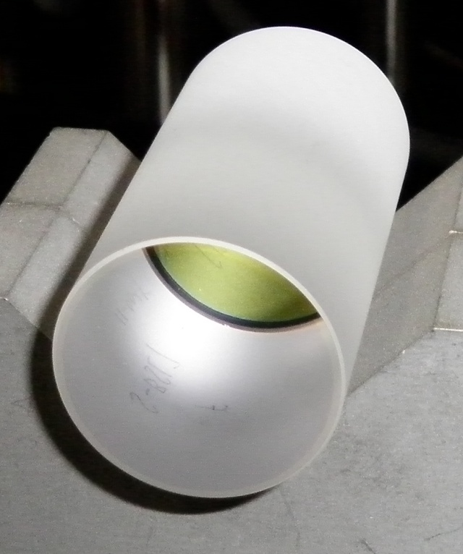

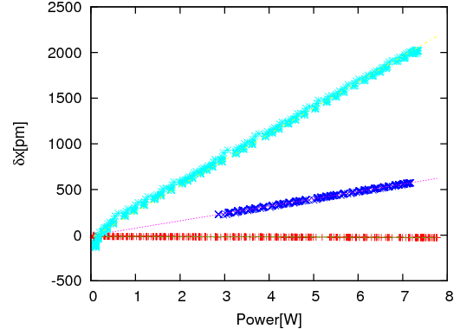
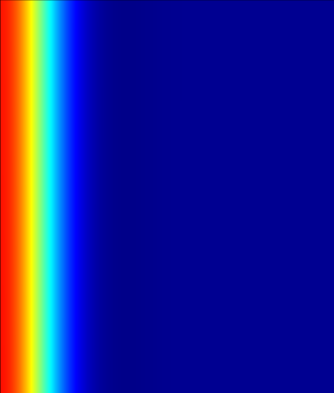
Result for BK7
Heat Equation
Standard glass ,
optical absorption (10⁻³-10⁻⁴ /cm)
20 mm dia.
energy source from
laser light
FEA (Finite Element Analysis)
Is used to calculate absorption
Laser dia. = 0.1 mm
Temperature change
Max: 0.01 degC
BK7
The more input power , the longer
radial
L
0.6 mm
284pm/W (L = 40mm)
0.6 mm
80pm/W (L = 10mm)
axial
✓
-2pm/W w/o sample
Optical absorption
10mm: 2230 ppm/cm
40mm: 2300 ppm/cm

Slide 7
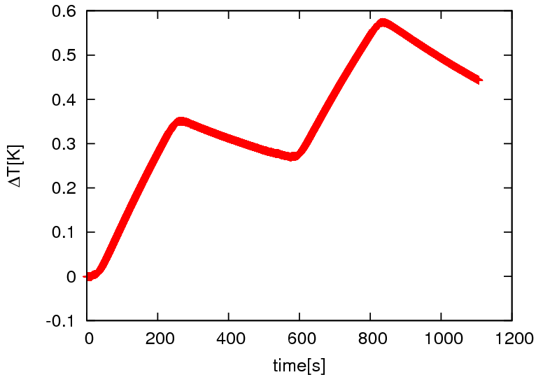
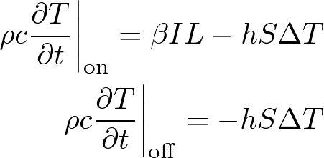
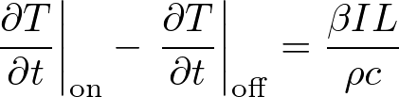
Calibration
Comparison with another method
A thermistor is attached on a lateral surface of the BK7 sample in order to measure the temperature change of the sample.
The difference between the gradient of the temperature change is almost independent of the boundary condition.
Off
On
Off
On
The experimental data and the numerical simulation are consistent.
✓
Optical absorption
1600 ppm/cm
Big difference from the other method

Slide 8
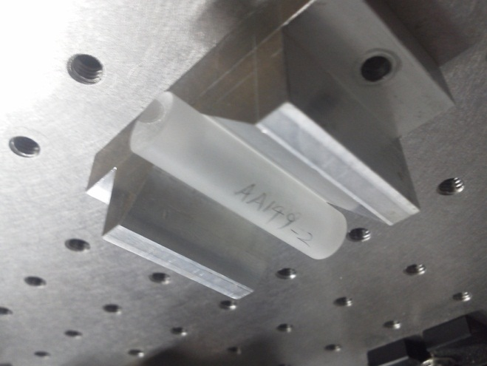
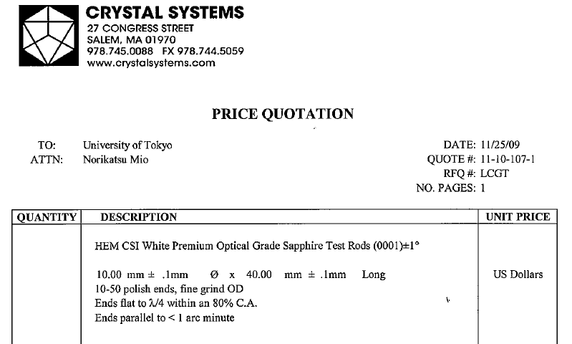
Sapphire sample
  C-axis rod (10mm dia., 40mm length)

Slide 9
Preliminary result
10 Samples
absorption [ppm/cm]
AA149 | 48 | 47
AC150 | 229 | 138 | 682 | 687
P401 | 34 | 32 | 65 | 67
AC150 shows quite high absorption. why ?
P401 contains lower pair and high absorption pair. What is the difference?

Slide 10
Conclusion
LCGT project started last year and the detector is under construction
We need sapphire that meets the requirement
Measured absorption and the result shows some variation from sample to sample

Slide 11
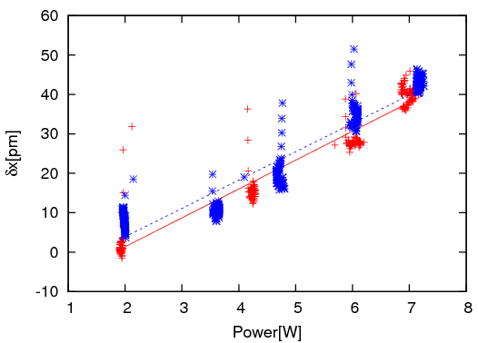
AA149
1:7.3pm/W→48ppm/cm
2:7.2pm/W→47ppm/cm

Slide 12
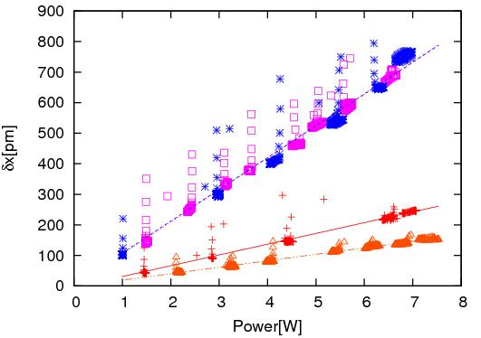
AC150
1:35.2pm/W→229ppm/cm
2:21.2pm/W→138ppm/cm
3:104.7pm/W→682ppm/cm
4:103.9pm/W→677ppm/cm

Slide 13
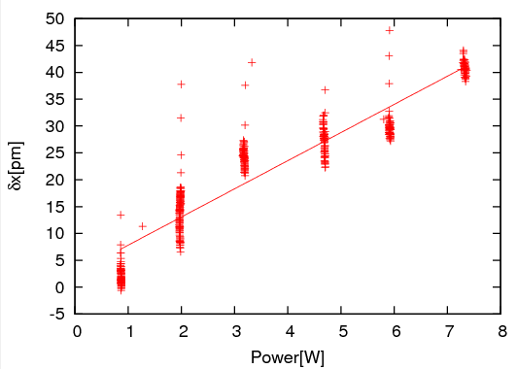
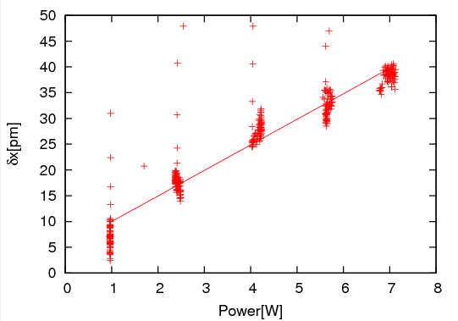
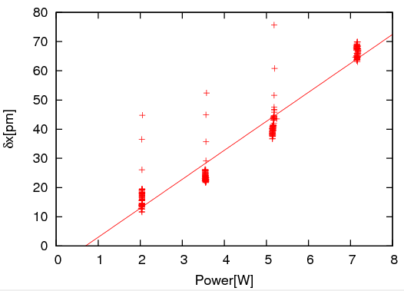
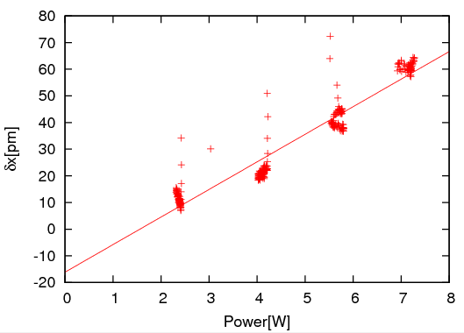
P401
5.2pm/W
34ppm/cm
5.0pm/W
32ppm/cm
9.9pm/W
65ppm/cm
10.3pm/W
67ppm/cm

