Slide 1
Seismic attenuation: from resonant bars to to ET, through Virgo, TAMA and LCGT
R. DeSalvo

Slide 2
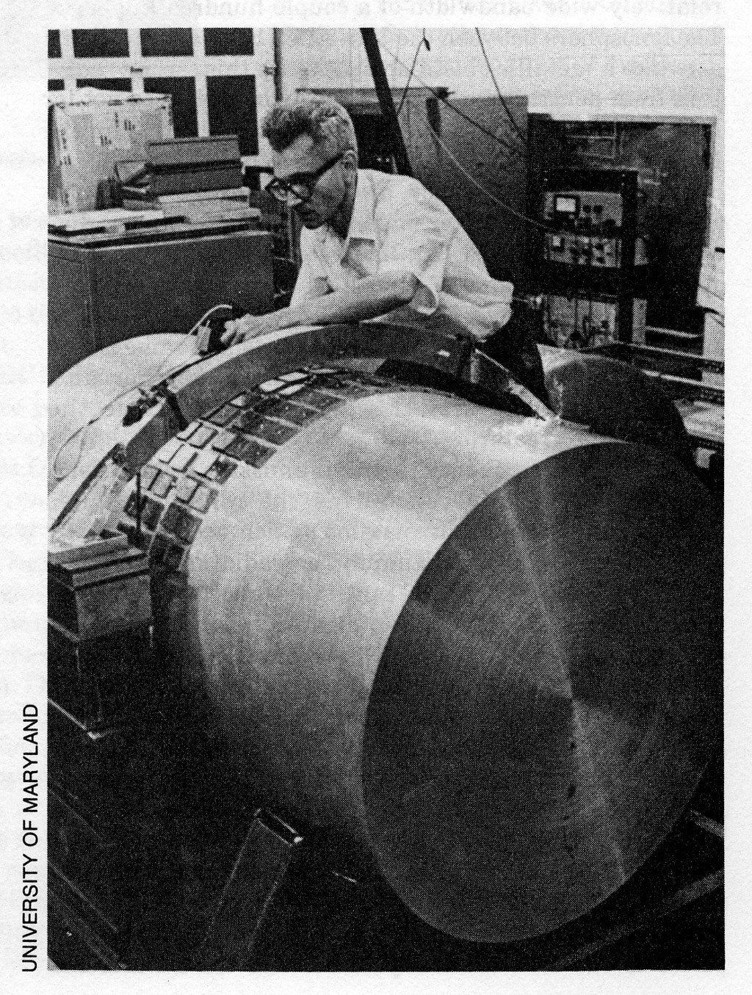
The beginning of Seismic attenuation for Gravitational Wave Detectors
Resonant bars needed suspensions and seismic attenuation
The task was comparatively easy because of the high frequency window of sensitivity (close to 1 kHz)
Rubber and steel stacks initially sufficed
Wire suspensions were very good in the horizontal direction
From the beginning the tough problem was with vertical attenuation
Joe Weber working at his bar
Now exposed at Hanford Obs.

Slide 3
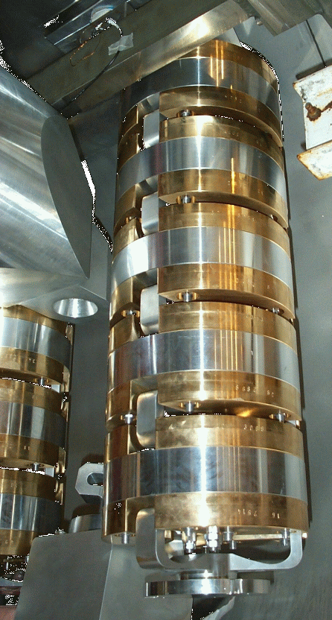
The beginning of Seismic attenuation for Gravitational Wave Detectors
Wires are rigid vertically
Helical springs have many resonances, and torque on load
Leaf springs were introduced for seismic attenuation of the resonant bar GW detectors
It was a perfectly adequate solution for resonant bars.
Auriga seismic attenuators

Slide 4
The beginning of Seismic attenuation for Gravitational Wave Detectors
Springs resonances are limited by the stretch length l_{s}
ƒ = 2 π √g/l_{s}
l_{s} is limited by the spring’s overall length and by its fractional bending
The spring’s fractional bending is limited by the maximum material’s yield stress (<<1% strain).
l_{s}

Slide 5
The beginning of Seismic attenuation for Gravitational Wave Detectors
Springs resonance frequencies are practically limited to~ 1Hz
Seismic attenuation starts at the resonant frequency, increasing as 1/f²

Slide 6
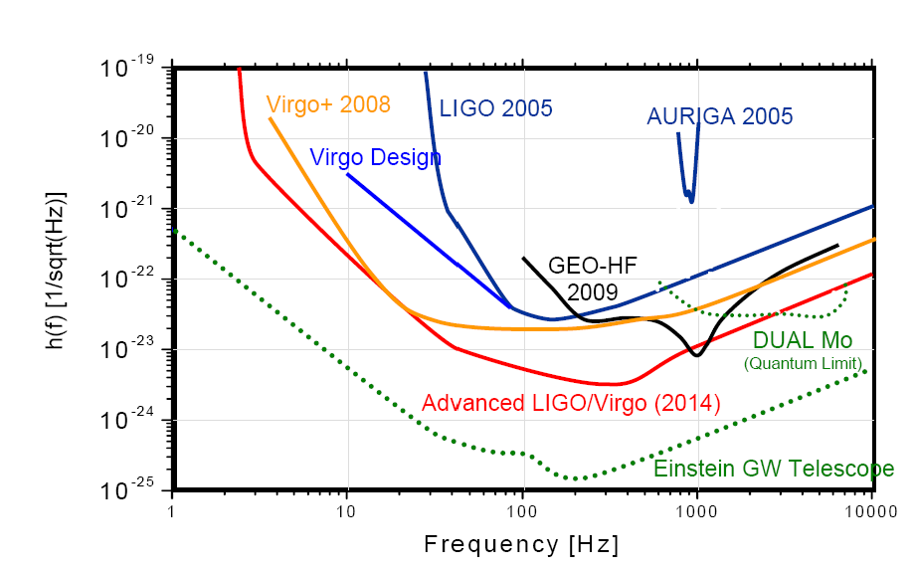
The beginning of Seismic attenuation for Gravitational Wave Observatories
Interferometric GW detectors can reach sensitivity at much lower frequencies
~10Hz in present and advanced interferometers
  Virgo, a-LIGO, b-LCGT
<10Hz, moving
towards 1Hz in
underground
interferometers
  a-LCGT, ET
Harald Lück for the European Gravitational-Wave Community

Slide 7
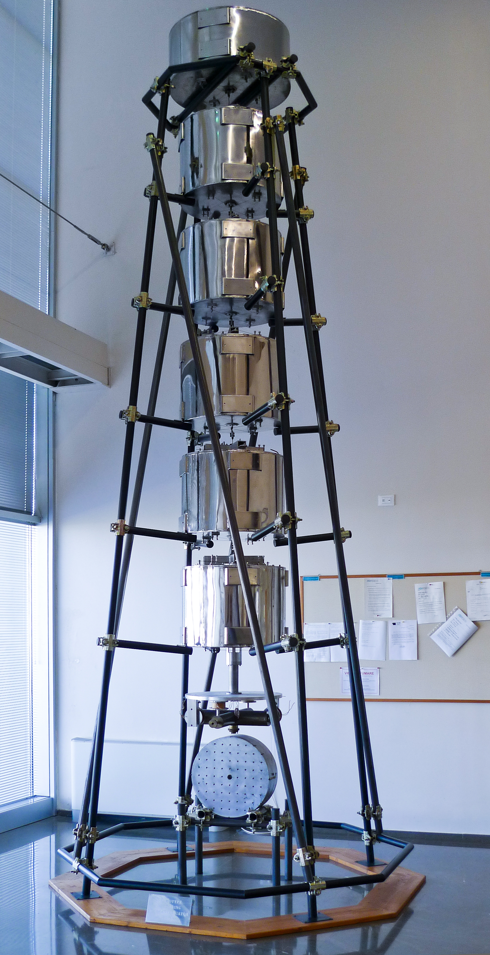
The beginning of Seismic attenuation for Gravitational Wave Observatories
Lower resonant frequency springs were necessary for the superattenuators of GW interferometric Observatories
The Helium filled bellow springs were invented (Giazotto)
Extremely performant, but quite thermally unstable
Proved the concept of the superattenuator chain
Now exposed in
The Virgo-EGO hall

Slide 8
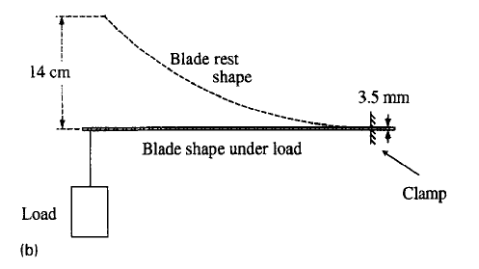
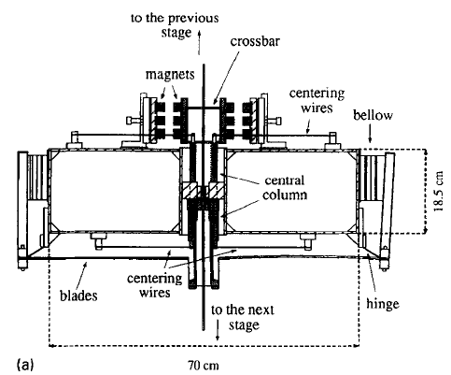
Modern Seismic attenuators cantilever springs with anti-springs
To solve the thermal instability Giazotto invents the filters with cantilever blades and magnetic anti springs.
Attenuation performance approaching that of He bellow filter
2.5 Hz

Slide 9
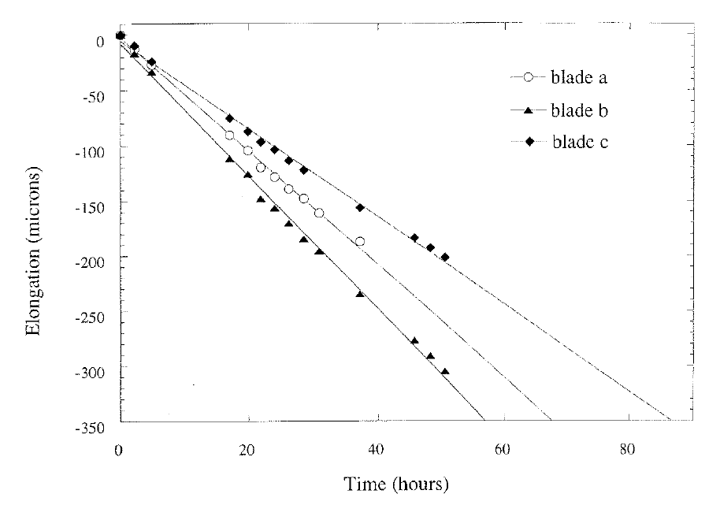
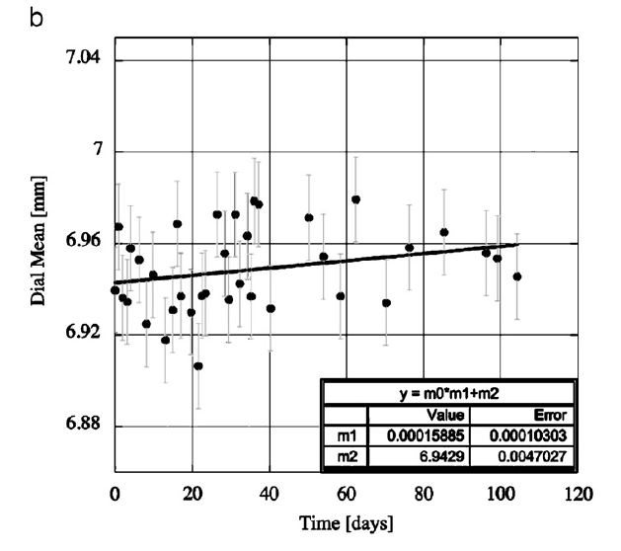
Superattenuator problems
The stress in the blades produce unacceptable creep in standard spring steel
Creep makes that cantilever blades were not a feasible alternative to Helium Bellows
The creep problem is solved by the introduction of Maraging steel (Valentini-DeSalvo)
Maraging is now ubiquitous
hours

Slide 10
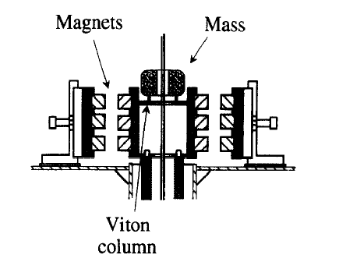
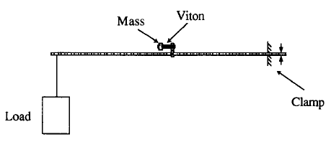
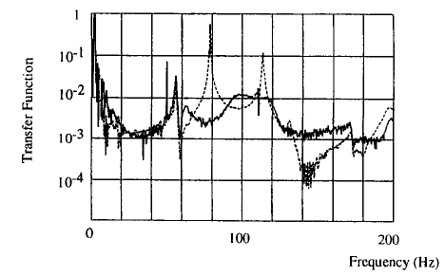
Superattenuator problems
Magnetic anti-springs (MAS) are bulky, and mechanically unstable
Centering wires required to avoid instabilities
Complexity generates many unwanted resonances
Resonant rubber damper are needed to damp resonances (Braccini)
Attenuation per filter is limited to ~40 dB

Slide 11
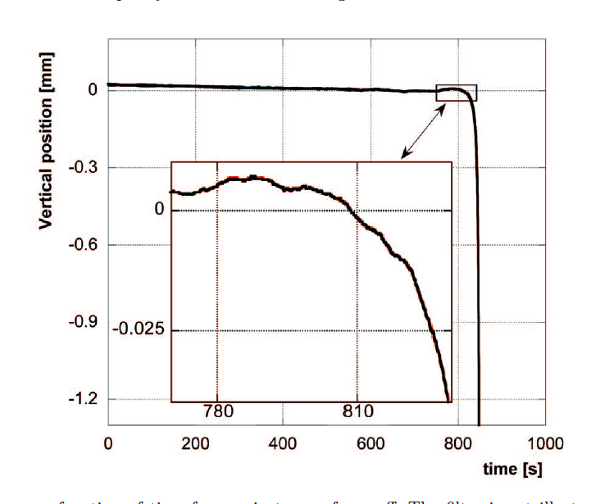
Superattenuator problems
For mysterious reasons the filters become unstable below 0.3 Hz
The target was 0.5 Hz, it was OK
Instability remained as an unexplained and unpleasant fact
Sudden runoff from
Equilibrium point

Slide 12
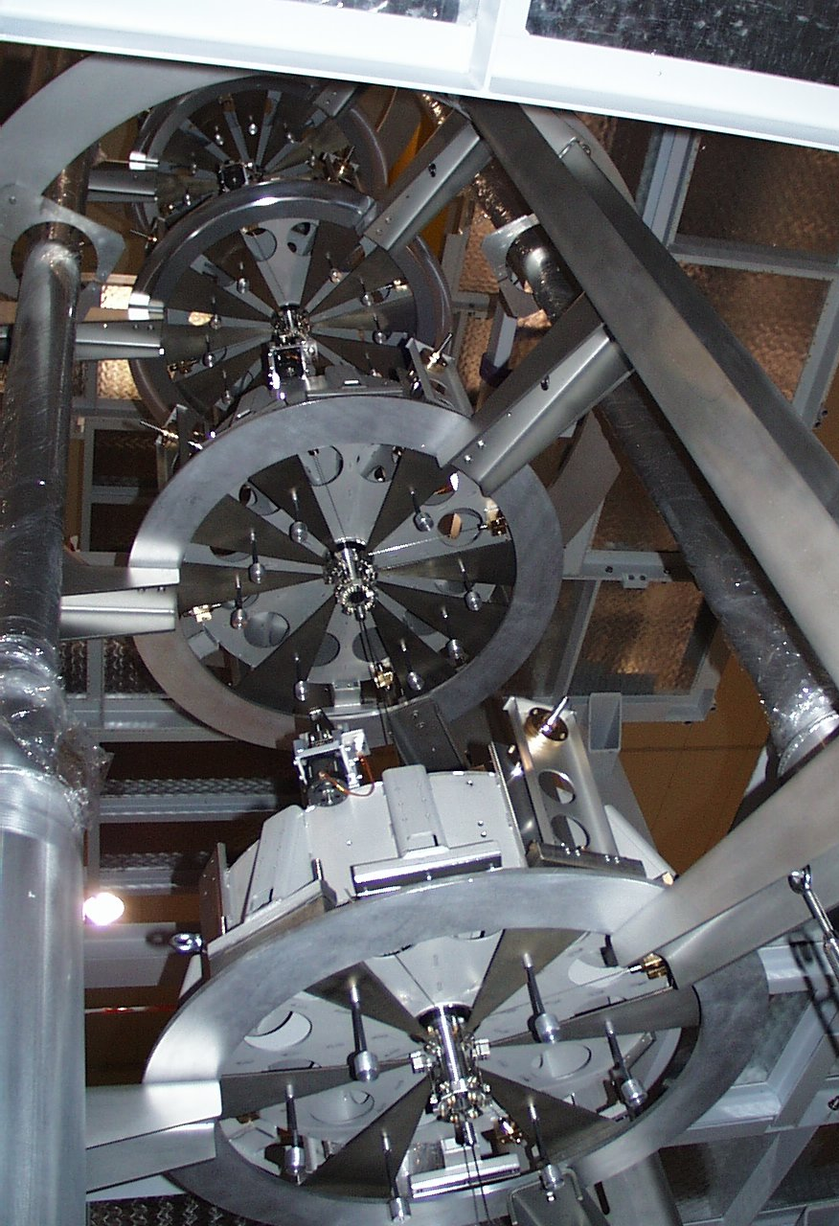
Superattenuator problems
The strength of magnets changes with temperature 10x faster than ∂Y/∂T
The working point changes with temperature
Thermal control of vacuum chambers was required
Courtesy
of Virgo

Slide 13
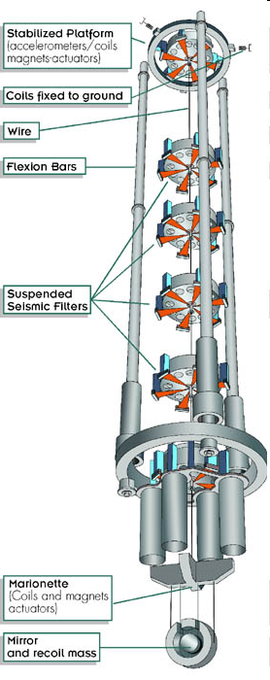
The other Superattenuator components
The inverted pendulum (Holloway-Winterflood) is introduced to provide mechanical attenuation at the microseismic peak frequency (0.1 to 0.3Hz)
Resonant frequency below 50 mHz was achievable
Counterweights were necessary for attenuation Exceeding 20 dB,
>60dB achieved
Ideal platform for active controls

Slide 14
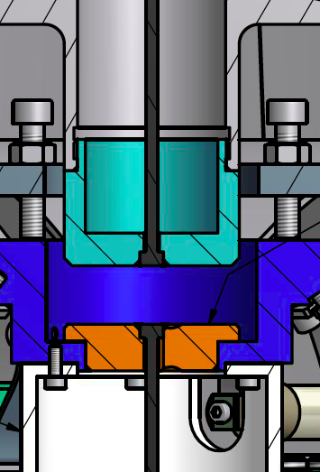
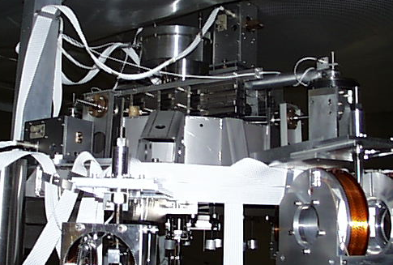
The other Superattenuator components
The double nail head wire allows shear-stress-free connections of suspended mechanical components (Galli-DeSalvo)
Large reduction of tilt-horizontal cross-talk
Lower mechanical noise

Slide 15
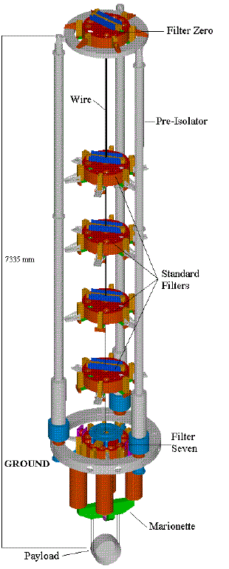
Superattenuator success
The Virgo superattenuators were an overwhelming success ! ! !
Allowed Virgo to ride earthquakes
  Lock is maintained even during small earthquakes

Slide 16
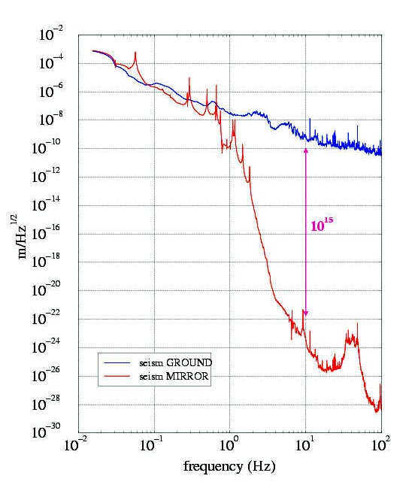
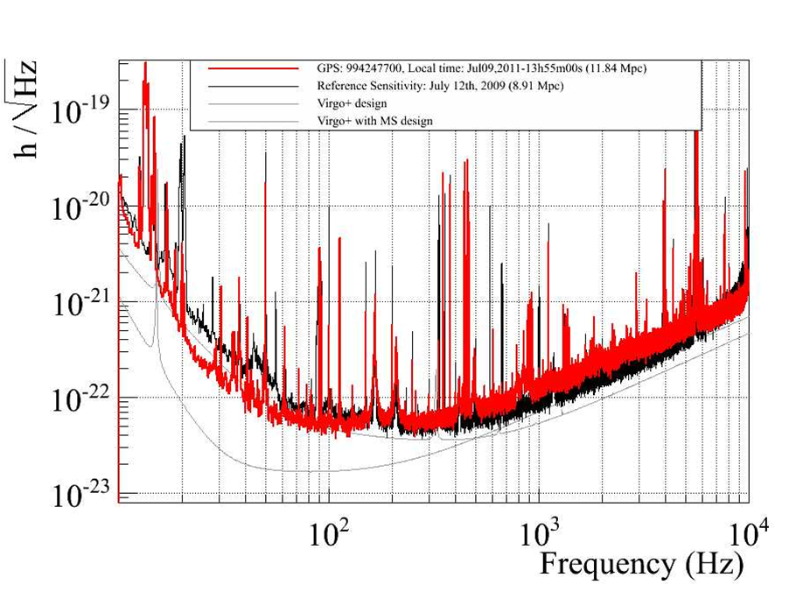
Superattenuator success
Virgo achieves the lowest frequency sensitivity to GW
Between wire and fiber thermal noise
Thermal Noise
Measured Upper Limit

Slide 17
Superattenuator drawbacks
The superattenuator filters are very complex, fussy and expensive mechanical instruments
The presence of large amounts of magnets and rubber dampers reduced their
Ultra High Vacuum compatibility
They were not bakeable after assembly
Differential vacuum was needed

Slide 18
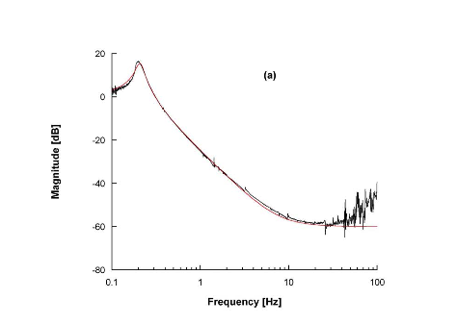
Superattenuator successors: GAS filters
The Geometric Anti Springs are invented (Cella-DeSalvo) and tested at LIGO (Bertolini-Marka-Sannibale-DeSalvo)
The unwanted mass of the MAS disappeared, and with it the unwanted resonances and their rubber dampers
Attenuation power
increases from 40 to 60dB/filter

Slide 19
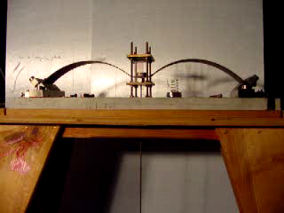
GAS spring demonstration
40 kg oscillating here

Slide 20
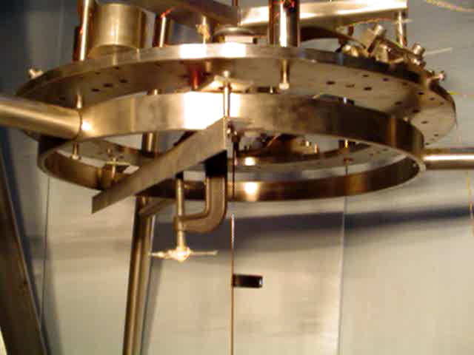
GAS filter characterization
70 kg hanging
From this wire

Slide 21
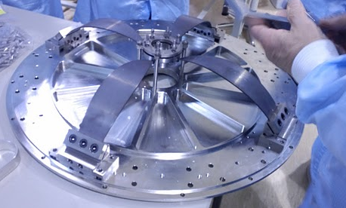
Superattenuator successors:
GAS filters
The number of parts is reduced by 1 order of magnitude
Cheaper instruments
Much easier tune-ability
The GAS filters are bakeable after construction
  No need for differential vacuum

Slide 22
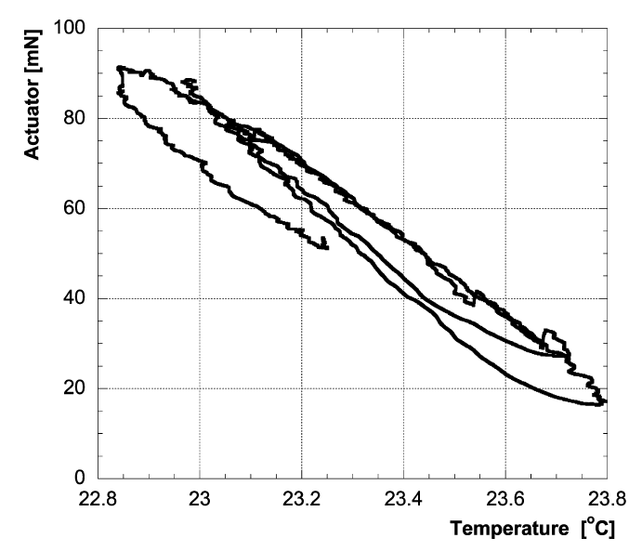
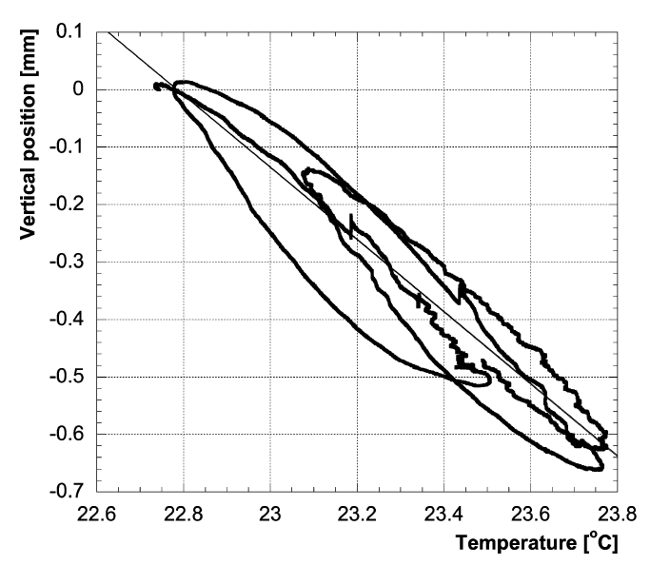
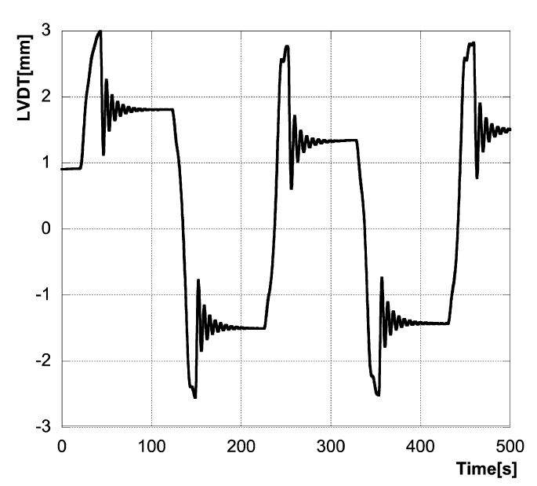
GAS filters problems
The mysterious instability below 300 mHz remained
Strange hysteresis is identified

Slide 23
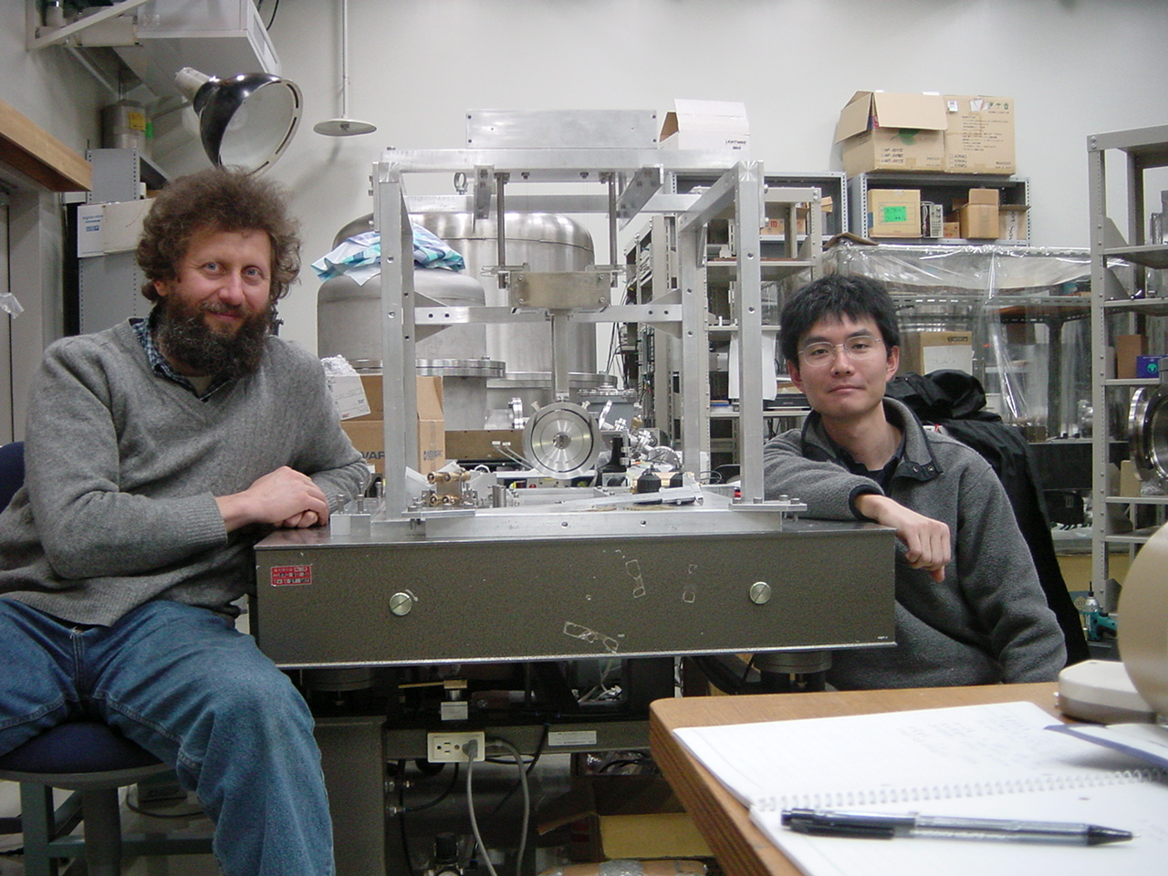
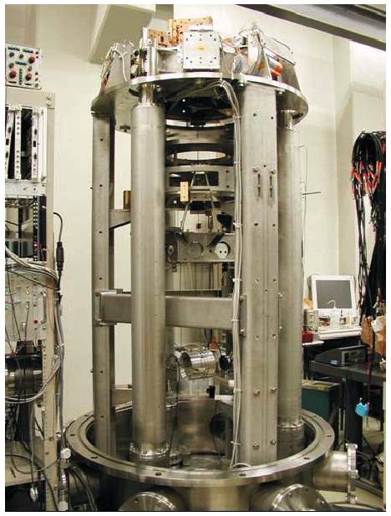
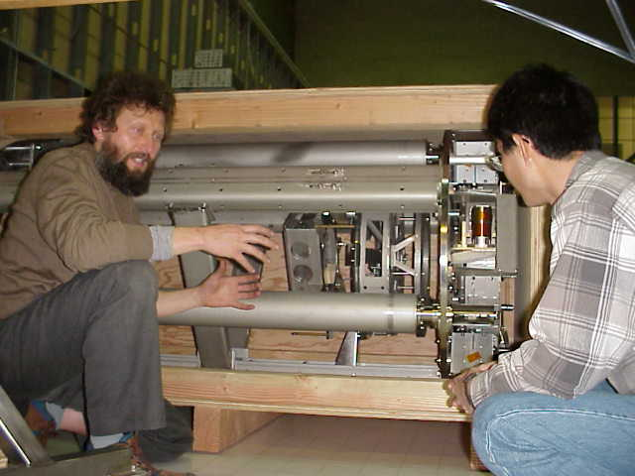
TAMA SAS
SAS is designed at Caltech (Takamori), tested in Hongo and installed in Mitaka (Takahashi)
TAMA low frequency performance improved

Slide 24
TAMA SAS
Improvement over Virgo:
GAS filters
Shorter and lighter Inverted Pendulums

Slide 25
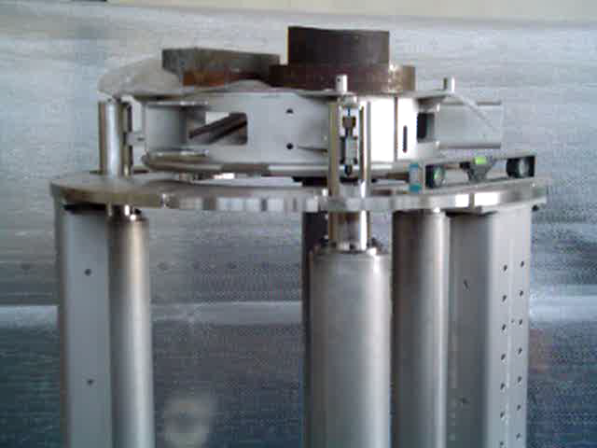
TAMA Inverted pendulum testing

Slide 26
Problems with TAMA SAS
Cabling rigidity limited the improvement
Outlined the necessity of attenuation overkill
Outlined the importance of soft cabling
Validated the concept for LCGT

Slide 27
Improvements after TAMA

Slide 28
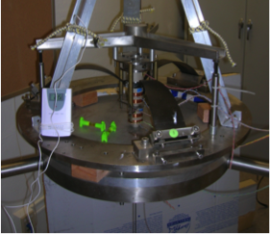
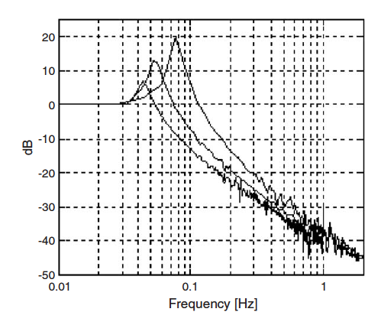
GAS improvements: EMAS
The introduction of Electro-Magnetic Anti Spring (Mantovani-DeSalvo) allows tuning of GAS to frequencies lower than 300 mHz
Instability becomes an overwhelming problem at low frequency

Slide 29
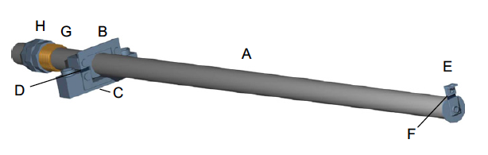
GAS improvements: magic wands
The mass of the cantilevers limits the GAS attenuation performance to 60 dB
Magic Wand compensators introduced (Stochino-DeSalvo)
The attenuation performance increases to 80 dB
Mysterious 1/f component fo attenuation is found

Slide 30
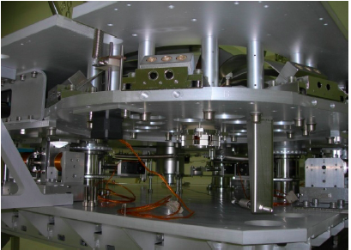
HAM SAS developments
Seismically attenuated optical benches based on SAS technology are developed for the LIGO pre-attenuators, and successfully tested at MIT (Stochino).
Inverted pendulum
are further advanced
by weight and size
reduction.

Slide 31
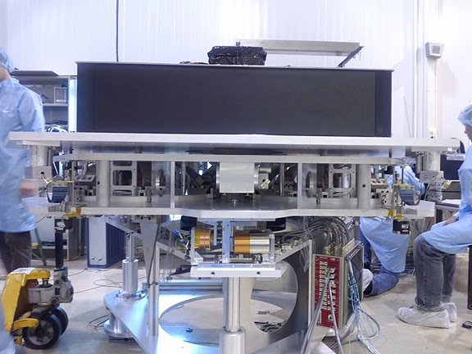
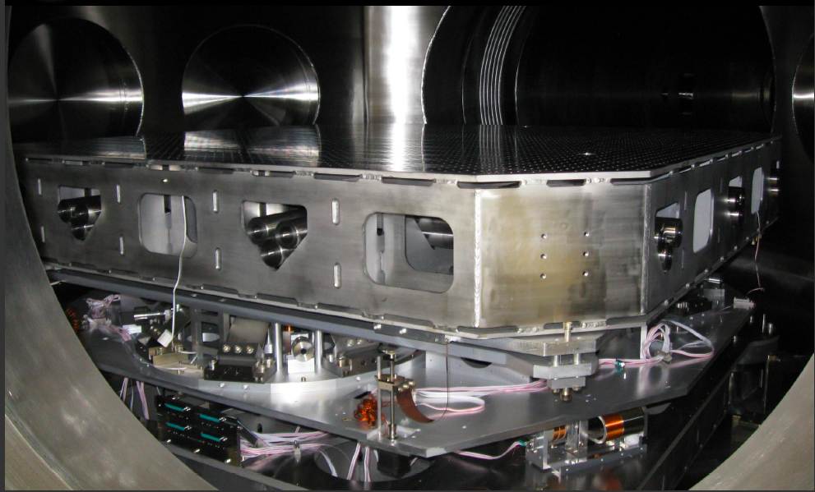
HAM SAS developments
HAM-SAS technology was rejected at LIGO, in favor of active seismic attenuator
The opposite choice was made for the AEI 10m test interferometer
facility (Bertolini)
Virgo also adopted
HAM SAS for injection
benches (NIKHEF)
Court. Alexander Wanner

Slide 32
Mechanical noise in metals
The mysterious mechanical noise in metals begins to be understood
Mechanical noise from
Self Organized Criticality (SOC) of dislocations in Maraging is identified (DiCintio-DeSalvo)
Ways out of instability
problems are now possible
Large jump

Slide 33
Seismic attenuators for LCGT
Please see Takahashi’s presentation
Following TAMA-SAS successful tests, LCGT adopts the SAS technology.
All advances are merged into the LCGT-SAS design (Sekiguchi-Takahashi-DeSalvo)
Magnetic damping of internal modes is introduced (Sekiguchi)

Slide 34
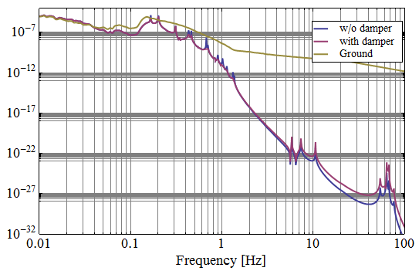
The LCGT-SAS
Seismic Attenuation System
is a modern, simplified and improved version of the Virgo Superattenuators
expected to have same attenuation capabilities than Virgo but at lower frequency

Slide 35
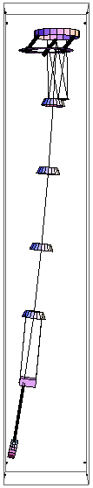
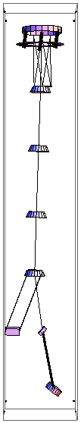
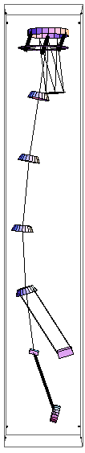
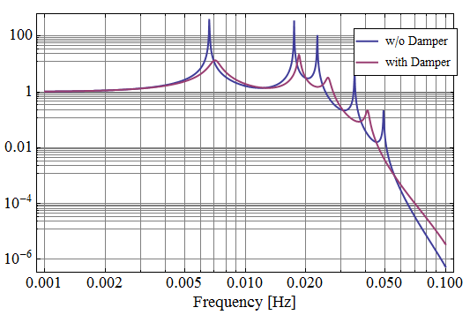
New idea, Magnetic damping
First filter dedicated to Eddy current damping of internal modes:
Good passive damping can be achieved
Great simplification ! ! !
35

Slide 36
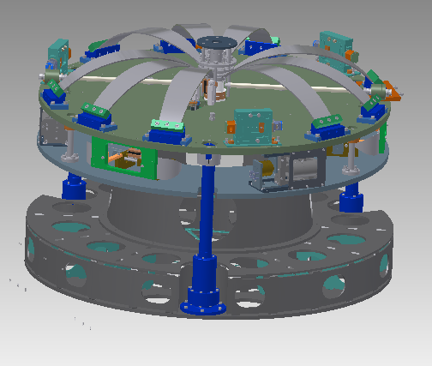
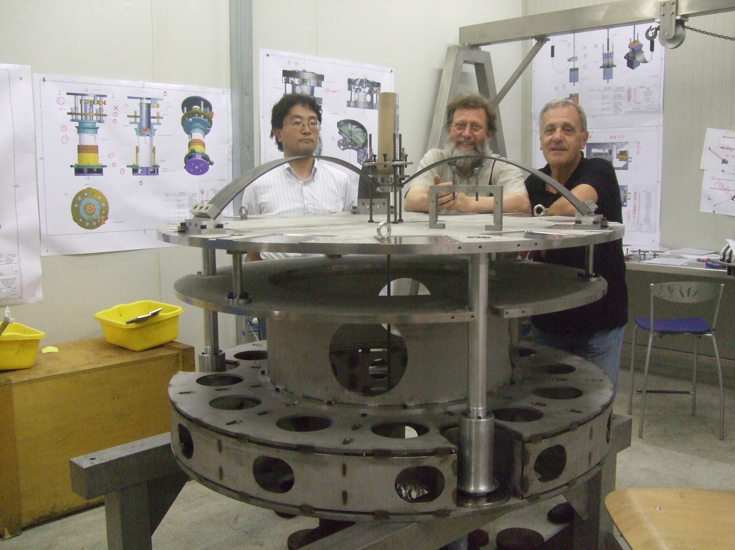
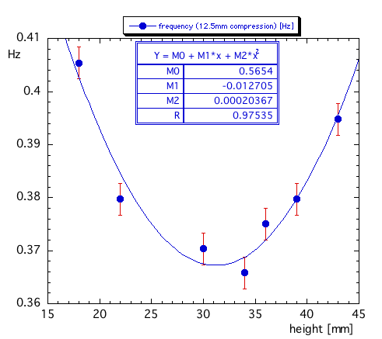
LCGT Top Filter / Inverted Pendulum preattenuator
Prototyped, undergoing tests

Slide 37
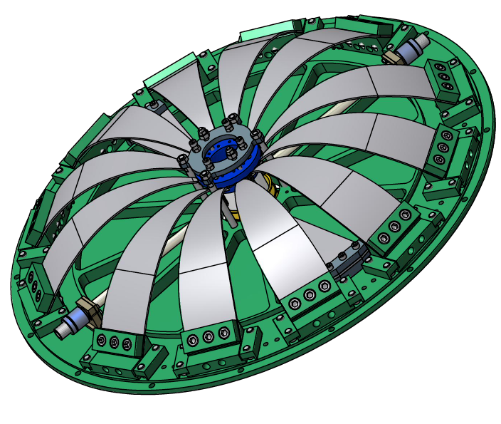
LCGT standard filter
The LCGT SAS standard filter was successfully developed and tested in collaboration with Virgo NIKHEF
73 cm diameter

Slide 38
LCGT SAS status
LCGT SAS design is finished and construction is well under way at Galli & Morelli (Lucca, I)*
Expected time of delivery < March 2013
* Galli & Morelli, specialized in this kind of precision mechanics, built all SAS attenuators, starting with the Virgo Superattenuators, to LCGT-SAS

Slide 39
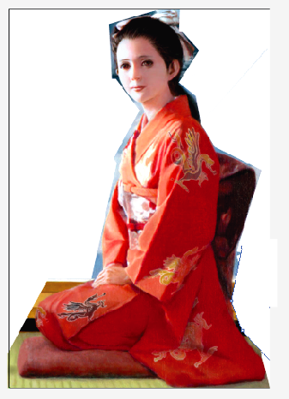
Seismic attenuators for LCGT
Underground constraints forced the concept of double tunnel construction (DeSalvo).
Large reduction of required rock removal
Better stability (less rock creep)
Much longer suspension wires
cryostat
See Ricci
and Kimura

Slide 40
Seismic attenuators for LCGT
Horizontal resonant frequencies of wire pendulum are limited by wire length
ƒ = 2 π √g/l
Longer wires are not necessary for LCGT, but will be necessary for 3rd generation to move towards the 1Hz domain

Slide 41
SAS technology
It was developed in a relay development race with Italy, US, Japan, Germany, Netherland
It provides a full set of seismic attenuation tools for GW observatories,
  Seismic chains for main mirrors
  Optical benches for auxiliar optics
It developed and keeps developing to match the growing requirements of GW detectors

Slide 42
What’s needed for ET?
Next generation GW detectors will be xylophones to extend the sensitivity to lower frequency
Current techniques provide seismic attenuation for next generation of GWD above 10 Hz.
New materials need to be developed to extend towards 1 Hz, and to produce vertical springs working below the microseismic peak

Slide 43
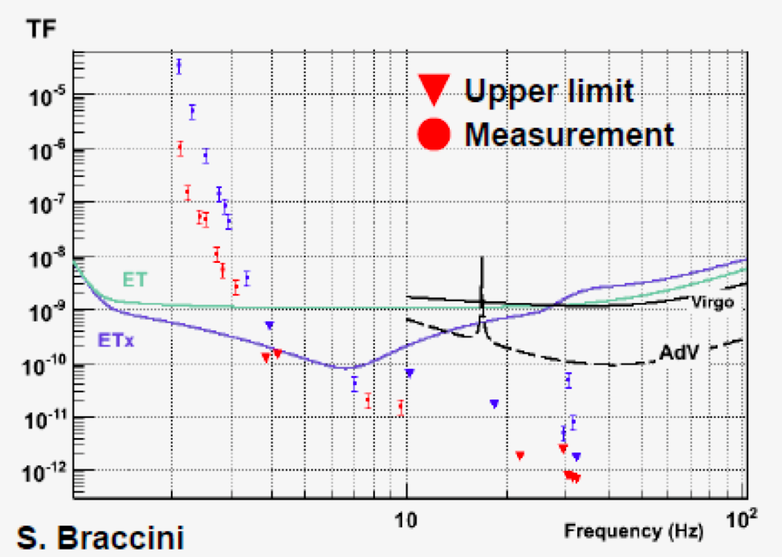
How far is Virgo

Slide 44
How far will LCGT be
Thermal Noise
Measured Upper Limit
courtesy
F. Frasconi

Slide 45
What’s needed for ET?
Longer wires already give LCGT a √2 frequency advantage
Even longer wires are possible but . . .
Magnetically softened pendula under study
    (Eric Thrane, G1100981 poster LSC Gainesville)
Lower resonant frequencies for vertical also needed
Glassy metals and other options are promising
Cryogenic vertical springs will be needed for thermal noise in the low frequency unit

