Slide 1
Science by LCGT
Hideyuki Tagoshi
(Osaka University)
2011/02/04 LCGT f2f meeting

Slide 2
Contents
Compact binary Coalescence (CBC)
NS-NS Merger rate, event rate
Parameter estimation accuracy
Gravitational Collapse
Pulsar
Stochastic background

Slide 3
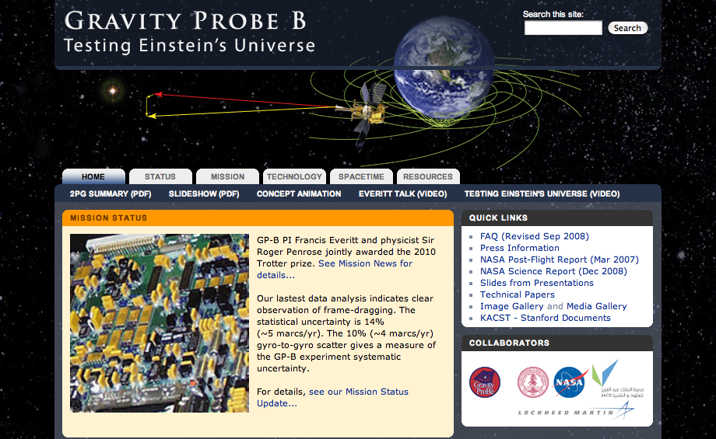
Detection of GW
Many aspect of general relativity have not been
tested experimentally.
Gravity Probe B project (USA):
test of frame dragging effect
around a rotating body
Gravitational wave: tensor mode propagating with
speed of light

Slide 4
Multimessenger gravitational-wave astronomy
Coordinated observations using different kinds of radiation :
electromagnetic, neutrino, cosmic ray, and gravitational wave.
Triggered search
Information of time and direction from other observation tools
is extremely advantageous for the gravitational-wave detection.
Gamma ray burst: stellar core collapse, compact binary merger
Neutrino: Supernova in/near our Galaxy
Wide field optical/IR telescope: watch CBC, GRB, SN
Follow-up search
Laser interferometer GW detector is wide field telescope by nature.
First detect GW candidate events, and use the information of the time and
direction in the electromagnetic observation.
Low latency data analysis pipeline is essential for this purpose.

Slide 5
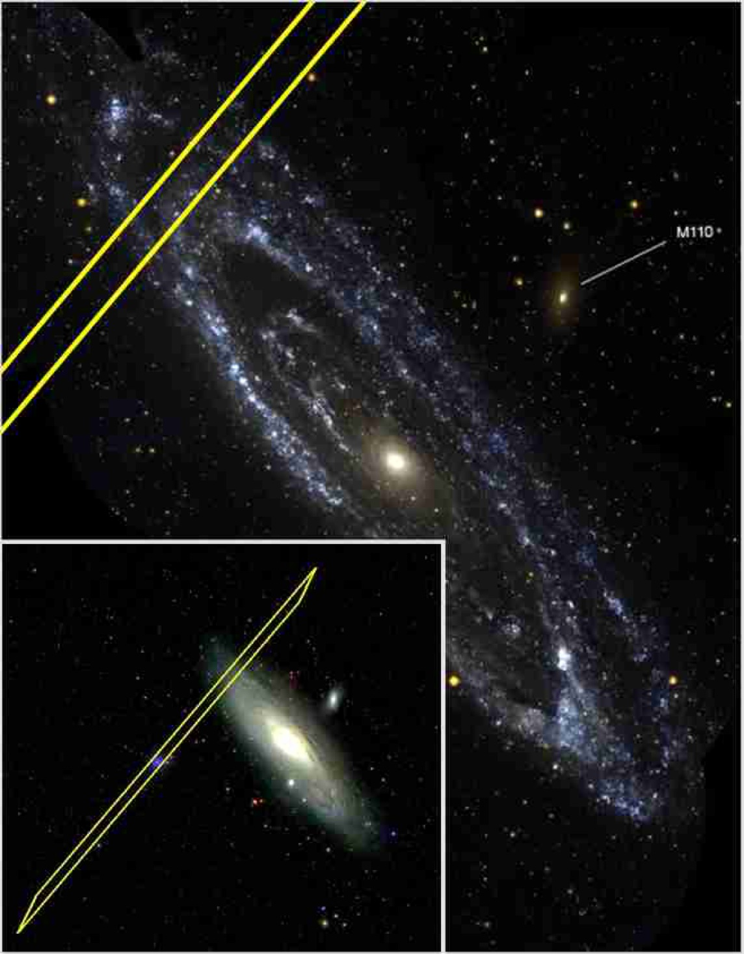
LIGO analysis : GRB070201
Astrophys. J. 681, 1419 (2008)
GRB070201: Short gamma ray burst (SGRB)
Direction: M31(Andromeda nebula, 770kpc)
Progenitor candidate of SGRB:
coalescence of NS-NS or NS-BH
However, inspiral signals are
not detected around the GRB trigger time
Thus, it is not the binary merger event
occurred in M31 (at 99% C.L.)

Slide 6
Compact binary coalescence

Slide 7
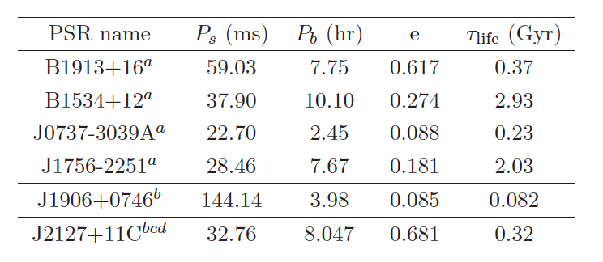
NS-NS merger rate
There are about 10 known and likely neutron star binaries.
6 neutron star binaries have life time is shorter than the age of the universe
(Lorimer, LRR, 11, (2008), 8)
Double pulsar
Most recently discovered (2006)

Slide 8
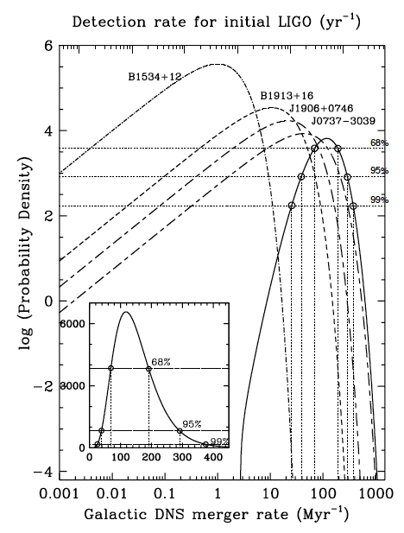


NS-NS merger rate
Galactic merger rate
Current standard LCGT design (VRSE-D)
gives horizon distance (@ρ=8)
= 282Mpc (z=0.065)
Event rate for LCGT :
However, systematic errors which are not
included in this evaluation may be large.
(Kim (’08), Lorimer (‘08))

Slide 9
Parameter estimation accuracy
Parameter estimation accuracy is the key factor
toward the gravitational wave physics / astronomy
Especially, angular resolution is important for the
multimessenger gravitational wave astronomy.
Can we identify the host galaxy of the source?
The answer is pessimistic.

Slide 10

Parameter estimation accuracy
Parameters of inspiral signals
9
Polarization
angle
Direction
to the source
Inclination
angle
Fisher matrix
Assume maximum likelihood detection strategy for multiple detectors
(coherent detection) and evaluate by using the Fisher matrix
The effects included
Detectors’ orientation (Curvature of the Earth)
The difference of the arrival time
Various value of are generated randomly, and
the distribution of the standard deviation of parameters are drawn.

Slide 11
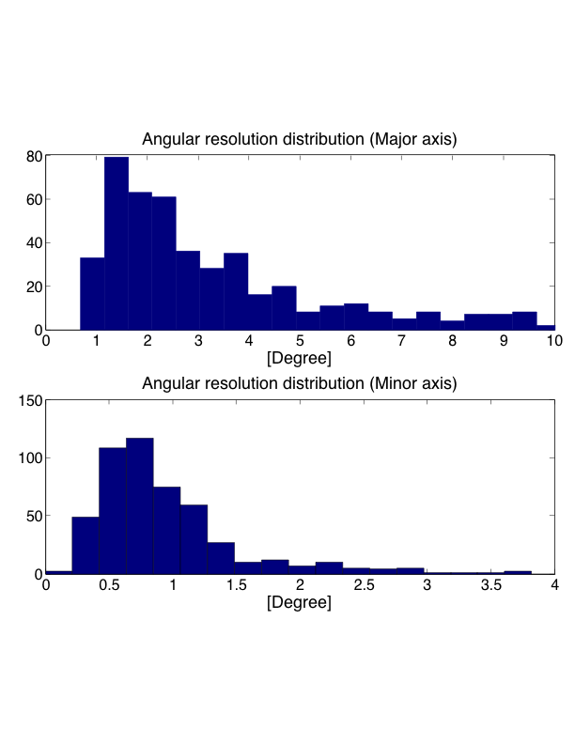
Angular resolution
(1.4,1.4)Msolar, @200Mpc
Advanced LIGO noise spectrum
LIGO-L1, VIRGO, LCGT (3 detectors)
Average S/N (ρ) 8.2-8.9 (at each detector)
Average resolution: major axis 7.6 deg.，minor axis 0.99 deg.
Typical value: major axis 1-2 deg., minor axis 0.5-1 deg.
Major axis
Minor axis
Error ellipse
Direction，inclination，polarization
are given randomly

Slide 12
Parameter estimation accuracy
Advanced LIGO noise spectrum
Signal to noise ratio at each detector (up to ISCO)
 | LIGO-L1 | LIGO-H1 | VIRGO-V1 | LCGT-K1
RWF | 6.6 | 8.3 | 6.4 | 8.1
FWF | 6.4 | 8.0 | 6.2 | 7.9
Parameter estimation errors (up to ISCO)
 |  | ln(r) | ln(Mc) | delta | tc[msec] | theta[min] | phi[min] | Omega[sr] | minor axis [min] | Major axis [min]
FWF | LHVK | 0.49 | 3.7x10⁻⁵ | 0.34 | 0.17 | 35 | 80 | 4.9x10⁻⁴ | 23 | 160
 | LVK | 0.50 | 4.4x10⁻⁵ | 0.41 | 0.20 | 36 | 100 | 6.4x10⁻⁴ | 24 | 200
 |  | ln(r) | ln(Mc) | ln(eta) | tc[msec] | theta[min] | phi[min] | Omega[sr] | minor axis [min] | Major axis [min]
RWF | LHVK | 0.46 | 9.0x10⁻⁵ | 8.9x10⁻³ | 0.35 | 33 | 75 | 4.3x10⁻⁴ | 22 | 150
 | LVK | 0.48 | 1.1x10⁻⁴ | 1.1x10⁻² | 0.42 | 33 | 94 | 5.6x10⁻⁴ | 22 | 188

Slide 13
Parameter estimation accuracy
Angular resolution
Angular resolution is not very good for sources at typical distance (@200Mpc).
The direction of the source may not be determined by GW alone.
Detection of the electromagnetic and neutrino counterpart is necessary to identify the host galaxy.
Distance
Chirp signal is often called “the standard siren”.
However, distance can not be determined very accurately
due to the pure accuracy of polarization and inclination angle.
We have to wait for more sensitive detectors like Einstein telescope to study cosmology by chirp signals.

Slide 14
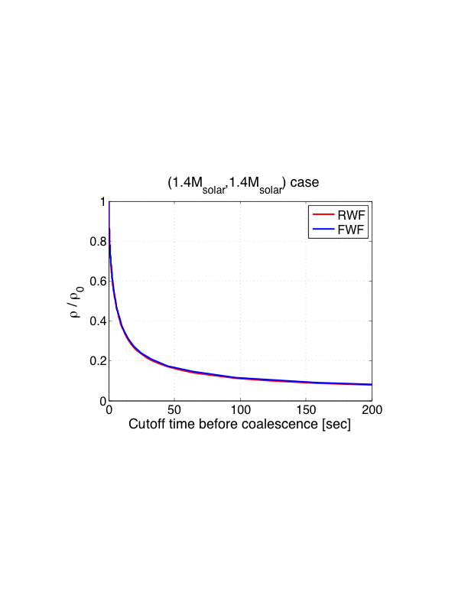
Low latency search for CBC
We want to analyze data as fast as possible.
Naive question: Is it possible to predict (or forecast) of the compact star merger
before the merger time by using inspiral signal?
Inspiral signal continues for a few seconds.
However, if we cut off the integration of the matched filter before the ISCO time,
S/N ratio decreases rapidly.
Parameter estimation accuracy become
very bad.
ρ : S/N cutted off before ISCO
ρ0: S/N up to ISCO
(1.4,1.4)Msolar, @200Mpc
Cutoff frequency : 50Hz (13 sec before ISCO)
Angular resolution : several 10 degree.

Slide 15
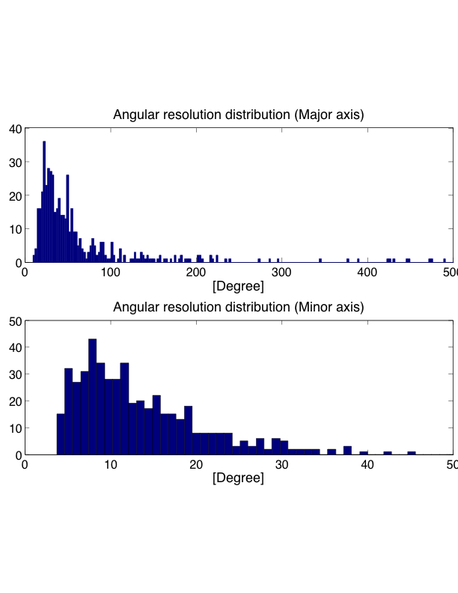
(1.4,1.4)Msolar, @200Mpc
Cutoff at 50Hz
(13 sec. before
ISCO)

Slide 16
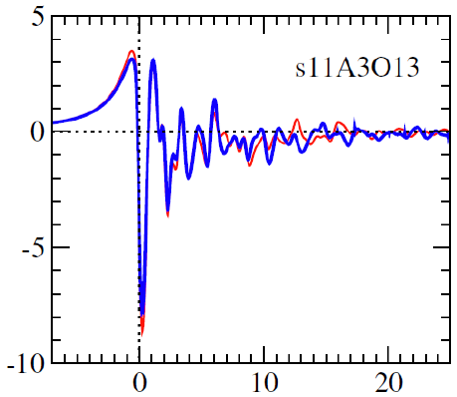
Supernova (Gravitational Collapse)
Ref. Ott, CQG, 26, 063001 (2009), Fryer and New, LRR, 14, 1 (2011)
Various possible gravitational wave emission mechanism.
Core collapse and bounce
Rotational non-axisymmetric instabilities of proto-neutron star
Post-bounce convection
Non-radial pulsations of proto-neutron star
Anisotropic neutrino emission
etc.
Related to the explosion
mechanism
Collapse and bounce wave form from
Dimmelmeier et al. 2008 [PRD 78, 064056]

Slide 17
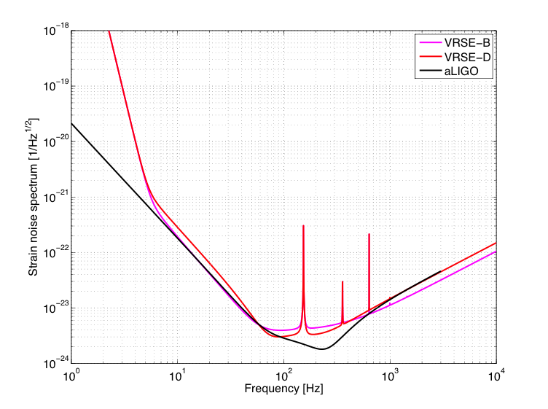
Gravitational Collapse
Location of characteristic frequency and amplitude
Gravitational Collapse at 10kpc
Dimmelmeier et al. (‘08)
PRD 78, 064056

Slide 18
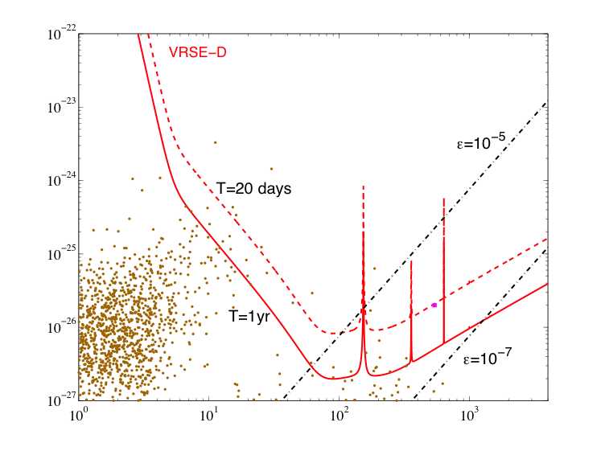

Continuous wave (rotating NS)
Maximum possible amplitude from pulsars
ε: ellipticity
Frequency [Hz]

Slide 19
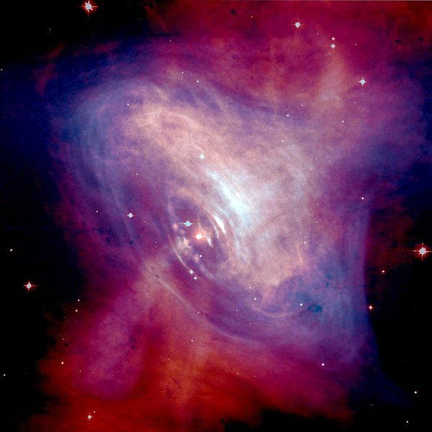



LIGO -Crab pulsar-
Neutron star in Crab nebula
Borne in 1054 by supernova
Crab nebula
Upper limit of gravitational amplitude derived from
the spin down rate of pulsar:
LIGO 9 months data from 2005-2006:
Astrophys. J. Lett. 683, L45 (2008)
Spin frequency 29.78Hz
Distance 2kpc
It was shown directory for the first time that
the gravitational radiation is not the major source of the spin down.
Most recent LIGO 2yrs data from 2005-2007:
Astrophys. J. 713, 671 (2010)

Slide 20
Magnetars
Soft gamma repeaters, anomalous X-ray pulsars
compact X-ray sources, occasional short burst (〜0.1sec)
Neutron stars with strong magnetic field(〜10¹⁵G)
20 such objects are known
Possible GW source
Non-radial pulsation modes may be exited.
Time and direction will be inferred from X- and γ-ray.
They exist in our Galaxy. Much closer than CBC or SNs

Slide 21
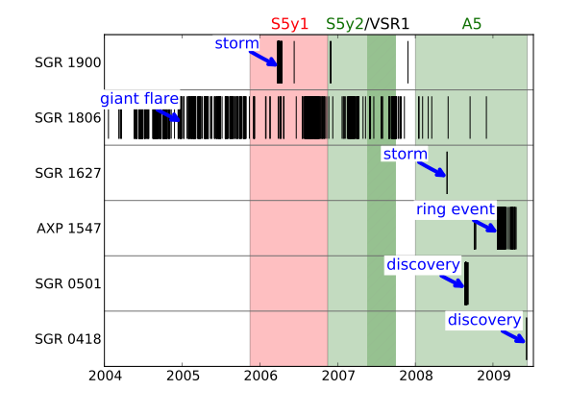
LIGO analysis of magnetars
arXiv:1011.4079
IPN event 1217
Fermi 8
〜10kpc
３
〜10kpc
２０７
(54)
56
〜11kpc
〜4kpc
844
〜１kpc
166
〜２kpc
3
Total 1279
analysed
21

Slide 22
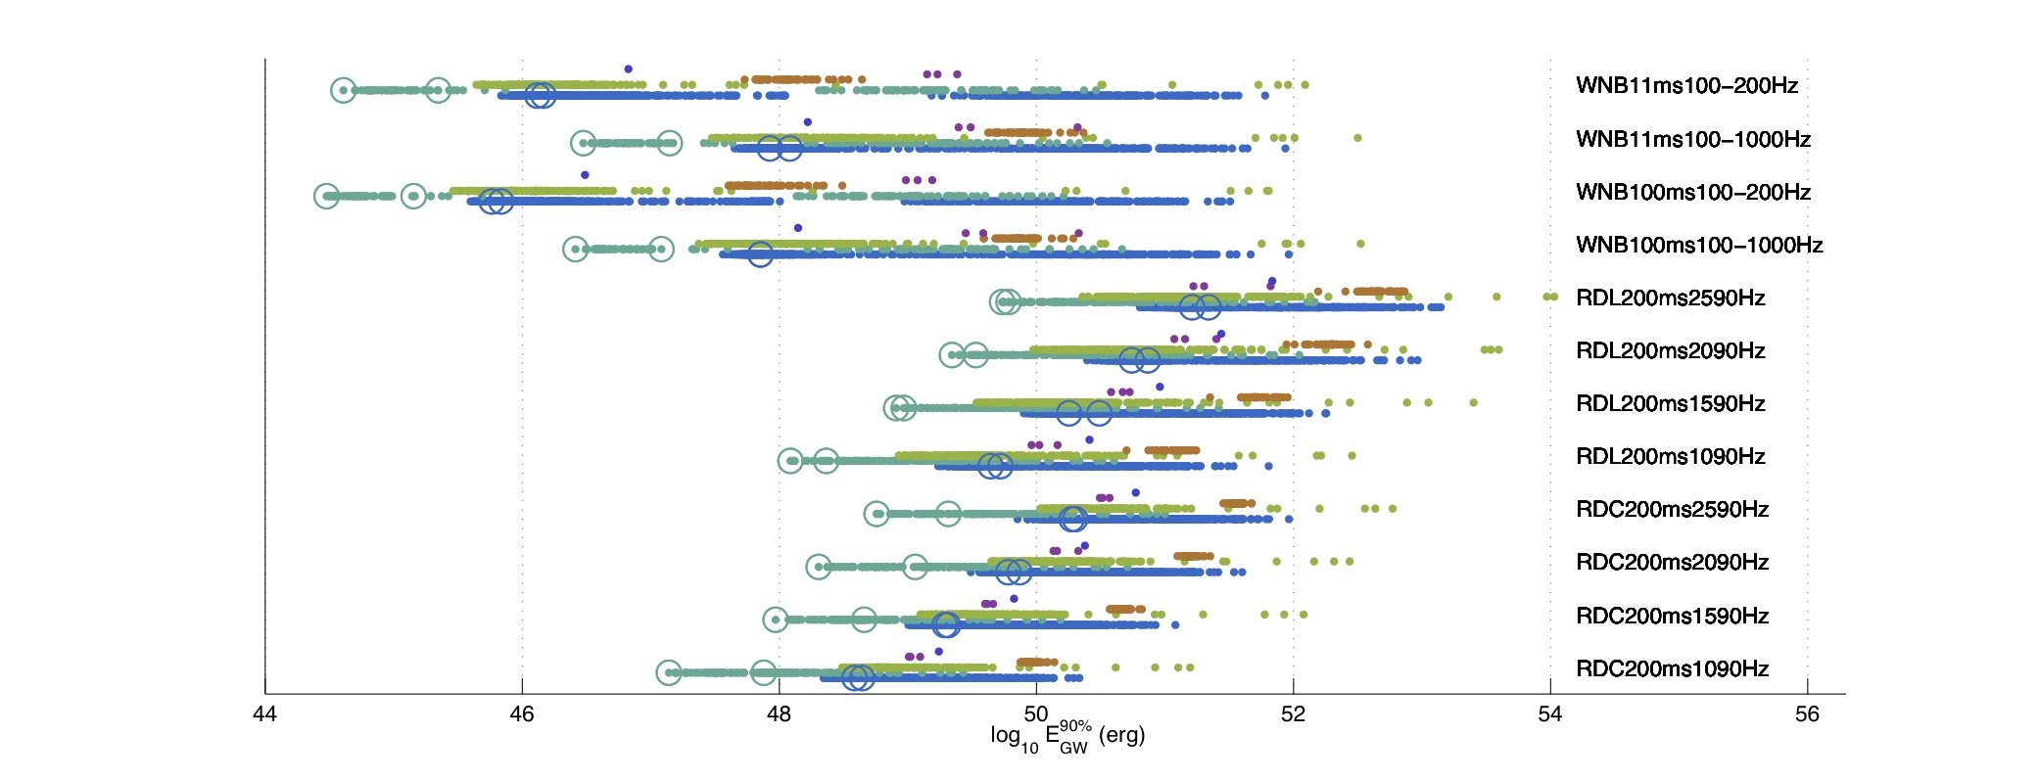
LIGO analysis of magnetars
arXiv:1011.4079
Upper limit to the energy radiated in GW
White noise burst
Ringdown
Each color represent a magnetar

Slide 23
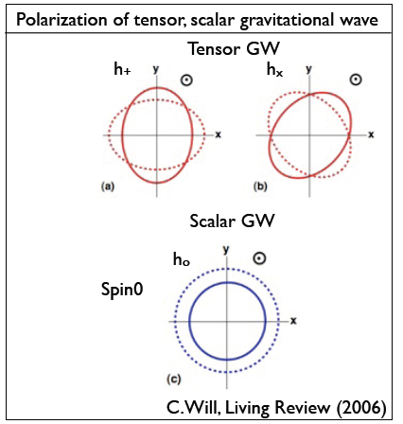
Gravitation theory
Scalar tensor theory of gravity (including Brans-Dicke theory)
Scalar gravitational wave
Binary NS-BH emit scalar gravitational waves.
(In NS-NS case, scalar wave emission is
suppressed due to symmetry)
However, in Brans-Dicke type theory,
the Brans-Dicke parameter, ω_{BD} , are already
constrained experimentally
(ω_{BD} >40000, Cassini satellite)
It is difficult to defeat this bound by using
inspiral signal.
Spherical core collapse of stars produce
scalar GW even if it is spherical symmetric.
If ω_{BD} =160,000 , we can detect scalar GW due to
Spherical core collapse occurred at 10kpc. (Hayama, talk at GWPAW(2011))

Slide 24
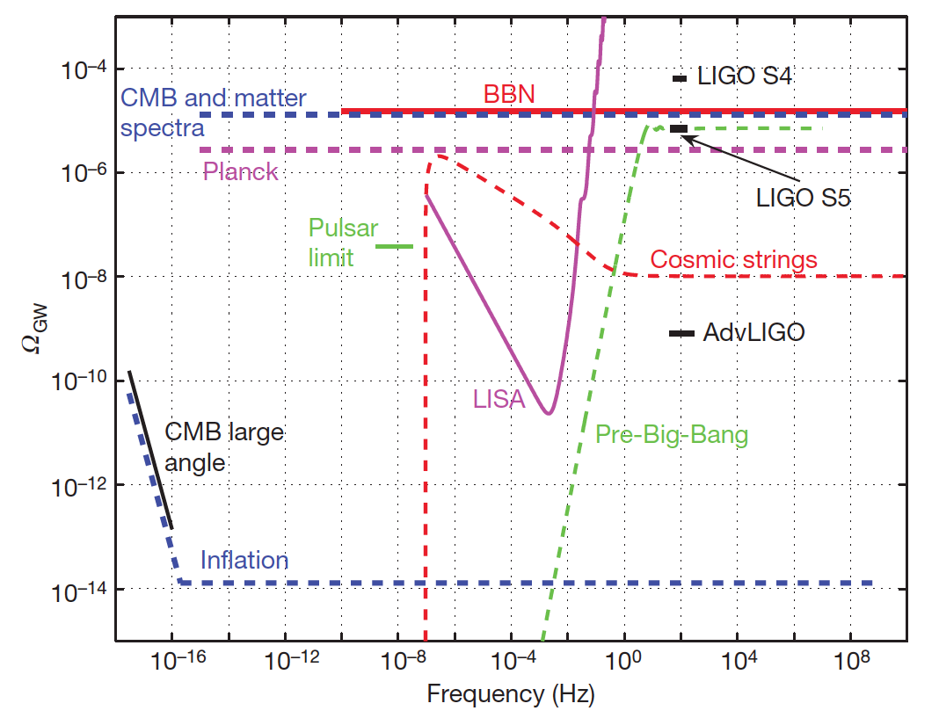
Stochastic background
LSC&Virgo, Nature 460, 990 (2009)

Slide 25
Summary
LCGT and advanced LIGO, advanced Virgo will observe GW from
CBC (NS-NS, possibly NS-BH, BH-BH) => GRB progenitor
Stellar core collapse within several 100 kpc.
might observe GW from (at least give strong constraint to)
continuous waves from rotating NS
burst waves from magnetars (SGR, AXP)
may not observe stochastic background (from inflation)
but some constraint are given.
may not be determine the distance to the source accurately.
Multimessenger gravitational wave astronomy is essential part to perform science.
(EM wave, neutrino, cosmic ray, …)

Slide 27
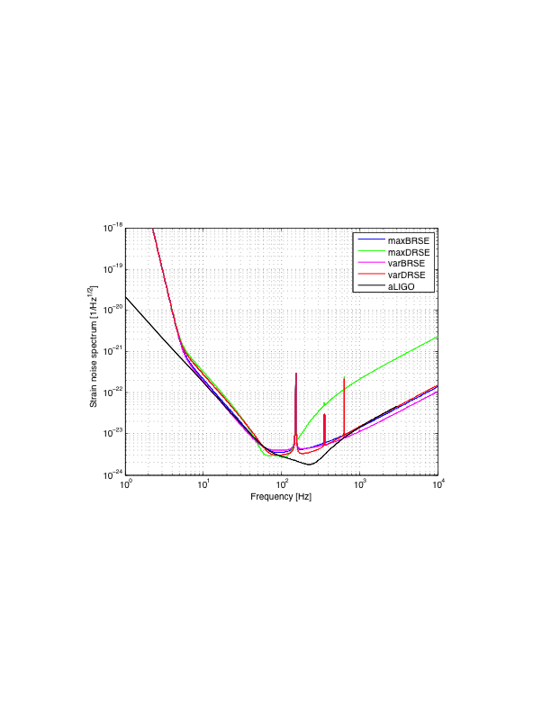
Detectors
Noise power spectrum・・・ assume all detectors have the same spectrum
LCGT (red) and Advanced LIGO (black)
Today’s results
are obtained by
Using aLIGO

Slide 28
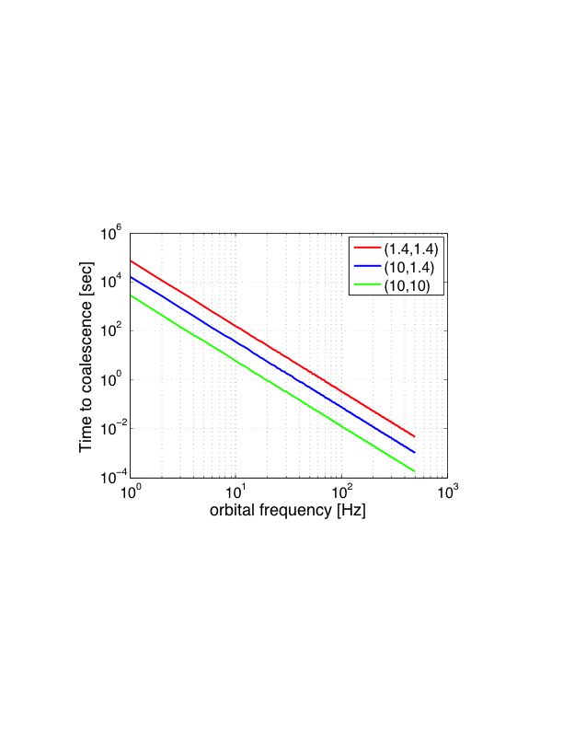
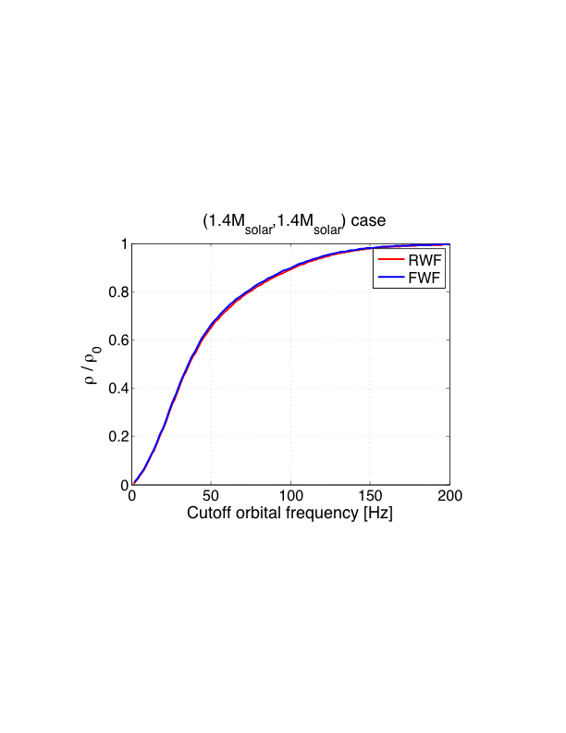
合体前でのカットオフとS/N減少率
軌道周波数と合体までの時間の関係
Cutoff周波数とS/Nの減少割合
合体までの時間と軌道周波数
合体前 | (1.4,1.4) | (10,1.4) | (10,10)
60秒 | 14.3Hz | 8.2Hz | 4.2Hz
10秒 | 28Hz | 16Hz | 8.2Hz
合体前打ち切り時間と
S/Nの減少率

Slide 29
合体前でのカットオフとS/N減少率
(1.4,1.4)Msolarの場合
合体までの時間と軌道周波数，S/N減少率の関係
合体前 | 60秒 | 30秒 | 10秒 | 5秒 | 1秒
軌道周波数 | 14.4Hz | 18.6Hz | 28.1Hz | 36.5Hz | 66.7Hz
ρ/ρ₀ | 0.15 | 0.21 | 0.37 | 0.50 | 0.76
ρ₀: ISCOまで積分する場合のS/N
ISCOでの周波数: 〜1570Hz

Slide 30
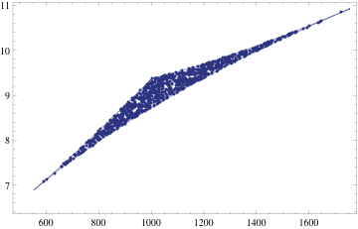
テンプレート数、CPUパワー
aLIGO ノイズスペクトラム
m₁, m₂ | 1-40Msolar | 1-2Msolar | 1.3-1.5Msolar
テンプレート数 | 1.1 x 10⁵ | 4800 | 36
CPU power | 28Gflops | 1.2Gflops | 8.8Mflops

Slide 31
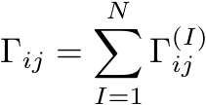


パラメータ推定誤差
Maximum likelihood 法による重力波信号検出を想定する．
それによるパラメータ推定誤差をフィッシャー行列により評価する．
複数の検出器のときは、検出器間のノイズに相関がなければ、
検出器ネットワークのFisher行列は、各検出器のFisher行列の和になる．
誤差
の分布

Slide 32
パラメータ推定誤差
Parameter estimation errors (LVK 3 detectors’ case, RWF)
fcutoff | Time to coalesce[sec] | ln(r) | ln(Mc) | ln(eta) | tc[msec] | theta[min] | phi[min] | Omega[sr] | minor axis [min] | Major axis [min]
ISCO | --- | 0.48 | 2.9x10⁻⁵ | 5.7x10⁻³ | 0.32 | 34 | 94 | 5.6x10⁻⁴ | 22 | 187
400Hz | 0.53 | 0.50 | 3.1x10⁻⁵ | 6.9x10⁻³ | 0.44 | 37 | 103 | 6.8x10⁻⁴ | 25 | 207
200Hz | 0.34 | 0.63 | 3.5x10⁻⁵ | 1.0x10⁻² | 0.99 | 66 | 171 | 1.9x10⁻³ | 41 | 343
100Hz | 2.15 | 1.1 | 4.7x10⁻⁵ | 2.2x10⁻² | 3.9 | 187 | 437 | 1.2x10⁻² | 102 | 877
50Hz | 13.7 | 2.7 | 7.6x10⁻⁵ | 6.5x10⁻² | 24.5 | 805 | 1623 | 1.8x10⁻¹ | 6.9度 | 54度
30Hz | 53 | 6.2 | 1.3x10⁻⁴ | 2.0x10⁻¹ | 128 | 2841 | 4813 | 1.9 | 25度 | 161度
20Hz | 157 | 12.3 | 2.4x10⁻⁴ | 6.0x10⁻¹ | 575 | 124度 | 177度 | 12.3 | 72度 | 357度

