Slide 1
Two Layers SAS: Damping of Torsion Mode
Feb. 5th, 2011
F2F Meeting
Takanori Sekiguchi,
Riccardo DeSalvo, Ryutaro Takahashi

Slide 2
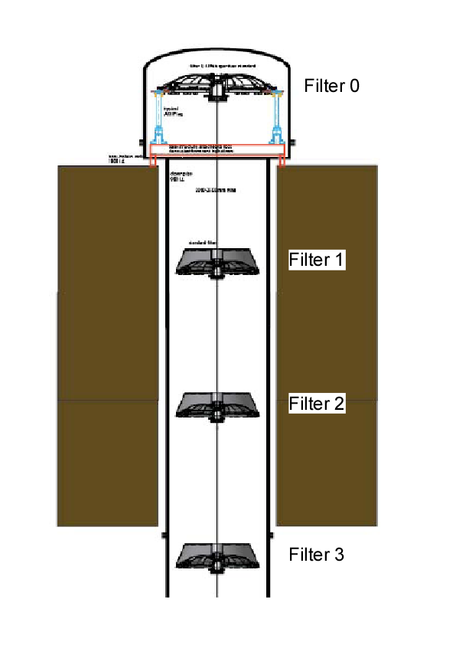
Torsion Mode of Filters
Each GAS filter is suspended by a single wire.
Single wire is flexible in torsion mode → good attenuation in yaw mode (rotation about vertical axis)
This mode has quite low resonant frequency & high Q
Once this mode is excited, filters keep oscillating for a long time.(During this time, we cannot lock interferometer.)

Slide 3
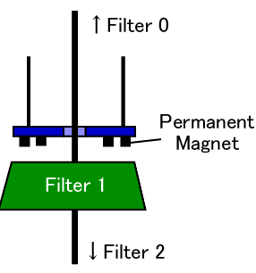
How to Damp This Mode?
A disc is suspended from Filter 0.
Permanent magnets attached to the disc damp the motion of Filter 1 by eddy current.
The motion of Filter 2 & 3 is also damped, if the torsional stiffness of each wire is optimal.
We need to optimize the damping strength & torsional stiffness of every wires. →Need Simulation

Slide 4
Torsional Stiffness of Wire
Torsional stiffness depends on the thickness of the wire.
D: Wire Diameter
Find optimal torsional stiffness of each wire = Find optimal thickness of each wire
ΦD
↓
↑

Slide 5
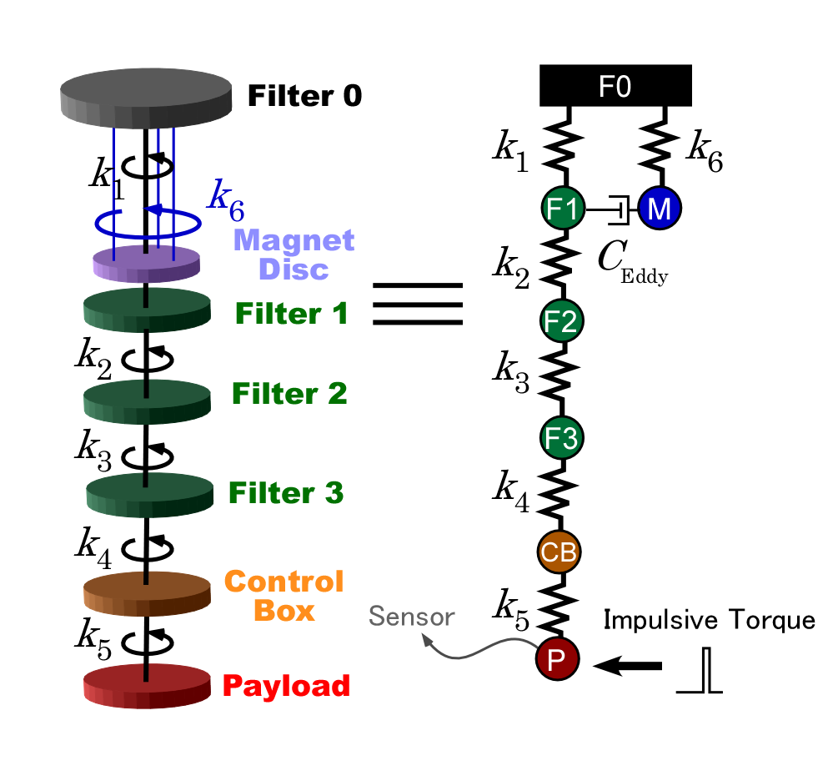
Simulation Model
1-D “point-mass” model
Impulsive torque is exerted to the payload, and angular displacement of the payload is sensed.
Calculate impulsive response → Estimate damping time
Find best parameters that shorten the damping time most

Slide 6
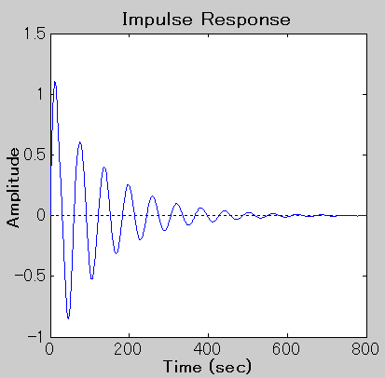
Simulation Result & Optimized Parameters
 | Value [Nm/rad]
k₁ | 0.70
k₂ | 0.70
k₃ | 0.70
k₄ | 0.27
k₅ | 0.27
k₆ | >10
C_{Eddy} = 5 kgm²/s
↑5 min.
↑10 min.
Torsional modes are damped in < 10 min.

Slide 7
Proposed Wire Design
From the torsional stiffness, wire diameters are calculated.
# | Diameter [mm] | Length [m]
1 | 3.74 | 2.1
2 | 3.74 | 2.1
3 | 3.74 | 2.1
4 | 2.94 | 2.1
5 | 2.45 | 1.0

Slide 8
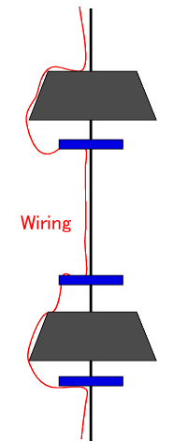
Note: Wiring Problem
In real case, wiring (for sensors and actuators) also introduces distributed damping.
This damping is less welcome because it may introduce creak noise.
We will study wiring configuration experimentally with prototype.

Slide 9
End

Slide 11
Appendix

Slide 12
Parameters Used in the Simulation
Moment of inertia of each filter
Filter Name | Detail | Moment of Inertia [kgm²]
Standard Filter | Filter 1~3 | 6.24
Payload | Platform | 1.95
 | Magnet Box | 2.35
 | Intermediate Mass | 0.69
 | Recoil Mass | 0.45
 | Test Mass | 0.17
 | Total | 5.61
Control Box |  | 2.0
Magnet Disc |  | 1.84
As the design of the control box is not fixed, its moment of inertia may change.

Slide 13
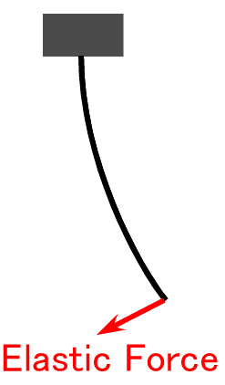
Proposed Wire Design (Detail)
From the torsional stiffness, wire diameters are calculated.
# | Diameter [mm] | Length [m]
1 | 3.74 | 2.1
2 | 3.74 | 2.1
3 | 3.74 | 2.1
4 | 2.94 | 2.1
5 | 2.45 | 1.0
Relatively thick wires (almost rods)
Thick wires are not good for horizontal attenuation. (Elasticity of wires may worsen the performance of SAS.)

Slide 14
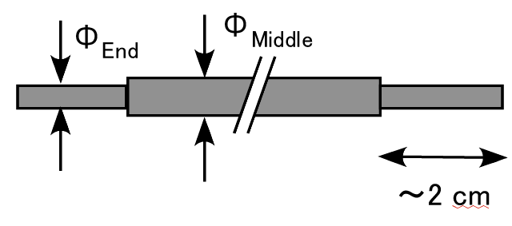
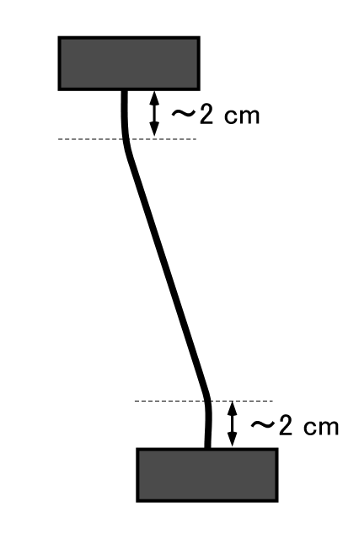
Proposed Wire Design (Detail)
This elastic stiffness only depends on the thickness of first few cm from the head of the wire.
We can make wires thick in the middle & thin at the ends.
# | Diameter (End) [mm] | Diameter (Middle) [mm] | Length [m]
1 | 3.74 | 3.74 | 2.1
2 | 3.44 | 3.74 | 2.1
3 | 3.11 | 3.74 | 2.1
4 | 2.74 | 2.94 | 2.1
5 | 2.45 | 2.45 | 1.0

