Slide 1
Commissioning work on the low temperature interferometer
5/17/2010 GWADW at Kyoto
Osamu Miyakawa (ICRR, U-Tokyo) and CLIO collaboration

Slide 2
Simple, compact interferometer for cryogenic
CLIO is a 100m scale prototype interferometer.
Simple optical configuration known as Locked-FP style( similar to old 40m in Mark II era) for independent DOFs.
Quite simple analog circuits, a very few monitors (view ports, CCDs)
Simple configuration is not a bad idea to identify noise sources, especially for low temperature experiment.
But, less flexibility, in fact…
Today’s talk is with
  Some curious experiences on low temperature interferometer experiment,
  To have more flexibility with a digital control being installed

Slide 3
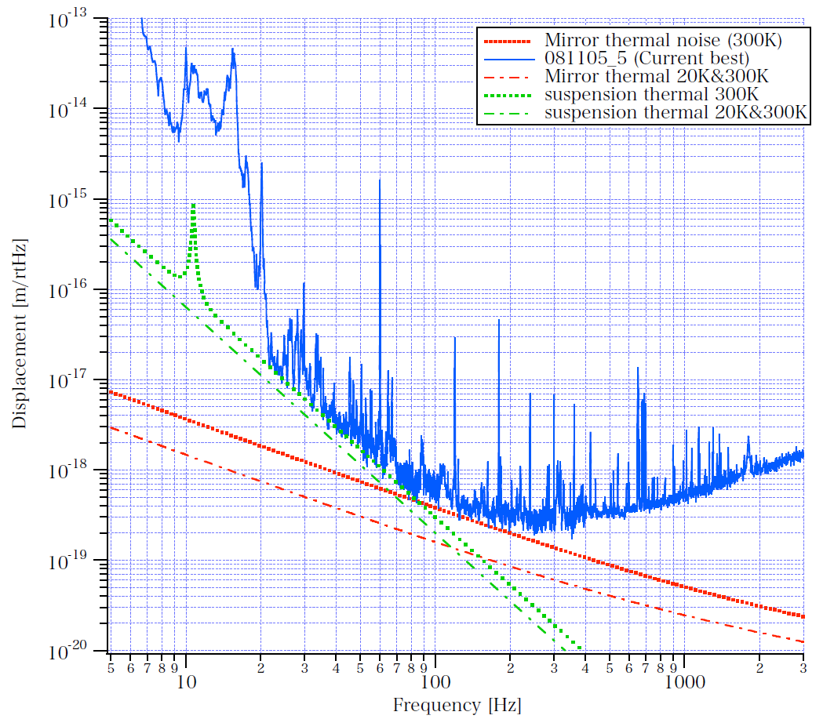
Expected sensitivity by cooling two front mirrors
Thermoelastic noise is inversely proportional to radius of beam, so front mirror is more effective for cooling.
Cooling mirror one by one in ordre to identify causes of troubles.
Replace thick amorphous fibers used in room temperature to 99.999%, d=0.5mm pure aluminum fibers
  Q on table top = 7000 @ 4K.
  Expected Q in CLIO = 4.85e4 (provides enough low thermal noise )
Final design: to be replaced to sapphire fibers
Notes:
3

Slide 4
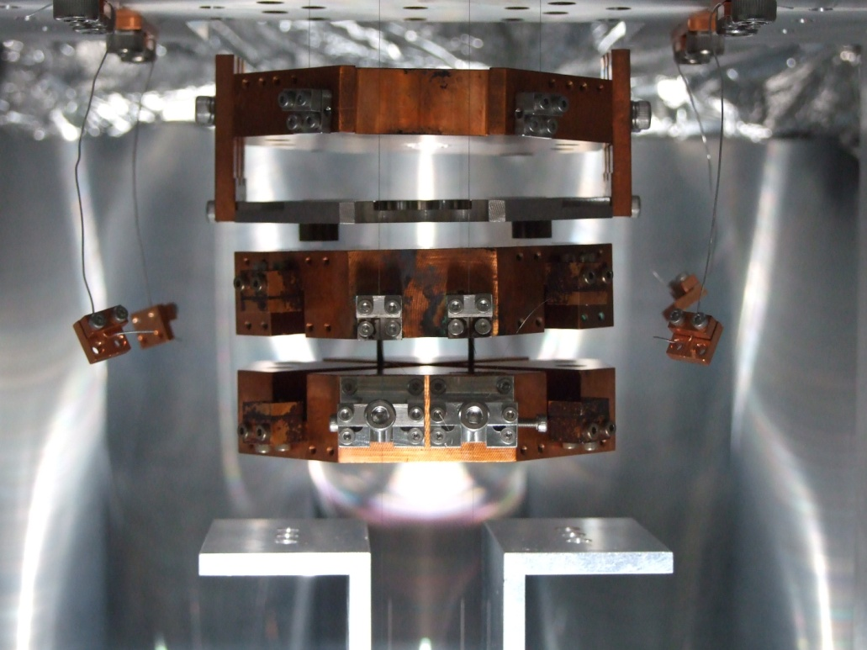
How to cool
●3 heat links between:
①Magnet Base and inner shield; 15cm
②CryoBase and inner shield; 31.5cm
③CryoBaseand and UpperMass; 11.5cm
φ0.5mm pure aluminum wire(5N RRR2400）
It takes 7-10day to be cooled down.
Room temp. part
Low temp. part
Magnet Base
Cryo
Base
Upper
Mass
Notes:
4

Slide 5
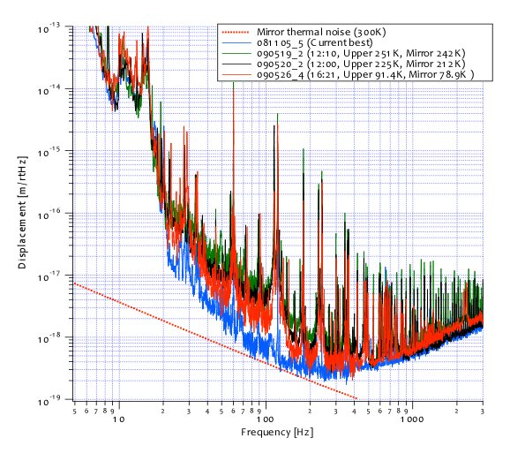
Low temperature experiment
Changing Temperature of Sapphire mirror
242K 5/19/2009
212K 5/20/2009
79K 5/26/2009
A big jump from 212K to 79K, because too much creaks when structures were shrinking to measure noise
Pendulum thermal noise was reduced continuously.
Notes:
5

Slide 6
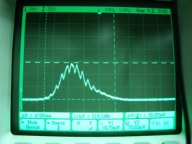
Troubles in low temperature
Very small leakage of air is not a critical problem in room temperature, but a critical problem in low temperature as contaminations on the mirror shown as change cavity reflectivity and transmissivity, and noisier above 1kHz
Needed a careful check for O-ring, gate valve with a leak detector.
Cavity with a pair of Low temp. mirror – room temp. mirror generate non-stationary, msec order noise. We guess the mechanism that particles from room temperature area hit low temperature mirror.

Slide 7
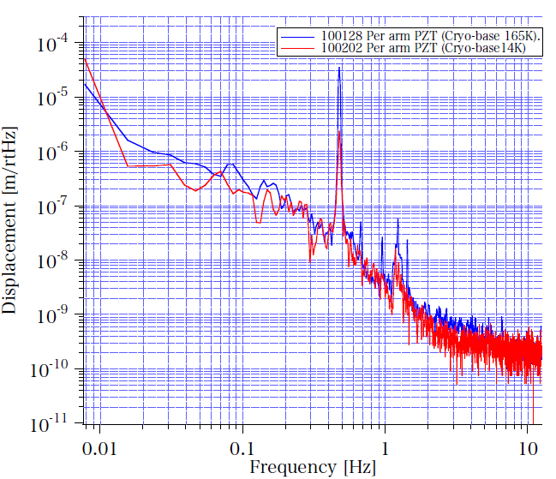
Over eddy current damping
Problem:
Over eddy current damping between Magnet Base and Cryo-Base in low temperature, because they move combinedly by too strong damping since the lower resistance by lower temperature
Solution: Wider gap between Magnet Base and Cryo Base to reduce damping force
Q~1000 in room temperature, Q~30 in low temperature
Or active local damping -> LSPI talk by Takanori Saito this afternoon
Magnet Base
Cryo
Base
Upper
Mass

Slide 8
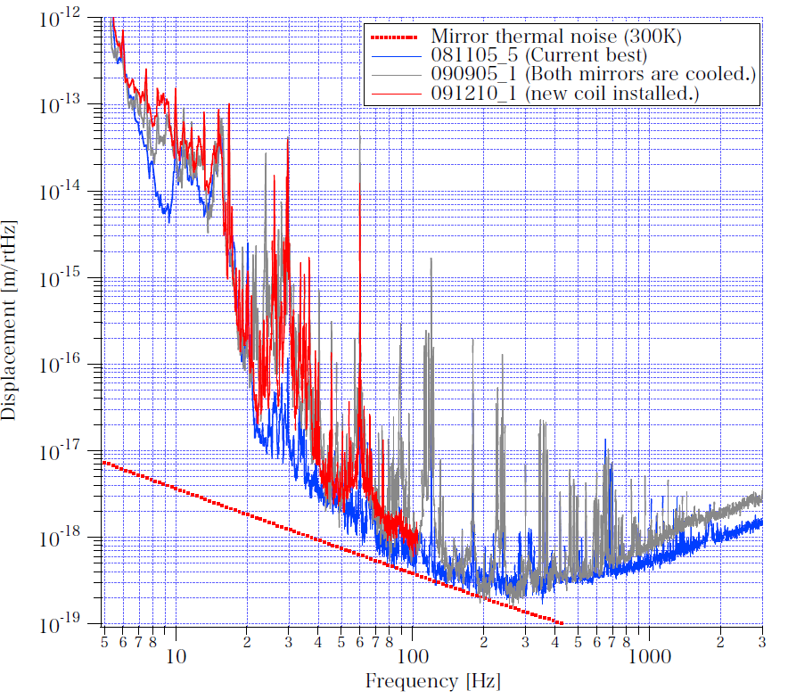
Reduced power line noise
Problem: too many power line noise for the small number of heat links
Guess:
Dependence of electrical resistance on coil wire increases the coupling between coil wire and magnet attached on the main mirror by lower temperature, and seismic motion of the coils transmits main mirrors directly.
Solution:
Replaced coil wire to phosphor bronze which has less resistance dependence on temperature.
Result: less power line noise below 100Hz
Notes:
8

Slide 9
With many efforts, we have overcome a limit in the room temperature.
Results on cooling experiment are shown at
Takashi Uchiyama’s talk
on tomorrow morning session.

Slide 10
Possibility of a digital control system
1. Increased the number of person 1->4 at site
2. Scheduled commissioning plan
3. Flexibility
4. As a prototype of LCGT
Installation of a digital system at CLIO with help of aLIGO engineers
->Shrink the time for noise hunting!

Slide 11
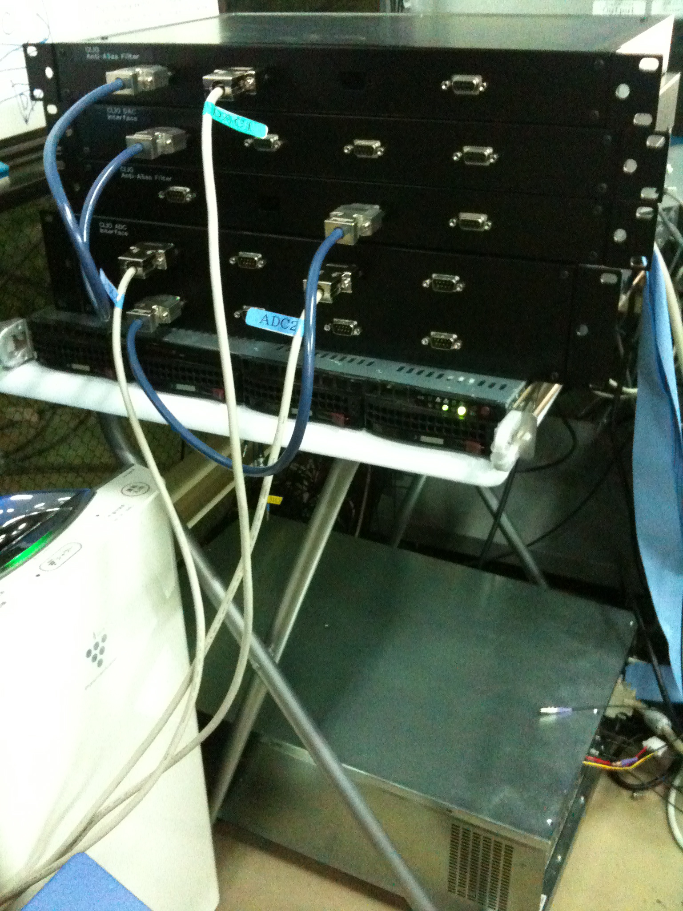
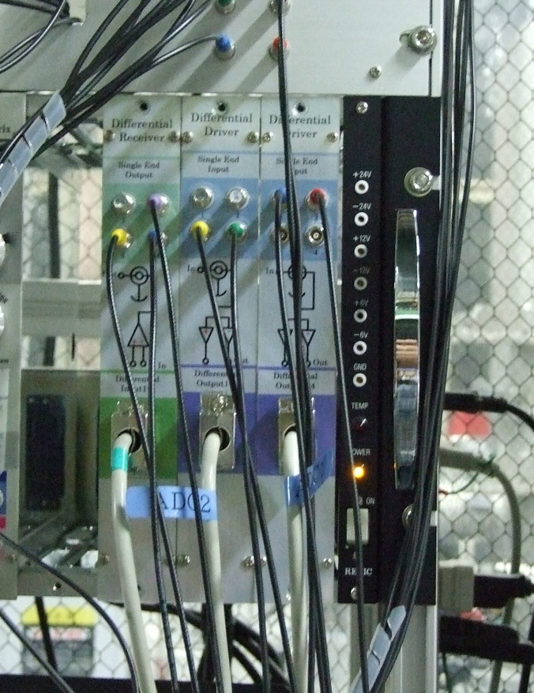
Pictures
Anti Imaging filters
Differential
receiver
timing
DAC adapter
Anti Alias filters
Differential
driver
ADC adapter
Real time PC
CentOS 5.2+real time kernel
4core x 2 Xeon
PCIe接続
Timing slave board
ADC/DAC
In Expansion Chassis
ADC:32ch/枚、$4K
DAC:16ch/枚、$3.5K
Binary Output:32ch/枚、$250
To ADC
adapter
From DAC
adapter
To NIM
modules

Slide 12
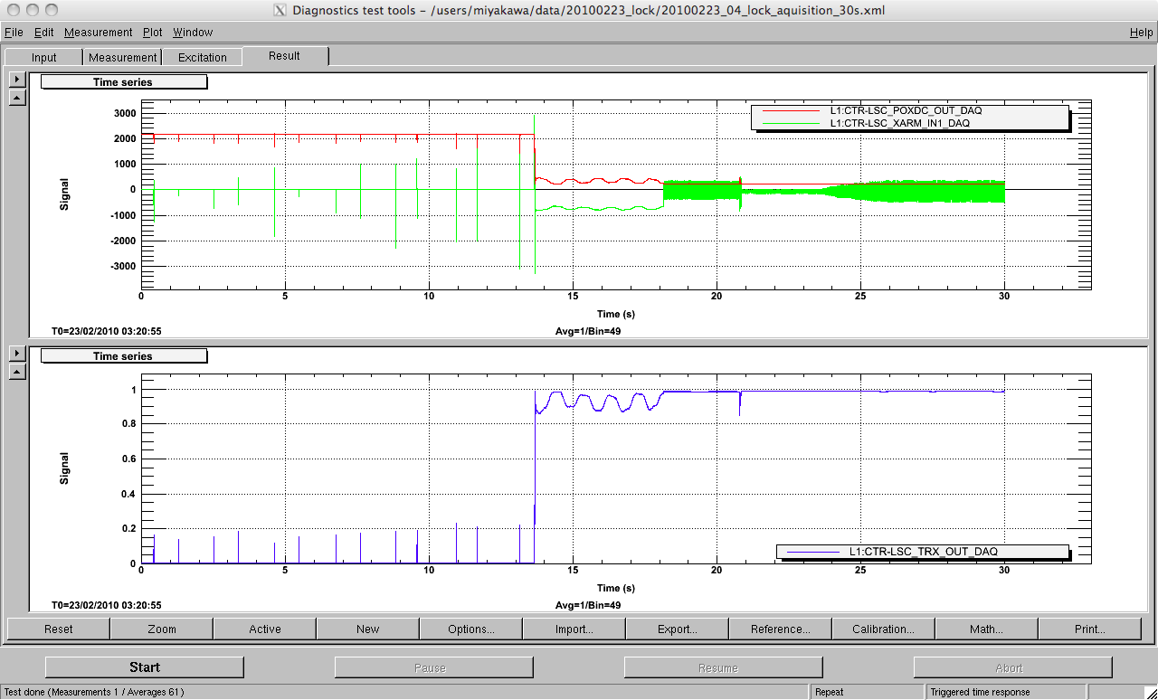
Arm locked by digital loop!
END
Reflected light
Error signal
Transmitted
light

Slide 13
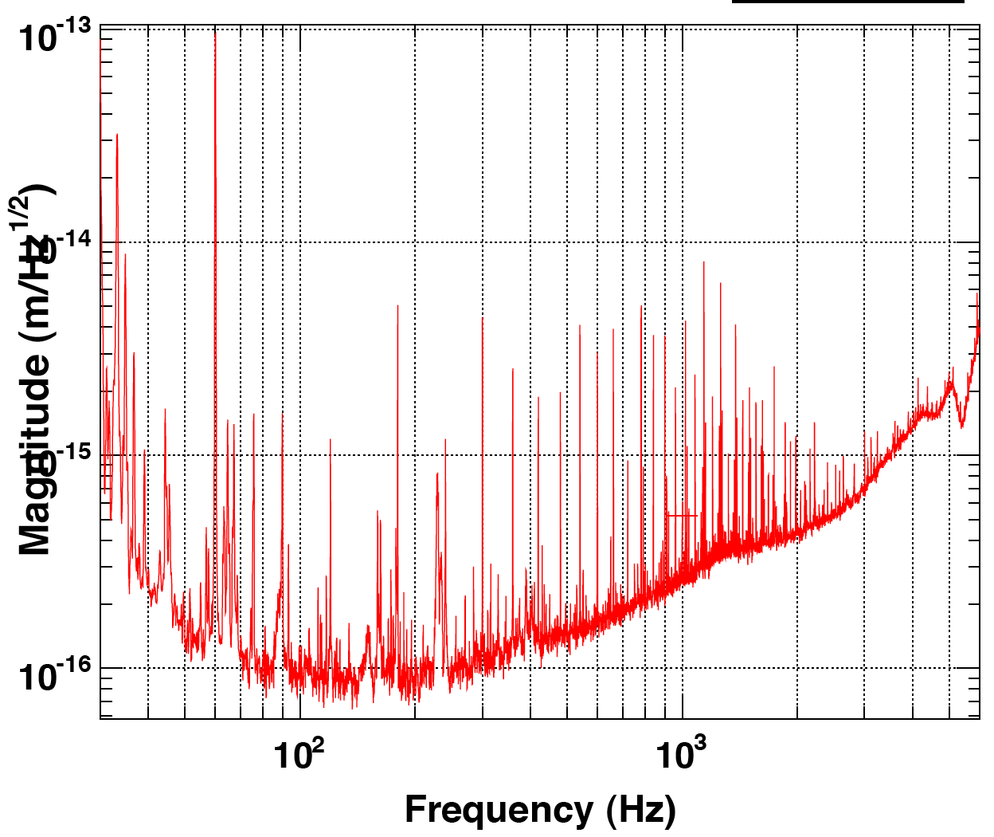
First noise curve with digital control
2 and half orders noisier than analog sensitivity
Too much ADC/DAC noise
Sensitivity will be improved once whitening /dewhitening filters are installed.

Slide 14
Development on digital
Developed systems at CLIO using digital system
  Auto initial alignment system for MC using picomotor
  Auto Lock acquisition system
  Calibration system
  Local damping system -> Takanori’s talk this afternoon
Very near future
  The same sensitivity as analog with whitening/dewhitening filters
  Auto beam centering system (sensitivity depends on beam centering strongly at CLIO)
  Long term monitors for laser power, seismic motion, temperature etc.
  Auto noise budget system
  MC length control system using another arm signal
Needs for LCGT
  3km data transfer system
  Proper timing clock (with help of Columbia group )
  Multiple PCs with PCIe switch for more channels

Slide 15
END

Slide 16
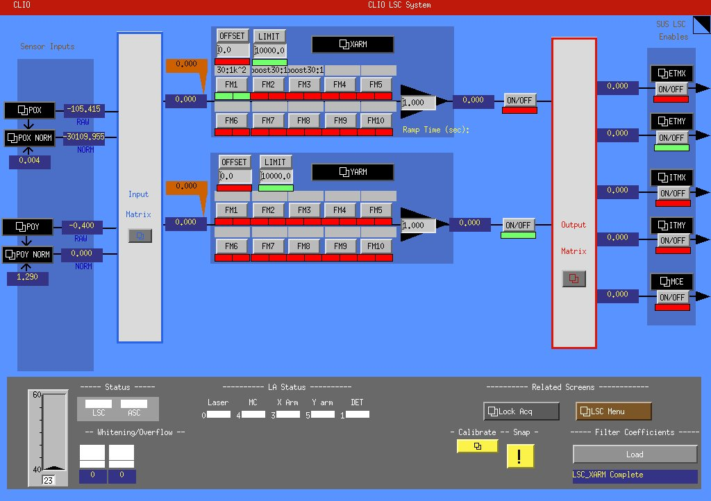
MEDM --Length sensing and control system
D/A
Feedback filters
Output to suspensions
Demodulated signal
from PD
mixer
A/D

